Slide 1
Design Pattern

Slide 2
Rule of thumb
Use design patterns only when you recognize situation which is causing you pain in future and only if there is no other simple OOP way to solve that problem
Design patterns are solutions to problems as they occur, not solutions to problems we think may occur

Slide 3
A design pattern provides a general reusable solution for the common problems occurs in software design. The patterns typically show relationships and interactions between classes or objects.
Design patterns are programming language independent strategies for solving a common problem. That means a design pattern represents an idea, not a particular implementation. By using the design patterns you can make your code more flexible, reusable and maintainable
It’s not mandatory to implement design patterns in your project always. Design patterns are not meant for project development. Design patterns are meant for common problem-solving. Whenever there is a need, you have to implement a suitable pattern to avoid such problems in the future.

Slide 4
Goal:
Understand the purpose and usage of each design patterns. So, you will be able to pick and implement the correct pattern as needed.

Slide 5
Types of Design Patterns
There are mainly three types of design patterns:
Creational
Structural
Behavioral

Slide 6
Creational Design Patterns
These design patterns are all about class instantiation or object creation.
These patterns can be further categorized into Class-creational patterns and object-creational patterns. While class-creation patterns use inheritance effectively in the instantiation process, object-creation patterns use delegation effectively to get the job done.
Creational design patterns are the Factory Method, Abstract Factory, Builder, Singleton, Prototype and Object Pool.

Slide 7
Singleton Design Pattern
Singleton pattern as the name suggests is used to create one and only instance of a class. There are several examples where only a single instance of a class should exist and the constraint be enforced. Caches, thread pools, registries are examples of objects that should only have a single instance.
Formally the Singleton pattern is defined as ensuring that only a single instance of a class exists and a global point of access to it exists.

Slide 8
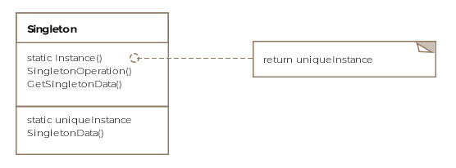
Class Diagram
The class diagram consists of only a single entity

Slide 9
Singleton Pattern Implementation.

