Slide 1
BENZ - HUB
Presented By:
Muskan Jain
Aqsa Adab
Sanjeev Pandey

Slide 2
CAR STOCK ANALYSIS

Slide 3
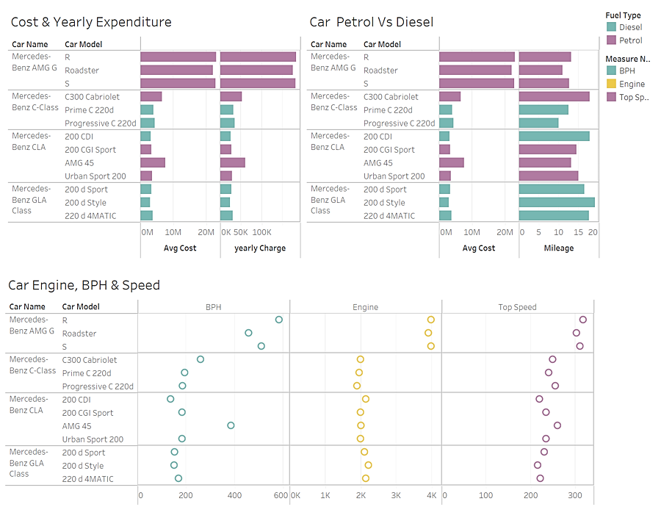

Slide 4
CAR SALES ANALYSIS

Slide 5
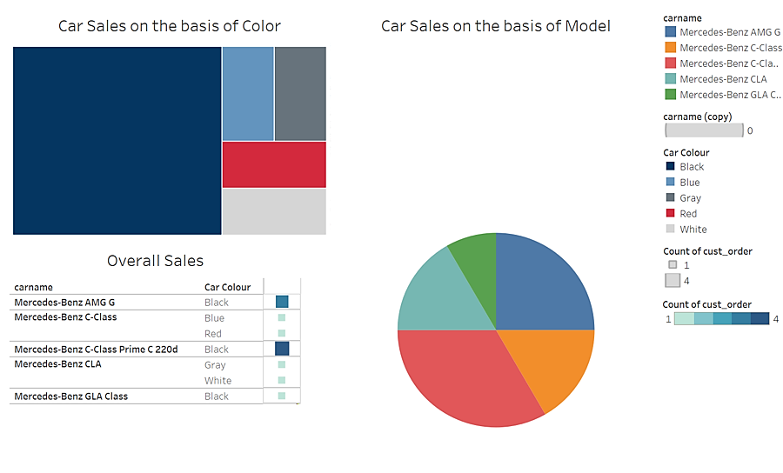

Slide 6
THANK YOU

