Slide 1
CONTENT PRESERVING WATERMARKING
AND QUERY BASED WATERMARKING FOR
XML DATA
Under the guidance of
- Dr. Ditipriya Sinha
-Abhishek Kumar (1406004)
-Prashant Kumar Singh (1406011)
-Sanjli Kumari (1406080)

Slide 2
OUTLINE
What is watermarking
Why watermarking
Cryptography vs. Steganography vs. watermarking
Category of Watermarking
Property of Watermarking
Watermarking on different media types
Text watermarking
Text watermarking techniques
Feature of technique used
Unicode confusable
Watermark Generation
Authorship verification
Output
Drawback
Possibilities in XML
Query based approach
Watermark insertion and detection algorithm
Future Work

Slide 3
WHAT IS WATERMARKING
Message that can be embedded into the digital data like video, pictures, text and databases and the embedded data can be extracted later
insertion of imperceptible and inseparable information into data for data integrity

Slide 4
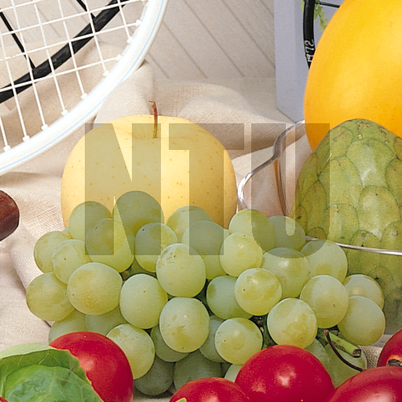

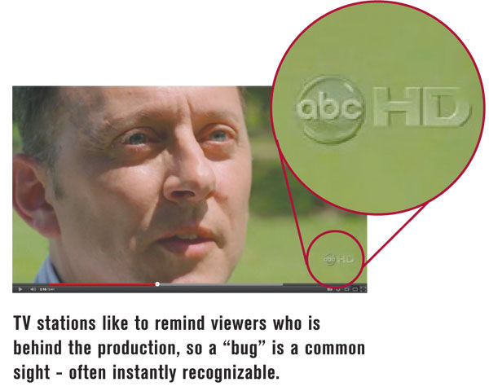
EXAMPLES

Slide 5
WHY WATERMARKING
for proof of ownership
copyrights protection
for tamper proofing
data integrity

Slide 6
CRYPTOGRAPHY VS.
STEGANOGRAPHY VS.
WATERMARKING

Slide 7
Cryptography algorithms make the document unreadable.
Steganography algorithms provide techniques to hide new information into the carrier, that is a readable document.
Watermarking algorithms ensure the authentication and the copyright protection by applying a watermark to the digital content.

Slide 8
CATEGORY OF
WATERMARKING

Slide 9
Invisible- Hidden in the carrier, does not appear to user.
Visible- Noticeable to the user.
Fragile- Detectable and can be easily altered and erased.
Distortion Based- Marking produces distortion to the underlying data.

Slide 10
Distortion Free- Does not produce any distortion to the data.
Robust- Detectable but not erasable.
Blind- No need of original document while extracting.
Non Blind- Requires original document while extracting.

Slide 11
PROPERTY OF WATERMARKING
Robustness
Security
Verifiability
Detectability
Cost
Data Payload

Slide 12
WATERMARKING FOR
DIFFERENT MEDIA TYPES
Text watermarking
Audio watermarking
Image watermarking
Video watermarking
Database watermarking

Slide 13
OUR WORK FOCUSES
ON
TEXT WATERMARKING

Slide 14
WHY TEXT WATERMARKING
Immense amount of textual knowledge is increasing daily
like- short text messages used for government, micro blogging
post, social media etc.
One of the largest bunch of digital contents that people can explore online.
Text watermarking is most difficult task among in comparison to other media watermarking.

Slide 15
TEXT WATERMARKING
TECHNIQUES
Image-based Techniques
Syntactic Techniques
Semantic Techniques
Structural Techniques

Slide 16
FEATURES
OF
OUR WORK

Slide 17
Belongs to Structural watermarking techniques.
Content preserving in nature
Password based watermark
Invisible
Detectable
Blind class

Slide 18
UNICODE CONFUSABLE
Among 120k of Unicode symbols some symbols are totally or partially indistinguishable from others with different hex codes.
Similarity between symbols represents security problem
These duplicates are being exploited to encode the bits of hidden payload.

Slide 19
 | Bit ‘ 0’ | Bit ‘1’
Symbol | Original Code | Duplicate Code
- | 0x002d | 0x2010
; | 0x003b | 0x037e
C | 0x0043 | 0x216d
D | 0x0044 | 0x216e
K | 0x004b | 0x212a
L | 0x004c | 0x216c
M | 0x004d | 0x216f
V | 0x0056 | 0x2164
X | 0x0058 | 0x2169
c | 0x0063 | 0x217d
d | 0x0064 | 0x217e
i | 0x0069 | 0x2170
j | 0x006a | 0x0458
l | 0x006c | 0x217c
v | 0x0076 | 0x2174
x | 0x0078 | 0x2179
Table 1.
Subset of confusable symbols used to encode the watermark. Original and Duplicate code for each symbol is shown.

Slide 20
White space | Bits | Unicode
Space | 000 | 0x0020
En Quad | 001 | 0x2000
Three-per-em Space | 010 | 0x2004
Four-per-em-Space | 010 | 0x2005
Punctuation Space | 011 | 0x2008
Thin Space | 100 | 0x2009
Narrow No-break Space | 110 | 0x202f
Medium Mathematical space | 111 | 0x205f
Table 2.
Encoding for white space symbols. In order to encode 3 bits in a single whitespace 8 different whitespace are used in total

Slide 21
FLOWCHART
Watermark
Generation
Embedding
of
Watermark
Extraction
of
Watermark
Authorship
Verification

Slide 22
WATERMARK GENERATION WITH PASSWORD
Text, t
All the world’s a stage and all the man and woman are merely players…
Hash(t,k)
Watermark, w
b9460a86157731eb
Password, k
***************
Given the original text ‘t’ and a password ‘k’, the Siphash function generates a cryptographic hash, representing the watermark w to be embedded.

Slide 23
UNICODE WATERMARK EMBEDDING
A the wor
Text
l
l
l
d
1 0 1 1 1 0 0 1 0 1
Watermark
Only the symbols with a related duplicate in Table 1 and 2 are used to embed the watermark.

Slide 24
ALGORITHM FOR EMBEDDING
1: T= {c1,….,c2} /*Text string of n Unicode characters */
2:Originals= {U+002c,U+002d,U+002e,…} /*List of confusable original symbols */
3:Duplicates={U+a4f9,U+2010,U+a4f8,…} /*List of confusable duplicate symbols*/
4:Space={U+0020,U+2002,U+2005,…} /*List of confusable white space*/
5:Confusables = Originals & Spaces /*List of all confusable*/
6: W = [b1,……,b64] /*Watermark bit array*/
7:GetDuplicate : Originals ->Duplicates
8:GetSpace : {000,……,111} -> Spaces
9: WT = [] /*watermarked text*/
10: for all c <- T do
11: if c <- Confusables /\ |W| !=0 then
12: if c <- Spaces then
13: bits = Pop(W,3)
14: lshift(bits,3-len(bits))
15: c= GetSpace(bits)
16: else
17: bit= Pop(W,1)
18: if bit = 1 then
19: c= GetDuplicate(c)
20: endif
21: endif
22: endif
23: Append(WT,c)
24:end for
35:return WT

Slide 25
ALGORITHM FOR EXTRACTION
1: /*Text string of n Unicode characters c*/
2: T= {c1,….,c2}
3: /*List of confusable original symbols */
4:Originals= {U+002c,U+002d,U+002e,…}
5:/*List of confusable duplicate symbols*/
6:Duplicates={U+a4f9,U+2010,U+a4f8,…}
7:/*List of confusable white space*/
8:Space={U+0020,U+2002,U+2005,…}
9: WT = [] /*Watermark bit array*/
10:SpaceMap : Space -> {000,……,111} /*Reverse mapping function*/
11: for all c <- T do
12: if c <- Spaces then
13: Append(W, SpaceMap(c))
14: else if c <- Originals then
15: Append(W,0)
16: else if c <- Duplicates then
17: Append(W,1)
18: endif
19: if |W| >= 64 then
20: break
21: endif
22: end for
23: return W[:64]

Slide 26
AUTHORSHIP VERIFICATION
Author
Hash(t,k)
w’ w
Text t with extracted Watermark w
Attacker
Hash(t,k’)
w’’ w
The password k is a proof of authorship. Once the watermark is extracted, only the author with the original password k is able to reproduce it.

Slide 27
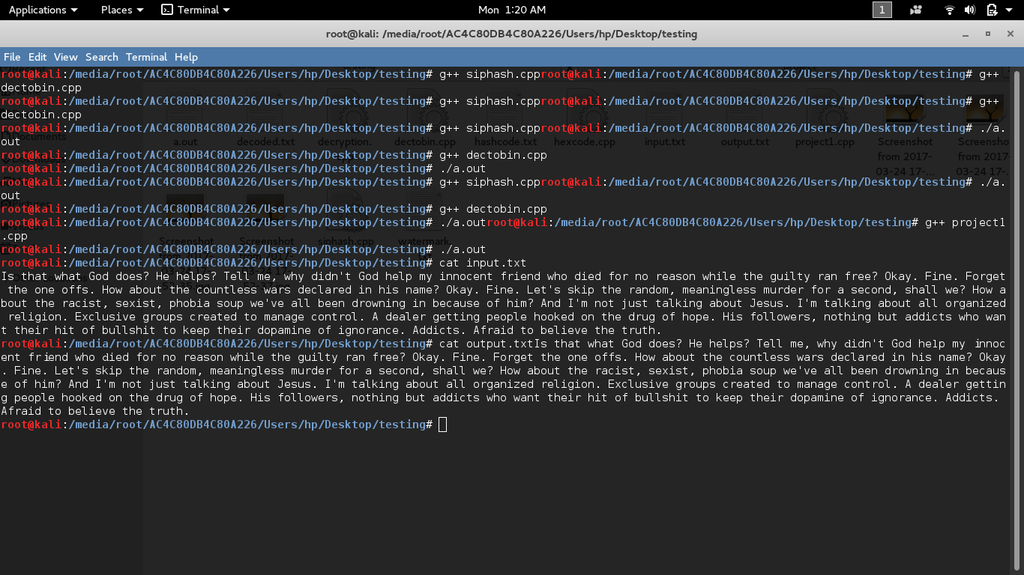
OUTPUT

Slide 28
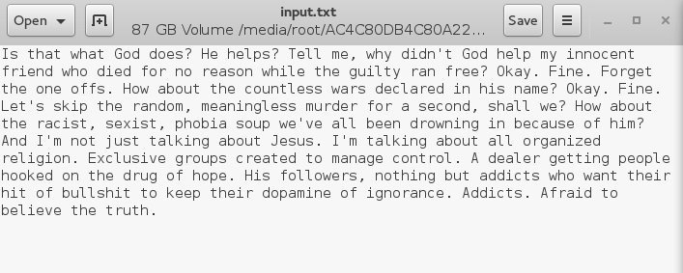
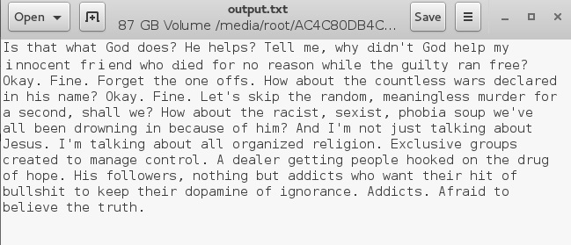
0x0064
0x006c
0x0069
0x217e
0x217c
0x2170

Slide 29
DRAWBACKS
Rewriting of the text manually.
Using OCR(Optical Character Recognition) Tool.
Localisation of the document (not in the knowledge of the owner).

Slide 30
POSSIBILITIES IN
XML

Slide 31
WHY XML?
XML has come into common use for the interchange of data over the internet.
Plenty of public data like Facebook, Twitter, and other online platform use XML as medium of transfer.

Slide 32
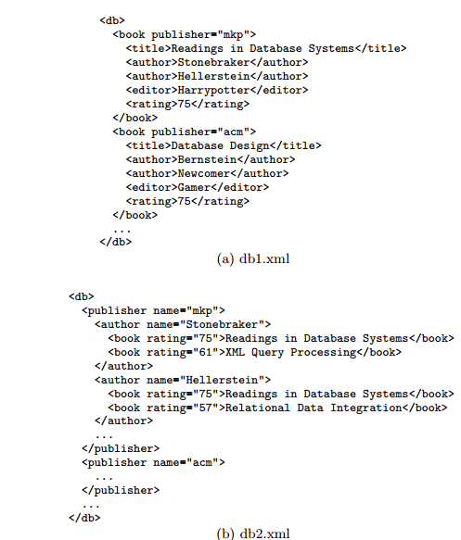
STRUCTURE REORGANIZATION

Slide 33
CHALLENGES
NATURE: Unlike multimedia data, XML data are diverse in nature , some are data centric and numeric while some are document-centric and verbose. Also it doesn’t have definite structure like relational database.
REORGANISATION: The flexible format of XML data in particular enables it to be reorganized easily, without losing any information.
REDUNDANCY ISSUES: For example, Many duplicated publisher entries that correspond to the same editor. If these duplicates are selected to embed different bits of a watermark, the watermark could be erased by making all the duplicates identical.

Slide 34
XML : Query Based scheme.

Slide 35
Why Query based approach?
RESILIENCE : They are able to survive through data reorganization or alteration.
REDUNDANCY INDEPENDENCE : They are independent of data redundancies, i.e., duplicated data elements should have the same identifier.
Differentiability: They are able to distinguish between data elements to achieve large watermark capacity. A larger watermark capacity helps to achieve better resilience and credibility of watermarking.

Slide 36
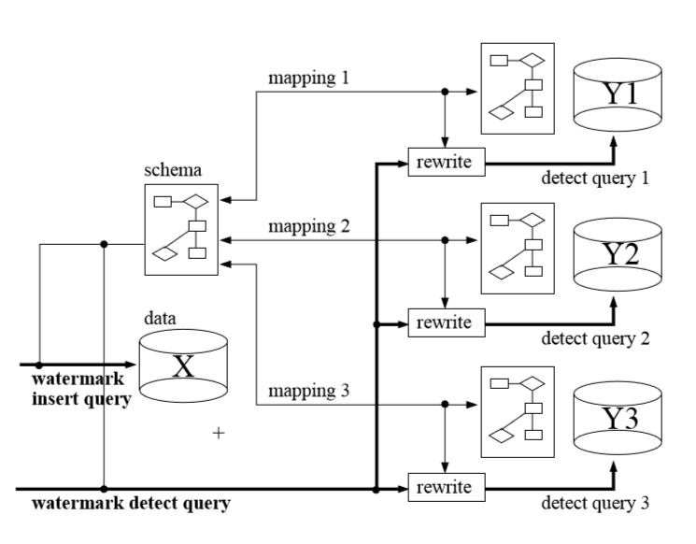
QUERY BASED APPROACH

Slide 37
How ?
Algorithms

Slide 38
MAIN SCHEMES
Identifier creation: Since primary key feature is unavailable so we create identifiers out of usability templates. For example: “db/book [author, editor]/title”.
Watermark Insertion: Includes the preparation step, the user first discovers all the functional dependencies based on the schema of the XML data, and specifies a number of query templates that represent the usability of the data. Execute the queries in Q on the original data to retrieve the data elements .The watermark bits are then embedded into these elements through selected watermark embedding algorithms.
Watermark detection: Execute the same set of queries to retrieve the data elements embedded with watermark bits, and reconstruct the watermark from them. As the schema and the data could be reorganized by attackers, the queries may have to be rewritten for the reorganized data.

Slide 39
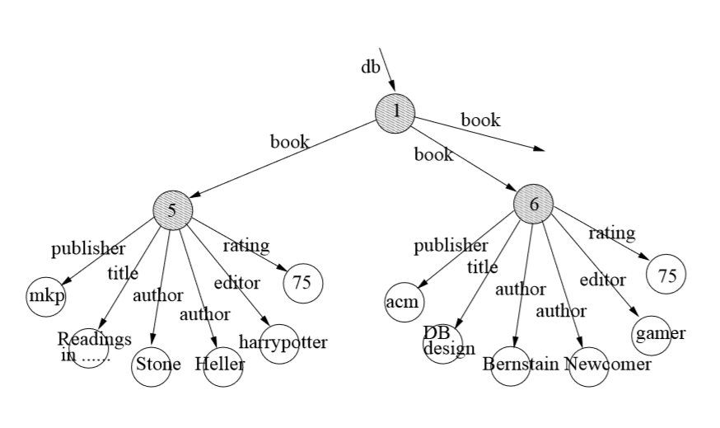

Slide 40
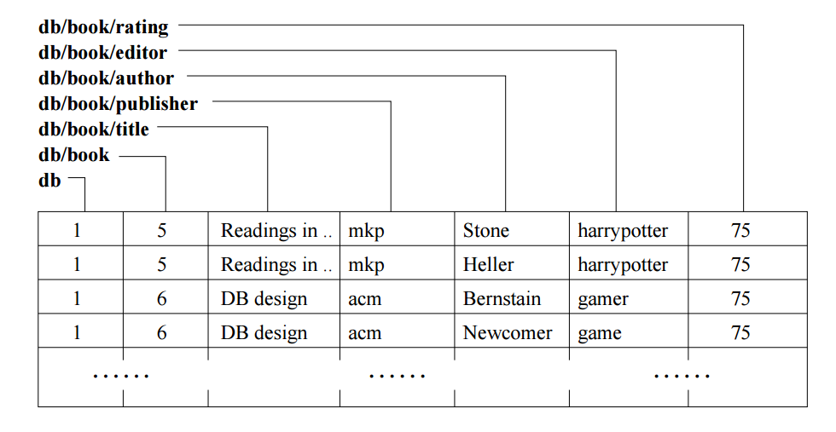

Slide 41
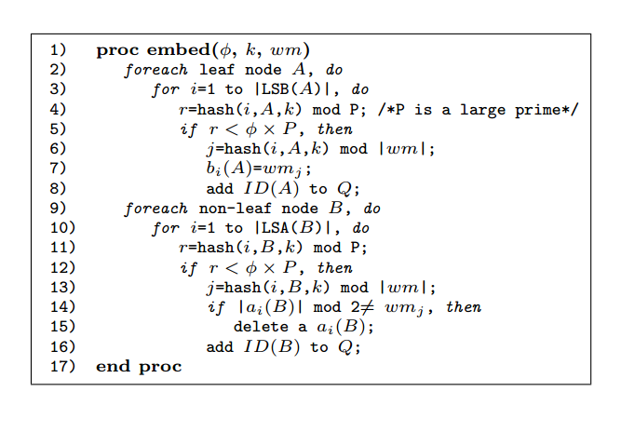
WATERMARK INSERTION
φ denote the proportion of the selected LSB.
hash function h() is used to assign to each LSB/LSA a hash value.
ID(A) is the query to identify A
k is a secret key.
e ith LSB of a leaf node A by bi(A), and the ith LSA of a non-leaf node B by ai(B).
Q is a set of queries to identify the selected leaf/non-leaf nodes for embedding watermarks.
Watermark can be embedded in
(i) leaf nodes by modifying their values (ii) non-leaf nodes by adding to or deleting their child nodes.
For example, the first ‘book’. We can change the attribute number to 1 by deleting an ‘author’, or to 3 by adding a fake ‘author’..

Slide 42
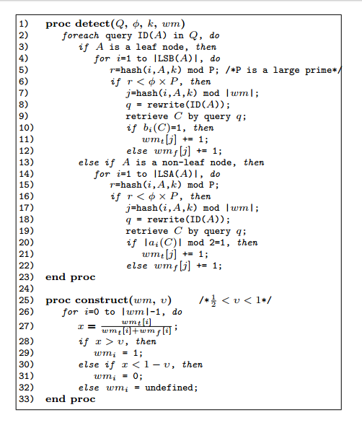
WATERMARK DETECTION
For selecting the watermarked nodes , the queries are redesigned on the original data into queries on the reorganized data according to the mapping between the original and reorganized schemas.
Each query in Q is rewritten and executed on the target data to retrieve the nodes that carry the watermarks.
If marked, LSB/LSA value is used to vote whether the corresponding watermark bit is 1 or 0. For each bit of the watermark, two buckets, wmt[i] and wmf [i], are used to count the votes. wmt[i] records the number of votes supporting wmi = 1 and wmf [i] records the number of votes supporting wmi = 0.

Slide 43
FUTURE WORK
Implementation of insertion and detection of watermark in XML documents.
Comparison of the work between XML and Text watermarking on basis of their computation time.

Slide 44
REFRENCES
T. Amano and D. Misaki. A feature calibration
method for watermarking of document images. In
Proceedings of the Fifth International Conference on
Document Analysis and Recognition, pages 91{94.
IEEE, 1999.
R. Agrawal and J. Kiernan. Watermarking relational
data: framework, algorithms and analysis. The VLDB
Journal, 12(2):157{169, 2003.
ftp://ftp.unicode.org/Public/security/revision-02/confusables.txt
https://en.wikipedia.org/wiki/SipHash
https://github.com/majek/csiphash
https://en.wikipedia.org/wiki/Digital_watermarking
http://ink.library.smu.edu.sg/sis_research/613

Slide 45
THANK YOU

