Slide 1

Prediction of Burned Area in Forest Fires MAJOR -PROJECT -MEMBERS under The Guidance of Dr. Ditipriya Sinha
Department Of Computer Science & Engineering
National Institute of Technology Patna
1.SANJEEV KUMAR(1406027)
2.Kuldeep Mahwar(1406025)
3.Sourabh Kori(1206031)

Slide 2
OUTLINE
Introduction
Dataset Description
Attribute information
Flow of the work
Sensor Deployment and Zone Division
Correlation
Feature Selection
Scatter Matrix
Selection of best Model
Keras Libraries
Results
Code Section
Conclusion
References

Slide 3
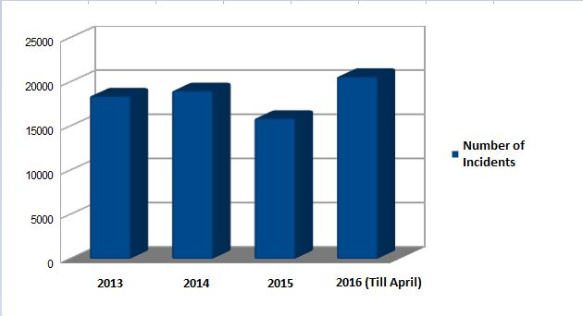
Why Forest Fire? (Introduction)
Increase in number of cases
It becomes important to study
With this we can somehow reduce the burnt area
By deploying or increasing more number of sensor in specific area
It is very important to detect these kinds of fires as early as possible so as to prevent the damage from it to ecological system

Slide 4
Dataset Description:
Title | Forest Fire Data Set
Data Set Characteristics: | Multivariate
Number of Instances: | 517
Area: | Physical
Number of Attributes: | 13
Associated Tasks: | Burned Area Calculation

Slide 5
Attribute Information:
1. X - x-axis spatial coordinate within the Montesinho park map: 1 to 9 2. Y - y-axis spatial coordinate within the Montesinho park map: 2 to 9 3. month - month of the year: 'jan' to 'dec' 4. day - day of the week: 'mon' to 'sun' 5. FFMC - FFMC index from the FWI system: 18.7 to 96.20 6. DMC - DMC index from the FWI system: 1.1 to 291.3 7. DC - DC index from the FWI system: 7.9 to 860.6 8. ISI - ISI index from the FWI system: 0.0 to 56.10 9. temp - temperature in Celsius degrees: 2.2 to 33.30 10. RH - relative humidity in %: 15.0 to 100 11. wind - wind speed in km/h: 0.40 to 9.40 12. rain - outside rain in mm/m2 : 0.0 to 6.4 13. area - the burned area of the forest (this output variable is very skewed towards 0.0, thus it may make sense to model with the logarithm transform).

Slide 6
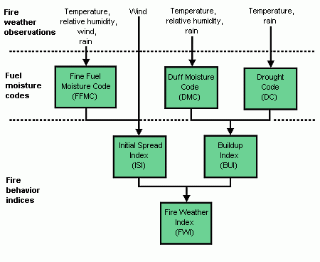
DIAGRAM

Slide 7
FLOW DIAGRAM OF OUR WORK:
Data Collection
Data Pre-Processing
Sensor Deployment and Zone Division
Correlation and
Feature Selection
Showing plots of all pairs using Scatter Matrix
Using Keras Libraries
Calculate the burned area
Results

Slide 8
Classes Description
a) Active Low
b) Active Medium
c) Active High

Slide 9
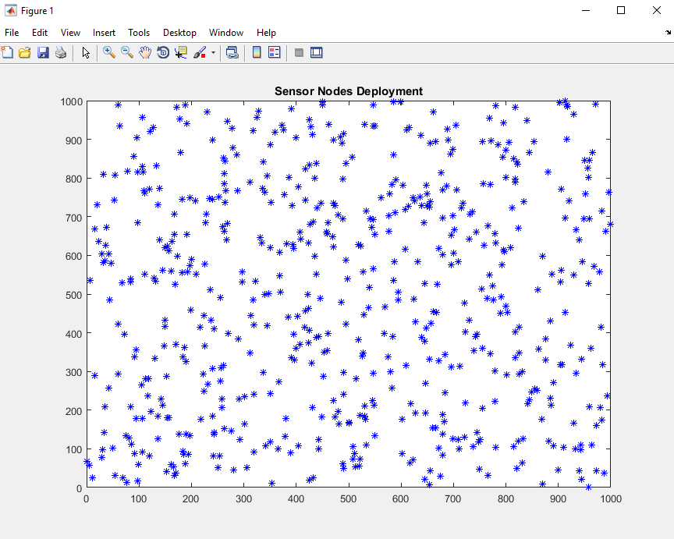
SENSOR DEPLOYMENT
WE RANDOMLY DEPLOY SENSOR IN THE REQUIRED AREA SO THAT WE DON’T GET ANY CONTINUITY.

Slide 10
ZONE DIVISION
WE USE THE EQUILATORY DISTANCE TO DIVIDE THE AREA IN DIFFERENT ZONES.
WE CAN CALCULATE THE WHOLE AREA INTO SUB AREA ,IT WILL LEAD OUR PROBLEM TO SUB PROBLEMS.

Slide 11
Zone Identification Condition
FFMC >= 70
Drought Code (DC) | Zone
DC< 300 | Low Active Zone
300 < DC < 500 | Medium Active Zone
DC > 500 | High Active Zone

Slide 12
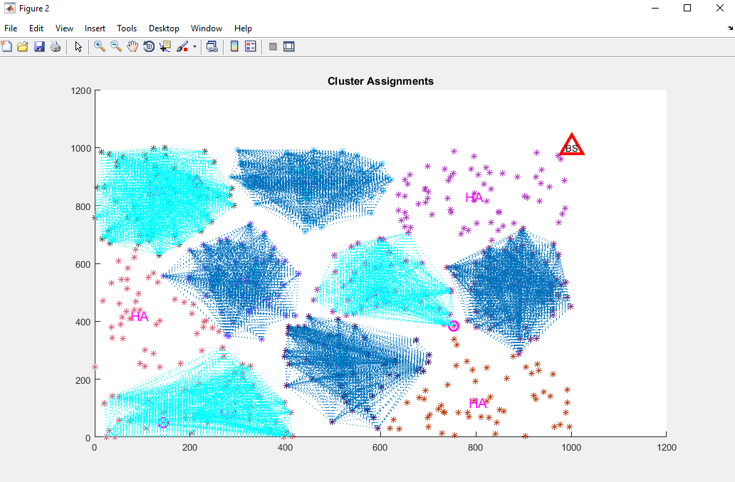
High Active ,Low Active, Medium Active zones

Slide 13
Classes description:
Active High
It includes the most affected region by fire
Highest number of sensor to be deployed here
Active Medium
It includes the moderate affected region by fire
Lesser number of sensor to be deployed here
Active Low
It includes the least affected region by fire
Very few number of sensor to be deployed here

Slide 14
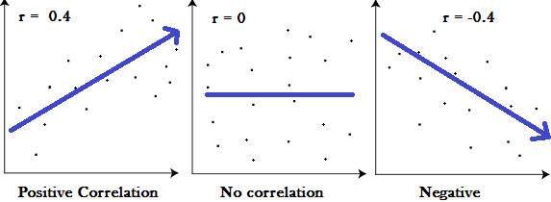
Correlation
A correlation is a number between -1 and +1 that measures the degree of association between two Attributes .

Slide 15

Feature Selection
In machine learning , It is the process of selecting a subset of relevant features(variables, predictors) for use in model construction.
Top reasons to use feature selection are:
It enables the machine learning algorithm to train faster.
It reduces the complexity of a model and makes it easier to interpret.
It improves the accuracy of a model if the right subset is chosen.
It reduces overfitting.
we have calculated the feature selection as:

Slide 16
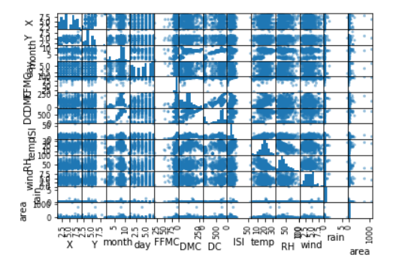
Scatter Matrix:
Showing the scatter plots of all pairs of given attributes.

Slide 17
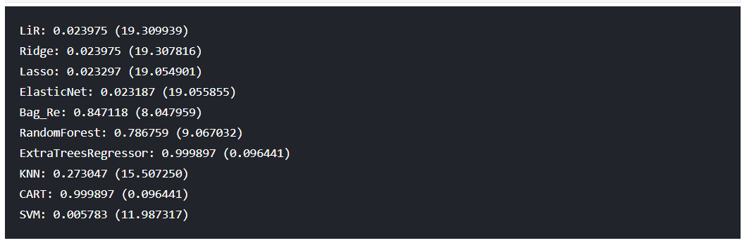
We will choose the best model for prediction of burnt area with a high
accuracy.
Selection of the best Model

Slide 18
Keras is a high-level neural networks API, written in Python
Keras is one of the most popular deep learning libraries in Python for research and development because of its
simplicity and ease of use.
It was developed with a focus on enabling fast experimentation.
With the functional API, it is easy to reuse trained models.
Focus on only what you need to quickly and simply define and build deep learning models.
Keras Libraries:

Slide 19
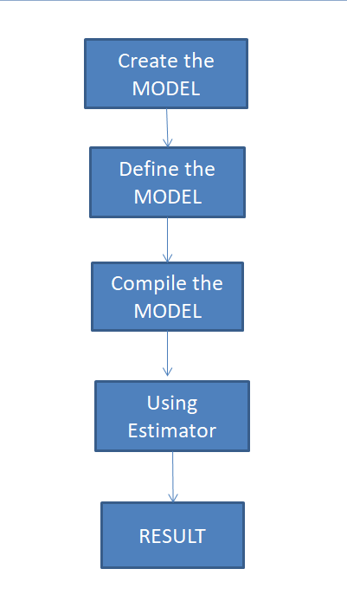
Workflow to predict the burned area using Keras API

Slide 20
1.Creation of model:
We create a Sequential model by passing a list of layer instances to the
constructor. The model needs to know what input shape it should expect.

Slide 21
2.Definition of model:
A layer instance is callable (on a tensor), and it returns a tensor
Input tensor(s) and output tensor(s) can then be used to define a Model.
Such a model can be trained just like Keras Sequential models.

Slide 22
3.Compilation of model:
Before training a model, We need to configure the learning process, which is
done via the compile method.

Slide 23
4.Estimators/Models :
An estimator is a predictor found from regression algorithm.
The process of training an ML model involves providing an ML algorithm (that is, the learning algorithm) with training data to learn from.
The term ML model refers to the model artifact that is created by the training process.

Slide 24
Results:
The final output of the areas is as follows:
Cluster | Area (in Hectares)
HA-1 | 3.66
HA-2 | 4.95
HA-3 | 5.53
HA-4 | 3.09

Slide 25
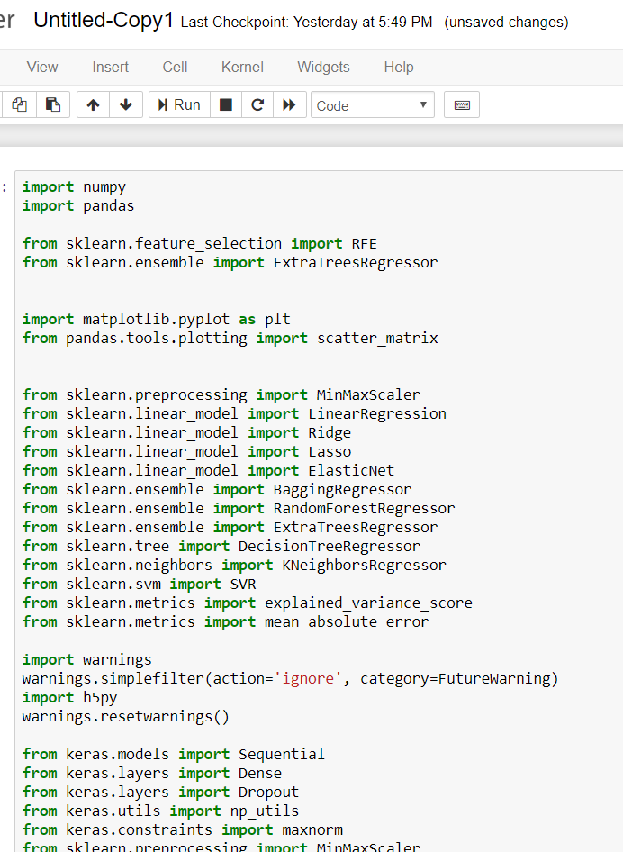
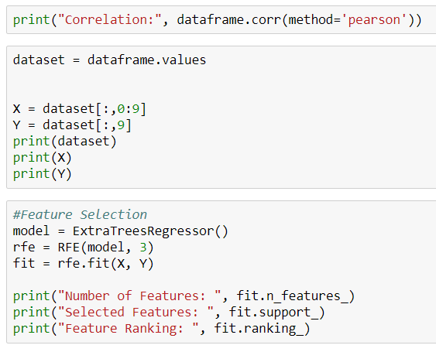
Code Section

Slide 26
Conclusion
Reducing the area being affected by fire.
Helping in predicting the intensity of forest fires.
Balancing economic problems as well as ecological damage.
Working with Local People, a way forward in containing Forest Fires.

Slide 27
References
Y. G. Sahin and T. Ince, “Early forest fire detection using radio-acoustic sounding system,” Sensors, vol. 9, no. 3, pp. 1485–1498, 2009.
M. Hefeeda and M. Bagheri, “Forest fire modeling and early detection using wireless sensor networks,” Ad-Hoc and Sensor Wireless Networks, vol. 7, no. 3-4, pp. 169–224, 2009.
U. Ganesh, M. Anand, S. Arun, M. Dinesh, P. Gunaseelan, and R. Karthik, “Forest fire detection using optimized solar-powered Zigbee wireless sensor networks,” International Journal of Scientific and Engineering Research, vol. 4, pp. 586–596, 2013
ZHANG J G, LI W B, K J M. Forest fire detection system based on ZigBee wireless sensor network [J], Journal of Beijing Forestry University, v 29, n 4, July, 2007, p 41-45
J. Fernandez-Berni, J. F. Martinez, "Early forest fire detection by vision-enabled wireless sensor networks", International Journal of Wildland Fire, vol. 21, no. 8, pp. 938-949, 2012

Slide 28
THANK YOU

