Slide 1

SECURITY IN CLOUD COMPUTING MINI -PROJECT -MEMBERS under The Guidance of Dr. Ditipriya Sinha
Department Of Computer Science & Engineering
National Institute of Technology Patna
1.SANJEEV KUMAR(1406027)
2.RAHUL KUMAR(1406010)
3.UDITA BHARTI(1406088)
4.SARASWATI(1406050)

Slide 2
OUTLINE
Introduction to Cloud Computing
Security
Security Challenges
Various Attacks
Literature Survey
Proposed Work
Single Group Key Generation & Distribution
Secure Communication in Multi-Group
Conclusion
Future Works
References

Slide 3
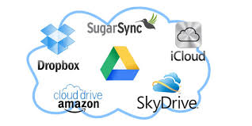
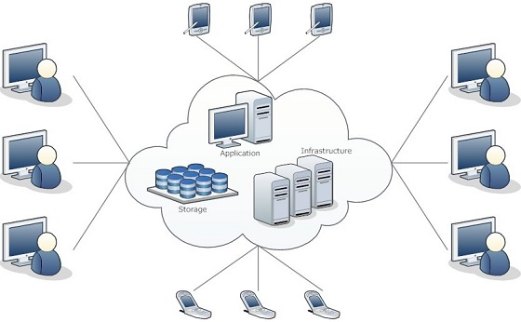
Introduction
The term Cloud refers to a Network or Internet. In other words,
we can say that Cloud is something which is present at remote
location. Cloud can provide services over network i.e. on
public networks or on private networks i.e. WAN, LAN or VPN.
We are using cloud almost everywhere
Applications such as
e-mail
Youtube,Facebook,WhatsApp..

Slide 4
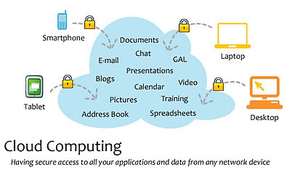
Introduction
Cloud Computing refers to manipulating, configuring, and accessing the applications online. It offers online data storage, infrastructure and application.
We need not to install a piece of software on our local PC and this is how, the cloud computing overcomes platform dependency issues. Hence, the Cloud Computing is making our business application mobile and collaborative.

Slide 5
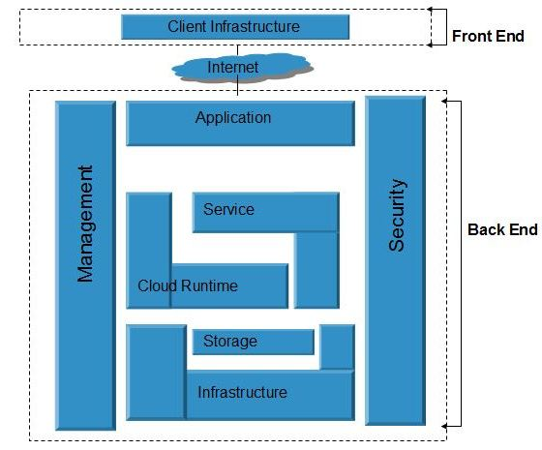
Archi-Tecture

Slide 6
Cloud in Real Life:-
Business requirements:- Netflix, Adobe connect, Expense reporting, Timesheet, Payroll systems
Email-Communication.
Backup Services.
Banking and Financial Services.
Social Networking:- Facebook, LinkedIn, MySpace, Twitter..
Improved Communications
Hospitals And Health-Care Databases

Slide 7
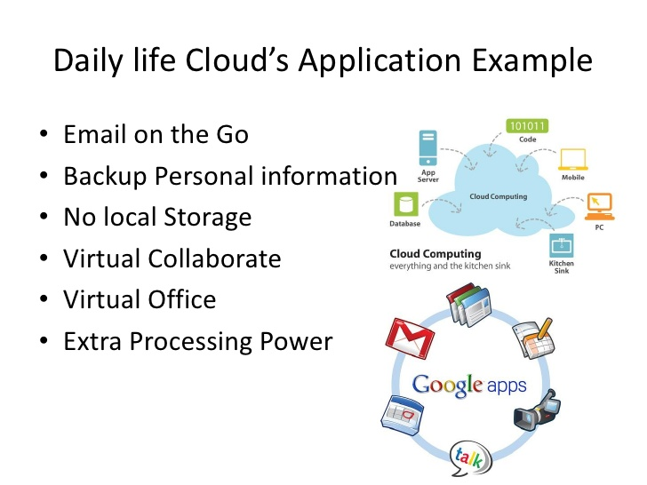
Cloud…...

Slide 8
Security Challenges
Data Protection:-Implementing a cloud computing strategy means placing critical data in the hands of a third party, so ensuring the data remains secure both at rest (data residing on storage media) as well as when in transit is of paramount importance.
User Authentication:-Data resting in the cloud needs to be accessible only by those authorized to do so, making it critical to both restrict and monitor who will be accessing the company's data through the cloud.
Contingency Planning:-With the cloud serving as a single centralized repository for a company's mission-critical data, the risks of having that data compromised due to a data breach or temporarily made unavailable due to a natural disaster are real concerns.

Slide 9
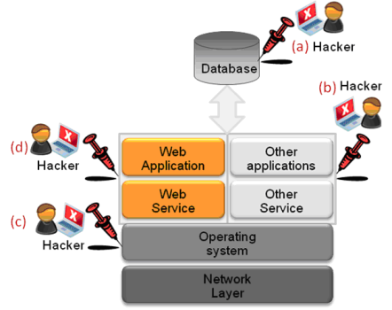
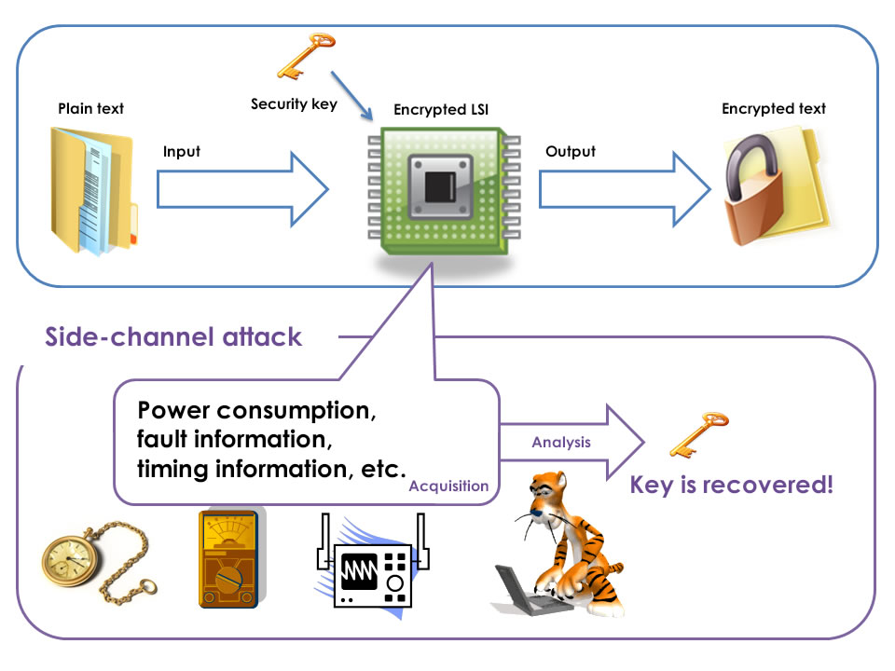
ATTACKs
1. Malware Injection Attack
2. Side Channel Attack
This attack is directed to compromise IaaS by placing a virtual machine co-resident to the victim VM and then it targets cryptographic implementation in system. By co-resident means that the VM has to be in the same host.
This attack focuses on adding/injecting a service implementation or evil virtual machine to cloud environment

Slide 10
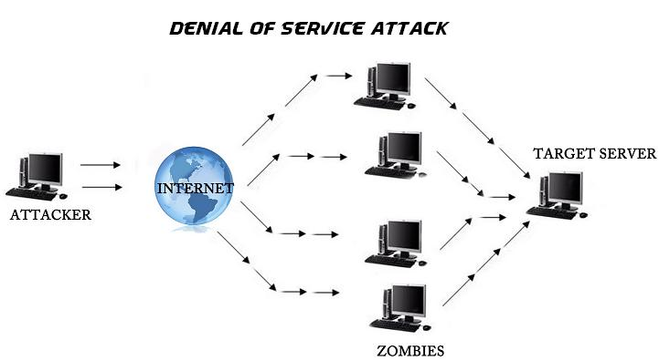
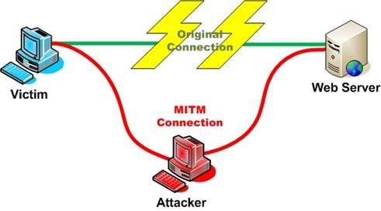
ATTACKs
3.Denial of Service Attacks (DoS Attacks):
4.Authentication and MiTM Attack
DoS attack definition remains same in the Cloud i.e. it prevents users from accessing a service. However, in a Cloud environment, DoS attacks get nasty
If attacker can place themselves between the user and the service provider then the MiTM attacks are also possible.

Slide 11
Literature Survey
Work1: A Dynamic Secure Group Sharing Framework in Public Cloud Computing [3], IEEE Transaction on Cloud Computing, 2014.
This method is preserving the privacy by supporting the updation of the group key pair whenever group member’s joining or leaving.
They have enhanced the Tree-Based Group Diffie-Hellman (TGDH), with the help of cloud server and supports the group key pairs negotiate and update the group key pairs even though not all of the group members are online together.
The drawback of this method is they used a large number of dummy nodes in tree construction and group key computation.

Slide 12
Literature survey
Work 2.1: Key Management Scheme for Multiple Simultaneous Secure Group Communication.[5] IEEE International Conference on Internet Multimedia Services Architecture and Applications (IMSAA), 1–6 (Dec 2009).
For secure multiple overlapped group communication , they used combination of key-based and secret share-based approach for key management.
The drawback of this paper is they considered semi-trusted third party as a key distribution center for managing the keys.

Slide 13
Literature survey
Work 2.2 :-A Tree Key Graph Design Scheme for Hierarchical Multi-Group Access Control
IEEE COMMUNICATIONS LETTERS, VOL. 13, NO. 11, NOVEMBER 2009
For a hierarchical multi-group access control mechanism that is utilizing group keys and tree key graph, and has lower rekeying overhead, They propose a tree key graph design scheme.
The drawback of this paper is that there is a high computation work which is not affodable in Real world Applications..

Slide 14
TGDH Protocol(Previous work)
Tree-Based Group Diffie-Hellman (TGDH), which uses a key tree to arrange all the keys.
Propose a interval-based rekeying algorithms:
Many group-oriented and distributed applications require security services.
Example: a closed and confidential business meeting in a p2p network.
We therefore need a secure distributed group key agreement scheme so that the group can encrypt their communication data with a common secret group key.

Slide 15
Tree-Based Group Diffie-Hellman Protocol (TGDH)
0
1
2
3
4
5
6
M₃
M₆
7
8
11
12
M₁
M₂
M₄
M₅
A key tree is formed. Each node v represents a secret (private) key K_{v} and a blinded (public) key BK_{v}.
BK_{v} = α^{Kv} mod p, where α and p are public parameters.
Every member holds the secret keys along the key path, and all the blinded keys in the key tree.
K₀ is the group key.

Slide 16
Requirements of Group Key Agreement
Distributed: there is no centralized key server, which has the following limitations:
A single point of failure; and
Not suitable for peer groups and ad hoc networks.
Collaborative: all group members contribute their own part to generate a group key.
Dynamic: the protocol remains efficient even when the occurrences of join/leave events are very frequent.

Slide 17
Challenges of Data Sharing
Muti group Sharing
Access Control
Security and Confidentiality of Sensitive Data:- Health-related data, Financial data, Government data etc.
Authorization & Authentication
Third Party involved
Storage Capability
High Computational Cost

Slide 18
Our Objective
Since Semi-trusted third party is involved in data sharing so no security.
Existing techniques have high computational cost. Therefore our main objective is to reduce the computational cost.
Most of the existing works are on single group communication but real world group communication are based on multiple groups.

Slide 19
Proposed Approach(For single group)
It consists of three phases:
Group Initialization
Group Key Management
Intra- and Inter-Group Secure Data Sharing

Slide 20
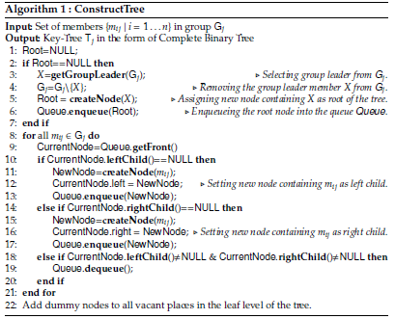
Group Initialization

Slide 21
Construction Of Complete Tree:-
m1:GL
m2
m3
m4
m5
D
m6

Slide 22
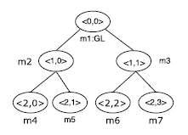




Group Key Management
${BK}_{<l,v>}=α^{{Pr}_{<l,v>}} mod p$ ……………………..(1)
$${IPr}_{<h−1,v>}={{BK}_{<h,2v+1>}}^{{Pr}_{<h,2v>}}mod p……….(2)$$
${IPr}_{<l,v>}={({BK}_{<l+1,2v+1>}}^{{IPr}_{<l+1,2v>}}mod p$)……………(3)

Slide 23
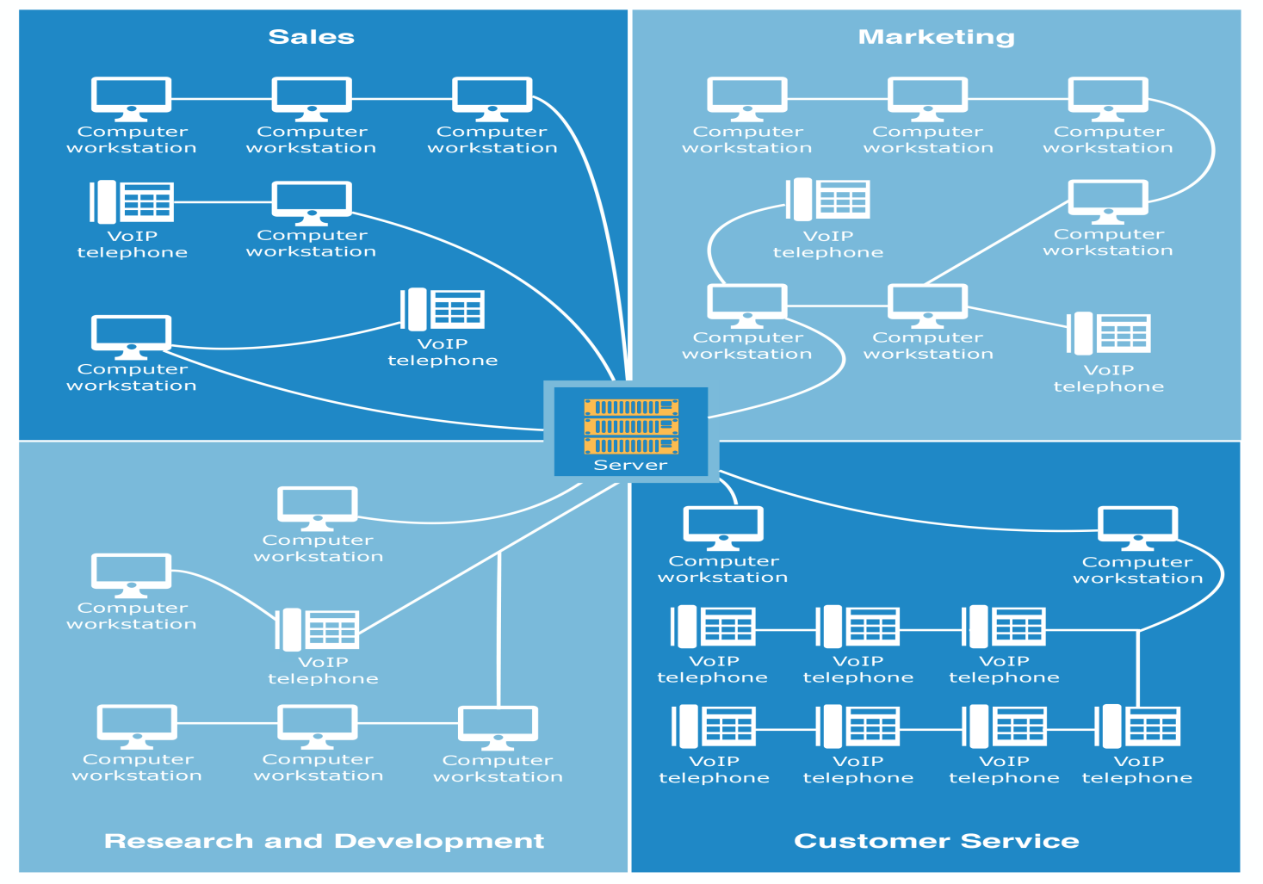
Real world application

Slide 24
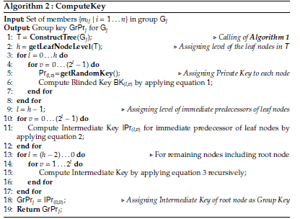
Algorithm of Group Key Computation

Slide 25
Generation of Private-Public Key Pair
Goldbachs conjecture [10]- “Every even integer n greater than 2 is the sum of two prime numbers.”
Hence GrPr_j (if GrPr_j is even) or GrPrj + 1 (if GrPr_j is odd) can be expressed as P + Q (P >= Q). Several such (P, Q) pairs may exist, and the pair having minimum P- Q is considered. This guarantees a unique pair (P,Q) for a given GrPr_j.
Once P and Q are obtained, the group leader then follows RSA algorithm [3] to compute a private-public key pair.

Slide 26
Group Event Management
Member joining
Member leaving
Rekeying

Slide 27
Member Joining
m1: GL
m2
m3
m4
m5
m7
m6
m8
Members Added..
m9

Slide 28
Member Leaving
m1: GL
m2
m3
m4
m5
m7
m6
m8
m9

Slide 29
Member Leaving
m1: GL
m2
m3
m4
m5
m7
m6
m8
D
Dummy Node

Slide 30
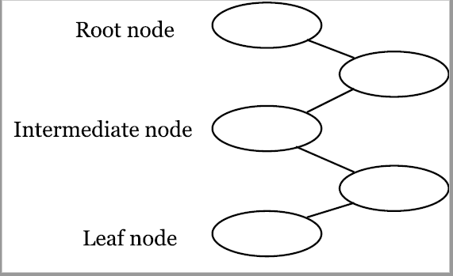
Rekeying
Rekeying (renewing the keys of the nodes) is performed for every single join/leave event to ensure backward and forward confidentiality.
rekey
rekey
rekey
rekey
rekey
t
Join
Leave
Join
Join
Leave
A special member called sponsor is elected to be responsible for broadcasting updated blinded keys.

Slide 31
Performance Comparison
Total computational cost = Tree construction cost+ Group key computation cost
If we consider ‘n’ members in a group, in proposed approach (n+1) number of nodes are required for tree construction during key generation.
On the other hand, TGDH approach requires (2n-1) number of nodes for constructing tree which is higher than proposed approach.
Storage cost for storing key related data is also double in existing approach w.r.t . Proposed approach.

Slide 32
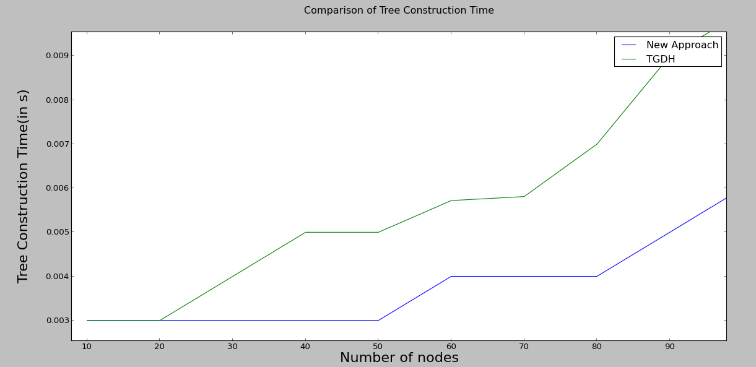
Performance Analysis

Slide 33
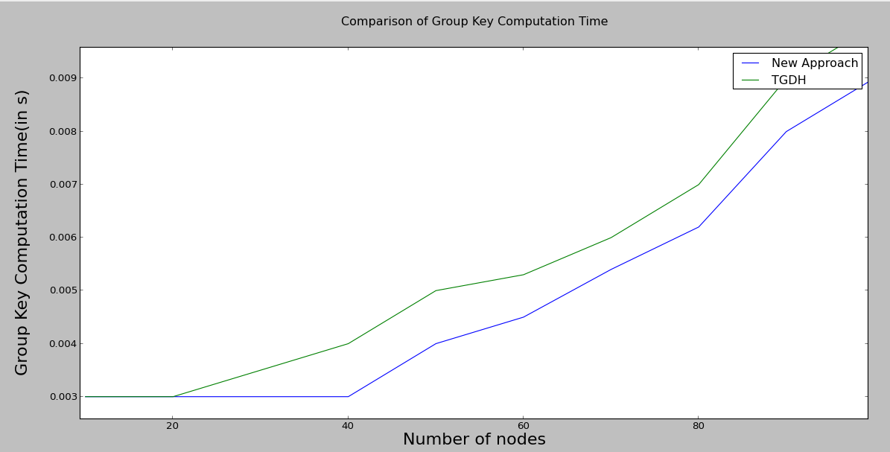
Performance Analysis…

Slide 34
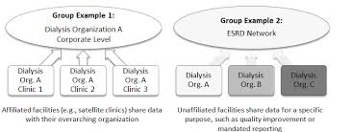
MULTI GROUP

Slide 35
SCENARIO OF MULTI-GROUP
1
2
KDC
G
1
2
…………UPTO N
G
-
X
-
X
X
Y
-
-
Y
-
-
Y
-
-
RESOURCE ALLOCATION MATRIX

Slide 36
Multi Group
In our Proposed approach,Each Group leader has a resource allocation matrix for each member that contains information like which member wants which resource etc.
The Central Key Distribution Center has all this resource allocation matrices.from all this matrices KDC will separate common member that is present in two or more groups.and inform the group leader about the common member.
The group leader will generate group key by removing the common member.

Slide 37
Multi Group
Each group leader generate group key.
KDC generate a group key for common members.
By using all group keys one final key is generated.
In this key each member has certain contribution.
Now if one member wants to communicate with other member this member will send a request to Group Leader.Group Leader will see its Resource Matrix Allocation to check whether both the members belongs to same group or not.

Slide 38
Multi Group
If both the members belongs to same group then group leader will give right to start communication.
and now both member will start sharing of data.
if the receiver is not in the same group then Group Leader will communicate with Group Administrator and Group administrator will see its Matrix and accordingly it will make connection with the right receiver to communicate.
Now both member can start communication.

Slide 39
Pseudo code
Each member will generate Group Key using the Algorithm described above.
Using all group key and a group key for common member. Group Administrator will generate a ultimate group key.
Using this key one member communicate with other member.

Slide 40
Future work
We have to implement the algorithm.
We have to analyze the proposed algorithm.

Slide 41
Conclusion
This framework is generic in the sense that it can adopt any organizational policies to maintain hierarchy in data sharing.
There is no involve of third party in data sharing. So this approach is more robust than existing approach.
The performance analysis shows that the proposed model can fit into the real world and has lower computational complexity in key management.
As the further plan, we will extend this to adopt more fine-grained policies in the same group. For example, student can share their data to student representative in the same group, but not to others.

Slide 42
References
1. Goyal, V., Tripathy, R.: An ecient solution to the arp cache poisoning problem. In: Australasian Conference on Information Security and Privacy. 40–51. Springer(2005).
2. H., K., B., C.R., J., S.: Novel defense mechanism against data flooding attacks inwireless ad hoc networks. IEEE Transactions on Consumer Electronics 56(2), 579–582 (2010).
3. Kahate, A.: Cryptography and Network Security. McGraw Hill Education (India) Private Limited (2016).
4. Khan, A.N., Kiah, M.M., Madani, S.A., Ali, M., Shamshirband, S., et al.: Incremental proxy re-encryption scheme for mobile cloud computing environment. The Journal of Supercomputing 68(2), 624–651 (2014).
5. Kim, Y., Perrig, A., Tsudik, G.: Tree-based group key agreement. ACM Transactions on Information and System Security (TISSEC) 7(1), 60–96 (2004).
6. M., A., R., D., E., K., U., K.S., V., V.A., K., L., y., Z.A.: Sedasc: Secure data sharing in clouds. IEEE Systems Journal PP(99), 1–10 (2015).
7. Modi, C., Patel, D., Borisaniya, B., Patel, A., Rajarajan, M.:Asurvey on security issues and solutions at dierent layers of cloud computing. The Journal of Supercomputing 63(2), 561–592 (2013).
8. Paterson, K.G., Quaglia, E.A.: Time-specific encryption. In: International Conference on Security and Cryptography for Networks. 1–16. Springer (2010).
9. R., A., B.B., A.: Key management scheme for multiple simultaneous secure group communication. In: 2009 IEEE International Conference on Internet Multimedia Services Architecture and Applications (IMSAA). 1–6 (Dec 2009).

Slide 43
THANK YOU

