Slide 1
AGENDA
What is Xpath
Xpath nodes
Relations of Nodes
Xpath Syntax
Use of wildcard characters
Predicates
Xpath Axes
Xpath Functions
Screenshots

Slide 2
Xpath
What we should already know
Xml
Html
Xpath is a syntax for defining parts of an XML document.
XPath uses path expressions to navigate in XML documents.
* Data has been collected from various sources.

Slide 3
Xpath Nodes
There are several nodes in xpath
Element
Attribute
Text
Namespace
Example:-
<bookstore> <book> <title lang="en">Harry Potter</title> <author>J K. Rowling</author> <year>2005</year> <price>29.99</price> </book> </bookstore>

Slide 4
Relationship of Nodes
Parent
e.g.:- Parent of “book” in previous example is “bookstore”
Children
e.g.:- Children of “book” in previous examples are “title, author, year, price”
Siblings
e.g.:- Siblings in previous examples are “title, author, year, price”

Slide 5
Cont.……
Ancestors
e.g.:- Ancestors of “title, author, year, price” are “book and bookstore”
Descendants
e.g.:- Descendants of “book and bookstore” are “title, author, year, price”

Slide 6
Xpath Syntax
/ is used for absolute path. It selects from the root node.
e.g. :- /html/body/div[3]/div[1]
// is used for relative path
e.g. :- //h3/a[text()=‘Working with XPath’]
. It selects current node
.. It selects parent of the current node
e.g.:- //book/..
@ It is used for attributes
e.g.:- //title[@lang=‘en’]

Slide 7
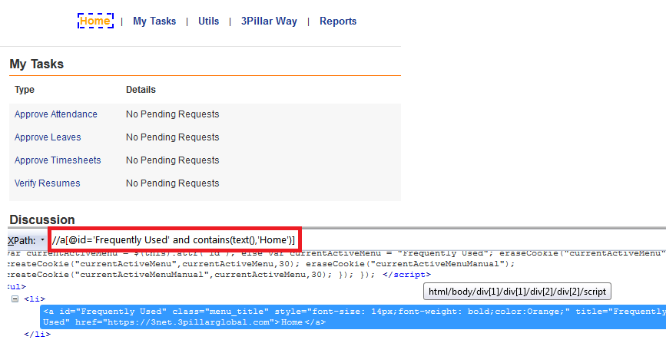
Example of xpath

Slide 8
Wildcards
When one wants to select unknown nodes
* => Matches any element node
@* => Matches any attribute node
Node() => Matches any node of any kind
example:- //*[text()=‘home’]
it will select any element from the document where text is home
//div[@id=‘frequently-used’]/div[‘*’]
It will select all the attributes in div element

Slide 9
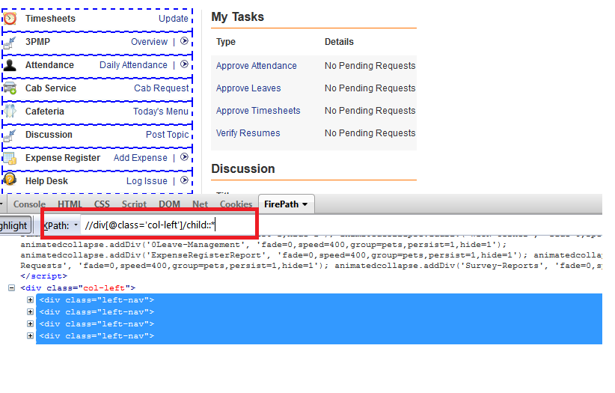
Wildcard characters

Slide 10
Predicates
Predicates are used to find a specific node or a node that contains a specific value.
Predicates are always embedded in square brackets.
example:- 1. //book/title[@lang=‘eng’]
Selects all the title elements that have an attribute named lang with a value of 'eng’.
2. /bookstore/book[last()]
Selects the last book element that is the child of the bookstore element

Slide 11
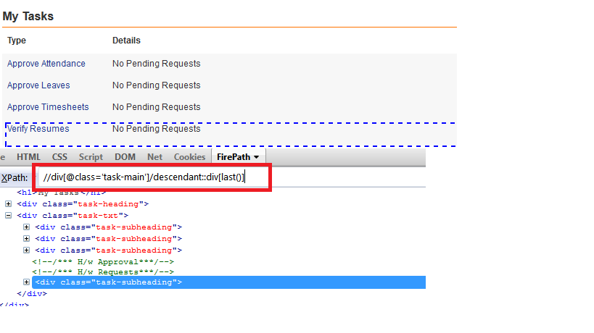
Predicates using descendant
//div[@class='task-main']/div[last()]

Slide 12
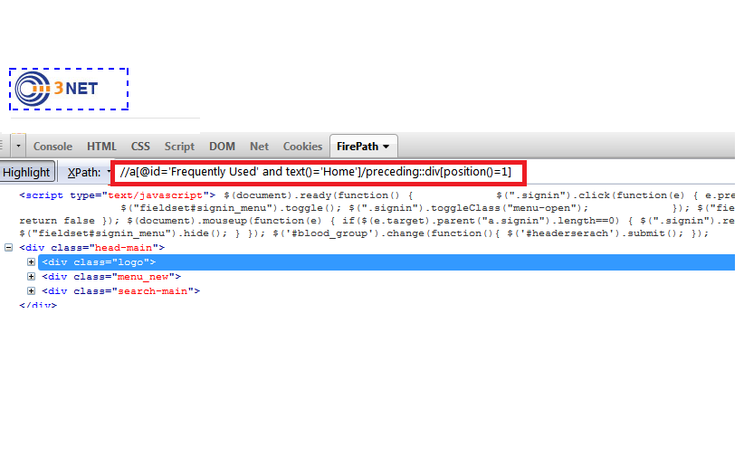
Predicates using(position)

Slide 13
Xpath Axes
Ancestor
Ancestor-or-self
Attribute
Child
Descendant
Descendant-or-self
Following
Following-sibling
Parent

Slide 14
Cont.……
Preceding
Preceding-sibling
self
Preceding
Preceding-sibling
self

Slide 15
Xpath Functions
Substring
Substring-before
Substring-after
String-length
Count
Translate
Choose
True
Number
Local-name

Slide 16
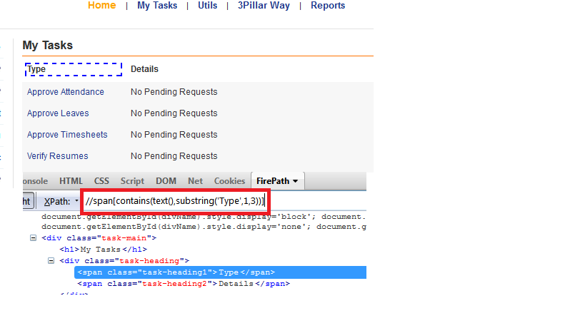
Substring

Slide 17
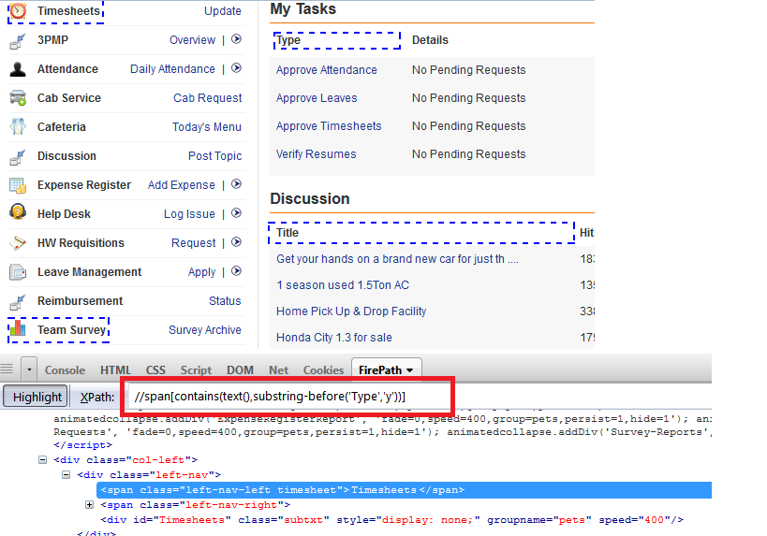
Substring-before

Slide 18
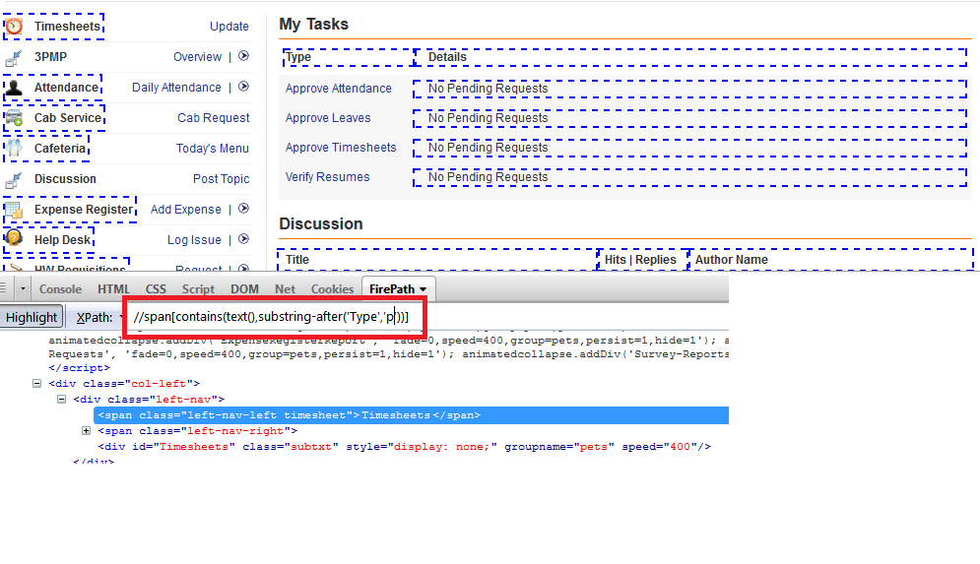
Substring-after

Slide 19
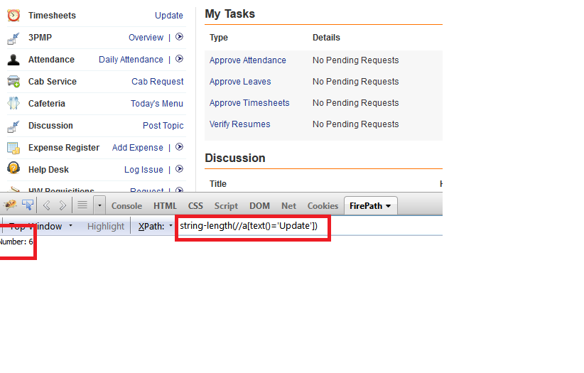
String-length

Slide 20
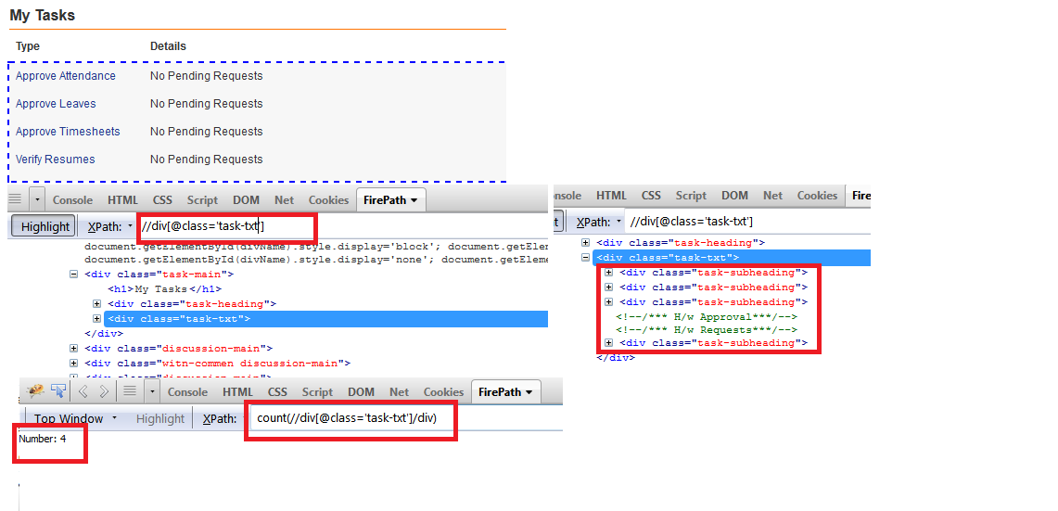
Count

Slide 21
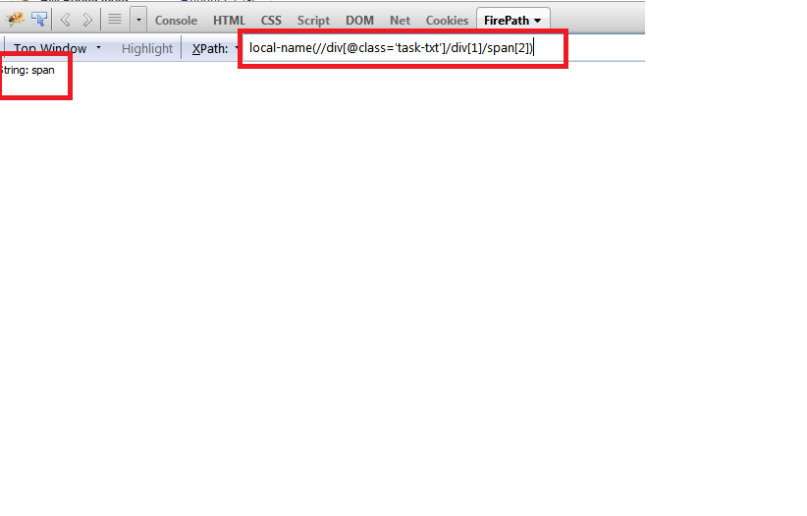
Local-name

Slide 22
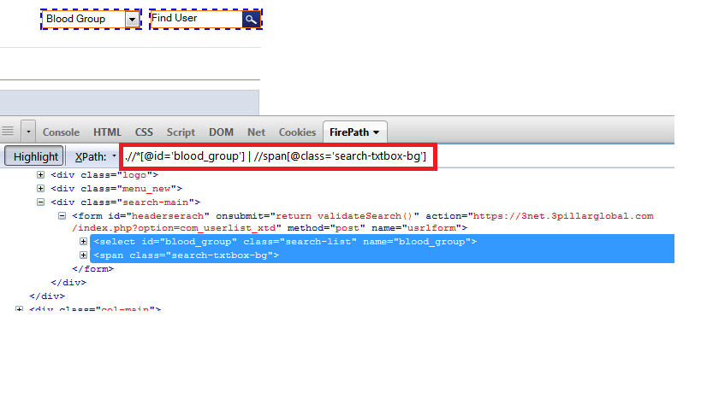
Dual Selection with | operator

Slide 23
THANKS!
Now let’s get to work!

