Slide 1

PSG College of Technology, Coimbatore
Department of Computer Science and Engineering
Automated Low-Resource On-Device Classroom Attendance via Sweep-Video Face Detection
Project Work (23Z711) | Review III
Guided by Ms Sneha C Co-guided by Dr Arul Anand
Ananya R S (23Z306)
Athish Pranav (23Z310)
Dileepan U S (23Z319)
Sanjeev S (23Z361)
Sreeharini Ganishkaa S (23Z370)
Notes:
[PERSON 1]
Good morning. We are presenting our project, "Automated Low-Resource On-Device Classroom Attendance via Sweep-Video Face Detection", guided by Ms Sneha C and co-guided by Dr Arul Anand.
This is our third review. Today we will present the completed system: the iOS and Android implementations, how our data is organised, and our benchmarking.

Slide 2
Introduction
Problem
Manual roll-call takes up lecture time and allows proxy attendance. Camera-based systems in the literature assume fixed cameras, clear photos or a GPU server.
Our approach
The teacher records a 10 to 15 second sweep of the classroom on a phone. The app detects, tracks and recognises every student on the phone itself, offline and on the CPU, and produces the attendance list.
Progress
iOS app complete with a native C++ engine
Android app complete with an ML Kit + ONNX engine
Multi-pose enrollment, CSV export, roster sharing
Benchmark mode with a live detector switch
Notes:
[PERSON 1]
First, the problem. Manual roll-call takes up lecture time and makes proxy attendance easy. Most automated systems in the literature need fixed cameras, clear photos, or a GPU server, which is expensive and sends students' faces off-site.
Our approach is simple: the teacher records a 10 to 15 second sweep of the classroom on their phone. The app finds, tracks and recognises every student on the phone itself. It works offline, on the CPU, and outputs the attendance list.
Both apps are now complete. iOS uses a native C++ engine, Android uses Google ML Kit with ONNX Runtime. We also added multi-pose enrollment, CSV export, roster sharing, and a benchmark mode where we can switch detectors live.

Slide 3
Market Survey
Approach | Example in use | Whole class at once | Extra hardware | Main drawback
Manual roll-call / register | Most classrooms | No | None | Slow, and proxies are easy. Teachers in Tamil Nadu schools spent over 45 min a day on it
Fingerprint terminal | Common in colleges and offices | No | Terminal per room or gate | Students queue one at a time; shared touch surface
Face-recognition device at entry | TNeGA DL-FRS, Tamil Nadu public schools | No | Edge device with camera | Marks arrival at the gate, not presence in a lecture
Face-recognition mobile app | AttendFy (App Store) | No | None | Captures faces one by one
CCTV + cloud processing | Real-time tracking + Firebase | Yes | Fixed camera per room + server | Costly per room; student video leaves campus
Our system | ClassRoom app | Yes | None (teacher's phone) | Accuracy varies based on classroom environmental factors
Gap: no common solution captures a whole class at once without extra hardware and without sending data off the device.
Notes:
[PERSON 1]
Before building, we looked at what is already used for attendance.
Manual roll-call is still the most common. It is slow and proxies are easy. A Tamil Nadu government case study reports that teachers in public schools spent over 45 minutes a day on attendance.
Fingerprint terminals are common in colleges, but students have to queue and touch the same device one at a time.
Tamil Nadu's e-Governance Agency deployed a face-recognition device at school entrances. It works well, but it marks arrival at the gate, not presence in a particular lecture.
There are also face-recognition mobile apps, such as AttendFy, but they capture faces one at a time.
CCTV with cloud processing, like our second base paper, can see the whole class, but needs a fixed camera in every room plus a server, and student video leaves the campus.
Our system is the only one in this list that captures the whole class at once using just the teacher's phone, with no extra hardware and no data leaving the device. Its open point is accuracy on real classrooms, which we are measuring next.

Slide 4
Progress
Planned | Status | What was done
Multi-device test setup | Done | Running on iPhone (iOS 26.6) and OnePlus CPH2661 (Android 16)
Off-angle and side-profile faces | Done | 3-pose enrollment (frontal, left 15°, right 15°)
Benchmark more detectors | Done | RetinaFace and Haar added with a live switch; speed measured on CPU
Rear rows and occlusion | Done | Rear-row zoom and desk tracking added to both pipelines
Classroom vs lab tests, look-alikes | Done | Tested in classroom and lab settings, including look-alike cases
Deployment packaging | Done | Release builds prepared for iOS and Android
Multi-sweep capture | Done | Several sweeps can be recorded for the same lecture
Consolidated attendance | Done | Results from all sweeps merged into one attendance list
Notes:
[PERSON 1]
This slide shows our progress against the plan we set out at the start. Every planned item is now done.
The multi-device test setup is complete: the app runs on an iPhone with iOS 26.6 and a OnePlus phone with Android 16. Off-angle faces are handled with three-pose enrollment, frontal and 15 degrees to each side. The rear-row zoom and desk tracking are in both pipelines.
We added RetinaFace and Haar as alternative detectors with a live switch in the app and measured their speed. We tested in classroom and lab settings, including look-alike cases, and prepared release builds for iOS and Android.
Two new features are also complete. Multi-sweep capture lets the teacher record several sweeps for the same lecture, and consolidated attendance merges the results of all sweeps into a single attendance list, so a student missed in one sweep can still be marked present from another.
Beyond the plan, we built a separate Android pipeline, support for multiple classes, roster sharing between phones, CSV export, importing recorded sweeps from the gallery, and light and dark themes.
[Person 2] will now take you through our data model and how the system is used and built.

Slide 5
ER Diagram
name
student_id
enrolled_at
id
vector (512-D)
class_id
CLASS
1
ENROLLS
N
STUDENT
1
HAS
N
FACE_EMBEDDING
M
status
Rectangle: entity · double: weak entity
Diamond: relationship · double: identifying
Oval: attribute · dashed: derived
Underline: key · dashed underline: partial key
Double line: every embedding needs a student
MARKED_IN
1
similarity_score
N
TAKES
created_at
N
ATTENDANCE_SESSION
present_count
Notes:
[PERSON 2]
This is the ER diagram of our data, drawn in Chen notation: rectangles are entities, ovals are attributes and diamonds are relationships.
A CLASS, identified by class_id, ENROLLS many STUDENTS. Each student is identified by student_id, their roll number, and also has a name and enrollment time.
Each student HAS face embeddings. FACE_EMBEDDING is a weak entity, shown by the double rectangle: an embedding cannot exist without its student. Its id is only a partial key, and it stores a 512-number vector. The double line means every embedding must belong to a student. Each student has three, one per enrolled pose.
A class TAKES many ATTENDANCE_SESSIONS, identified by their creation time. Between STUDENT and ATTENDANCE_SESSION is a many-to-many relationship, MARKED_IN: a student appears in many sessions and a session contains many students. The relationship itself carries the status, present or absent, and the similarity score.
present_count is a derived attribute, shown dashed, because it is calculated from the statuses rather than stored.
Students, classes and embeddings are stored on the phone; attendance sessions are exported as CSV.
Before the use cases, here are the assumptions our system makes.

Slide 6
Assumptions
Teacher and device
The teacher already owns a smartphone (iOS 16+ or Android 7.0+)
It has a working rear camera that records 1080p video and a gyroscope
About 200 MB of free storage; no internet connection is needed
Students and enrollment
Every student is enrolled once, in person and with consent (3 face poses)
Roll numbers are unique within a class
Faces are mostly uncovered and roughly facing the front during the sweep
Classroom
Students sit in rows facing the teacher, who stands at the front
Normal indoor lighting, not a dark room
Back rows appear in the upper part of the frame (the rear-row zoom relies on this)
How it is used
The teacher pans slowly for 10 to 15 s, following the on-screen speed warning
One sweep per lecture, taken while students are seated
The teacher reviews the list and corrects errors before exporting
Notes:
[PERSON 2]
Every system is built on some assumptions, so here are ours, in four groups.
First, the teacher and the device. We assume the teacher already owns a smartphone running iOS 16 or Android 7 or later, with a rear camera that records 1080p video and a gyroscope. It needs about 200 MB of free space, and no internet connection.
Second, students and enrollment. Each student is enrolled once, in person and with consent, by capturing three face poses. Roll numbers are unique within a class, and during the sweep faces are mostly uncovered and roughly facing the front.
Third, the classroom. Students sit in rows facing the teacher, who stands at the front. The room has normal indoor lighting. Because of perspective, the back rows appear in the upper part of the frame, and our rear-row zoom relies on that.
Fourth, how it is used. The teacher pans slowly for 10 to 15 seconds, guided by the on-screen speed warning, takes one sweep per lecture while students are seated, and reviews the list before exporting.
With these assumptions in place, let us look at how the teacher uses the system.

Slide 7
Use Case Diagram
ClassRoom App
Create / select class
Enroll student
(3 face poses)
Recognise non-frontal face
angled seating, turned head: matched to left / right enrolled poses
Student
Record classroom sweep
«extend»
Generate attendance
(on device)
Recognise occluded face
spectacles, hand or partial cover: matched on visible features
Teacher
Review and override attendance
Flag undetected student
head down or asleep: marked absent for teacher review
«extend»
Export CSV / share roster
Notes:
[PERSON 2]
This is the use case diagram. There are two actors, the teacher and the student.
The teacher creates or selects a class, enrolls each student once by capturing three face poses, records the classroom sweep, lets the app generate attendance on the device, reviews and overrides it if needed, and finally exports it as CSV or shares the roster.
The student's role is passive: they are enrolled once and then appear in the sweep.
On the right are three extension use cases, shown with the extend relationship. They describe optional behaviour that is triggered only when a certain condition occurs while attendance is being generated.
First, recognising a non-frontal face: if a student is sitting at an angle or has turned their head, the face is matched against the left and right poses captured at enrollment.
Second, recognising an occluded face: if a student is wearing spectacles or a hand partly covers the face, matching relies on the remaining visible features. Enrolling students as they normally appear, for example with their usual glasses, helps here.
Third, flagging an undetected student: if a student has their head down or is asleep, the face cannot be detected. The student is marked absent, and this extends the review step, where the teacher can override it.
Now let me show how the iOS version is built.

Slide 8
iOS Implementation: Architecture
UI layer
Flutter UI (Dart)
Home, Enrollment, Capture, Processing, Results
dart:ffi call on a background isolate
Interface
C API
ClassroomProcessSweepVideo(), ClassroomEnrollStudentFromPhoto() → JSON result
Processing
C++17 engine (static CocoaPod, force-loaded into the app binary)
FrameSampler
BlurFilter
FaceDetector
DeskTracker
ArcFaceEmbedder
IdentityClusterer
CosineMatcher
RosterDB
Libraries
OpenCV 4.14
ONNX Runtime 1.23
SQLite3
Runs on the iPhone CPU only (no GPU / Neural Engine)
Notes:
[PERSON 2]
This is the iOS architecture, from top to bottom.
At the top is the Flutter UI, written in Dart. These are the screens the teacher uses.
When the teacher processes a sweep, Flutter calls into native code using dart:ffi, on a background isolate so the UI doesn't freeze.
That call goes through a small C API. There are two main functions, one to process a sweep video and one to enroll a student, and both return their result as JSON.
Below that is our C++17 engine, which does all the actual work: frame sampling, blur filtering, face detection, desk tracking, ArcFace embedding, clustering, matching and the roster database. It's packaged as a static CocoaPod and linked directly into the app.
The engine uses OpenCV for vision, ONNX Runtime to run the neural networks, and SQLite to store the roster. Everything runs on the iPhone's CPU.
[Person 3] will now walk through the iOS pipeline.

Slide 9
iOS Implementation: Pipeline
1. Capture
1080p sweep video, 10 to 15 s
2. Frame sampling
4 FPS; full-res + 640×360 copy
3. Blur filter
Laplacian variance, drop frames below 15
4. Face detection
YuNet INT8 on full frame + 3 tiles over the rear-row band
5. Desk tracking
Optical flow → affine motion; group faces by desk
6. Embedding
2 sharpest faces per desk → ArcFace, 512-D
7. Clustering
Agglomerative (HAC), threshold 0.35
8. Matching
Cosine similarity vs SQLite roster, threshold 0.40
Rear-row zoom: extra passes only on the band where the back rows sit, not the whole frame.
Desk tracking: the moving camera sees past occluding heads; sightings of one student are grouped by desk.
Best-2 embedding: only the 2 sharpest faces per desk go to ArcFace, instead of every face in every frame.
Notes:
[PERSON 3]
Here is the iOS pipeline. The shaded steps are our own contributions.
One, the teacher captures a 1080p sweep. Two, we sample 4 frames per second and keep a full-resolution copy and a small 640 by 360 copy. Three, blurry frames from camera shake are dropped.
Four, face detection with YuNet, including our rear-row zoom.
Five, desk tracking. Because the camera is moving, a student hidden behind someone in one frame is usually visible in another. We estimate camera motion with optical flow and group every sighting of a face into a "desk".
Six, for each desk we only send the two sharpest faces to ArcFace, which turns each face into a 512-number vector. This avoids running the model on every face in every frame.
Seven, vectors of the same person are clustered, and eight, each cluster is matched against the enrolled roster. Students above the threshold are marked present.
Next, let me go deeper into the face detection engine.

Slide 10
Face Detection Engine
Tile 1
YuNet INT8
Light CNN face detector, 0.1 MB. Gives a box and 5 landmarks per face.
1. Full-frame pass on a 640×360 copy, score ≥ 0.40
2. Rear-row pass 3 tiles over the back-row band, each enlarged to 640 px, score ≥ 0.35
3. Merge map boxes to 1080p, drop overlaps (IoU ≥ 0.35) and faces under 14 px
4. Hand-off landmarks used to align each face for ArcFace
Why only a band? Back-row faces shrink to a few pixels. Tiling the whole frame (SAHI) costs too much on a phone, so we zoom only where the back rows sit.
Also: auto-rotation for sideways video; RetinaFace or Haar selectable at runtime. Android uses Google ML Kit with the same rear-row crop idea.
Tile 2
Tile 3
Rear-row band (10–65% of height)
Front rows: found in the full-frame pass
Measured on CPU: 6.1 ms per frame (full frame only), 30.3 ms with the rear-row tiles.
Notes:
[PERSON 3]
This slide focuses on the face detection engine, which is step four of the pipeline.
We use YuNet INT8, a light CNN face detector that is only 0.1 MB. For every face it gives a bounding box and five landmarks: two eyes, the nose and two mouth corners.
Detection runs in two passes. The first pass runs on a 640 by 360 copy of the whole frame, which finds the front and middle rows quickly.
The problem is the back rows. At that size, faces six to eight metres away shrink to just a few pixels, and the detector misses them. A known fix is SAHI, which cuts the whole image into tiles and runs the detector on each one. But that is too slow on a phone.
So we use the classroom's geometry. The back rows always sit in a band across the upper part of the frame, from about 10 to 65 percent of the height. We run a second pass only on that band, as three overlapping tiles, each enlarged to 640 pixels. That makes distant faces big enough to detect.
Then we merge. Boxes are mapped back to the full 1080p frame, overlapping duplicates are removed, and anything under 14 pixels is dropped. The landmarks are used to align each face before recognition.
On a CPU, the plain pass takes about 6 milliseconds per frame, and with the rear-row tiles about 30.
The detector can also be switched to RetinaFace or Haar at runtime for comparison. Android uses a different detector, Google ML Kit, so let me move to the Android version.

Slide 11
Android Implementation: Architecture
Flutter UI (Dart)
Same screens as iOS
ClassroomEngine (Dart, background isolate)
Motion compensation, desk grouping, exemplar selection, clustering, matching
Kotlin (MethodChannel)
MediaMetadataRetriever extracts frames at 4 FPS (max 40) and a rear-row crop of each
Google ML Kit
Face detection, accurate mode, on the full frame and the crop
ONNX Runtime
ArcFace MobileFaceNet via flutter_onnxruntime, 512-D output
Storage: JSON roster per class in app storage, CSV export
Tested on: OnePlus CPH2661, Android 16, CPU only
Notes:
[PERSON 3]
The Android version shares the same Flutter UI, but the processing is built differently.
In the middle is our ClassroomEngine, written in Dart, running on a background isolate. It handles motion compensation, desk grouping, picking the best faces, clustering and matching.
It uses three platform services. First, a Kotlin layer, called through a MethodChannel, which uses Android's MediaMetadataRetriever to pull frames from the video at 4 frames per second, plus a cropped band for the rear rows. Second, Google ML Kit for face detection. Third, ONNX Runtime, which runs the same ArcFace model as iOS.
The roster is stored as a JSON file per class, and we tested on a OnePlus phone running Android 16.

Slide 12
Android Implementation: Pipeline
1. Capture
1080p sweep video, 10 to 15 s
2. Frame extraction
Kotlin, 4 FPS, up to 40 frames
3. Rear-row crop
Band from 12% to 67% of frame height
4. Face detection
ML Kit on frame and crop; duplicates merged
5. Desk grouping
Frame-to-frame shift; faces within 85 px = one desk
6. Embedding
2 best faces per desk → ArcFace (ONNX)
7. Clustering + matching
HAC 0.35; cosine vs 3-pose references, 0.38
 | iOS | Android
Frame decoding | OpenCV, in C++ | MediaMetadataRetriever, in Kotlin
Face detector | YuNet INT8 (RetinaFace / Haar selectable) | Google ML Kit
Camera motion | Optical flow + affine fit | Global translation estimate
Roster storage | SQLite | JSON file
Notes:
[PERSON 3]
This is the Android pipeline. The goal is the same, but the stages differ. Again, the shaded steps are our contributions: the rear-row crop, desk grouping and best-two embedding.
Frames are extracted in Kotlin, and a rear-row crop from 12 to 67 percent of the frame height is saved for each frame. ML Kit detects faces in both the full frame and the crop, and duplicates are merged.
We then estimate the shift between frames and group faces within 85 pixels into one desk. The two best faces per desk go to ArcFace, and the results are clustered and matched against the three enrolled poses of each student.
The table at the bottom summarises the differences. iOS decodes video with OpenCV in C++, Android uses Kotlin. iOS uses YuNet, Android uses ML Kit. iOS models camera motion with an affine fit, Android uses a simpler shift. iOS stores the roster in SQLite, Android in JSON.
[Person 4] will now explain how ML Kit does the detection step.

Slide 13
Face Detection on Android: ML Kit (BlazeFace)
BACKBONE
16×16 map (stride 8)
small faces · 2 anchors/cell = 512
Input frame
full frame or rear-row crop
Initial convolution
stride 2
Single BlazeBlocks
5×5 depthwise + 1×1 pointwise
Double BlazeBlocks
downsampling + residual skips
8×8 map (stride 16)
large faces · 6 anchors/cell = 384
DETECTION HEADS
Box regressor 4 offsets (dx, dy, dw, dh)
896 anchors
512 + 384 candidate boxes
Non-max suppression
overlapping boxes merged by IoU
Final face boxes
box + score per face
Keypoint head 6 points (12 coordinates)
Classifier head face confidence (sigmoid)
In our app: ML Kit runs twice per frame, on the full frame and on the 12–67% rear-row crop (accurate mode, min face 1% of width). Boxes are merged (IoU ≥ 0.35, ≥ 14 px) and sent to ArcFace.
Architecture from Bazarevsky et al., "BlazeFace: Sub-millisecond Neural Face Detection on Mobile GPUs", 2019. Google does not publish ML Kit's exact internal model.
Notes:
[PERSON 4]
This slide shows how face detection works on Android. ML Kit's face detector comes from Google's BlazeFace family, a detector designed specifically for mobile phones.
The top row is the backbone, which extracts features from the image. The input is either the full frame or our rear-row crop. It first goes through one convolution with stride 2, which halves the size. Then come single BlazeBlocks: each uses a 5 by 5 depthwise convolution followed by a 1 by 1 pointwise convolution, which is much cheaper than a normal convolution. Double BlazeBlocks go deeper, shrinking the image further and using residual skip connections so the network trains well.
The backbone produces two feature maps. The 16 by 16 map, at stride 8, keeps finer detail and catches small faces, with 2 anchors per cell, giving 512. The 8 by 8 map, at stride 16, catches large faces, with 6 anchors per cell, giving 384. An anchor is simply a candidate box position. Together that is 896 candidate boxes.
For every anchor, three heads make predictions. The box regressor gives four offsets to adjust the box position and size. The keypoint head gives 6 facial points. The classifier head gives a confidence score between 0 and 1 that this is a face.
Many anchors fire on the same face, so non-max suppression merges overlapping boxes using IoU, leaving one final box per face.
In our app, ML Kit runs twice per frame: once on the full frame and once on the rear-row crop from 12 to 67 percent of the height, in accurate mode with a minimum face size of 1 percent of the width. We merge the boxes, drop duplicates and tiny faces, and send the rest to ArcFace.
Next, how this data is stored on the phone.

Slide 14
How Data Is Stored
On the teacher's phone (app's private storage)
Stored per student
Roll number and name
3 face embeddings, 512 numbers each
Not stored
Sweep frames: processed in memory on iOS, cache cleared each run on Android
Nothing is uploaded to any server
Leaves the phone only when the teacher shares
Attendance CSV: student ID, name, status, score
Roster JSON: to hand a class over to another teacher
models/
YuNet, RetinaFace, Haar, ArcFace (16.4 MB), copied from the app on first launch
classes.json
List of the teacher's classes
roster_<class>.db (iOS)
SQLite: students table + embeddings table
roster_<class>.json (Android)
Roll no., name, enrol time and 3 embeddings per student
Temporary (cleared or replaced)
sweep_frames/ (Android)
Extracted frames; emptied at the start of every run
attendance_<time>.csv
Created only when the teacher taps Export
Notes:
[PERSON 4]
Earlier we saw the data model. This slide shows where each piece of that data physically lives.
Everything is inside the app's private storage on the teacher's phone. The models folder holds the four model files, 16.4 MB in total, copied from the app package on first launch. classes.json lists the teacher's classes. Each class then has its own roster file: a SQLite database on iOS, with a students table and an embeddings table, or a JSON file on Android.
Some files are temporary. On Android, extracted frames go into a sweep_frames folder that is emptied at the start of every run. The attendance CSV is only created when the teacher taps Export.
Per student, we store only the roll number, name and three face embeddings. Sweep frames are not kept, and nothing is uploaded to any server. Data leaves the phone only when the teacher chooses to share a CSV, or a roster JSON to hand the class to another teacher.
Since this data is biometric, the next slide covers privacy.

Slide 15
Privacy and Biometric Data Protection
What is kept
Can a face be rebuilt from a stored embedding?
Camera frame
processed in memory, not saved to the roster
One-way by design. 37,632 pixel values are compressed to 512 numbers (73.5 : 1). Many different images map to similar vectors, so no exact inverse exists.
Tested on our own model. A direct inversion attack on our ArcFace model produced only noise, not a face.
Residual risk. Published attacks can generate look-alike faces from ArcFace embeddings so embeddings are still treated as sensitive biometric data under the DPDP Act, 2023.
ArcFace (on device)
face crop 112×112×3 = 37,632 values
512-D embedding
512 numbers, about 2 KB per pose
Safeguards
No cloud upload; data leaves only when the teacher exports
Stored in the app's private sandbox, protected by OS file encryption
Planned: keystore-backed roster encryption and per-student deletion
Local roster
app sandbox only (SQLite / JSON)
Notes:
[PERSON 4]
In our last review, the jury asked a fair question: what happens if someone steals the stored data? Can they get the students' faces back? This slide and the next answer that.
On the left is what the app keeps. The camera frame is processed in memory and never saved to the roster. ArcFace turns each 112 by 112 face crop, which is 37,632 pixel values, into an embedding of just 512 numbers. Only that embedding is stored, inside the app's private storage.
Can a face be rebuilt from it? The embedding is one-way by design: 37,632 values are compressed to 512, and many different images map to similar vectors, so there is no exact inverse. We also attacked our own model directly, which I will show on the next slide, and it produced only noise.
We want to be honest about the residual risk: research such as Mai et al. and Arc2Face shows that strong attacks with a learned face generator can produce look-alike faces from ArcFace embeddings. So we still treat embeddings as sensitive biometric data under India's DPDP Act, 2023.
Our safeguards are: no cloud upload, with data leaving the phone only when the teacher exports it; storage inside the app's sandbox, protected by the phone's built-in file encryption; and, as next steps, keystore-backed encryption of the roster and deleting a student's data on request.
[Person 5] will now show the attack we ran on our own model.

Slide 16
Face Reconstruction Attack on Stored Embeddings
Attack setup
Model: our arcface_mobilefacenet.onnx
Target: a stored 512-D embedding of an enrolled student
Method: black-box gradient ascent (Natural Evolution Strategies)
Start: blank grey 112×112 image; 16 perturbations per step, 60 steps
Goal: maximise cosine similarity between the image's embedding and the target
Findings
No face emerged: the image became high-frequency noise while similarity rose to 0.376
Why: 37,632 pixel values map to 512 numbers, so countless non-face images share a similar embedding
Mitigation: cancelable biometrics (BioHashing): store embeddings after a secret, per-class random projection, so a leaked template can be revoked and reissued.
Notes:
[PERSON 5]
Here is the attack we ran on our own model.
We took our actual ArcFace model file and one stored embedding of an enrolled student. Starting from a blank grey image, we ran a black-box gradient ascent attack called Natural Evolution Strategies. At each of 60 steps, it tries 16 small random changes to the image and moves in the direction that makes the image's embedding more similar to the student's stored embedding.
The chart shows the result. Cosine similarity to the target rose from zero to 0.04 at step 10, 0.21 at step 30 and 0.376 at step 60. But the image itself never became a face. It turned into high-frequency noise. The reason is that 37,632 pixel values are compressed to 512 numbers, so countless non-face images can share a similar embedding, and the optimisation finds those instead of a face.
There is an important finding in the red line. Our app's match threshold on Android is 0.38, and the noise image reached 0.376, very close to it. So even though a face cannot be seen, a stolen embedding could still be misused to fool the matcher, and it must be protected.
This test also has a limitation: stronger attacks that use a learned face generator, like the published work by Mai et al. and Arc2Face, can produce look-alike faces, and our test does not cover those.
Our planned mitigation is cancelable biometrics, also called BioHashing: each embedding is transformed with a secret random projection per class before storing. If the data ever leaks, we change the projection and re-enroll, and the leaked templates become useless.
Next, the device requirements and our benchmarking.

Slide 17
Storage, Memory and Device Requirements
Storage | Size
iOS app build | 86.8 MB
Bundled models (total) | 16.4 MB
ArcFace MobileFaceNet | 13.6 MB
RetinaFace / Haar / YuNet | 1.8 / 0.9 / 0.1 MB
One embedding (binary) | 2 KB
Per student: SQLite | 6 KB
Per student: JSON | ≈ 32 KB
60 students: SQLite | ≈ 0.4 MB
60 students: JSON | ≈ 1.9 MB
Memory (RAM) | Size
One 1080p frame | 6.2 MB
Its 640×360 copy | 0.7 MB
Frames per sweep (4 FPS) | 40 to 60
Frames held in memory | ≈ 280 to 415 MB
Models loaded | ≈ 16 MB
Device | Minimum
iOS | 16 or later
Android | 7.0 (API 24)+
Processor | ARM64 CPU
GPU / NPU | Not needed
Rear camera | 1080p video
Sensor | Gyroscope
RAM (recommended) | 4 GB
Network | Not needed
Pipeline configuration
Sampling
4 FPS
Blur cut-off
15
YuNet score
0.40 / 0.35
Duplicate IoU
0.35
Cluster
0.35
Match (iOS / Android)
0.40 / 0.38
Sizes from the model files and code; JSON size estimated for 3 embeddings per student. RAM is estimated from the frames the code keeps in memory, not profiled on a phone. Tested on iPhone (iOS 26.6) and OnePlus CPH2661 (Android 16).
Notes:
[PERSON 5]
This slide covers storage, memory and device requirements.
On storage: the iOS app build is about 87 MB, of which 16.4 MB is models, mostly ArcFace at 13.6 MB. One face embedding is 2 KB in binary, so a student with three poses takes 6 KB in SQLite, or about 32 KB as JSON text. A 60-student class is about 0.4 MB in SQLite or 1.9 MB in JSON.
On memory: one 1080p frame is about 6.2 MB, and its small copy 0.7 MB. A 10 to 15 second sweep at 4 frames per second gives 40 to 60 frames, so roughly 280 to 415 MB of frames in memory. This is estimated from what the code keeps, not yet profiled on a phone, and reducing it is a planned optimisation.
For the device, we need iOS 16 or Android 7.0 or later, an ARM64 CPU, a rear camera that records 1080p and a gyroscope. No GPU and no network are needed, and we recommend 4 GB of RAM.
At the bottom are the main settings of the pipeline: 4 frames per second, a blur cut-off of 15, YuNet score thresholds of 0.40 and 0.35, duplicate IoU of 0.35, cluster threshold 0.35, and match thresholds of 0.40 on iOS and 0.38 on Android.

Slide 18
Benchmarking: Setup
System under test
Android app: ML Kit detection, rear-row crop, desk grouping, ArcFace (ONNX Runtime), clustering and matching
Default thresholds (cluster 0.35, match 0.38)
Device
OnePlus CPH2661, Android 16, CPU only, offline
Classroom test
One real classroom, 41 students enrolled
All 41 students present during the sweep
Ground truth: the actual roll for that lecture
Metrics
Students marked present vs. actually present
Attendance recall = correctly marked present ÷ actually present
False-absence rate = present students marked absent
Notes:
[PERSON 5]
Now our benchmarking, starting with the setup.
We tested the complete Android system end to end: ML Kit detection with the rear-row crop, desk grouping, ArcFace through ONNX Runtime, clustering and matching, all with the default thresholds. It ran on a OnePlus phone with Android 16, on the CPU and fully offline.
The test was done in a real classroom. 41 students were enrolled, and all 41 were present during the sweep. Our ground truth is simply the actual roll for that lecture.
We measure attendance directly: how many students the app marked present compared with how many were actually present. From that we get attendance recall, which is the share of present students that were correctly marked present, and the false-absence rate, which is the share of present students wrongly marked absent. For an attendance system, false absences are the most important error.

Slide 19
Benchmarking: Results
Base paper : static classroom photos on an NVIDIA T4 GPU
Model | Precision | Recall | F1 | Time per image
Haar Cascade | 0.92 | 0.32 | 0.47 | 0.66 s
MTCNN | 0.99 | 0.92 | 0.96 | 6.14 s
YOLOFace | 1.00 | 0.99 | 1.00 | 2.63 s
RetinaFace | 0.99 | 1.00 | 1.00 | 10.75 s
Real classroom test (IOS, 41 students enrolled, all present)
41
students enrolled and present
27
marked present by the app
65.9%
attendance recall (27 / 41)
14
false absences (34.1%)
Every student marked present was actually present (no false presences, since all 41 attended). The 14 students the app missed are the main gap to close: their faces were not detected or matched with enough confidence in this sweep.
[1] G. F. Ananda, H. A. Nugroho and I. Ardiyanto, "Comparative analysis of multi-face detection methods in classroom environments," IEEE ICVEE, 2024.
Notes:
[PERSON 5]
The top table is from our base paper: four detectors tested on static classroom photos with an NVIDIA T4 GPU. RetinaFace and YOLOFace were very accurate but took 2.6 to 10.8 seconds per image, even on a GPU.
The bottom row is our real classroom result. All 41 enrolled students were present, and the app marked 27 of them present. That is an attendance recall of 65.9 percent, with 14 false absences, or 34.1 percent.
Every student the app marked present was actually present, so there were no false presences. The gap is the 14 students the app missed, whose faces were not detected or not matched with enough confidence in this sweep.
Note that this measures complete attendance, from video to roll, while the base paper measures only face detection on still photos, so the numbers are not directly comparable.
This result is also why we added multi-sweep capture and consolidated attendance: a student missed in one sweep can be picked up in another. Our next steps are to measure how much multiple sweeps improve recall, and to tune detection for distant and turned faces.
We will now show recordings from our classroom testing.

Slide 20
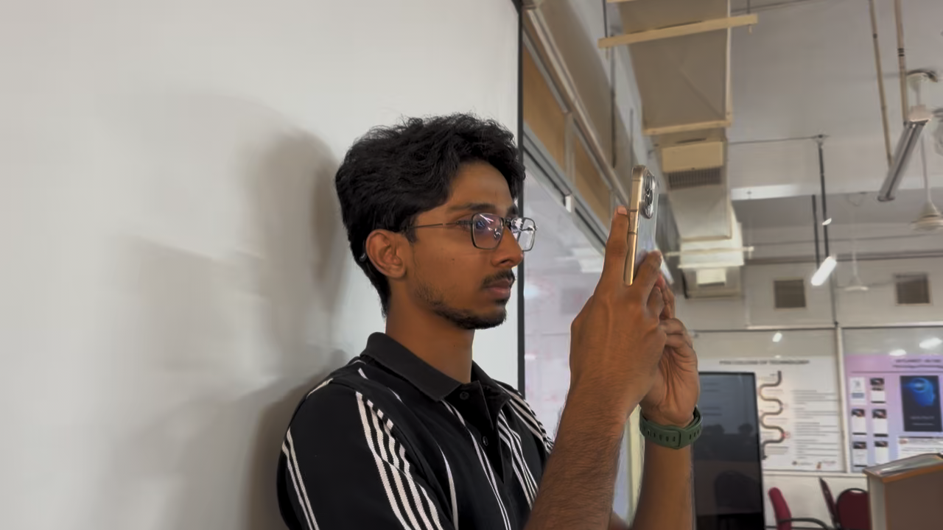
Live Classroom Test
Notes:
[PERSON 5]
This recording shows a student being enrolled: the app guides the capture of three face poses, frontal, left and right, and stores the resulting embeddings in the class roster.

Slide 21
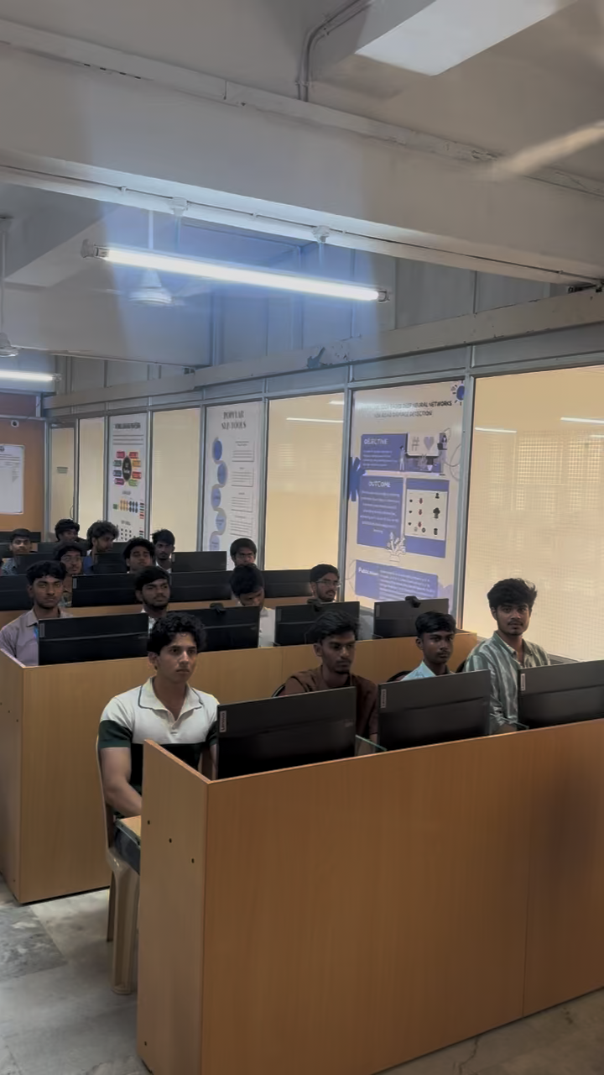
Live Classroom Test: Classroom Sweep
Notes:
[PERSON 5]
This recording shows the teacher recording the classroom sweep, panning slowly across the rows while the app warns if the pan is too fast.

Slide 22
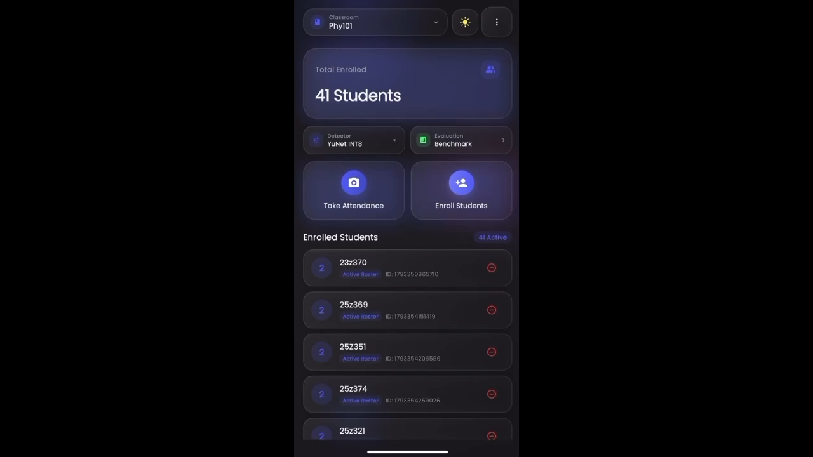
Live Classroom Test: Attendance Result
Notes:
[PERSON 5]
This recording shows the attendance result: the list of students marked present and absent, which the teacher can review, correct and export as CSV.
Thank you. We are happy to take questions.

