Slide 1
VanRakshak: AI-Enabled Drone Patrolling System for Forest
Authorities to Detect Poaching, Illegal Logging,
and Encroachment in Real Time
Mentored by
Presented by
Mentor Name:
Dr. Rajendra Thilahar C
Team Lead Name:
Sanjeev Kumar S
Designation of Mentor:
Team Lead Reg No
212224040290
Department of Mentor:
Year/Department:
3, CSE
College of Mentor:
Saveetha Engineering College
College Name
Saveetha Engineering College
Phone no :
+91 90920 30227
Phone no :
8925536470
Email Id:
Email Id:
hello@sanjeevkumar.me
07/04/2026
Saveetha Engineering College
1

Slide 2
VANRAKSHAK
AI-Enabled Drone Patrolling System for
Forest Authorities to Detect Poaching,
Illegal Logging, and Encroachment in Real Time
AI-Powered Autonomous Wildlife Intelligence Platform
MSME Idea Hackathon 6.0
Theme: Other Frontier Technologies
Saveetha Engineering College
Department of CSE

Slide 3
VISION
Building India's Indigenous Wildlife
Intelligence Platform
To build India's leading indigenous AI-powered wildlife intelligence platform that enables autonomous forest surveillance, protects biodiversity, and assists authorities in preventing poaching, illegal logging, forest fires, and encroachment through real-time edge AI.
15 km²
Coverage per sortie
<3 sec
Alert latency
95%+
Detection accuracy
VanRakshak | MSME Idea Hackathon 6.0
2

Slide 4
THE PROBLEM
Forests Are Vast. Surveillance Isn't.
India's forests span vast, often inaccessible terrain. Manual patrols, static CCTV, and occasional drone flights leave critical gaps — poaching, illegal logging, encroachment, and early-stage fires go undetected until it's too late.
!
!
!
Limited Coverage
Personnel Shortage
Delayed Detection
Vast, remote forest terrain is impossible to patrol continuously on foot.
Forest departments are chronically understaffed for the area they guard.
Incidents are discovered hours or days after they occur.
!
!
!
Poor Night Visibility
No Intelligent Analysis
High Patrol Risk
Most poaching and logging activity happens after dark.
Raw footage with no automated threat detection or prioritization.
Ground teams face direct physical danger confronting armed poachers.
3

Slide 5
MARKET GAP
Existing Solutions Fall Short
Manual Patrol
Low coverage · no night vision · no AI · high human risk
Static CCTV
Fixed coverage · no autonomy · needs manual review
Commercial Drones
Records video only — no onboard intelligence or real-time alerts
The gap: no existing system autonomously detects, classifies, and alerts on
forest threats in real time — that's exactly what VanRakshak delivers.
VanRakshak | MSME Idea Hackathon 6.0
4

Slide 6
PRODUCT OVERVIEW
VanRakshak
AI-Powered Autonomous Wildlife Intelligence Platform
VanRakshak combines autonomous drones, multi-sensor fusion, edge computing, and intelligent threat analytics to monitor forests in real time — turning raw footage into actionable intelligence for forest authorities.
AT A GLANCE
Sector
Other Frontier Technologies
Prototype Compute
NVIDIA Jetson Orin Nano
✓
Autonomous Drone Patrol
✓
Multi-Sensor Fusion
Core Sensors
✓
Edge AI Inference
✓
Real-Time Threat Detection
RGB · Thermal · LiDAR · GPS · IMU
✓
✓
Primary Users
GPS-Tagged Alerts
Mission Planning & Dashboard
Forest Departments, National Parks
Ask
₹15 Lakhs (MSME Hackathon)
VanRakshak | MSME Idea Hackathon 6.0
5

Slide 7
HOW IT WORKS
From Sensor Data to Field Response
1
2
3
4
Patrol mission assigned to the drone fleet
Drone autonomously flies predefined forest routes
RGB, thermal & LiDAR sensors capture live data
Edge AI performs onboard inference
5
6
7
8
Suspicious activity detected & confidence scored
GPS-tagged alert with image/video evidence generated
Alert reaches the Forest Command Dashboard
Response team is dispatched
VanRakshak | MSME Idea Hackathon 6.0
6

Slide 8
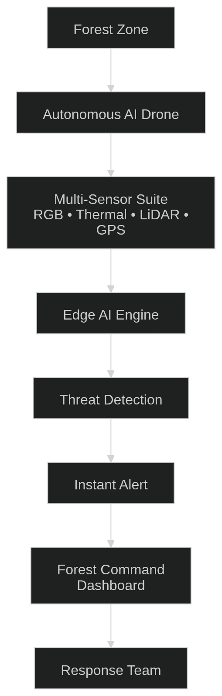
TECHNOLOGY
Product Architecture
Forest Zone → Drone
Autonomous drone launches to patrol a defined forest zone.
Multi-Sensor Suite
RGB, thermal, LiDAR & GPS capture a full picture of the terrain.
Edge AI Engine
Onboard inference detects threats without needing constant connectivity.
Alert → Dashboard
Instant, GPS-tagged alerts reach the Forest Command Dashboard.
Response Team
Officers are dispatched with precise location and visual evidence.
7

Slide 9
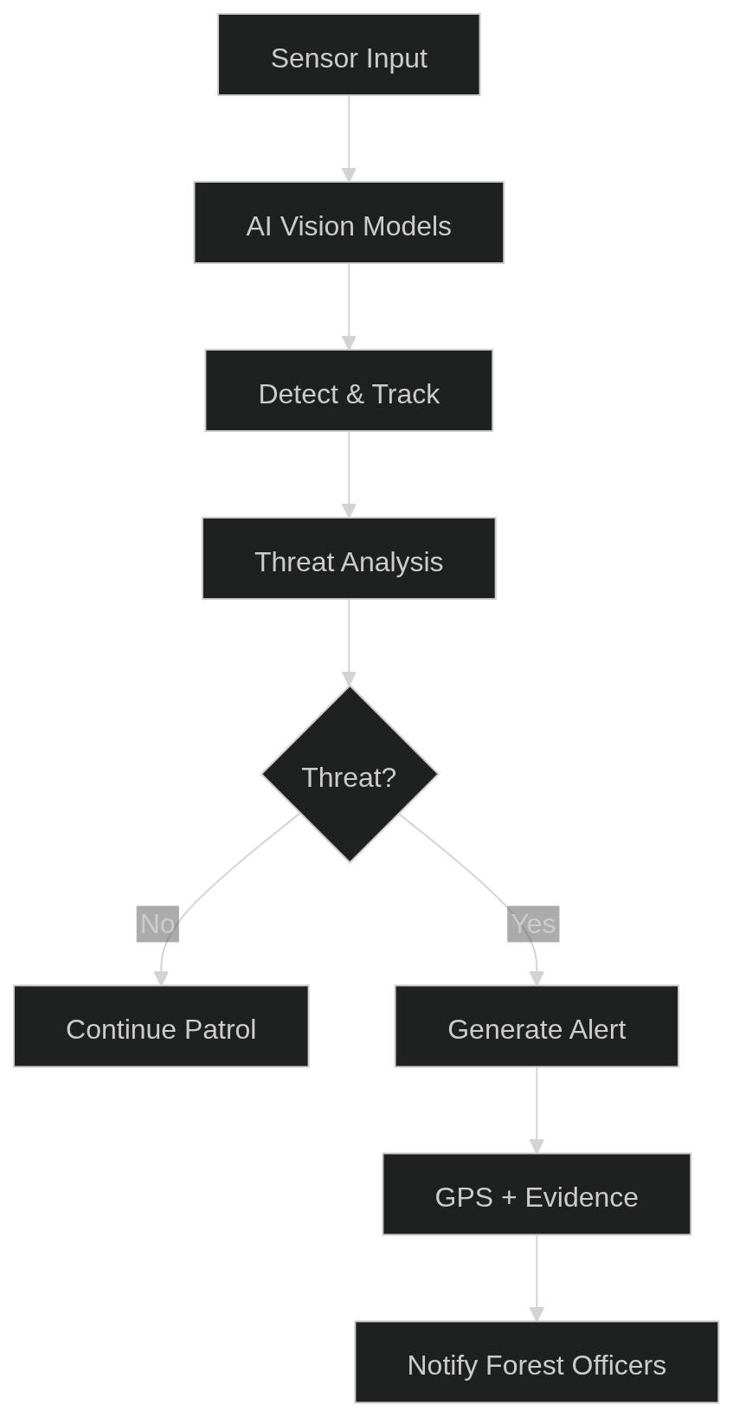
TECHNOLOGY
AI Pipeline
AI Vision Models
YOLO & RT-DETR object detection tuned for forest environments.
Detect & Track
Multi-object tracking follows movement across frames.
Threat Analysis
Behavioral and contextual signals classify the activity type.
Confidence Scoring
Every detection is scored to minimize false alarms (<5%).
Alert Generation
High-confidence threats trigger GPS-tagged alerts with evidence.
8

Slide 10
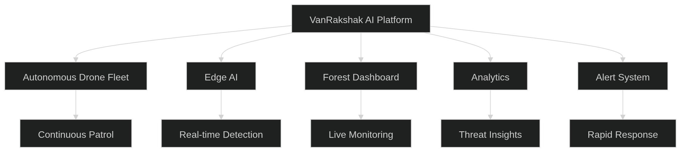
TECHNOLOGY
Product Ecosystem
VanRakshak is a platform, not just a drone — five connected pillars work together.
VanRakshak | MSME Idea Hackathon 6.0
9

Slide 11
TECHNOLOGY
Technology Stack
Hardware
Edge Computing
Artificial Intelligence
Platform
Autonomous Drone Platform
Prototype: NVIDIA Jetson Orin Nano
YOLO Object Detection
Forest Intelligence Dashboard
RGB Camera
Future: FPGA Edge Accelerator
RT-DETR Detection Models
Alert Engine
Thermal Camera
Future: Custom AI ASIC
Multi-Object Tracking
Mission Planner
LiDAR
Threat Classification
Analytics
GPS
IMU
VanRakshak | MSME Idea Hackathon 6.0
10

Slide 12
COMPETITIVE ADVANTAGE
Why VanRakshak Wins
Capability
Manual Patrol
CCTV
Commercial Drone
VanRakshak
Coverage
Low
Fixed
Medium
High
Autonomy
None
None
Partial
Full
Night Vision
No
Limited
Rare
Yes
AI Detection
No
No
No
Yes
Edge Computing
No
No
No
Yes
Real-time Alerts
No
No
No
Yes
Patent-Backed IP: Application No. 202341070952 A | Published: 03/11/2023
Continuous Monitoring
No
Partial
No
Yes
VanRakshak | MSME Idea Hackathon 6.0
11

Slide 13
MARKET OPPORTUNITY
Who We Serve, and Why It Matters
1
Target Customers
2
Pain Points
State Forest Departments, Wildlife Protection Authorities, National Parks; expanding to NGOs, eco-tourism, mining, railways & disaster management.
Vast unmonitored terrain, staff shortages, delayed incident detection, and dangerous manual patrols in remote regions.
3
Value Proposition
4
Revenue Opportunity
Continuous autonomous monitoring with real-time AI threat detection — faster response, lower risk, wider coverage.
Rising government investment in AI, drones & smart conservation technology fuels demand for scalable indigenous platforms.
VanRakshak | MSME Idea Hackathon 6.0
12

Slide 14
BUSINESS MODEL
Multiple Revenue Streams, Built for Scale
PRIMARY REVENUE
RECURRING REVENUE
₹
Drone Hardware Sales
↻
Annual Maintenance Contracts
↻
AI Analytics Subscription
₹
Drone-as-a-Service (DaaS)
↻
Training Programs
↻
Government Contracts
VanRakshak | MSME Idea Hackathon 6.0
13

Slide 15
ROADMAP · 2026
From Prototype to National Deployment
Prototype
Forest Trials
Multi-State
Deployment
Pilot
Commercial
Product
National
Expansion
VanRakshak | MSME Idea Hackathon 6.0
14

Slide 16
FUNDING ASK
Seeking ₹15 Lakhs
MSME Idea Hackathon 6.0 — Proposed Allocation
Drone Hardware & Prototype
35%
TOTAL ASK
AI Model Development
₹15,00,000
25%
Edge Computing Hardware
Funds the drone prototype, edge AI stack, dashboard build, and field validation with partner forest departments through pilot deployment.
15%
Dashboard Development
10%
Field Testing & Validation
10%
Documentation & Certification
5%
VanRakshak | MSME Idea Hackathon 6.0
15

Slide 17
SUCCESS METRICS
Targets That Prove the Platform Works
>95%
<3 sec
>15 km²
Detection Accuracy
Alert Latency
Coverage per Sortie
>45 min
<5%
>60%
Flight Time
False Alarm Rate
Patrol Cost Reduction
VanRakshak | MSME Idea Hackathon 6.0
16

Slide 18
FUTURE VISION
From a Drone Solution to a National
Wildlife Monitoring Network
+
+
+
+
Drone Fleet
Ground Sensors
Acoustic Sensors
Satellite Data
+
+
+
Weather Intelligence
Predictive Analytics
National Wildlife
Monitoring Network
VanRakshak | MSME Idea Hackathon 6.0
17

Slide 19
VanRakshak
“From Surveillance to Intelligence.”
Protecting India's forests through autonomous AI.

