Slide 1
VanRakshak: AI-Enabled Drone Patrolling System for Forest Authorities
to Detect Poaching, Illegal Logging, and Encroachment in Real Time
Team Members
Sanjeev Kumar S
Prajan SS
Kamlesh Y
3rd Year CSE | Robotics & Automation
Department of CSE
Saveetha Engineering College
Mentor – Dr. Rajendra Thilahar C
Department of AI & DS
VanRakshak | AI wildlife protection system

Slide 2
Vision
Autonomous Forest Response Agent
The Problem Today
Current forest monitoring systems mostly record footage and depend on human operators to detect threats.
VanRakshak, Autonomous Aerial Agent
Continuously patrols predefined forest routes
Understands the environment using onboard AI
Assesses threats in real time
Takes safe autonomous actions
Coordinates with forest rangers
Key Capabilities
Anti-poaching
Illegal logging detection
Wildlife monitoring
Early fire response
Human-wildlife conflict prevention

Slide 3
Hardware Architecture
Airframe, edge compute, sensor suite, and modular mission payloads
Core hardware stack
• Airframe and propulsion tuned for long patrol endurance
• Edge compute and flight controller for onboard decision-making
• Modular mission payloads for alerting and fire response
Sensor suite
• RGB camera for daytime visual detection
• Thermal camera for low-light and heat signatures
• LiDAR for terrain and obstacle awareness
• Audio sensors for acoustic cues and alerts
Detailed hardware diagram appears on the next slide.

Slide 4
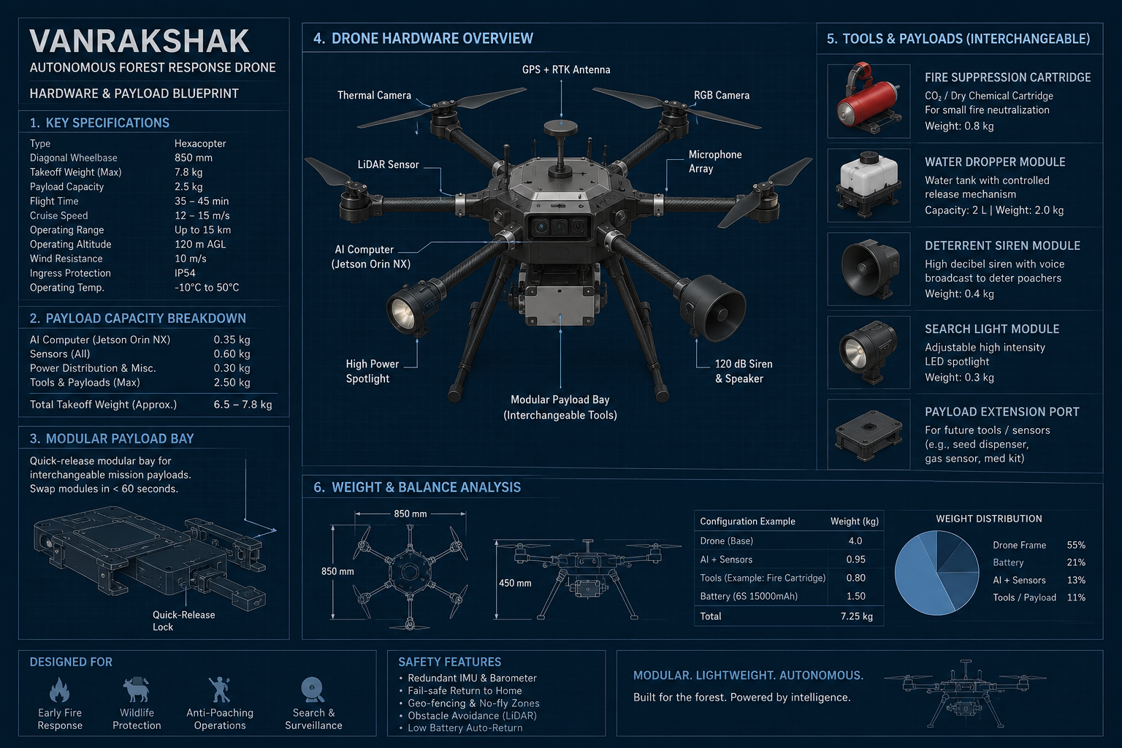
Hardware Architecture Diagram
Expanded standalone view of the drone hardware stack

Slide 5
AI Perception Pipeline
How the drone senses, understands, and tracks its environment
Sensor Fusion
Combines RGB, thermal, LiDAR, and audio streams into one picture.
YOLO Detection
Detects humans, animals, vehicles, smoke, and fire.
ByteTrack
Tracks movement and identity over time.
Classification
Identifies animal species, vehicles, weapons, and equipment.
World Model
Maintains GPS history, object identities, past observations, and protected zones.
Mission Agent
Vision-language model + LLM planner + risk engine decide: alert, siren, fire suppression, or continue patrol.
Detailed pipeline diagram follows in the next slide.

Slide 6
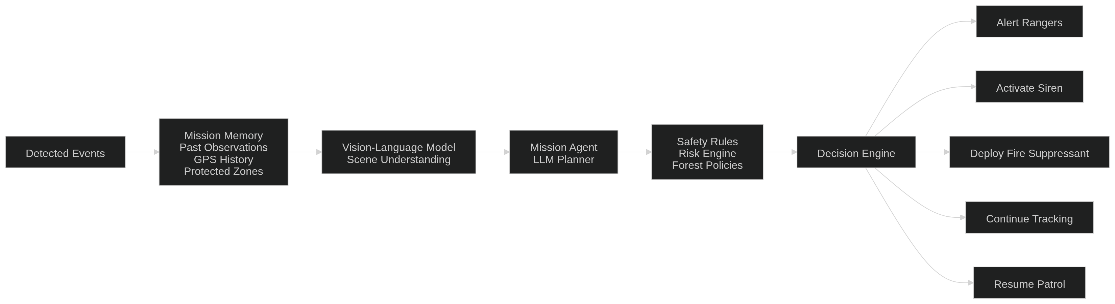
AI Perception Pipeline Diagram
Expanded standalone view of the sensing, tracking, and mission pipeline

Slide 7
Autonomous Decision Loop
The continuous mission cycle that runs onboard every drone
Mission cycle
Patrol route
Scan environment
Detect objects
Analyze situation
Compute risk score
Select best response
Response options
Notify rangers
Activate warning siren
Deploy fire suppressant
Continue tracking
Detailed flow diagram on the next slide

Slide 8
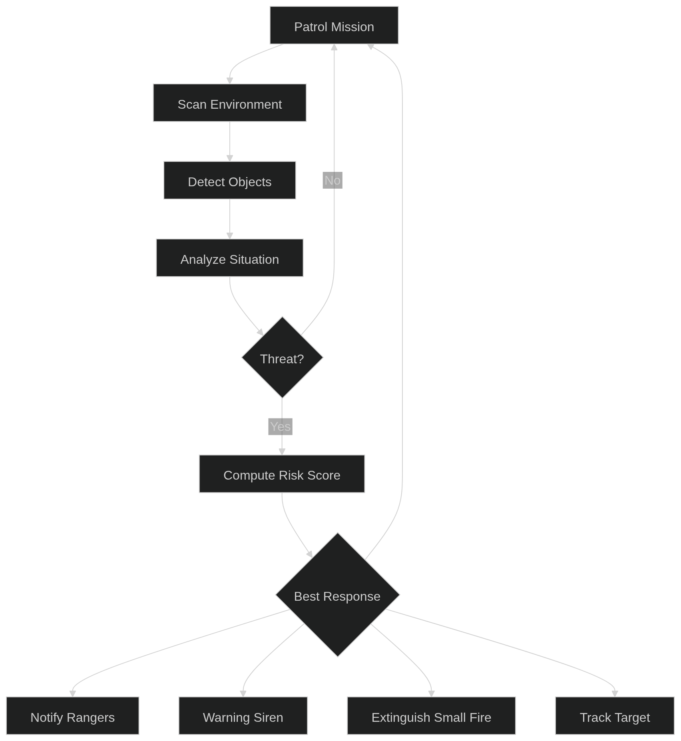
Autonomous Decision Loop Diagram
Expanded standalone view of the onboard mission cycle

Slide 9
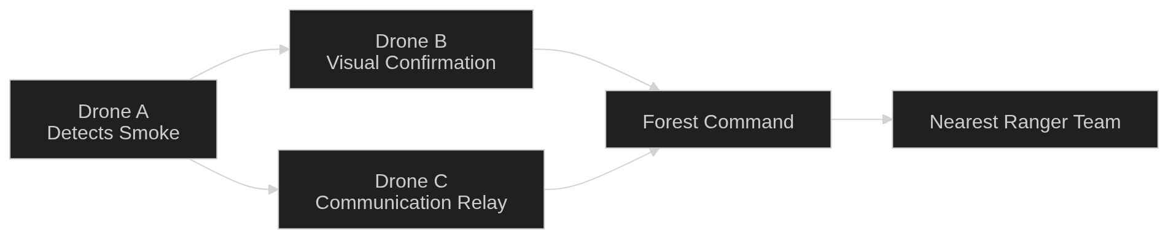
Multi-Drone Collaboration
Cooperative drone fleet for larger, more reliable coverage
How It Works
One drone detects an incident, another verifies it visually, and a third maintains a communication relay in areas with poor network coverage before alerting Forest Command and the nearest ranger team.
Advantages
Larger forest coverage
Redundant sensing
Reliable communication
Faster response time
Higher detection confidence

Slide 10
Innovation & Future Scope
Why VanRakshak is different, and where it goes next
Current Drones
Record footage
Require manual review
Limited autonomous capability
Future Improvements
Swarm coordination
Predictive wildfire monitoring
Satellite integration
Ranger body camera integration
Wildlife population analytics
VanRakshak
Edge AI processing
Autonomous navigation
World model and mission memory
AI mission planning
Modular payload system
Multi-drone collaboration

