Slide 1
IT Systems for MedExpress Discussion Document

Slide 2
Customer Context
An India-based startup in the on-line Pharma space by a team of highly experienced professionals
Vision is to be the largest all India level e-business in Pharma space over 2 years
Key Value Proposition is around assurance of ordering and receiving Genuine Drugs in a convenient fashion
Innovation in business model and deploying right technology solutions seen as key levers to differentiate services

Slide 3
IT Solution Brief
Define, Design, implement and evolve an IT Solution that can optimally support the business vision and operational needs
Technology stack should not create a vendor lock-in; should have large community support and proven maturity
Develop a roadmap that allows field level learnings and innovations to be accommodated
Stay capital efficient and avoid any significant upfront capital expenses
Design the solution with Mobile and Cloud First approach
IT Partner should be an active partner in co-creation and execution process over 2-3 years

Slide 4
Potential Solution Approaches
Storefront focused
Backend focused
Full Coverage Solution
Leveraging Magento based store front
Focus on end consumer front ending experience
Fast time to market
Cost effective solution to test market
Test backend process and tailor it accordingly
Limited or no backend process automation
Leveraging OOTB Ofbiz based backend system
Focus on backend process automation for hassle free & timely delivery of medicines
Fast time to market
Cost effective solution to test market
Limited front end experience to end consumer
Focus on both frontend & backend experience
Longer initial build but more seamless system
Delay in time to market
Relatively increased initial TCO

Slide 5
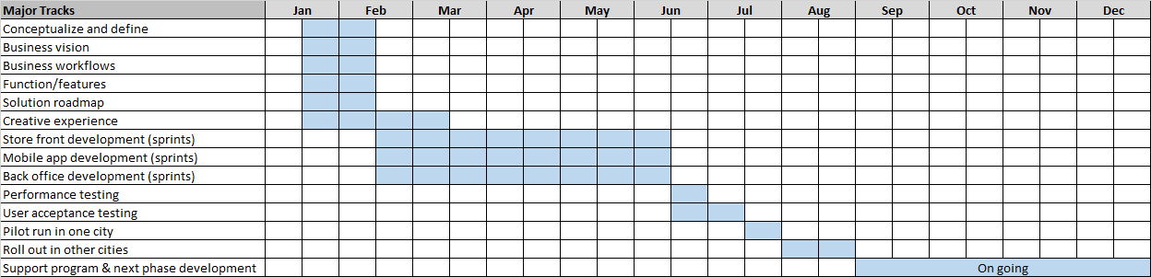
Proposed Timelines
Please refer to Anil Bajpai ecommerce road map_v1.0.xlsx for detailed breakdown of phase wise requirements

Slide 6



Proposed Solution
Customer Mobile App
Customer Mobile App
Customer portal
Logistics system
Procurement management system
Order management system (OMS)
Reports
Inventory management system
CRM system
Catalog system
Accounting system
Customer servicing center

Slide 7
Proposed Team
Team composition
Roles
Business analyst
UX lead
UX designer
UI developer
Technical architect
Lead developer
Sr. developer
Mobile developer
Lead QA
QA analyst
Cloud engineer
Project manager

Slide 8
Next Steps
Validate the solution and the requirement phasing
Budgetary estimates can be established ones the overall solution and the scope of work are further firmed up
The timelines are illustrative based on past work and needs to be validated based on further detailing of solution
Razorfish Neev shall execute the project on time & material basis

Slide 9

Case Studies
An IT-Led Business Transformation Initiative – A Holistic approach

Slide 10
Farm Fresh to You – A California-based Leading Provider of Organic Produce
Started in 1976, Farm Fresh to You delivers fresh organic produce to over 50,000 families in California
Neev built a next generation IT system for Farm Fresh to You (FFTY) that enabled them operate and scale their business quickly and efficiently, while keeping customers happy
The system comprised a Magento eCommerce store connected to a custom-built ERP system and a vTiger CRM system, an integrated Sales Portal and an iPad App
The Neev solution touched all aspects of Demand Generation, Demand Fulfillment and Supply Chain Management
We also developed:
A Sales Representative Portal and iPad App - Features include integrating with a credit card reader and ability for customers to sign Order requests
A Reports server – Includes reports regarding Complaints, Projections, Accounting, commission payouts, Receivables, Customer care team metrics etc.
Integration with 3rd party logistics and address verification providers
Private Cloud based architecture set-up
Implementing Failsafe strategy for web service failures
We face a challenge in ETL of FFTY data from FileMaker. Instead Talend was used

Slide 11
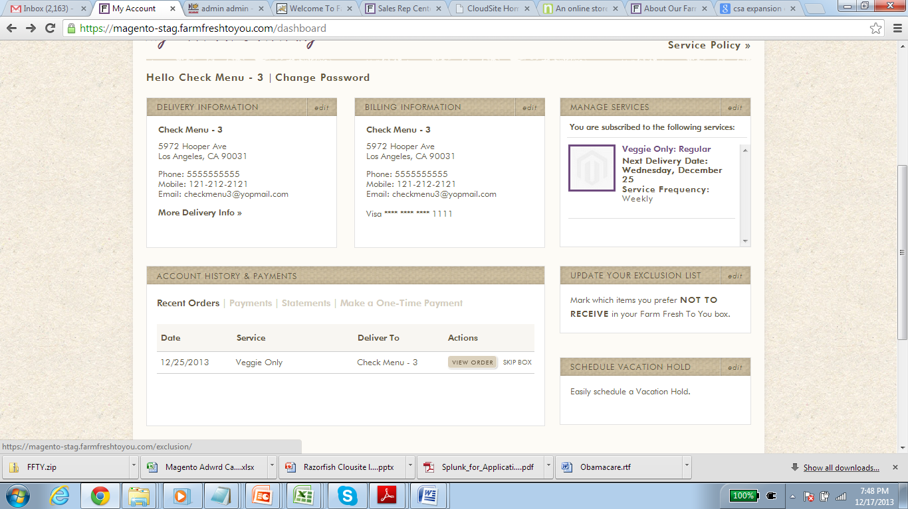
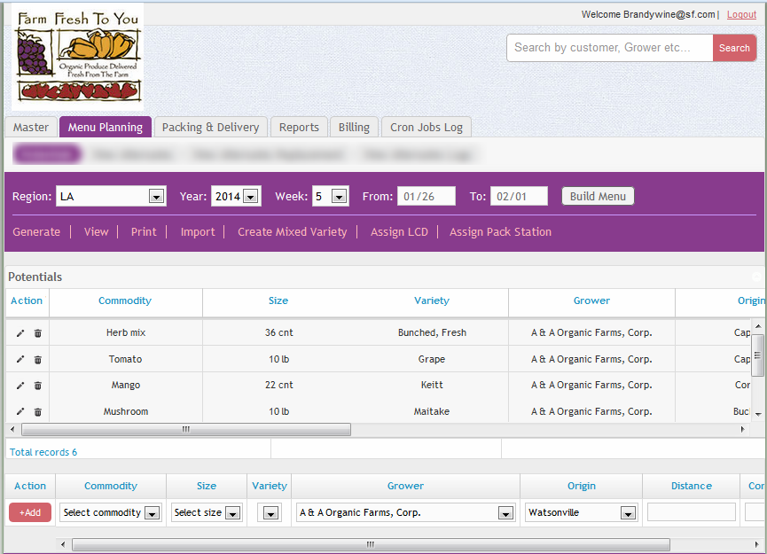
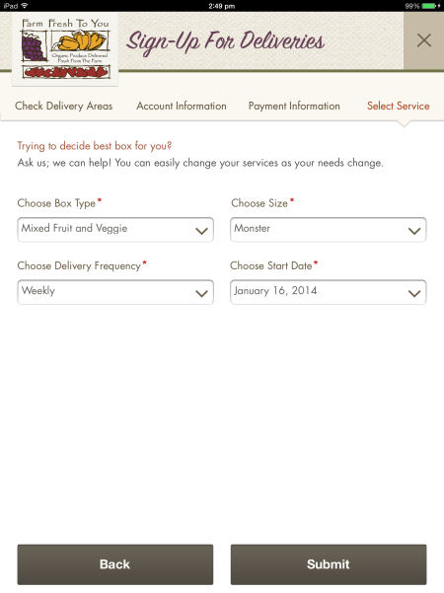
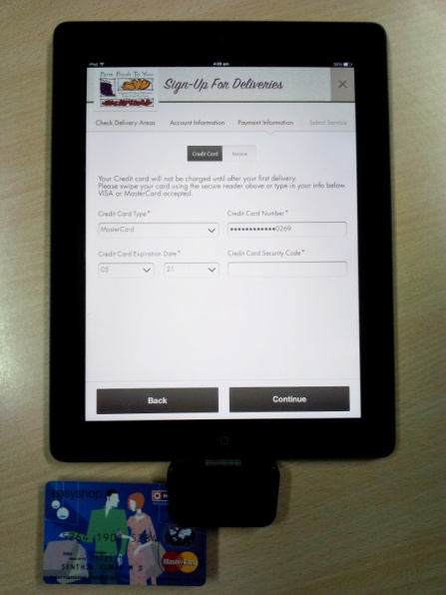
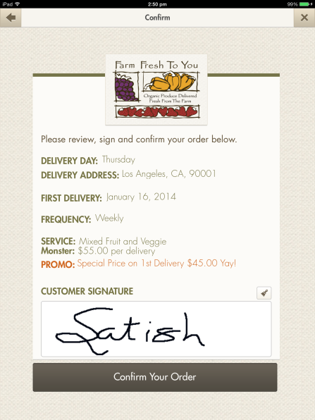
Farm Fresh to You – A California-based Leading Provider of Organic Produce

Slide 12

Case Studies
Building Giftease.com – A Popular Online Gifting store

Slide 13
Giftease.com
Neev designed and developed Giftease.com, an online gifting store
The store is built on a PHP framework using Magento Enterprise Edition 1.12
Provides ability to manage the entire front-end of the website from an admin panel
CCAvenue and PayU are used as payment gateways. SMS gateway integration done for COD order fulfilment process
The store automatically identifies a shipping carrier based on the location of the person and COD module
Custom themes and payment gateway plug-ins were integrated into the store
The key challenges were performance enhancement and implementation of customized auto-order lifecycle process
The unique features of this store are the gift finder (helps search gifts based on occasions, recipient, age group and price) end-to-end customized auto-order process, enabling generation of large number of invoices and shipments with a single click and customized gift-wrapping options
Over 6000 visitors visit the online store every month. The store receives over 2600 orders every month. The average basket price is in the range of Rs.500 to Rs.1200. On an average, 50 orders are placed every month

Slide 14
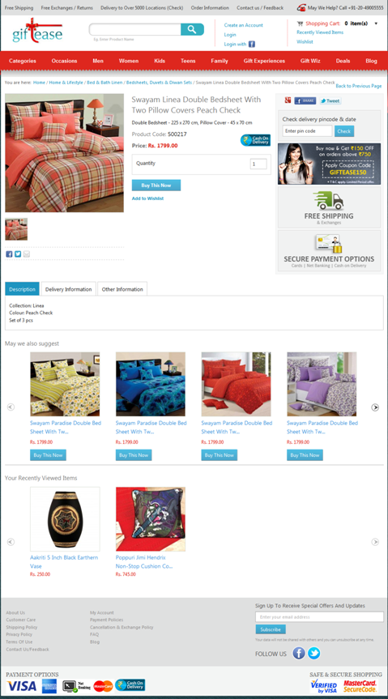
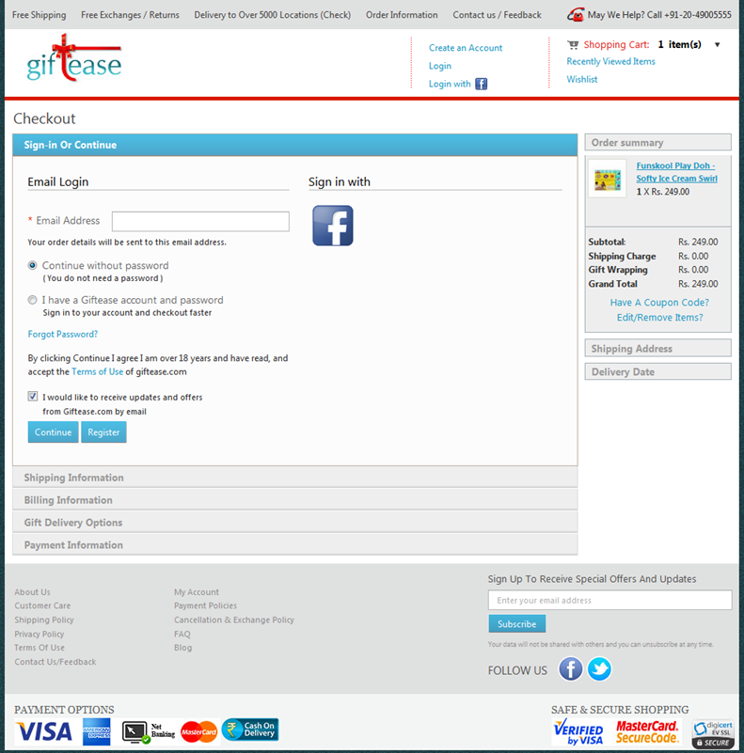
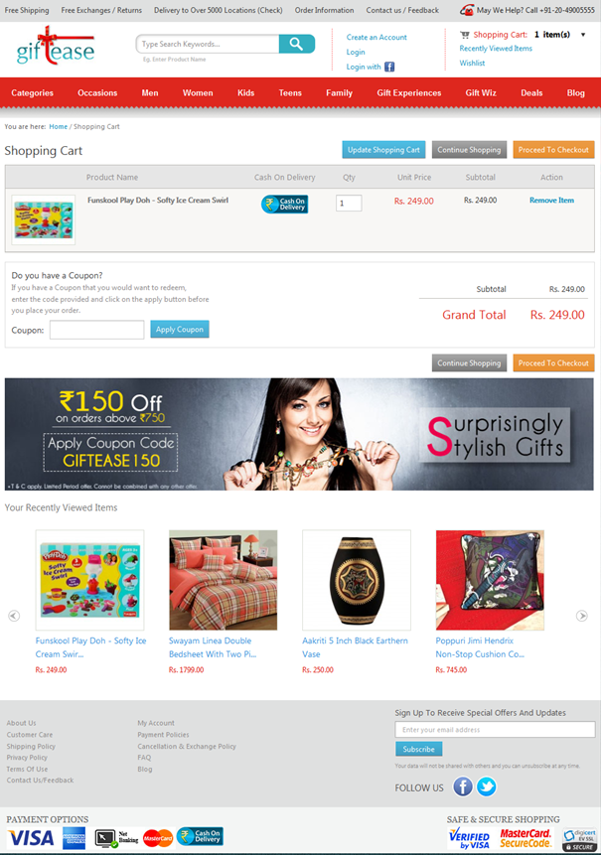
Giftease.com

