Slide 1

CAP444 OBJECT ORIENTED PROGRAMMING USING C++

Slide 2
Working with files and streams
c++ streams,
c++ stream classes,
classes for file stream operations,
opening & closing files,
detection of end of file,
more about open(): file modes,
file pointer & manipulator,
sequential input & output operation,
updating a file: random access,
command line arguments

Slide 3




Slide 4
#include <iostream>
using namespace std;
int main()
{
int num;
cout<<"Enter number"<<endl;
cin>>num;
return 0;
}
Temporary Storage
RAM
aaa
5

Slide 5
Managing Output Stream/Input Stream
The sequence of bytes given as input to the executing program and the sequence of bytes that comes as output from the executing program are called stream. In other words, streams are nothing but the flow of data in a sequence.
Hard disk
File
Stream: flow of data
RAM
Input stream
Output stream
variable
File
Data from variable to file- output stream
Data from file to variable-input stream
We have predefine classes to manage all these things

Slide 6
C++ Stream Classes
The I/O system of C++ contains a set of classes which define the file handling methods.

Slide 7
Classes for file stream
ios
istream
ostream
>>
extraction
<<
iostream
insertion
ifstream
fstream
ofstream
istream_withassign
ostream_withassign
cin
cout

Slide 8
1. ios/iostream
ios stands for input output stream.
This class is the base class for other classes in this class hierarchy.
This class contains the necessary facilities that are used by all the other derived classes for input and output operations.

Slide 9
2. istream
istream stands for input stream.
This class is derived from the class ‘ios’.
This class handle input stream.
The extraction operator(>>) is overloaded in this class to handle input streams from files to the program execution.
This class declares input functions such as get(), getline() and read().

Slide 10
3. ostream
ostream stands for output stream.
This class is derived from the class ‘ios’.
This class handle output stream.
The insertion operator(<<) is overloaded in this class to handle output streams to files from the program execution.
This class declares output functions such as put() and write().

Slide 11
4. streambuf:-
This class contains a pointer which points to the buffer which is used to manage the input and output streams.
5. fstreambase:-
This class provides operations common to the file streams. Serves as a base for fstream, ifstream and ofstream class.
This class contains open() and close() function.

Slide 12
6. ifstream:-
This class provides input operations.
It contains open() function with default input mode.
Inherits the functions get(), getline(), read(), seekg() and tellg() functions from the istream.
7. ofstream:-
This class provides output operations.
It contains open() function with default output mode.
Inherits the functions put(), write(), seekp() and tellp() functions from the ostream.

Slide 13
8. fstream:-
This class provides support for simultaneous input and output operations.
Inherits all the functions from istream and ostream classes through iostream.
9. filebuf:-
Its purpose is to set the file buffers to read and write.
We can also use file buffer member function to determine the length of the file.

Slide 14
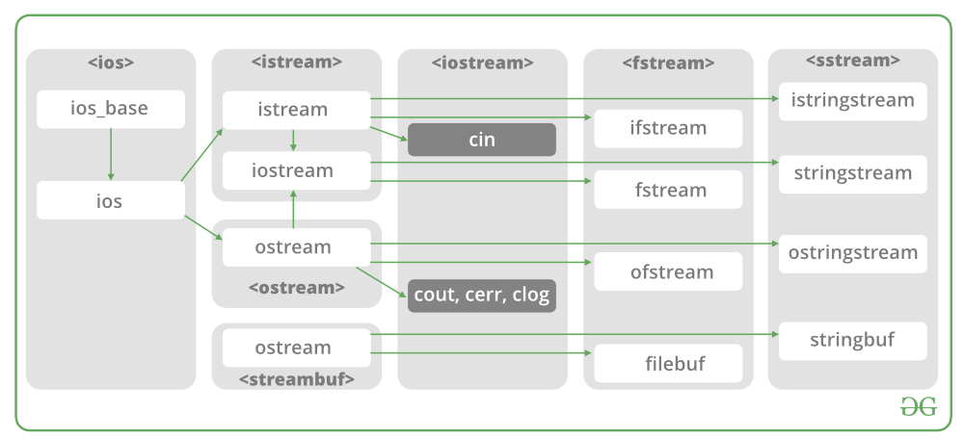

Slide 15
In C++, files are mainly deal with three classes fstream, ifstream, ofstream.
ofstream: This Stream class indicates the output file stream and is applied to create files for writing information to files
ifstream: This Stream class indicates the input file stream and is applied for reading information from files
fstream: This Stream class can be used for both read and write from/to files.

Slide 16
C++ provides us with the following operations in File Handling:
Creating a file: open()
Reading data: read()
Writing new data: write()
Closing a file: close()

Slide 17
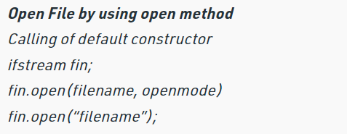

Slide 18
File Modes
ios::in | Open for input operations.
ios::out | Open for output operations.
ios::binary | Open in binary mode.
ios::ate | Set the initial position at the end of the file. If this flag is not set, the initial position is the beginning of the file.
ios::app | All output operations are performed at the end of the file, appending the content to the current content of the file.
class | default mode parameter
ofstream | ios::out
ifstream | ios::in
fstream | ios::in | ios::out

Slide 19
ios::in | Searches for the file and opens it in the read mode only(if the file is found).
ios::out | Searches for the file and opens it in the write mode. If the file is found, its content is overwritten. If the file is not found, a new file is created. Allows you to write to the file.
ios::app | Searches for the file and opens it in the append mode i.e. this mode allows you to append new data to the end of a file. If the file is not found, a new file is created.

Slide 20
ios::binary | Searches for the file and opens the file(if the file is found) in a binary mode to perform binary input/output file operations.
ios::ate | Searches for the file, opens it and positions the pointer at the end of the file. This mode when used with ios::binary, ios::in and ios::out modes, allows you to modify the content of a file.
ios::trunc | Searches for the file and opens it to truncate or deletes all of its content(if the file is found).

Slide 21
ios::nocreate | Searches for the file and if the file is not found, a new file will not be created.

Slide 22
C++ provides us with the following operations in File Handling:
Creating a file: open()
Reading data: read()
Writing new data: write()
Closing a file: close()

Slide 23
Opening Files
open() In case of creating new file:
Using ofstream class
Syntax:
ofstream fout;
fout.open(“filename”)
open() In case of reading file:
Using ifstream class
Syntax:
ifstream fin;
fin.open(“filename”)

Slide 24
Closing Files
close() In case of creating new file:
Using ofstream class
Syntax:
ofstream fout;
fout.close()
close() In case of reading file:
Using ifstream class
Syntax:
ifstream fin;
fin.close()

Slide 25
Reading and Writing into Files
Writing File: used ofstream class:
Syntax:
ofstream fout;
fout.open(“filename”);
fout<<“data”;
Reading File: used ifstream class:
Syntax:
ifstream fin;
Ifstream.open(“filename”);
using get() or getline()

Slide 26
Reading Files: using get() function
The get() function is member of ifstream class. It is used to read character form the file.
while(!fin.eof())
{
fin.get(ch);
cout<<ch;
}
will read all the characters one by one up to EOF(end-of-file) reached.

Slide 27
Writing Files: using put() function
ofstream fout; // create output stream
char ch=‘a’;
int i;
fout.open("filename", ios::app) ;
/* write the characters to file using put() */
fout.put(ch);
fout.close();

Slide 28
Detecting End-of-File
While reading data from a file, if the file contains multiple rows, it is necessary to detect the end of file.
This can be done using the eof() function of ios class.
It returns 0 when there is data to be read and a non-zero value if there is no data.
Syntax:
ifstream fin;
char ch;
Ifstream.open(“filename”);
while(!fin.eof())
{
fin.get(ch);
cout<<ch;
}

Slide 29
Reading Files: using getline() How to process a file line by line in C++?
In C++, you may open a input stream on the file and use the getline() function from the <string> to read content line by line into a string and process them.
Ifstream fin;
fin.open("d://demo//file1.txt");
string str;
while(getline(fin,str))
{
cout<<str<<endl;
}

Slide 30
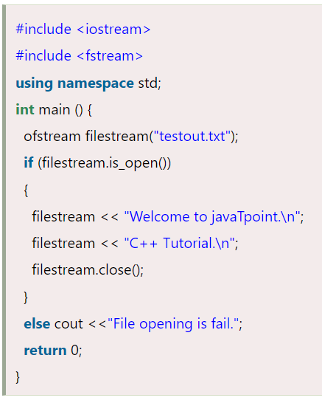
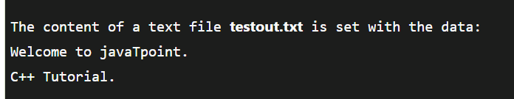
writing to a file

Slide 31
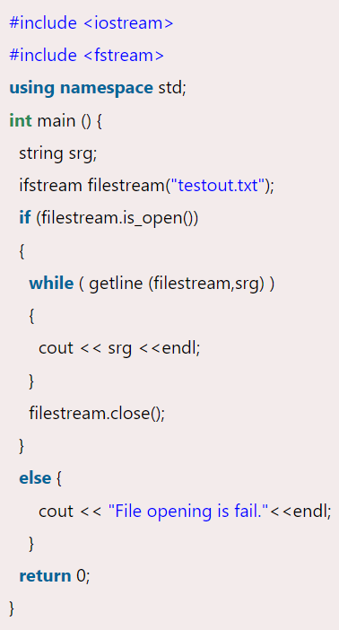

reading from a file

Slide 32
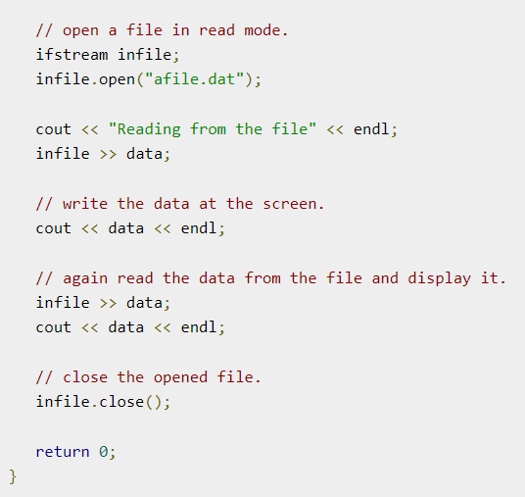
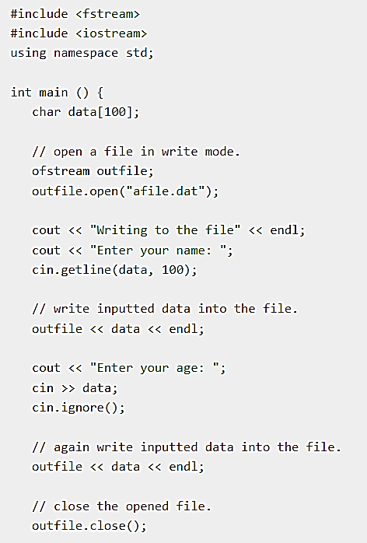
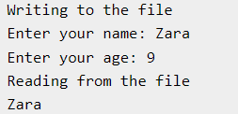

Slide 33
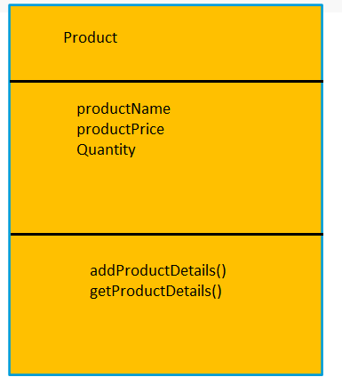
Steps:
1. Create a product class
Class
Data Members
Member functions()

Slide 34
Steps:
2. Create a file and fill all product records.
3. Update your file, fill more records into file
3. Display output to the user screen with product details.

Slide 35
To append file content
ios::app
ofstream fout;
fout.open(“filename”,ios::app);
File Mode

Slide 36
Check file is existing or not:
ifstream fin;
fin.open(“abc.txt”);
If(fin)
{
cout<<“File is existing”<<endl;
}
else{
cout<<“File is not existing”<<endl;
}

Slide 37
Read/Write Class Objects from/to File in C++
The data transfer is usually done using '>>' and <<' operators. But if you have a class with 4 data members and want to write all 4 data members from its object directly to a file or vice-versa.

Slide 38
To write object's data members in a file :
// Here file_obj is an object of ofstream
file_obj.write((char *) & class_obj, sizeof(class_obj));
To read file's data members into an object :
// Here file_obj is an object of ifstream
file_obj.read((char *) & class_obj, sizeof(class_obj));

Slide 39
#include <iostream>
#include<fstream>
using namespace std;
ofstream fout;
ifstream fin;
int main()
{
fout.open("hello.txt", ios::in);
fout<<"hello"<<endl;
fout.close();
return 0;
}
A.
File will create and hello will be written on file
B.
Compilation Error
C.
Nothing will be happen
D.
None

Slide 41
Topics:
Working with files and streams :
file pointer & manipulator,
sequential input & output operation,
updating a file: random access,
command line arguments

Slide 42
file pointer
Topics will be there in coming slides

Slide 43
file manipulator
Manipulators are simply an instruction to the output stream that modify the output in various ways. In other words, we can say that manipulators are operators that are used to format the data display.

Slide 44
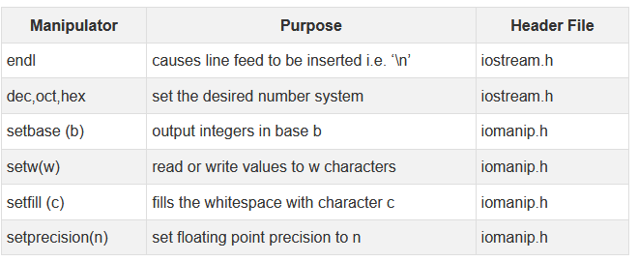

Slide 45
Sequential and Random I/O
C++ allows data to be read or written from a file in sequential or random fashion.
Reading data character by character or record by record is called sequential access.
Reading data in any order is known as random access.
The fstream class provides functions like get(), read() for reading data and put(), write() for writing data to a file.

Slide 46
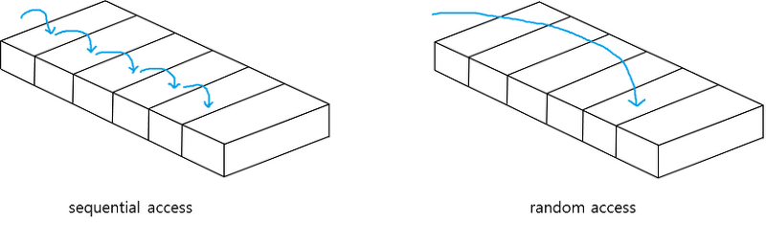

Slide 47




Slide 48
For example, if you have to modify a value in record no 21, then using random access techniques, you can place the file pointer at the beginning of record 21 and then straight-way process the record. If sequential access is used, then you'll have to unnecessarily go through first twenty records in order to reach at record 21.
In C++, random access techniques is achieved by manipulating seekg(), seekp(), tellg() and tellp() functions.

Slide 49
File Pointers:
Every file will contain two pointers: a read pointer or also known as a get pointer and a write pointer also known as a put pointer. The read pointer or a get pointer is used to read data and the write pointer or put pointer is used to write data to a file. These pointers can be manipulated using the functions from stream classes. Those functions are:
seekg() and seekp()

Slide 50
seekp() function allow us to move the output pointer to specified location for writing purpose within the file. The basic syntax for seekp() function is :
fileObject.seekp(long_num, origin);
fileObject: pointer to file
long_num: no. of bytes in file we want to skip
origin: where to begin

Slide 51
seekg() function allow us to move the Input pointer to specified location for reading purpose within the file. The basic syntax for seekg() function is :
fileObject.seekg(long_num, origin);
fileObject: pointer to file
long_num: no. of bytes in file we want to skip
origin: where to begin

Slide 52
origin:
ios::beg start of the file ios::cur current position of the pointer ios::end end of the file
Ex:
fin.seekg(0, ios::beg);

Slide 53
seekg() | moves get pointer(input) to a specified location
seekp() | moves put pointer (output) to a specified location
tellg() | gives the current position of the get pointer
tellp() | gives the current position of the put pointer

Slide 54
Setting the EOF flag off, to allow the access of file again for reading:-
Ifstream fin;
fin.clear();

Slide 55
Which function is used to reposition the file pointer? a) moveg() b) seekg() c) changep() d) go_p()

Slide 56
Which of the following is used to move the file pointer to start of a file?
a) ios::beg
b) ios::start
c) ios::cur
d) ios::first

Slide 57
Command-line arguments
Command-line arguments are given after the name of the program in command-line shell of Operating Systems.
To pass command line arguments, we use main() with two arguments :
first argument is the total number of command line arguments and
second is list of command-line arguments.

Slide 58
Syntax:
int main(int argc, char *argv[ ])
{
return 0;
}
first parameter argc holds the count of command-line arguments and the second parameter, an array of character pointers holds the list of command-line arguments.
first element in the array, i.e., argv[0] holds the filename. First command-line parameter will be available in argv[1], second parameter in argv[2] and so on.

Slide 59
To run in command line:
D:\>g++ abc.cpp -o obj1.exe
D:\>obj1.exe

Slide 60
Any Query?
Unit-4 End

