Slide 1
FAKE NEWS DETECTION USING AUTOENCODERS
SANJEEVI KUMAR V
au21CB46
KGiSL INSTITUTE OF TECHNOLOGY
3/21/2024 Annual Review

Slide 2
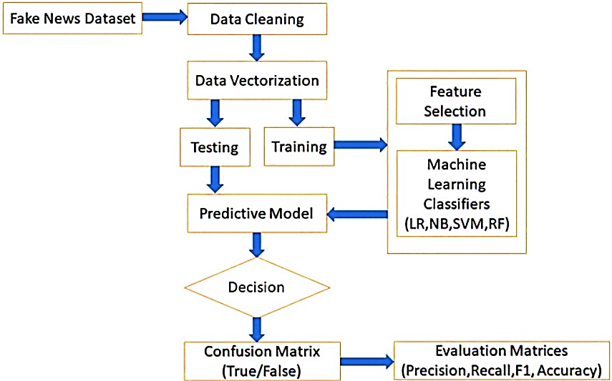
FAKE NEWS DETECTION USING AUTOENCODERS
3/21/2024 Annual Review

Slide 3


AGENDA
PROBLEM STATEMENT
PROJECT OVERVIEW
WHO ARE THE END USERS?
SOLUTION
WOW IN THE SOLUTION
MODEL
RESULT
3/21/2024 Annual Review

Slide 4

PROBLEM STATEMENT
This project aims to develop a reliable fake news detection system. This system will distinguish between factual news articles and fabricated ones with high accuracy. In light of the growing presence of misinformation online, particularly on social media platforms, the objective is to create an automated solution for identifying misleading content. By achieving this, the system can contribute to curbing the spread of disinformation and upholding the credibility of online communication.
3/21/2024 Annual Review

Slide 5

PROJECT OVERVIEW
Generative Adversarial Networks (GANs) and autoencoders serve distinct purposes in machine learning. GANs excel at generating novel data that closely resembles a given dataset. This is achieved through the simultaneous training of a generator network and a discriminator network. In contrast, autoencoders specialize in compressing high-dimensional data into a lower-dimensional representation, followed by its reconstruction. While both offer valuable functionalities in data generation and dimensionality reduction, respectively, they are not typically employed directly for fake news detection.
Supervised learning algorithms like Support Vector Machines (SVMs), random forests, or deep learning models such as Recurrent Neural Networks (RNNs) and Convolutional Neural Networks (CNNs) are commonly used in this context. In conclusion, while GANs and autoencoders contribute to data processing pipelines, they are not the mainstay methods for detecting fake news.
3/21/2024 Annual Review

Slide 6

WHO ARE THE END USERS?
Social Media Platforms
Educational Institutions
Fact-Checking Organizations
News Organizations
Government Agencies
General Public
3/21/2024 Annual Review

Slide 7

SOLUTION AND PROPOSITION
The features extracted by autoencoders and the synthetic data generated by GANs are integrated to train a classification model. This model is designed to learn the distinguishing characteristics between real and fake news articles based on the learned representations. The training process involves optimizing the model's parameters to minimize classification errors and ultimately achieve superior overall accuracy.
GANs are employed to generate synthetic examples of both genuine and fabricated news articles. This data augmentation process enriches the training dataset, allowing the model to learn a broader spectrum of features and enhance its robustness in identifying diverse types of fake news.
Autoencoders play a crucial role in extracting informative features from the textual content of news articles. By compressing the input data into a lower-dimensional latent space representation, autoencoders can effectively capture the underlying patterns and semantic nuances that differentiate real from fake news.
Following successful training and validation, the fake news detection system can be implemented in various contexts. This includes social media platforms, news websites, and online forums. By identifying and mitigating the spread of misinformation, the system serves as a valuable tool for promoting informed decision-making and safeguarding the integrity of information dissemination channels.
The performance of the fake news detection system is rigorously evaluated using established metrics such as accuracy, precision, recall, and F1-score. To assess its effectiveness in real-world scenarios and generalization ability, the system is further validated on a separate test dataset.
3/21/2024 Annual Review

Slide 8

THE WOW IN YOUR SOLUTION
1. Feature Engineering
2. Real-time Monitoring
3. Improved Performance
4. Explainability
5. Scalability
3/21/2024 Annual Review

Slide 9
MODELLING
The selection of appropriate models for fake news detection is contingent upon the characteristics of the data and the specific goals of the system. Here's an overview of some frequently employed models in this domain:
1. Traditional Machine Learning Models:
- Logistic Regression
- Support Vector Machines (SVM)
- Random Forest
- Naive Bayes
2. Deep Learning Models:
- Recurrent Neural Networks (RNNs)
- Convolutional Neural Networks (CNNs)
- Long Short-Term Memory (LSTM) Networks
3. Ensemble Models:
- Voting Classifier
- Bagging and Boosting Techniques (e.g., AdaBoost, XGBoost)
4. Hybrid Models:
- Combining multiple models and techniques to improve overall performance and robustness.

Slide 10
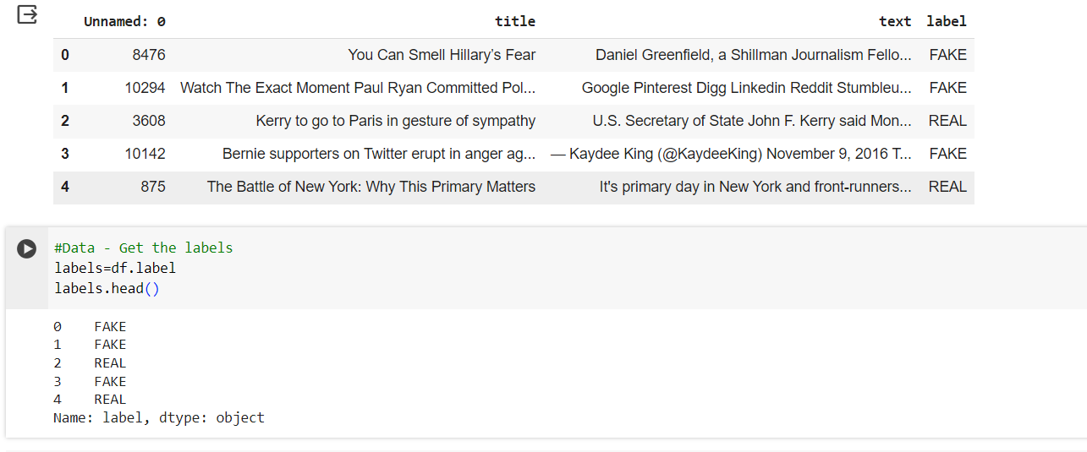
RESULTS
https://drive.google.com/drive/folders/1C72YHSqzaePDzLqu0peaZmeMQi6WXr2H?usp=sharing
3/21/2024 Annual Review

