Slide 1

Apache Cassandra: Building a Fast Data Platform

Slide 2
The Elevator Pitch
open source
distributed
decentralized
elastically scalable
“Apache Cassandra is an open source distributed, decentralized, elastically scalable, highly available, fault-tolerant, tuneably consistent, row-oriented database that bases its distribution design on Amazon’s Dynamo and its data model on Google’s Bigtable. Created at Facebook it is now used at some of the most popular sites on the Web”
fault-tolerant
consistent
highly
tuneably
available
row-oriented
Dynamo
Bigtable
Facebook
most
popular
Cassandra: The Definitive Guide, 2nd Edition
Eben Hewitt, Jeff Carpenter

Slide 3
A Brief History…
Cassandra was created by Facebook for Inbox Search
Ex-Amazon and Microsoft Employees
Released, open-source, to Google code in 2008
Apache Incubator project in 2009
Top-level Apache project in 2010
Used by CERN, Facebook, Twitter, Netflix, eBay, Reddit, Instagram…
“Hands down winner for transaction processing performance” – Tony Bain

Slide 4
Different Types of Data
80% of all modern data is unstructured
90% of the worlds data was created in the last 2 years
Need a strategy to analyse, process and understand unstructured data
Structured | Semi-Structured | Unstructured
Relational Databases | NoSQL Databases | Email
 | CSV | Word Document
 | JSON | Video
 | XML | Web Page
 |  | Audio
 |  | Presentations

Slide 5
Different NoSQL
Document | Column | Graph | Key Value | Object
The central concept is the document. Assume that documents capture or encode all data. Often encoded as XML, JSON or YAML. | Data arranged with data stored in columns. A timestamp is used to differentiate current and stale records. Many columns form a Column Collection. | Uses graph structures and semantic queries. Nodes and edges with properties are used to represent data and relationships. | A data store designed for storing, retrieving and managing associative arrays (hash/dictionary). Records are quickly retrieved via a unique key. | A database management system in which information is represented as objects as used in an object-oriented language.
MongoDB CouchDB RavenDB | Cassandra HBase Accumulo | neo4j JanusGraph Tinkerpop | Redis Riak Oracle NoSQL | db4o ObjectDB JADE

Slide 6
CAP Theorem
“When designing distributed web services, there are three properties that are commonly desired: consistency, availability, and partition tolerance. It is impossible to achieve all three.”
*Brewer's conjecture and the feasibility of consistent, available, partition-tolerant web services Seth Gilbert & Nancy Lynch

Slide 7
Cassandra Architecture
Multi-Master, Asynchronous Replication (Shared Nothing Architecture)
Distributed
Configurable replication
Tuneable consistency
Data partitioning over nodes
Multiple data centres and racks
Self discovering (Gossip Protocol)

Slide 8
Clusters, Infrastructure & Data
Cluster - Top-level
Infrastructure
Datacentre – Locations / Workloads
Rack – Fault tolerance
Node - Servers
Data
Keyspace – Grouping of tables
Table – Collection of similar data
Partition – Division of data

Slide 9
Tables, Partitions & Columns
Tables store similar data
Data is distributed across partitions
Partitions contain may rows
Rows within a partition are ordered
Rows contain many columns
A column is a name/value pair
A column contains metadata
Rows can be sparse

Slide 10
Partitions, Nodes & Tokens
Nodes are assigned a range of tokens
Virtual Nodes are dynamically allocated
VNodes allow consistent performance
VNodes scale better with the cluster
Partition keys are hashed to a token
Partition is owned by the matching node
Partition is replicated to other nodes

Slide 11
Data Modelling
“Primary Keys Are Forever – After you create a table, there is no way to modify the primary key, because this controls how data is distributed within the cluster, and even more importantly, how it is stored on disk.”
Cassandra: The Definitive Guide, 2nd Edition
Eben Hewitt, Jeff Carpenter

Slide 12
Data Modelling
Cassandra is optimised for writing data so favours denormalization
Data modelling should begin with the queries rather than entities
Diagrammatic data models help visualise flow (see Chebotko Diagrams)
Designs should aim to minimise the number of partitions being read
Sorting data is a design decision not a runtime query option
Immutable data will help prevent tombstoning
Consistency is tuned per-query so think what characteristics each requires

Slide 13
Chebotko Diagrams
Data requirements by query
Downstream queries model flow
Provide simple, informative visualisation
Popularised by Artem Chebotko

Slide 14
Cassandra Query Language (CQL - DDL)
Create Keyspace – Set the replication strategy and factor
Create Table – Set the partition, clustering and columns
Create Index – Add additional filters for searching tables
Create Materialized View – Denormalization of data, server-side
Create Triggers – Implementation of ITrigger, run before DML statements
Create Function – User defined, Java/Javascript, functions and aggregates
Create Type – Attach multiple data fields to a column
Create User – Security and rights assignment

Slide 15
Cassandra Query Language (CQL - DML)
Select – Query data from a table, supports JSON output
Insert – Insert data into a table, supports JSON input
Update – Update existing data, supports JSON input
Delete – Delete data from a table
Light Weight Transactions – Linear serialization of read/write operations
Insert-if-not-exists
Update-if-exists

Slide 16
Useful Terms
Gossip – Discovery of the cluster from peers
Memtable – In-memory data store
SSTable – On-disk representation of a memtable
Hinted Hand-off – Stored writes for an offline node
Bloom Filter – Bitmask used to identify availability of data
Tombstones – Delete/TTL marks items as deleted
Compaction – Managing data stored on disk, removing tombstones
Snitch – Inform Cassandra about network topology

Slide 17
CLIENT LIBRARIES
.NET (https://github.com/datastax/csharp-driver)
Java (https://github.com/datastax/java-driver)
NodeJS (https://github.com/datastax/nodejs-driver)
Python (https://github.com/datastax/python-driver)
Scala (https://github.com/outworkers/phantom)
Clojure (https://github.com/mpenet/alia)
C++ (https://github.com/datastax/cpp-driver)
Spark (https://github.com/datastax/spark-cassandra-connector)

Slide 18
Code Sample (Scala)
import com.datastax.driver.core.Cluster
implicit val session = new Cluster().Builder()
.addContactPoints(“localhost”)
.withPort(9042)
.build()
.connect()
case class Product(store_id: UUID,
product: String,
cost: Decimal)
val results = session.execute(“SELECT * FROM products;”)
val products = results.map(r => Product(
r.getUUID(“store_id”),
r.getString(“product”),
r.getDecimal(“cost”))
Import the driver
Connect to the cluster
Define a product class
Execute the query
Map the result set to the product

Slide 19
Code Sample (SPARK)
import org.apache.spark.sql.SparkSession
Import org.apache.spark.{SparkConf,SparkContext}
val conf = new SparkConf()
val sc = new SparkContext(conf)
val spark = SparkSession.builder().getOrCreate()
val df = spark.read
.format(“org.apache.spark.sql.cassandra”)
.options(Map(“table”->“products”,“keyspace”->“retail”))
.read()
spark.write
.format(“org.apache.spark.sql.cassandra”)
.options(Map(“table”->“prod_copy”,“keyspace”->“retail”))
.save()
Import namespaces
Configure, create context and build session
Read data from Cassandra through Spark
Write a copy of the data to Cassandra

Slide 20
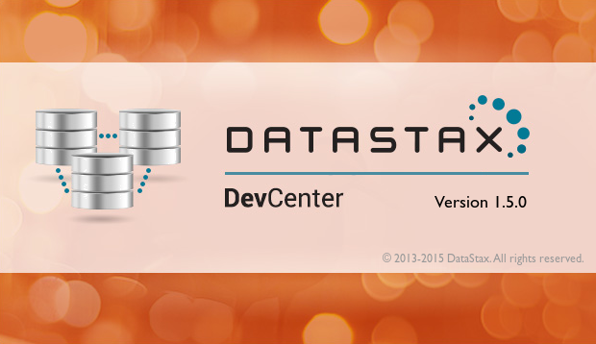
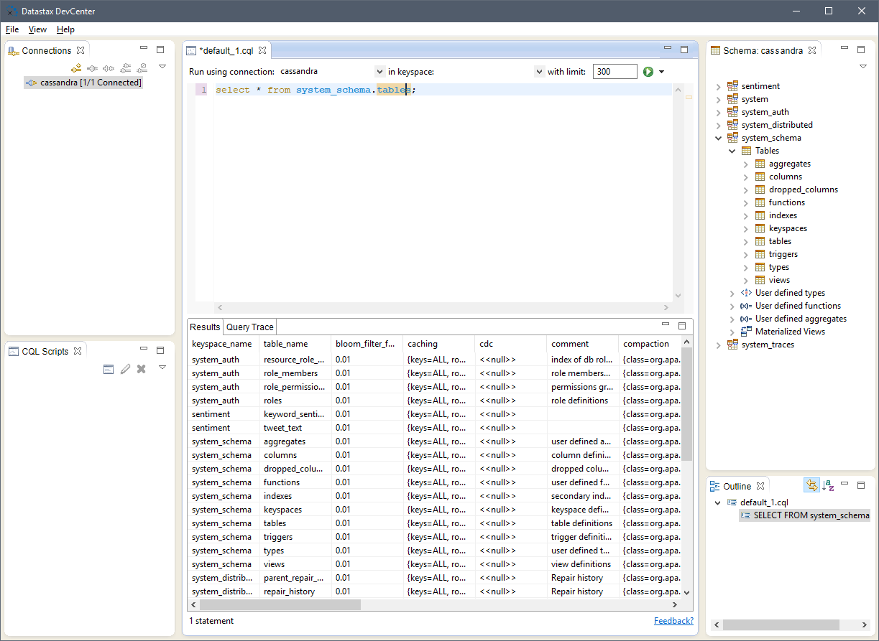
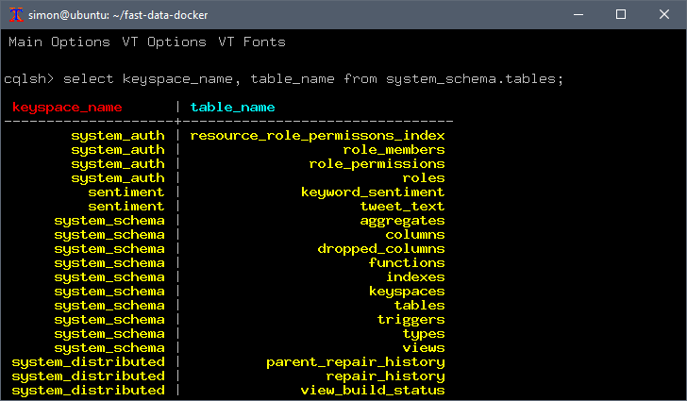
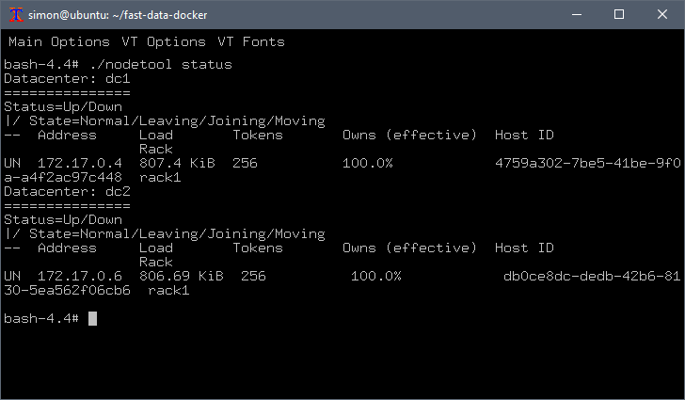
Tools
cqlsh - REPL for executing CQL statements
nodetool – Command line to manage a cluster
sstableloader – Bulk dat loading
ccm – Cassandra Cluster Manager, virtualise a local cluster
DataStax DevCenter – IDE

Slide 21
BIG DATA
“Big data is data sets that are so voluminous and complex that traditional data-processing application software are inadequate to deal with them.”
“Big data challenges include capturing data, data storage, data analysis, search, sharing, transfer, visualization, querying, updating, information privacy and data source.”

Slide 22
The 5 Vs
Volume | Variety | Velocity | Veracity | Value
The amount of data generated every second | Different types of data | Speed data moves around | Trustworthiness of data | Business strategy to monetize data
Horizontal scalability allows nodes to be added as data grows Partitioning of data allows subsets of data to be processed | Support for sparse rows allows tables to store different data structures Queries support JSON output for SELECT and input for INSERT | Replication across many nodes improves data access times Replication between data centres | Supports TDE for data at rest. Encrypted channels protect in flight Merkel Trees maintain data integrity by comparing hashes | Different workloads supported in different data centres Analytics run in real-time without affecting BAU systems

Slide 23




SMACK STACK
S | M | A | C | K
Spark | Mesos | Akka | Cassandra | Kafka
Streaming Analytics Map Reduce | Orchestration Elastic Scalability Resilience | Scalable Parallel API | Data Storage Optimised Select Multi-Data Centre | Data Ingestion Stream Source At-least-once

Slide 24
Demo Fast Data Platform
Linux Host (Ubuntu 16.04 LTS)
Docker Containers (Alpine Linux)
ZooKeeper
Kafka
Cassandra
Cassandra/Spark
Akka Microservices
Multi-Data Centre Cassandra
Spark Analytics Workload

Slide 25
Kafka
ZooKeeper
Configuration store
Consumer offsets
Dockerfile
FROM alpine:3.7
RUN apk update \
&& apk add bash wget openjdk8-jre \
&& wget http://mirror.ox.ac.uk/sites/rsync.apache.org/zookeeper/zookeeper-3.4.12/zookeeper-3.4.12.tar.gz \
&& tar xzf zookeeper-3.4.12.tar.gz \
&& rm zookeeper-3.4.12.tar.gz \
&& echo tickTime=2000 > /zookeeper-3.4.12/conf/zoo.cfg \
&& echo dataDir=/zookeeper-3.4.12/data >> /zookeeper-3.4.12/conf/zoo.cfg \
&& echo clientPort=2181 >> /zookeeper-3.4.12/conf/zoo.cfg
EXPOSE 2181
ENTRYPOINT ["/zookeeper-3.4.12/bin/zkServer.sh", "start-foreground"]
Kafka
Distributed commit log
Publisher/subscriber model
Dockerfile
FROM alpine:3.7
RUN apk update \
&& apk add bash wget openjdk8-jre \
&& wget http://mirror.ox.ac.uk/sites/rsync.apache.org/kafka/1.1.0/kafka_2.11-1.1.0.tgz \
&& tar xzf kafka_2.11-1.1.0.tgz \
&& rm kafka_2.11-1.1.0.tgz
EXPOSE 9092
COPY run-kafka.sh .
ENTRYPOINT ["/bin/sh", "/run-kafka.sh"]

Slide 26
Cassandra
Cassandra
Create a cluster to hold data
Create live and analytics data centres
Single-node data centres for demo
Configured for low memory usage
Dockerfile
FROM alpine:3.7
RUN apk update \
&& apk add bash wget openjdk8-jre python2 \
&& wget http://mirror.ox.ac.uk/sites/rsync.apache.org/cassandra/3.11.2/apache-cassandra-3.11.2-bin.tar.gz \
&& tar xzf apache-cassandra-3.11.2-bin.tar.gz \
&& rm apache-cassandra-3.11.2-bin.tar.gz
EXPOSE 7000 7001 7199 9042 9160
COPY run-cassandra.sh .
ENTRYPOINT ["/bin/bash", "-c", "/apache-cassandra-3.11.2/bin/Cassandra", "-fR"]

Slide 27
Data Ingestion
Twitter Streaming
Scala application
Akka Actors
Use the twitter4j library to read tweets
Use Stanford NLP for Sentiment Analysis
Filter tweets by keyword
Publish results to Kafka
Multiple publishers
Code Fragments
val config = new ConfigurationBuilder()
.setOAuthConsumerKey(getEnvironmentOrDefault("TWITTER_CLIENT_ID", ""))
.setOAuthConsumerSecret(getEnvironmentOrDefault("TWITTER_CLIENT_SECRET", ""))
.setOAuthAccessToken(getEnvironmentOrDefault("TWITTER_ACCESS_TOKEN", ""))
.setOAuthAccessTokenSecret(getEnvironmentOrDefault("TWITTER_ACCESS_TOKEN_SECRET", ""))
.build
val filter = new FilterQuery(keywords.split(","): _*)
val stream = new TwitterStreamFactory(config).getInstance
val listener = listenerFactory()
stream.addListener(listener)
stream.filter(filter)
val kafkaBootstrapServer = getEnvironmentOrDefault("KAFKA_BOOTSTRAP_SERVER", "kafka:9092")
val properties = new Properties()
properties.put("bootstrap.servers", kafkaBootstrapServer)
properties.put("key.serializer", "org.apache.kafka.common.serialization.StringSerializer")
properties.put("value.serializer", "org.apache.kafka.common.serialization.StringSerializer")
val producer = new KafkaProducer[String, String](properties)
val json = write(info)
val record = new ProducerRecord(topic, status.getId.toString, json)
producer.send(record)

Slide 28
Spark Stream Processing
Stream Processing
Kafka streaming
Time windowed (Tumbling Window)
Convert RDD to Data Frame
Spark SQL
Submit job to cluster
Run on driver
Code Fragments
val conf = new SparkConf()
val sc = new SparkContext(conf)
val ssc = new StreamingContext(sc, Seconds(60))
val props = Map(
"bootstrap.servers" -> getEnvironmentOrDefault("KAFKA_BOOTSTRAP_SERVER", "kafka:9092"),
"key.deserializer" -> classOf[StringDeserializer],
"value.deserializer" -> classOf[StringDeserializer],
"auto.offset.reset" -> "earliest",
"group.id" -> "0",
"enable.auto.commit" -> (true: java.lang.Boolean)
)
val topics = Array("sentiment")
val stream = KafkaUtils.createDirectStream[String, String](ssc, PreferConsistent, Subscribe[String,String](topics, props))
stream.foreachRDD((rdd, t) => {
val spark = SparkSession.builder().config(rdd.sparkContext.getConf).getOrCreate()
import spark.implicits._
}
ssc.start
ssc.awaitTermination
ssc.stop(true, true)

Slide 29
Simple API
Rest API
Scala application
Akka HTTP
DataStax Cassandra Driver
Dockerfile
FROM alpine:3.7 AS build
RUN apk --update --no-cache add wget openjdk8 bash \
&& wget -q https://cocl.us/sbt01316tgz \
&& tar xzf sbt01316tgz \
&& rm sbt01316tgz \
&& mkdir /build
ENV PATH="/sbt/bin:${PATH}"
COPY . /build
WORKDIR /build
RUN sbt -J-Xms1024m -J-Xmx4g assembly
FROM alpine:3.7
RUN apk --update --no-cache add openjdk8-jre
COPY --from=build /build/target/scala-2.11/rest-api-assembly-*.jar /rest-api.jar
ENTRYPOINT ["/usr/bin/java", "-jar", "/rest-api.jar"]
Code Fragments
implicit val system = ActorSystem()
implicit val executor = system.dispatcher
implicit val materializer = ActorMaterializer()
implicit val session = new Cluster
.Builder()
.addContactPoints(getEnvironmentOrDefault("CASSANDRA_SERVER", "cassandra"))
.build()
.connect()
val statement = session.prepare("SELECT * FROM sentiment.keyword_sentiment")
pathPrefix("current") {
get {
val result = session.executeAsync(statement.bind)
val mapped = result.map(_.asScala.map(r => KeywordSentiment(
r.getString("keyword"), r.getString("day"), r.getLong("timestamp"),
r.getDecimal("sentiment").doubleValue, r.getDecimal("weighted").doubleValue,
r.getInt("count")
)))
onSuccess(mapped) { m =>
complete(HttpEntity(ContentTypes.`application/json`, m.toList.toJson.toString))
}
}
}
val future = Http().bindAndHandle(routes, "0.0.0.0", 5000)

Slide 30
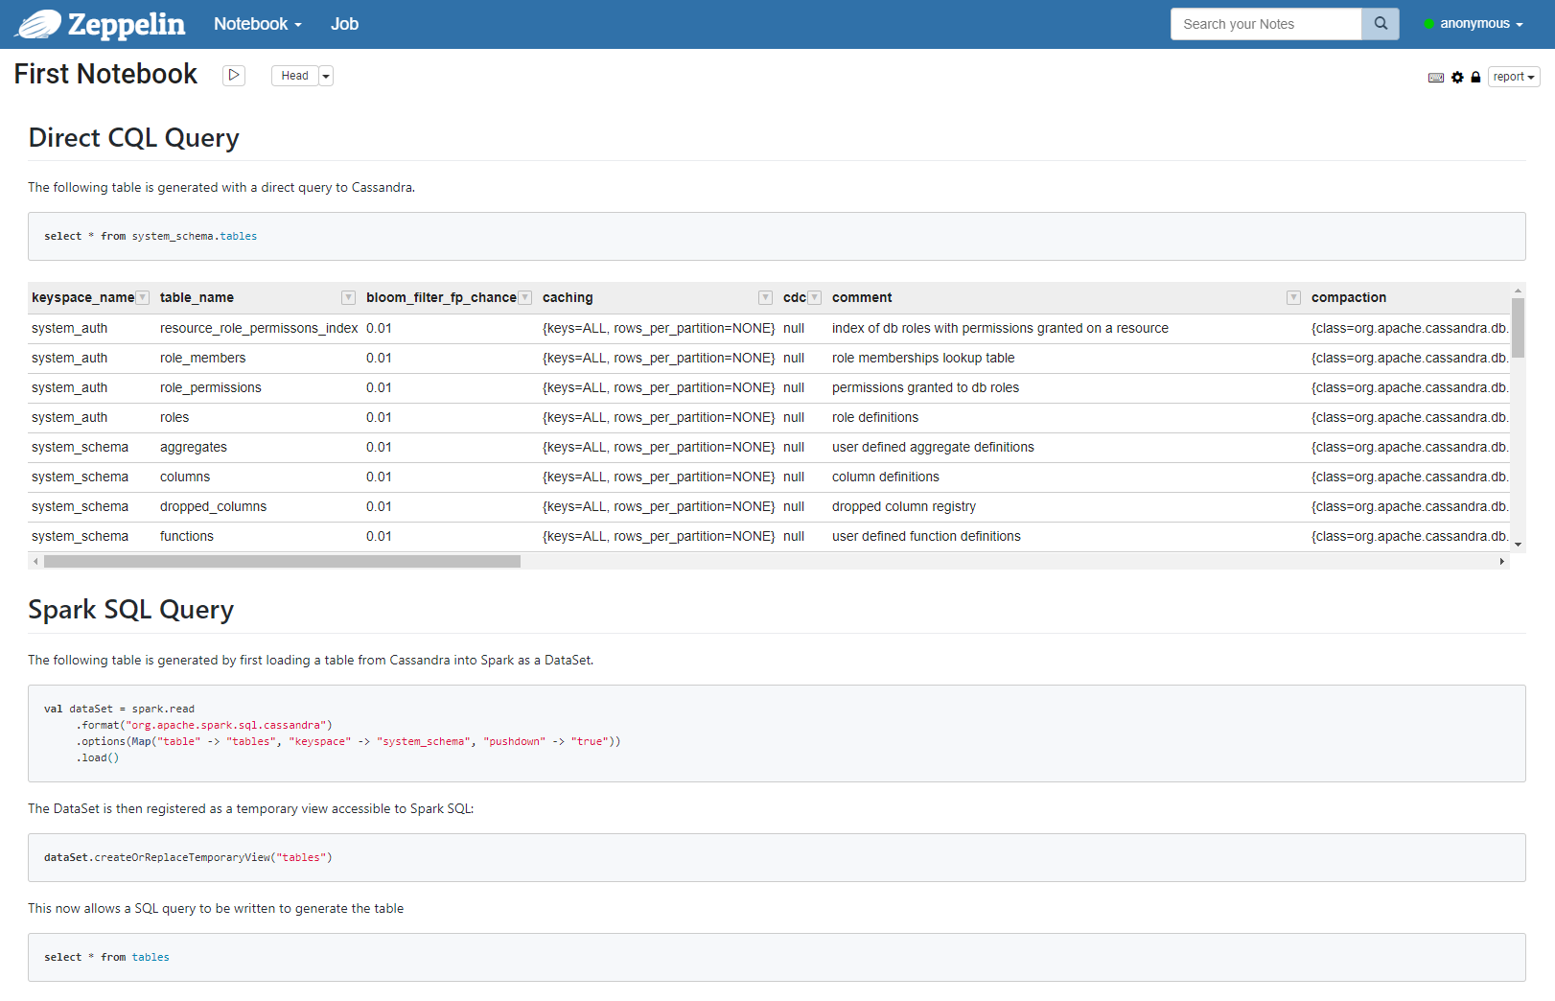
Data Visualisation
Apache Zeppelin
Web-based notebook application
Interactive data analytics
Collaborative documents
Integrated Spark, Scala, SQL, pyspark
Interpreters for most common languages
Import/export notebooks
Notebooks JSON format

Slide 31

Datastax
DataStax are a data management software vendor
Key contributor to Apache Cassandra
Publish training materials and certification
Provide a certified enterprise product (DataStax Enterprise)
Lucene/SOLR Integration
DataStax Graph
CDFS
Managed Cloud
Develop open-source drivers for major languages

Slide 32

Cassandra & Azure
Datastax Enterprise available in the marketplace
Azure supports DC/OS and Marathon on ACS
Azure CosmosDB supports Cassandra wire-protocol
Kafka is available as part of HDInsights on Azure
Spark is part of Azure Data Bricks
Spark 2.3.0+ supports native Kubernetes integration
Service Fabric on Azure supports Java and the Actor Pattern
Serverless functions

Slide 33
The End.

