Slide 1

Subject-Specific Flashcard Reader
Sanjeevitha C S
23AD123

Slide 2

Camera
OCR
CSV Lookup
Display + Audio
Introduction:
Subject Specific Flashcard Reader — a camera-based study assistant.
Converts physical flashcards into instant multimedia explanations
using OCR and CSV lookup.
Displays text, images, videos, and also reads the explanation aloud.
Helps to learn faster with immediate, multimedia-based feedback.

Slide 3
Problem Statement :
Users lose interest with traditional flashcards due to limited information
Traditional flashcards require manual searching for explanations, images, or examples.
Manual searching interrupts active learning and slows revision.
Existing OCR tools are unstable across frames, lack multimedia linkage, and rarely
provide integrated narration.

Slide 4
Objectives:
Interactive
Real-Time OCR
Multimedia
User-friendly
Make flashcards interactive and engaging
Build a lightweight web app that reads flashcard keywords
through camera in real-time.
Ensure stable keyword detection across multiple frames.
Retrieve explanations, fun facts, images, and video links
from a CSV dataset.
Provide Text-to-Speech (TTS) narration and fallbacks (Google Images / YouTube) when needed.
Make the system user-friendly, extensible, and easy to maintain.

Slide 5

Proposed Method :
Camera Input
Real-Time OCR
A camera captures images of physical flashcards or learning materials.
Optical Character Recognition (OCR) processes the text on the flashcard without needing an internet connection.
Dataset Matching
Text-to-Speech Explanation
Found – Explanation + Fun Fact + Images/Video
Not Found – Redirect to Google/Youtube search
The system provides clear, concise verbal explanations via Text-to-Speech (TTS), directly to the user

Slide 6
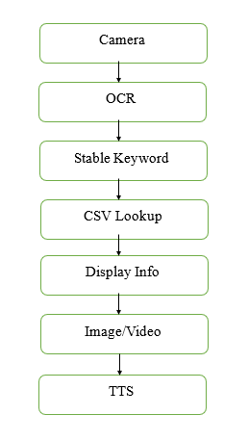
System Architecture
Camera: Captures the flashcard shown by the user.
OCR: Extracts text from the captured image.
Stable Keyword Check: Confirms the same keyword appears across multiple frames.
CSV Lookup: Searches the dataset for the matching keyword.
Display Info: Shows explanation and fun facts on the screen.
Image/Video: Displays related images or videos if available.
TTS: Reads out the explanation using text-to-speech.

Slide 7
Implementation
Dataset Setup
Flashcard Capture
Contains: category, keywords, explanation, fun fact, image/video link
Stored in CSV format for easy access and fast lookup
Camera captures the flashcard image
OCR extracts text from the image
Dataset Matching
Fallback search
System searches for extracted text in dataset
If found , show explanation , fun fact, multimedia
Provides Google Images or YouTube search links if keyword not found
Ensures user always gets information

Slide 8
Technology Used :
OpenCV
Captures live camera feed.
Tesseract OCR
Extracts text from flashcards.
Pandas
Loads, searches and manages the CSV flashcard dataset.
gTTs
Generate clear audio explanations using Text-to-Speech.
Web Integration
Google Images & YouTube search for extra content
Flask
Backend framework that handles OCR, search dataset and send results to user

Slide 9
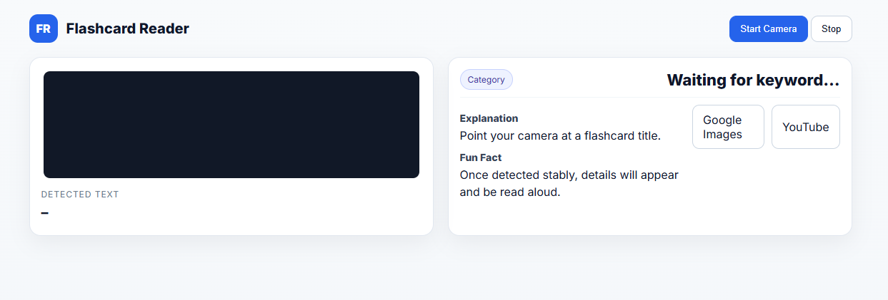
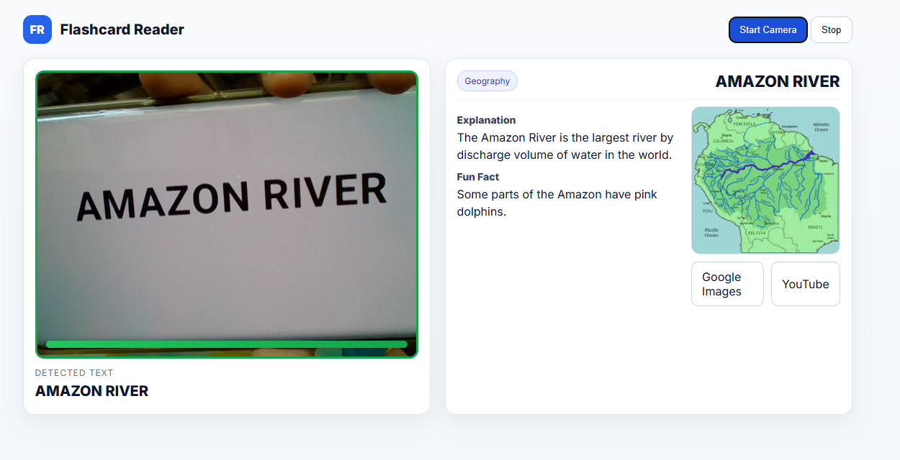
Output Screenshots :
Home Page
Result Page

Slide 10
Literature Survey :
Traditional classroom methods are lecture-based and often passive.
Existing EdTech tools (e.g., Byju’s) focus on digital content but depend on manual navigation.
Research shows active learning, OCR, and AI-powered tools improve retention and reduce teacher effort.
Gap: Current systems lack real-time interaction, instant explanation retrieval, and integrated audio support.
Market Analysis :
EdTech Growth : Global market -> $404 billion by 2025 , India -> $10 billion by 2025
Key Players : Byju’s , Vedantu , Coursera
Opportunities : AI tutoring, gamifies learning, scalable classroom
Scope : Reduce teacher workload, boost student engagement , provide scalable solutions

Slide 11


Conclusion :
Our Interactive Learning Assistant offers a powerful bridge between traditional and digital learning methodologies.
Affordable
Low Internet Usage
Cost-effective for schools and families.
Works smoothly with minimal connectivity.
Engaging
Scalable
Boosts student interest and retention.
Easily implemented across many classrooms.

