Slide 1
BIOMETRIC VOTING SYSTEM
Guide: Presented By:
RAMA BANSAL SANJEEV KUMAR

Slide 2
INTRODUCTION
Biometric Voting System is an application where the user is recognized by his/her finger pattern.
As finger pattern of each human being is different, the voter can be easily authenticated.

Slide 3
PROBLEM DEFINITION
A voter who lost his/her voter id cannot vote in the election.
A voter can not vote multiple times or multiple candidates.

Slide 4
METHODOLOGY
SDLC Iterative Model-
Iterative process starts with a simple implementation of a subset of the software requirements and iteratively enhances the evolving versions until the full system is implemented.

Slide 5
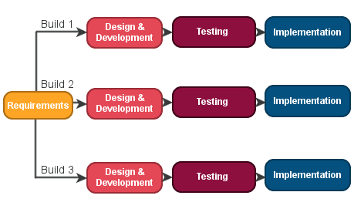
METHODOLOGY

Slide 6
CONCEPT TO BE IMPLEMENTED
The modules to implemented are:-
Login: This module enables the admin and login to the system by entering id and password.
Registration: In this module the Electoral officer register the voters and candidates.
Updation: Any type of correction can be made.
View Records: Admin will able to view the records.
Vote: Voters will vote.
Remove Record: Admin can remove the record of any voter or candidates.
Result: After the election system will generate the result.

Slide 7
SOFTWARE REQUIREMENT SPECIFICATION
Software Requirements:
Operating System: - Windows
Database: - MySQL
Language: - Java
Hardware Components:
Processor: - 1.4GHz and above
Hard Disk: - 5 GB
RAM: - 1 GB

Slide 8
ADVANTAGES
The system will not allow the voter to vote two or more candidates.
The system will allow the user to vote for one time for a particular election.
The system will authenticate the user through his fingerprint so the user is uniquely identified.

Slide 9
DISADVANTAGES
If the voter finger pattern has some cut or got damaged the system might not recognize the user.

Slide 10
THANK YOU

