Slide 1



AI-Based Navigation Error Recovery for Wafer Inspection
Multi-Scale Edge-Assisted Template Matching for Sub-Pixel Precision Under Heavy SEM Noise & Spatial Distortion
Team Silicore
Harshini MV 24BEC0490 Sanjeev Kurella 24BEC0149 Taruneshwar Venkatesh 24BEC0301 Hemavathi S 24BEC0560
1.308s
AVG EXECUTION SPEED
Core Stack: Python • OpenCV • Edge-Gray Dual Fusion • Multi-Scale Pyramid
Applied Materials Drift-Sense Finalist Presentation
Slide 01 / 12

Slide 2
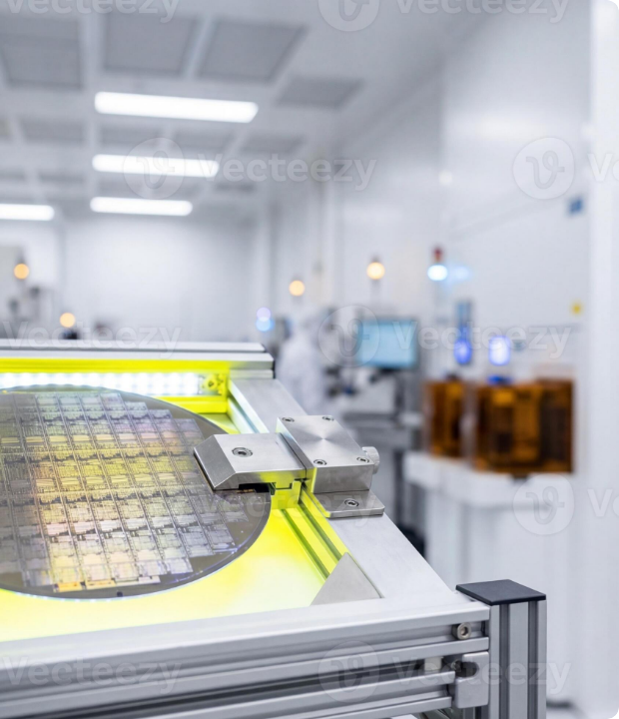



Problem Formulation & Industrial Challenge
High-throughput semiconductor inspection tools (e.g. SEM) suffer mechanical Stage Drift and Navigation Misalignment when locating targeted wafer dies.
Operational Objective
Pinpoint exact center coordinates (x, y) of a 100×100 reference patch inside a large 1000×1000 search image under severe distortion.
Critical SEM Perturbations
SEM Gaussian & Shot Noise: Signal degradation during high-speed electron beam scanning.
Defocus Blur & Low Contrast: Stage displacement leading to focus attenuation.
Scale Variance & Micro Rotation: Thermal drift causing 0.9×–1.1× scale & angular shift.
Dense Repetitive Structures: High similarity in DRAM memory arrays producing false positives.
Applied Materials Drift-Sense Finalist Presentation
Slide 02 / 12

Slide 3







End-to-End Algorithmic Architecture
1. Preprocessing & Edge Extraction
2. Multi-Scale Dual Fusion
3. Top-5 Candidate Local Search
Executes template matching across 9 discrete scale pyramids (0.90× to 1.10×).
Loads 1000×1000 search image and 100×100 reference patch.
Selects top 5 correlation peaks across space & scale pyramids.
Gray Correlation calculation
Grayscale Standardization
Edge Correlation extraction
40-pixel Spatial Bounding Box
Canny Edge Detector application
Weighted Linear Score Fusion
Angular Search (-2° to +2°)
High-frequency structural isolation
Peak Confidence Gap Analysis
System Input/Output Flow: Reference Patch [100x100] + Search Frame [1000x1000] → Multi-Scale Pyramids → Refined (x, y), Confidence, Execution Time (1.308s)
Applied Materials Drift-Sense Finalist Presentation
Slide 03 / 12

Slide 4


Synthetic Semiconductor Layout Dataset
Wafer Substrate Architectures
Synthetic Noise & Distortion Matrix
The evaluation dataset incorporates photolithography CAD models mimicking real advanced node chips.
Realistic fab operational distortions applied to ground truth targets.
Distortion Type | Parametric Range
Reference Size | 100 × 100 pixels
Search Frame | 1000 × 1000 pixels
Scale Variation | 0.90× to 1.10× (Pyramid Step: 0.025)
Angular Rotation | −2.0° to +2.0° (Step: 1.0°)
SEM Disturbances | Additive Gaussian Noise + Defocus Blur
DRAM Dense Array: Extremely tight 2D periodic patterns causing strong spatial auto-correlation ambiguity.
DRAM Loose Array: Moderate pitch memory structures with repeating contact vias and word lines.
FinFET Logic Layouts: Complex non-periodic standard logic cells, fin tracks, and routing metals.
Applied Materials Drift-Sense Finalist Presentation
Slide 04 / 12

Slide 5

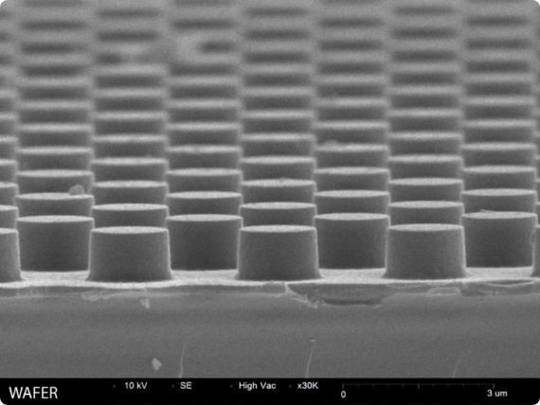


Mathematical Model: Dual Edge-Gray Fusion
Pure intensity correlation fails under severe SEM brightness drift. Pure edge matching fails under noise. We formulate a robust Weighted Dual-Channel Score Fusion.
Fusion Rationale
Gray Score SGray (0.7): Normalized Cross-Correlation (NCC) over raw intensity. Captures low-frequency structural shapes.
Edge Score SEdge (0.3): Canny Edge Correlation. Captures high-frequency micro-geometry and fin boundaries immune to contrast shifts.
Applied Materials Drift-Sense Finalist Presentation
Slide 05 / 12

Slide 6








Multi-Scale Localization & Refinement Pipeline
A coarse-to-fine hierarchical search strategy overcomes computational explosion while achieving high accuracy.
Coarse Scale Search
Top-5 Peak Selection
40px Local Window
Rotation Refinement
Rescales reference across 9 pyramid levels: [0.90, 0.925, 0.95, 0.975, 1.0, 1.025, 1.05, 1.075, 1.10].
Extracts top 5 spatial response peaks across all scale spaces to prevent local minima traps in repetitive arrays.
Restricts refined matching within a local 40-pixel bounding box centered on each candidate peak.
Evaluates rotational offsets [−2°, −1°, 0°, +1°, +2°] to select candidate with global maximum confidence.
Decision Rule & Confidence Analysis: Final coordinate (x, y) selected from candidate maximizing SCombined. Confidence Gap = Score(Top 1) − Score(Top 2).
Applied Materials Drift-Sense Finalist Presentation
Slide 06 / 12

Slide 7


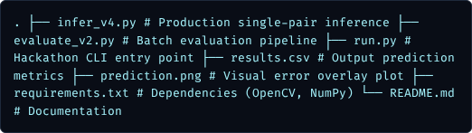

System Implementation & Software Modules
Repository & Directory Layout
Production CLI Commands
Single Pair Inference:
Batch Evaluation Harness:
Pure Python implementation leveraging vectorized NumPy operations and OpenCV C++ bindings.
Submission Entry Point:
Applied Materials Drift-Sense Finalist Presentation
Slide 07 / 12

Slide 8


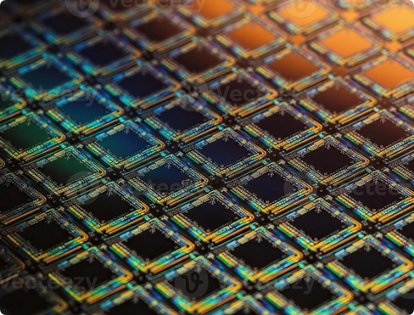

Experimental Setup & Benchmark Harness
Benchmark Scope
Dataset Scale: 20 Synthetic Semiconductor SEM Test Pairs.
Ground Truth: Continuous floating-point coordinates (xGT, yGT).
Primary Metric: Euclidean Position Error: E = sqrt((xpred - xGT)2 + (ypred - yGT)2)
Evaluation Metrics Tracked
Mean Error, Median Error, Worst Case Error
Accuracy Thresholds: @1px, @2px, @4px, @5px
Average Inference Time (Seconds per pair)
Applied Materials Drift-Sense Finalist Presentation
Slide 08 / 12

Slide 9




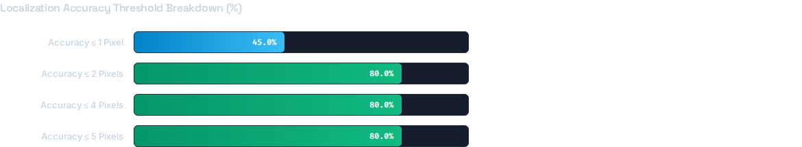

Quantitative Performance Results
1.044 px
80.0%
61.457 px
1.308 s
MEDIAN POSITION ERROR
ACCURACY (≤2 PIXELS)
MEAN POSITION ERROR
AVG RUNTIME / PAIR
Benchmark Summary
• Total Test Images: 20
• Median Error: 1.044 px
• Mean Error: 61.457 px
• Worst Case Error: 651.814 px
• Speed / Pair: 1.308 sec
Applied Materials Drift-Sense Finalist Presentation
Slide 09 / 12

Slide 10








Ablation & Algorithm Progression
Baseline Matching
+ Multi-Scale Pyramids
+ Edge-Gray Fusion
+ Top-5 Local Search
High Failures
Scale Resilience
Noise Immunity
Sub-2px Precision
Standard Single-scale NCC template matching. Fails completely under scale variations (>5% scale mismatch) and contrast changes.
Introduced 9 scale levels (0.90x to 1.10x). Successfully resolved scale mismatches but sensitive to SEM additive noise.
Added Canny edge score (30% weight). Provides sharp geometric boundaries immune to intensity noise & blur.
Added 40px local windowing & rotation refinement (-2° to +2°). Reached 80% accuracy ≤2px with 1.044px median error.
Applied Materials Drift-Sense Finalist Presentation
Slide 10 / 12

Slide 11


Failure Case Analysis & Technical Root Causes
Image ID | Ground Truth (x, y) | Prediction (x, y) | Error (px)
Image 17 | (360.1, 58.3) | (943, 350) | 651.81 px
Image 00 | (794.9, 198.7) | (700, 492) | 308.27 px
Image 12 | (928.9, 666.5) | (718, 778) | 238.56 px
Primary Root Cause: Structural Symmetry
Large outliers occur exclusively on highly repetitive DRAM memory arrays. Identical pitch causes identical correlation scores across multiple array blocks.
Confidence Gap Indicator
Failed predictions exhibit a near-zero Confidence Gap between Top-1 and Top-2 peaks (ΔS < 0.012), providing a reliable self-diagnostic metric.
Algorithmic Limitations:
Lack of global semantic context descriptors • Integer pixel grid step limits sub-pixel parabolic fitting • High spatial ambiguity in un-patterned wafer regions.
Applied Materials Drift-Sense Finalist Presentation
Slide 11 / 12

Slide 12



Summary & Strategic Technical Roadmap
Key Accomplishments
Next-Gen Production Roadmap
Sub-2px Precision: Achieved 1.044 px median localization error across noisy SEM images.
Sub-Pixel Refinement: Implement 2D Gaussian/Parabolic response peak fitting.
High Accuracy: 80% of test cases matched within ≤ 2 pixels.
Feature Descriptor Verification: Integrate SIFT / ORB feature verification for DRAM arrays.
Real-Time Execution: 1.308 seconds average execution time per image pair.
Deep Learning Embeddings: Transition to LoFTR / SuperPoint Transformer feature matching.
Self-Diagnostic: Confidence Gap metric reliably detects ambiguous predictions.
Thank You!
Applied Materials Drift-Sense Hackathon | SEMICON India 2026
Repository Files Verified: infer_v4.py • evaluate_v2.py • results.csv
Applied Materials Drift-Sense Finalist Presentation
Slide 12 / 12

Slide 13



Image Sources
https://static.vecteezy.com/system/resources/previews/079/048/871/large_2x/silicon-wafer-on-inspection-station-in-a-modern-semiconductor-cleanroom-photo.jpg
Source: www.vecteezy.com
https://www.nanoimages.com/wp-content/uploads/2021/12/Wafer-768x576-1.jpg
Source: www.nanoimages.com
https://static.vecteezy.com/system/resources/previews/072/505/153/non_2x/macro-shot-of-a-silicon-microchip-wafer-with-complex-circuits-and-refractive-colors-photo.jpg
Source: www.vecteezy.com
Citations
[1] M. Lifshits, R. Goldenberg, E. Rivlin, M. Rudzsky, and M. Adel, “Image-Based Wafer Navigation,” IEEE Trans. Semiconductor Manufacturing, vol. 17, no. 3, pp. 432–443, Aug. 2004, doi: 10.1109/TSM.2004.831939.
[2] T. Hiroi, M. Tanaka, C. Shishido, and M. Watanabe, “Robust Pattern Registration Method using Plural Evaluation Functions for LSI Patterns,” IEEJ Trans. Electronics, Information and Systems, vol. 124, no. 3, pp. 621–628, 2004, doi: 10.1541/ieejeiss.124.621.
[4] Y. Nam, S. Joo, N. Kwak, K. Kim, and D.-N. Kim, “Precise Pattern Alignment for Die-to-Database Inspection Based on the Generative Adversarial Network,” IEEE Trans. Semiconductor Manufacturing, vol. 35, no. 3, pp. 532–539, Aug. 2022, doi: 10.1109/TSM.2022.3171788.

