Slide 1
How To: Deep Learning Workspace
August 23, 2017

Slide 2
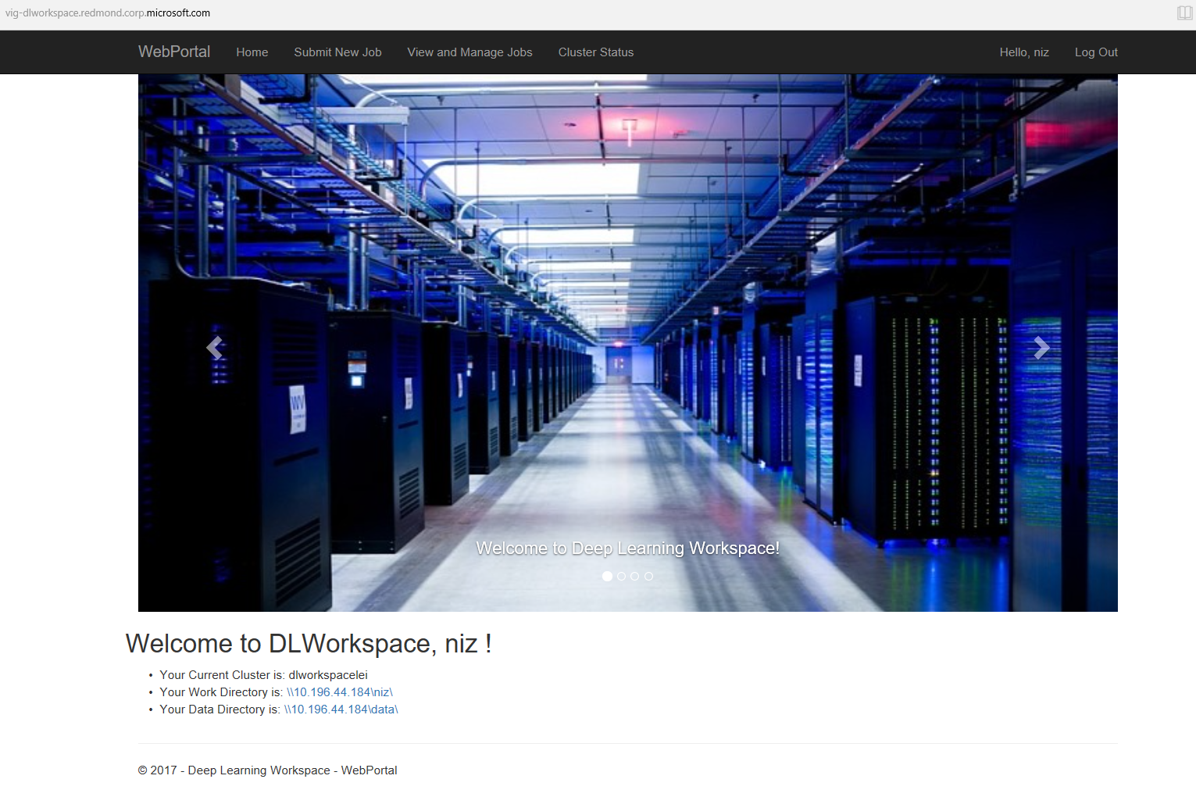
DL Workspace
Use Chrome to open the site instead of Edge!!

Slide 3
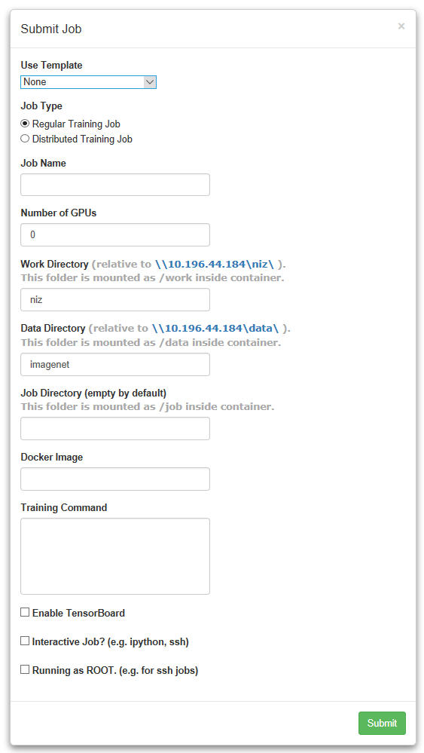
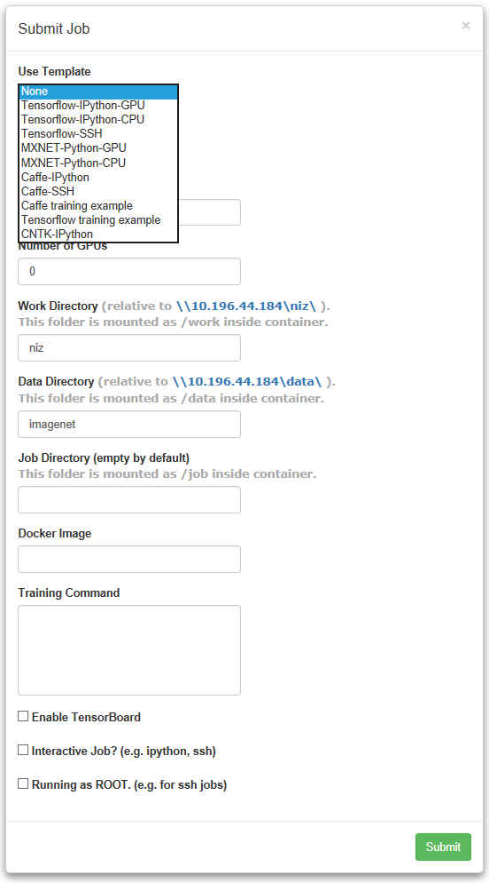
Submit Job - Interactive Job - Training Job

Slide 4
Caffe-Ipython Job

Slide 5
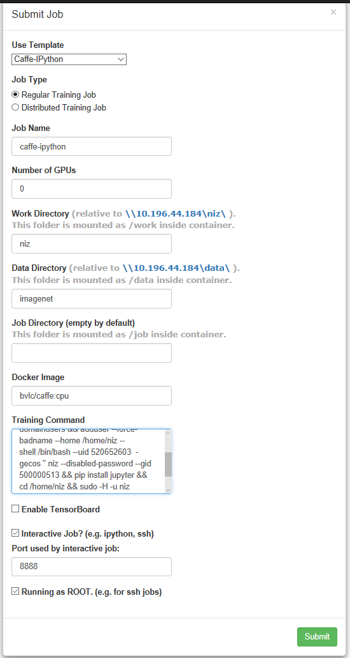
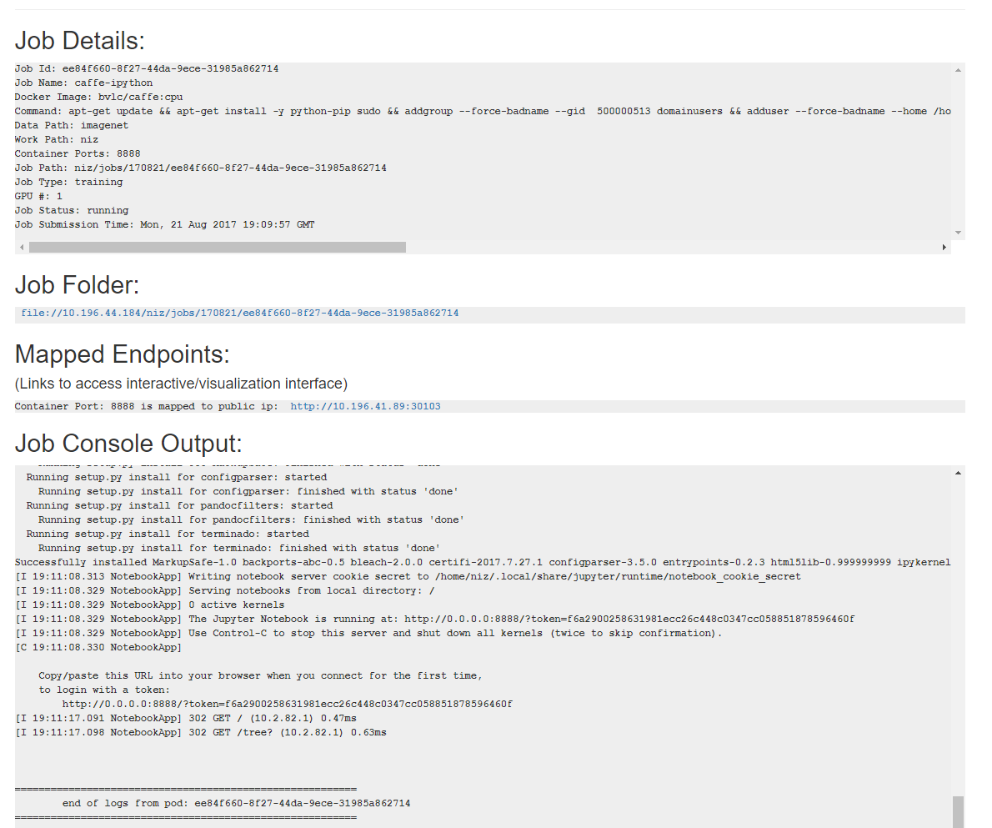

Slide 6
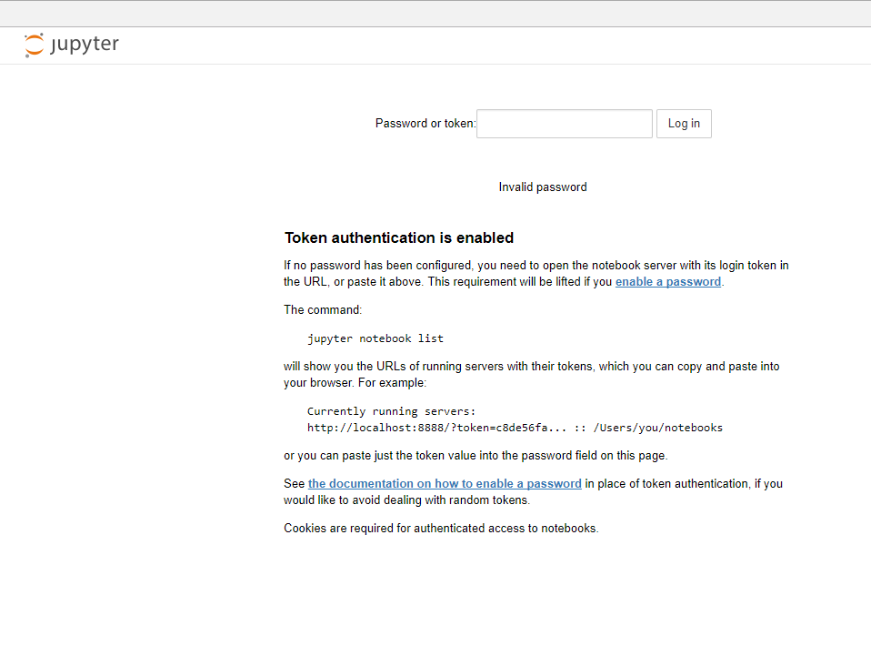
Copy the token from Job console output to here

Slide 7
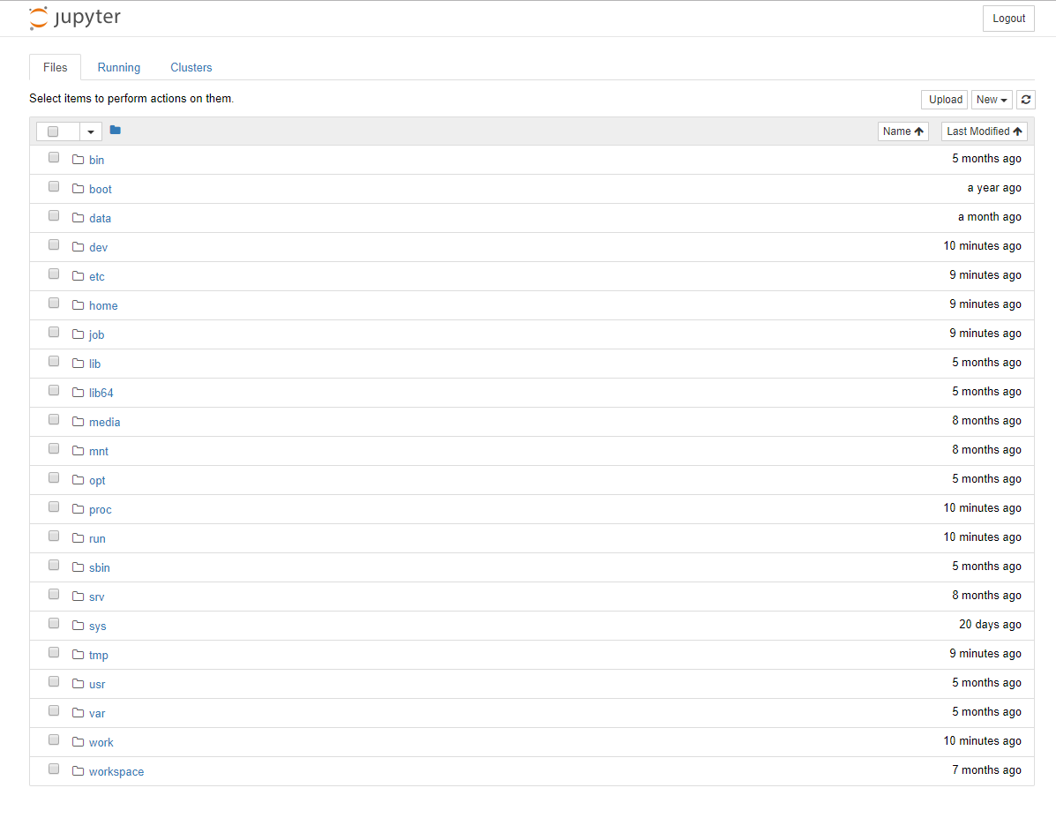
Use it as a normal Ipython notebook environment

Slide 8
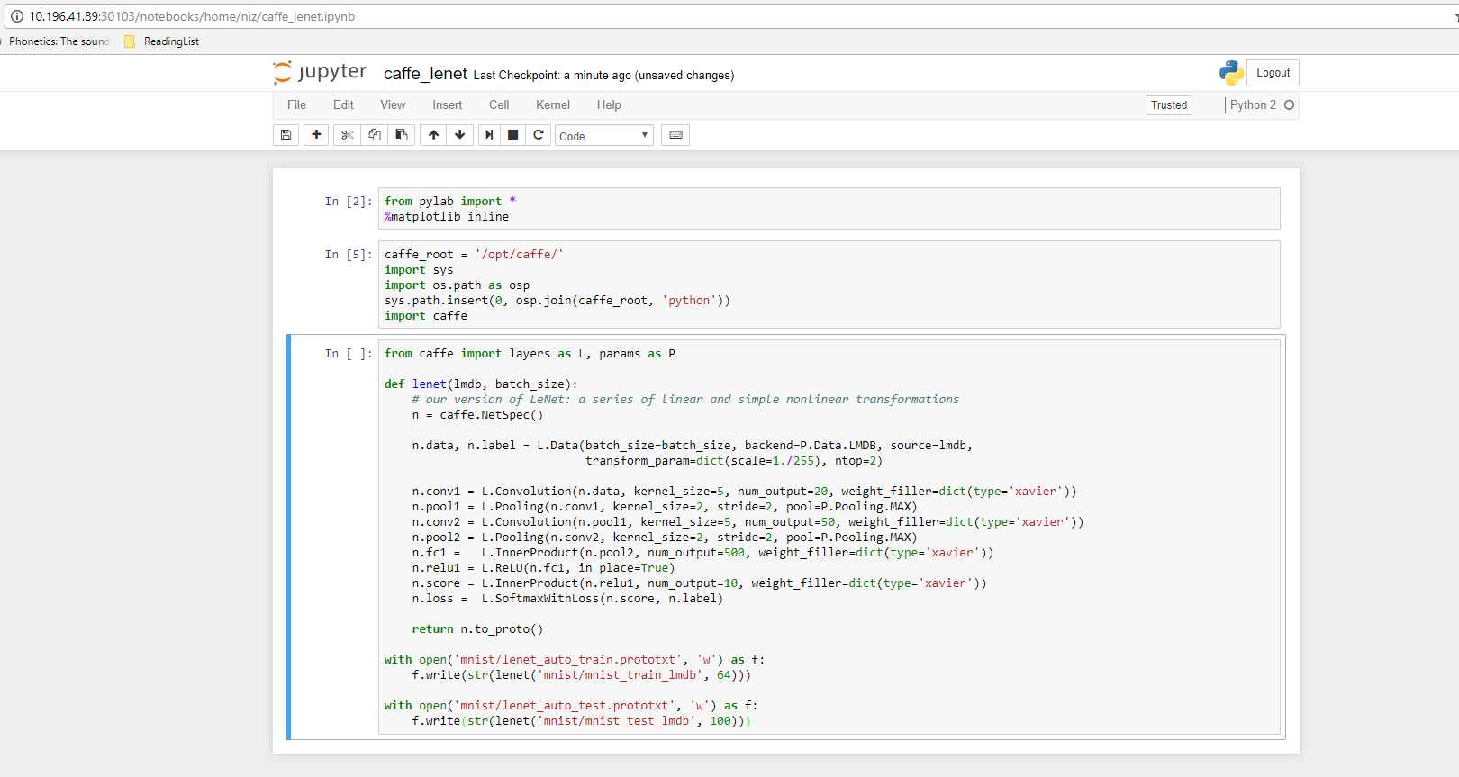

Slide 9
Caffe-SSH Job

Slide 10
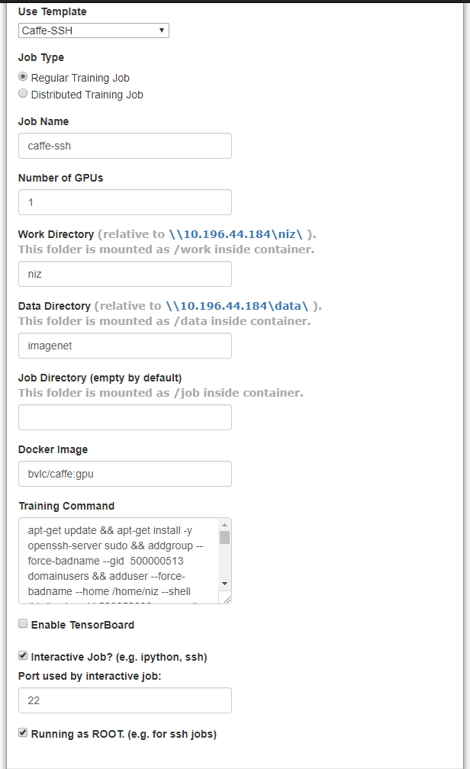
Submit a caffe-ssh job:
Claim the number of GPUs you want to use
Select the docker image to use, e.g., bvlc/caffe:gpu was chosen here

Slide 11
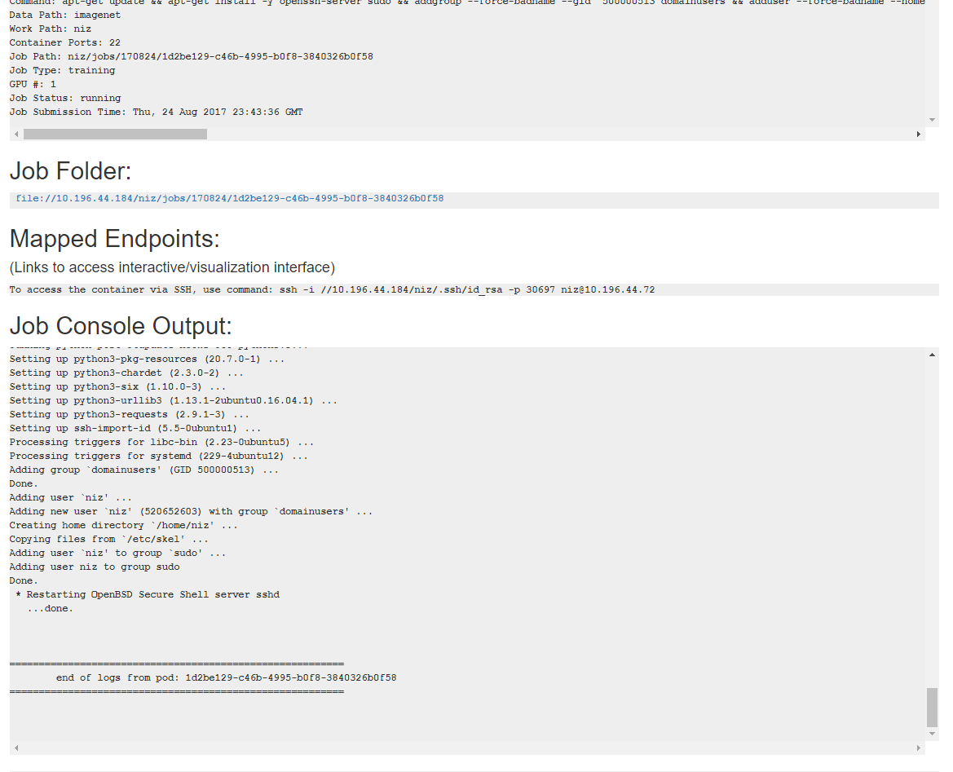
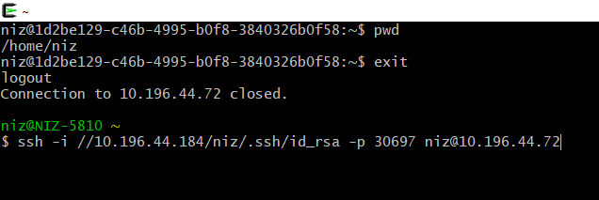
Type this command in Cygwin
After you log in, you can work as like in a normal terminal
If you don’t have Cygwin, please go and download it
The command didn’t work on linux box but can make it happen by copying the id_rsa private key to your linux box

Slide 12
Training Job Caffe training example

Slide 13
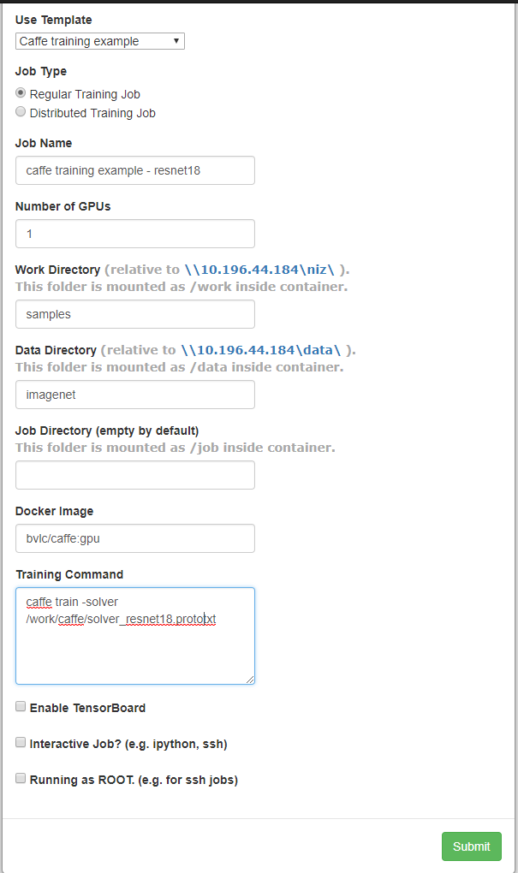
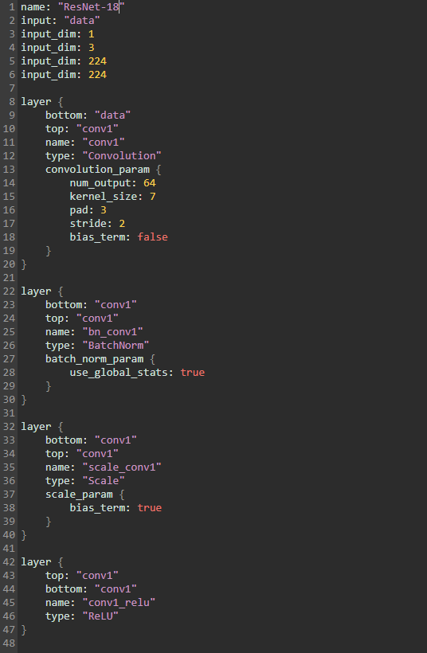
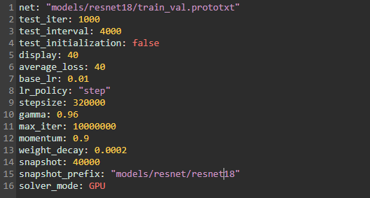

Slide 14
