Slide 1
DENTal Office management SYSTEM
TEAM DEADLOCKERS
Presented by:
Sanjeev Dharanipathy (001310589)
Harrsini Sekar (001344424)
Gayatri Reddiar (001058953)
Sridhar Panneerselvam (001347216)

Slide 2
OBJECTIVES
Developing a centralized system for a Dental Clinic to facilitate in the management of daily dental activities. The system will offer functionalities like management of dental appointments across locations, tracking invoices and payments, as well as, maintaining an inventory of supplies and equipment. The system will house dentist, patient, insurance, and third party vendor records.

Slide 3
Summary of the design
The model enables the admin of the system to book appointments across different dental branches based on dentist availability. These appointments can be managed through an interactive GUI. The admin can also view invoices and track payments of patients against an appointment.
The dentist can manage his/her appointments and update treatment details of patient against a particular appointment.
The patient dental records are maintained which can be referred to by dentists to provide informed medical consultations.
The variety of treatments offered by the clinic are maintained and used to record patient treatments in the model.
The system inventories supplies and equipment which will help the admin of the system in tracking all medical supplies across multiple dental locations.

Slide 4
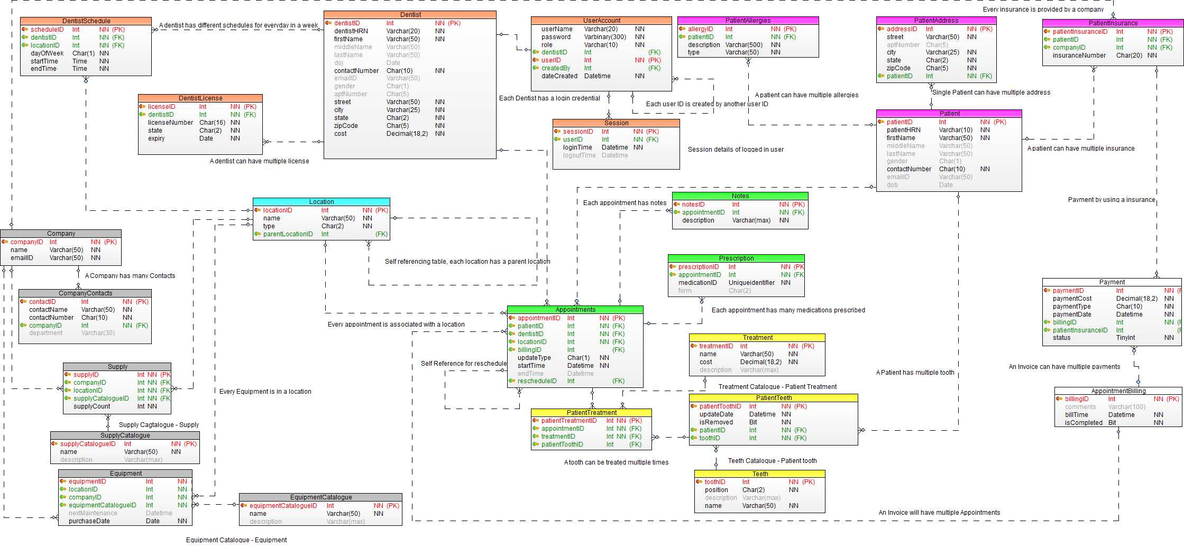
Entity RELATIONSHIP DIAGRAM

Slide 5
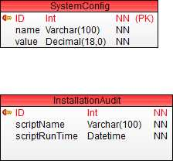
Entity RELATIONSHIP DIAGRAM

Slide 6
DDL script (Patient Teeth)
create table PatientTeeth (patientToothID int primary key identity(1,1),
patientID int not null foreign key references Patient(patientID),
toothID int not null foreign key references Teeth(toothID),
updateDate datetime not null,
isRemoved bit not null)

Slide 7
DML script (Patient Teeth)
insert into PatientTeeth (patientID,toothID,updateDate,isRemoved)
values (1,1,GETDATE(),0),
(1,2,GETDATE(),0),
(1,3,GETDATE(),0),
(1,4,GETDATE(),0),
(1,5,GETDATE(),0),
(1,6,GETDATE(),0),
(1,7,GETDATE(),0),
(1,8,GETDATE(),0)

Slide 8
DML script (Patient Teeth)
update PatientTeeth set isRemoved = 1 where patientID =1 and toothID = 8

Slide 9
DML script (Patient Teeth)
delete from PatientTeeth where patientID = 1 and toothID = 8

Slide 10
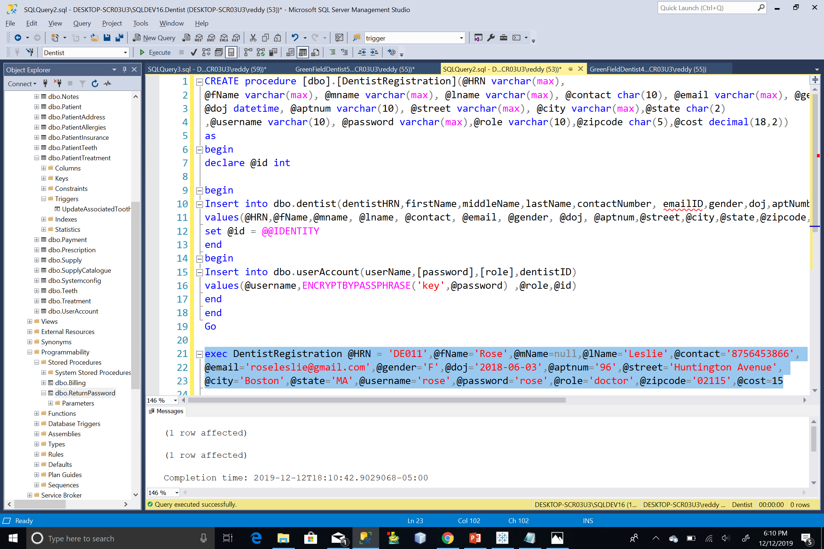
Stored Procedure
(add Dentist account)

Slide 11
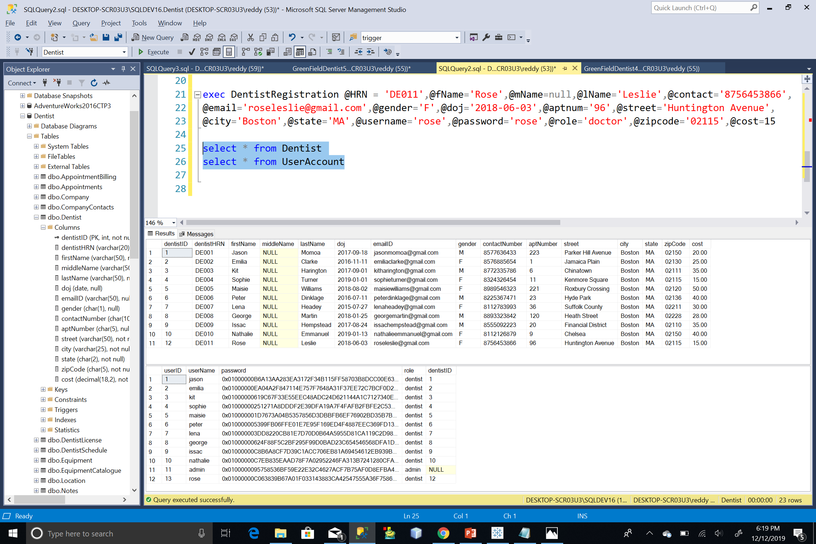
Stored Procedure
(add Dentist account)

Slide 12
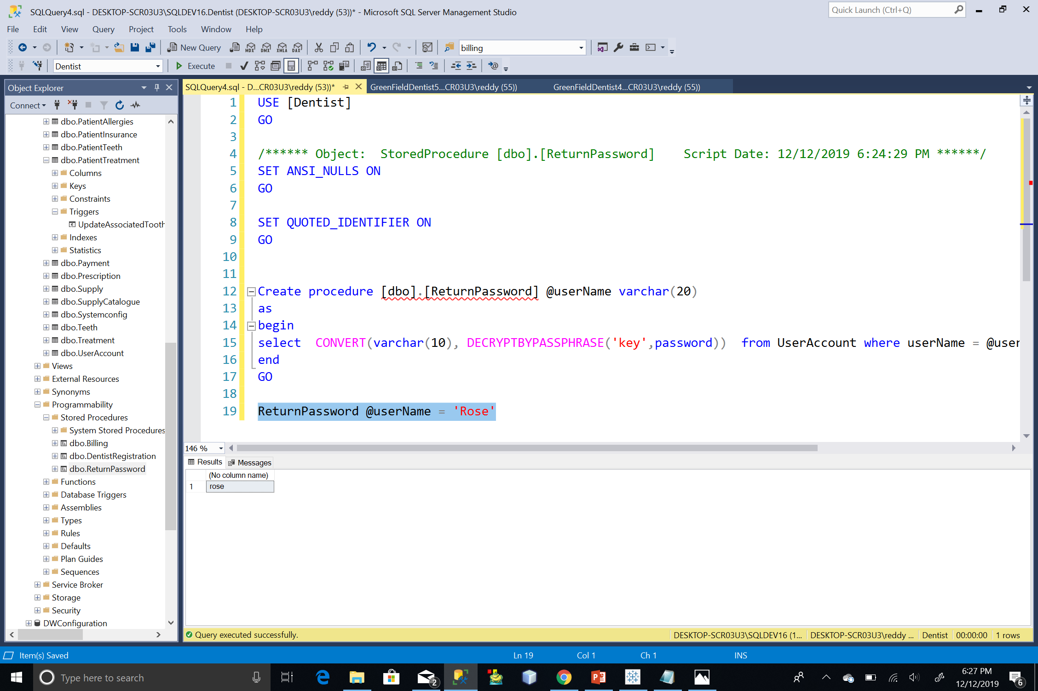
STORED PROCEDURE
(Return decrypted password)

Slide 13
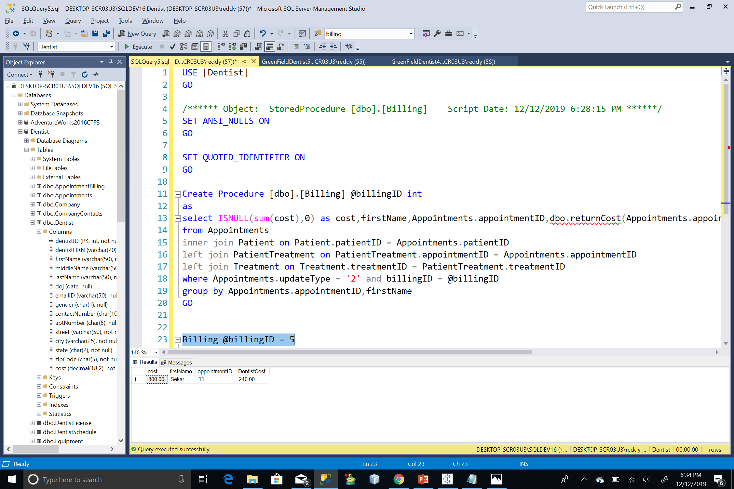
Stored Procedure
(fetch billing details)

Slide 14
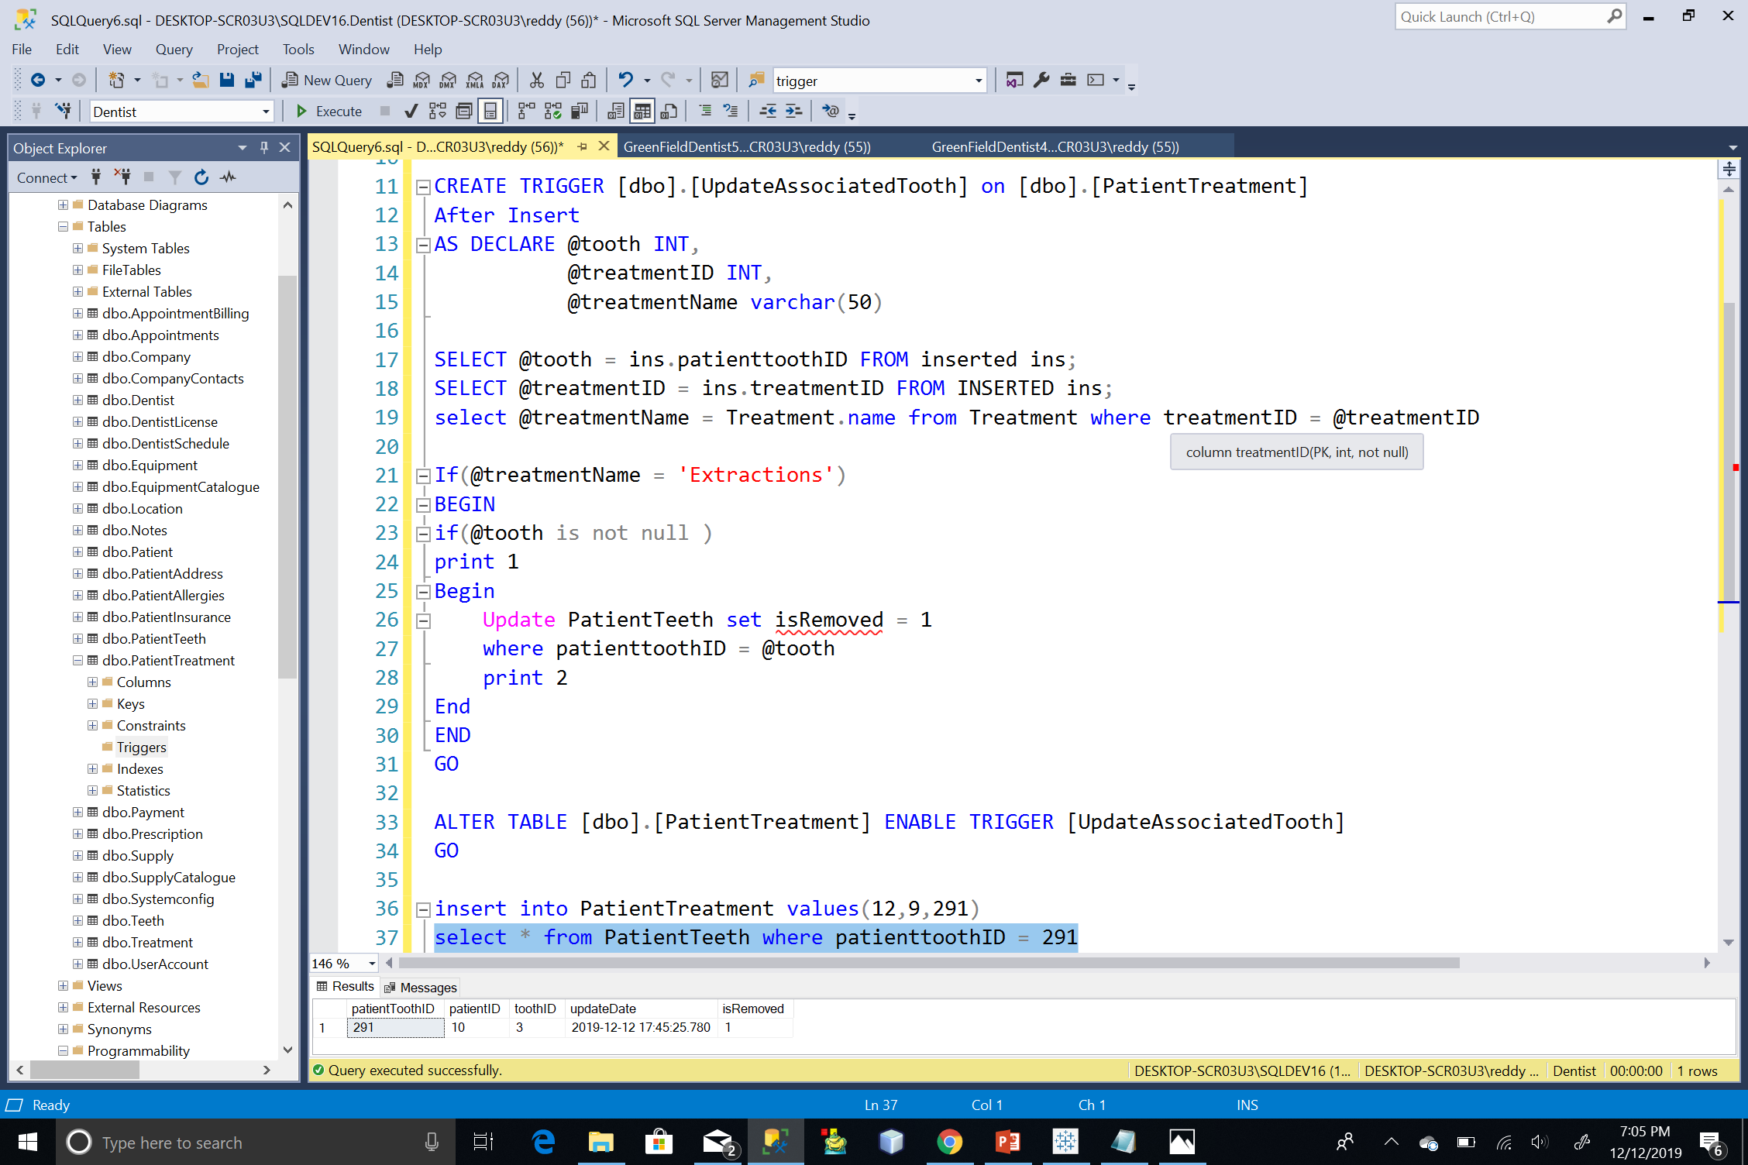
TRIGGER(TOOTH extraction)

Slide 15
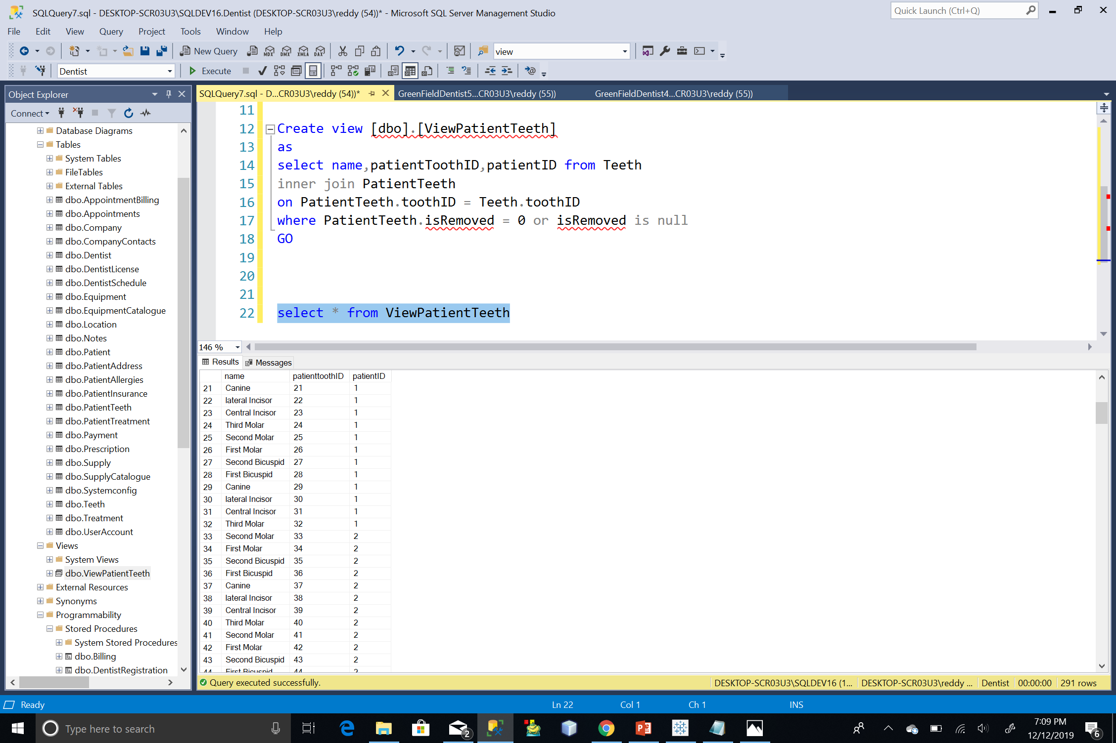
VIEW
(Viewpatientteeth)

Slide 16
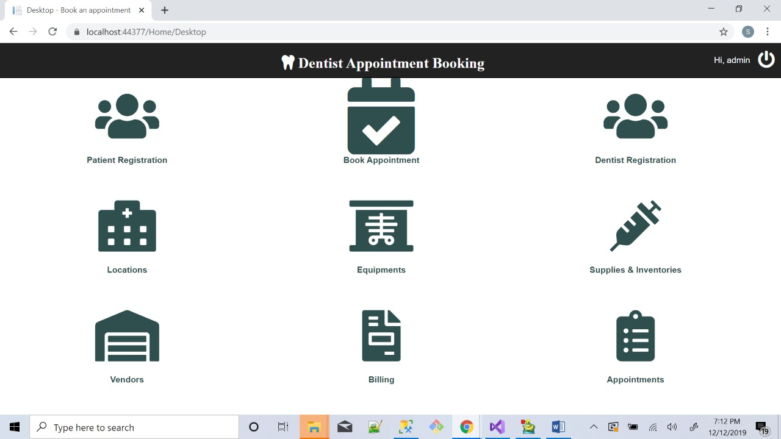
GUI
(ADMIN DASHBOARD)

Slide 17
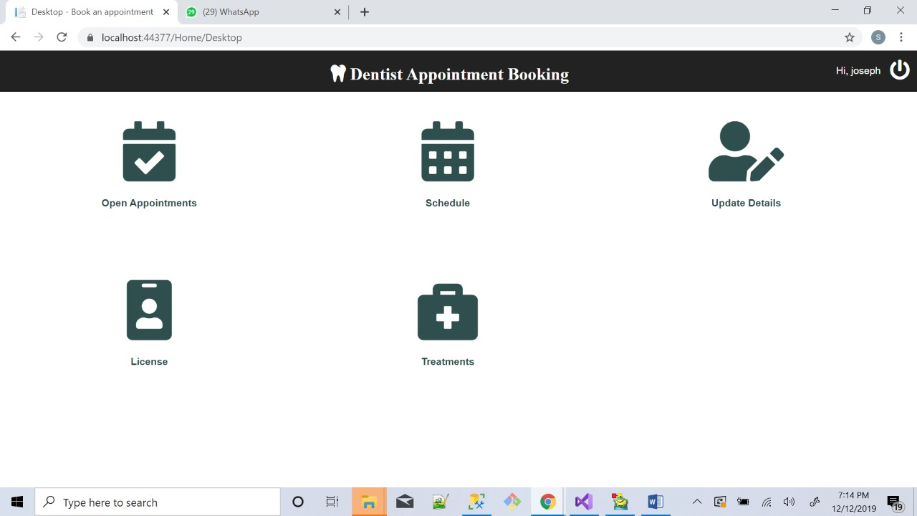
GUI
(dentist DASHBOARD)

Slide 18
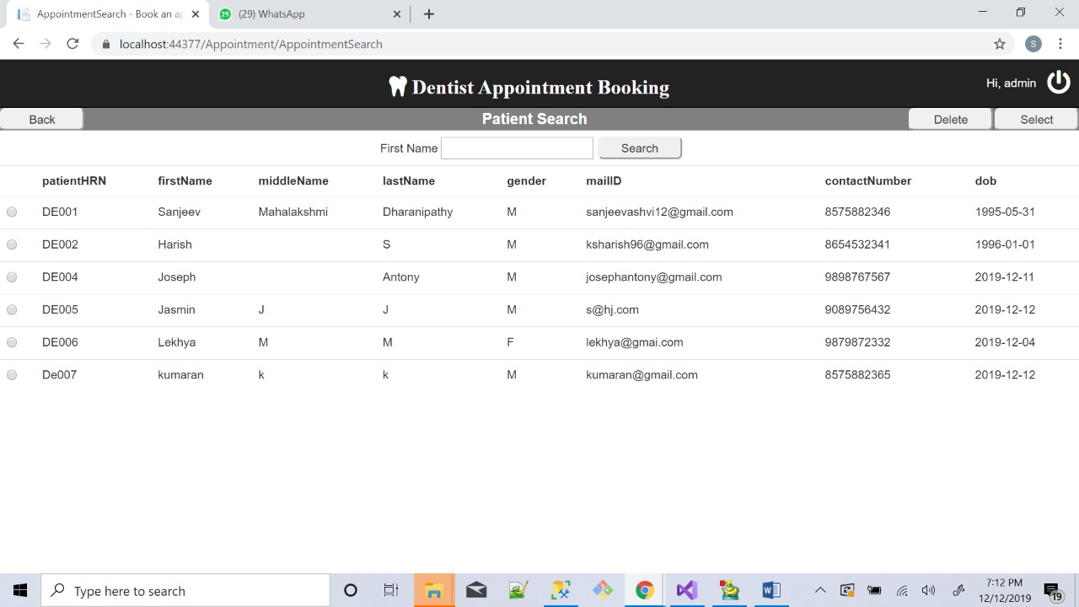
GUI
(Patient search)

Slide 19
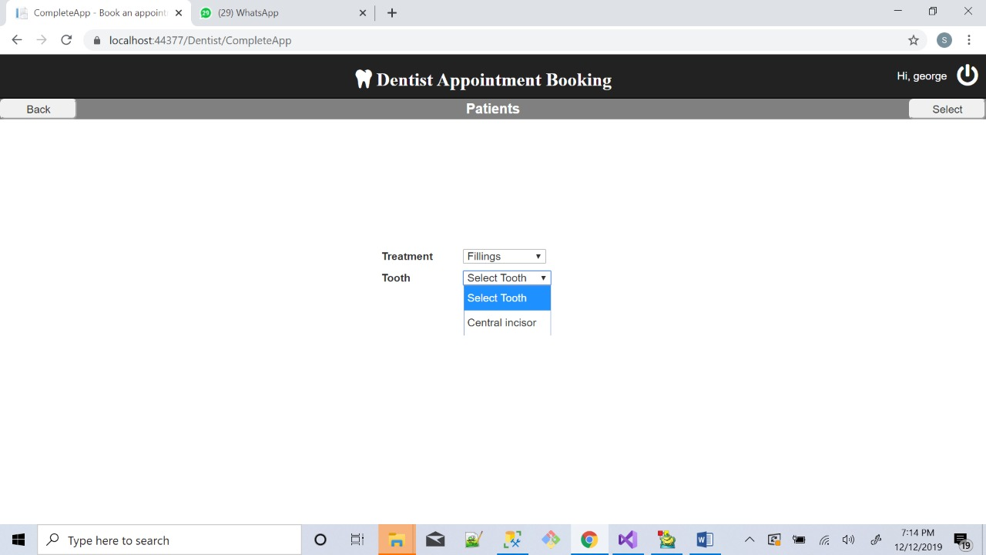
GUI
(TREATMENT)

Slide 20
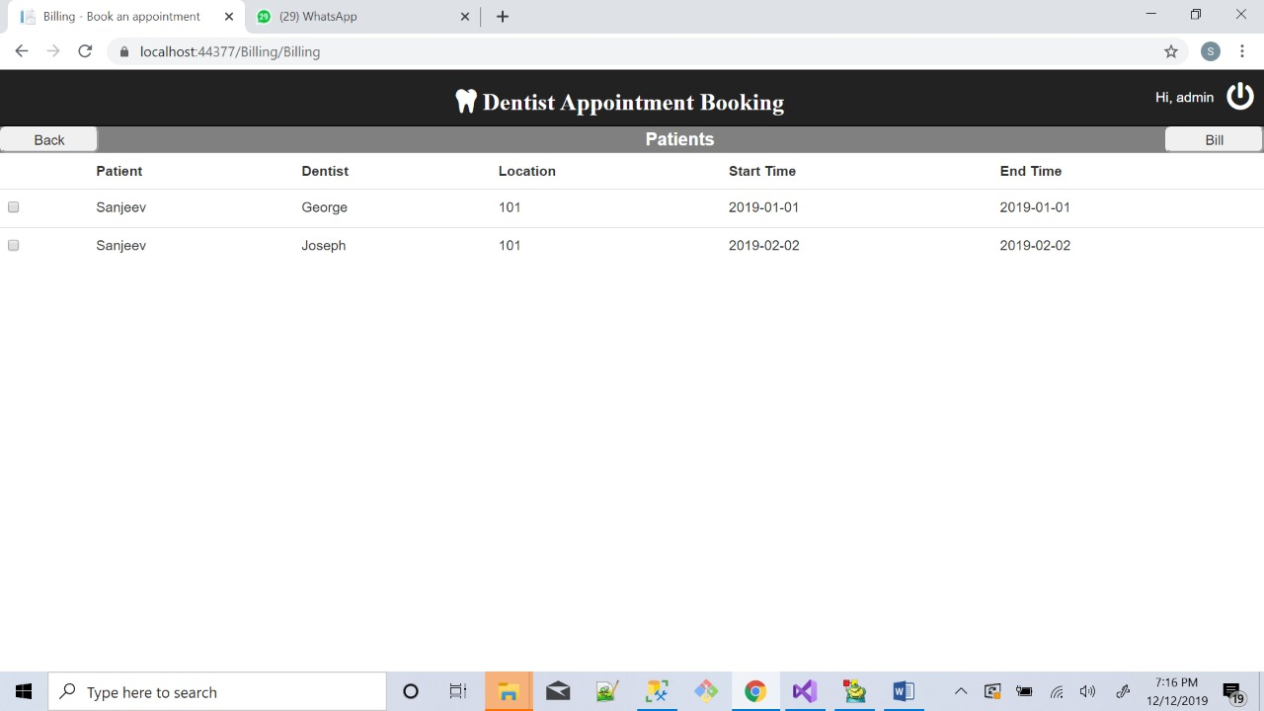
GUI
(Appointment billing)

Slide 21
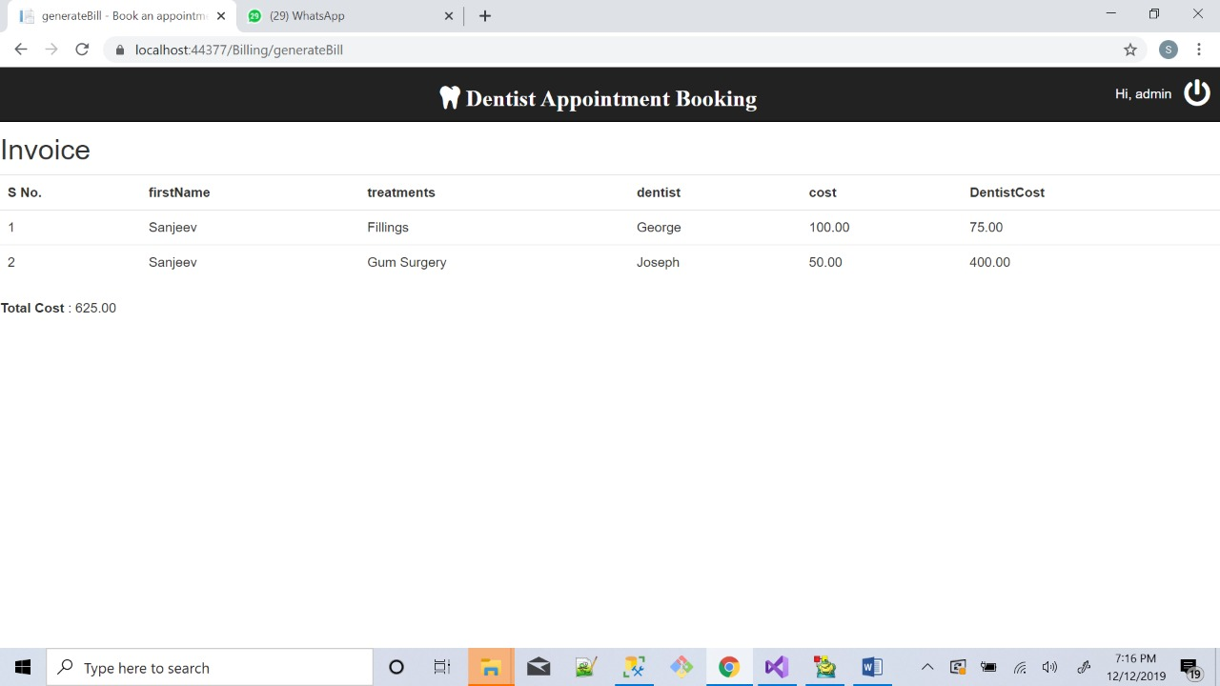
GUI
(Invoice)

Slide 22
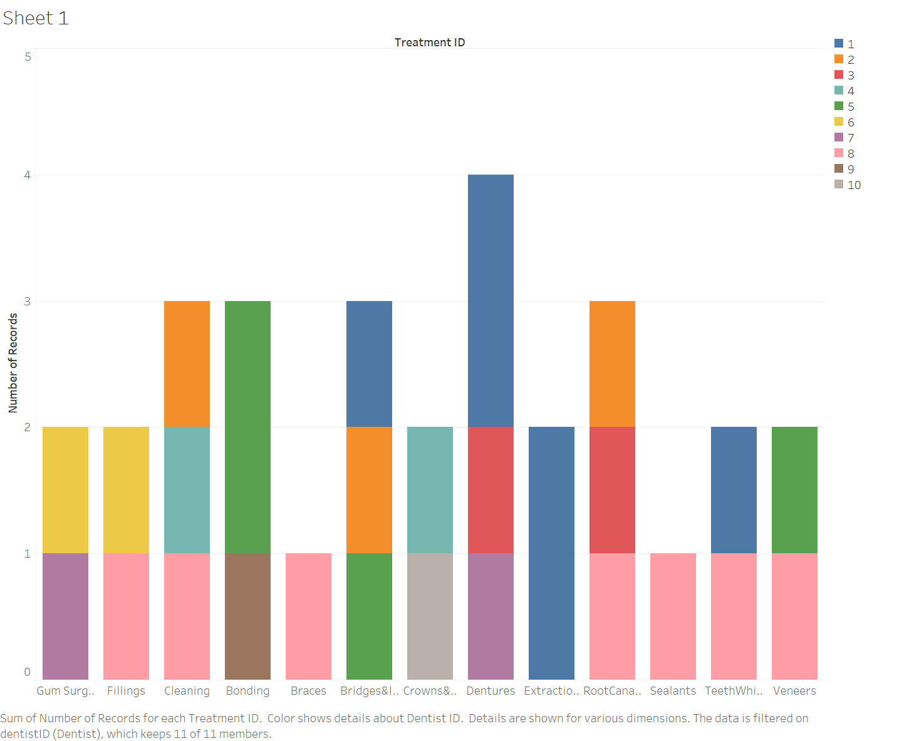
DASHBOARD 1
-Bar Graph for Treatments performed which is further distributed based on Dentists performing the treatments.
- Data can be filtered based on Dentist ID.

Slide 23
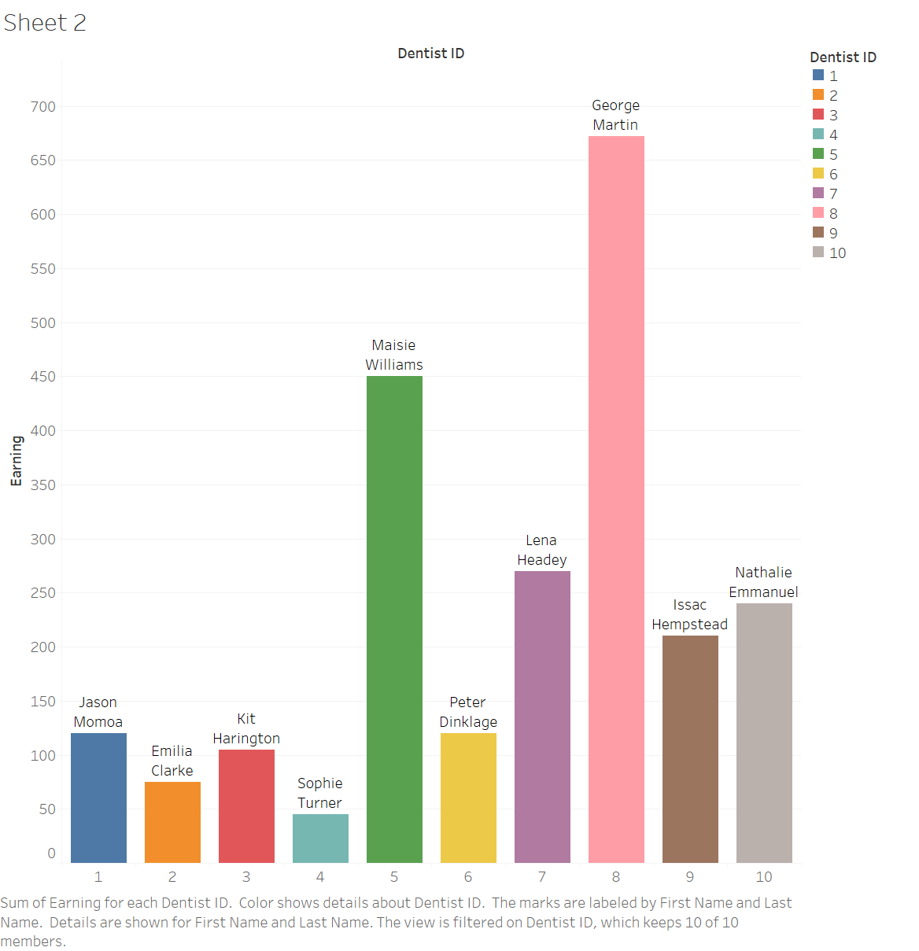
DASHBOARD 2
-Bar Graph for Earnings by Dentists.
Earnings is calculated based on dentist cost and appointment duration of a particular dentist.

Slide 24
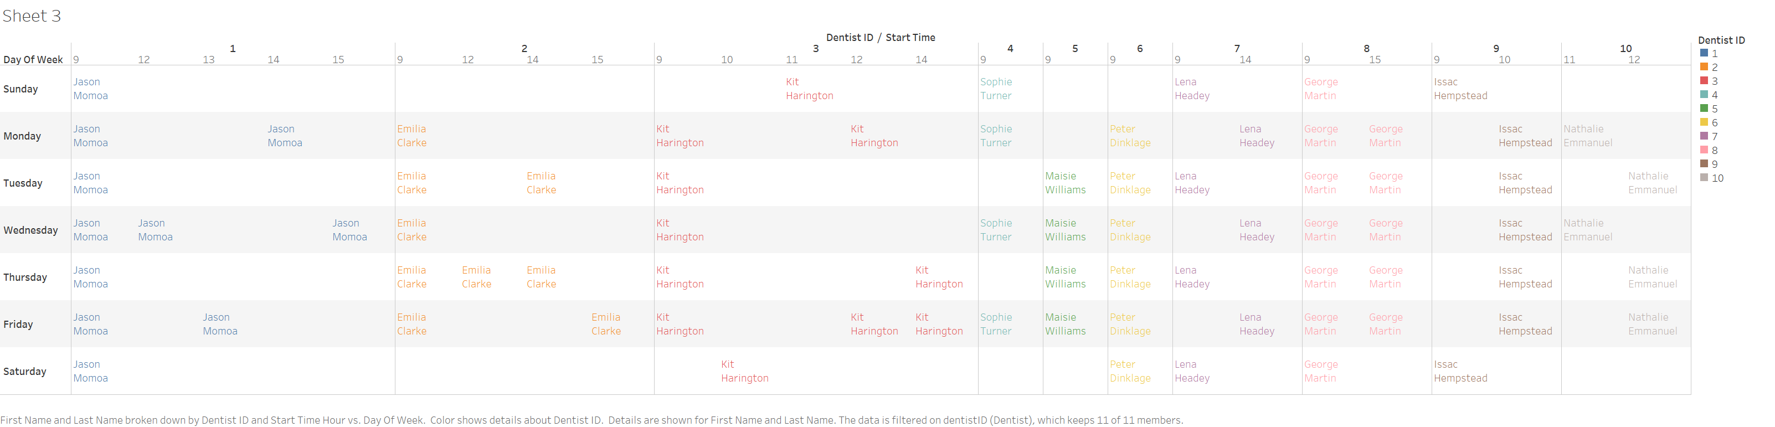
DASHBOARD 3
-Dentist Availability/Schedule table

Slide 25

questions our model can answer?
Working hours of Dentist in a week.
Dentist earnings based on cost per block.
Most performed treatments.
Popular dentist based on treatments/earnings.
Patient Treatment History.
Rescheduling of appointments and charges for rescheduling.
Patient Teeth data and tracking a tooth, if extracted.
Tracking Supplies and Equipment location-wise.
Tracking payments against a bill.
Multiple appointments clubbed against a single invoice.
Bill is the summation of treatment cost and consultancy cost(functional block).
Payment split based on mode of payment.
Securing login credentials.
Storing session information.
Tracking scripts that is run in the database.

Slide 26
THANK YOU

