Slide 1
ORGANIZING CSS
Sanjeev Prajapati

Slide 2
CHANGE IS OBVIOUS

Slide 3

CSS is Simple

Slide 4


Slide 5


Slide 6


Slide 7
Guideline for organizing css
Set up Bases
Make it modular
Follow OOCSS, SMACSS, BEM
Use css pre-processor Less, sass, stylus
Automate design task
Document the Style Guide

Slide 8
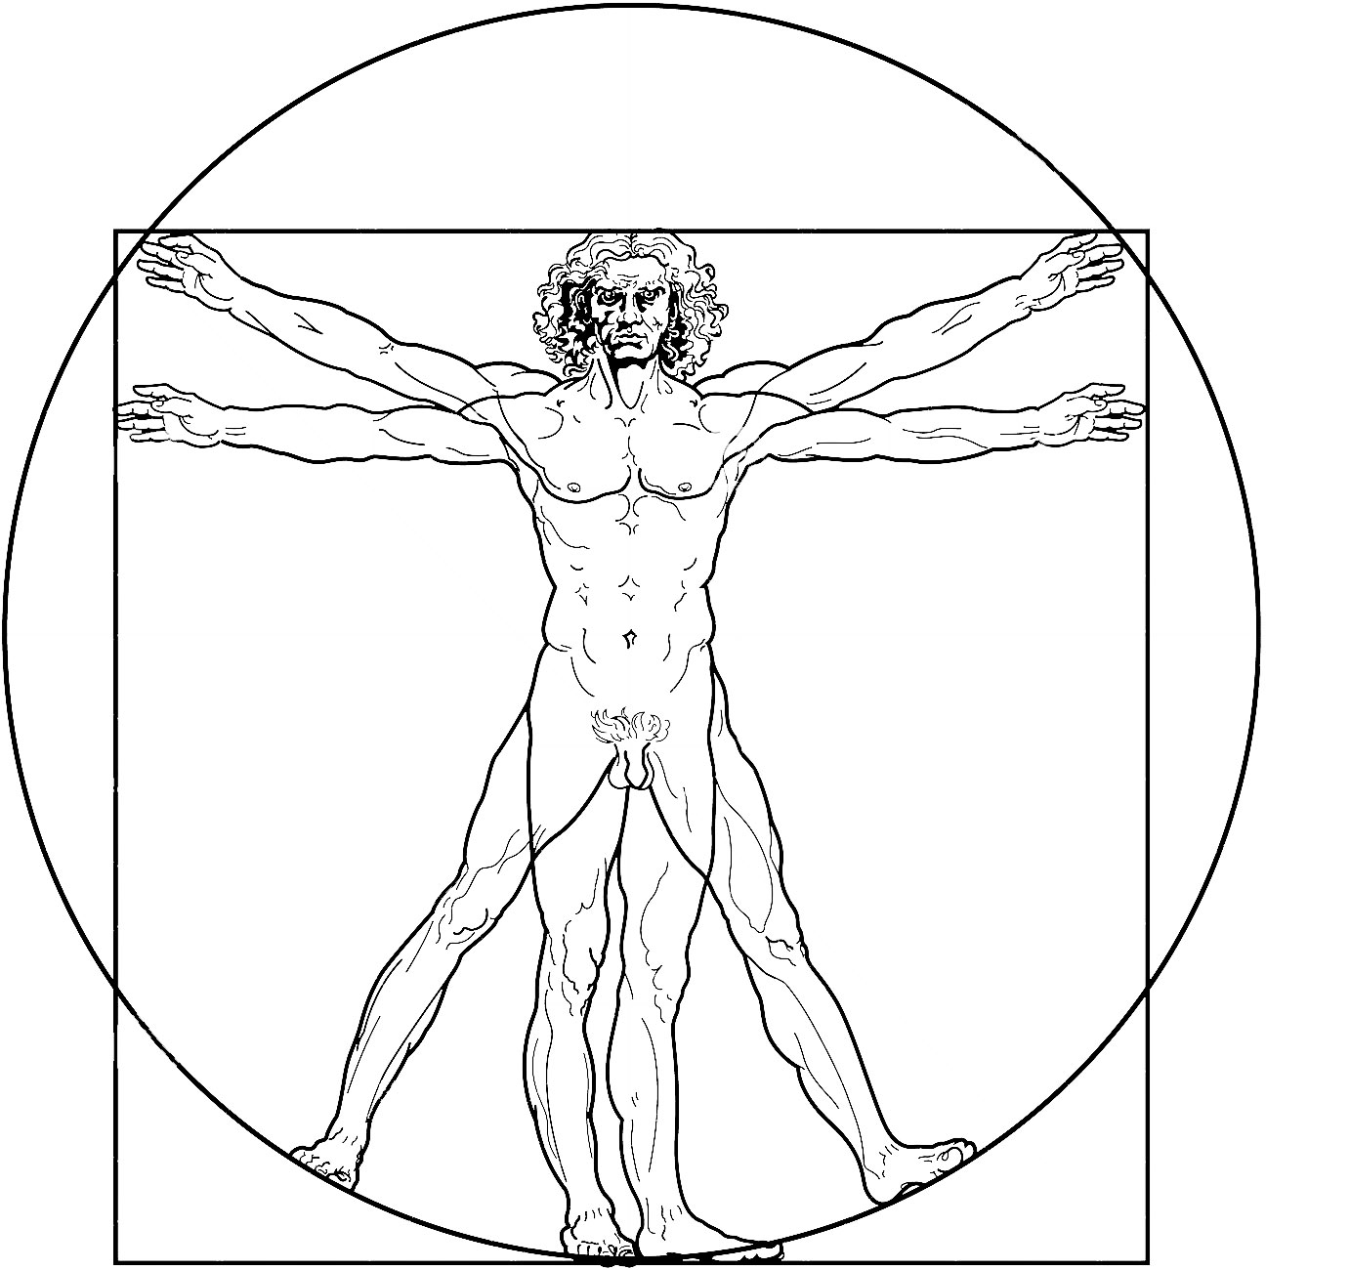
Set up base
Height=width

Slide 9
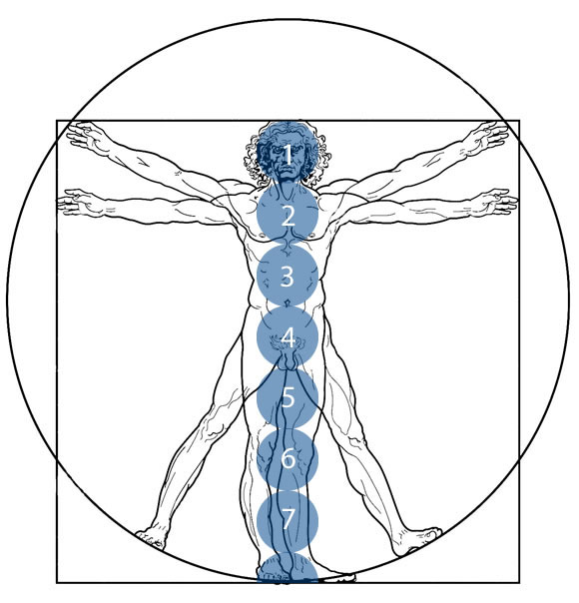
Set up base
@head-height: 7inch;
.body{
width: @head-height*2;
height: @head-height*7.5;
}

Slide 10
Set up base
@base-color: perfect_blue;
@base-font-size: 14px;
@base-font-family: Helvetica, Sans-serif;
.heading{
color: darken(@base-color, 20%);
font-size: @base-font-size + 4px;
font-family: @base-font-family;
}

Slide 11
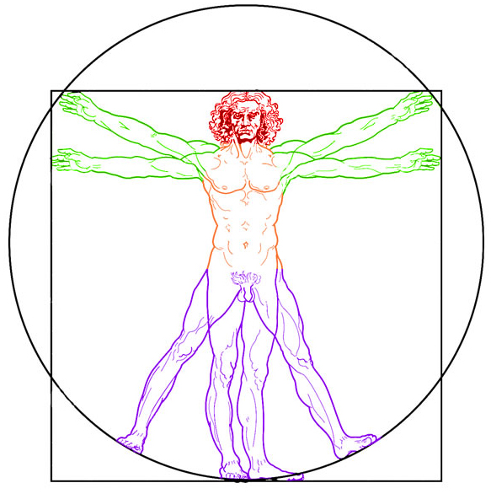
Make css modular
//in csss file human_style.css separate partial files are imported
@import ‘_base.css’;
@import ‘ _head.css’;
@import ‘_hand.css';
@import ‘_torso.css’;
@import ‘_leg.css’;
@import ‘_fit_the_human_in_Mobile.css’
i.e @import ‘_media.css'

Slide 12



Follow principles

Slide 13



Use css Preprocessor

Slide 14




Automate you repeating task

Slide 15
Document your Style Guide
A living style Guide that helps better understand your code,
Style Guide also help to co-ordinate with other developer

Slide 16
sanjeevpraja@gmail.com
sanjeevpraja@github.io

