Slide 1
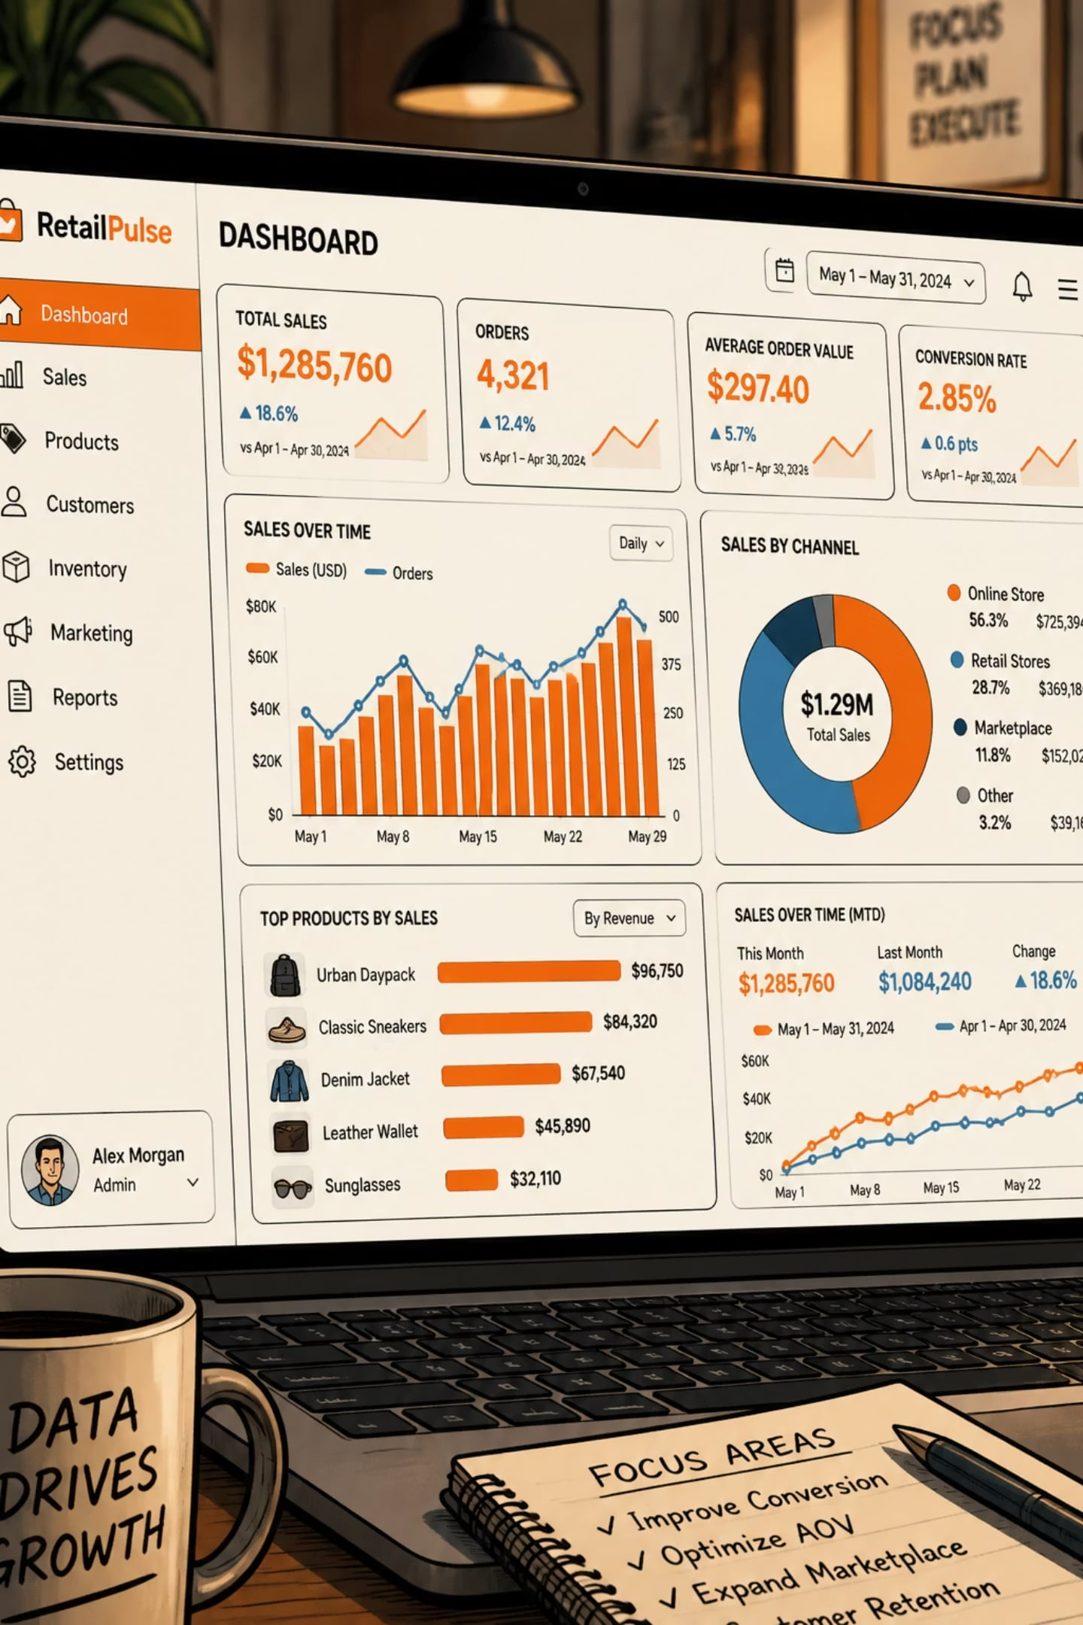
Customer Shopping Behavior Analysis
3,900 purchases • 18 columns • goal: uncover spending patterns, segments, preferences, subscriptions

Slide 2
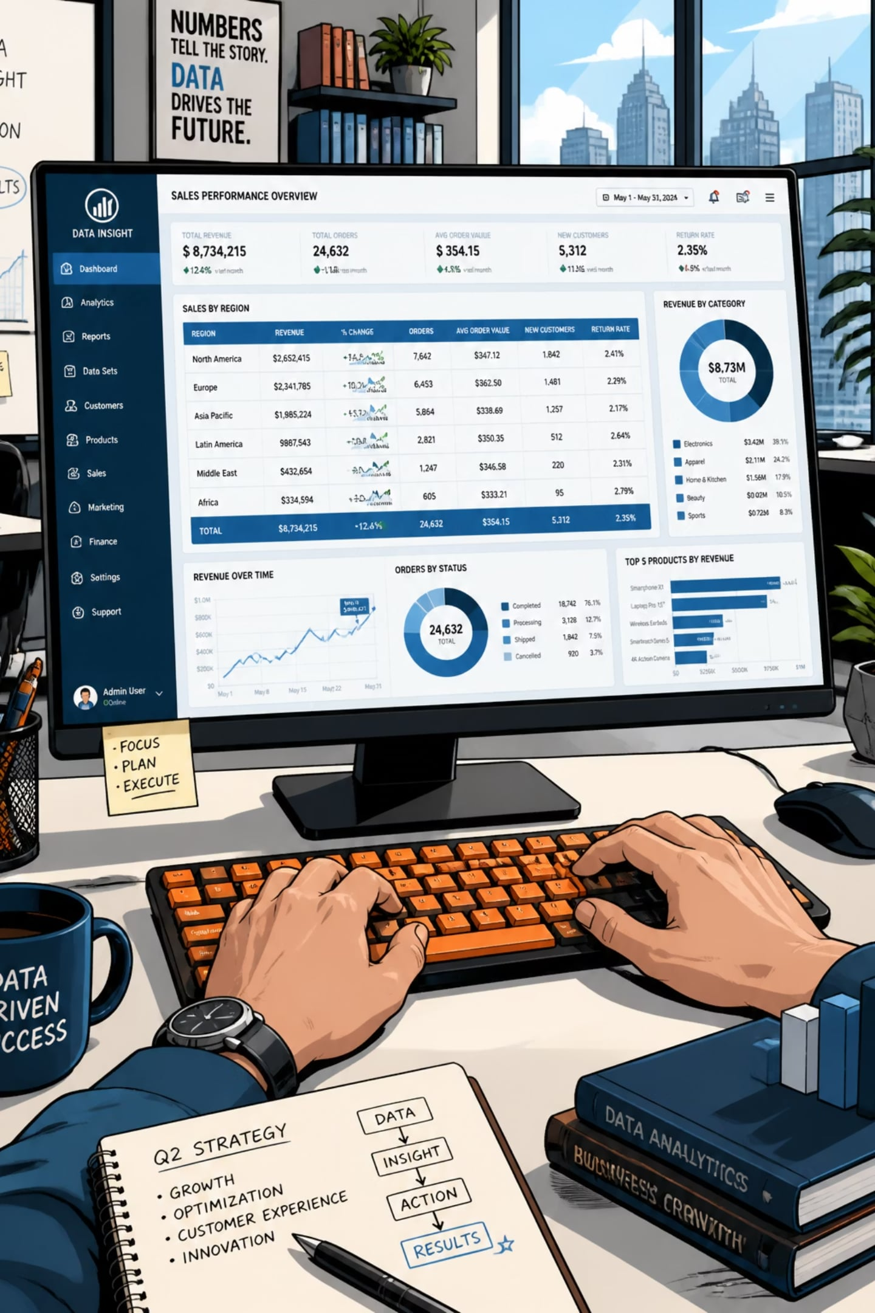
Dataset Snapshot
Volume
Features
Missing
Rows: 3,900
18 columns — demographics, purchase details, behavior
Review Rating missing: 37 values

Slide 3

Data Preparation (Python)
01
Load & Explore
pandas, df.info(), describe()
02
Impute Ratings
Median per product category
03
Standardize
rename → snake_case
04
Feature Eng.
age_group, purchase_frequency_days
05
Drop Redundancy
promo_code_used removed (redundant with discount_applied)

Slide 4

Database Integration
Cleaned DataFrame loaded to PostgreSQL for SQL analysis and business queries.
Why SQL?
Outcome
Structured queries, aggregations, segmentation
Answer business questions at scale

Slide 5
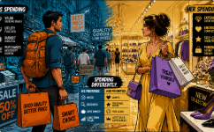

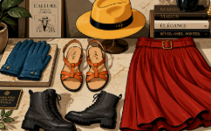
Key SQL Findings — Revenue & Spending
Revenue by Gender
High-Spend Discount Users
Top Rated Items
Gloves 3.86 • Sandals 3.84 • Boots 3.82 • Hat 3.80 • Skirt 3.78
Female: 75,191 • Male: 157,890
839 rows — customers used discounts but spent above average

Slide 6
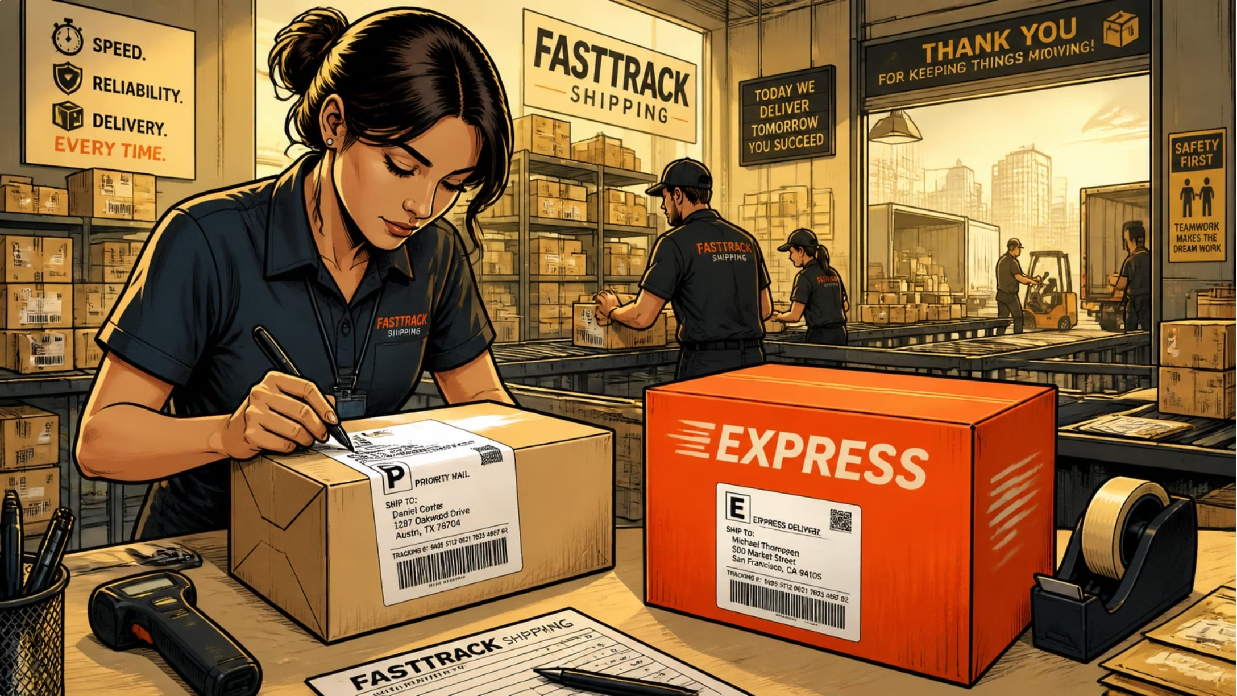
Shipping, Subscriptions & Repeat Behavior
Shipping avg spend — Standard: 58.46 • Express: 60.48
Subscribers: 1,053 customers — avg spend 59.49 — total revenue 62,645
Non-subscribers: 2,847 — avg spend 59.87 — total revenue 170,436
Repeat buyers (>5 purchases): more likely to subscribe (data shown)

Slide 7

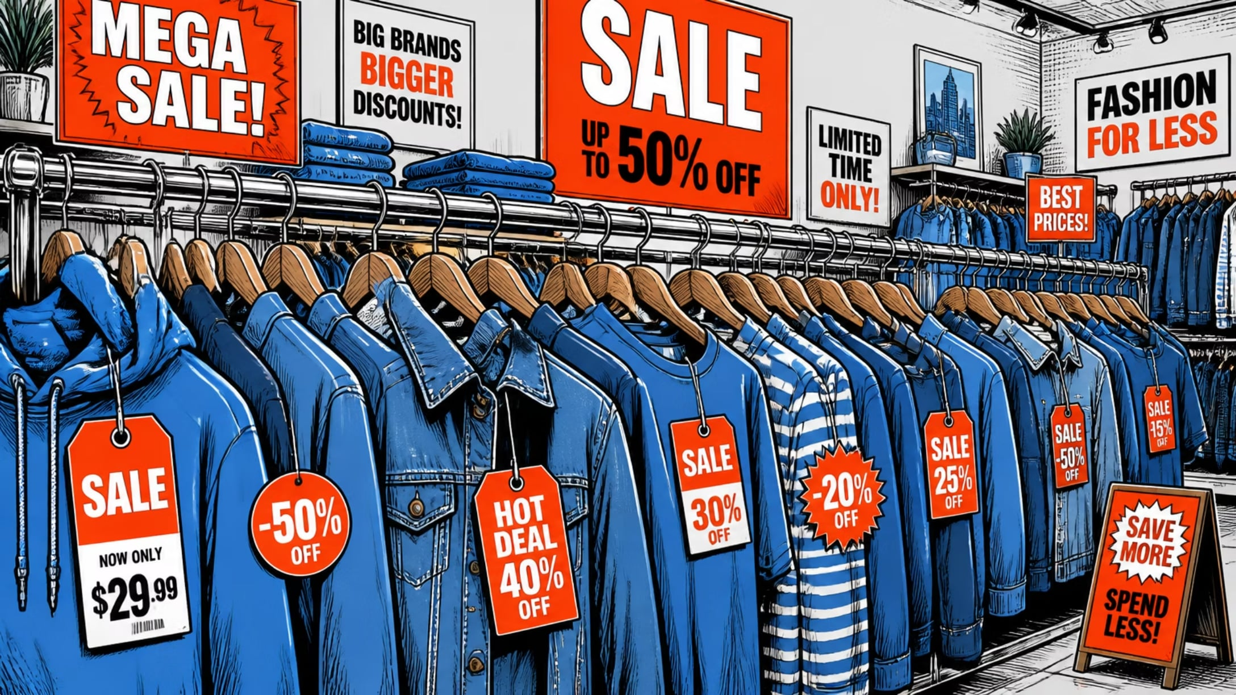

Product & Discount Insights
Discount-Dependent
Top items with high discount rates: Hat 50% • Sneakers 49.66% • Coat 49.07% • Sweater 48.17% • Pants 47.37%
Top Products by Category
Accessories: Jewelry, Sunglasses, Belt — Clothing: Blouse, Pants, Shirt — Footwear: Sandals, Shoes, Sneakers — Outerwear: Jacket, Coat

Slide 8
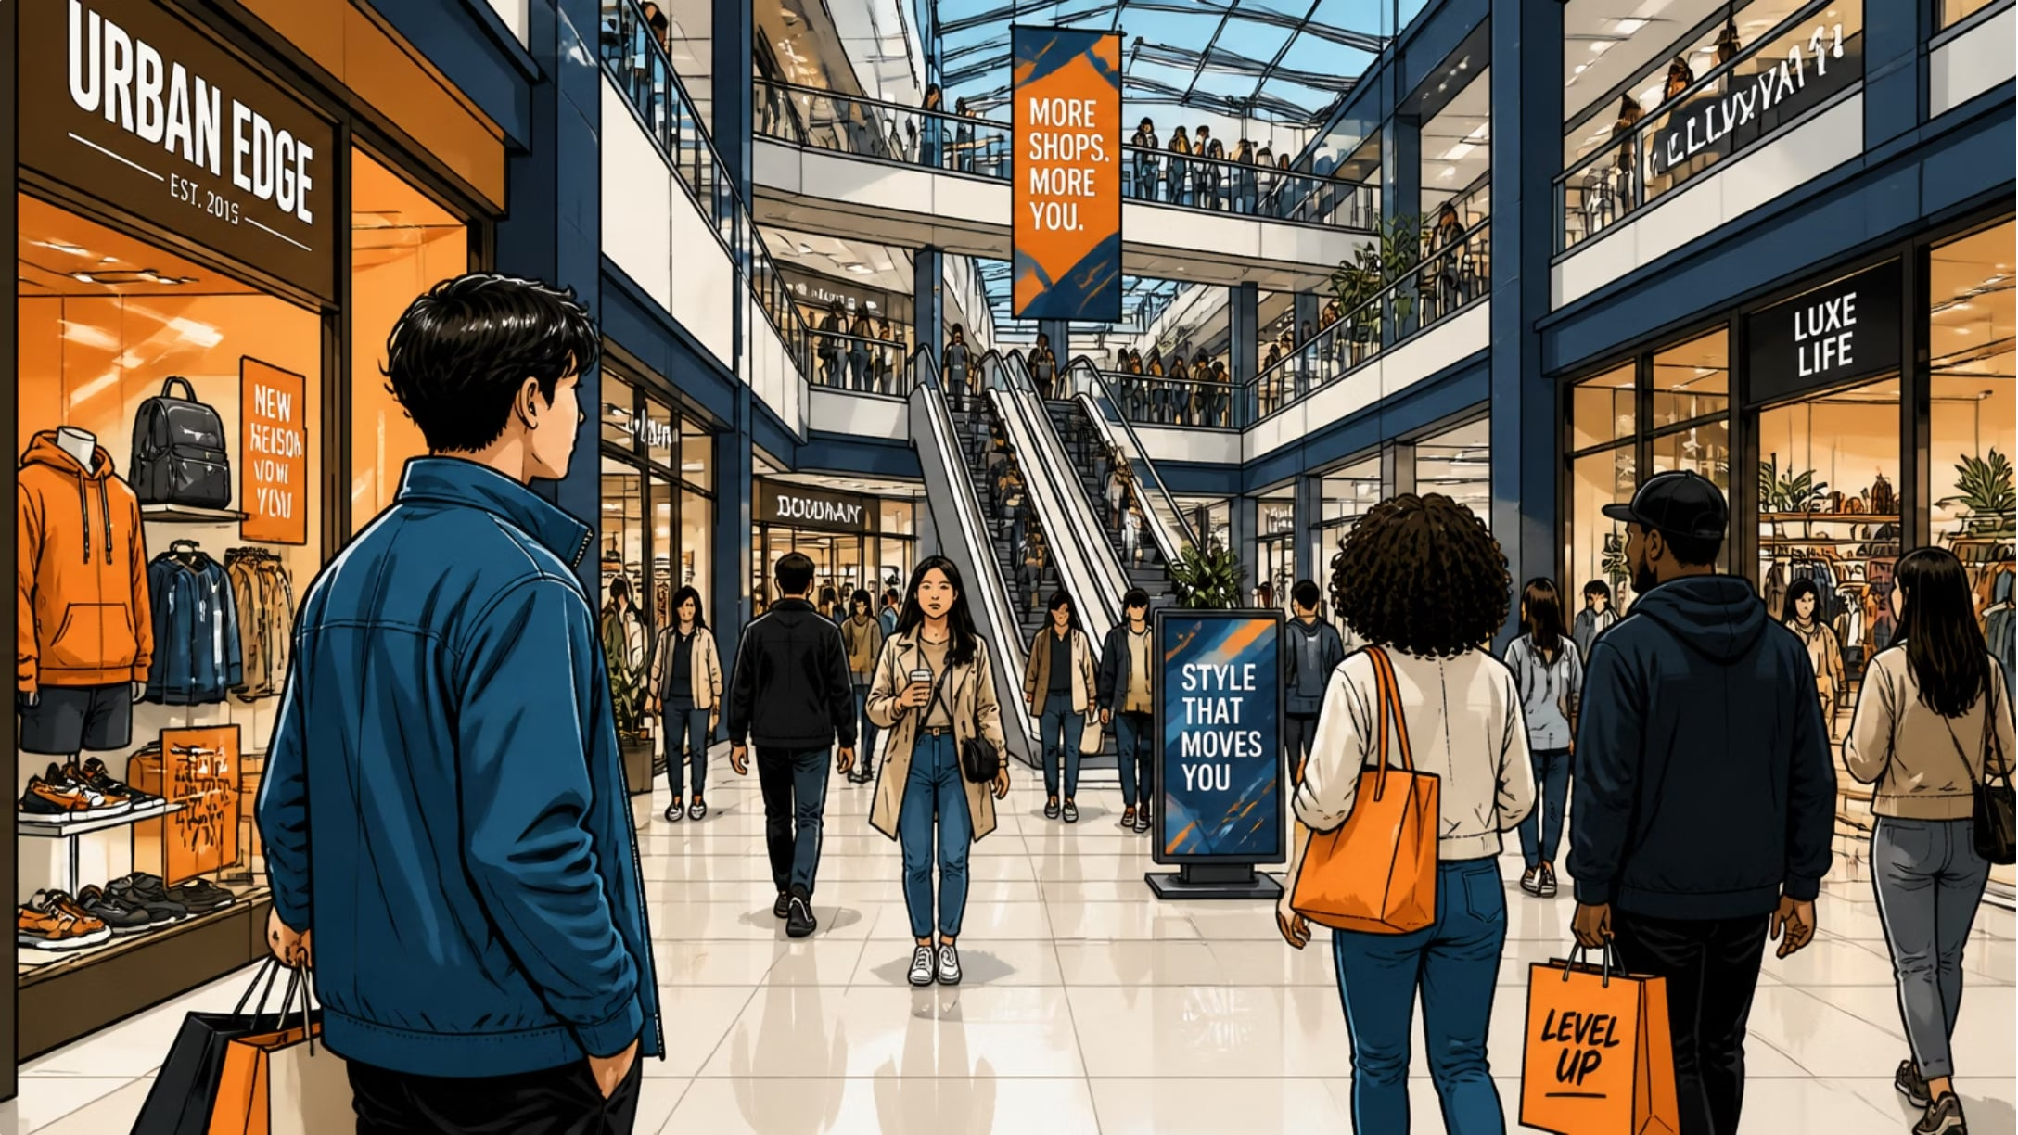
Customer Segments & Age Revenue
Segments
Loyal: 3,116 • Returning: 701 • New: 83
Revenue by Age Group
Young Adult 62,143 • Middle-aged 59,197 • Adult 55,978 • Senior 55,763

Slide 9
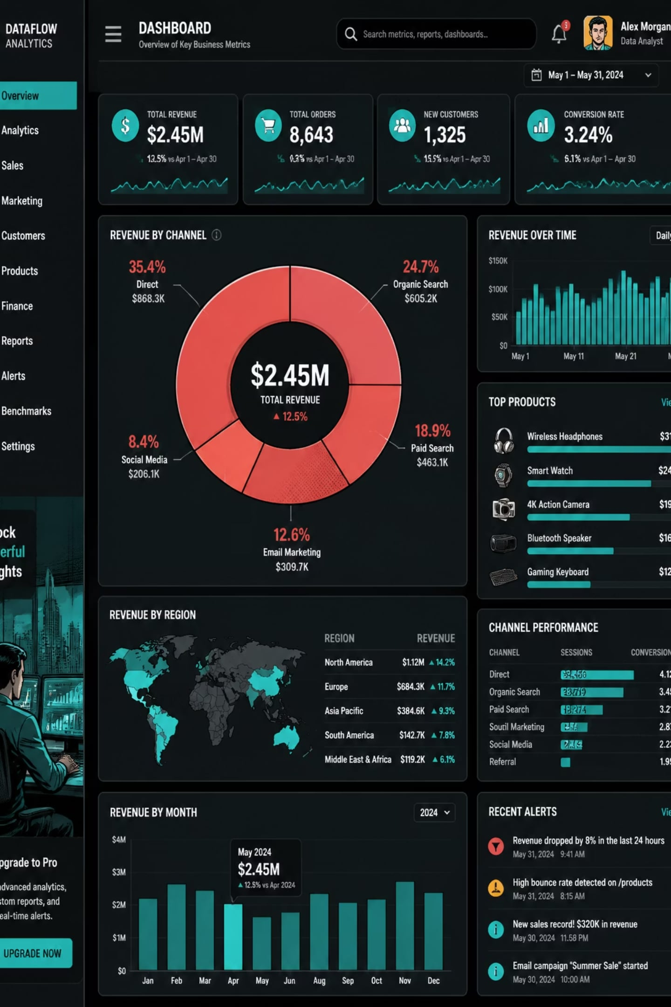
Power BI Dashboard Highlights
3.9K customers • Avg purchase $59.76 • Avg rating 3.75 • Subscriptions: Yes 27% / No 73%
Top revenue: Clothing (~90K) • Sales: Clothing (~1,800)

Slide 10


Business Recommendations
Boost Subscriptions
Loyalty Programs
Review Discount Policy
Product Positioning
Promote exclusive subscriber benefits
Reward repeat buyers to grow "Loyal" segment
Balance sales lift with margin control
Highlight top-rated & best-selling items in campaigns
Targeted Marketing
Focus on high-revenue age groups and express-shipping users

