Slide 1

A presentation on our project Hostel Management System

Slide 2

Objectives of Our Project
The objective is to make an automated system to carry out the various operation of a Hostel.

Slide 3

Project Category:

Slide 4


Tools and Platforms to be used

Slide 5

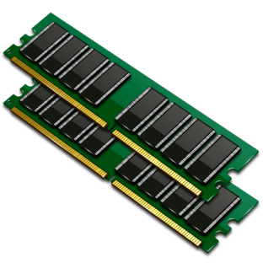


Platform Requirement:
Windows 7 and up.
1GB of RAM.
50MB of hard disc space.
Monitor: resolution at least 1024x768.

Slide 6

Problem analysis
The old system of keeping records in hostel was paper file system.

Slide 7

Advantage of our current program.
Less human error.
Manual labor can be reduced.
High security.
Easy to handle.
Easy data updating.
Easy record keeping.

Slide 8




Identification of need
Main Menu
Hostel Module
Room Module
Student’s Registration Module

Slide 9




Identification of need
Student’s Registration Charges Module
Services Module
Fee Payment Module
Inventory Module

Slide 10



Project organization (the team)
System Designer.
Programmer.
Documentation.

Slide 11

Feasibility study
What is feasibility study?

Slide 12

Technical feasibility

Slide 13



Economical feasibility

Slide 14

Operational feasibility

Slide 15
Software Development Life Cycle
This project follows the Waterfall model
Requirement Gathering and analysis
System Design
Implementation
Integration and Testing
Maintenance
Requirement Gathering and analysis
System Design
Implementation
Integration and Testing

Slide 16

System design

Slide 17
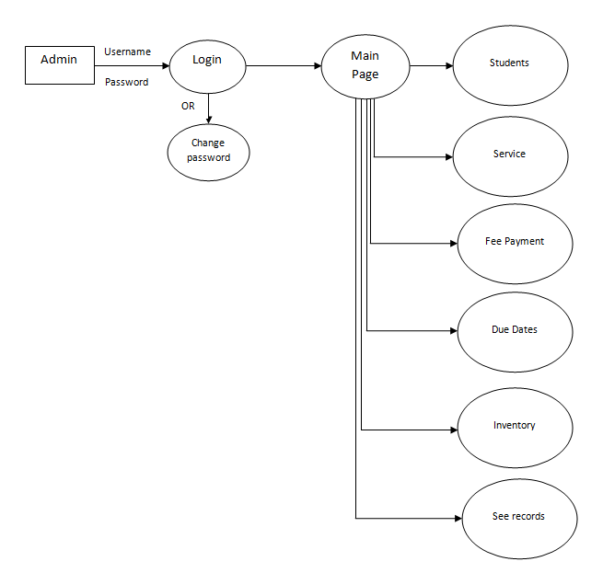
DFD 0

Slide 18
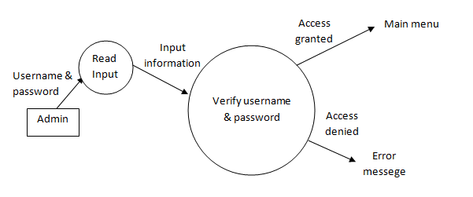
DFD (Login)

Slide 19
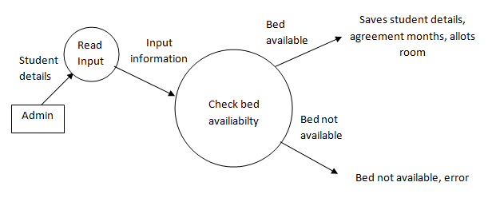
DFD (Students)

Slide 20
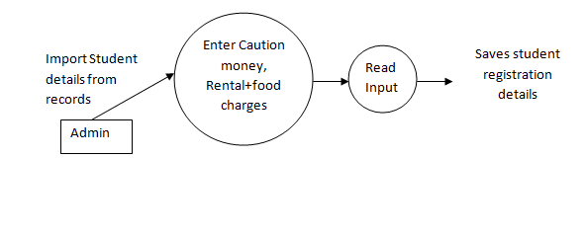
DFD (Registration Charges)

Slide 21
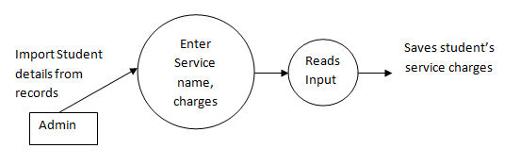
DFD (Services)

Slide 22
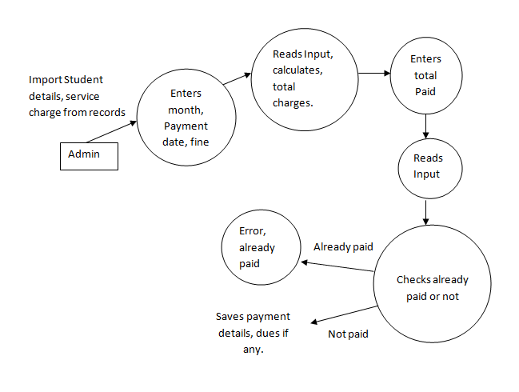
DFD (Fee Payment)

Slide 23
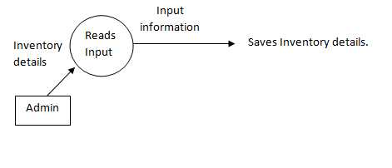
DFD (Inventory)

Slide 24

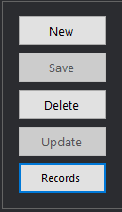

Special feature of module design
Dark theme that’s easy on eyes.
Easy to understand procedure.
Common UI elements in each module.

Slide 25
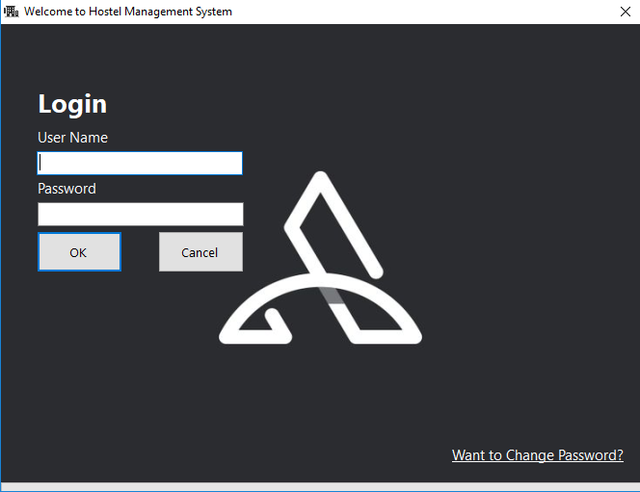
Login Page

Slide 26
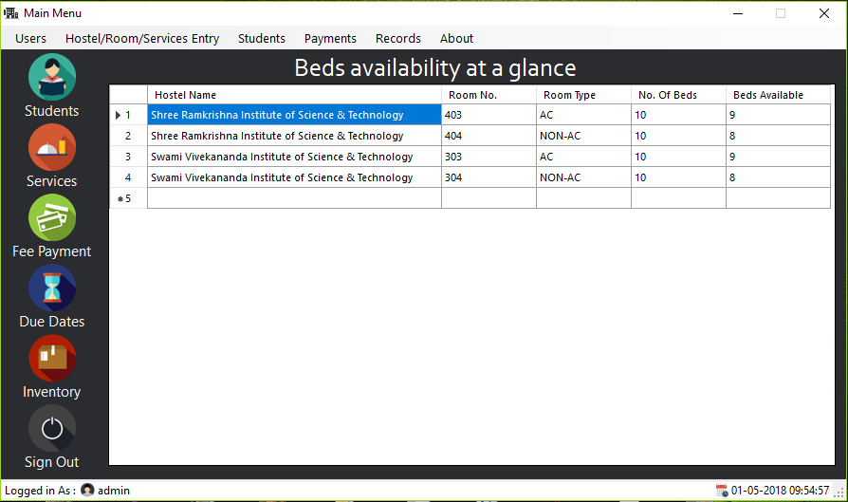
Main page

Slide 27
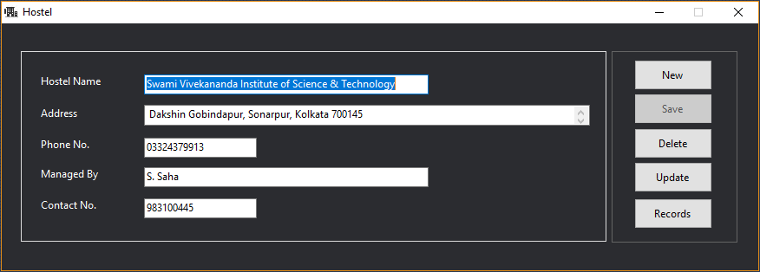
Hostel module

Slide 28
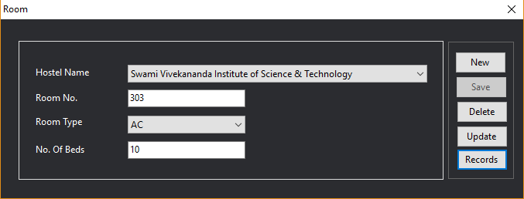
Room module

Slide 29
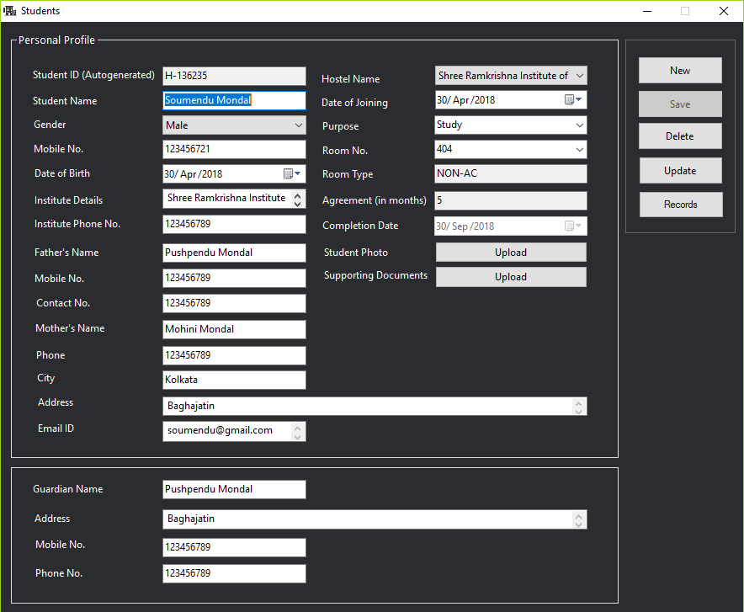
Students page

Slide 30
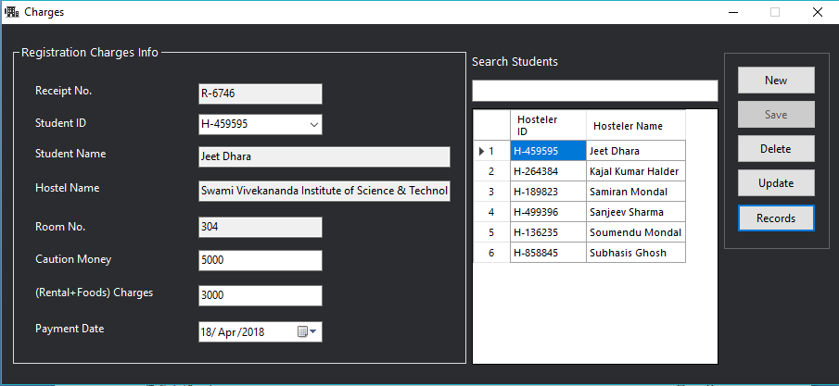
Student registration charges

Slide 31
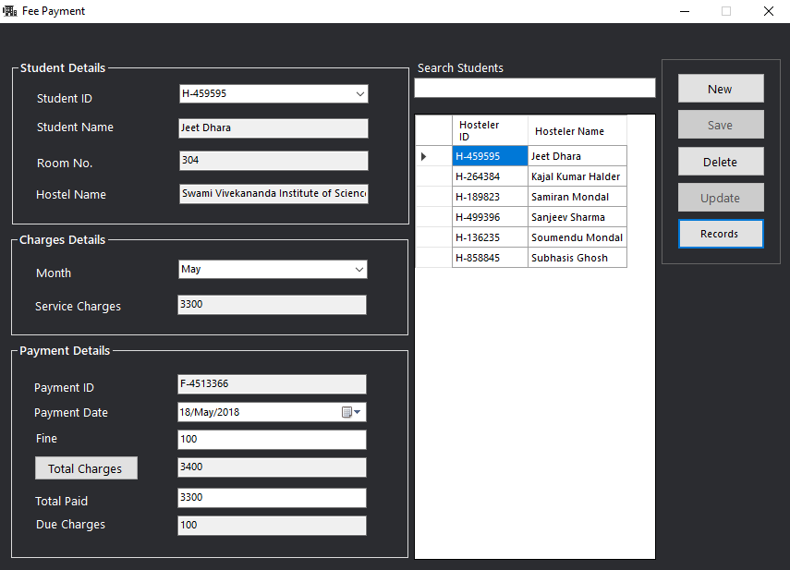
Fee payment

Slide 32
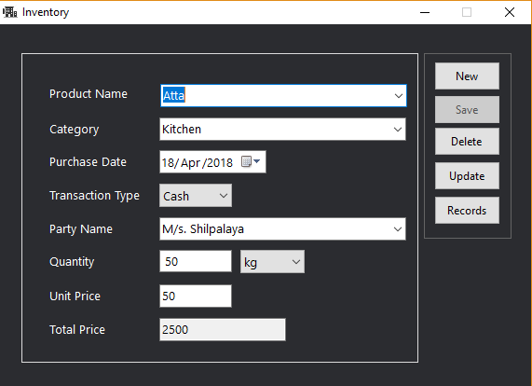
Inventory

Slide 33
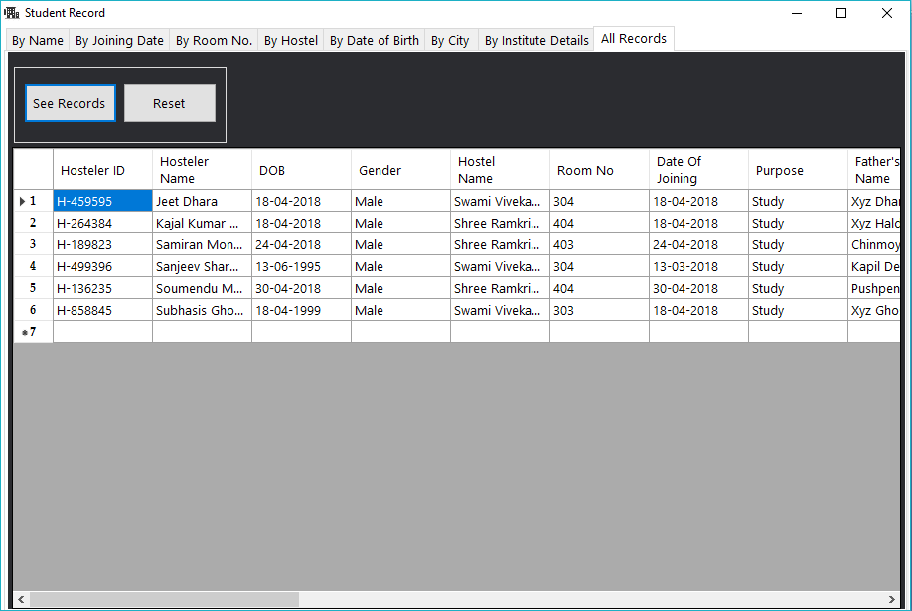
Records

Slide 34

Conclusion
Hostel Management System is a desktop based system which automates all the activities in the hostel which is currently manual.
It enhances the overall performance of the system, removes the necessity of maintaining all the registers.
Removes all kinds of manual errors.
Work overhead of employees is reduced.

Slide 35


