Slide 1
Causal effect of early planting date recommendation on soybean yield
Santosh Sanjel
Postdoctoral scholar
Penn State (Esker lab)

Slide 2
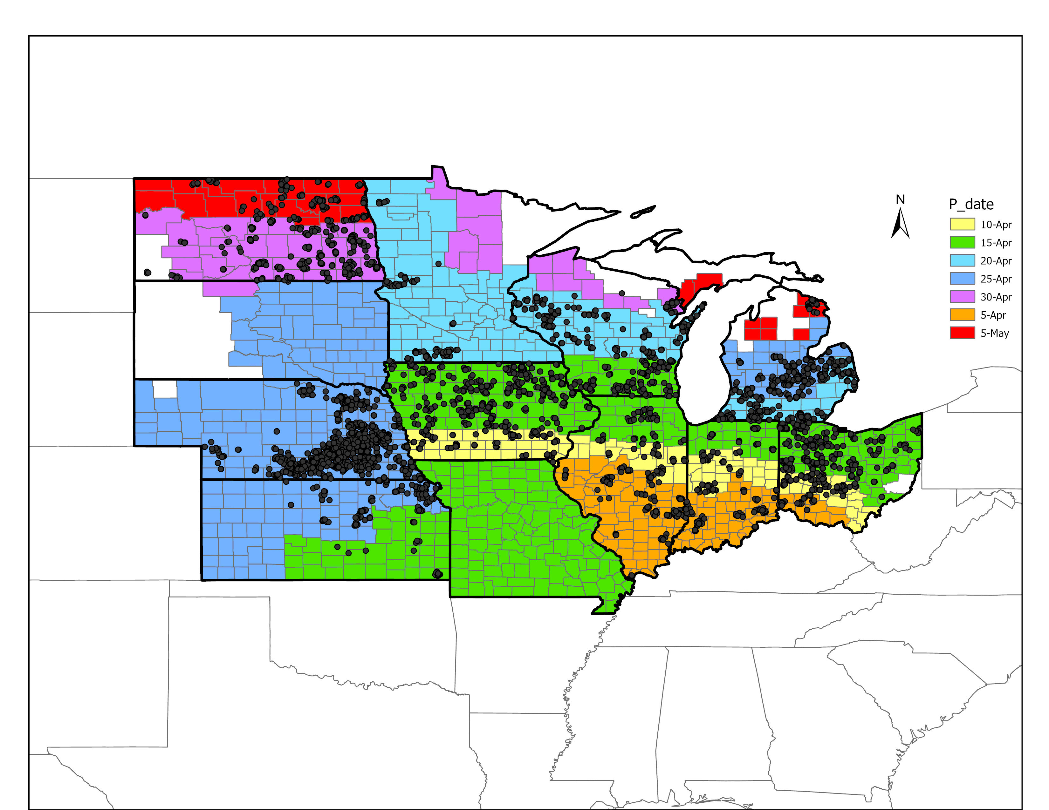
Causal model framework
Data: Soybean farmer survey data from 11 states in North Central US
Planting date recommendation zones map developed by soybean researchers
Intervention: Adhering to recommended planting date
Soybean planting date recommendation zones
T = 1 : Optimal plating
T = 0 : Non-optimal planting
T
Y
Soybean yield
Color based on optimality
Source: Conley et al
2700-003-23_Planting-Date-V1.pdf (soybeanresearchinfo.com)

Slide 3
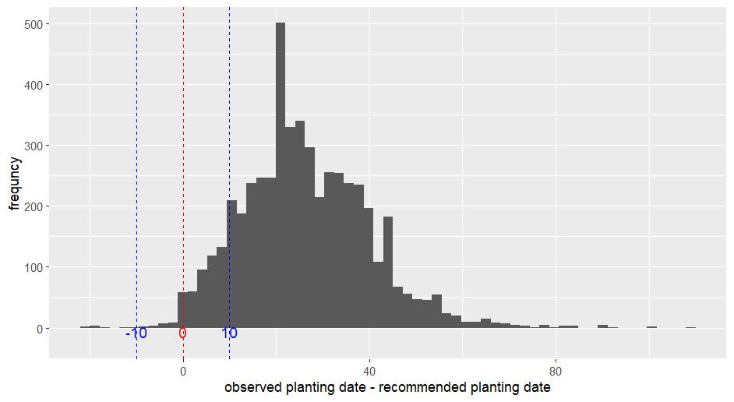
Distribution: Observed planting date - recommended planting date
Treatment assignment:
Optimal planting
T = 1, if
-10 ≤ PD – rPD ≤ 10
Non-optimal planting
T = 0, if
10 ≤ PD – rPD ≤ 108
T = 0
T = 0
T = 1
Summary: PD – rPD
Min. Q1 Median Mean Q3 Max
-22 17 25 26.34 35 108

Slide 4
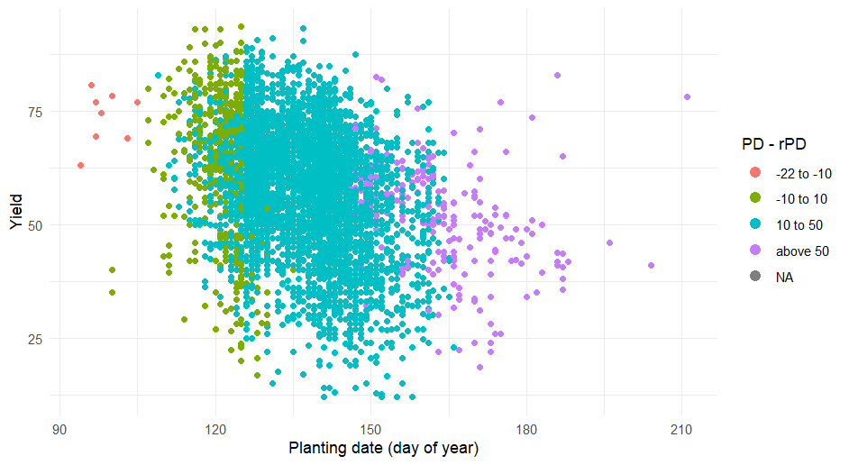
Treatment assignment ~ observed Yield

Slide 5
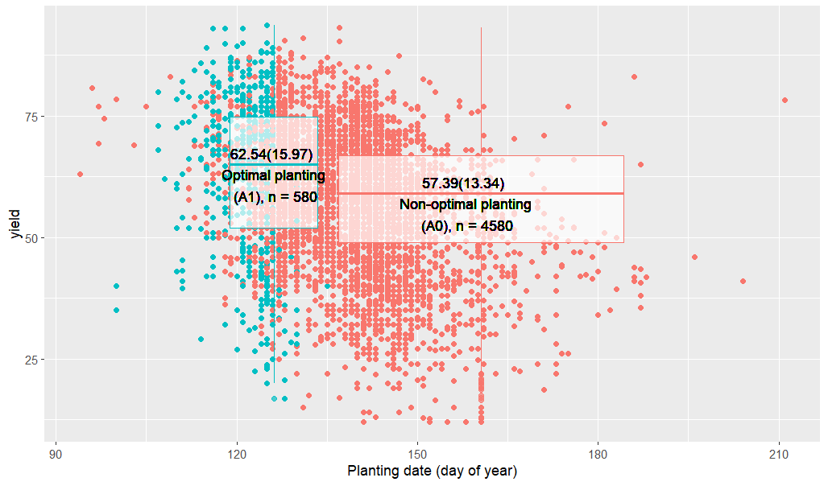
Soybean yield difference stratified by planting decision

Slide 6
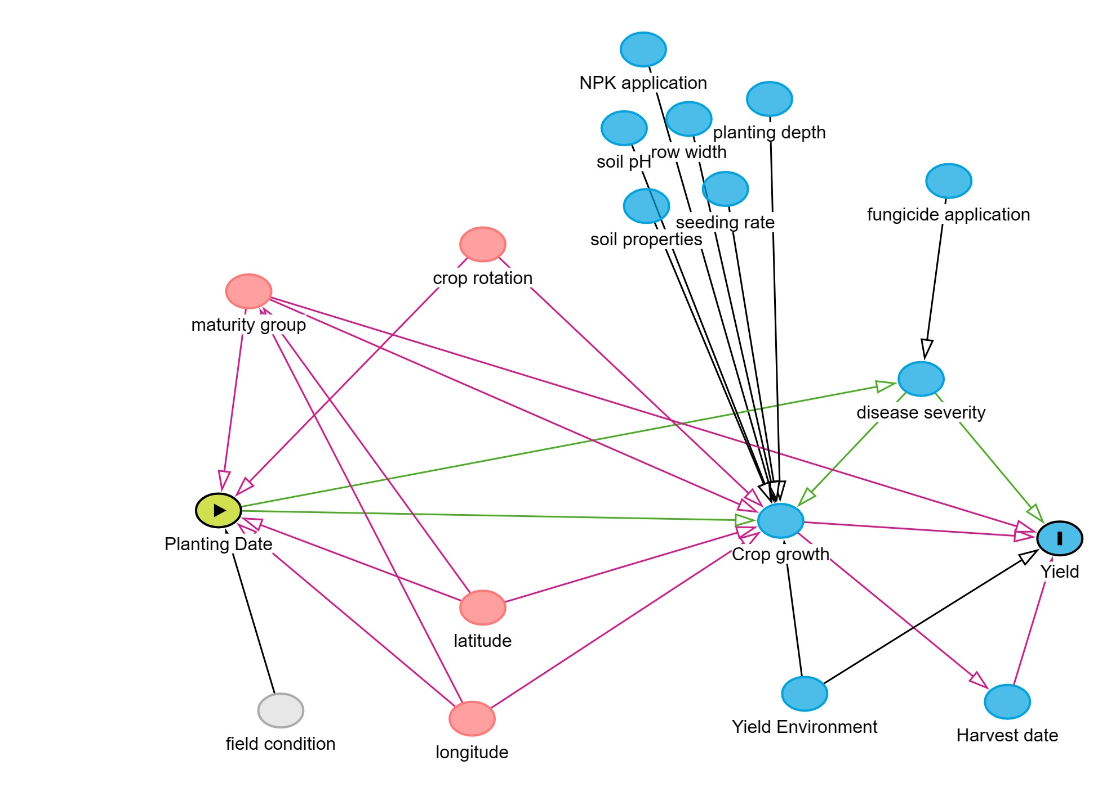
Minimum adjustment set
crop rotation, latitude, longitude, maturity group

Slide 7
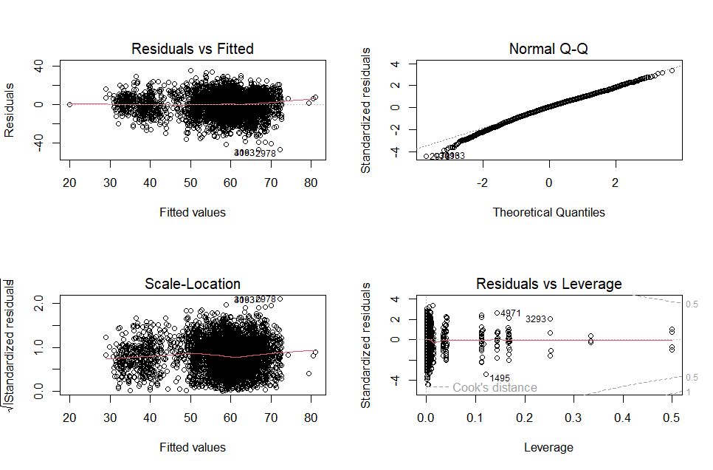
Method 1: Adjusted Naive()linear regression, using minimum adjustment set
Y ~ A + latitude + longitude + maturity.group + previous.crop
Adjusted fit -Summary
Variable | Coefficient | CI.95 | p-value
A | 3.3 | [2.3;4.3] | <0.1

Slide 8
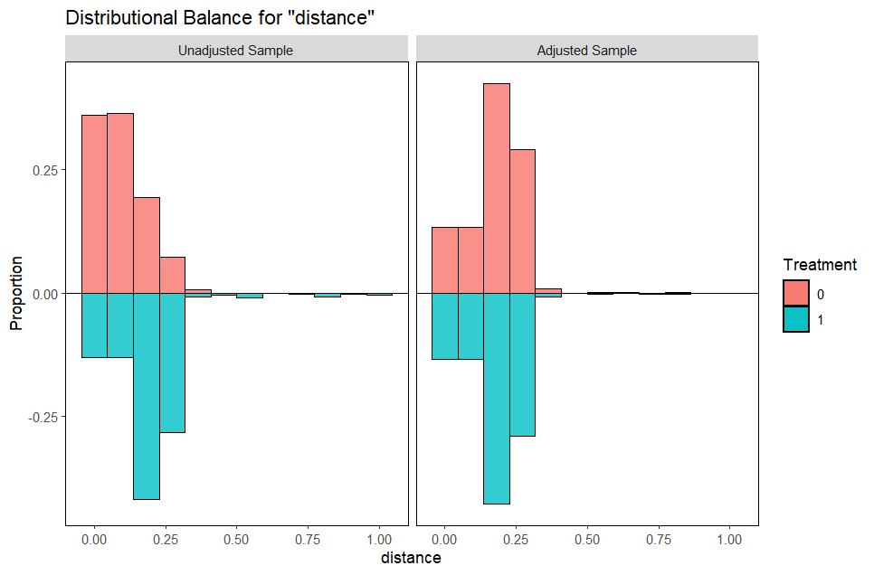
Method 2: Propensity score matching
Sample sizes | sizes
 | Control | Treated
All | 4062 | 489
Matched | 477 | 477
Unmatched | 3585 | 12
Put weight to all data points
Use all data
> (Full.matching)

Slide 9
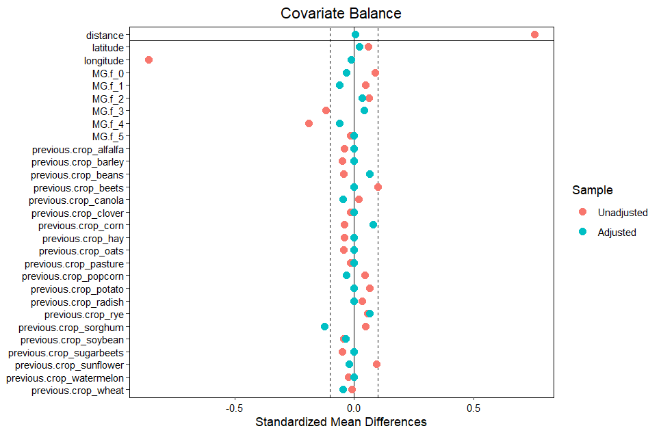
PSM
ATE -PSM Method (Matched)
Var. | Coefficient | CI.95 | p-value
A | 3.33 | [1.32;5.35] | 0.001228
Adjustd PS model (wighted)
Count and
Categorize the prev. crops
Wheat as a separate category

Slide 10
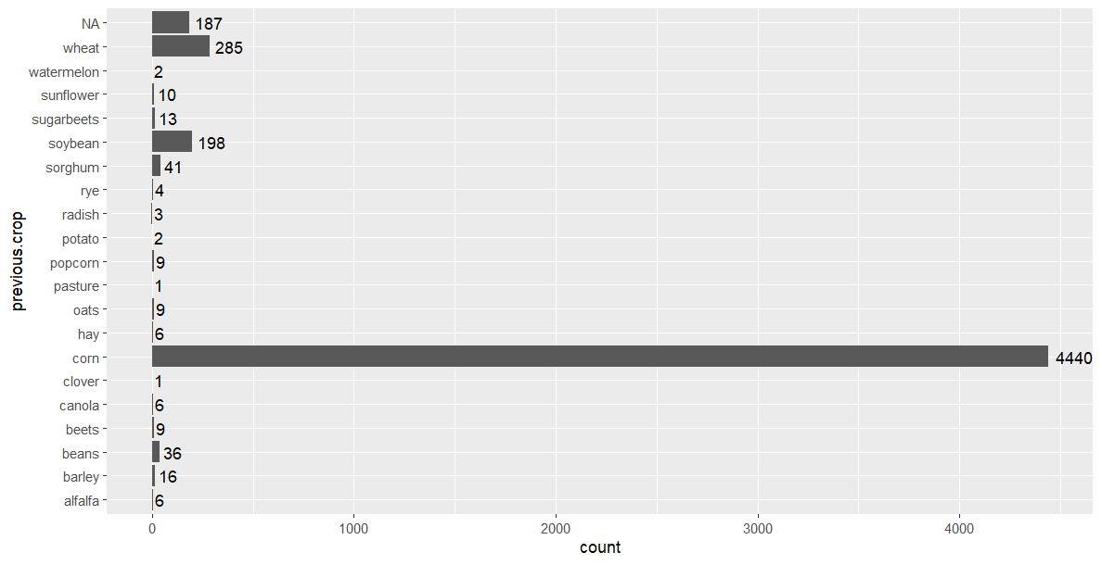

Slide 11
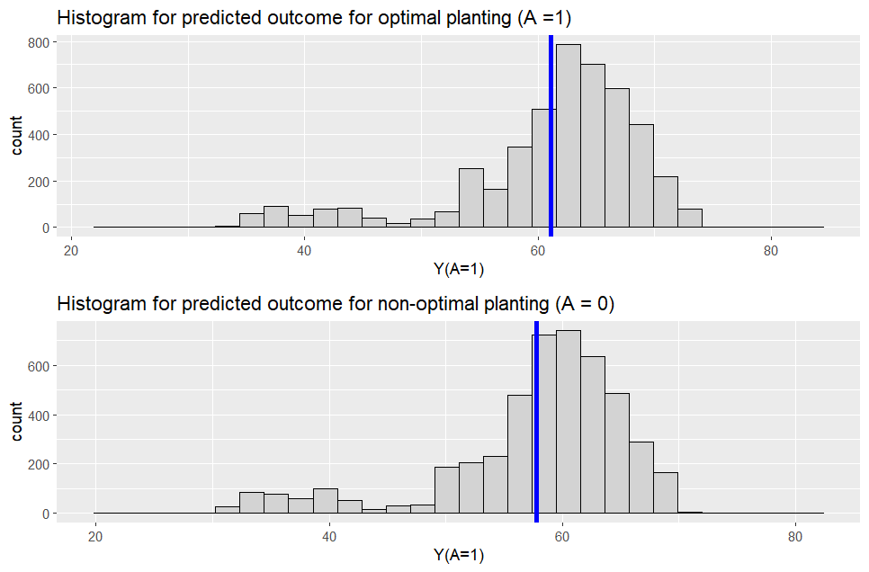
Method 3: G-computation (Linear regression with minimal adj. set)
G-computation summary
Mean(Pred.Y1) | 61.1
Mean(Pred.Y0) | 57.8
Pred.TE | 3.3
No histogram needed for pred TE, just point estimate
Remove NAs

Slide 12
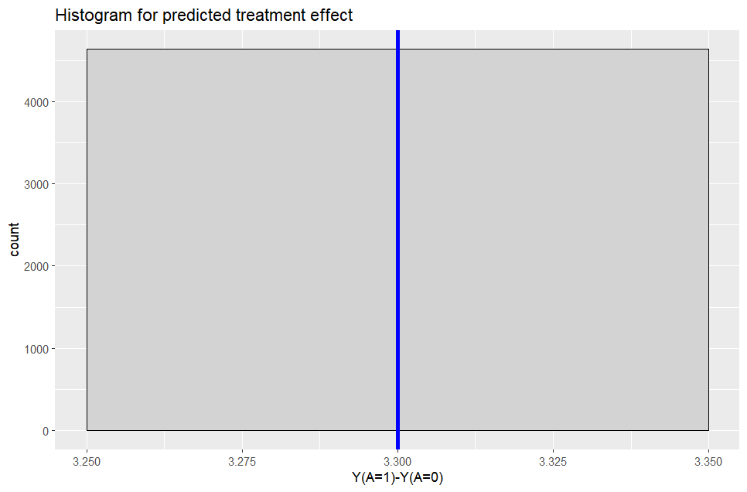
Doubly robust method
If either psm or g- computation mis-specifty, then this method has capacity to reduce that
summary(Pred.TE) # all 3.3 is it normal?
Min. 1st Qu. Median Mean 3rd Qu. Max. NA's
3.3 3.3 3.3 3.3 3.3 3.3 650

Slide 13
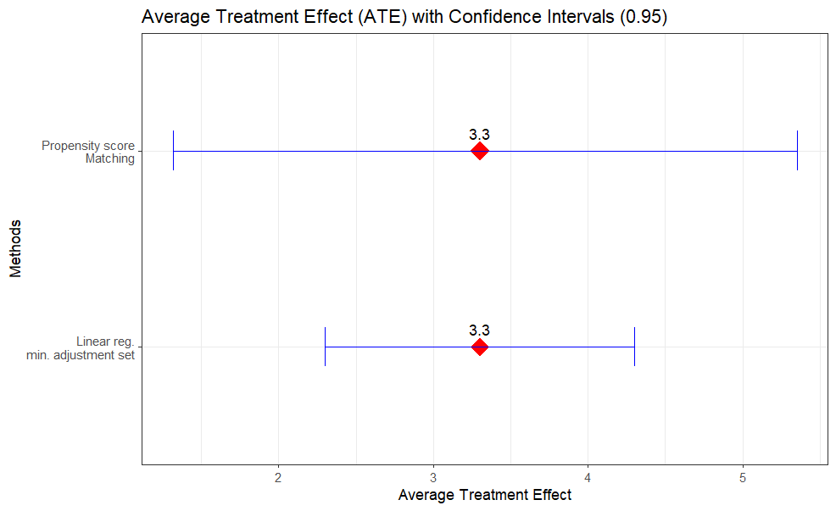

Slide 16
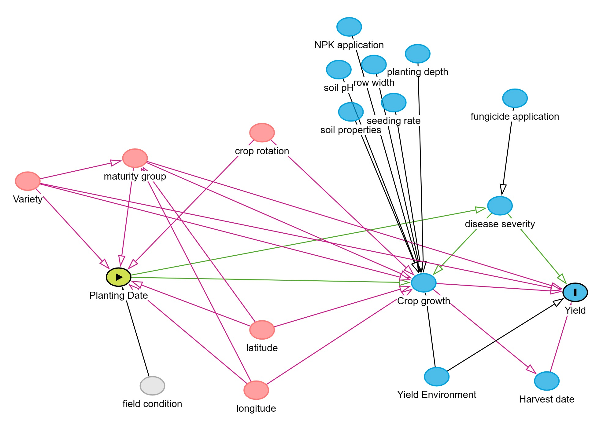
Minimum adjustment set
crop rotation, latitude, longitude, maturity group

Slide 17
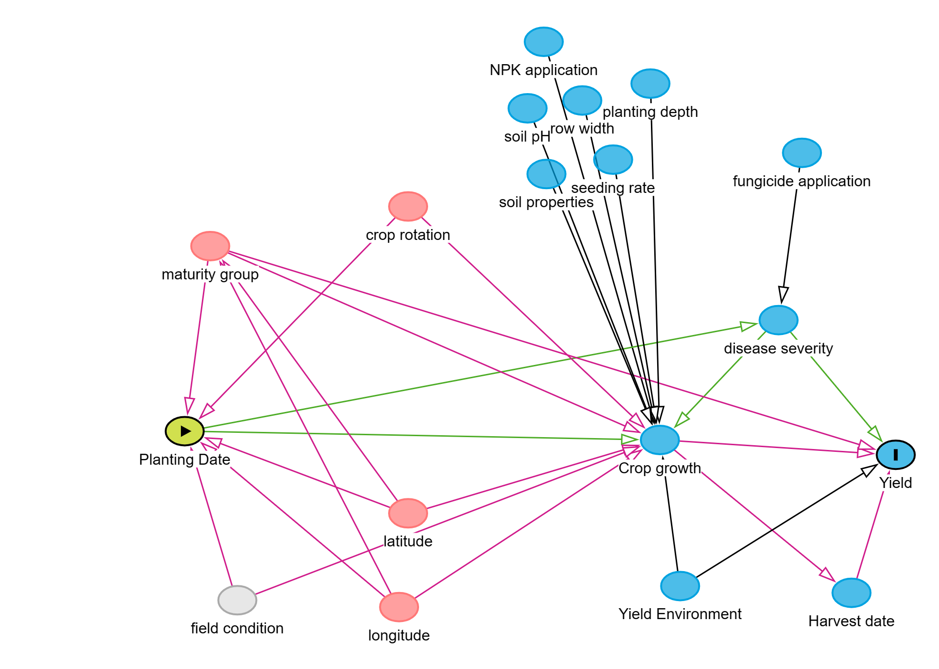
No adjustment set
Due to unobserved field condition

