Slide 1
FINAL-YEAR PROJECT
A VR Fall-Prevention
Trainer for Older Adults
Three habits that stop falls at home: seeing the danger, holding the rail, and getting across a room without bumping into anything.
Team 20
Sanjesh Nandha K · CB.SC.U4CSE23242
Jeevan Raj K R · CB.SC.U4CSE23262
Prasanth P M · CB.SC.U4CSE23263
B.Tech CSE, Amrita Vishwa Vidyapeetham
Notes:
Built in Godot 4.7 with OpenXR, about 13,700 lines of code. It runs in a headset, or on an ordinary laptop with a keyboard and mouse, so it can be shown anywhere.

Slide 2
Why this, and why in VR
Falls hurt more older people than anything else, and most happen at home, in rooms they have lived in for years. The dangers are ordinary ones: a wire across the floor, a mat that slips, a light too dim to see a step by.
A leaflet can list them. It cannot put someone in the room and ask them to find them.
Spot the hazard
1
Point at anything that could trip them and press the trigger
Hold the rail
2
What VR adds
We measure how much of the stairs they held on for
They practise in a real-looking room, and cannot actually fall
We can watch what they do, not just ask what they know
It is the same house every time, so you can see them improve
Cross the room
3
Step on each ring without walking into anything unsafe
Notes:
Everything else in the build is there to measure these three habits honestly.

Slide 3
One house, seven spaces, all built to real size
Everything is at real size. Ceilings 2.4 m, doorways 0.9 m wide, each stair step 19 cm high. Size matters more than how pretty it looks: a doorway even half a metre too wide teaches the wrong sense of space, and judging space is the whole point.
Living room
Bedroom
Bathroom
27
real dangers to find
Hallway
7
safe things, put there on purpose
Kitchen
Stairs
15
danger patches on the floor
26
walks to get right, in and out
Front path, pavement, road and crossing
Floor plan, to scale · the hall is 12 m end to end
Notes:
Every room opens off one 12 m hallway. The front door leads to a street with a zebra crossing, because a lot of falls happen outdoors.

Slide 4
What one session looks like
1
2
3
Welcome
Explore
Cross
Nine buttons on the wall. Everything is shown and read out loud.
Find the dangers in any order. Each room says when it is done.
One ring lights at a time, in the room you are in. Step on each without bumping anything.
4
5
6
Street
Balance
Debrief
Out of the front door. Press the button, wait for the green man, cross, then cross back.
Reach out three times. We measure how far they wobble.
Scores, what was missed, and what to work on next time.
No time limit. They can hear the instructions again, turn the voice off, or stop early.
Notes:
Steps 3 and 4 are the newest. The rings are now judged on the path the person actually walked, and crossing the road is scored on its own, walked there and back.

Slide 5
THE FIVE TRAINING TASKS
What the person does, and
what each one really tells us
Each task trains one habit, and each gets its own score. So someone who spots dangers well but still walks into them can be told exactly that.

Slide 6
Task 1 — Recognising a hazard
Point at anything that could cause a fall and pull the trigger. A right answer glows green, is named out loud, and gets one line of advice: "Run wires around the edge of the room, never across the floor."
Hazards by room
Street
8
Two choices worth explaining
Living room
4
Seven things are safe on purpose: the sturdy armchair, the hall table, the towel rail. Pointing at one is noted but never punished, and gets a gentle reply rather than a buzz. Being a little too careful is a good habit.
Kitchen
4
Bathroom
3
Bedroom
3
Walking into something you had not yet spotted is a near miss. It warns you, costs points, and is counted separately from one you had already found. Being told is not the same as noticing.
Staircase
3
Hallway
2
27 real · 7 safe
Notes:
The total is counted from the room itself, so adding a new hazard updates the scoring on its own.

Slide 7
Task 2 — Holding the rail, and the stairs
We measure how much of the stairs they held the rail for, not just whether they touched it once. The pass mark is 60%, which is generous: letting go for a moment to open a door is normal.
The fix, in three parts
1
The stairs are fenced off, so you cannot point anywhere inside them
A gap we had to close
2
Marked discs on the steps are the only places you can go
You get around by pointing at where you want to be. That let someone stand at the top of the stairs, point at the hallway below, and arrive there at once. They never walked the steps, so the rail was never measured, and it looked like a perfect run.
3
A disc only lights while the rail is held, and only the next step up or down
So the stairs are taken one step at a time, up and down, with a hand on the rail. There is no way to skip them.
Notes:
This is the only place where the software stops you. Everywhere else it watches and measures, but never blocks.

Slide 8
Task 3 — Crossing a room without touching anything
Spotting something and getting past it are two different skills. Someone can point at the coffee table, name it correctly, and still walk their shin into it. Five rooms and the pavement have a line of rings on the floor, one lit at a time. The walk between two rings is one leg.
A leg fails if you touch something
A leg fails if your route went through it
You stepped on the wet floor, the wire or the footstool on the way. This half catches careless walking.
We record where you walked every 12 cm and check the whole path. Going round the table counts as going round it. Jumping over it does not.
The walks are meant to be awkward
Rings in a straight, safe line would test nothing. In 13 of the 26 walks the direct route is blocked: the rug edge runs across the hall, the cupboard door stands open in the kitchen. Before any ring was placed, the computer checked that a safe way round really exists.
Notes:
Walking into something counts even if you had already spotted it. The near miss is about noticing; this is about getting around. Judging the straight line between rings, rather than the path actually walked, used to hold a perfect room at 81.

Slide 9
Tasks 4 and 5 — Reaching, and crossing the road
Balance
Crossing the road — its own test
Based on a reaching test physiotherapists use. Three goes: one forward, one to each side. A countdown gives them time to settle and says when measuring starts, so they are never scored by surprise.
Wobble is measured from where they were standing at "go", not from a fixed point. Otherwise someone who starts slouched and then stands up straight looks very unsteady for doing the right thing.
Falls outdoors are rarely about the pavement. They are about how someone crosses. So crossing gets its own score out of 100, and is walked there and back.
35
Pressed the button and waited for the green man
25
Looked both ways, properly, just before stepping off the kerb
20
Used the crossing, and left room from the coming car — 10 each
That decision is 35% of the score. The other 65% is the walk across: setting off without dawdling, staying on the stripes, and being over before the traffic moves. It measures, but it never stops you.
Notes:
The balance score is a rough guide, not a medical measurement, and the screen says so. Cars brake for anyone in the road, measured from the bumper rather than the middle of the car, so standing in front of one stops it.

Slide 10
MEASUREMENT
Scoring, and the part that
adapts to the participant
Every test is scored on its own, so the system can tell a participant which specific skill to work on — and then put them there next session.

Slide 11
How a session is scored
Each room, out of 100
50%
dangers found in that room
20%
holding the rail, where there is one
30%
getting across without bumping anything
Minus 10 each time they walk into something they had not spotted, up to −20.
If a room cannot test something, that part is dropped and the rest share it out. But skipping the rings on purpose scores zero for that 30%, because otherwise ignoring the task would be the easy way to a high score. The street works a little differently: 60% dangers, 40% the walk.
Notes:
The street is 60% dangers and 40% the walk along the pavement. Crossing the road is scored on its own: 65% the walk across, 35% the decision to step off.

Slide 12
The part that adapts
From the second session on, the system picks the test they most need: their weakest average over the last three sessions, if it is below 90. The board names it, the voice mentions it, and an amber light stands in that room's doorway until they walk in.
Performance board, on the wall
Test
Last
Today
Hallway
82
91
Why a light and not a lock
Living room
74
79
Kitchen
88
85
It points the way without nagging. They can ignore it and do the rooms in any order — the same idea used everywhere except the stairs.
The rule is deliberately simple. It is a sensible starting point, not something that has been properly tested yet.
Bathroom
69
68
Staircase
90
94
Bedroom
77
83
Balance
81
80
Today's focus: the bathroom
Notes:
Example numbers. The board updates itself as the session is scored.

Slide 13
ENGINEERING
How it is built, how it looks real,
and how it runs on anything
Godot 4.7 and OpenXR. 50 scripts, about 13,700 lines of code, 13 scenes, 566 objects in the house and street — and nothing downloaded from anywhere.

Slide 14
Choices made for the people using it
A
The view never moves on its own
A slip is a sound, a spoken warning and a red flash at the edge of the screen — never a lurch of the view. Moving the view when the person did not ask for it is the quickest way to make someone feel sick, and older people take the longest to shake it off.
B
You move by pointing, always
Gliding along is the other main cause of sickness. So you point at where you want to be and arrive there, and the edges of the view dim while you do. There is no other option.
C
A proper seated mode
Sitting down lifts the view so their eyes are at standing height. Worktops and handrails stay where their hands expect them.
D
Buttons on the wall, not menus
Most of the controller is switched off, so a stray thumb cannot do anything by accident. Everything you can change is a real button on the wall that you press.
Instructions are on screen and read aloud, and can be heard again or turned off at any time.
Notes:
These come from reading, and from what is known about how VR affects people. That is reasoning, not proof: none of it has been tried with older adults yet.

Slide 15
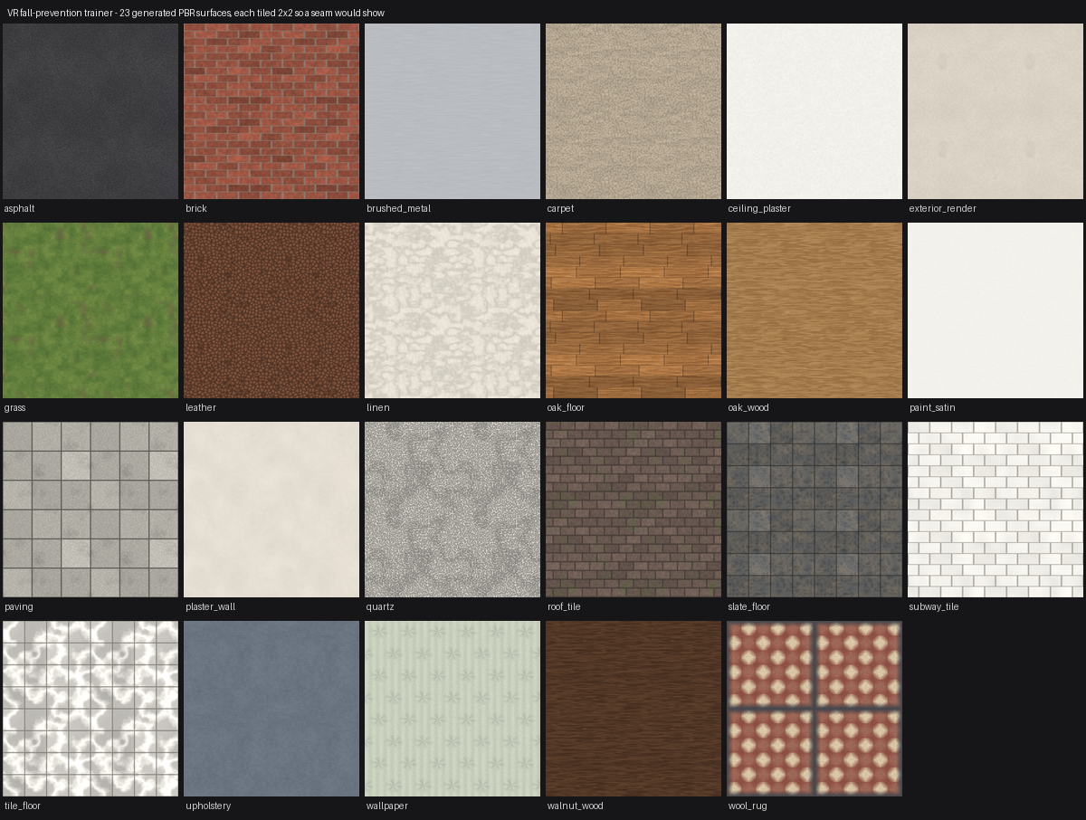
Every surface made from scratch
The machine this was built on could not download anything. So all 25 surfaces — the colour, the bumpiness and the shine of each — are drawn by a script in the project itself. Oak boards, porcelain, slate, carpet, plaster, brick, paving, tarmac, leather, quartz, brushed steel.
Why that turned out better
A surface drawn at its real size repeats with no visible join, and anything built from those measurements comes out the right size on its own.
The patterns are laid onto the room rather than onto each object, so floorboards run the whole length of the hallway and the lines between tiles carry on across a doorway instead of starting again at every slab.
23 of the 25 surfaces, each repeated four times so any join would show
Notes:
Also made by script: every object has softly rounded 18 mm edges, and each room builds its own skirting, coving, door frames and real windows cut into the walls.

Slide 16
Making it run on a laptop
Making it look real switched on effects that need a powerful graphics card. On a thin laptop that was far too much. So the expensive ones are grouped into three levels, picked automatically at startup and swapped at any time with F8.
Smooth
Balanced
Ultra
Built-in graphics
Most machines
Desktop with a graphics card
Simpler lighting, and no shadows from the lamps. Draws at three quarters size and sharpens it back up. Keeps every surface, the rounded edges and the shadows from the sun.
Adds reflections, softer shadows from the sun, and shafts of light through the windows. Draws at 85% size.
Everything: light bouncing off the walls, haze in the air, and every lamp casting its own shadow. Full size.
The most expensive thing was shadows from lamps. Each lamp has to look in six directions, so five lamps meant drawing the room thirty extra times every frame.
Notes:
The frame rate was also uncapped, so a thin laptop got hot and then slowed itself down the longer it ran.

Slide 17
Four more things it does
A
Night mode, on its own button
One press turns the whole house and street dark. The daylight goes, a dim moon comes up, the ceiling lamps come on brighter, eight lamp posts and fourteen street lights light up, and nine windows glow from inside. Bad light causes falls on its own, so the two rooms that are meant to be dim stay dim.
B
Walls you cannot walk through
You now slide along whatever you walk into instead of going through it, so a wall is a wall. Cars measure the gap from their bumper rather than their middle, and brake for anyone standing in the road.
C
The crossing, in both directions
Reaching the far pavement sets the crossing up again the other way, with the rings renamed for the way back. Getting there was only ever half the trip.
D
A street with people on it
Seven houses, a street tree, a drain, wet leaves, and four people who walk their own routes, wait at the kerb for the green man, and step out of your way.
Also on the wall: a button you press twice to clear the saved scores, and a voice that talks about the room you are actually standing in.
Notes:
Night mode uses the same dangers and the same scoring — it is a change of lighting, not a second house, so a room is scored the same way in the dark as in daylight. All four of these came out of walking the build end to end in the headset.

Slide 18
Where it stands
✓
Five measured training tasks
dangers, handrail, walking, balance, crossing the road
✓
Six rooms and a street, day or night
27 real dangers, 7 safe ones, 26 walks
✓
Scored per test, and adaptive
the weakest skill becomes next time's focus
✓
Runs in a headset or on a laptop
three quality levels, swapped with F8
Next: try it with older adults, and measure a second rail at the bath.
Notes:
Thank you. Happy to demonstrate it live — it runs on a laptop with keyboard and mouse, no headset needed.

