Slide 1
NREGA program
Sanjeev Kumar

Slide 2
● How effective is NREGA in providing employment opportunities to rural households?
● Are there regional disparities in the implementation and outcomes of the scheme?
● What is the utilization of the allocated budget, and how does it correlate with employment generation?
● What are the key factors contributing to the completion of NREGA works, and are there any roadblocks to its success?
● Can data-driven insights guide policymakers and administrators in optimizing the scheme's impact?

Slide 3
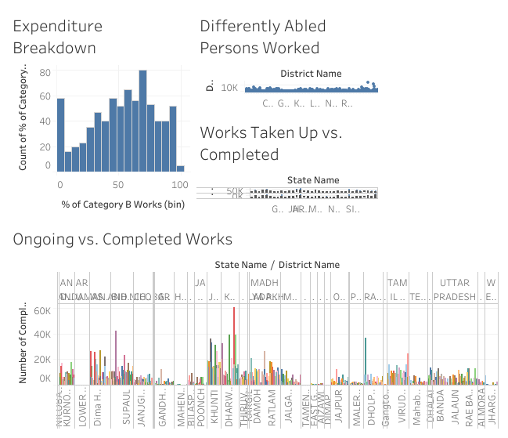
1. How effective is NREGA in providing employment opportunities to rural households?

Slide 4
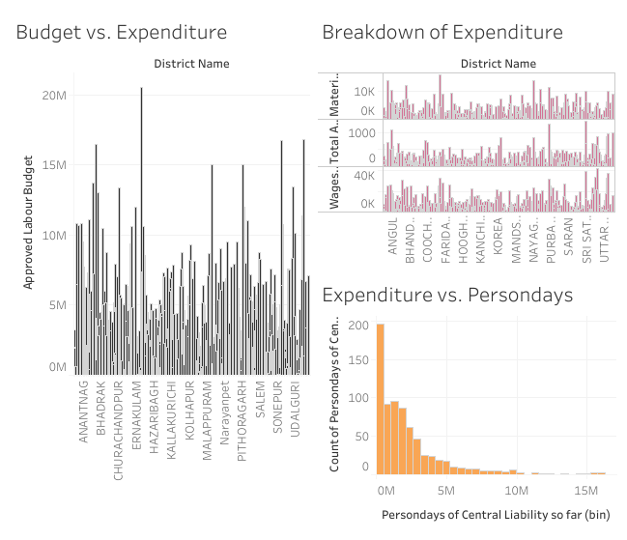
2. Are there regional disparities in the implementation and outcomes of the scheme?

Slide 5
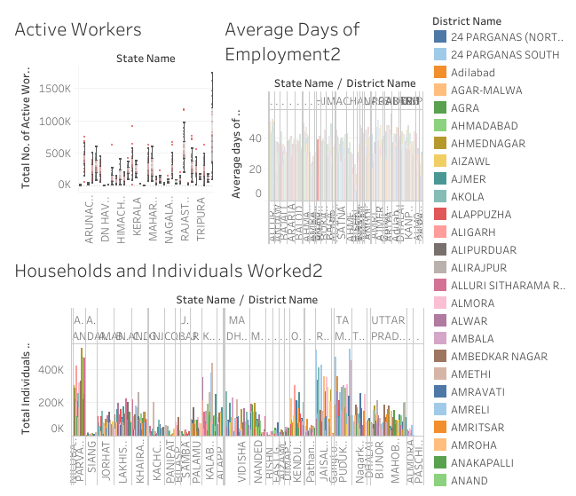
3. What is the utilization of the allocated budget, and how does it correlate with employment generation?

Slide 6
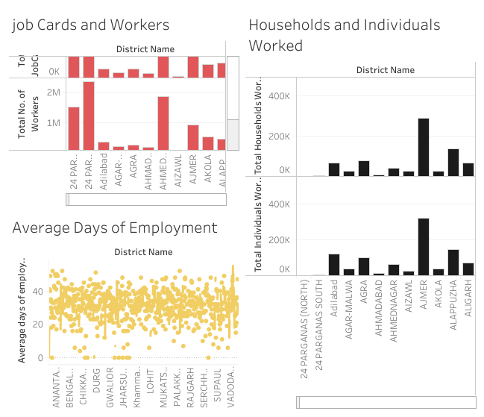
4. What are the key factors contributing to the completion of NREGA works, and are there any roadblocks to its success?

