Slide 1
ContainerGuard
Container Security Monitoring & Compliance Platform
Real-time security telemetry, vulnerability scanning, and compliance enforcement for containerized applications
Team Segmentation Fault
Sanjib Sen · Jackson Saenz · Ahsan Habib
COSC 6352 · Advanced Operating Systems Texas A&M University, Corpus Christi · Spring 2026

Slide 2
Agenda
1. Project Overview
2. System Model
3. Architecture
4. Algorithms & Protocols
5. Concurrency & Distribution
6. Implementation Plan
7. Evaluation Plan
8. Challenges
9. Team Roles
ContainerGuard / COSC 6352 Project Proposal

Slide 3
1. Project Overview
What problem are we solving?

Slide 4
The Problem
Containers are everywhere, rapidly growing in self hosted community
Startups and general users deploy hundreds of containers with no unified view of what happens inside them at runtime.
Security Solutions between Enterprise vs Community
SECURITY BLIND SPOTS
WHY IT MATTERS
Unauthorized network connections
Unexpected open ports
Sensitive file access (/etc/x)
Resource anomalies (e.g., crypto-mining)
Vulnerable base images in production
Containers share the host kernel => one compromise can escalate
Short-lived containers make forensics hard
Compliance (CIS Benchmarks) requires continuous monitoring
Growing use of self hosted projects
Ever heard of immich, coolify, nextcloud, docker-osx?
ContainerGuard / COSC 6352 Project Proposal

Slide 5
Our Solution
A distributed monitoring platform with three core components:
Lightweight Agent
Central Server (FastAPI)
Web Dashboard + Grafana
Deployed per container. Collects: Network I/O, Open Ports, File Access, CPU/Memory, Processes
Aggregates telemetry & enforces security: Compliance, Alerts, Vuln Scanner, Anomaly Detection
Real-time operator UI: Live Metrics, Alert Feed, CVE Reports, Compliance Status
Similar to: Sysdig Secure, Falco, Datadog Container Monitoring but for Open-Source community
ContainerGuard / COSC 6352 Project Proposal

Slide 6
2. System Model & Assumptions
What kind of distributed system?

Slide 7
System Model
Architecture: Centralized (Hub & Spoke)
Network: Reliable (Docker bridge/overlay)
Single control-plane server + N distributed agents, one per host or container. Agents are stateless collectors that push telemetry to the server.
Communication over TCP (HTTP + WebSocket). Retries with exponential backoff handle short-lived failures.
Failure Model: Crash-Failure
Consistency Model
Agent crash => server detects via missed heartbeats. Server crash => agents buffer locally & replay on reconnect.
Eventual consistency for metrics (1-5s lag OK). Strong consistency for compliance state & alert acks (PostgreSQL ACID).
ContainerGuard / COSC 6352 Project Proposal

Slide 8
3. High-Level Architecture
Components and communication

Slide 9
Architecture
Container 1 Agent
Container 2 Agent
Container 3 Agent
. . .
Container N Agent
▼
HTTP REST (telemetry every Xs, heartbeat every Ys)
Central Server (FastAPI)
Telemetry Collector
Compliance Engine
Vuln Scanner (Trivy)
Alert Manager
Metrics Exporter
Internal event bus: Redis Pub/Sub
▼
PostgreSQL State & Events
Redis Cache & Pub/Sub
Prometheus Time-series
→
Grafana Dashboards
▲
WebSocket (real-time push)
Web Dashboard (React + TypeScript + Tailwind)
ContainerGuard / COSC 6352 Project Proposal

Slide 10
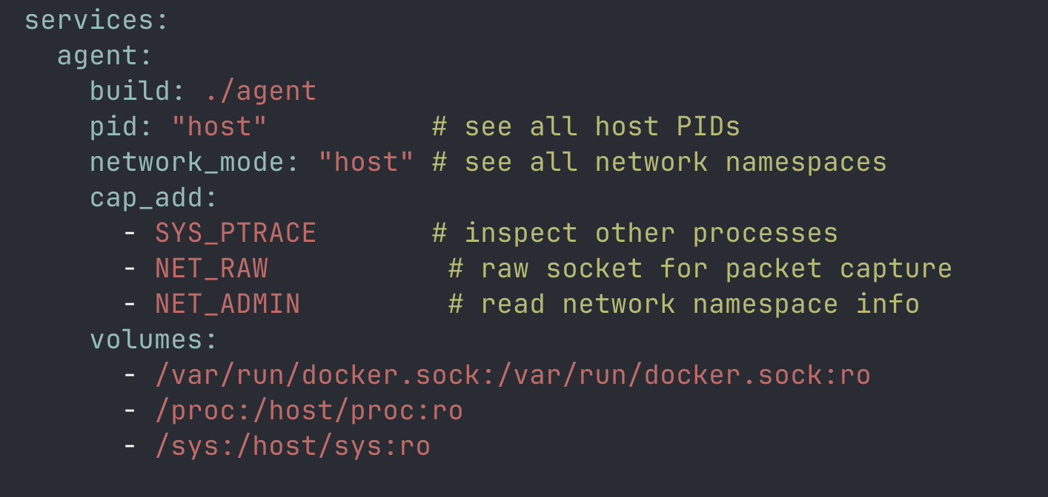
Agent Service

Slide 11
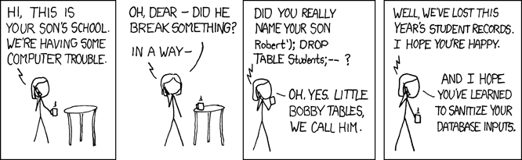
Communication Patterns
Path | Protocol | Pattern
Agent => Server | HTTP REST | Push telemetry every 5s, heartbeat every 10s
Server => Dashboard | WebSocket | Real-time push on new events
Server internal | Redis Pub/Sub | Event bus (ingest => alert => broadcast)
Prometheus => Server | HTTP scrape | Pull metrics every 15s from /metrics
Agent <= Server | HTTP REST | Agent polls config every 60s
Agent Data Collected
Server Capabilities
Inbound/outbound connections, Listening ports + PIDs, File read/write events, CPU/Memory/Net/Disk, Running processes, DNS queries
Telemetry aggregation, Compliance rule evaluation, Trivy image scanning, Threshold-based alerting, Z-score anomaly detection, Prometheus metrics export
ContainerGuard / COSC 6352 Project Proposal

Slide 12
4. Algorithms & Protocols
What makes this distributed?

Slide 13
Algorithms & Protocols
Anomaly Detection
Failure Handling
Sliding Window + Z-Score • 5-min rolling average per metric per container • Alert when value > 2 std deviations from mean • Configurable per metric (CPU, memory, net I/O)
Agent => Server: exponential backoff (1s, 2s, 4s... max 30s) Heartbeat: 30s missed => "unreachable", 5min => "offline" Idempotent ingestion: unique batch IDs, server deduplicates
Network Security Rules
Compliance Rule Engine
• Allowlist / Blocklist for outbound destinations • Port exposure detection for unexpected listeners • Connection rate limiting (N conns/sec threshold)
JSON predicates evaluated against container state: { "condition": "ALL proc.user != root" } Evaluated periodically + on matching telemetry events
ContainerGuard / COSC 6352 Project Proposal

Slide 14
5. Concurrency / Parallel / Asynchronous / Distributed
How do we handle concurrent operations?

Slide 15
Agent Concurrency (Single Node)
Core: asyncio event loop drives all collectors concurrently
Async Tasks (non-blocking)
Background Threads (blocking I/O)
ResourceCollector => reads /proc + cgroups
PortCollector => parses /proc/net/tcp
ProcessCollector => psutil.process_iter()
Batch sender => drains queue every 5s
FileCollector => watchdog (inotify) thread
NetworkCollector => raw socket recv() thread
Synchronization
asyncio.Lock => shared telemetry buffer
asyncio.Queue => thread-to-async bridge
ContainerGuard / COSC 6352 Project Proposal

Slide 16
Server & System-Level Concurrency
Server (Single Node)
Distributed Properties
FastAPI + Uvicorn => async ASGI request handling
Gunicorn => multiple worker processes (1 per core)
asyncio.create_task => background jobs (compliance, scans)
SQLAlchemy async pool => connection management
Redis Pub/Sub => decouples ingestion from alerting & WebSocket
Agents are independent => no inter-agent communication
Natural load distribution => each agent handles one container
Server is stateless => all state in PostgreSQL + Redis
Horizontally scalable => add server instances behind a load balancer
Self-scheduling => agents manage their own intervals
ContainerGuard / COSC 6352 Project Proposal

Slide 17
6. Implementation Plan
How will we build it?

Slide 18
Tech Stack
Layer | Technology | Why
Language | Python 3.12 | Strong systems monitoring ecosystem
Package Manager | uv | Fast project/package manager, replaces pip + venv + poetry
API Framework | FastAPI | Async-native, auto OpenAPI docs, WebSocket support
Server | Uvicorn + Gunicorn | Production async ASGI with worker management
ORM / Migrations | SQLAlchemy 2.0 + Alembic | Async ORM with schema migrations
Database | PostgreSQL 16 | ACID transactions for alerts & compliance
Cache / PubSub | Redis 7 | Real-time event bus + caching layer
Metrics | Prometheus + Grafana | Industry standard metrics pipeline
Vuln Scanner | Trivy | Open-source, scans images + filesystems
Frontend | React + TypeScript + Tailwind | Modern real-time dashboard UI
Monitoring Libs | psutil, watchdog, scapy | CPU/mem, file events, network capture
ContainerGuard / COSC 6352 Project Proposal

Slide 19
Project Structure
container-guard/ ├── docker-compose.yml │ ├── agent/ │ ├── pyproject.toml # uv managed │ └── src/ │ ├── main.py │ ├── config.py │ ├── models.py │ ├── collectors/ │ │ ├── network.py │ │ ├── ports.py │ │ ├── filesystem.py │ │ ├── resources.py │ │ └── processes.py │ └── transport/ │ ├── client.py │ └── buffer.py
server/ ├── pyproject.toml # uv managed ├── alembic/ └── src/ ├── main.py ├── api/ # REST endpoints ├── core/ # business logic ├── db/ # SQLAlchemy models ├── workers/ # background tasks └── metrics/ # Prometheus exporter dashboard/ # React + Tailwind grafana/ # provisioning configs prometheus/ # scrape configs demo/ # sample containers
ContainerGuard / COSC 6352 Project Proposal

Slide 20
Milestones
Weeks 1-3
Foundation ·
Project scaffolding (uv, Docker Compose) · Agent resource collector (psutil) · Server skeleton with registration & heartbeat · DB schema + Alembic migrations · Basic Prometheus exporter
Weeks 4-6
Core Monitoring ·
All agent collectors (network, ports, files, processes) · Telemetry storage & REST APIs · WebSocket broadcast · Dashboard with container list + charts · Grafana dashboards
Weeks 7-9
Security Features ·
Trivy vulnerability scanning · Compliance rule engine · Alert manager + thresholds · Network allowlist/blocklist · Anomaly detection (Z-score)
Weeks 10-12
Polish & Demo ·
Full dashboard UI · Agent offline buffering · Deploy vulnerable demo containers · Load testing · Documentation & report
ContainerGuard / COSC 6352 Project Proposal

Slide 21
7. Evaluation Plan
How will we prove it works?

Slide 22
Demo Scenarios
# | Scenario | Expected Result
1 | Process writes to /etc/shadow | ALERT within 5 seconds
2 | Container binds unexpected port 4444 | Dashboard shows port in real-time
3 | CPU spike via stress-ng | Anomaly detection triggers ALERT
4 | Scan nginx:1.14 image | CVE report with severity breakdown
5 | Outbound request to blocked IP | ALERT + logged in dashboard
6 | Kill agent process | Server marks "unreachable" within 30s
7 | Stop & restart server | Agents buffer locally, replay on reconnect
ContainerGuard / COSC 6352 Project Proposal

Slide 23
Performance Targets & Testing
< 3s
< 2%
< 30 MB
50+
Telemetry latency (event => dashboard)
Agent CPU overhead
Agent memory footprint
Containers per server instance
Unit Tests
Integration Tests
Fault Injection
Each collector module, compliance engine, alert manager pytest + pytest-asyncio
Full Agent => Server telemetry pipeline end-to-end httpx + Docker
Kill agents/server, verify recovery, buffering, heartbeat detection
ContainerGuard / COSC 6352 Project Proposal

Slide 24
8. Challenges & Difficulties

Slide 25
Challenges & Mitigations
Challenge | Mitigation
Race conditions in shared telemetry buffer | asyncio.Lock + asyncio.Queue for thread-to-async bridge
Agent overhead on monitored container | Read /proc directly instead of spawning commands; configurable intervals
Data volume at scale | 5s batching, server-side sampling, PostgreSQL time partitioning
Clock skew across agents | UTC everywhere; server applies receipt timestamp for ordering
Network capture needs privileges | Agent runs with NET_RAW + SYS_PTRACE capabilities
Trivy scan blocking the API | Async subprocess; results streamed via WebSocket
WebSocket fan-out at scale | Redis Pub/Sub as broadcast layer, one coroutine per client
ContainerGuard / COSC 6352 Project Proposal

Slide 26
9. Team Roles

Slide 27
Team Roles
Agent Engineer
Server Engineer
Frontend / DevOps
Sanjib Sen
Jackson Saenz
Ahsan Habib
All collector modules (network, ports, files, resources, processes), transport layer, ring buffer, heartbeat
FastAPI endpoints, DB schema, compliance engine, alert manager, Trivy integration, Prometheus exporter
React dashboard, WebSocket integration, Grafana dashboards, Docker Compose, CI/CD, demo scenarios
Shared
Code reviews, testing, documentation, presentation
ContainerGuard / COSC 6352 Project Proposal

Slide 28
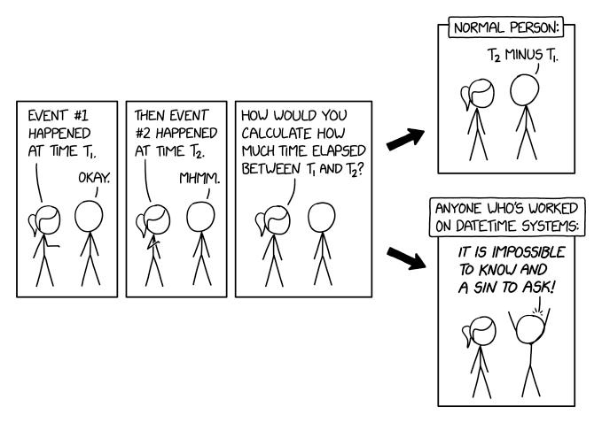
Thank You
Questions?

