Slide 1

On DatoCMS Site Testing
Capstone Project Presentation

Slide 2
Outline
Problem Statement
Integrated Architecture and Project Flow
Project Structure
Test Scenarios
TestNG Reports
Reports Generated on Cucumber Website
Allure Reports
Technologies and Tools Used
Conclusion

Slide 3

Problem Statement
To effectively test the various functionalities of DatoCMS website with Selenium Automation tool and to generate TestNG Reports, Cucumber Reports, and Allure Reports.

Slide 4
Integrated Architecture and Project Flow
TestNG.xml
Design Pattern
Reporting
Page Object Model
TestNG Reports
Steps
Cucumber
Step Definitions
, Feature files and Scenarios
Pages
Selenium locators, WebElements…
Online Cucumber Report
User Defined Functions
TestNG Test Cases
Test Cases Written using TestNG annotations, Runner Class
Allure Reports
BrowserFactory
(includes Selenium WebdriverManager)
Utilities
Test Cases Helpers

Slide 5
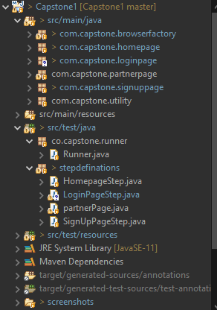
Project Structure

Slide 6
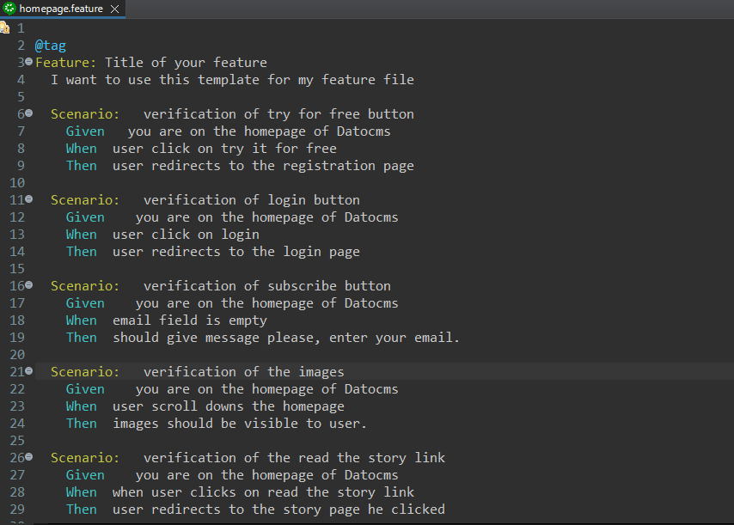

Slide 7
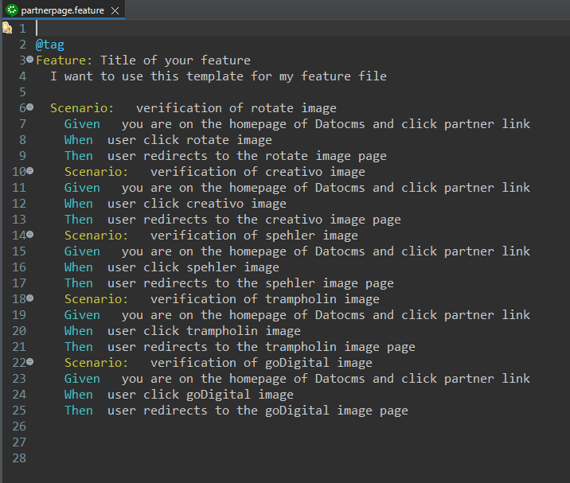

Slide 8
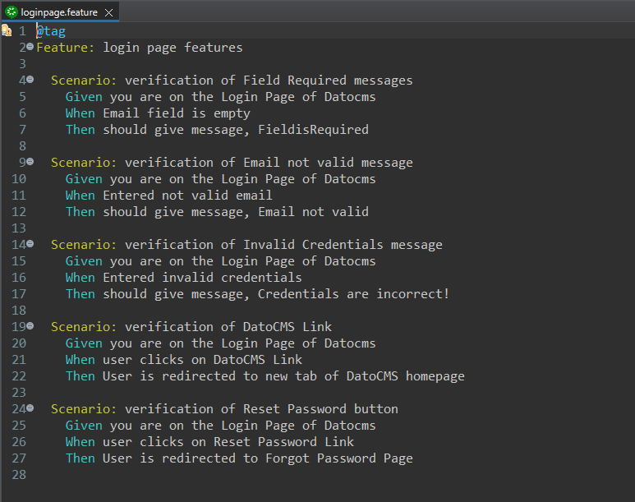

Slide 9
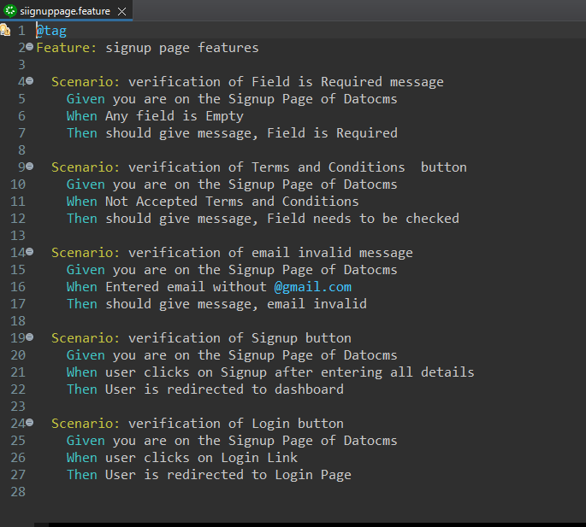

Slide 10
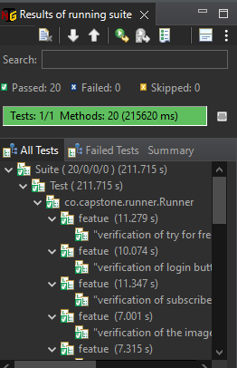
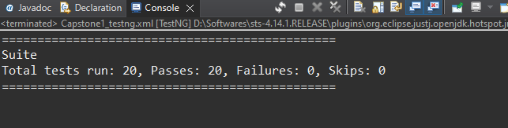
20 Test Suites Running Successfully

Slide 11
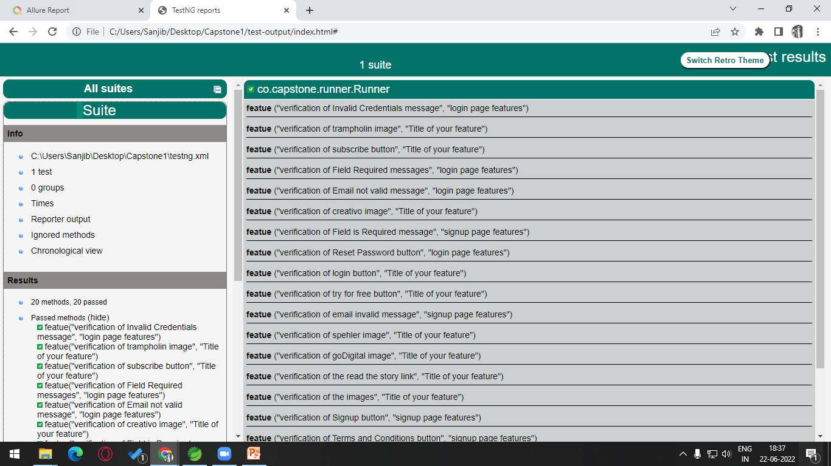
TestNG Reports

Slide 12
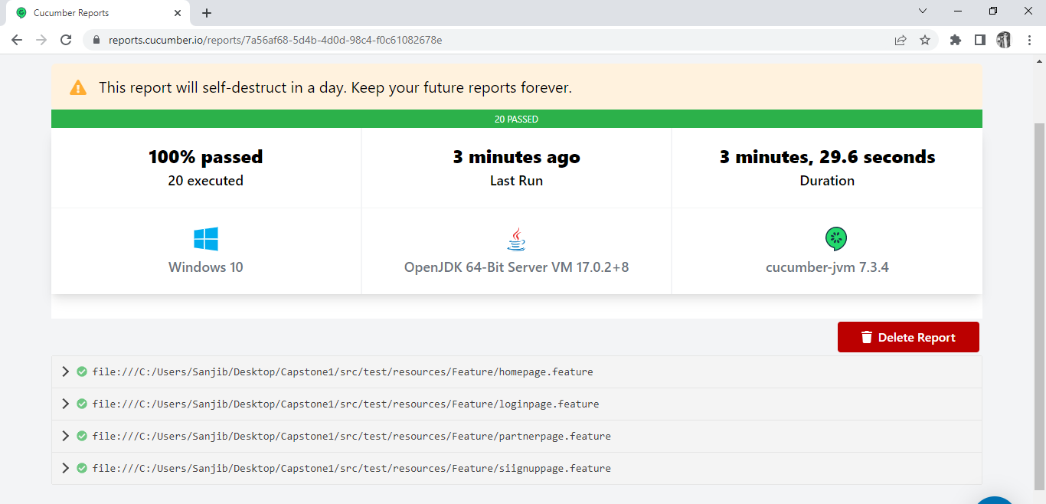
Online Cucumber Reports

Slide 13
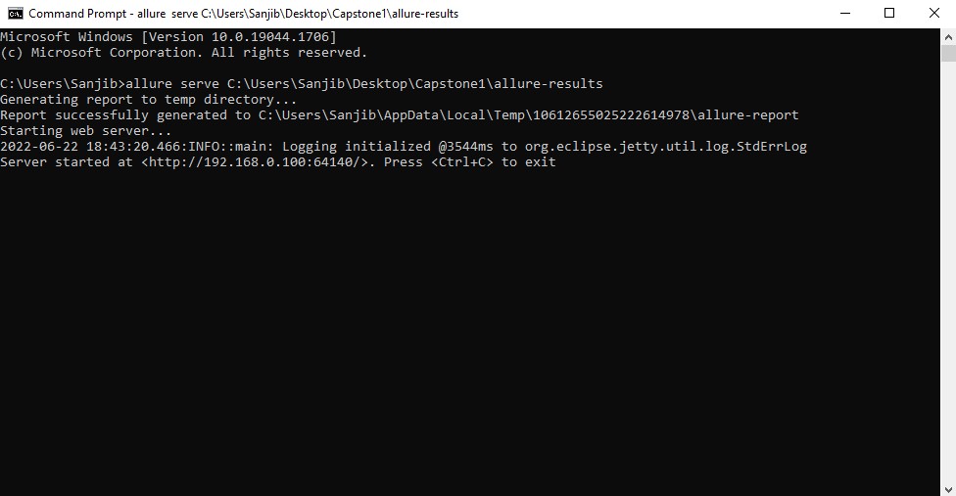
GENERATING ALLURE REPORT

Slide 14
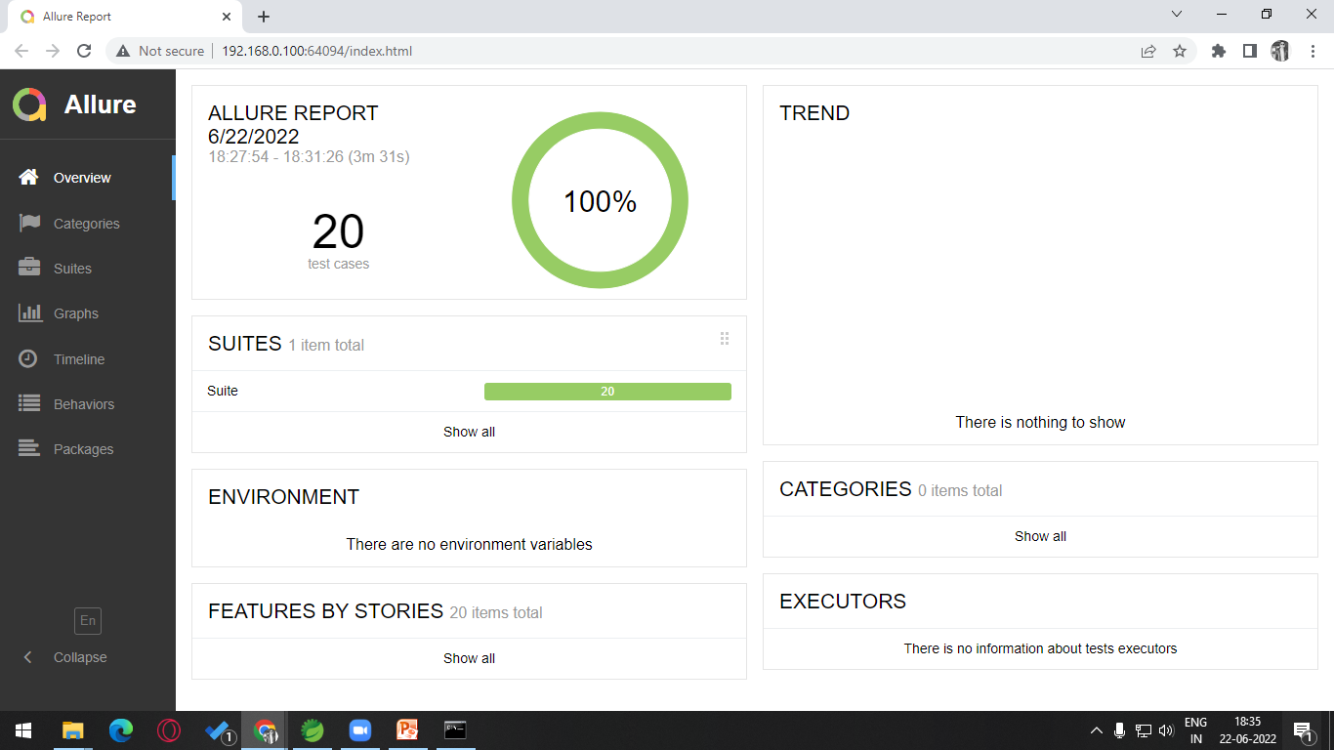

Slide 15







Technologies and Tools Used

Slide 16
Conclusion
To conclude, with this Capstone Project, we not only implemented but also integrated various things which we learnt over these months and tested Datocms website succesfully providing various Test Reports.

Slide 17
Thank You…

Slide 18


