Slide 1
A First Look into Code Generation for Deep Learning operators
Sitong An, PPP 28th Jan

Slide 2
Overview
With much emphasis on algorithm development, deployment (i.e. doing inference on data in production environment, usually in C++ and with CPUs) used to be relatively neglected
TF/PyTorch etc. can only run inference on its own model. Dependency is heavy. Usage in production environment in C++ is cumbersome.
ONNX [1], Open Neural Network Exchange, aim to define a common standard for describing DL models, with graphs, nodes and operators.
I initially proposed to develop an ONNX-based inference engine as part of TMVA when I joined ROOT team.

Slide 3
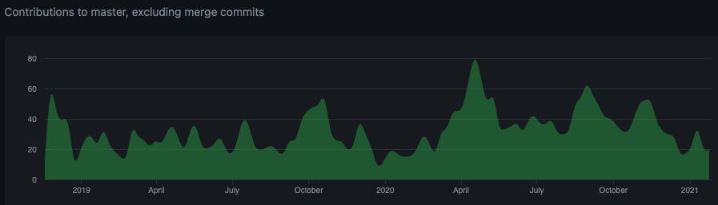
The ML community at large noticed the missing link in production too, with concentrated effort to address it.
ONNX Runtime[2] developed rapidly to be a powerful, efficient inference engine for ONNX models, backed by Microsoft
Now supporting many languages, accelerators, Inference as a service…

Slide 4
The original inference engine proposed has been developed to an initial demonstrator status (simple DNN network)
We decided not to try to invent the wheel while others are inventing a bigger one
ONNX Runtime still imposes a relatively large dependency
  C++ example [3], note that its C++ API is still marked experimental
  Efforts exist to integrate ONNXRuntime into CMSSW [4] -> had to fix a hard-coded thread pool for the LSTM operator
How about an inference engine that takes ONNX model as input and automatically generate snippets of C++ code that hard-code the inference function, easily invokable directly from any C++ project, with the only dependency on BLAS?

Slide 5
Code example
Transpose a tensor with shape [1,2,3,4] by permutation [3,2,1,0]
  i.e. the output tensor will have a shape of [4,3,2,1]
Automatic generated code:
for (int id = 0; id < 24 ; id++){
tensor_2[id / 24 % 1 * 1 + id / 12 % 2 * 1 + id / 4 % 3 * 2 + id / 1 % 4 * 6] = tensor_1[id];
}

Slide 6
Code example
Relu operator operating on a [2,2] tensor
Automatic generated code:
for (int id = 0; id < 4 ; id++){
tensor_6[id] = ((tensor_5[id] > 0 )? tensor_5[id] : 0);
}

Slide 7
Code example
Gemm(matrix multiplication) operator, with alpha/beta =1.0, tranA =0, transB =0, operating on tensor [2,3] and [3,2]
Using the B^{T} * A ^{T} = (A * B)^{T} trick to call fortran-based blas (expecting column major) on row major matrices
Allow free transpose of A/B without additional work -> change parameters passed to blas without affecting the trick
char op_1_transA = 'n’;
char op_1_transB = 'n’;
int op_1_m = 2;
int op_1_n = 2;
int op_1_k = 3;
float op_1_alpha = 1;
float op_1_beta = 1;
int op_1_lda = 3;
int op_1_ldb = 2;
BLAS::sgemm_(&op_1_transB, &op_1_transA, &op_1_n, &op_1_m, &op_1_k, &op_1_alpha, tensor_4, &op_1_ldb, tensor_3, &op_1_beta, tensor_5, &op_1_n);

Slide 8
Proposed interface (tentative)
RModelParser_ONNX parser; //dependency on protobuf only on the parser
RModel model = parser.Parse(“./LinearNN.onnx”); //decoupled from the parser.
// Rmodel is an Intermediate representation that can be serialised into a ROOT file
model.Generate("./LinearNN.hxx");

Slide 9
RModel
class RModel{
private:
std::unordered_map<std::string, InputTensorInfo> fInputTensorInfos; //graph input only; not including operator input (intermediate tensors)
std::unordered_map<std::string, TensorInfo> fReadyInputTensorInfos; std::unordered_map<std::string, InitializedTensor> fInitializedTensors; std::unordered_map<std::string, TensorInfo> fIntermediateTensorInfos; std::vector<std::unique_ptr<ROperator>> fOperators;
bool fAllTensorInitialized = false;
std::string fName="UnnamedModel"; std::string fFileName; //file name of original model file for identification
std::string fParseTime; //UTC date and time string at parsing
std::string fGC; //generated code
bool fNeedGemm = true;
const std::vector<std::string>
fAllowedStdLib = {"algorithm"};
std::set<std::string> fNeededStdLib;

Slide 10
void Initialize();
public: //explicit move ctor/assn
RModel(RModel&& other);
RModel& operator=(RModel&& other); //disallow copy
RModel(const RModel& other) = delete;
RModel& operator=(const RModel& other) = delete;
RModel(){}
RModel(std::string name, std::string parsedtime);
const std::vector<size_t>& GetTensorShape(std::string name);
const ETensorType& GetTensorType(std::string name);
bool CheckIfTensorAlreadyExist(std::string tensor_name);
void AddInputTensorInfo(std::string input_name, ETensorType type, std::vector<Dim> shape);
void AddInputTensorInfo(std::string input_name, ETensorType type, std::vector<size_t> shape);
void AddOperator(std::unique_ptr<ROperator> op, int order_execution = -1);
void AddInitializedTensor(std::string tensor_name, ETensorType type, std::vector<std::size_t> shape, std::shared_ptr<void> data);
void AddIntermediateTensor(std::string tensor_name, ETensorType type, std::vector<std::size_t> shape);
void AddNeededStdLib(std::string libname);
void Generate();

Slide 11
Soon to run a full-run test on a simple DNN model
Next time on PPP: benchmarking results
-> Does this style of code generation allow us to make full use of JITting?
  How to better accommodate potential integration with RDF?
  How to better make use of cling optimization?

Slide 12
Suggestions/recommendations?

Slide 13
References
[1] https://onnx.ai
[2] https://github.com/microsoft/onnxruntime
[3] https://github.com/microsoft/onnxruntime/blob/master/samples/c_cxx/model-explorer/model-explorer.cpp
[4] https://indico.cern.ch/event/844092/contributions/3632227/attachments/1945670/3228075/ML_Inference_CMSSW_20191115_H_Qu.pdf

