Slide 1
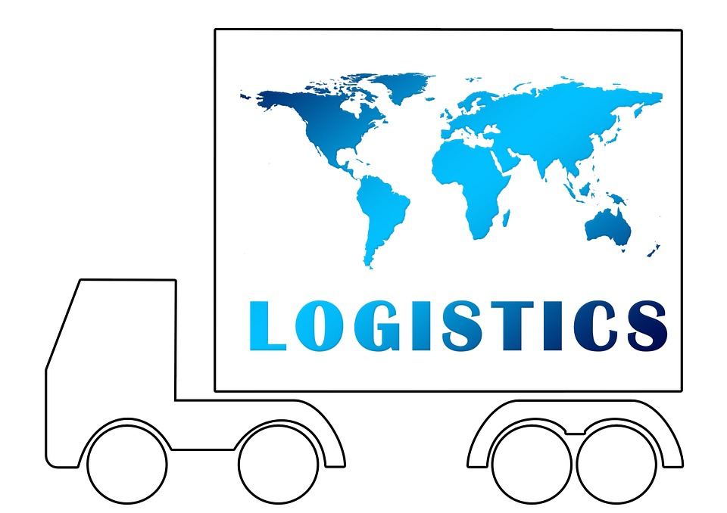
Logistics and distribution
Name: Olim Rakhmatov
ID: 12194905

Slide 2






Manufacturer
Logistics
Warehouse
Consumers
Raw materials
Agents
Supply chain management

Slide 3
Distribution and Logistics
60%
Railroad
Our company uses railroad shipment for local distribution and for those countries that do not have direct access to sea channels
45%
Seaway
Transferring great number of our products through ships are the most cost efficient.
75%
Airways
Air freight is most preferable type of distribution channel, due to its safety and speed.

Slide 4
Warehouses
Main distributors located in 4 countries
Provides fast and safe distribution worldwide
A
B
C
D
A
United States of America
B
Germany
C
China
D
Australia

Slide 5

Thank you!

