Slide 1



Slide 2
Team name : আচমকা (Achomka)
Team No : 01

Slide 3
The Concept
Contact system with Government officials’ categorized by division and district

Slide 4
Features
List of government officials’ categorized by divisions and districts
Officials’ contact info
Direct calling, SMS and email sending facility just by one touch

Slide 5
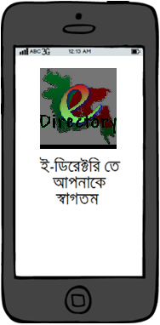
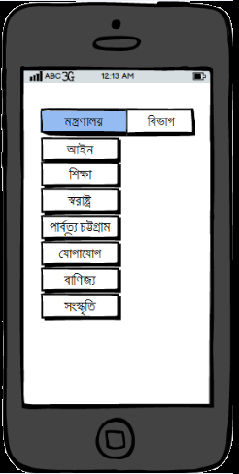
What we developed in GDG

Slide 6
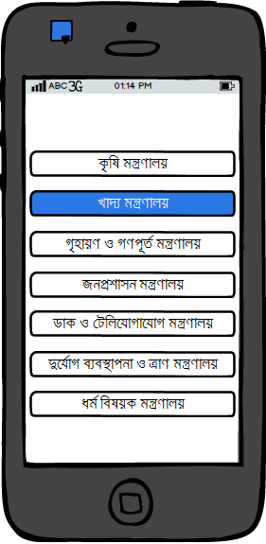
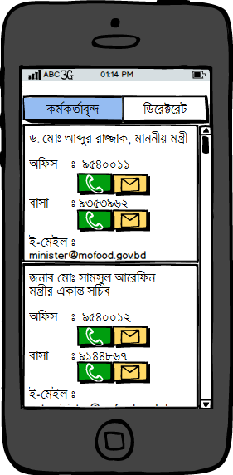
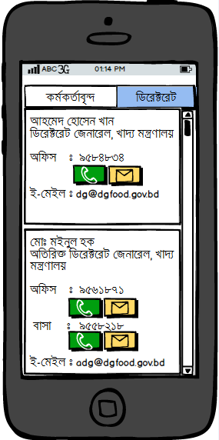
What we developed in GDG

Slide 7
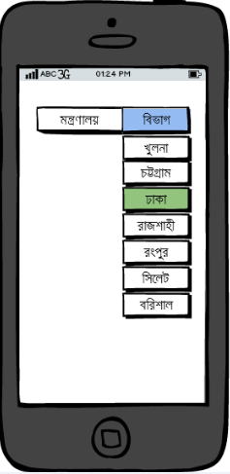
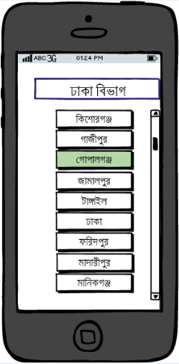
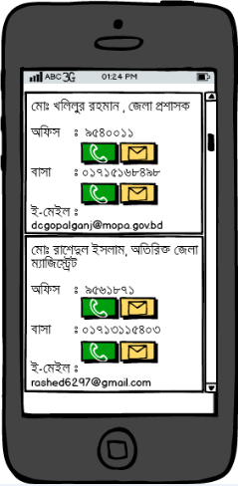
What we developed in GDG

Slide 8
Final Vision
Direct search option
Include contact info all officials, not only government
Include list of all offices according to the districts

Slide 9
Supports We Need
Database Access of officials’ contact information

Slide 10
Team Details
1) Iffatur Ridwan Samanta
Contact no - +88-01677-127703, +88-01689-149075
email – sama_vns13@yahoo.com
Gitlink – https://github.com/IffaturRidwan
2) Tanvir Ahmed Fuad
Contact no - +88-01675-786134
email – tanvir_fuad@ovi.com
Gitlink – https://github.com/tanvirfuad
3) Sanjida Nasreen Tumpa
Contact no - +88-01914-639095
email – tumpa_sanjida@yahoo.com
Gitlink - https://github.com/sanjida17

Slide 11
THANK YOU

