Slide 1


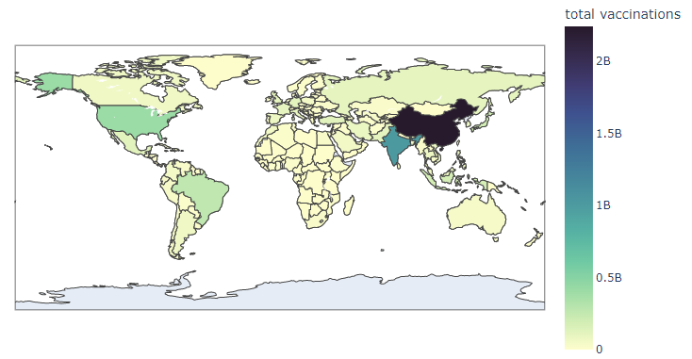
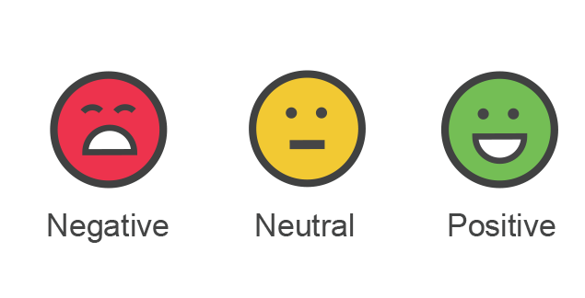

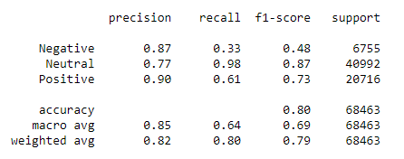
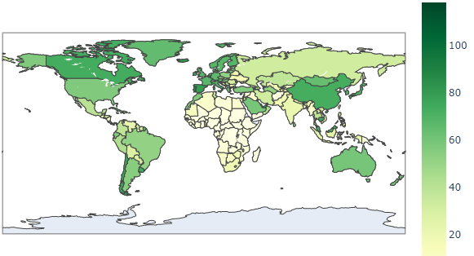
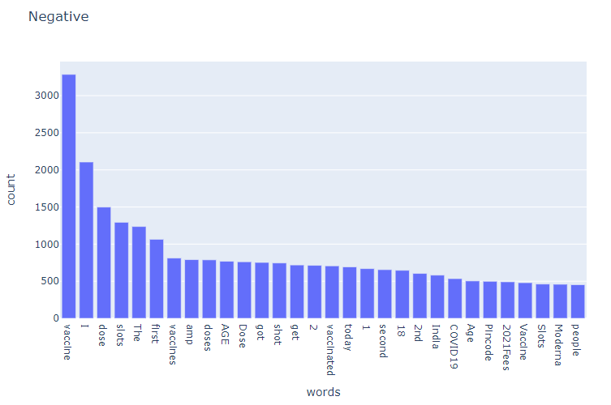
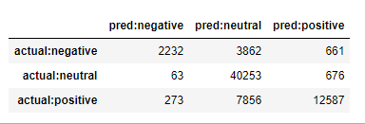
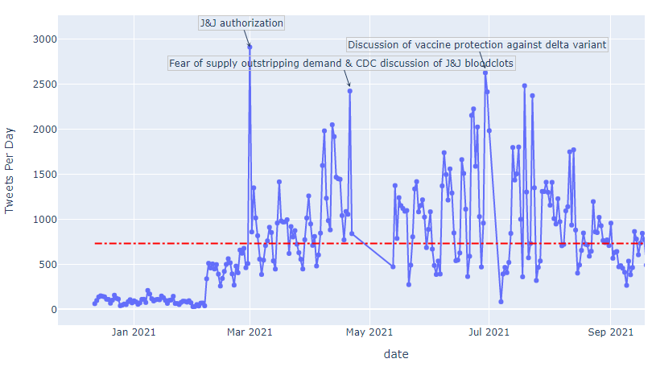
Online Guard: Identifying the misinformation in social media and its impact on COVID-19 vaccination progress in different countries
Sanjida Akter Sharna (Student), Dr. William Eberle (Advisor)
Department of Computer Science, Tennessee Tech University
The emergence of the novel coronavirus pandemic has caused a myriad of problems worldwide. One such problem is misinformation, which in itself should be considered a risk.
Since the outbreak of the COVID-19 pandemic, popular social media platforms are flooded by exaggerated phony news which is affecting our society.
Although the pertinent tools and existing techniques can support fact-checking and identification of conspiracy, misinformation, and negative sentiment at various stages, a complete end-to-end solution is complicated.
We propose a thorough analysis and identification system named Online Guard using natural language processing tools and supervised learning techniques to identify the relationship between misinformation from the negative sentiment of COVID19 vaccine-related tweets and vaccination progress rate and its impact in different countries for a particular time period.
Exploratory Analysis of Vaccination Progress in Different Country
Background and Major Contributions
Understanding Experimental Analysis using Flow diagram
Datasets Acquisition
Data preprocessing
-Handling missing data
-Dropping unnecessary columns
-Formatting date format
Data cleaning
-Removing hashtags
-Removing URLs
-Removing whitespaces
-Removing special characters
-Removing digits
-Removing stop words
Data labelling
-Using Textblob python library
Feature Selection
Model Training and Analysis
-Split dataset into Training set and Testing set
-Feature Extraction(using TFID vectorizer)
^{-Train the model}
^{-Exploratory Analysis}
-Analysis of experimental result
From the below figure we can see that in most of the countries total vaccination progress is near to zero
3-way sentiment polarity
- Text only is classified
- Positive/Negative/Neutral
-Textblob classifier
Textual sentiment classifier (3-way)
Experimental Result Analysis
Figure 4: Total vaccination in different countries (January 2021- September 2021)
Training Accuracy: 80.721%
Test Accuracy: 80.4405%
Data Collection and Pre-processing for the Experimentations
Figure 1: Performance of the ML model (Naïve Bayes)
we have collected two data set from the Kaggle site. One is COVID-19 all vaccines tweet dataset and another is country vaccination dataset.
Table 1: Attribute description For COVID-19 all vaccines tweet dataset
Figure 5: Fully vaccinated percentage in different countries (January 2021- September 2021)
Attribute Name | Attribute Description
User location | The location the twitter user
text | Text content of the tweet
date | Date of the tweet
Conclusion: Empirical Findings Observations
Identifying misinformation and negative emotions are important to provide an intimation of terrors lurking inside social media platforms (Twitter) during the pandemic crisis
Figure 2: Confusion Matrix
Figure 3: Bar chart of negative word count
Table 2: Attribute description For Country Vaccination dataset
Time Series Analysis of Tweets Per Day and its Impact on Vaccination Progress
Attribute Name | Attribute Description
country | The country for which the vaccination information is provided
date | Date for the data entry
total_vaccinations | The absolute number of immunizations in the country
people_vaccinated | The number of people who receive at least one vaccine shot
people_fully_vaccinated | The number of people received entire set of vaccine immunization scheme
Propagation and acceptance of covid vaccine activities are negatively co-related (hypothesis) with social media platforms’ increasing misinformation
Reference
1.https://www.kaggle.com/gpreda/all-covid19-vaccines-tweets
2. https://www.kaggle.com/gpreda/covid-world-vaccination-progress
.

