Slide 1
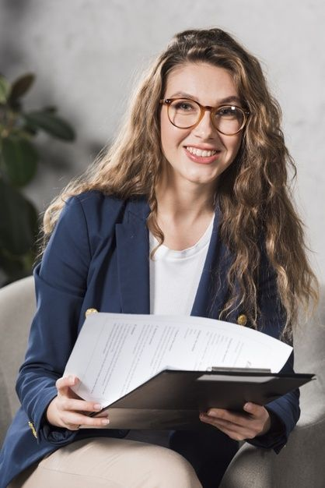

Maharun Nur Sanjida
Web developer
Experience
Web designer and developer
Contact
IIST Polytechnic Institute (10-Oct-22-present)
Phone:+8801881538885
Education
Email:meherunnursanjida@gmail.com
Kazipara,Mirpur10,
Diploma in Computer Engineering
Dhaka-1216
Dhaka Mohila Polytechnic Institute (DMPI)
Profile
CGPA: Apperd
Create website layout/user interface by using standard HTML/CSS practices.
Training Title: Web Development
Secendory School Certificate (SSC)
Kaliakoir Pilot Girls High School (KPGHS)
CGPA: 4.61
Skills
Web Designer
Web Developer
Reference
Dr. Sheikh Abu Reza
Director
Former Director (DTE)
Cell:01711802800
E-mail:bteb.reza@gmail.com

