Slide 1
HCI DA Daily Expense Management System Developed in PHP & MySQL SANJIL K C – 20BCE1855

Slide 2
Abstract
We are developing an Web application named as “Daily Expense Tracker System” and this application is used to manage the application user‘s daily expenses in a more efficient and manageable way. By using this application we can reduce the manual calculations for their daily expenses and keep the track of the expenditure. In this application, user can provide his/her expense to calculate his/her total expenses per day and these results will stored for unique user.
Existing System
In existing, we need to maintain the Excel sheets, CSV etc. files for the user daily and monthly expenses. In existing, there is no as such complete solution to keep a track of its daily expenditure easily. To do so a person as to keep a log in a diary or in a computer, also all the calculations needs to be done by the user which may sometimes results in errors leading to losses.

Slide 3
MODULES
In Daily Expense Tracker System we use PHP and MySQL database. This is the project which keeps records of daily expenses.
User

Slide 4
User module
Dashboard: In this section, user can briefly view expenses on a daily basis, monthly basis, and yearly basis.
Expenses: In this section user can manage the expenses (add/delete).
Expense Report: In this section, user can view expenses on day-wise basis, month-wise basis , year-wise basis, and category-wise according to periods of time.
Profile: In this section, user can update his/her profile.
Change Password: In this section, user can change his/her passwords
Logout: Through this button, user can log out.

Slide 5
Requirement Specification
Hardware Configuration:
Client Side
Server Side
RAM | 512 MB
Hard Disk | 10GB
Processor | 1.0 GHz
RAM | 1 GB
Hard Disk | 20GB
Processor | 2.0GHz

Slide 6
Continue.....
Software Requirement:
Client Side
Server Side
Web Browser | Google Chrome or any compatible browser
Operating System | Windows or any equivalent OS
Web Server | APACHE
Server side Language | PHP5.6 or above version
Database Server | MySQL
Web Browser | Google Chrome or any compatible browser
Operating System | Windows or any equivalent OS

Slide 7
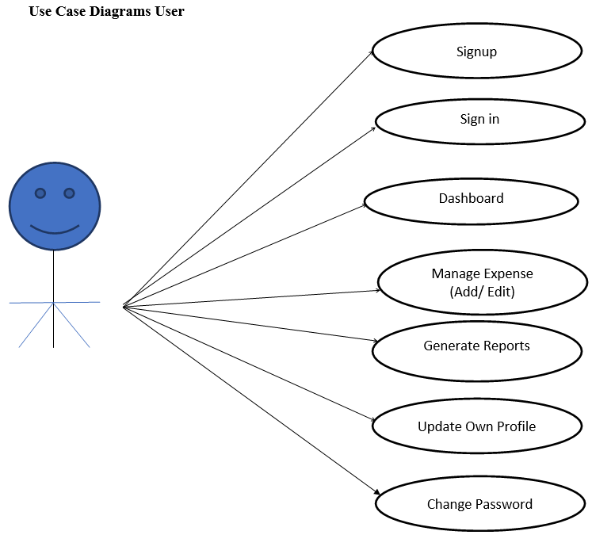
Use Case Diagram
Notes:
USECASE DIAGRAM: A Use case is a description of set of sequence of actions. Graphically it is rendered as an ellipse with solid line including only its name. Use case diagram is a behavioral diagram that shows a set of use cases and actors and their relationship. It is an association between the use cases and actors. An actor represents a real-world object. Primary Actor – Sender, Secondary Actor Receiver.

Slide 8
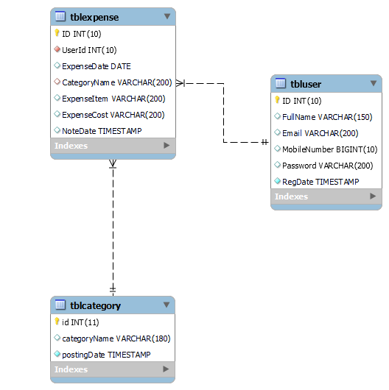
Class / Schema Diagram
Notes:
Class Diagram:
A description of set of objects that share the same attributes operations, relationships, and semantics

Slide 9
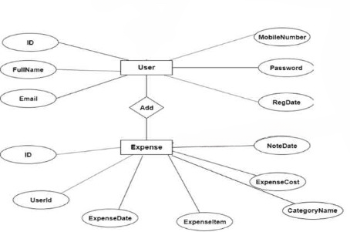
ER Diagram

Slide 10
Implementation and System Testing
After all phase have been perfectly done, the system will be implemented to the server and the system can be used.
System Testing
The goal of the system testing process was to determine all faults in our project .The program was subjected to a set of test inputs and many explanations were made and based on these explanations it will be decided whether the program behaves as expected or not. Our Project went through two levels of testing
Unit testing
Integration testing

Slide 11
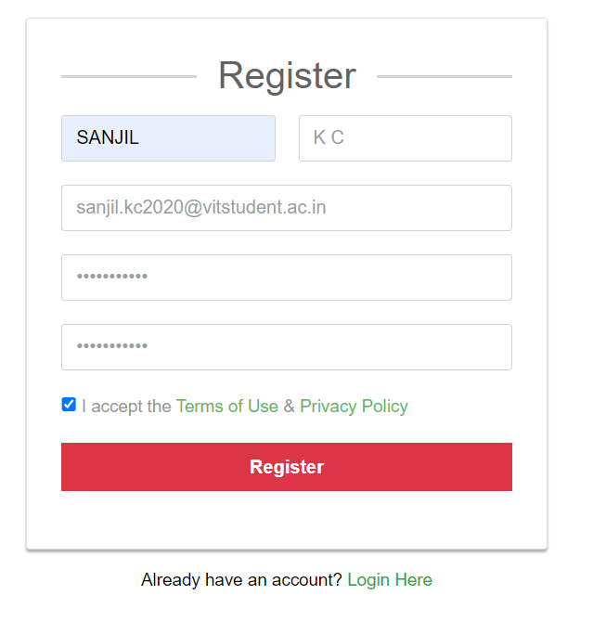
Project Screens
1 Register

Slide 12
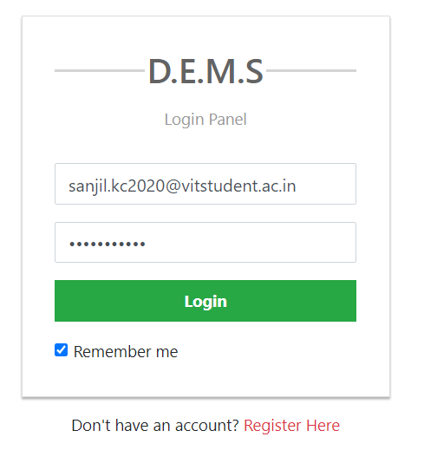
2 Login Page

Slide 13
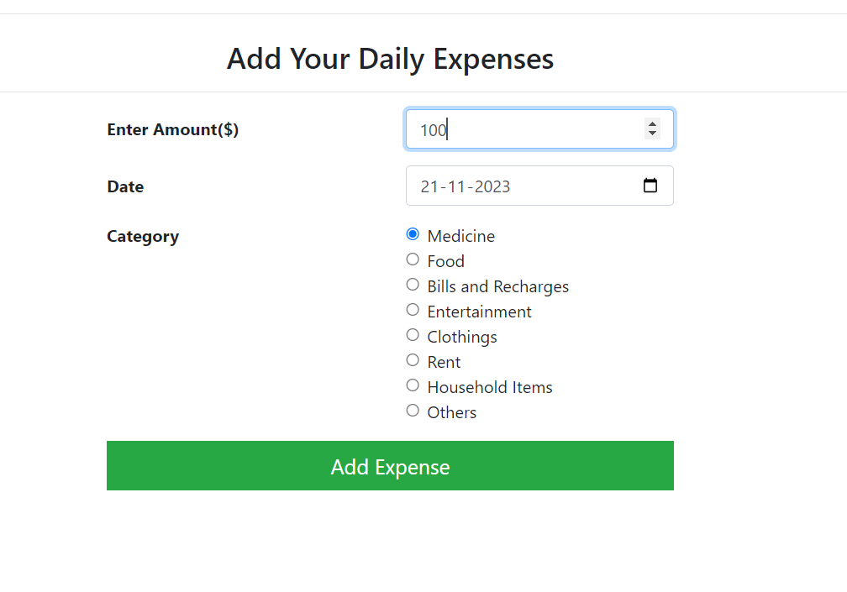
3 Add Expense

Slide 14
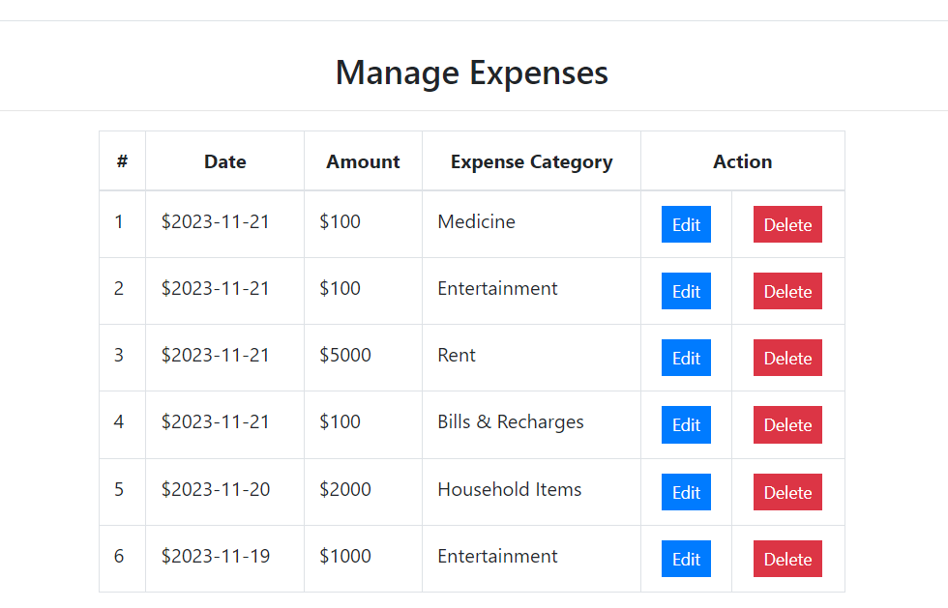
4 Manage Expense

Slide 15
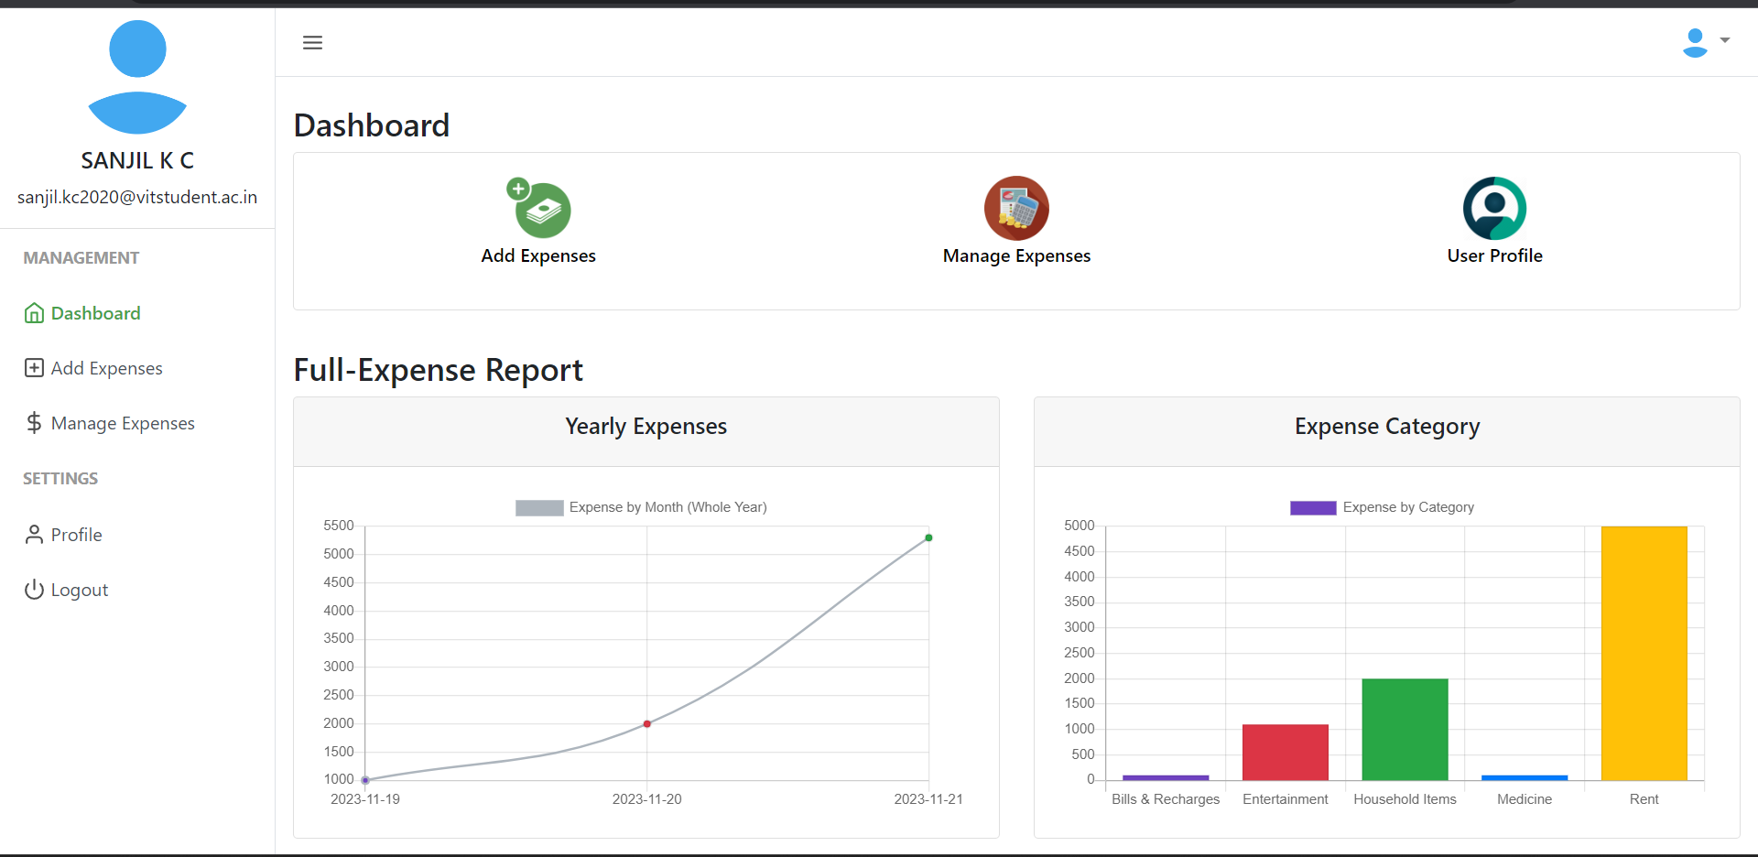
5 Dashboard

Slide 16
Conclusion
The project titled as Daily Expense Tracker System was deeply studied and analysed to design the code and implement. It was done under the guidance of the experienced project guide. All the current requirements and possibilities have been taken care during the project time.
Daily Expense Tracker System is used for maintain the daily expenses.

Slide 17
References
For PHP
https://www.w3schools.com/php/default.asp
https://www.sitepoint.com/php/
https://www.php.net/
For MySQL
https://www.mysql.com/
http://www.mysqltutorial.org
For XAMPP
https://www.apachefriends.org/download.html

Slide 18
Thank You

