Slide 1

CSE1003 – Digital Logic Design House Price Prediction
Winter Semester 2020-21
Digital Assignment – DA1,DA2,DA3
MOHAMED ASHRAF ALI (20BCE1630)
SANJIL K C (20BCE1855)

Slide 2
Abstract
The relationship between house prices and the economy is an important motivating factor for predicting house prices. A property’s value is important in real estate transactions. Housing price trends are not only the concern of buyers and sellers, but it also indicates the current economic situation. Therefore, it is important to predict housing prices without bias to help both the buyers and sellers make their decisions. In this project, we are going to create a website where user have to add some property details for predicting the house price, enter date for forecasting the price till that date and budget range for recommending best location. This project uses two datasets, one includes some features and large entries of housing sales in Mumbai and another contains house price index of Mumbai. We are using different feature selection methods and feature extraction method with Multiple Linear Regression to predict the current house price and using ARIMA model for forecasting the price after few years in Mumbai and also uses content based recommendation system to recommend best location according to their budget in nearby area of interest.

Slide 3
Motivation behind the project
Growing unaffordability of housing has become one of the major challenges for metropolitan cities around the world. In order to gain a better understanding of the commercialized housing market we are currently facing, we want to figure out what are the top influential factors of the housing price. Apart from the more obvious driving forces such as the inflation and the scarcity of land, there are also a number of variables that are worth looking into. Therefore, we choose to study the house prices predicting problem on Kaggle, which enables us to dig into the variables in depth and to provide a model that could more accurately estimate home prices. In this way, people could make better decisions when it comes to home investment.

Slide 4
Role of Machine Learning in the project
Machine learning is a branch of Artificial Intelligence which is used to analyse the data more smartly. It automates the process using certain algorithms to minimize human intervention in the process.
In this machine learning project, we are going to predict the house price using python. This project will help the sellers and buyers to have an overview of the situation so that they can act accordingly.
Here we are going to use linear regression to predict the house price. In a nutshell linear regression is a machine learning tool that helps you to make predictions by using the existing data (basically the relationship between the target data and set of other data). In our case, the house price basically depends on the parameters such as the number of bedrooms, location, size of living area, nearby places, etc.,

Slide 5
Components Required
S.No | Component Name | Range/Type | Quantity
1. | LOGIC GATE | AND GATE | 2
2. | WIRE | WIRE | 6
3. | INPUT | VOLTAGE SOURCE | 4

Slide 6
Brief Description on working
We are using Multiple Linear Regression Model for prediction and ARIMA Model for forecasting. Multiple linear regression (MLR), also known simply as multiple regression, is a statistical technique that uses several explanatory variables to predict the outcome of a response variable. The goal of multiple linear regression (MLR) is to model the linear relationship between the explanatory (independent) variables and response (dependent) variable. In essence, multiple regression is the extension of ordinary least-squares (OLS) regression that involves more than one explanatory variable. The Formula for Multiple Linear Regression Is:
yi=β0+β1xi1+β2xi2+...+βpxip+ϵ

Slide 7
where, for i= n observations: yi=dependent variable xi = explanatory variables β0=y-intercept (constant term) βp=slope coefficients for each explanatory variable ϵ=the model’s error term (also known as the residuals) The multiple regression model is based on the following assumptions: There is a linear relationship between the dependent variables and the independent variables. The independent variables are not too highly correlated with each other. yi observations are selected independently and randomly from the population. Residuals should be normally distributed with a mean of 0 and variance σ. The coefficient of determination (R-squared) is a statistical metric that is used to measure how much of the variation in outcome can be explained by the variation in the independent variables. R2 always increases as more predictors are added to the MLR model even though the predictors may not be related to the outcome variable. R2 by itself can't thus be used to identify which predictors should be included in a model and which should be excluded. R2 can only be between 0 and 1, where 0 indicates that the outcome cannot be predicted by any of the independent variables and 1 indicates that the outcome can be predicted without error from the independent variables. When interpreting the results of a multiple regression, beta coefficients are valid while holding all other variables constant ("all else equal"). The output from a multiple regression can be displayed horizontally as an equation, or vertically in table form. Recommender System is a system that seeks to predict or filter preferences according to the user’s choices. Recommender systems are utilized in a variety of areas including movies, music, news, books, research articles, search queries, social tags, and products in general.

Slide 8
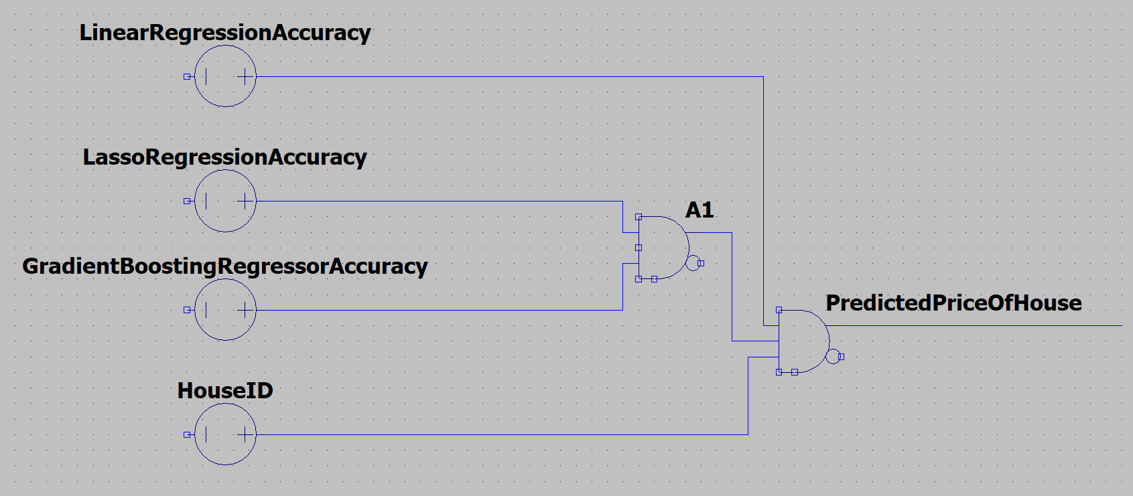
Circuit Diagram

Slide 9
Software used & Short description of software
Coding Language : Python3, HTML, PythonFlask
Coding software : Anaconda, Spyder, JupyterNotebook,Sublime text 3
Anaconda is a distribution of the Python and R programming languages for scientific computing (data science, machine learning applications, large-scale data processing, predictive analytics, etc.), that aims to simplify package management and deployment.
Spyder is an open-source cross-platform integrated development environment (IDE) for scientific programming in the Python language. Spyder uses Qt for its GUI and is designed to use either of the PyQt or PySide Python bindings.The Jupyter Notebook is an open source web application that you can use to create and share documents that contain live code, equations, visualizations, and text.
Sublime Text is a shareware cross-platform source code editor with a Python application programming interface (API). It natively supports many programming languages and markup languages, and functions can be added by users with plugins, typically community-built and maintained under free-software licenses.

Slide 10
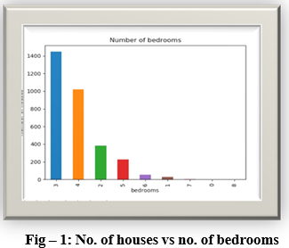
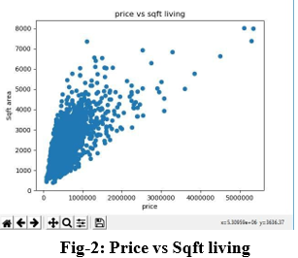
Output waveforms and Results

Slide 11
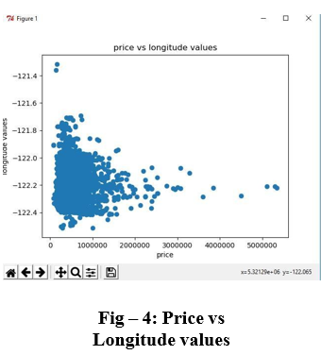
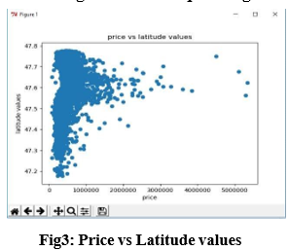

Slide 12
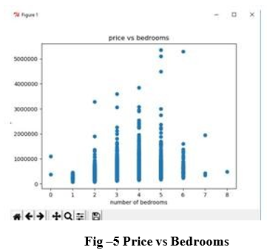
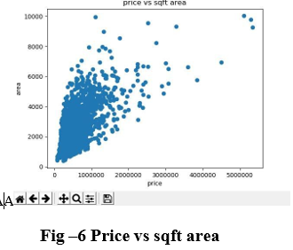
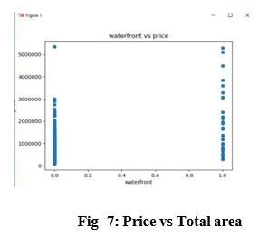

Slide 13
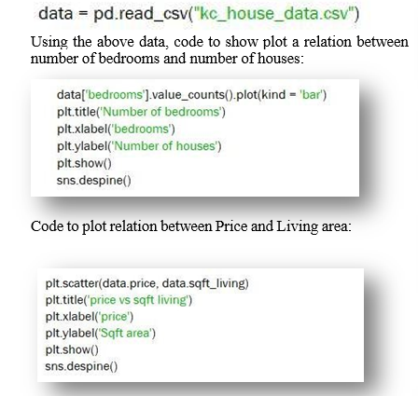
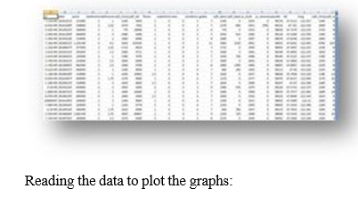
Screen shot / Photo of the project Implementation

Slide 14
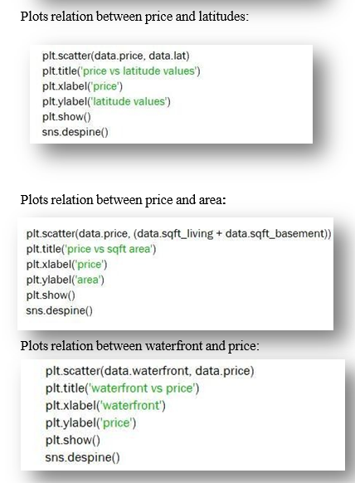
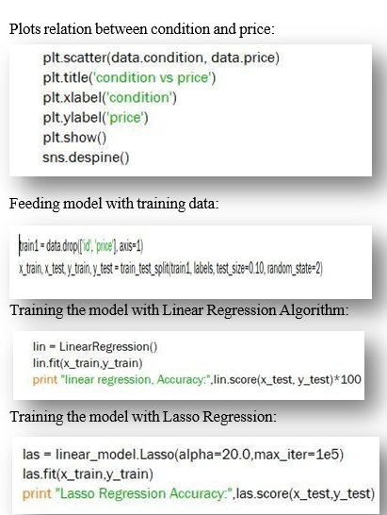

Slide 15
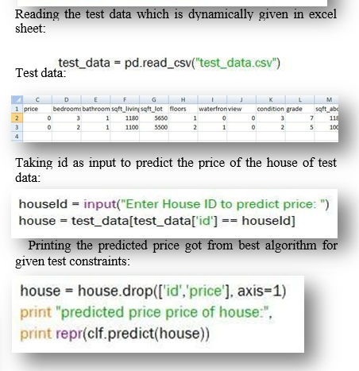

Slide 16
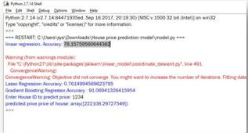
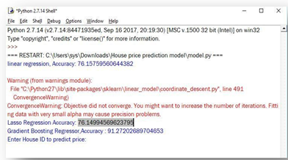
Screen shot / Photo of the project Output
Linear Regression accuracy:
Lasso Regression accuracy:

Slide 17
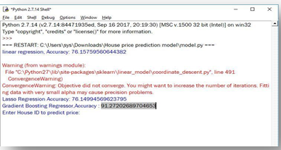

Gradient Boosting Regression accuracy:
Taking input ID for prediction:

Slide 18
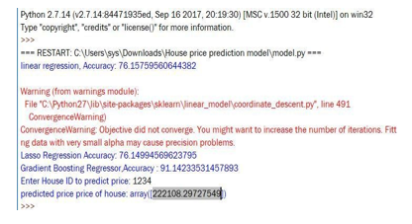
Getting predicted price as output:

Slide 19
Inferences obtained from the project
Throughout this project we made a machine learning regression project from end-to-end and we learned and obtained several insights about regression models and how they are developed.

Slide 20
Societal Impact of the project
Prediction house prices are expected to help people who plan to buy a house so they can know the price range in the future, then they can plan their finance well. In addition, house price predictions are also beneficial for property investors to know the trend of housing prices in a certain location.

Slide 21
Application(s)
Thus, there is a need to predict the efficient house pricing for real estate customers with respect to their budgets and priorities. This paper efficiently analyses previous market trends and price ranges, to predict future prices.

Slide 22
Future scope of the project
The project “HOUSE PRICE PREDICTION BASED ON SOME ECONOMIC FACTORS” is an application that is developed to predict the price of house which is helpful for future of customer. ... The proposed system describes Hedonic Pricing model which accurate 67% exact value of house in future.

Slide 23
Conclusion
We have managed out how to prepare a model that gives users for a novel best approach with take a gander at future lodging value predictions. A few relapse strategies have been investigated Furthermore compared, when arriving during a prediction strategy In light of XG support. Straight former imply works bring been utilized within our model, something like that that future value predictions will have a tendency towards All the more sensible values. We concocted an approach with use similarly as considerably information as time permits for our prediction system, by adopting those ideas from claiming gradient boosting.
Inspite of Hosting generated all the attempting provision that met our introductory requirements, there are Different upgrades that could be produced later on. These incorporate upgrades we didn't settle on because of constrained duration of the time. A real worry for the prediction framework may be the stacking period. Moreover, our data set takes more than one day should prepare. As opposed performing the computations sequentially, we might utilize various processors and parallel the computations involved, which might possibly decrease the preparation time Furthermore prediction period. Include All the more functionalities under the model, we can give choices for client with select a district alternately locale should produce those high temperature maps, as opposed to entering in the list.

Slide 24
References
https://medium.com/@ageitgey/machine-learning-is-fun-80ea3ec3c471
https://www.sas.com/en_us/insights/analytics/machine- learning.html#machine-learning-importance
http://www.wired.co.uk/article/machine-learning-ai-explained
https://deeplearning4j.org/ai-machinelearning-deeplearning
David E. Rapach , Jack K. Strauss “ Forecasting real housing price growth in the Eighth District states”
Vasilios Plakandaras+ and Theophilos♦, Rangan Gupta*, Periklis Gogas “Forecasting the U.S. Real House Price Index”
Gupta and Das (2010) Forecasting the US Real House Price Index: Structural and Non-Structural Models with and without Fundamentals
Rangan Gupta “Forecasting US real house price returns over 1831– 2013: evidence from copula models”

