Slide 1
Image Encryption
TRIPLE DES

Slide 2
Table of Contents
01
02
03
04
INTRODUCTION
TECHNOLOGIES USED
ARCHITECTURE
SUMMARY

Slide 3
01
Introduction

Slide 4
PROJECT
This is a simple website developed for the purpose of IMAGE ENCRYPTION using TRIPLE DATA ENCRYPTION STANDARD. The aim is to provide higher security standards during the transfer of images over the network.Further detailed explanation is given in the submitted report.

Slide 5
DEVELOPER
The project was developed by SANJITA S.
I have completed my second year in MSc.Software systems from PSG College of technology, Coimbatore.
Email : sanjusrini2001@gmail.com
Linkedin:https://www.linkedin.com/in/sanju-srinivasan/

Slide 6
02
Technologies used

Slide 7
Technologies
HTML
CSS
01
02
FRONTEND TEMPLATES
STYLING FRONTEND TEMPLATES
BOOTSTRAP
PYTHON, DJANGO
03
04
STYLING FRONTEND TEMPLATES
BINDS THE FRONTEND AND BACKEND BY RENDERING TEMPLATES SQLITE3 IS USED FOR STORING THE IMAGES

Slide 8
03
Architecture

Slide 9
Understanding the Project
Triple DES
Crypto.cipher
Django
Encryption and Decryption(Detailed explanation in the report)
Package consisting of algorithms for confidentiality.
(Implementation)
Project developed using django (framework built on python)

Slide 10
WEB PAGES
HOME PAGE
Encryption / decryption page navigation.
Encryption page
Images can be encrypted here.
Decryption page
Encrypted files can be decrypted here.

Slide 11
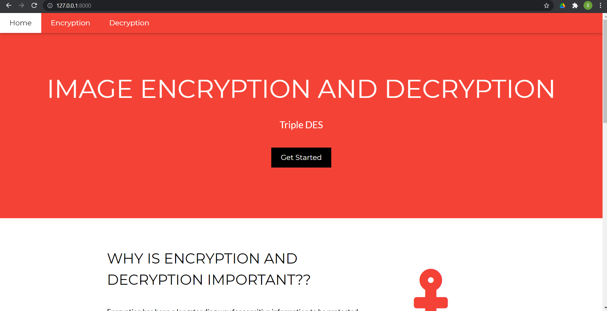
HOME PAGE (preview)

Slide 12
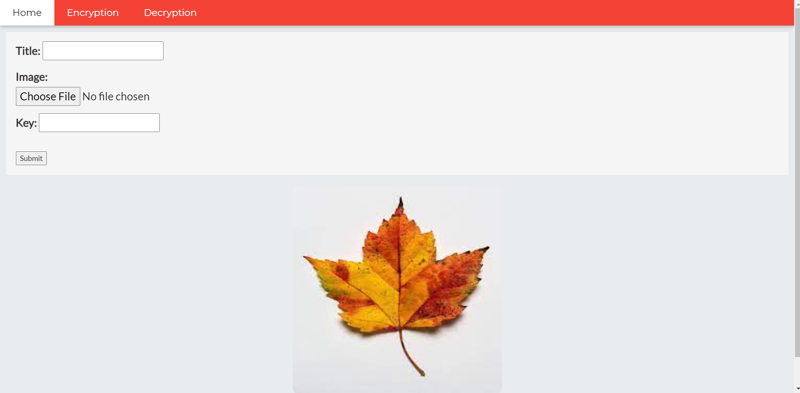
ENCRYPTION PAGE

Slide 13
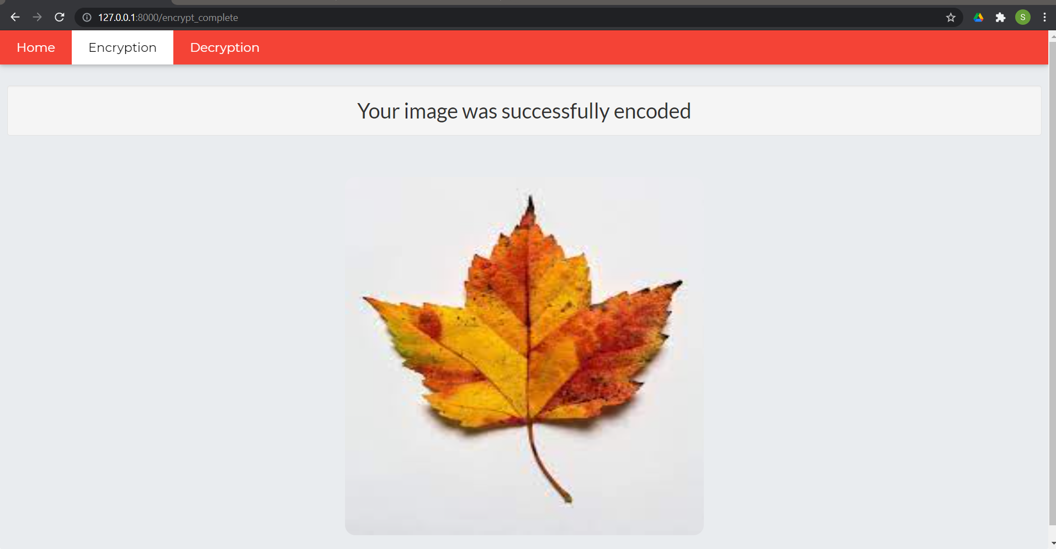
ENCRYPTION_COMPLETE

Slide 14
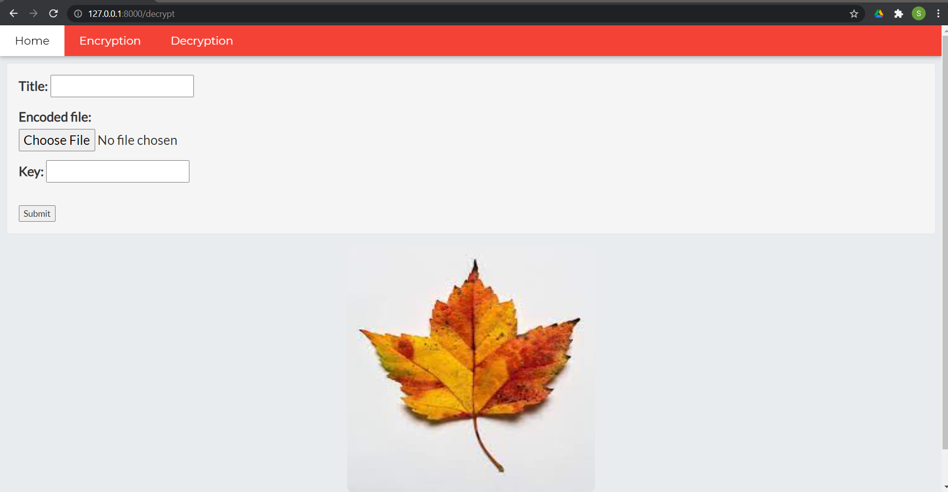
DECRYPTION PAGE

Slide 15
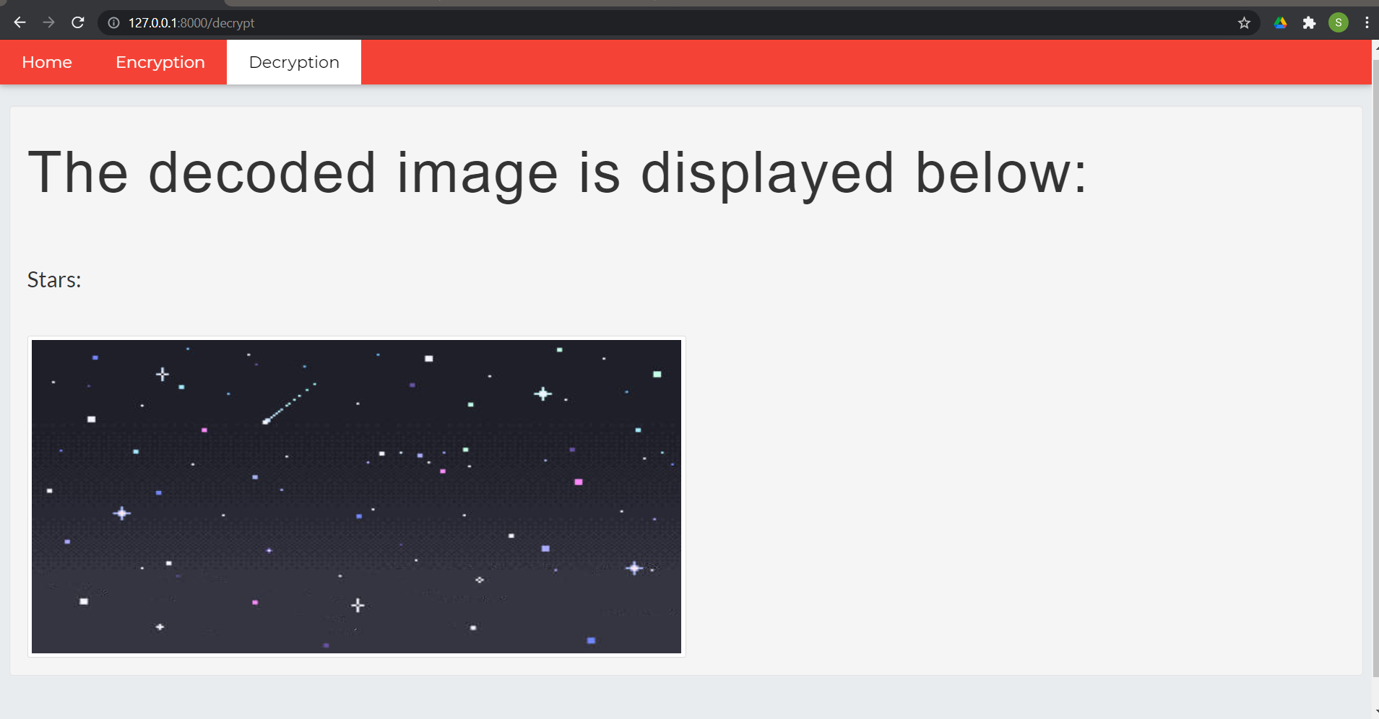
DECRYPTION_COMPLETE

Slide 16
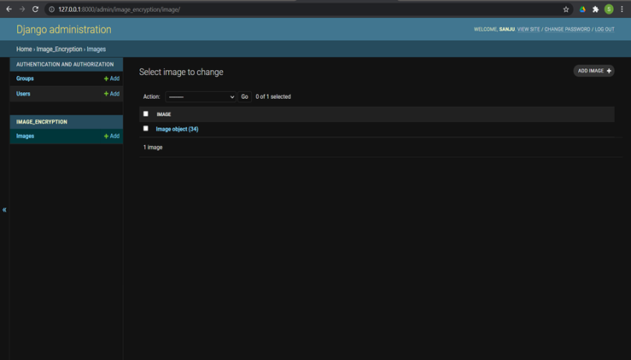
DATABASE

Slide 17
SUMMARY
Triple DES is
More secure than DES and prevents intrusion attacks
Best when 3 unique secret keys used
Cyber Security is one of the most important domains in the IT industry. Lets learn new algorithms and techniques to keep all our data safe.

Slide 18
THANK YOU
Regards,
SANJITA S

