Slide 1
F107 – Foundations of Computer Science Lecture 1 Dr. Sanjit Kumar Saha

Slide 2
Topics
Foundations of Computer Science
Computation models
Computer components
Hardware vs. Software
History of computing machines
Types of computing machines
Number systems
Decimal, binary, octal, hexadecimal systems
Basic arithmetic
“Foundations of CS” by B. Forouzan
Chapters 1 and 2

Slide 3
Computer
What is a computer?
Electronic device
Takes input (instructions from the user), process it and gives the desired output (result)

Slide 4
Computer
Inputs
Processor
Outputs
What is a computer?

Slide 5
Computer
Inputs
Processor
Outputs
What is a computer?
Program

Slide 6
Computer
Inputs
Processor
Outputs
What is a computer?
Programmable processor that transforms inputs in well-defined manner into outputs
Program

Slide 7
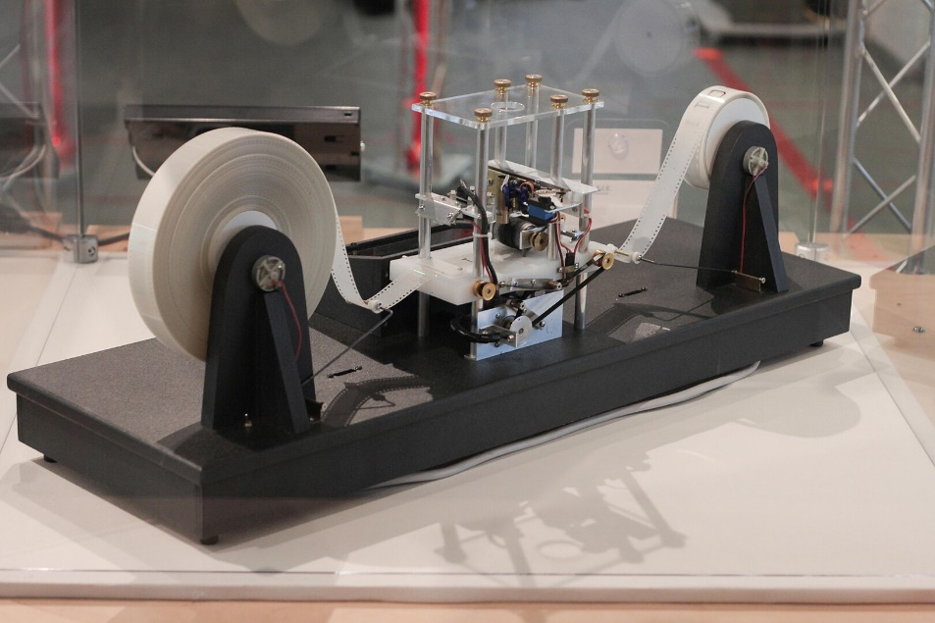
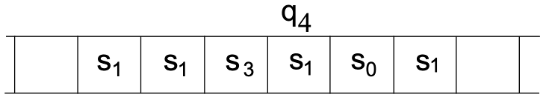
Turing Machine Model
Formalization proposed by Alan Turing in 1936
Theoretical device that edits symbols on a tape
Defines computability
Basis for theoretical computer science and current computers
Operation of a specific Turing Machine
Infinitely long memory tape
Discrete cells containing symbols from an alphabet
Machine has two major components
Head points at a cell
State
Actions:
Process content of cell, depending on current state
Go to left, go to right, or halt
Pictures: Wikipedia

Slide 8
Universal Turing Machine
What about different tasks?
Tasks have an own associated Turing machine (or multiple)
Generalization: Universal Turing Machine
A single machine that can simulate any other Turing machine
Interprets both as input
Description of a specific Turing Machine
Actual data to work on
Introduces programmability into theoretical computing
Important ability: “Turing Completeness”
A “computing device” that can simulate any Turing Machine
Not all tasks can be computed!

Slide 9
Von Neumann Architecture Model
Concept introduced in 1945 by John von Neumann
Foundation in most modern computer systems
Hardware vs. Software
Pictures: Wikipedia

Slide 10
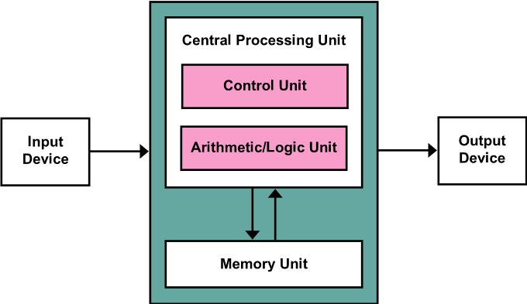
Von Neumann Architecture Model
Concept introduced in 1945 by John von Neumann
Foundation in most modern computer systems
Hardware vs. Software
Computer consists of two major parts
Hardware
Memory
Central processing unit (control unit, ALU)
Input and outputs (I/O)
Software
Program and data
Both stored in the same memory
Extensions of the V-N-A: Specialized hardware components
Pictures: Wikipedia

Slide 11
Components of a (Present-Day) Computer
Hardware: physical parts
Mainboard
CPU
Memory (RAM, HDD, SSD, …)
Software: operational instructions
Operating System
Programs
Data:
Binary format representation of values

Slide 12
Programs and Algorithms
Instruction
Most basic single task for a CPU
Algorithms
Step-by-step methods to solve problems
Programs
Sequences of instructions that realize algorithms
Instructions are grouped into functions
Allow to reuse sets of instructions to make programming scalable
Take inputs and generate outputs
Programming language
Formal representation of instructions
Following specific syntax and have semantics
High-level and low-level languages

Slide 13
Taxonomy of Computers
Taxonomies based on
Computational Capabilities
Purpose
General Purpose Computers: can be tailored to needs
Special Purpose Computers: Special setup for one task
Data Handling
Best-Effort System: Unpredictable performance
Real-Time System: Guaranteed execution times
Mainframes: handle large-scale processing
Minicomputers: devices support multiple concurrent users
Embedded systems: specific-purpose devices
Supercomputers: extremely fast, parallel systems
Microcomputers: devices support one user; laptops, desktops
Location
Local System: All components locally available
Distributed System: Geographically separation of computation/storage

Slide 14
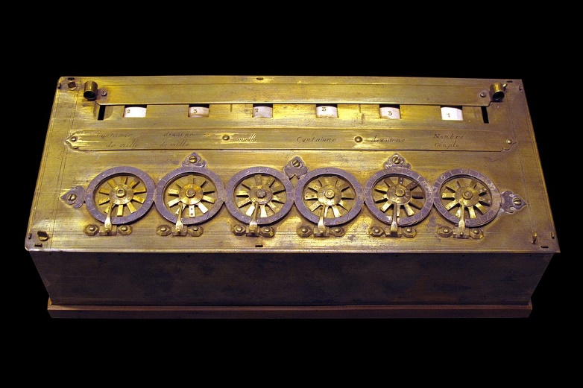
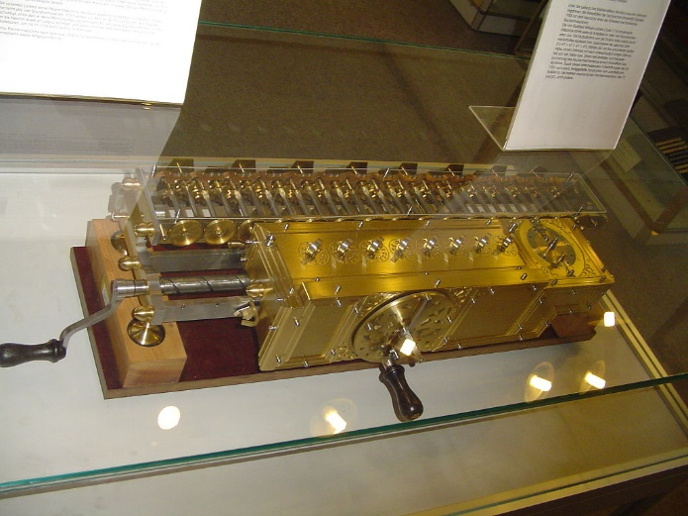
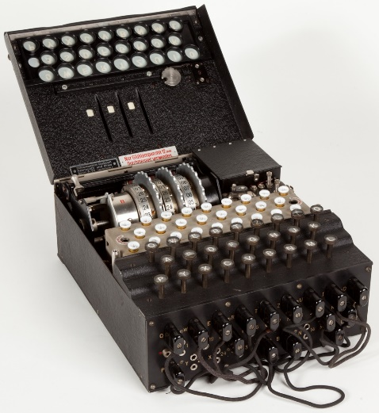
History of Mechanical Computing Machines
Pascaline (1642) – mechanical adder (Pascal)
Leibniz Wheel (17th century) – four-function calculator
Jacquard Loom (1804) – punch card programming for looms
Analytical Engine (1837) – Babbage created device that had ALU, memory, and control engine
Enigma (1940) – Encryption and decryption machine for secure communication
Pictures: Wikipedia

Slide 15
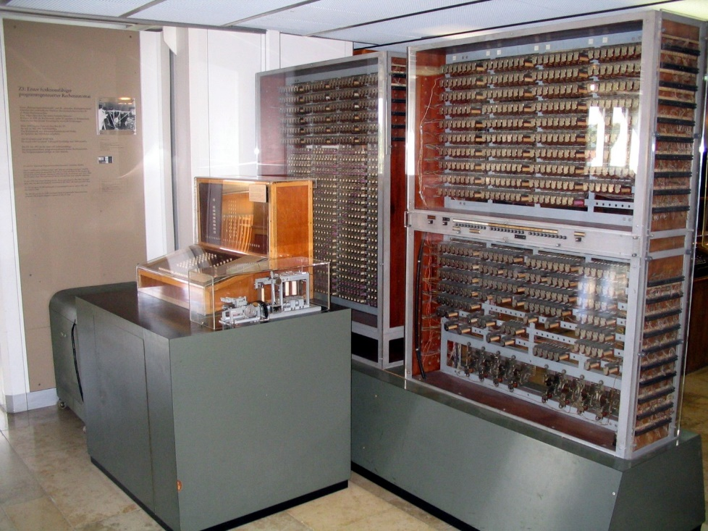

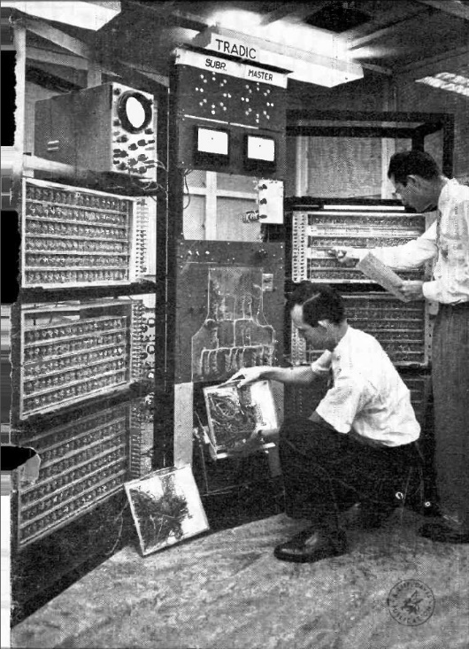
History of Electronical Computing Machines
Z3 (1941): Konrad Zuse invented first programmable electronic computer
ENIAC (1945): first general-purpose computer
EDSAC (1949): first to use stored program concept
TRADIC (1954): first transistor-based computer
Pictures: Wikipedia

Slide 16
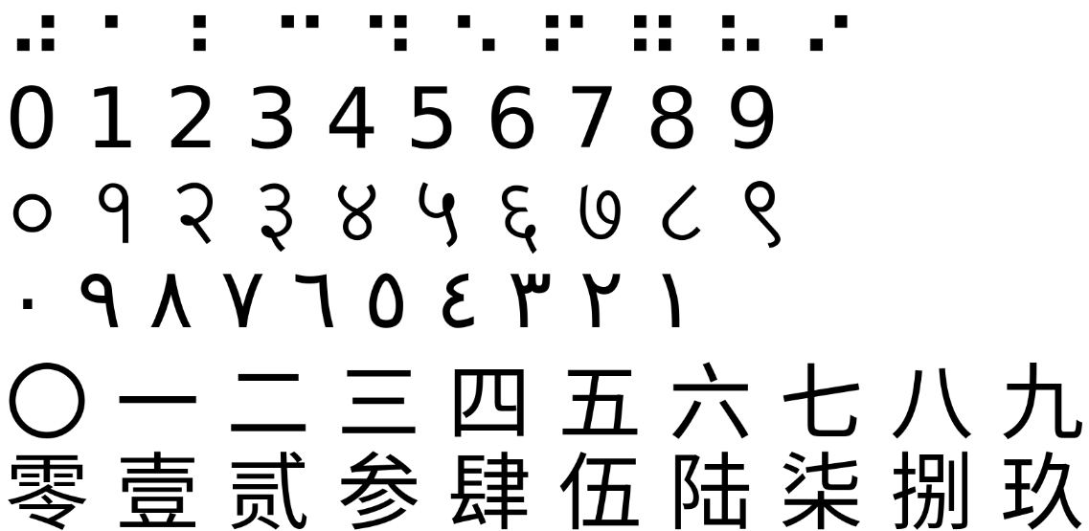
Number Systems Overview
Number systems define representation of numbers using symbols
Positional systems
Non-positional systems
Symbols represent certain meaning
Can be combined
Humans: Decimal System
Base-10
Machines: Binary System
Base-2
Pictures: Wikipedia

Slide 17
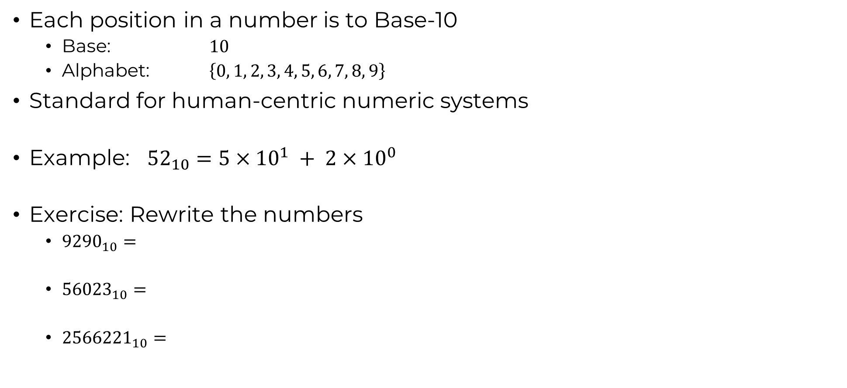
Decimal System (Base-10)

Slide 18
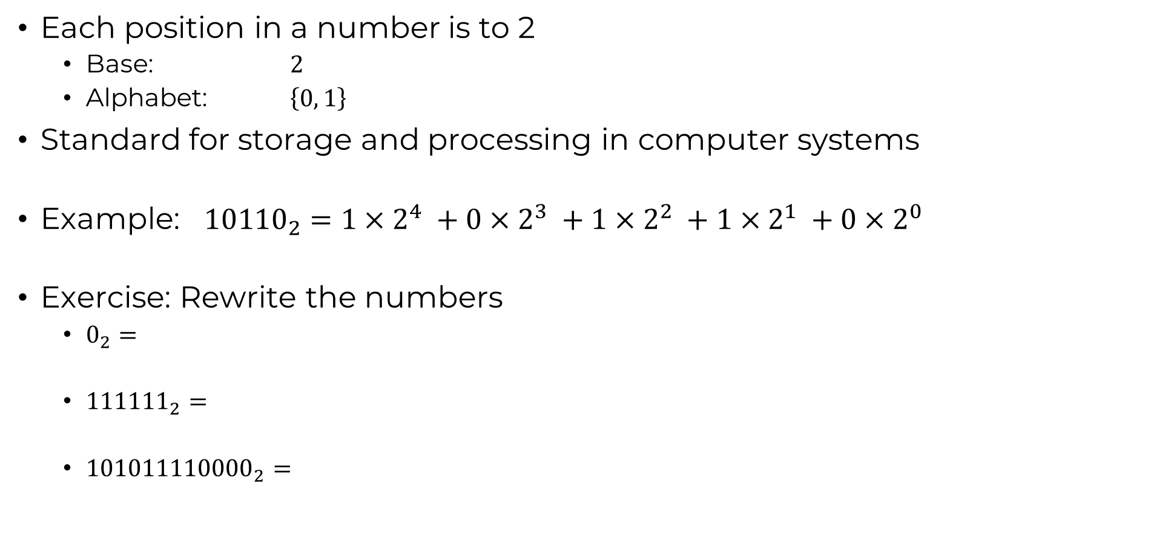
Binary System (Base-2)

Slide 19
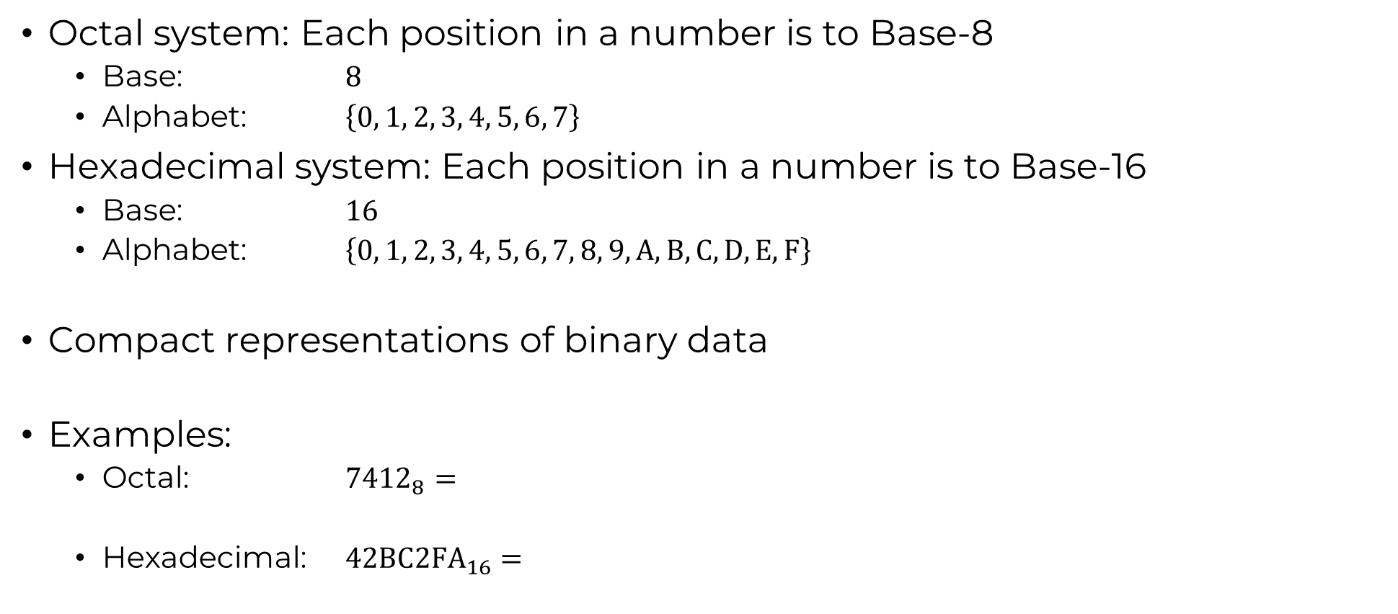
Octal and Hexadecimal System (Base-8/-16)

Slide 20
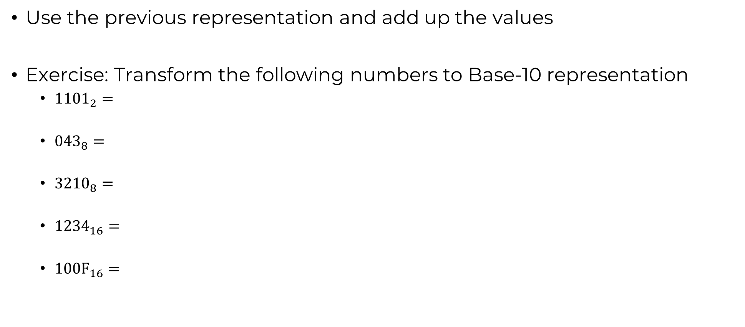
Conversions to Base-10

Slide 21
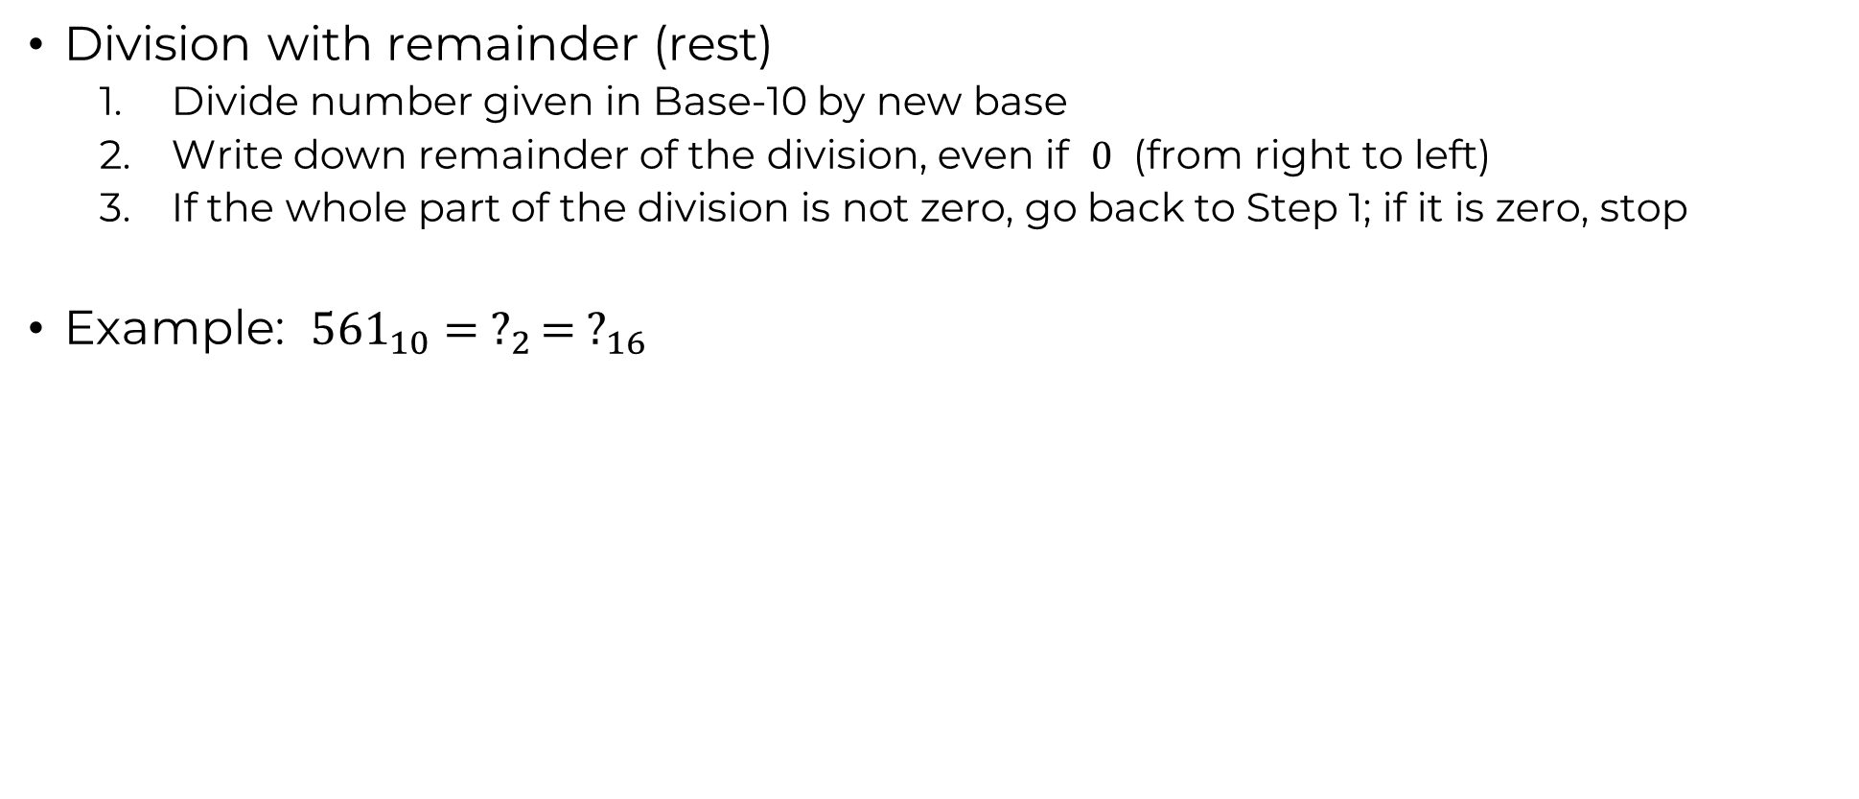
Conversions from Base-10

Slide 22
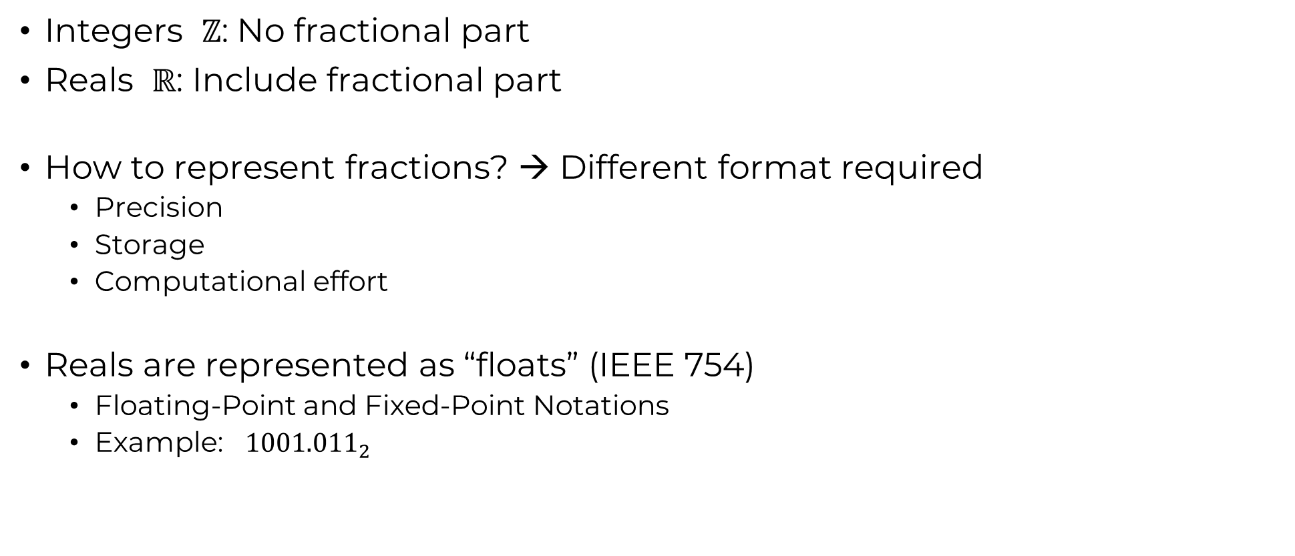
Real Numbers vs. Integer Numbers
See Session 3

Slide 23
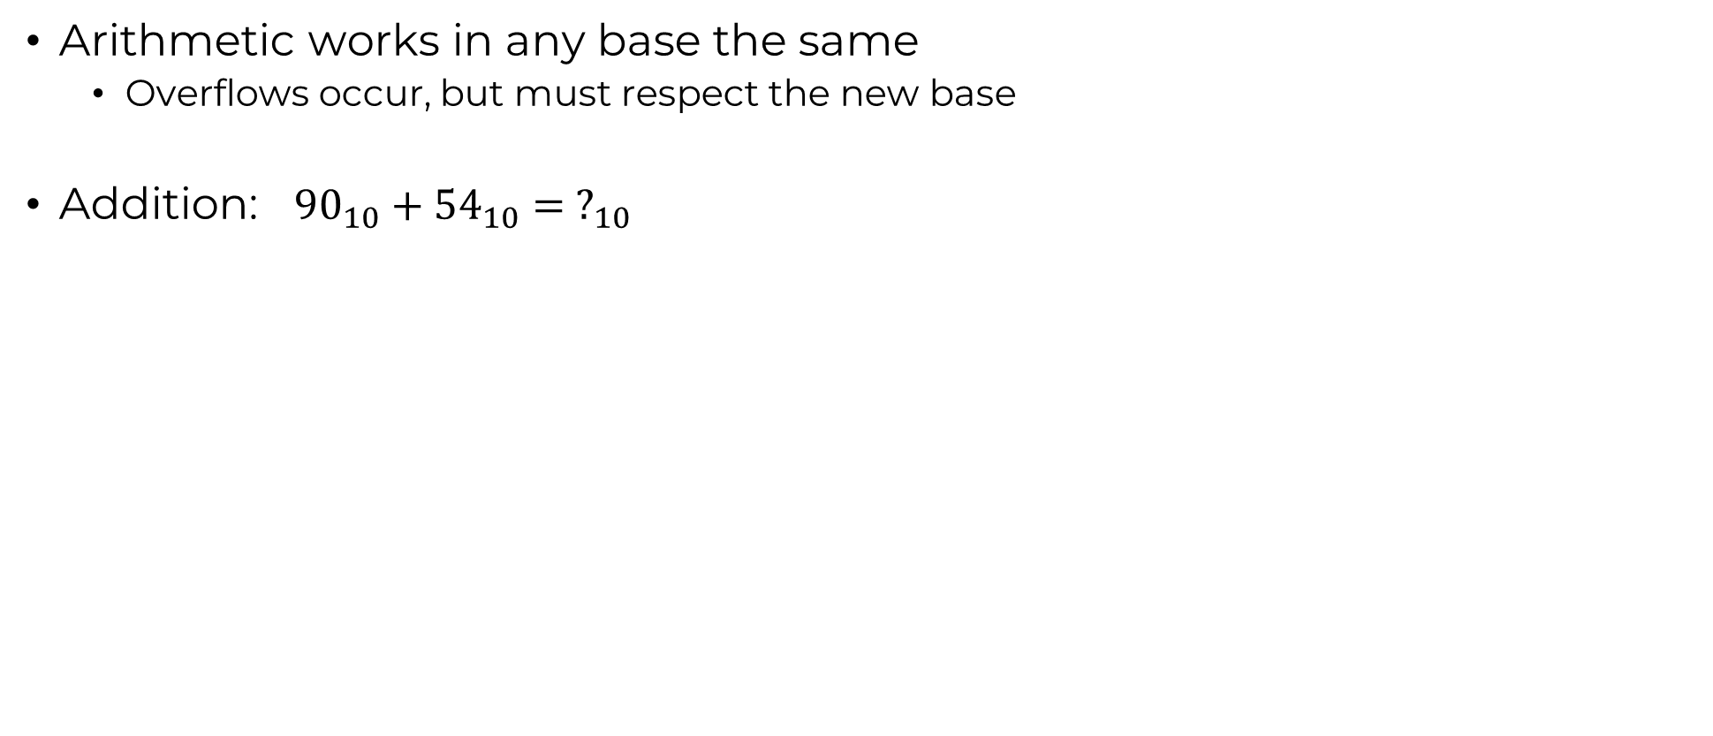
Arithmetic in Base-2

Slide 24
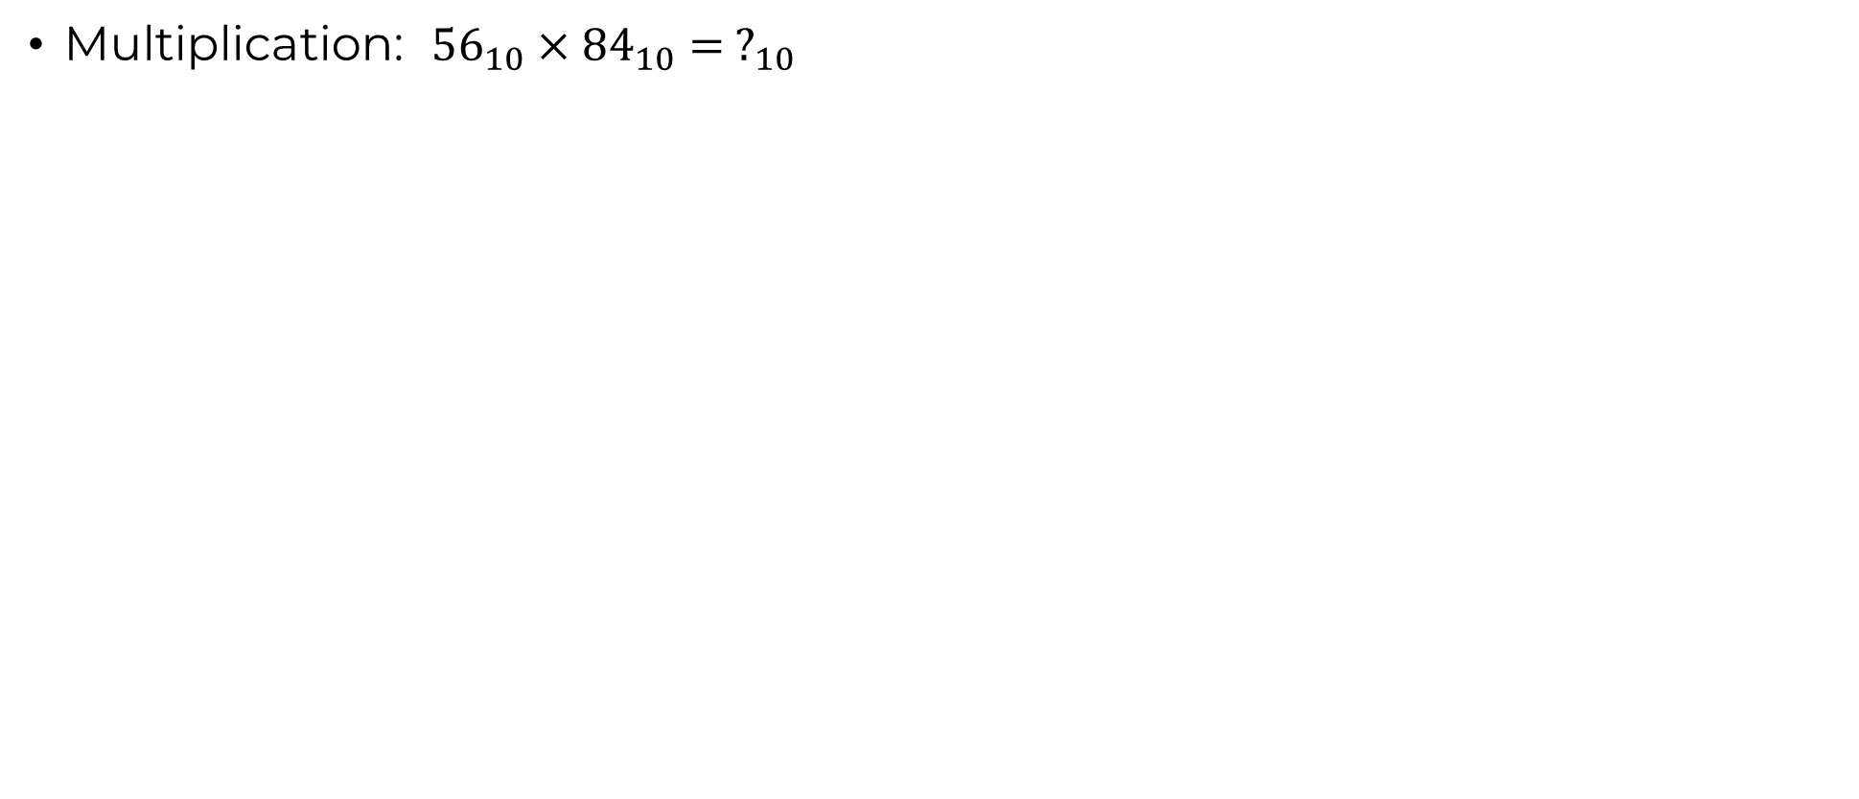
Arithmetic in Base-2

Slide 25
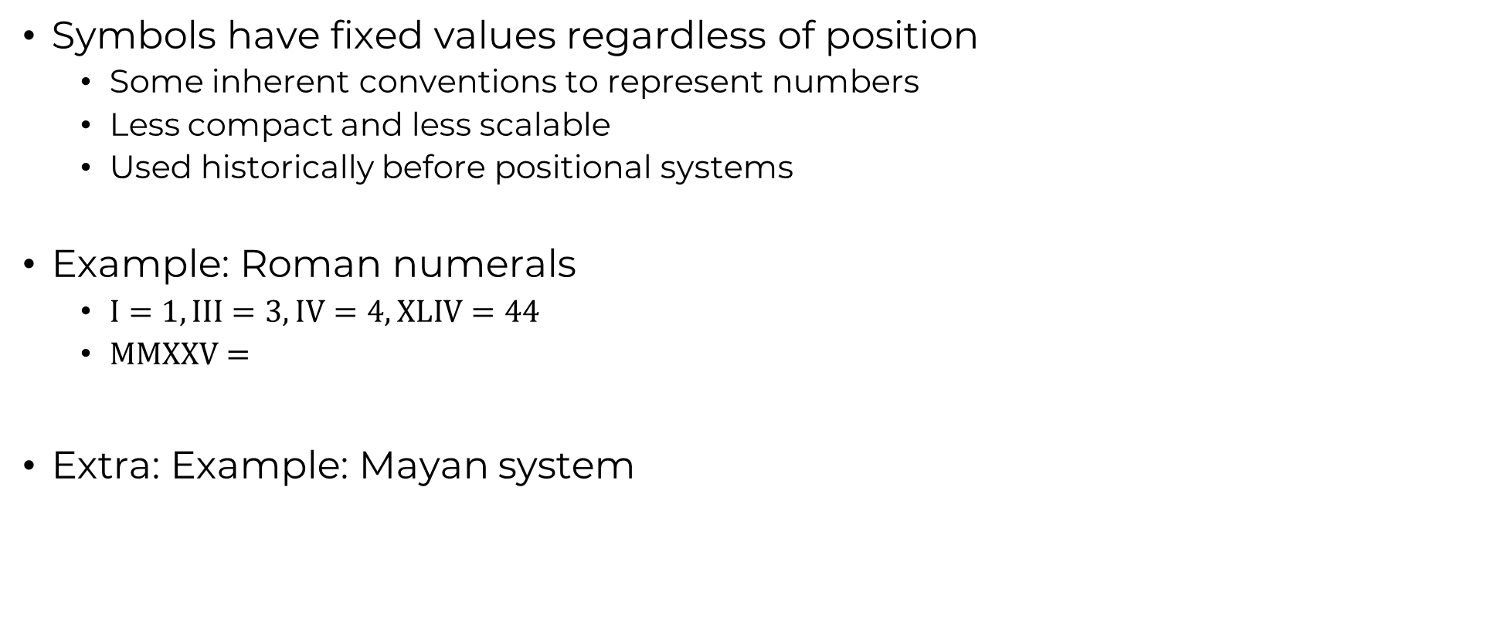
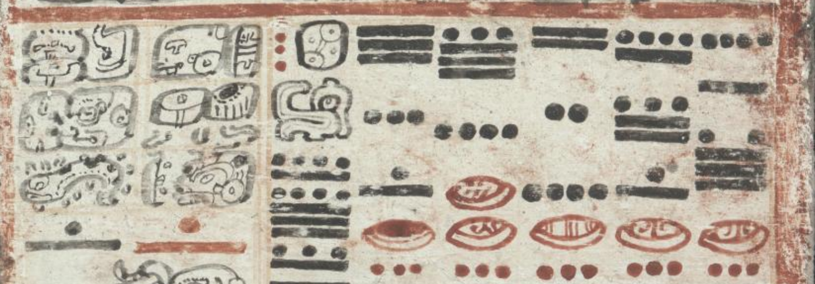
Non-Positional Number Systems
I | V | X | L | C | D | M
1 | 5 | 10 | 50 | 100 | 500 | 1000

Slide 26
Task 1
Explain the key differences between the Turing and Von Neumann models

Slide 27
Task 2
Create a taxonomy diagram showing types of computers with examples

Slide 28
Task 3
Describe the historical significance of the Jacquard Loom

Slide 29
Task 4
List and describe the four components of the Von Neumann architecture

Slide 30
Task 5
What makes a system 'Turing complete'?

Slide 31
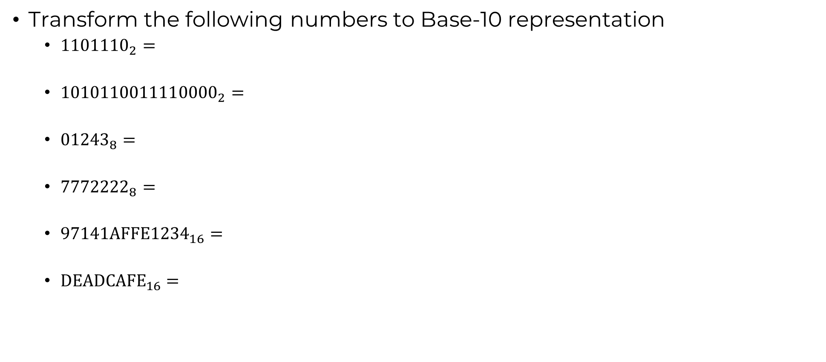
Task 6

Slide 32
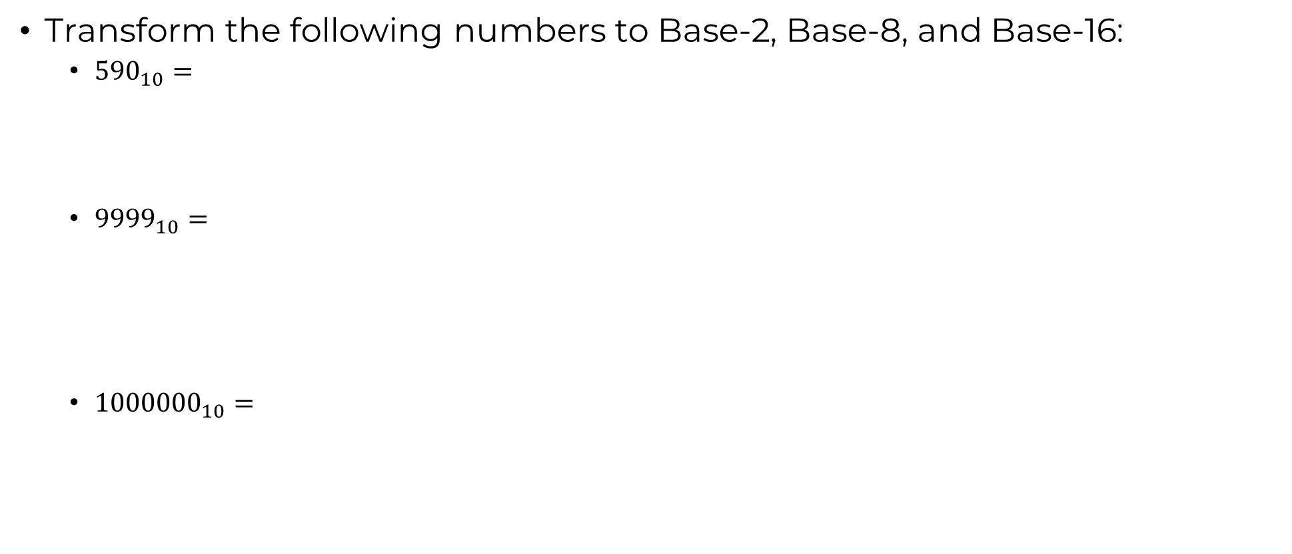
Task 7

Slide 33
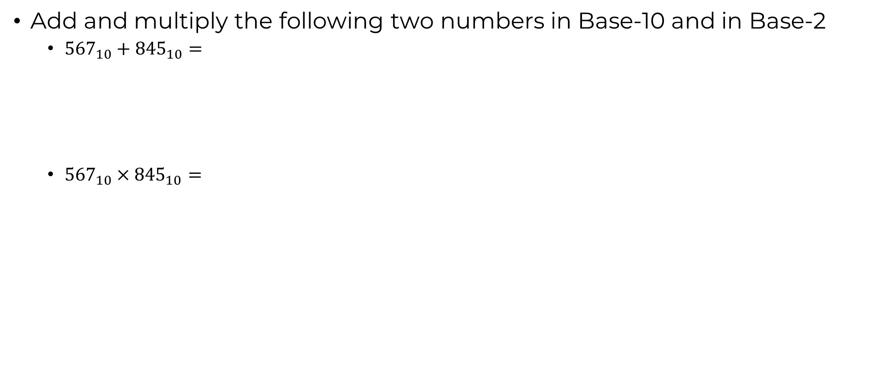
Task 8

Slide 34
Task 9
Describe the steps to convert a fractional Base-2 number to Base-10

Slide 35
Task 10
Describe floating-point representation and mention its limitations

