Slide 1
CITYFIX
Citizen-powered city issue
reporting & tracking
One platform where a citizen photographs a pothole, the authority routes it, the crew fixes it, and the citizen can see that it was actually resolved.
Planned, specified and executed end-to-end by AI agents — BMAD · WDS · AIDLC · Specsmd
Next.js 14 · TypeScript strict · PostgreSQL 16 + Prisma · MapLibre + OSM · Playwright + Vitest

Slide 2
HOW THIS WAS BUILT
The project was planned, specified and executed by AI agents
Four agentic methodologies were chained — each one owning a different layer — and every artefact they produced is still in the repository.
BMAD
WDS
AIDLC
Specsmd
Agent library & method
Design & spec lane
Delivery lifecycle
AI-DLC orchestration
Mary · John · Sally · Winston · Amelia
Saga · Freya · Mimir
Product · Architect · Dev · QA agents
Master · Inception · Construction · Ops
Supplied the specialist agent roles and the method modules the other lanes compose.
→
Turned the idea into a product brief, personas, 33 page specs, a design system and 5 work orders.
→
Ran the intent through ideation, inception and construction as guarded, gated stages.
→
Orchestrated the intent, dispatched the stages, and enforced the human checkpoints.
15 agent personas, 7 method modules
69 design artefacts · 8,294 lines
23 staged pipeline · 4 phases
14 agents · 4 phase agents
The output of one lane is the input of the next. BMAD supplies the roles, WDS writes the specification, AIDLC runs the lifecycle against it, and Specsmd orchestrates the agents that do the work.
CityFix
2

Slide 3
BMAD · THE AGENT LIBRARY
Specialist agents, each with a narrow job and a point of view
BMAD supplied the role roster that every other lane draws on. They are not chat personas — each carries a method, a checklist and a definition of done.
Mary
John
Sally
BUSINESS ANALYST
PRODUCT MANAGER
UX DESIGNER
Channels Porter and Minto. Grounds every finding in verifiable evidence and represents every stakeholder voice.
Drives Jobs-to-be-Done over template filling. User value first; technical feasibility is a constraint, not the driver.
Balances empathy with edge-case rigor. Starts simple, evolves through feedback, and serves a genuine user need.
Winston
Amelia
Murat
SYSTEM ARCHITECT
SENIOR ENGINEER
TEST ARCHITECT
Favours boring technology for stability. Ties every architectural decision back to business value.
Test-first discipline. 100% pass before review. Every statement citable, every path exact.
Risk-based strategy, ATDD, contract and performance testing. Strong opinions, weakly held.
Alongside the software crew, BMAD also ships a creative module — Sophia the storyteller, Maya the design-thinking coach, Carson the brainstorming specialist, Dr. Quinn the problem solver, Victor the innovation strategist — and Caravaggio, the presentation expert.
15 agent personas across 7 modules — installed in-repo at _bmad/.
CityFix
3

Slide 4
WDS · THE DESIGN LANE
The idea became a specification before a line of code was written
WDS ran the project through five design phases. Each phase left an artefact on disk that the next phase consumed — and that the build later consumed too.
A
B
C
D
E
Product Brief
Trigger Map
UX Scenarios
Design System
Development
4 files
7 files
38 files
12 files
8 files
The civic problem, the make-or-break constraint, and the headline finding: authority onboarding gates success, not citizen acquisition.
Four personas scored on 16 driving forces. Result: process-integrity forces dominate — success is gated by operational clarity, not emotional design.
33 screens specified as spec-as-contract. Every screen carries its own route, states, data and acceptance criteria.
Tokens, components and hero mockups. These tokens are the literal source of the palette this very deck is built from.
Tech audit, master PRD and 5 work orders with an explicit dependency graph — WO-000 first, then the four personas.
69 artefacts · 8,294 lines of specification · 33 screens · 4 personas · 5 work orders
Every number here is a file count in design-artifacts/ — the specification is not a claim, it is a directory.
CityFix
4

Slide 5
AIDLC · SPECSMD · THE ENGINE ROOM
The plan was executed as guarded stages, not improvised
AIDLC defined the lifecycle and its gates. Specsmd supplied the orchestrator that dispatches the agents, holds the context and enforces the human checkpoints.
THE PIPELINE
WHAT THE ENGINE ENFORCES
Ideation
Guard policy
Intent, feasibility, market research, scope, rough mockups
Strict. The engine refuses a step that would skip a required gate — refusals are recorded, not argued with.
▼
Inception
Human checkpoints
Requirements, stories, architecture, units, bolts
Plan approval, assumption confirmation and verification-command selection are human stops. Auto mode never touches them.
▼
Construction
Persistent context
Code generation, build and test, delivery planning
Org, team, project and phase rules are re-resolved every session, so the agents never drift from the contract.
▼
Operation
Full trace
Deploy, observe, validate performance
Every stage writes an artefact, a review and an audit shard. The build log is reconstructible after the fact.
23 stages configured for this intent · 14 specialised agents · 4 phase orchestrators · guard refusals logged, not hidden.
CityFix
5

Slide 6
THE PROBLEM
A broken streetlight is reported to nobody
There is no single place to report a city problem, no way to know who owns it, and no way to know if it was ever fixed.
No single front door
No ownership
Reports scatter across phone calls, Facebook, Messenger and different government channels. Citizens do not know where to file.
A complaint arrives with no ward, no responsible agency and no priority. It sits in a list nobody owns.
No trail
No dedup
Once filed, the citizen has no visibility. Submitted → fixed? Or silently dropped?
Forty people report the same pothole. Without proximity detection the agency sees forty issues instead of one.
CityFix closes every one of those gaps — not with a bigger phone tree, but with one traceable pipeline.
CityFix
6

Slide 7
THE SOLUTION
Four roles, one ticket, one trail
A single report is threaded through the chain: filed by a citizen, triaged by a dispatcher, resolved by a crew, governed by an admin.
Citizen
Dispatcher
Crew
Admin
Rahim
Habib
Rashid
Anwar
/home
/dispatcher
/crew
/admin
Photograph a problem, drop a pin, follow the status trail, confirm the fix.
Triage the queue, dedup near-identical reports, set priority, assign a crew, route it.
See only their assigned ward, work the job, prove it with a photo, resolve it.
Configure cities, wards and taxonomy, oversee tickets, and audit every mutation.
Submitted
→
Routed
→
In progress
→
Resolved
One status vocabulary, shared by every surface — the citizen and the agency read the same trail.
CityFix
7

Slide 8
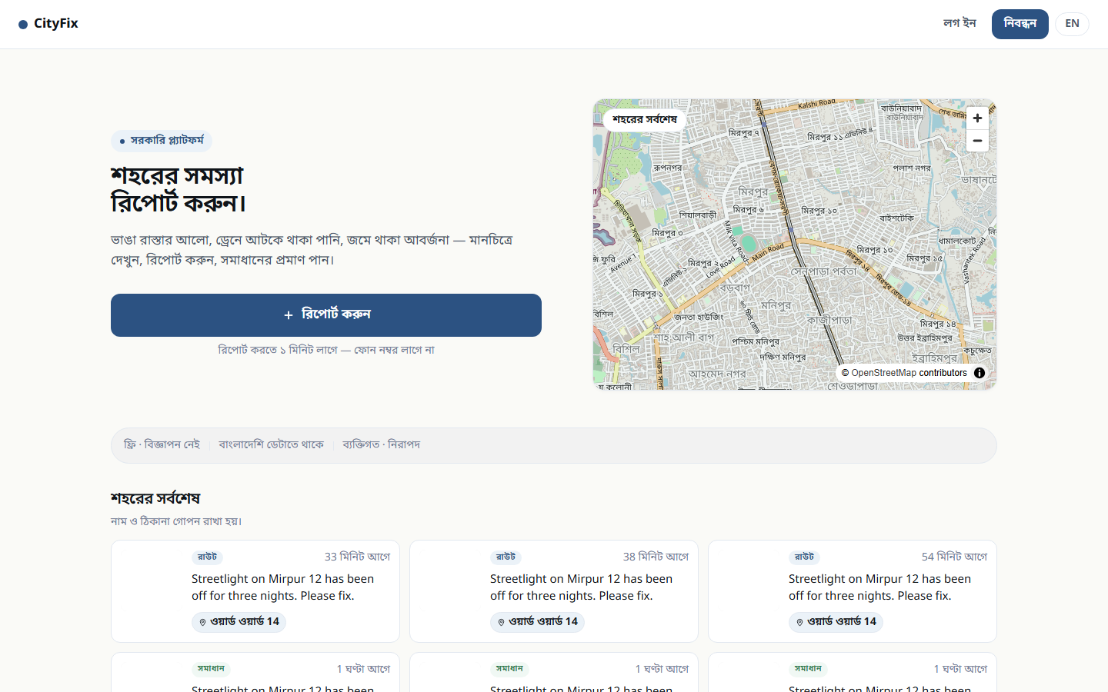
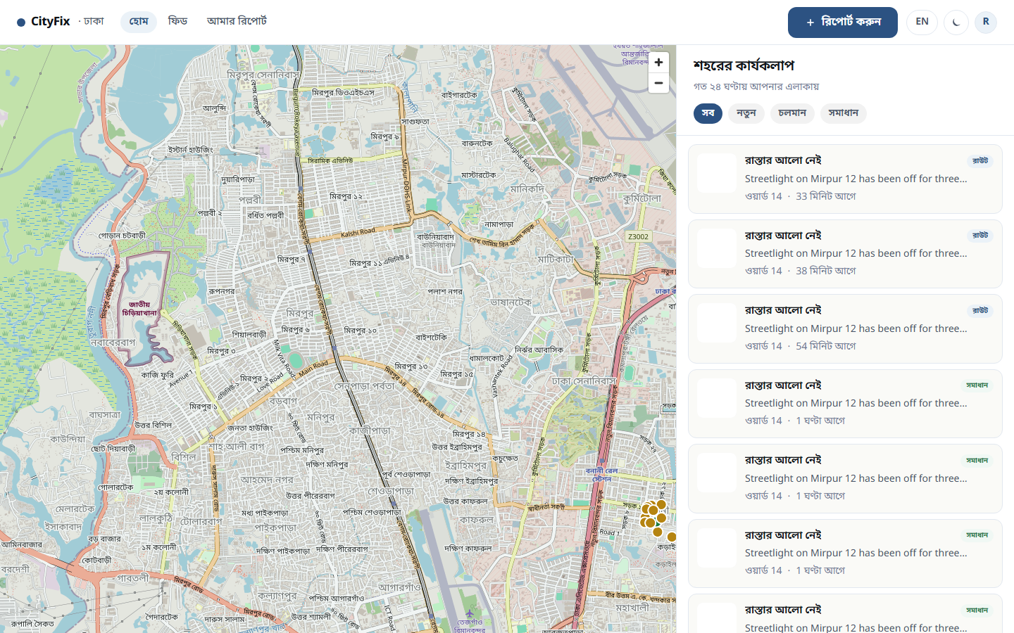
CITIZEN JOURNEY
One tap from the street to a tracked report
The public landing explains the civic promise; the citizen home is a live map of real reports around Dhaka.
Public landing — the citizen promise
Citizen home — live MapLibre map with real seeded reports
CityFix
8

Slide 9
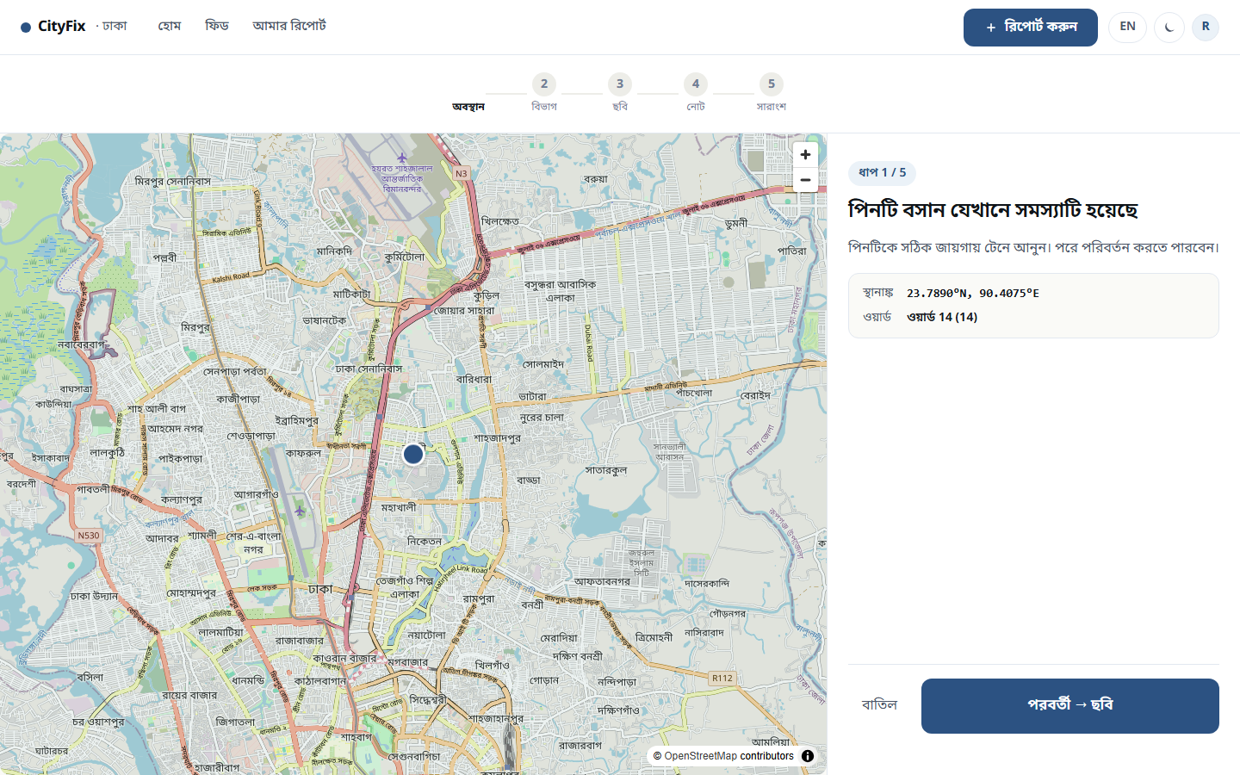
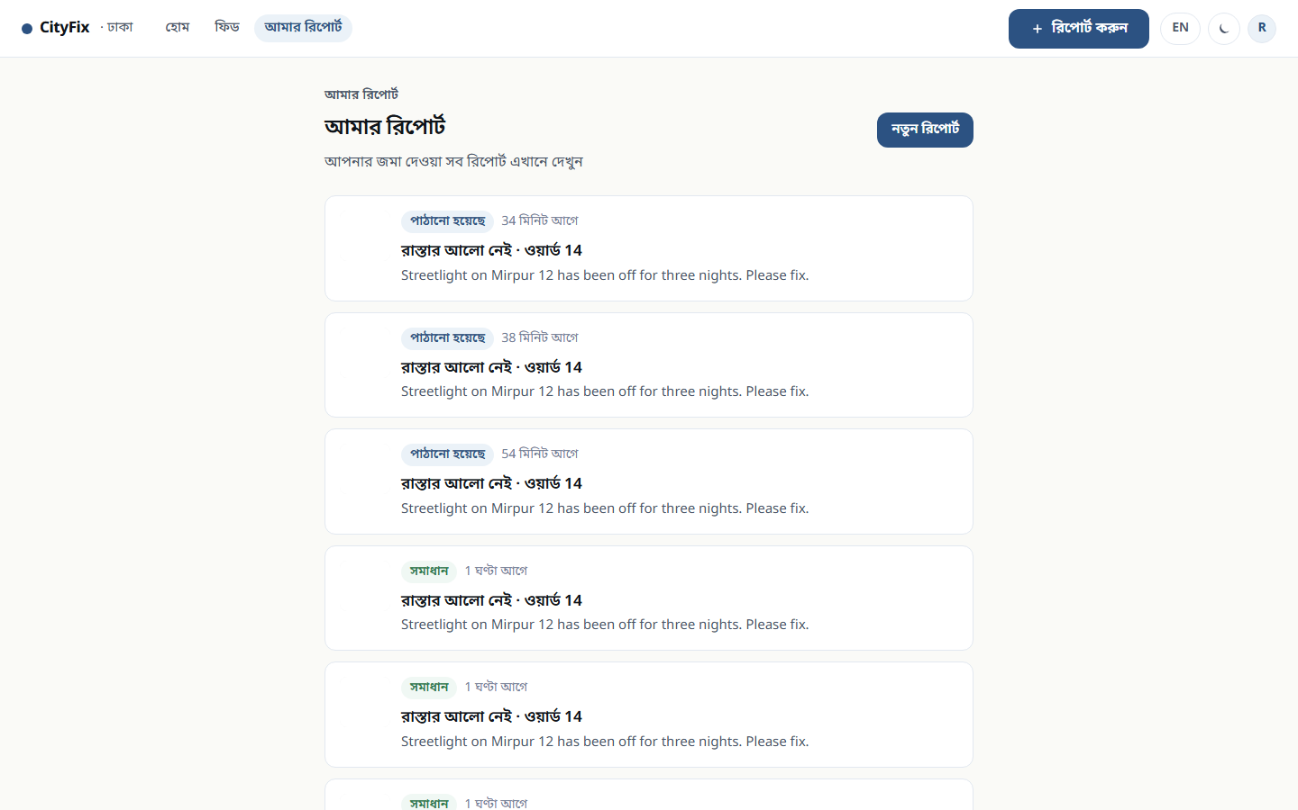
CITIZEN JOURNEY
Report it with a photo and a pin — then watch it move
Category and location are captured with the report; "My reports" is the citizen’s own view of the trail.
Report flow — category, photo, map pin
My reports — the citizen’s own trail
CityFix
9

Slide 10
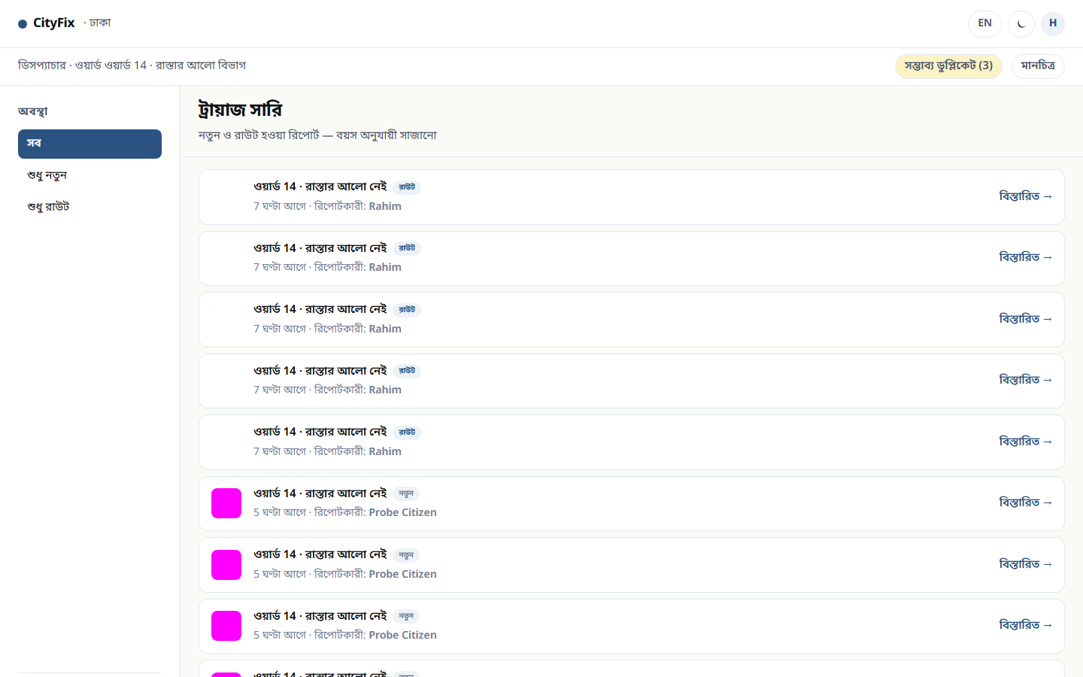
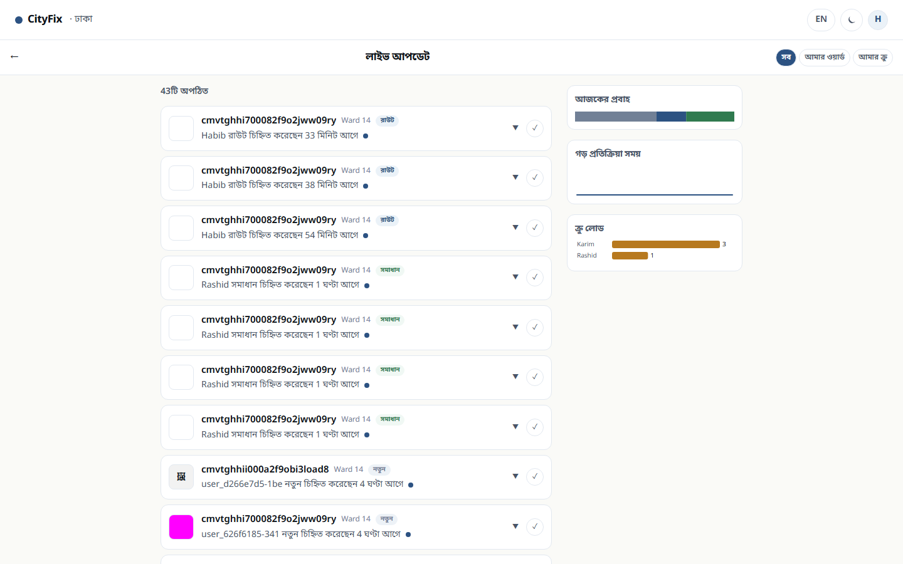
DISPATCHER
The triage queue: priority, dedup and assignment in one view
Habib sees every open ticket with its ward, priority badge and assignment state — then routes it.
Monitor — live status view
Triage queue — Ward 14, 30 open tickets
CityFix
10

Slide 11
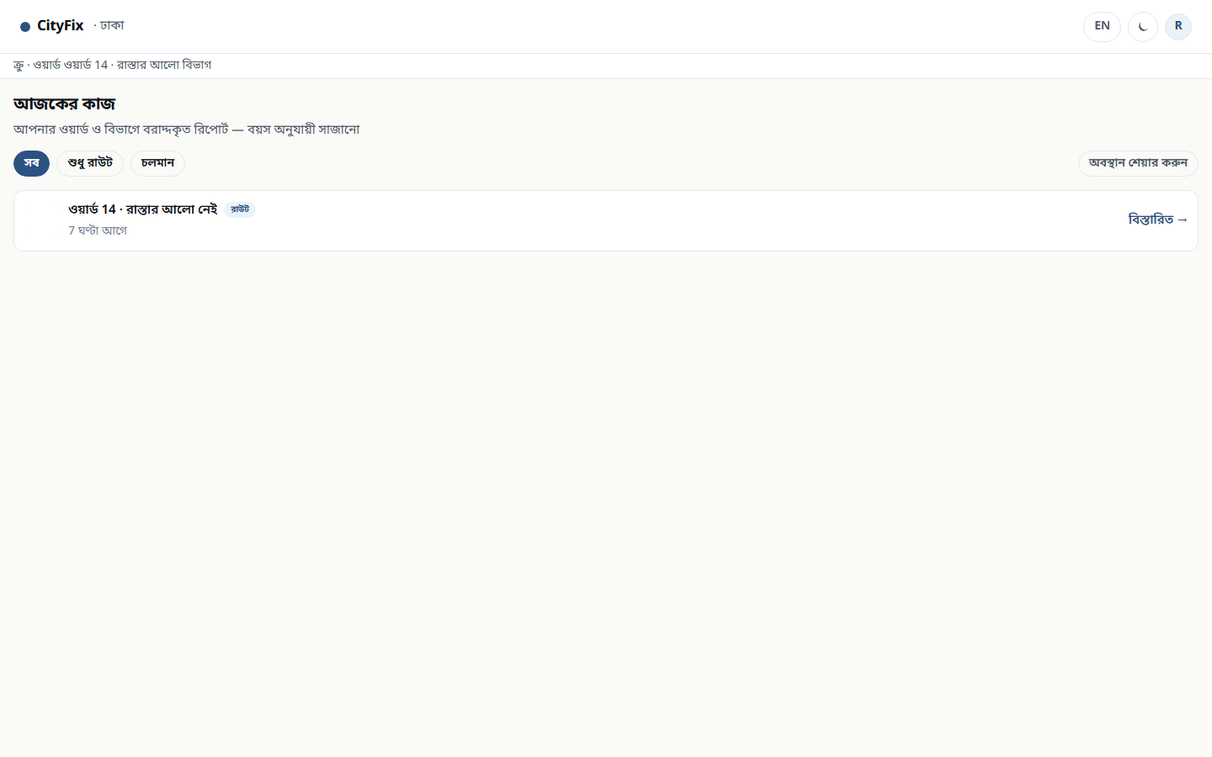
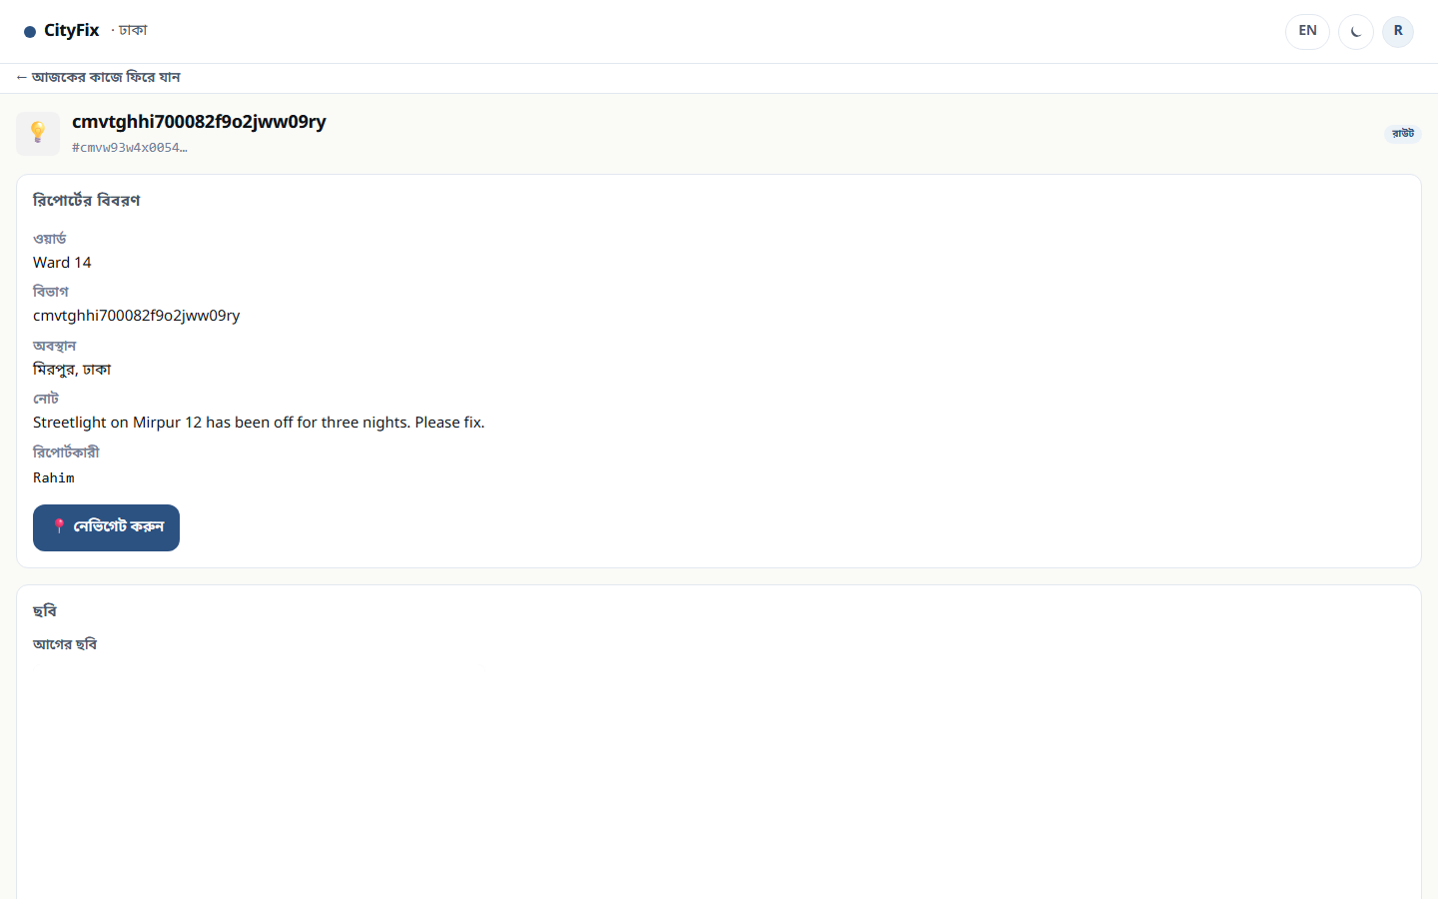
CREW
The field surface: only my ward, only my work
A crew member is not a dispatcher with fewer buttons — the surface is scoped to the assignments they can actually act on.
Scoped by ward
Rashid works Ward 14 — not the whole city.
Actionable only
The API returns only `routed` and `in_progress`.
Crew assignments — one open job in Ward 14
Proof required
Resolution needs a photo before the ticket closes.
The job itself
Role-enforced
The API refuses a crew session on dispatcher routes.
The crew surface is deliberately sparse: it shows work, not everything the city knows about.
CityFix
11

Slide 12
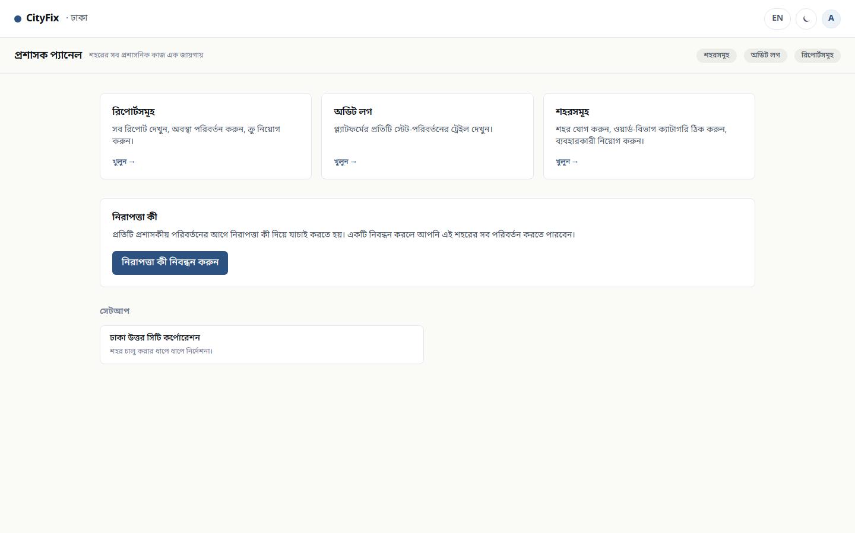
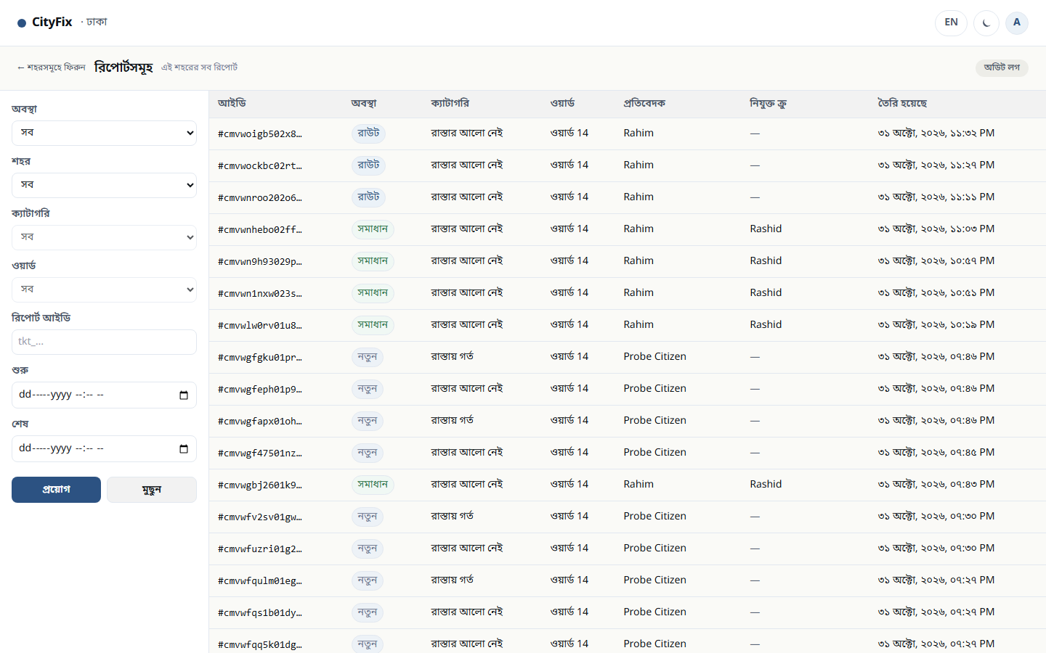
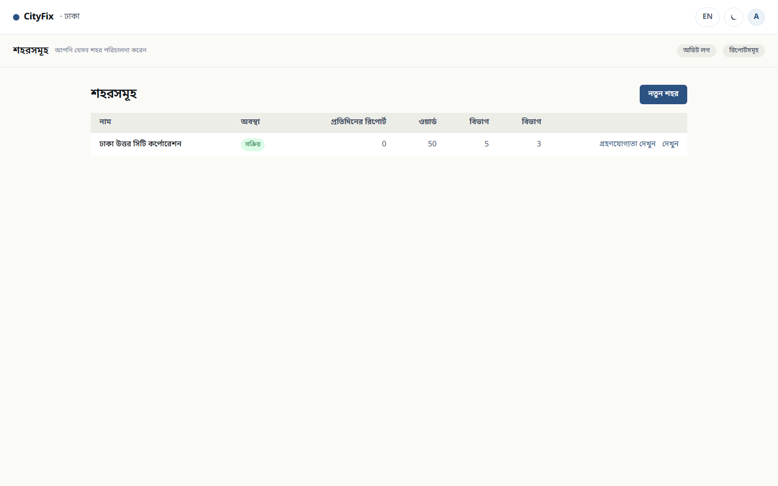
ADMIN
The console that governs the platform
Anwar configures the city, watches the ticket estate and reads the audit trail — and every write is WebAuthn-gated.
Ticket estate
Admin console
Scoped, not global — A city admin governs one city.
WebAuthn on writes — A passkey signs every mutation.
Audit on every change — Who, what, when — recorded.
City setup — wards, taxonomy, adoption
CityFix
12

Slide 13
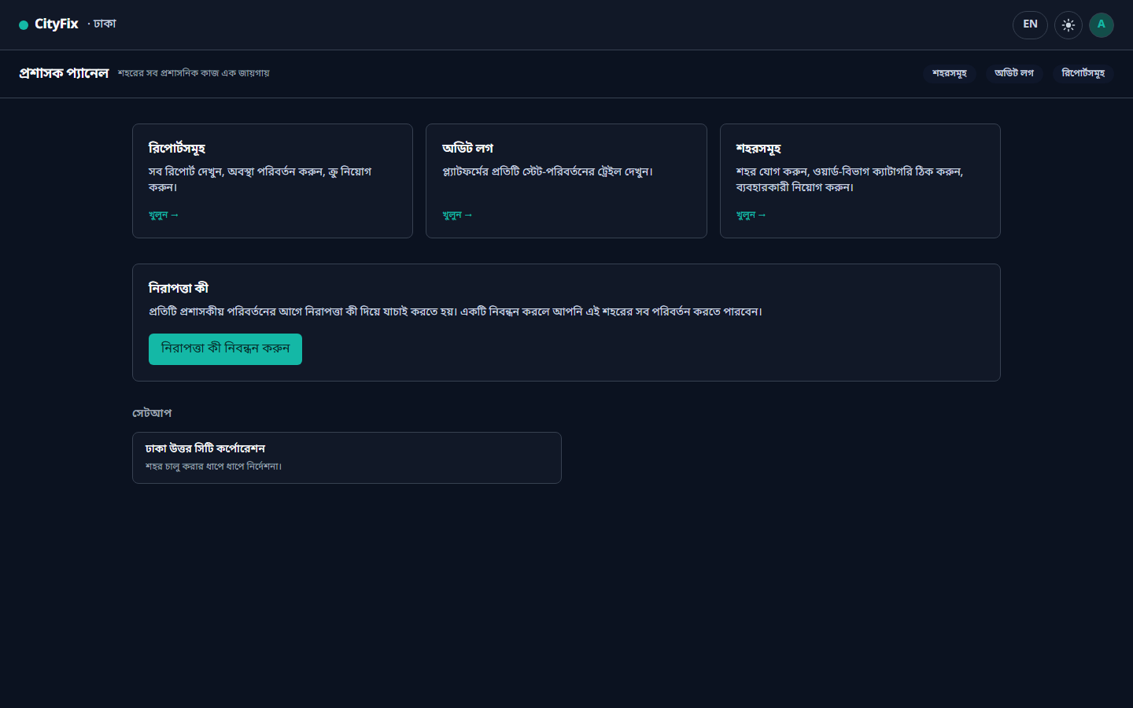
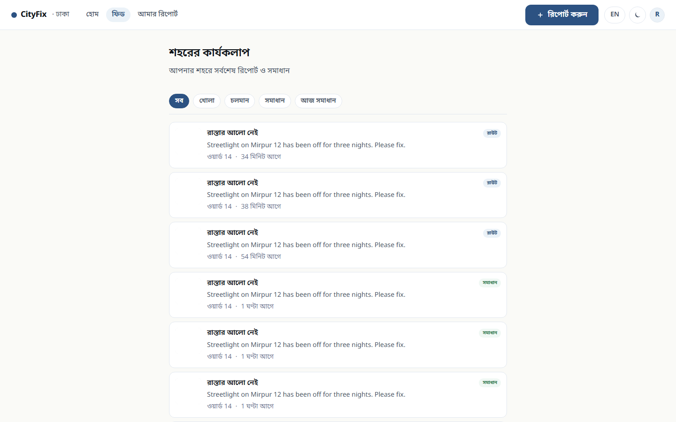
ADMIN
One design system — light, dark, and public by default
The admin console honours the shared theme system rather than hardcoding a palette, and the public feed shows the city's progress without an account.
Admin console in dark theme — same design tokens, inverted
Public activity feed — the city's progress, visible to anyone
CityFix
13

Slide 14
UNDER THE HOOD
Architecture
A conventional, deliberately boring stack — chosen for the audit trail it produces, not for novelty.
Client
Server
Domain
Data
Next.js 14 App Router
React 18 + TypeScript strict
Tailwind v3 + CSS custom properties
MapLibre GL JS + OSM raster
Route handlers + Zod at every boundary
Signed HTTP-only session cookies
Rate limiting + login lockout
Web Push (VAPID)
Service layer returning Result<T, E>
Ticket transitions + dedup (50 m)
City / ward / taxonomy model
WebAuthn for admin writes
PostgreSQL 16
Prisma 5 — typed client only
Raw SQL forbidden in app code
Platform audit log
Every service-layer call returns Result<T, E> — no exception crosses a boundary, and every state change is written to the audit log.
CityFix
14

Slide 15
EVIDENCE
The claims are measured, not asserted
Every number below comes from a command in this repository that runs against the real database.
1142
15 / 15
unit tests
visual baselines
Vitest — domain, services, auth, serializers
Playwright pixel baselines, gating on merge
45
53 / 53
role & theme specs
walkthrough observations
Playwright against a live app + Postgres
One ticket threaded through all four roles
Recorded Construction Verification Command
npx tsc --noEmit && npm run test:unit && npm run test:mockups && curl -fs http://localhost:3000/
CityFix
15

Slide 16
WHAT'S NEXT
The pipeline is proven; the city is next
The platform layer, the four-role chain and the audit trail are complete. What remains is deployment and real-world scale.
DEPLOYMENT
CITIZEN ONBOARDING
Ship the pilot
Real SMS provider
Hosting target is still open — Vercel vs Cloudflare vs Railway is the one decision left to ratify.
The OTP provider is a stub from the platform layer; WO-004 selects and wires the production provider.
INFRASTRUCTURE
GROWTH
Scale the map
More cities
OSM raster tiles are dev-grade. Mapbox or a self-hosted tile server is the production path past pilot volume.
The city / ward / taxonomy model is data-driven from day one — a new city is configuration, not a fork.
Thank you — questions welcome.
cityfix · Next.js 14 · PostgreSQL 16 · Prisma · MapLibre
CityFix
16

Slide 17
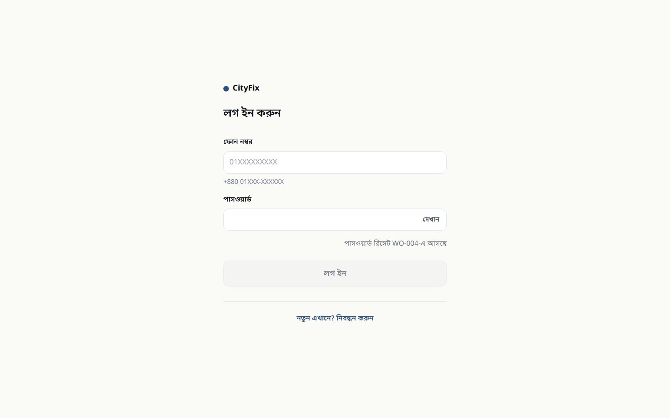
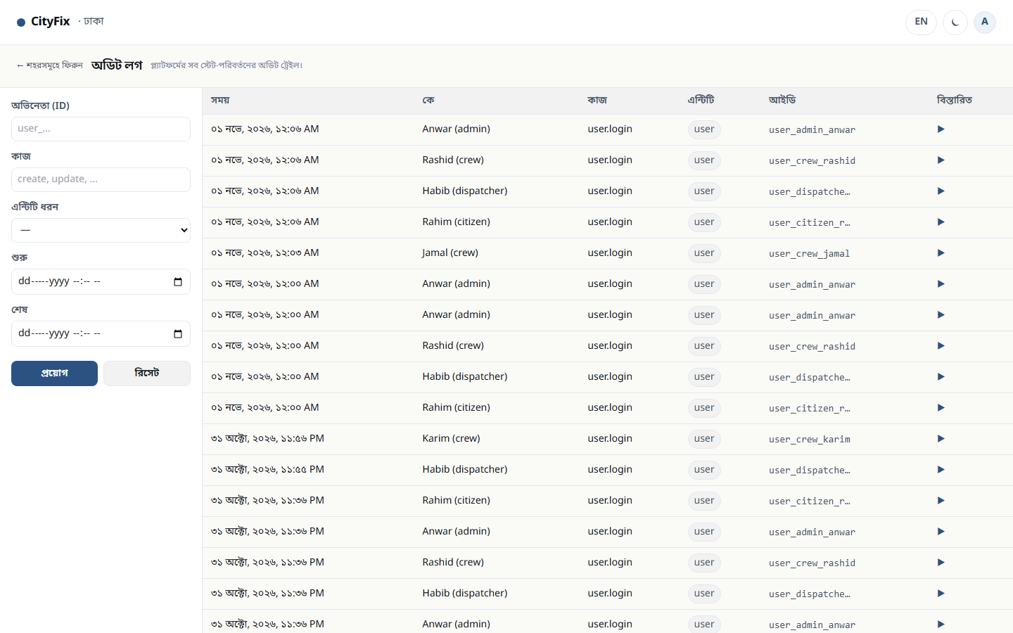
APPENDIX
Entry points and the public activity feed
Every entry point routes by role: the site root, the splash and a `?next=` deep link all resolve the same way.
Splash
Audit trail
Login
CityFix
17

