Slide 1
DevOps

Slide 2
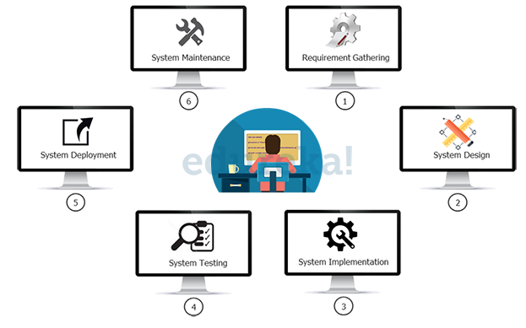
Traditional Process

Slide 3
Traditional Process
In the above diagram you will see the phases it will involve:
In phase 1 – Complete Requirement is gathered and SRS is developed
In phase 2 – This System is Planned and Designed using the SRS
In phase 3 – Implementation of the System takes place
In phase 4 – System is tested and its quality is assured
In phase 5 – System is deployed to the end users
In phase 6 – Regular Maintenance of the system is done

Slide 4
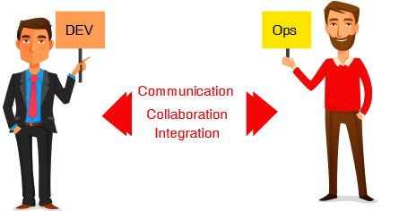
What is DevOps ?
DevOps movement really started with a Session in Velocity Conference in 2009
Patrick Debois, who’s often called “the father of DevOps”, coined the word “DevOps”.
Formed by combining two words: “development” and “operations”.
A collaborative way of developing and deploying software.
A software development method that
stresses communication, collaboration
and integration between software
developers and information technology
(IT) operation professionals.

Slide 5
What is DevOps ?
DevOps is an approach based on agile and lean principles in which business owners, development, operations, and quality assurance team collaborate to deliver software in a continuous stable manner
DevOps is an environment that promotes cross practicality, shared business tasks and belief
DevOps is a movement that improves IT service delivery agility
DevOps is a culture that promotes better working relationship within the company
DevOps is a set of practices that provides rapid, reliable software delivery

Slide 6
“The key to understanding what is DevOps lies in the intention of DevOps, that is to create superior-quality software more quickly and with more reliability while causing greater communication and collaboration between teams.”

Slide 7
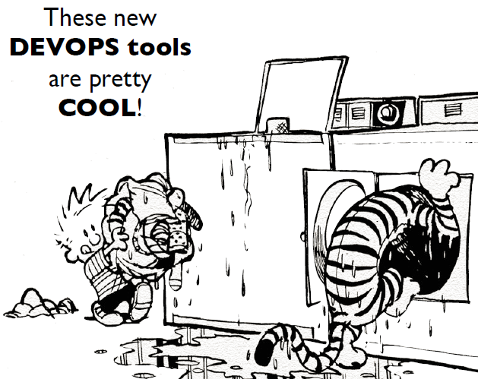
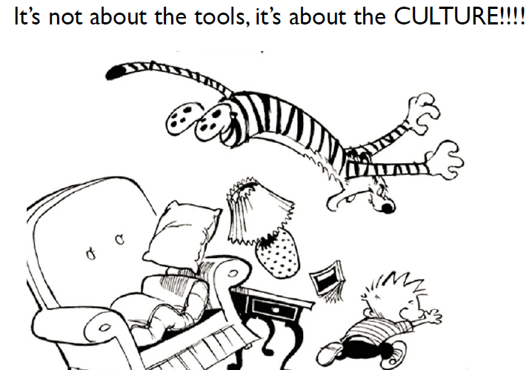

Slide 8
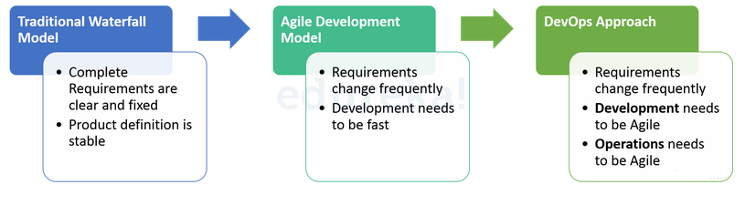
Evolution of Software Development
DevOps evolved from existing software development strategies/methodologies over the years in response to business needs.

Slide 9
Issues Blocking Software Delivery
Building and maintaining servers – Time consuming and unproductive
No environment management - Differences in development and production environments
Slow deployments – Costly error prone manual process and efforts
No shared ownership - Lack of feedback and proper metric leads
No proper configuration management - Discrepancies in managing configurations
Deployments are a blocker - Upgrade risk due to manual management of multiple application configuration and versions - Dependency on specific deployment engineer
Production downtime - Due to lack of improper deployment instructions / checklist
Hacking – Fixing directly in production (instead of a proper hotfix process) and forgets to check-in into source control

Slide 10
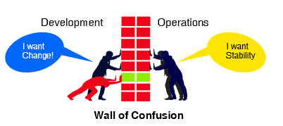
Need For DevOps
Wall of confusion - Developers want to deliver changes as soon as possible. Operations want reliability and stability.
DevOps break down the walls between development and operations team, unifying development to operations for better, faster outcomes.

Slide 11
Principles of DevOps
Five Basic Principles of DevOps :
Eliminate the blame game, Open post-mortems, Feedback, Rewarding failures
Continous Delivery, Monitoring, Configuration Management
Business value for end user
Performance Metrics, Logs, Business goals Metrics, People Integration Metrics, KPI
Ideas, Plans, Goals, Metrics, Complications, Tools

Slide 12
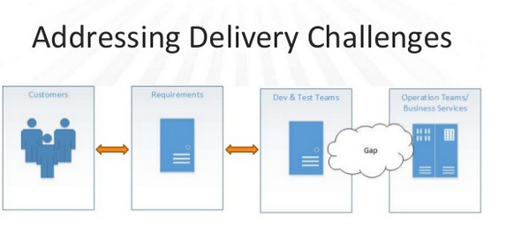
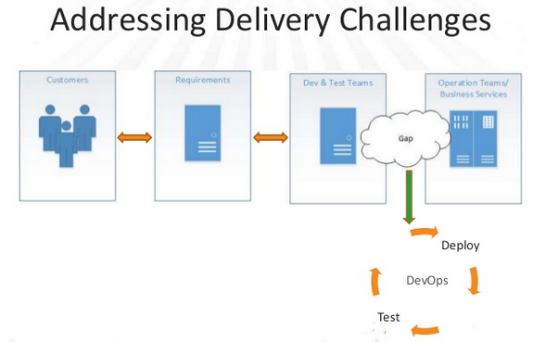

Slide 13
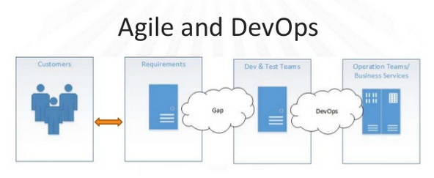
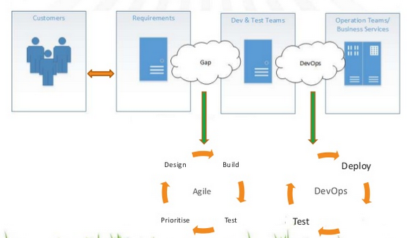

Slide 14
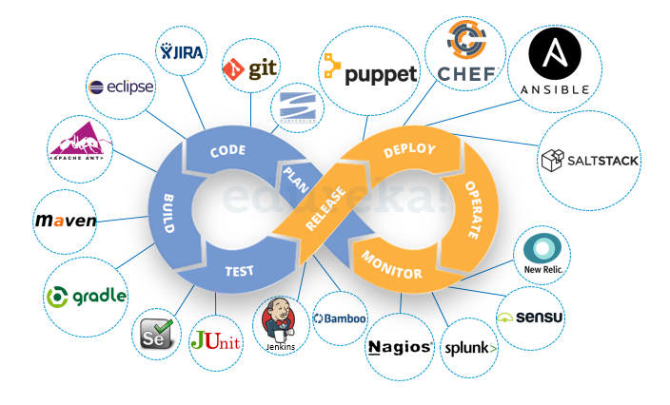
Common Tools

Slide 15
Continuous Development
Software is developed continuously.
Unlike the Waterfall model the software deliverables are broken down into multiple sprints of short development cycles.
Developed and then delivered in a very short time.
Stage involves the Coding and Building phases and makes use of tools such as Git and SVN for maintaining the different versions of the code, and tools like Ant, Maven, Gradle for building / packaging.
Code forwarded to the QAs for testing.

Slide 16
Continuous Testing
Is the process of executing automated tests as part of the software delivery pipeline in order to obtain feedback on the business risks associated with a software release candidate as rapidly as possible.
Continuous Testing provides instant insight on whether a release candidate is too risky to proceed through the delivery pipeline.
Continuous Testing expects testing to be embedded within the development process, not tacked on at the end.
Expects a stable test environment with valid test data to be available for each and every test run.

Slide 17
Continuous Testing - Fact
Everyone accepts that Agile and DevOps are all about change—transforming DevOps people, processes, and technologies to deliver innovative software as rapidly as possible.
In spite of all this change, one thing tends to remain the same: the software testing process. One recent study reports that 70% of organizations have adopted Agile, but only 30% automate testing.
For Continuous testing, automation tools like Selenium, JUnit etc are used.
Once the code is tested, it is continuously integrated with the existing code.

Slide 18
Continuous Integration
Is a development practice that requires developers to integrate code into a shared repository several times a day
Code supporting new functionality is integrated with the existing code.
The changed code, should also ensure that there are no errors in the runtime environment, allowing us to test the changes and check how it reacts with other changes.
“Continuous Integration doesn’t get rid of bugs, but it does make them dramatically easier to find and remove.”

Slide 19
Continuous Integration - How to do it
Developers check out code into their private workspaces
When done, commit the changes to the repository
The CI server monitors the repository and checks out changes when they occur
The CI server builds the system and runs unit and integration tests
The CI server releases deployable artefacts for testing
The CI server assigns a build label to the version of the code it just built
The CI server informs the team of the successful build
If the build or tests fail, the CI server alerts the team
The team fixes the issue at the earliest opportunity
Continue to continually integrate and test throughout the project

Slide 20
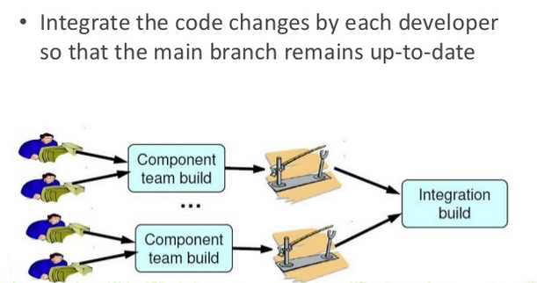
Continuous Integration

Slide 21
Continuous Deployment
Can be thought of as an extension of continuous integration
Aiming at minimizing lead time, the time elapsed between development writing one new line of code and this new code being used by live users, in production.
"Essentially, it is the practice of releasing every good build to users”
Since the new code is deployed on a continuous basis, automation tools play an important role for executing tasks quickly and frequently. Puppet, Chef, SaltStack and Ansible are some popular tools that are used in this stage.

Slide 22
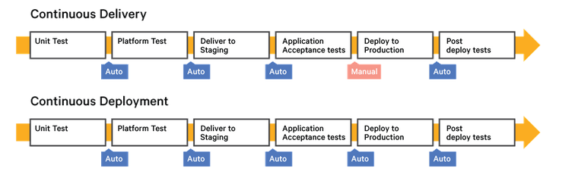
Continuous Delivery vs Continuous Deployment
While continuous deployment may not be right for every company, continuous Integration is an absolute requirement of DevOps practices

Slide 23
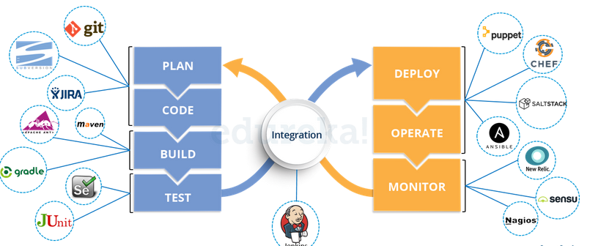
Tool Positioning

Slide 24
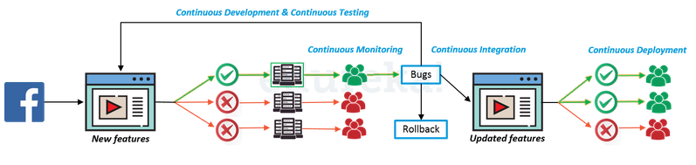
Facebook Dark Launching Technique
Is the process of gradually rolling out production-ready features to a select set of users before a full release.
Allows development teams to get user feedback early on, test bugs, and also stress test infrastructure performance.
Deployment through a dedicated deployment pipeline.
In below picture see that that only one deployment pipeline is turned on to deploy the new features to a select set of users.

Slide 25
Facebook Dark Launching Technique
The remaining hundreds of pipelines are all turned off at this point.
Continuous monitoring of the features deployed to specific user s to collect feedback and identify bugs.
Once stability is achieved, the features will be gradually deployed on other user bases by turning on other deployment pipelines.

Slide 26
DEVOPS – DELIVERY PIPELINE

Slide 27
Delivery Pipeline
The pipeline breaks down the software delivery process into stages.
Each stage is aimed at verifying the quality of new features from a different angle to validate the new functionality and prevent errors from affecting your users.
The pipeline should provide feedback to the team and visibility into the flow of changes to everyone involved in delivering the new feature/s.
In a pipeline, developers can add a stage to deploy their application more often and more quickly.
There is no such thing as “The Standard Pipeline”.

Slide 28
Roles Of Stages
A typical CD pipeline will include the following stages:
  Build automation (BUILD STAGE)
  Test automation (TEST STAGE)
  Deployment automation. (DEPLOY STAGE)

Slide 29
Delivery Pipeline - Example
Build jobs compile and package application source code from Git or Jazz source control management (SCM) repositories.
The build jobs produce deployable artifacts, such as WAR files or Docker containers.
In addition, can run unit tests within build automatically. Each time the source code changes, a build is triggered.
A deployment job takes output from a build job and deploys it to the server.

Slide 30
DEVOPS TECHNIQUE – DOCKER CONTAINER

Slide 31
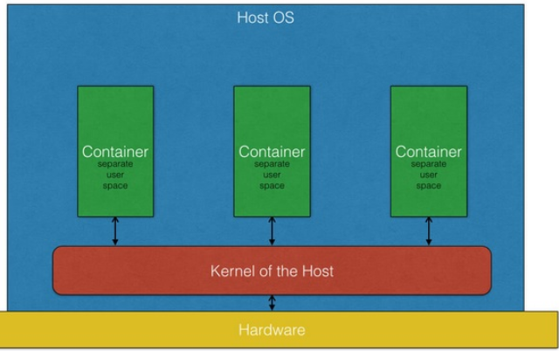
Docker Container
A container image is a lightweight, stand-alone, executable package of a piece of software that includes everything needed to run it: code, runtime, system libraries, settings.
Containerized software will always run the same, regardless of the environment.

Slide 32
Docker Container
This approach allows pieces of code to be put into smaller, easily transportable pieces that can run anywhere Linux is running.
The real benefit is in DevOps and testing, because the applications can be built and tested much more quickly.

Slide 33
DEVOPS TECHNIQUE – CLOUD DEPLOYMENT

Slide 34
Cloud
Cloud computing, often referred to as simply “the cloud,” is the delivery of on-demand computing resources.
Everything from applications to data centres, over the internet on a pay-for-use basis.
In cloud computing, the word cloud is used as a metaphor for "the Internet“.

