Slide 1
Web Services

Slide 2
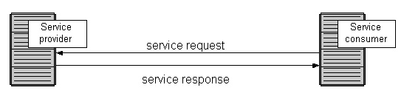
What is a Service ?
Services are self-contained programs, perform predetermined tasks.
Services :
    are resuable components
    exposes a well defined interface
    uses messages to hide implementation details
    loosely coupled.

Slide 3
What is a Web service ?
From the W3C Web Services Architecture Working Group:
    A Web service is a software system designed to support interoperable machine-to-machine interaction over a network.
    It has an interface described in a machine-processable format (specifically WSDL).
    Other systems interact with the Web service in a manner prescribed by its description using SOAP messages, typically conveyed using HTTP with an XML serialization in conjunction with other Web-related standards”

Slide 4
What is a Web service ?
Explanation .. Continued
A web service is a
    collection of open protocols
    standards used for exchanging data between applications or systems.
    Software applications written in various programming languages and running on various platforms can use web services to exchange data over computer networks like the Internet .
    This interoperability (e.g., between Java and Python, or Windows and Linux applications) is due to the use of open standards.

Slide 5
What is a Web service ?
Explanation .. Continued
a standardized way of integrating Web-based application using the XML, SOAP, WSDL and UDDI open standards over an Internet protocol backbone.
Because all communication is in XML, web services are not tied to any one operating system or programming language
Definition does not mandate any particular specification, such as SOAP, WSDL, or UDDI and does not declare any specific protocols like HTTP

Slide 6
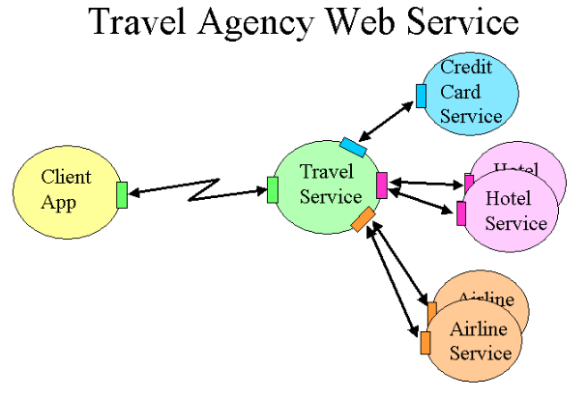
What is a Web service ?
To summarize, a complete web service is:
    Is available over the Internet or private (intranet) networks
    Uses a standardized XML messaging system
    Is not tied to any one operating system or programming language
    Is self-describing via a common XML grammar
    Is discoverable via a simple find mechanism

Slide 7
General Examples
Validate or enter customer information.
Enter sales orders.
Query items on stock (delivery dates, discounts, prices, and so on).
Create purchase orders.
Validate credit card information.

Slide 8
Real World Examples
Industry: Electronic payment processing
    Application: Web payment services (EFSnet)
Industry: Retail merchandise
    Application: Fraud detection
Industry: Transportation rental
    Application: Connect existing mainframe reservation system to access and integration with business partners
Industry: Package delivery service
    Application: Package tracking inquiry

Slide 9
W3C Standards
XML
• Basic data format
SOAP
• Message packaging and delivery
WSDL
• Service description
other standards may be involved:
    Communications (HTTP, JMS, IIOP, and so on)
    Discovery (UDDI, WSIL and others)
    Interoperability (WS-I profiles)

Slide 10
Java API for creating Web services
Java API for XML-based Web services (JAX-WS) is the programming model for JEE Web services
    Uses annotations
JAX-RPC stands for Java API for XML-based RPC
    a remote procedure call is represented by an XML-based protocol such as SOAP
JAX-WS represents a significant advance over its predecessor, JAX-RPC

Slide 11
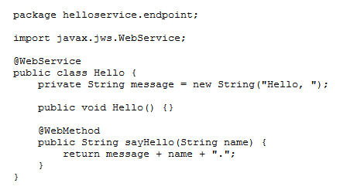
JAX - WS

Slide 12
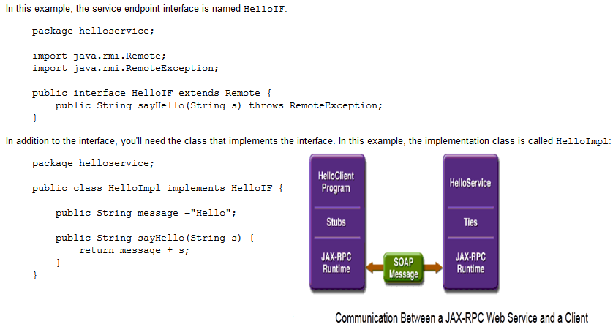
JAX – RPC

Slide 13
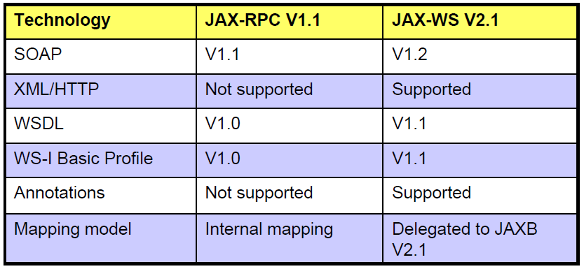
JAX-WS Vs JAX-RPC

Slide 14
JAX-WS Vs JAX-RPC
JAX-RPC V1.1 grew into JAX-WS V2.0.
JAX-WS supports later versions of SOAP, SAAJ and WS-I Basic Profile.
WSDL defines a SOAP-less HTTP binding ignored by JAX-RPC but supported by JAX-WS.
JAX-RPC maps to Java V1.4. JAX-WS maps to Java V5.0 and relies on many features new in Java V5.0, such as annotations and parameterized data types.

Slide 15
JAX-WS Vs JAX-RPC
The data mapping model
    JAX-RPC has its own data mapping model, which covers about 90 percent of all schema types. Those that it does not cover are mapped to javax.xml.soap.SOAPElement.
    The JAX-WS data mapping model is JAXB. JAXB promises mappings for all XML schemas.
The dynamic programming model
    The JAX-WS dynamic client model is quite different from JAX-RPC, and includes document-oriented functionality and dynamic asynchronous functionality.
• JAX-WS also adds a dynamic server model, which JAX- RPC does not have

Slide 16
SOAP
stands for Simple Object Access Protocol
is a simple XML-based protocol to let applications exchange information over HTTP.
is a communication protocol between applications
communicates via Internet
is platform independent
is language independent

Slide 17
SOAP Syntax
A SOAP message MUST be encoded using XML
A SOAP message MUST use the SOAP Envelope namespace
A SOAP message MUST use the SOAP Encoding namespace
A SOAP message must NOT contain a DTD reference
A SOAP message must NOT contain XML Processing Instructions

Slide 18
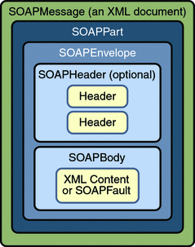
SOAP

Slide 19
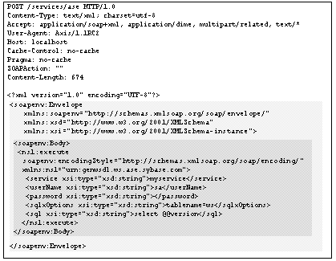
Sample SOAP
Envelope
Body

Slide 20
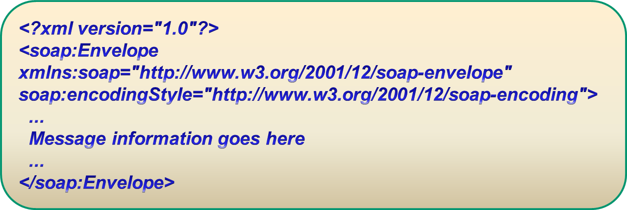
SOAP Envelope Element
SOAP Envelope element is the root element of a SOAP message.
This element defines the XML document as a SOAP message.

Slide 21
Xmlns Namespace and EncodingStyle
Namesapace
  Value : http://www.w3.org/2001/12/soap-envelope
  defines the Envelope as a SOAP Envelope.
EncodingStyle
  define the data types used in the document
  applies to all child elements.
  no default encoding

Slide 22
SOAP Header Element
It’s optional
application-specific information about the SOAP message.
  authentication, payment.
If it is present, it must be the first child element of the Envelope element.

Slide 23
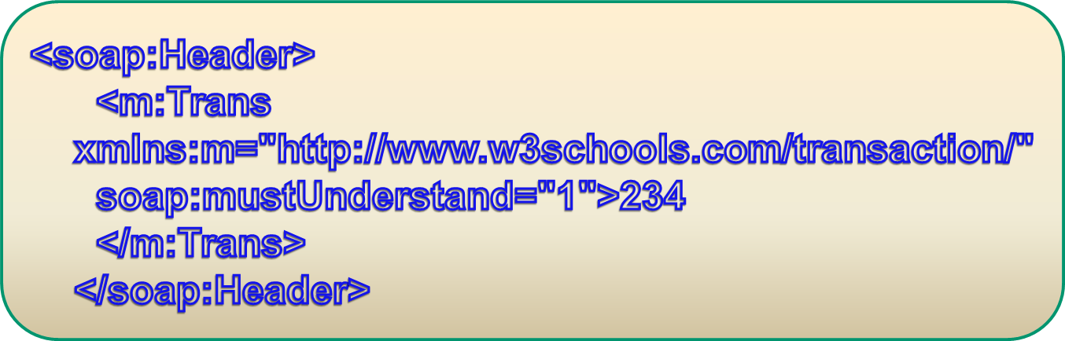
SOAP Header Element
All immediate child elements of the Header element must be namespace-qualified.

Slide 24
WSDL
Web Services Description(definition 2.0) Language
Xml based language
Describes the functionality of the webservice
Message description
Describes public interface
Version 1.1 is not W3C recommendation

Slide 25

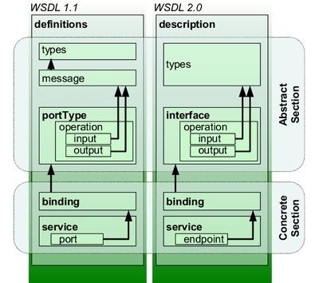
WSDL

Slide 26
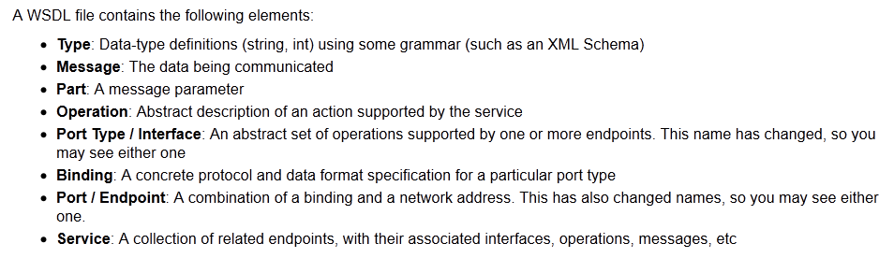
WSDL

Slide 27
WSDL Document Structure
Element | Defines
<types> | The data types used by the web service
<message> | The messages used by the web service
<portType> | The operations performed by the web service
<binding> | The communication protocols used by the web service

Slide 28
WSDL Types
WSDL Types
  The <types> element defines the data types that are used by the web service.
  For maximum platform neutrality, WSDL uses XML Schema syntax to define data types

Slide 29
WSDL Messages
The <message> element defines the data elements of an operation.
Each message can consist of one or more parts. The parts can be compared to the parameters of a function call in a traditional programming language.

Slide 30
Message
<message name='Calculator_add'>
<part element='tns:add' name='add'/>
</message>
<message name='Calculator_addResponse'>
<part element='tns:addResponse' name='addResponse'/>
</message>

Slide 31
WSDL Ports
The <portType> element is the most important WSDL element.
It describes a web service, the operations that can be performed, and the messages that are involved.
The <portType> element can be compared to a function library (or a module, or a class) in a traditional programming language.

Slide 32
Port type
<portType name='Calculator'>
<operation name='add' parameterOrder='add'>
<input message='tns:Calculator_add'/>
<output message='tns:Calculator_addResponse'/>
</operation>
</portType>

Slide 33
WSDL Bindings
WSDL Binding
  The <binding> element defines the message format and protocol details for each port.

Slide 34
Binding
<binding name='CalculatorBinding' type='tns:Calculator'>
<soap:binding style='document' transport='http://schemas.xmlsoap.org/soap/http'/>
<operation name='add'>
<soap:operation soapAction=''/>
<input>
<soap:body use='literal'/>
</input>
<output>
<soap:body use='literal'/>
</output>
</operation>
</binding>

Slide 35
Services
<service name='CalculatorService'>
<port binding='tns:CalculatorBinding' name='CalculatorPort'>
<soap:address location='http://localhost:8080/Calculator/Calculator'/>
</port>
</service>

Slide 36
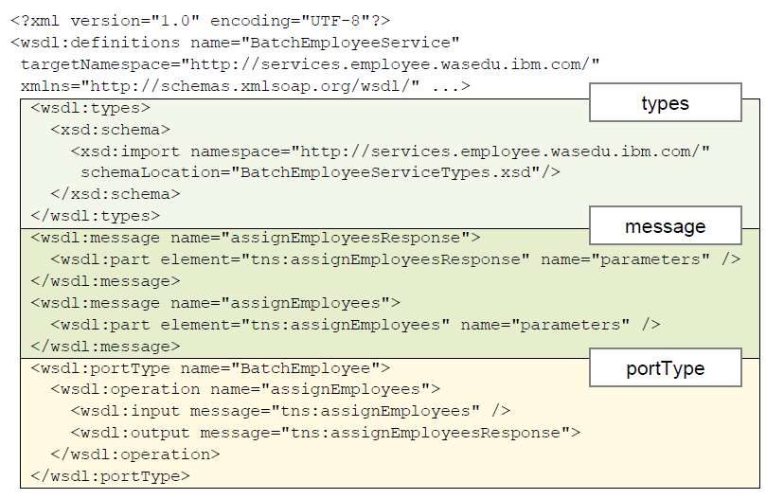
Sample WSDL ( 1 of 2)

Slide 37
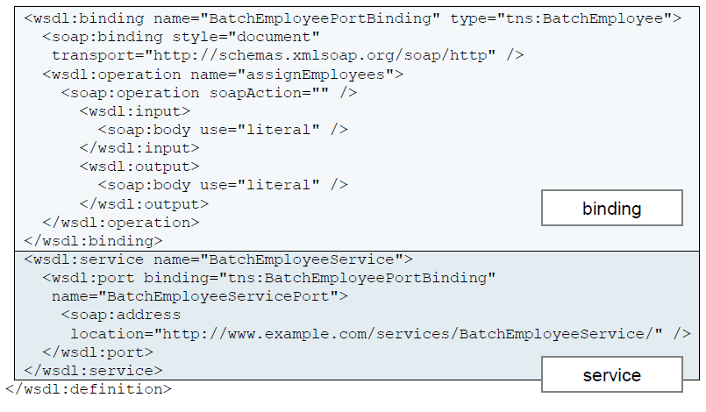
Sample WSDL (2 of 2)

Slide 38
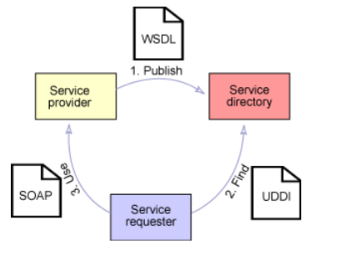
Relationship Between Core Standards

Slide 39
Web service creation
Top-Down
- Based on Web service interface and XML types
- Design the implementation by creating WSDL.
- Recommended approach for creating new web service
    Bottom-Up
    Web service created on existing business logic in Java Bean or EJB.
    No XSD or WSDL design skills are needed.

Slide 40
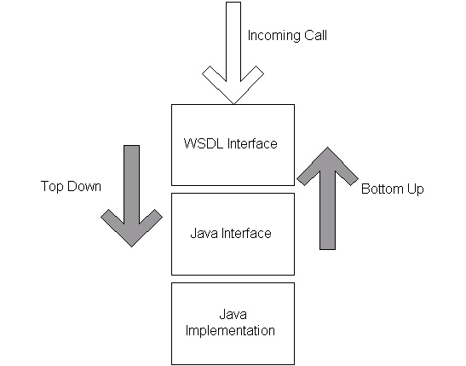
Top Down & Bottom Up

Slide 41
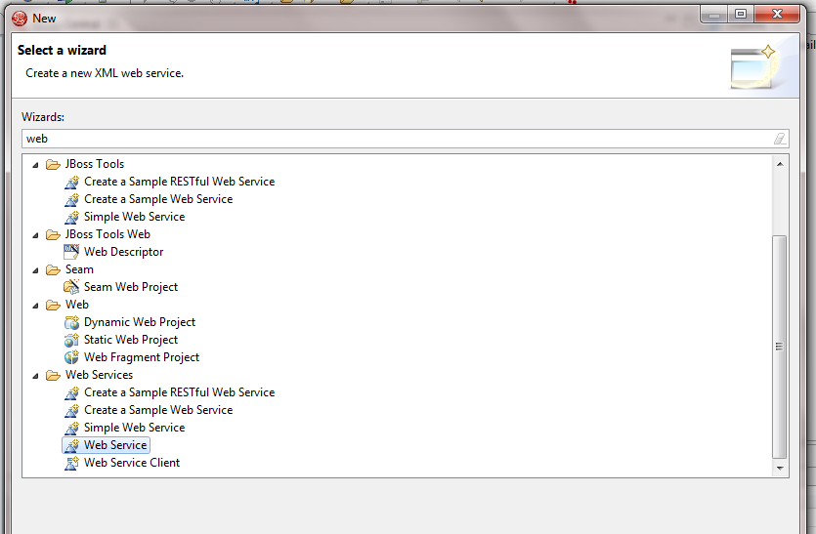
Top-Down (1 of 3)

Slide 42
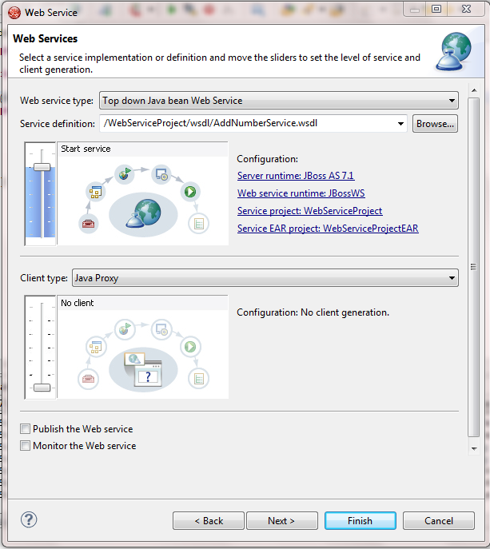
Top-Down (2 of 3)

Slide 43
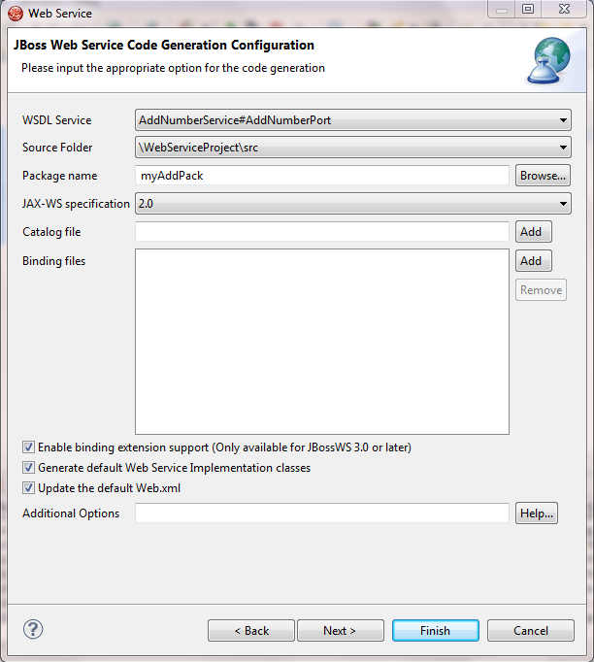
Top-Down (3 of 3)

Slide 44
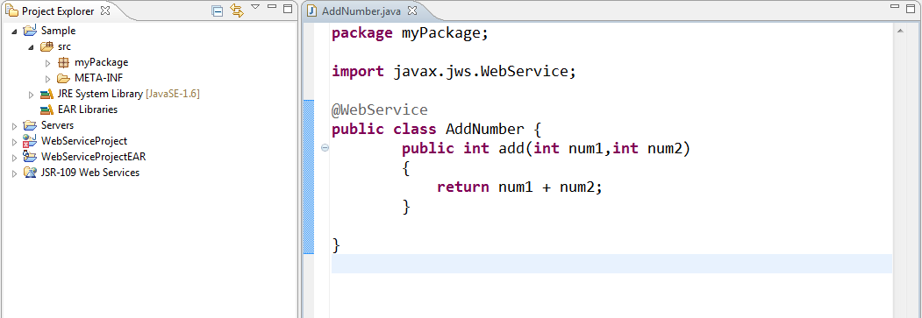
Bottom-Up (1 of 3)

Slide 45
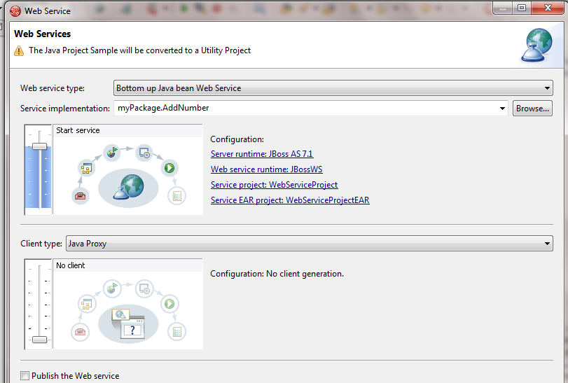
Bottom-Up (2 of 3)

Slide 46
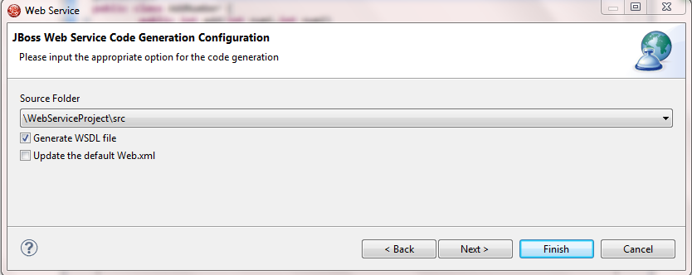
Bottom-Up (3 of 3)

Slide 47
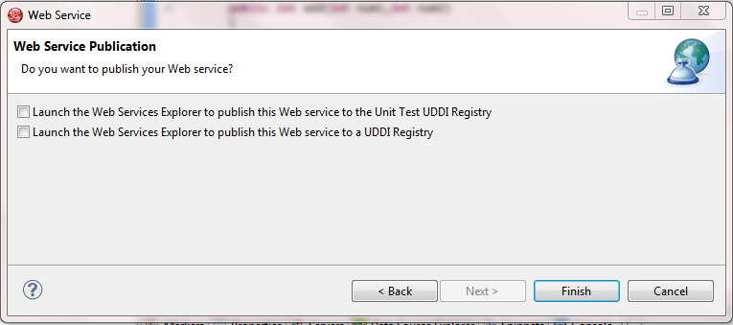
Bottom-Up (4 of 3)

Slide 48
Bottom Up
Process of creating WSDL file from Java Bean
generally this approach is used in the process of creating service
Any class which has @Webservice and any method that has @Webmethod will be part of WSDL
Creates JAXWS package which has
  Method Bean
  Response Bean

Slide 49
Bottom up
WSDL expected to be placed and exposed as web resource
web.xml will be updated
Each web service is associated with WSDL
Once WSDL file is obtained, webservice can be tested using WSDL test browser

Slide 50
Web service generation customizing
JAX-WS will create webservices with default choice. But we can override these attributes and creat WSDL
  Name space
    It’s based on java package
    We may adopt to organizational standards
  Service Name & port address
    By default based on the name of service implementation
    We may hide the class name& use external name

Slide 51
Web service generation customizing
Methods
  By default all public method in class are exposed
  We may give unique operation name for overloaded function
  We may not expose all the public method in class
Parameters
  By default parameter names are the same as in the implementation class.
  You might want to change these for organizational reasons, forbetter documentation, or to avoid default names like “arg0”.

Slide 52
WebService Defaults
Change @WebService defaults with the following properties:
  name
    The value of wsdl:portType
  targetNamespace
    The XML namespace of the WSDL
  serviceName
    The service name of the Web service, that is, the value of wsdl:service
– endpointInterface
  The qualified name of the service endpoint interface
  portName
    The value of wsdl:portName

Slide 53
Customization @WebService
@WebService(targetNamespace = "http://ws.ibm.com/sample/",
serviceName = "ConverterService",
portName = "ConverterPort")
public class ConverterDelegate {
@WebMethod
public void method(){}
}

Slide 54
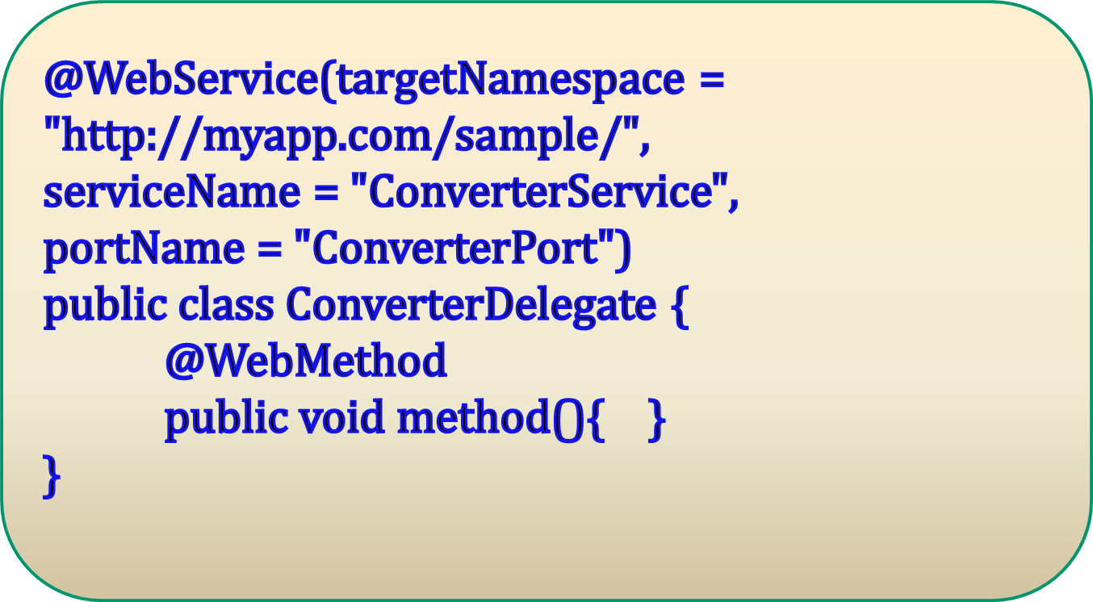
Customization @WebService

Slide 55
@WebMethod Customization
operationName
  Specifies the name of the wsdl:operation that for this method. The default value is the name of the Java method.
action
  Defines the value (a URI) of the SOAPAction header in HTTP. This gives the receiving servlet a hint as to the intent of the message.
exclude
  If true, indicates that the method should be excluded from the Webservice. The default value is false.

Slide 56
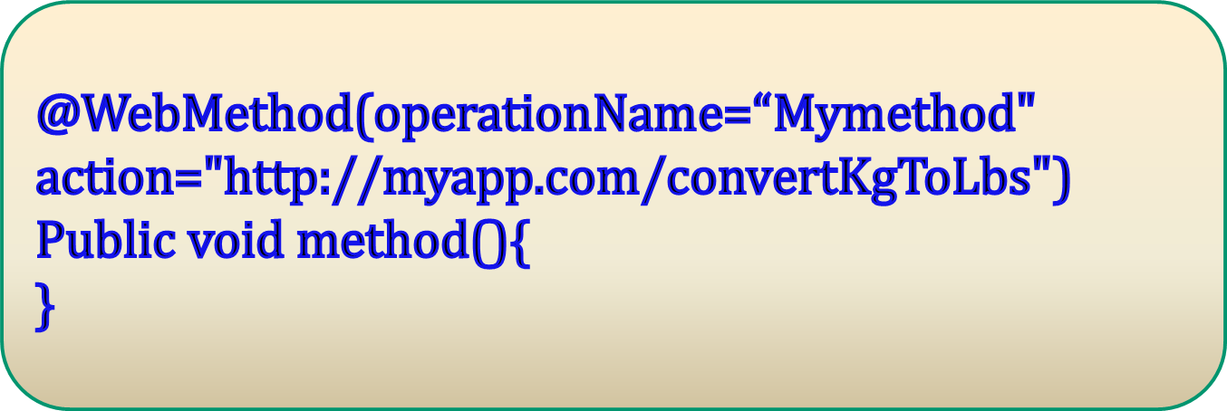
@WebMethod Sample

Slide 57
@WebParam
partName
  Defines the name of the wsdl:part attribute that represents this parameter.
  Do not use if the operation is document style and the parameter style is WRAPPED.
Name
  If the operation is remote procedure call (RPC)-style and the partName attribute is not
  specified, this is the name of the wsdl:part attribute that represents the parameter.
  If the operation is document-style or the parameter maps to a header, this is the local name of the XML element that represents the parameter.
    This attribute is required if the operation is document-style, the parameter style is BARE, and the mode is OUT or INOUT.

Slide 58
@WebParam
targetNamespace
  Specifies the XML namespace of the XML element for the parameter. It applies only for document bindings when the attribute maps to an XML element. The default value is the targetNamespace for the Web service.
Header
  Specifies whether the parameter is in a message header rather than a message body. The default value is false.
Mode
  The value represents the direction in which the parameter flows for this method. Valid values are IN, INOUT, and OUT.

Slide 59
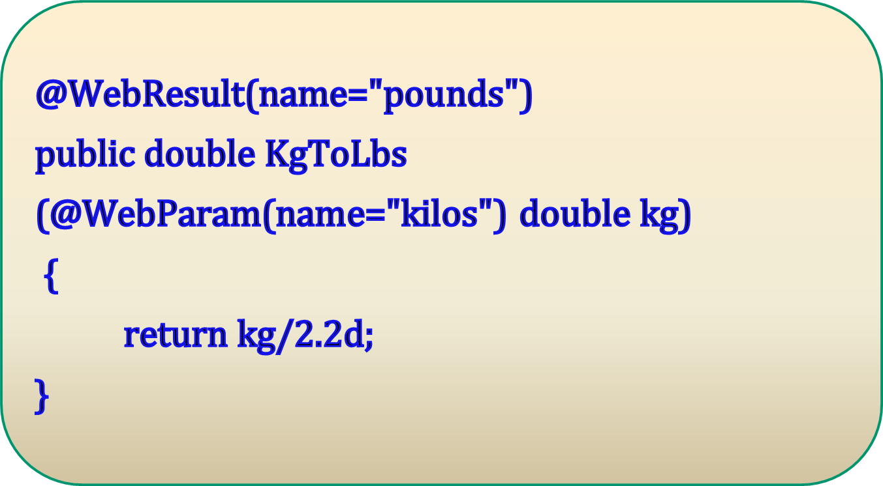
@WebParam

Slide 60

JAX-WS client for webservice
Supports two Web service clients.
1. Managed clients
    Web services for Java EE clients are defined by Java Specification Requirements (JSR) 109 and are managed clients because they run in a Java EE container.
    can use Java Naming and Directory Interface (JNDI) look up to perform service lookup, or you can use annotations to inject instances of a JAX-WS service or port

Slide 61
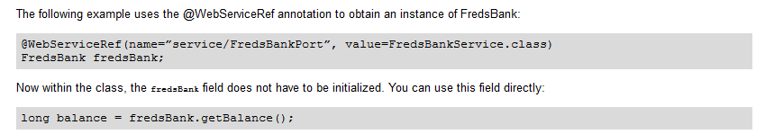
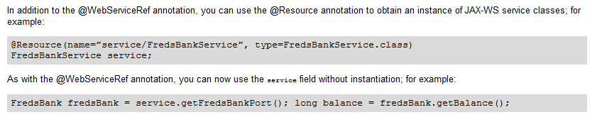
JAX-WS client for webservice
    use the @WebServiceRef or @Resource annotation to declare managed clients.

Slide 62
JAX-WS client for webservice
2. Unmanaged clients
    Java Platform, Standard Edition (Java SE 6) clients that use the JAX-WS runtime environment to invoke Web services and do not run in any Java EE container.
    is a stand-alone Java client that can directly inspect a WSDL file and formulate the calls to the Web service by using JAX-WS APIs.

Slide 63
JAX-WS client for webservice
The JAX-WS client programming model supports both
    Dispatch client API (dynamic client) and
    Dynamic proxy client API (static client).
both enables synchronous and asynchronous invocation of JAX-WS Web services.

Slide 64
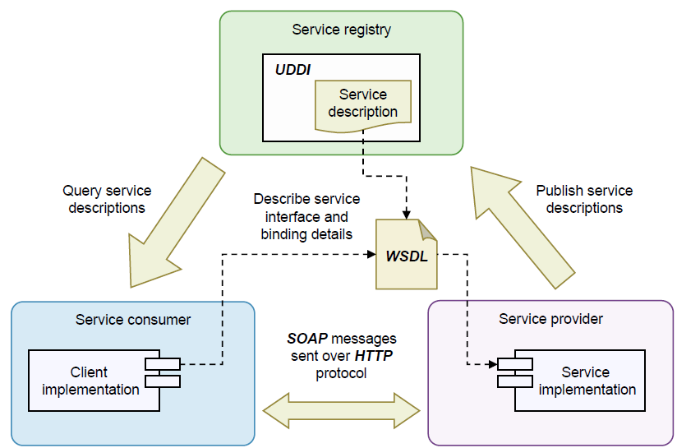
Role Of Registry

