Slide 1
RESTful Service
©2017 Teknoturf Info Services. Private and Confidential.

Slide 2
What is a service-oriented architecture (SOA)?
A service?
  A repeatable business task, for example:
  Open an account
  Perform a credit check
A service-oriented architecture?
  An IT architectural style that supports integrating your business as linked services

Slide 3
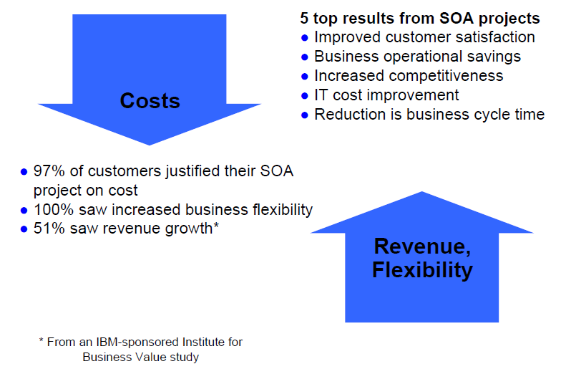
What is driving SOA?

Slide 4
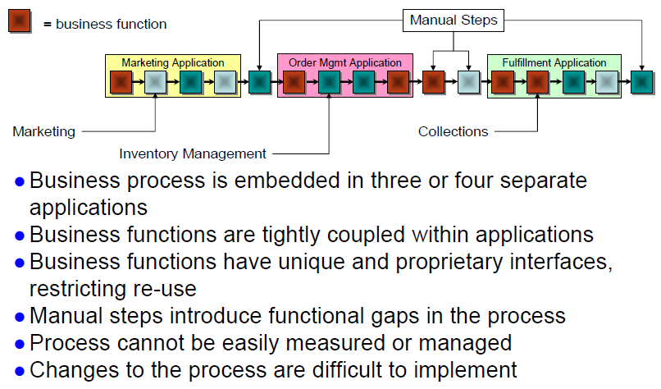
The need for business integration

Slide 5
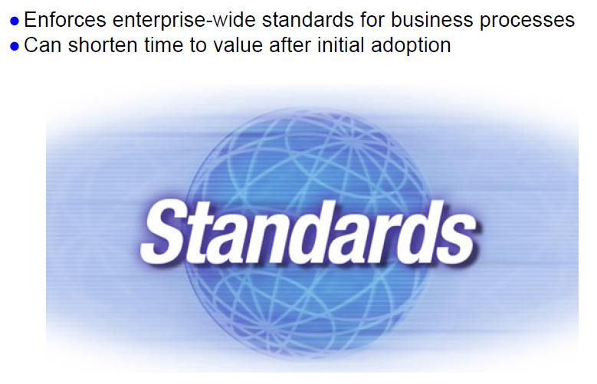
Benefits of adopting SOA

Slide 6
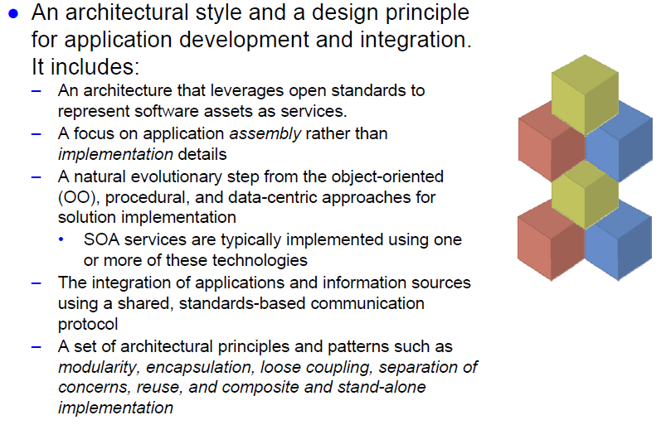
More on service-oriented architecture

Slide 7
What is a service?
Services are functions or operations available across a network:
– Well-defined interfaces
– Well-defined quality of service (QoS) capabilities and requirements
– Well-known endpoints
Services can be integrated across or within enterprises
Services are accessible independently of implementation or
transport
Services are offered by service providers
– Publish interface, policies and endpoint
Services are used by service consumers
– Securely, transactionally scoped, reliably
Services are mediated by service mediators and intermediaries
– Providing extensible discovery, selection, metering, monitoring, logging, and so forth

Slide 8
What are Web services?
Web services can be thought of as a collection of standards derived from XML which facilitate application interoperability
“A Web service is a software system identified by a URI whose
public interfaces and bindings are defined and described using
XML. Its definition can be discovered by other software
systems. These systems may then interact with the Web
service in a manner prescribed by its definition, using XML
based messages conveyed by Internet protocols ”
(W3C Web Services Architecture Group note, February 2004)
Definition does not mandate any particular specification, for
example, SOAP
Definition does not mandate any specific protocol, like HTTP

Slide 9
What is REST ?
REST stands for REpresentational State Transfer.
Is a web standards based architecture and uses HTTP Protocol for data communication.
A resource is accessed by a common interface using HTTP standard “methods”.

Slide 10
What is REST ?
Representational
  Clients possess the information necessary to identify, modify, and/or delete a web resource.
State
  All resource state information is stored on the client.
Transfer
  Client state is passed from the client to the service through HTTP.

Slide 11
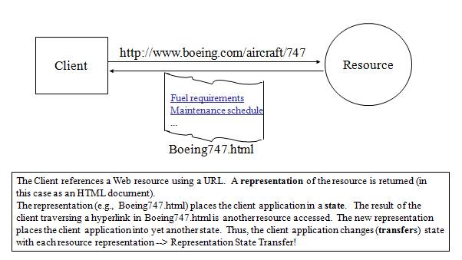
Why is it called "Representational State Transfer"?

Slide 12
Four Basic Design Principles
Use HTTP methods explicitly.
Be stateless.
Expose directory structure-like URIs.
Transfer XML, JavaScript Object Notation (JSON), or both.

Slide 13
Use HTTP methods explicitly
key characteristics of a RESTful Web service is the explicit use of HTTP methods in a way that follows the protocol as defined by RFC 2616.

Slide 14
Expose directory structure-like URIs
REST Web service URIs should be intuitive to the point where they are easy to guess. Think of a URI as a kind of self-documenting interface that requires little, if any, explanation or reference for a developer to understand what it points to and to derive related resources.

Slide 15
HTTP-REST Request Basics
The HTTP request is sent from the client.
  Identifies the location of a resource.
  Specifies the verb, or HTTP method to use when accessing the resource.
  Supplies optional request headers (name-value pairs) that provide additional information the server may need when processing the request.
  Supplies an optional request body that identifies additional data to be uploaded to the server (e.g. form parameters, attachments, etc.)

Slide 16
HTTP Methods
GET − Provides a read only access to a resource.
POST/PUT− Used to create a new resource and update an existing resource
DELETE − Used to remove a resource.

Slide 17
HTTP GET
How clients ask for the information they seek.
Issuing a GET request transfers the data from the server to the client in some representation
<protocol>://<servicename>/<ResourceType>/<ResourceID>
GET http://localhost/books
  Retrieve all books
GET http://localhost/books/ISBN-0011021
  Retrieve book identified with ISBN-0011021
GET http://localhost/books/ISBN-0011021/authors
  Retrieve authors for book identified with ISBN-0011021

Slide 18
HTTP POST, HTTP PUT
HTTP POST creates a resource
HTTP PUT updates a resource
POST http://localhost/books/
  Content: {title, authors[], …}
  Creates a new book with given properties
PUT http://localhost/books/isbn-111
  Content: {isbn, title, authors[], …}
  Updates book identified by isbn-111 with submitted properties

Slide 19
HTTP DELETE
Removes the resource identified by the URI
DELETE http://localhost/books/ISBN-0011
  Delete book identified by ISBN-0011

Slide 20
Representations
How data is represented or returned to the client for presentation.
Two main formats:
  JavaScript Object Notation (JSON)
  XML
It is common to have multiple representations of the same data

Slide 21
Representations
XML
  <COURSE>
    <ID>CS2650</ID>
    <NAME>Distributed Multimedia Software</NAME>
  </COURSE>
JSON
  {course
    {id: CS2650}
    {name: Distributed Multimedia Sofware}
  }

Slide 22
Real Life Examples
Google Maps
Google AJAX Search API
Yahoo Search API
Amazon WebServices

Slide 23
Environment Setup
Jersey Framework to create RESTful Web Services
Setup JDK
Setup Jersey framework libraries
Setup Apache Tomcat or Application server

Slide 24
Producing REST Services
REST services in Java web applications can be implemented in several ways:
As a plain Java Servlet
  Adequate for very simple REST services.
  Requires a lot of “boiler plate” code for complex services.
Using a REST service framework.
  Eliminates the need to write “boilerplate” code.
  Typically integrates with other technologies, such as Spring.
Java provides the JAX-RS specification for use by providers of REST service frameworks.

Slide 25
REST Services with JAX-RS
JAX-RS is a Java standard API for REST services:
Services are annotation driven
Provides support for data binding.
Provides advanced APIs for content negotiation.
CXF provides an implementation of JAX-RS:
Supports CXF filters, interceptors, and invokers to customize and extend the service.
Configurable through Spring.
Integrates with security providers.

Slide 26
CXF Web Services Framework
Apache CXF provides robust support for several web service patterns and specifications:
JSR APIs: JAX-WS, JAX-RS, JSR-181 annotations, SAAJ
WS-* specifications for web service interoperability.
Rich support support for message transports, protocol bindings, content negotiation, data bindings, and so forth.
Flexible, lightweight deployment in a variety of web application containers or stand-alone.
Tooling for code generation
Tools for WSDL and WADL publishing.

Slide 27
JAX-RS Annotations
JAX-RS HTTP Method Annotations:
@GET @POST
@PUT @DELETE
Applied to a Java method to bind it to an HTTP method.
Only one HTTP annotation may be applied to a single Java method.
Multiple Java methods may be given the same HTTP method annotation, assuming they are bound to different paths.

Slide 28
JAX-RS @Path Annotation
@Path annotations may be supplied to customize the request URI of resource.
@Path on a class defines the base relative path for all resources supplied by that class.
@Path on a Java class method defines the relative path for the resource bound to that method.
@Path on a method is relative to any @Path on the class.
In the absence of @Path on the class or method, the resource is defined to reside at the root of the service.
A leading forward slash (/) is unecessary as the path is always relative.

Slide 29
Annotations
@Path
Relative path of the resource class/method.
@GET
HTTP Get request, used to fetch resource.
@PUT
HTTP PUT request, used to create resource.
@POST
HTTP POST request, used to create/update resource.
@DELETE
HTTP DELETE request, used to delete resource.
@HEAD
HTTP HEAD request, used to get status of method availability.
@Produces
States the HTTP Response generated by web service. For example, APPLICATION/XML, TEXT/HTML, APPLICATION/JSON etc.

Slide 30
Annotations
@Consumes
States the HTTP Request type. For example, application/x-www-formurlencoded to accept form data in HTTP body during POST request.
@PathParam
Binds the parameter passed to the method to a value in path.
@QueryParam
Binds the parameter passed to method to a query parameter in the path.
@HeaderParam
Binds the parameter passed to the method to a HTTP header.
@FormParam
Binds the parameter passed to the method to a form value.
@DefaultValue
Assigns a default value to a parameter passed to the method.

Slide 31
Client API
Used to access web resources and provides integration with JAX-RS providers.
The Client API is defined in the javax.ws.rs.client package.

Slide 32
Creating a Basic Client Request Using the Client API
1. Obtain an instance of the javax.ws.rs.client.Client interface.
2. Configure the Client instance with a target.
3. Create a request based on the target.
4. Invoke the request.
Client client = ClientBuilder.newClient();
String name = client.target("http://localhost:8080/FirstProject/ProductService/prodList") .request(MediaType.TEXT_PLAIN) .get(String.class);
©2017 Teknoturf Info Services. Private and Confidential.

Slide 33
Creating a Basic Client Request Using the Client API
Obtaining the Client Instance
  Client client = ClientBuilder.newClient();
Setting the Client Target
  WebTarget myResource = client.target(" http://localhost:8080/FirstProject/ProductService/prodList ");
Setting Path Parameters in Targets
  WebTarget myResource = client.target(" http://localhost:8080/FirstProject/ProductService/prodList ") .path("userid") .queryParam("chapter", "1");
Invoking the Request
  Invocation.Builder builder = myResource.request("text/plain");
©2017 Teknoturf Info Services. Private and Confidential.

Slide 34
Set Calling Method
Invoke the request by calling one of the methods of the Invocation.Builder instance that corresponds to the type of HTTP request the target REST resource expects. These methods are:
  get()
  post()
  delete()
  put()
  head()
  options()
©2017 Teknoturf Info Services. Private and Confidential.

