Slide 1

Landslide Disaster Mitigation with Predictive Analysis
REVIEW 1
Nitish G 18BCB0151
Sanjit Kumar 18BCE0715
Tanya Warrier 18BCB0102

Slide 2
Dataset Description
Publisher
Context
Dimensions
National Aeronautics and Space Administration
https://data.nasa.gov/Earth-Science/Global-Landslide-Catalog-Export/dd9e-wu2v
The Global Landslide Catalog (GLC) was developed with the goal of identifying rainfall-triggered landslide events around the world, regardless of size, impacts or location.
Rows : 11K
Columns : 31
Each row is a : Landslide

Slide 3
Mapping data is the key element for modern rescue operations, improved forecasting for on-ground activity and better communication during a crisis. High-accuracy predictive analysis of natural disasters has great potential in saving lives.
PROBLEM DOMAIN

Slide 4
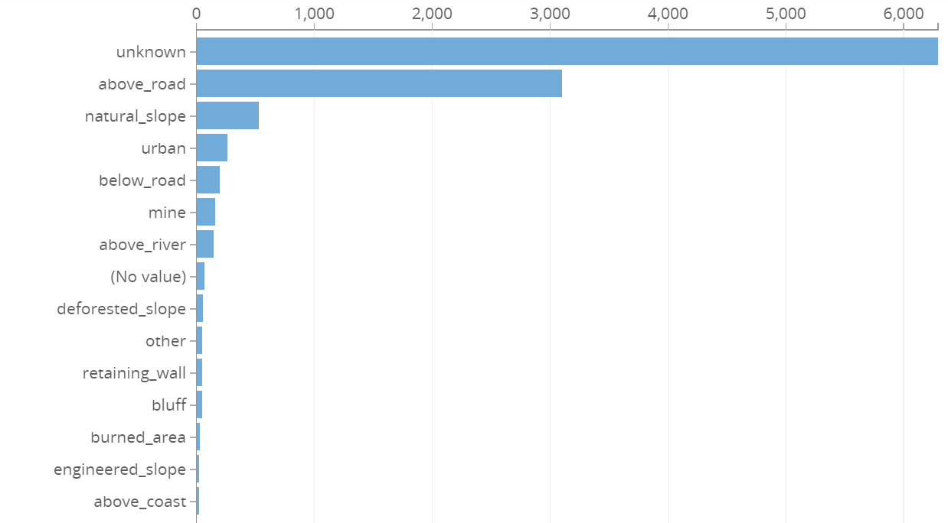
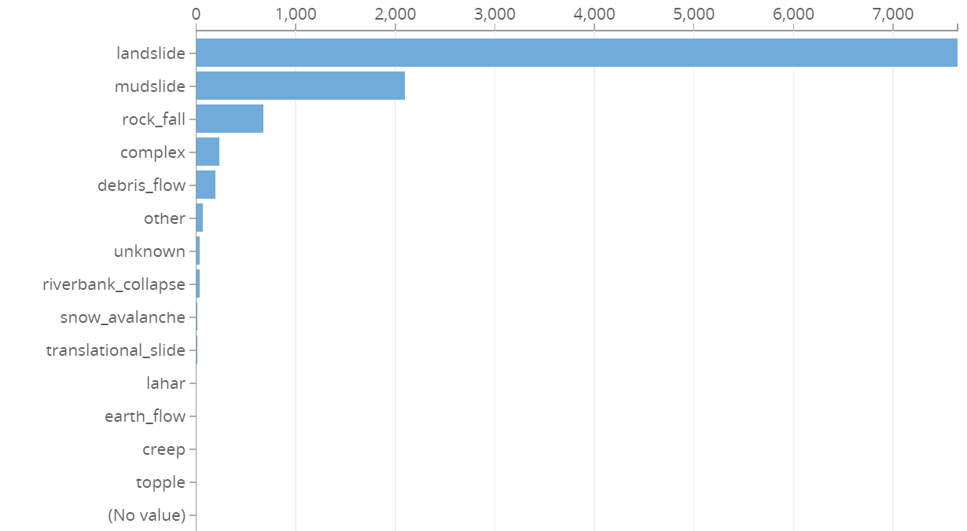
LANDSLIDE SETTINGS
LANDSLIDE CATEGORIES

Slide 5
Implementation

Slide 6
Proposed Approach
Classification
Analysis
Visualisation
Machine Learning
Landslide Event Prediction. Classification Problem.
Deep Neural Networks with Tensorflow 2.0
Accuracy of Prediction and its changes with change in hyper-parameters
Analysis of prediction
Javascript
Dashboard
ReactJS
D3, Google Charts, React-Vis
Tech Stack: Tensorflow, Flask, ReactJS, HTML/CSS

Slide 7
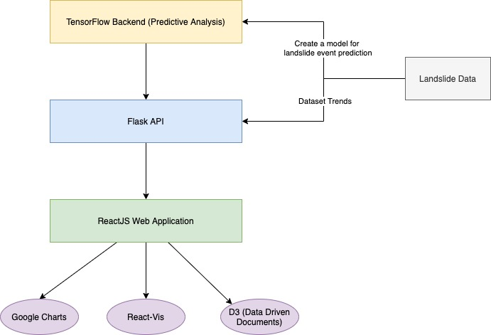

Slide 8
Estimation of attributes for Visualisation
Visualisation of Dataset Trends:
Will be studying and visualising just the dataset trends -
landslide_category, landslide_trigger, fatality_count, location_accuracy, landslide_size, fatality_count, country_name (to name a few). Experiment on this.
During Machine Learning Analysis:
Will plot the training and testing accuracy against hyper-parameters as a part of finding out the ideal set of hyper-parameters for the analysis.
Post Machine Learning Analysis:
Generate scores for the probability of landslides occurring in different locations. Will be visualising this wrt different landslide-prone locations.

