Slide 1
Java IO Packages

Slide 2
Introduction
Java I/O (Input and Output) is used to process the input and produce the output based on the input.
Java uses the concept of stream to make I/O operation fast. The java.io package contains all the classes required for input and output operations.
We can perform file handling in java by java IO API.

Slide 3
Stream
A stream is a sequence of data. In Java a stream is composed of bytes. It's called a stream because it's like a stream of water that continues to flow.
In java, 3 streams are created for us automatically. All these streams are attached with console.
1) System.out: standard output stream
2) System.in: standard input stream
3) System.err: standard error stream

Slide 4
Output Stream& Input stream
Java application uses an output stream to write data to a destination, it may be a file, an array, peripheral device or socket.
Java application uses an input stream to read data from a source, it may be a file, an array, peripheral device or socket.

Slide 5
OutputStream class
OutputStream class is an abstract class. It is the superclass of all classes representing an output stream of bytes. An output stream accepts output bytes and sends them to some sink.

Slide 6
Useful methods of OutputStream
Method | Description
1) public void write(int)throws IOException | is used to write a byte to the current output stream.
2) public void write(byte[])throws IOException | is used to write an array of byte to the current output stream.
3) public void flush()throws IOException | flushes the current output stream.
4) public void close()throws IOException | is used to close the current output stream.

Slide 7
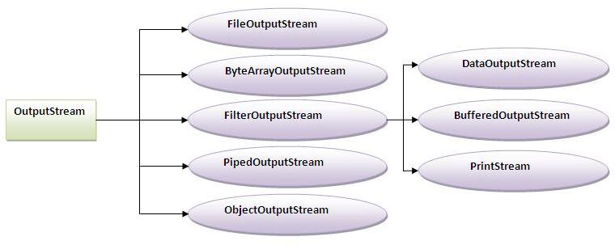

Slide 8
InputStream Class
InputStream class is an abstract class. It is the superclass of all classes representing an input stream of bytes.
Method | Description
1) public abstract int read()throws IOException | reads the next byte of data from the input stream. It returns -1 at the end of file.
2) public int available()throws IOException | returns an estimate of the number of bytes that can be read from the current input stream.
3) public void close()throws IOException | is used to close the current input stream.

Slide 9
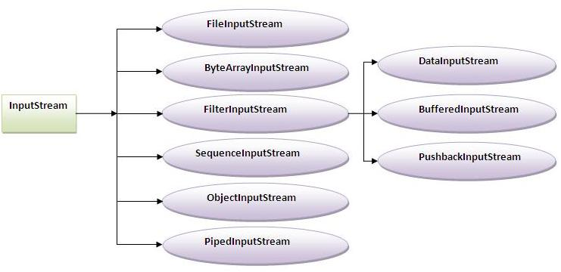

Slide 13
Java File Class
The File class is an abstract representation of file and directory pathname. A pathname can be either absolute or relative.
The File class have several methods for working with directories and files such as creating new directories or files, deleting and renaming directories or files, listing the contents of a directory etc.

Slide 14
File Constructor
Constructor | Description
File(File parent, String child) | It creates a new File instance from a parent abstract pathname and a child pathname string.
File(String pathname) | It creates a new File instance by converting the given pathname string into an abstract pathname.
File(String parent, String child) | It creates a new File instance from a parent pathname string and a child pathname string.
File(URI uri) | It creates a new File instance by converting the given file: URI into an abstract pathname.

Slide 15
Methods of File Class
Modifier and Type | Method | Description
static File | createTempFile(String prefix, String suffix) | It creates an empty file in the default temporary-file directory, using the given prefix and suffix to generate its name.
boolean | createNewFile() | It atomically creates a new, empty file named by this abstract pathname if and only if a file with this name does not yet exist.
boolean | canWrite() | It tests whether the application can modify the file denoted by this abstract pathname.String[]
boolean | canExecute() | It tests whether the application can execute the file denoted by this abstract pathname.

Slide 16
boolean | canRead() | It tests whether the application can read the file denoted by this abstract pathname.
boolean | isAbsolute() | It tests whether this abstract pathname is absolute.
boolean | isDirectory() | It tests whether the file denoted by this abstract pathname is a directory.
boolean | isFile() | It tests whether the file denoted by this abstract pathname is a normal file.
String | getName() | It returns the name of the file or directory denoted by this abstract pathname.
String | getParent() | It returns the pathname string of this abstract pathname's parent, or null if this pathname does not name a parent directory.

Slide 17
Path | toPath() | It returns a java.io.file.Path object constructed from the this abstract path.
URI | toURI() | It constructs a file: URI that represents this abstract pathname.
File[] | listFiles() | It returns an array of abstract pathnames denoting the files in the directory denoted by this abstract pathname
long | getFreeSpace() | It returns the number of unallocated bytes in the partition named by this abstract path name.
String[] | list(FilenameFilter filter) | It returns an array of strings naming the files and directories in the directory denoted by this abstract pathname that satisfy the specified filter.
boolean | mkdir() | It creates the directory named by this abstract pathname.

Slide 18
import java.io.*;
class File1
{
public static void main(String[] args) {
try {
File f = new File("firstfile.txt");
if (f.createNewFile()) {
System.out.println("New File is created!");
} else {
System.out.println("File already exists.");
}
} catch (IOException e) {
e.printStackTrace();
}
}
}

Slide 19
// to list all the file in the directoryjav
import java.io.*;
class File2
{
public static void main(String[] args)
{
File f=new File("C:/users/admin/desktop/java/");
String filenames[]=f.list();
for(String filename:filenames){
System.out.println(filename);
}
}
}

Slide 20
Java FileWriter and FileReader
Java FileWriter and FileReader classes are used to write and read data from text files. These are character-oriented classes, used for file handling in java.

Slide 21
Java FileWriter class
Java FileWriter class is used to write character-oriented data to the file.
Constructors of FileWriter class:
FileWriter(String file) :creates a new file. It gets file name in string.
FileWriter(File file) :creates a new file. It gets file name in File object.

Slide 22
Methods of FileWriter
Methods | Description
1) public void write(String text) | writes the string into FileWriter.
2) public void write(char c) | writes the char into FileWriter.
3) public void write(char[] c) | writes char array into FileWriter.
4) public void flush() | flushes the data of FileWriter.
5) public void close() | closes FileWriter.

Slide 23
Java File Reader class
Java FileReader class is used to read data from the file. It returns data in byte format like FileInputStream class.
Constructor | Description
FileReader(String file) | It gets filename in string. It opens the given file in read mode. If file doesn't exist, it throws FileNotFoundException.
FileReader(File file) | It gets filename in file instance. It opens the given file in read mode. If file doesn't exist, it throws FileNotFoundException.

Slide 24
Method | Description
1) public int read() | returns a character in ASCII form. It returns -1 at the end of file.
2) public void close() | closes FileReader.

Slide 25
Write To a File
We used the FileWriter class together with its write() method to write some text to the file.
import java.io.FileWriter;
import java.io.IOException;
public class writefile
{
public static void main(String[] args) {
try
{
FileWriter fw = new FileWriter("one.txt");
fw.write("First file program to write something on it");
fw.close();
System.out.println("Successfully wrote to the file.");
} catch (Exception e) {
System.out.println("An error occurred.");
}
}
}

Slide 26
Read a File
import java.io.*;
import java.util.Scanner; // Import the Scanner class to read text files
public class readfile
{
public static void main(String[] args) {
try {
File f = new File("one.txt");
Scanner s = new Scanner(f);
while (s.hasNextLine()) {
String data = s.nextLine();
System.out.println(data);
}
s.close();
} catch (FileNotFoundException e) {
System.out.println("An error occurred.");
}
}
}

Slide 27
There are many available classes in the Java API that can be used to read and write files in Java: FileReader, BufferedReader, Files, Scanner, FileInputStream, FileWriter, BufferedWriter, FileOutputStream

Slide 28
Implementation of …
1. Byte stream
2. Character stream
3. Buffered stream
4. Data stream
5. Object Stream
6. File stream

Slide 29
Byte stream in java
Java byte streams are used to perform input and output of 8-bit bytes. Though there are many classes related to byte streams but the most frequently used classes are, FileInputStream and FileOutputStream. Following is an example which makes use of these two classes to copy an input file into an output file −

Slide 30
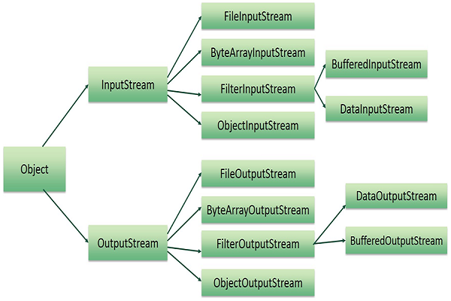

Slide 31
File input/output stream
Java FileInputStream class obtains input bytes from a file. It is used for reading byte-oriented data (streams of raw bytes) such as image data, audio, video etc. You can also read character-stream data. But, for reading streams of characters, it is recommended to use ______________class.
Java FileOutputStream is an output stream used for writing data to a _________

Slide 32
FileOutputStream Methods
Method | Description
protected void finalize() | It is used to clean up the connection with the file output stream.
void write(byte[] ary) | It is used to write ary.length bytes from the byte array to the file output stream.
void write(byte[] ary, int off, int len) | It is used to write len bytes from the byte array starting at offset off to the file output stream.
void write(int b) | It is used to write the specified byte to the file output stream.
FileChannel getChannel() | It is used to return the file channel object associated with the file output stream.
FileDescriptor getFD() | It is used to return the file descriptor associated with the stream.
void close() | It is used to closes the file output stream.

Slide 33
Sample program using FileOutputStream
import java.io.*;
class Simplewrite
{
public static void main(String ar[])
{
try
{
FileOutputStream f = new FileOutputStream (“abc.txt");
//f.write(45);
String s = "This the Fileoutputstream program";
byte b[] = s.getBytes(); // convert the string in to byte array
f.write(b);
f.close();
}catch(Exception e)
{
System.out.println(e);
}
}
}
Note: to check the output see that a file called abc.txt is created in the path where you executed this program

Slide 34
Java FileInputStream class methods
Method | Description
int available() | It is used to return the estimated number of bytes that can be read from the input stream.
int read() | It is used to read the byte of data from the input stream.
int read(byte[] b) | It is used to read up to b.length bytes of data from the input stream.
int read(byte[] b, int off, int len) | It is used to read up to len bytes of data from the input stream.
long skip(long x) | It is used to skip over and discards x bytes of data from the input stream.
FileChannel getChannel() | It is used to return the unique FileChannel object associated with the file input stream.
FileDescriptor getFD() | It is used to return the FileDescriptor object.
protected void finalize() | It is used to ensure that the close method is call when there is no more reference to the file input stream.
void close() | It is used to closes the stream.

Slide 35
Example of FileInputStream class
Java FileInputStream class obtains input bytes from a file FileOutputStream
import java.io.*;
class Simpleread
{
public static void main(String ar[])
{
try
{
FileInputStream f = new FileInputStream(“abc.txt");
int i = 0;
//int i=fin.read();
// System.out.print((char)i);
while((i=f.read())!= -1)
{
System.out.print((char)i);
}
f.close();
}catch(Exception e)
{
System.out.println(e);
}
}
}

Slide 36
import java.io.*;
public class filestream {
public static void main(String args[]) {
try {
byte b [] = {11,21,3,40,5};
OutputStream os = new FileOutputStream("test.txt");
for(int x = 0; x < b.length ; x++) {
os.write( b[x] ); // writes the bytes
}
os.close();
InputStream is = new FileInputStream("test.txt");
int size = is.available();
for(int i = 0; i < size; i++) {
System.out.print((char)is.read() + " ");
}
is.close();
} catch (IOException e) {
System.out.print("Exception");
}
}
}

Slide 37
ByteArray-Stream
The ByteArrayInputStream class allows a buffer in the memory to be used as an InputStream. The input source is a byte array.
The ByteArrayOutputStream class stream creates a buffer in memory and all the data sent to the stream is stored in the buffer.

Slide 38
Byte Array Input stream
public int read()
This method reads the next byte of data from the InputStream. Returns an int as the next byte of data. If it is the end of the file, then it returns -1.
public int read(byte[] r, int off, int len)
This method reads upto len number of bytes starting from off from the input stream into an array. Returns the total number of bytes read. If it is the end of the file, -1 will be returned.
public int available()
Gives the number of bytes that can be read from this file input stream. Returns an int that gives the number of bytes to be read.
public void mark(int read)
This sets the current marked position in the stream. The parameter gives the maximum limit of bytes that can be read before the marked position becomes invalid.
public long skip(long n)
Skips ‘n’ number of bytes from the stream. This returns the actual number of bytes skipped.

Slide 39
ByteArray Output Stream
public void reset()
This method resets the number of valid bytes of the byte array output stream to zero, so all the accumulated output in the stream will be discarded.
public byte[] toByteArray()
This method creates a newly allocated Byte array. Its size would be the current size of the output stream and the contents of the buffer will be copied into it. Returns the current contents of the output stream as a byte array.
public String toString()
Converts the buffer content into a string. Translation will be done according to the default character encoding. Returns the String translated from the buffer's content.
public void write(int w)
Writes the specified array to the output stream.
public void write(byte []b, int of, int len)
Writes len number of bytes starting from offset off to the stream.
6 public void writeTo(OutputStream outSt)
Writes the entire content of this Stream to the specified stream argument.

Slide 40
import java.io.*;
public class bytestream {
public static void main(String args[])throws IOException {
ByteArrayOutputStream b = new ByteArrayOutputStream(12);
while( b.size()!= 10 ) {
// Gets the inputs from the user
b.write("hello".getBytes());
}
byte b1 [] = b.toByteArray();
System.out.println("Print the content");
for(int x = 0 ; x < b1.length; x++) {
// printing the characters
System.out.print((char)b1[x] + " ");
}
System.out.println(" ");
int c;
ByteArrayInputStream bInput = new ByteArrayInputStream(b1);
System.out.println("Converting characters to Upper case " );
for(int y = 0 ; y < 1; y++) {
while(( c = bInput.read())!= -1) {
System.out.println(Character.toUpperCase((char)c));
}
bInput.reset();
}
}
}

Slide 41
FilterOutputStream Class
Java FilterOutputStream class implements the OutputStream class. It provides different sub classes such as BufferedOutputStream and DataOutputStream to provide additional functiona
Java FilterInputStream class implements the InputStream. It contains different sub classes as BufferedInputStream, DataInputStream for providing additional functionality. So it is less used individually.lity. So it is less used individually.

Slide 42
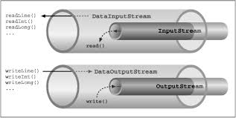
Data Input/output Stream
A data input stream enable an application read primitive Java data types from an underlying input stream in a machine-independent way(instead of raw bytes). That is why it is called DataInputStream – because it reads data (numbers) instead of just bytes.

Slide 43
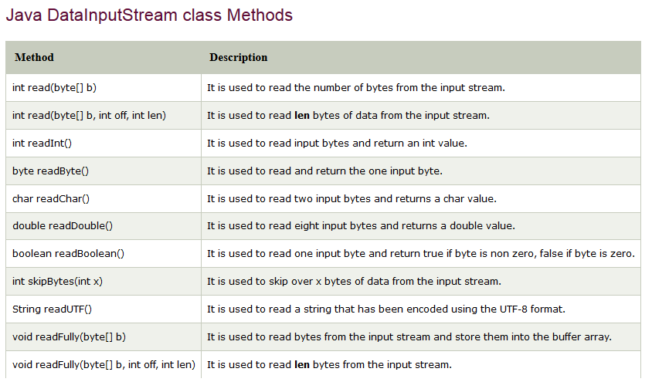
DataInputStream Class

Slide 44
import java.io.*;
class Datain
{
public static void main(String[] args) throws IOException
{
FileInputStream in = new FileInputStream("sample.txt");
DataInputStream di = new DataInputStream(in);
int count = in.available();
byte[] ary = new byte[count];
in.read(ary);
for (byte bt : ary)
{
char k = (char) bt;
System.out.print(k);
}
}
}

Slide 45
Java DataOutputStream Class
Java DataOutputStream class allows an application to write primitive Java data types to the output stream in a machine-independent way.
Java application generally uses the data output stream to write data that can later be read by a data input stream.

Slide 46
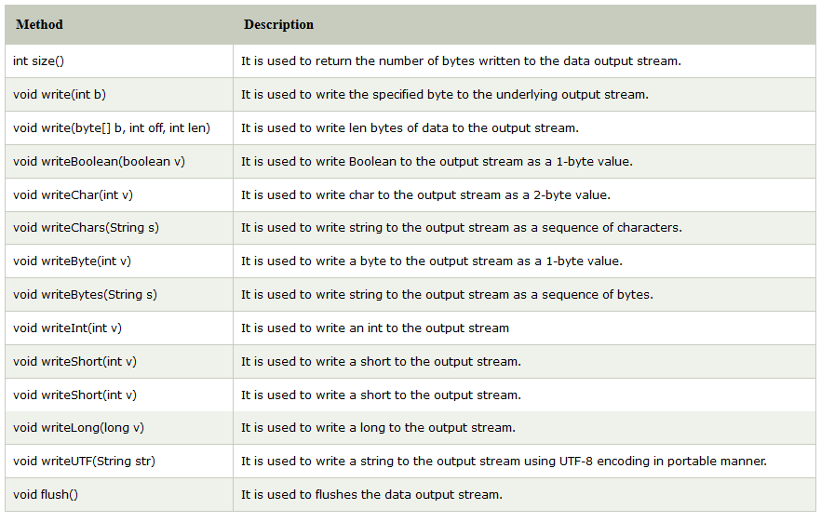

Slide 47
import java.io.*;
public class Dataout
{
public static void main(String[] args) throws IOException
{
FileOutputStream f = new FileOutputStream("Sample.txt");
DataOutputStream data = new DataOutputStream(f);
data.writeChars("This is Dataoutputstream
programming");
data.flush();
data.close();
System.out.println("Success...");
}
}

Slide 48
Buffered Stream
Java BufferedInputStream Class
Java BufferedInputStream class is used to read information from stream. It internally uses buffer mechanism to make the performance fast.
The important points about BufferedInputStream are:
When the bytes from the stream are skipped or read, the internal buffer automatically refilled from the contained input stream, many bytes at a time.
When a BufferedInputStream is created, an internal buffer array is created.
BufferedOutputStream-Java BufferedOutputStream class is used for buffering an output stream. It internally uses buffer to store data. It adds more efficiency than to write data directly into a stream. So, it makes the performance fast.

Slide 49
Java BufferedOutputStream Class
Java BufferedOutputStream class is used for buffering an output stream. It internally uses buffer to store data. It adds more efficiency than to write data directly into a stream. So, it makes the performance fast.
Java BufferedOutputStream class constructors
BufferedOutputStream(OutputStream os) - It creates the new buffered output stream which is used for writing the data to the specified output stream.
BufferedOutputStream(OutputStream os, int size) It creates the new buffered output stream which is used for writing the data to the specified output stream with a specified buffer size.

Slide 50
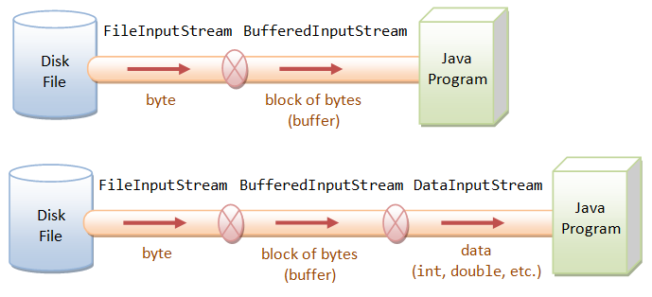

Slide 51
void write(int b) - It writes the specified byte to the buffered output stream.
void write(byte[] b, int off, int len) - It write the bytes from the specified byte-input stream into a specified byte array, starting with the given offset
void flush() - It flushes the buffered output stream.

Slide 52
BufferedOutputStream Example
import java.io.*;
public class BOS
{
public static void main(String args[])throws Exception
{
FileOutputStream f=new FileOutputStream("BOS.txt");
BufferedOutputStream bout=new BufferedOutputStream(f);
String s="Welcome to Buffered Reader Programming.";
byte b[]=s.getBytes();
bout.write(b);
bout.flush();
bout.close();
f.close();
System.out.println("success");
}
}

Slide 53
BufferedInputStream
Java BufferedInputStream class is used to read information from stream. It internally uses buffer mechanism to make the performance fast.
The important points about BufferedInputStream are:
When the bytes from the stream are skipped or read, the internal buffer automatically refilled from the contained input stream, many bytes at a time.
When a BufferedInputStream is created, an internal buffer array is created.

Slide 54
BufferedInputStream(InputStream IS) - It creates the BufferedInputStream and saves it argument, the input stream IS, for later use.
BufferedInputStream(InputStream IS, int size) - It creates the BufferedInputStream with a specified buffer size and saves it argument, the input stream IS, for later use.

Slide 55
Methods of Buffered Input Stream
Method | Description
int available() | It returns an estimate number of bytes that can be read from the input stream without blocking by the next invocation method for the input stream.
int read() | It read the next byte of data from the input stream.
int read(byte[] b, int off, int ln) | It read the bytes from the specified byte-input stream into a specified byte array, starting with the given offset.
void close() | It closes the input stream and releases any of the system resources associated with the stream.

Slide 56
void reset() | It repositions the stream at a position the mark method was last called on this input stream.
void mark(int readlimit) | It sees the general contract of the mark method for the input stream.
long skip(long x) | It skips over and discards x bytes of data from the input stream.
boolean markSupported() | It tests for the input stream to support the mark and reset methods.

Slide 57
Mark and reset method in BufferedInputStream
import java.io.BufferedInputStream;
import java.io.FileInputStream;
import java.io.IOException;
import java.io.InputStream;
public class bufferedinput{
public static void main(String[] args) throws Exception {
InputStream iStream = null;
BufferedInputStream bis = null;
try {
// read from file c:/test.txt to input stream
iStream = new FileInputStream("c:/users/admin/desktop/java/one.txt");
// input stream converted to buffered input stream
bis = new BufferedInputStream(iStream);
// read and print characters one by one
System.out.println("Char : "+(char)bis.read());
System.out.println("Char : "+(char)bis.read());
System.out.println("Char : "+(char)bis.read());
// mark is set on the input stream
bis.mark(0);
System.out.println("Char : "+(char)bis.read());
System.out.println("reset() invoked");
// reset is called
bis.reset();
// read and print characters
System.out.println("char : "+(char)bis.read());
System.out.println("char : "+(char)bis.read());
} catch(Exception e) {System.out.println(e);}
}
}

Slide 58
import java.io.*;
public class BufferedInputStreamExample{
public static void main(String args[]){
try{
FileInputStream fin=new FileInputStream(“c:/users/admin/desktop/java/one.txt");
BufferedInputStream bin=new BufferedInputStream(fin);
int i;
while((i=bin.read())!=-1){
System.out.print((char)i);
}
bin.close();
fin.close();
}catch(Exception e){System.out.println(e);}
}
}

Slide 59
Character streams
Java Byte streams are used to perform input and output of 8-bit bytes, whereas Java Character streams are used to perform input and output for 16-bit unicode. Though there are many classes related to character streams but the most frequently used classes are, FileReader and FileWriter. Though internally FileReader uses FileInputStream and FileWriter uses FileOutputStream but here the major difference is that FileReader reads two bytes at a time and FileWriter writes two bytes at a time.

Slide 60
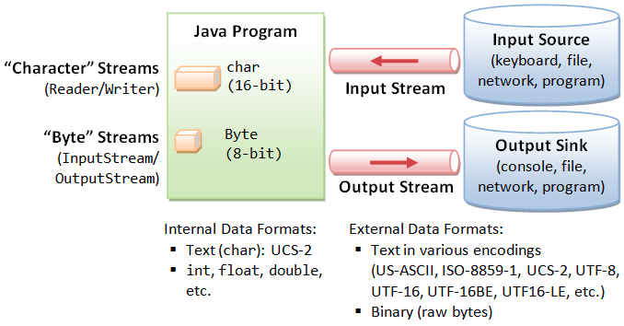

Slide 61
Java FileWriter and FileReader
Java FileWriter and FileReader classes are used to write and read data from text files. These are character-oriented classes, used for file handling in java.
Java has suggested not to use the FileInputStream and FileOutputStream classes if you have to read and write the textual information.

Slide 62
Character stream example
import java.io.*;
public class charstream {
public static void main(String args[]) throws
IOException {
FileReader in = null;
FileWriter out = null;
try {
in = new FileReader("Sample.txt");
out = new FileWriter("Sample2.txt");
int c;
while ((c = in.read()) != -1) {
out.write(c);
}
}finally {
if (in != null) {
in.close();
}
if (out != null) {
out.close();
}
}
}
}

Slide 63
Buffered Reader/Writer class
Java.io.BufferedReader class reads text from a character-input stream, buffering characters so as to provide for the efficient reading of characters, arrays, and lines.
Following are the important points about BufferedReader −
The buffer size may be specified, or the default size may be used.
Each read request made of a Reader causes a corresponding read request to be made of the underlying character or byte stream.

Slide 64
The Java.io.BufferedWriter class writes text to a character-output stream, buffering characters so as to provide for the efficient writing of single characters, arrays, and strings.
Following are the important points about BufferedWriter −
The buffer size may be specified, or the default size may be used.
A Writer sends its output immediately to the underlying character or byte stream.

Slide 65
Java BufferedReader Class
Java BufferedReader class is used to read the text from a character-based input stream. It can be used to read data line by line by readLine() method. It makes the performance fast. It inherits Reader class.
Java BufferedReader class constructors
BufferedReader(Reader rd) - It is used to create a buffered character input stream that uses the default size for an input buffer.
BufferedReader(Reader rd, int size)- It is used to create a buffered character input stream that uses the specified size for an input buffer.

Slide 66
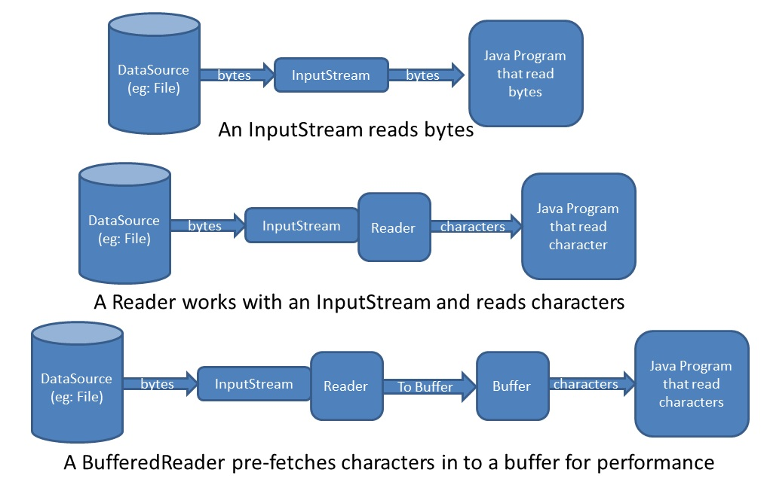

Slide 67
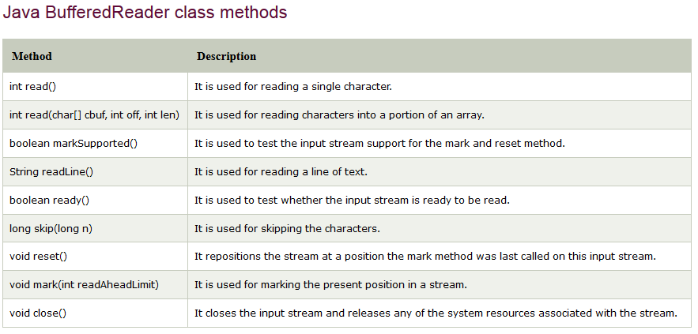

Slide 68
import java.io.*;
public class BuffRead
{
public static void main(String args[])throws Exception
{
InputStreamReader r=new InputStreamReader (System.in);
BufferedReader br=new BufferedReader(r);
System.out.println("Enter your Regno and name");
String name=br.readLine();
int no = Integer.parseInt(br.readLine());
System.out.println(" Hello "+name + " " +no);
}
}

Slide 69
Buffered Writer
import java.io.*;
public class bufferedwriter
{
public static void main(String[] args) throws Exception
{
FileWriter writer = new FileWriter
("c://users/admin/desktop/java/one.txt");
BufferedWriter buffer = new BufferedWriter(writer);
buffer.write("Welcome to java File handling
programming.");
buffer.close();
System.out.println("Success");
}
}

Slide 70
Similarly go through the rest all Classes such as
CharArrayReader
CharArrayWriter
PrintStream
PrintWriter
OutputStreamWriter
InputStreamReader
PushbackInputStream
PushbackReader
StringWriter
StringReader
PipedWriter
PipedReader
FilterWriter
FilterReader

Slide 71
Serialization and Deserialization in Java
Serialization in Java is a mechanism of writing the state of an object into a byte stream.
It is mainly used in Hibernate, RMI, JPA, EJB and JMS technologies.
The reverse operation of serialization is called deserialization.
Advantages of Java Serialization
It is mainly used to travel object's state on the network (which is known as marshaling).

Slide 72
java.io.Serializable interface
Serializable is a marker interface (has no data member and method). It is used to "mark" Java classes so that objects of these classes may get the certain capability.
import java.io.Serializable;
public class Student implements Serializable{
int id;
String name;
public Student(int id, String name) {
this.id = id;
this.name = name;
}
}

Slide 73
import java.io.*;
class Student implements Serializable{
int id;
String name;
public Student(int id, String name) {
this.id = id;
this.name = name;
}
}
class serial
{
public static void main(String args[])throws Exception
{
Student s1 =new Student(211,"ravi");
FileOutputStream fout=new FileOutputStream("f.txt");
ObjectOutputStream out=new ObjectOutputStream(fout);
out.writeObject(s1);
out.flush();
System.out.println("success");
}
}

Slide 74
Deserialization in java
Deserialization is the process of reconstructing the object from the serialized state.It is the reverse operation of serialization.

Slide 75
import java.io.*;
class Student implements Serializable{
int id;
String name;
public Student(int id, String name) {
this.id = id;
this.name = name;
}
}
class deserial
{
public static void main(String args[])throws Exception
{
ObjectInputStream in=new ObjectInputStream(new
FileInputStream("f.txt"));
Student s=(Student)in.readObject();
System.out.println(s.id+" "+s.name);
in.close();
}
}

Slide 76

END

