Slide 1
Multithreading Unit - 3

Slide 2
Topics to be covered
Life cycle of a Thread
Creating Thread
Thread Scheduler
Sleeping a Thread
Calling run() method

Slide 3
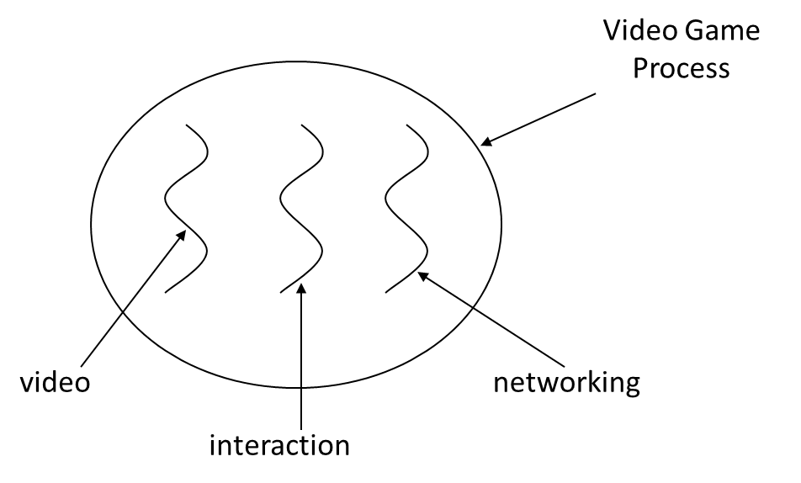
Thread
Individual and separate unit of execution that is part of a process ( Process- is a program in execution, Thread – dispatch able unit of work)
multiple threads can work together to accomplish a common goal.

Slide 4
Multitasking
Multitasking is a process of executing multiple tasks simultaneously. We use multitasking to utilize the CPU. Multitasking can be achieved by two ways:
Process-based Multitasking(Multiprocessing)
Thread-based Multitasking(Multithreading)
Threads share the same address space.
Thread is lightweight.
Cost of communication between the thread is low.

Slide 5
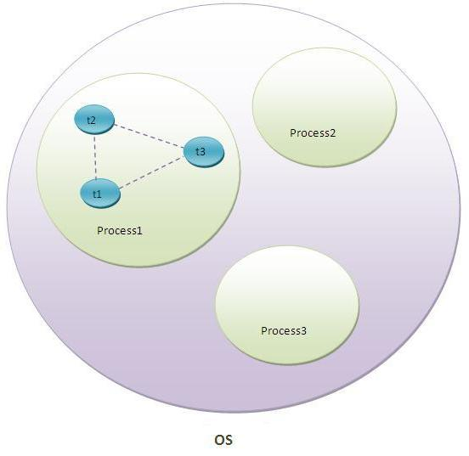
Thread in java
A thread is a lightweight sub process, a smallest unit of processing. It is a separate path of execution.
Threads are independent, if there occurs exception in one thread, it doesn't affect other threads. It shares a common memory area.
Note: At a time one thread is executed only.

Slide 6
Life cycle of a Thread (Thread States)
The life cycle of the thread in java is controlled
by JVM. The java thread states are as follows:
New
Runnable
Running
Non-Runnable (Blocked)
Terminated

Slide 7
1) New:
The thread is in new state if you create an instance of Thread class but before the invocation of start() method.
2) Runnable:
The thread is in runnable state after invocation of start() method, but the thread scheduler has not selected it to be the running thread.
3) Running
The thread is in running state if the thread scheduler has selected it.
4) Non-Runnable (Blocked)
This is the state when the thread is still alive, but is currently not eligible to run.
5) Terminated
A thread is in terminated or dead state when its run() method exits.

Slide 8
Creating thread
There are two ways to create a thread:
By extending Thread class
By implementing Runnable interface.

Slide 9
Thread class
Thread class provide constructors and methods to create and perform operations on a thread. Thread class extends Object class and implements Runnable interface.
Commonly used Constructors of Thread class:
Thread()
Thread(String name)
Thread(Runnable r)
Thread(Runnable r,String name)

Slide 10
Commonly used methods of Thread class:
public void run(): is used to perform action for a thread.
public void start(): starts the execution of the thread. JVM calls the run() method on the thread.
public void sleep(long miliseconds): Causes the currently executing thread to sleep (temporarily cease execution) for the specified number of milliseconds.
public int getPriority(): returns the priority of the thread.
public int setPriority(int priority): changes the priority of the thread.

Slide 11
public String getName(): returns the name of the thread.
public void setName(String name): changes the name of the thread.
public Thread currentThread(): returns the reference of currently executing thread.
public int getId(): returns the id of the thread.
public Thread.State getState(): returns the state of the thread.
public boolean isAlive(): tests if the thread is alive.

Slide 12
Starting a thread
start() method of Thread class is used to start a newly created thread.
It performs following tasks:
A new thread starts(with new call stack).
The thread moves from New state to the Runnable state.
When the thread gets a chance to execute, its target run() method will run.

Slide 13
Sample program
Class sample extends Thread
{
public void run()
{
System.out.println("thread is running...");
}
public static void main(String args[])
{
Sample t1=new sample();
t1.start();
}
}

Slide 14
Thread Scheduler in java
Thread scheduler in java is the part of the JVM that decides which thread should run.
There is no guarantee that which runnable thread will be chosen to run by the thread scheduler.
Only one thread at a time can run in a single process.
The thread scheduler mainly uses preemptive or time slicing scheduling to schedule the threads.

Slide 15
Sleep() in java
The sleep() method of Thread class is used to sleep a thread for the specified amount of time.
Syntax:
public static void sleep(long miliseconds)throws InterruptedException
public static void sleep(long miliseconds, int nanos)throws InterruptedException

Slide 16
Creating Threads Example 1
class thread1 extends Thread
{
public void run()
{
try
{
System.out.println("thread1");
sleep(1000);
System.out.println(" Thread1 is running now... ");
}catch(Exception e) { System.out.println(e.toString());
}
}
}
class threadtest
{
public static void main(String arg[])
{
thread1 t1 = new thread1();
thread2 t2 = new thread2();
thread3 t3 = new thread3();
System.err.println("Starting thread");
t1.start();
t2.start();
t3.start();
System.out.println("threads started");
}
}
class thread2 extends Thread
{
public void run()
{
try
{
System.out.println("thread2");
sleep(2000);
System.out.println(" Thread2 is running now... ");
}catch(Exception e) { System.out.println(e.toString());
}
}
}
class thread3 extends Thread
{
public void run()
{
try
{
System.out.println("thread3");
sleep(3000);
System.out.println(" Thread3 is running now... ");
}catch(Exception e) { System.out.println(e.toString());
}
}
}

Slide 17
Can we start a thread twice??
No. After starting a thread, it can never be started again. If you does so, an IllegalThreadStateException is thrown. In such case, thread will run once but for second time, it will throw exception.

Slide 18
What if we call run() method directly instead start() method?
Each thread starts in a separate call stack.
Invoking the run() method from main thread, the run() method goes onto the current call stack rather than at the beginning of a new call stack.

Slide 19
Instead start() ; if run() is used?
class sample extends Thread
{
public void run()
{
System.out.println(" thread running");
/*try
{
sleep(1000);
System.out.println("thread running now");
}catch(Exception e){}*/
for(int i=1;i<5;i++){
try{Thread.sleep(500);}catch(InterruptedException e){System.out.println(e);}
System.out.println(i);
}
}
public static void main(String ar[])
{
sample s = new sample();
sample s2 = new sample();
s.start();
s2.start();
//s.run();
//s2.run();
}
}

Slide 20
Thread priority
Each thread have a priority. Priorities are represented by a number between 1 and 10. In most cases, thread scheduler schedules the threads according to their priority (known as pre-emptive scheduling). But it is not guaranteed because it depends on JVM specification that which scheduling it chooses.

Slide 21
3 constants defined in Thread class:
public static int MIN_PRIORITY
public static int NORM_PRIORITY
public static int MAX_PRIORITY
The value of MIN_PRIORITY is 1
The value of MAX_PRIORITY is 10.

Slide 22
class threadtest
{
public static void main(String arg[])
{
thread1 t1 = new thread1();
thread2 t2 = new thread2();
thread3 t3 = new thread3();
System.err.println("Starting thread");
t1.setPriority(Thread.MAX_PRIORITY);
t2.setPriority(Thread.MIN_PRIORITY);
t1.start();
t2.start();
t3.start();
System.out.println("threads started");
}
}
class thread1 extends Thread
{
int time;
public void run()
{
try
{
System.out.println("thread1");
sleep(1000);
}catch(Exception e) { System.out.println(e.toString());
}
}
}

Slide 23
Creating thread using Runnable interface
Runnable interface:
The Runnable interface should be implemented by any class whose instances are intended to be executed by a thread. Runnable interface have only one method named run().
public void run(): is used to perform action for a thread.

Slide 24
//Program using interface
class runnable implements Runnable
{
public void run()
{
System.out.println("thread is running...");
}
public static void main(String a[])
{
runnable m1=new runnable();
Thread t1 =new Thread(m1);
t1.start();
Thread t2 = new Thread(m1);
t2.start();
}
}
//program using class
Class sample extends Thread
{
public void run()
{
System.out.println("thread is running...");
}
public static void main(String args[])
{
Sample t1=new sample();
t1.start();
}
}

Slide 25
Reasons for implementing a Runnable interface
There are two reasons for implementing a Runnable interface preferable to extending the Thread Class:
1. If you extend the Thread Class, that means that subclass cannot extend any other Class, but if you implement Runnable interface then you can do this.
2. The class implementing the Runnable interface can avoid the full overhead of Thread class which can be excessive.

Slide 26
performing single task by multiple threads
class tasking implements Runnable{
public void run(){
System.out.println("task one");
}
public static void main(String args[]){
Thread t1 =new Thread(new tasking());//passing anonymous object //of tasking class
Thread t2 =new Thread(new tasking());
t1.start();
t2.start();
}
}

Slide 27
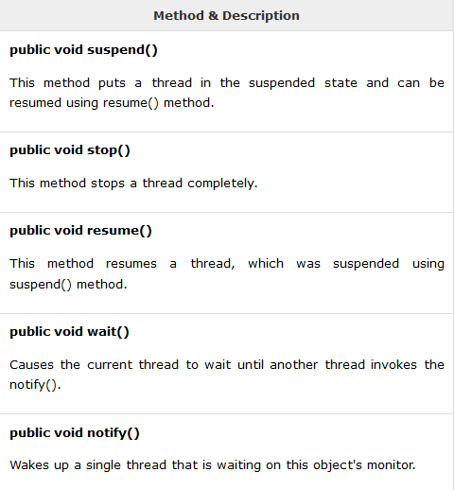
Major operations on thread control

Slide 28
Thread join
The join() method waits for a thread to die. In other words, it causes the currently running threads to stop executing until the thread it joins with completes its task.
Methods:
public void join()throws InterruptedException
public void join(long milliseconds)throws InterruptedException

Slide 29
class join1 extends Thread{
public void run(){
for(int i=1;i<=5;i++){
try{
Thread.sleep(500);
}catch(Exception e){System.out.println(e);}
System.out.println(Thread().getName()+i);
}
}
public static void main(String args[]){
join1 t1=new join1();
join1 t2=new join1();
join1 t3=new join1();
t1.start();
try{
t1.join();
}catch(Exception e){System.out.println(e);}
t2.start();
t3.start();
}
}

Slide 30
Synchronized in Java
Multi-threaded programs may often come to a situation where multiple threads try to access the same resources and finally produce erroneous and unforeseen results.
So it needs to be made sure by some synchronization method that only one thread can access the resource at a given point of time.

Slide 31
synchronized(sync_object)
{
// Access shared variables and other
// shared resources
}

Slide 32
Example program – threadsync.java
class multi
{
synchronized void multiplication(int n)
{
for(int i=1;i<=5;i++){
System.out.println(n*i);
try{
Thread.sleep(400);
}catch(Exception e)
{System.out.println(e);}
}
}
}
class threadsync
{
public static void main(String aa[])
{
multi m = new multi();
thread1 t1 = new thread1(m);
thread2 t2 = new thread2(m);
t1.start();
t2.start();
}
}
class thread1 extends Thread
{
multi m;
thread1(multi t)
{
this.m=t;
}
public void run()
{
m.multiplication(5);
}
}
class thread2 extends Thread
{
multi m;
thread2(multi t)
{
this.m=t;
}
public void run()
{
m.multiplication(10);
}
}

Slide 33
Dead lock in java
Deadlock in java is a part of multithreading. Deadlock can occur in a situation when a thread is waiting for an object lock, that is acquired by another thread and second thread is waiting for an object lock that is acquired by first thread. Since, both threads are waiting for each other to release the lock, the condition is called deadlock. – deadlock.java

Slide 34
class deadlock
{
public static void main(String aa[])
{
final String a="a";
final String b ="b";
Thread t1 = new Thread()
{
public void run()
{
synchronized(a)
{
System.out.println("thread1: locked a");
try
{
Thread.sleep(100);
}catch(Exception e) { }
synchronized(b)
{
System.out.println("thread1: locked b");
}
}
}
};
Thread t2 = new Thread()
{
public void run()
{
synchronized (b) {
System.out.println("Thread 2: locked b");
try { Thread.sleep(100);} catch (Exception e) {}
synchronized (a) {
System.out.println("Thread 2: locked a");
}
}
}
};
t1.start();
t2.start();
}
}

Slide 35
Inter thread Communication
wait() -causes current thread to wait until another thread invokes the notify() method or the notifyAll() method for this object
public void notify() -Wakes up a single thread that is waiting on this object's monitor.
public void notifyAll() -Wakes up all the threads that called wait( ) on the same object.

Slide 36
class student extends Thread
{
int amount=1000;
void withdraw(int amount)
{
synchronized(this)
{
System.out.println("Withdrawing...");
if( this.amount<amount)
{
System.out.println("Low balance....");
try
{
wait();
}catch(Exception e){}
}//if ends
this.amount=this.amount-amount;
System.out.println("withdraw completed");
}
}
synchronized void deposit(int amount)
{
System.out.println("going to deposit...");
this.amount=this.amount+amount;
System.out.println("deposit completed... ");
notify();
}
} // student ends
class interth{
public static void main(String args[]){
student s=new student();
new Thread(){
public void run(){s.withdraw(1500);}
}.start();
new Thread(){
public void run(){s.deposit(1000);}
}.start();
}}

Slide 37
Thank you

