Slide 1
Unit -3
Exception handling in JAVA

Slide 2
Exception Handling in Java
It is the mechanism to accomplish normal flow of the application to handle runtime errors such as ClassNotFound, IO, SQL, Remote etc…
In java, exception is an event that disrupts the normal flow of the program. It is an object which is thrown at runtime.

Slide 3
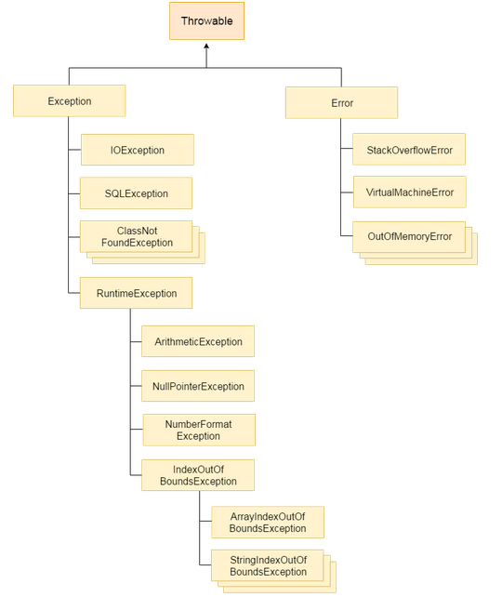
Hierarchy of Java Exception classes

Slide 4
Types of Exception
There are mainly two types of exceptions: checked and unchecked exception. The sun microsystem says there are three types of exceptions:
Checked Exception
Unchecked Exception
Error

Slide 5
Difference between checked and unchecked exceptions
1) Checked Exception
The classes that extend Throwable class except RuntimeException and Error are known as checked exceptions e.g.IOException, SQLException etc. Checked exceptions are checked at compile-time.
2) Unchecked Exception
The classes that extend RuntimeException are known as unchecked exceptions e.g. ArithmeticException, NullPointerException, ArrayIndexOutOfBoundsException etc. Unchecked exceptions are not checked at compile-time rather they are checked at runtime.
3) Error
Error is irrecoverable e.g. OutOfMemoryError, VirtualMachineError, AssertionError etc.

Slide 6
Common exceptions
1. 50/0 → Arithmetic exception
2. String S = null, S.o.p(s.length) →_______________________
3. int a[5];
a[6] = 20; → _________________
4. String s= “HELLLO”;
S.o.p(Interger.parseInt(S)); → _________

Slide 7
Java Exception Handling Keywords
There are 5 keywords used in java exception handling.
try -> try block is used to enclose the code that might throw an exception. It must be used within the method
Catch -> Java try block must be followed by either catch or finally block. catch block is used to handle the Exception. multiple catch block with a single try is also possible
Finally-> Java finally blockis always executed whether exception is handled or not. Java finally block follows try or catch block.

Slide 8
Throw -> The throw keyword in Java is used to explicitly throw an exception from a method or any block of code. We can throw either checked or unchecked exception. The throw keyword is mainly used to throw custom exceptions. When a throw statement is encountered and executed, execution of the current method is stopped and returned to the caller
Throws ->Whereas the throws keyword is used to declare that a method may throw one or some exceptions

Slide 9
Syntax
java try-catch
try{
//code that may throw exception
}catch(Exception_class_Name ref){}
try-finally block
try{
//code that may throw exception
}finally{}

Slide 10
Example program for arithmetic exception
// program using exception
class exp1
{
public static void main(String ar[])
{
try
{
int a = 50/0;
System.out.println("the value of a "+a);
}catch(Exception e){System.out.println(e);}
System.out.println("lines of coding continues");
} }
// program with out exception
class exp1
{
public static void main(String ar[])
{
int a = 50/0;
System.out.println("the value of a "+a);
}
}

Slide 11
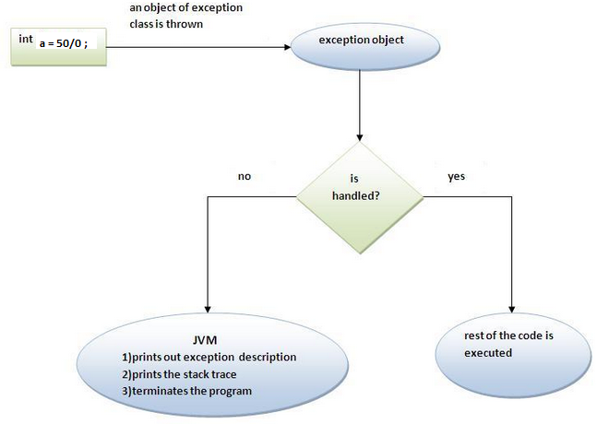
How exception is handled using try-catch

Slide 12
Multiple catch block
class exp2
{
public static void main(String ar[])
{
try
{
String s = "helo";
int a[] = new int[5];
a[5]= Integer.parseInt(s);
} catch (NumberFormatException e )
{
System.out.println("\nNumber format:"+e);
}
catch(ArrayIndexOutOfBoundsException e)
{
System.out.println("\nArray index: "+e);
}
catch(Exception e){}
System.out.println("\nprogram continues...");
}
}

Slide 13
Conclusions from multiple catch
At a time only one Exception is occured and at a time only one catch block is executed.
All catch blocks must be ordered from most specific to most general i.e. catch for ArithmeticException must come before catch for Exception . (Get the answer for this conclusion)

Slide 14
Nested try-catch block
Some cases where certain set of code causes some error and another set of code causes another error then we are in need of nested try-catch block..(Example program exp3.java)

Slide 15
class exp3
{
public static void main(String ar[])
{
try
{
try
{
String s = "helo";
int a = Integer.parseInt(s);
} catch (NumberFormatException e ){
System.out.println("\nNumber format:"+e);
}
try
{
int a[] = new int[5];
a[5]= 100;
}catch(ArrayIndexOutOfBoundsException e)
{
System.out.println("\nArray index: "+e);
}
}catch(Exception e)
{
System.out.println("General exeception.....");
}
System.out.println("\nprogram continues...");
}
}

Slide 16
Finally block
Java finally block is a block that is used to execute important code such as closing connection, stream etc. Java finally blockis always executed whether exception is handled or not. Java finally block follows try or catch block.

Slide 17
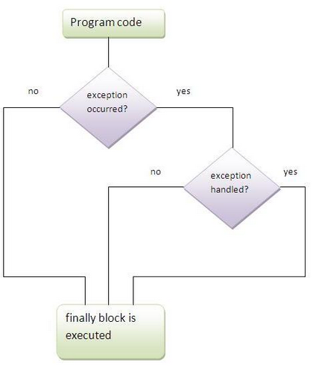
Finally block

Slide 18
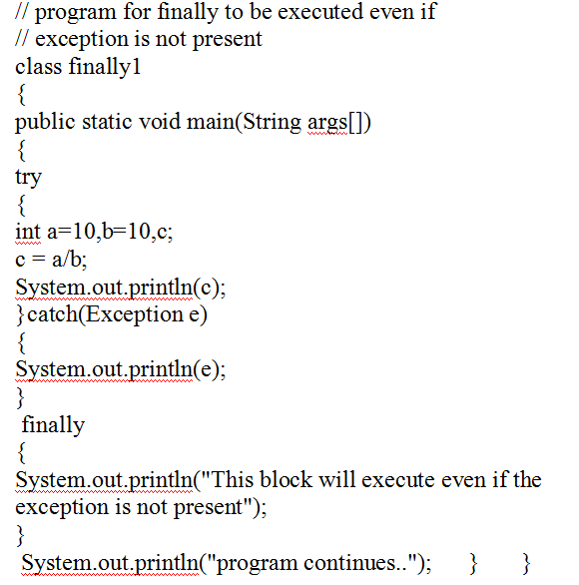

Slide 19
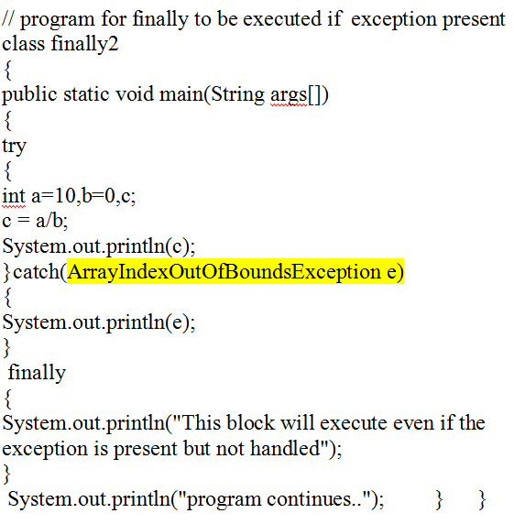

Slide 20
class finally2
{
public static void main(String args[])
{
try
{
int a[] = new int[10];
a[23]=45;
}
finally
{
int a=10, b=0;
int c = a/b;
System.out.println(c);
System.out.println("This block will execute even if the exception is present but not
handled");
}
System.out.println("program continues..");
}
}

Slide 21
Try-catch inside finally block
class finally2
{
public static void main(String args[])
{
try
{
int a[] = new int[10];
a[23]=45;
} catch(Exception e) {System.out.println(e);}
finally
{
try
{
int a=10, b=0;
int c = a/b;
System.out.println(c);
System.out.println("This block will execute even if the exception is present but not
handled");
}catch(Exception e){System.out.println(e);}
}
System.out.println("program continues..");
}
}

Slide 22
User-defined Exception
If you are creating your own Exception that is known as custom exception or user-defined exception. Java custom exceptions are used to customize the exception according to user need.

Slide 23
import java.util.*;
class Incometax extends Exception
{
Incometax(String s)
{
super(s);
}
}
class userdefinedexception
{
static void check(int salary) throws Incometax
{
if(salary <100000)
throw new Incometax("No need to pay tax");
else
System.out.println("Pay your tax");
}
public static void main(String args[])
{
int n;
Scanner s = new Scanner(System.in);
System.out.println("Enter your annual salary");
n = s.nextInt();
try{
check(n);
}catch(Exception e){System.out.println("Exception caught: "+e);}
System.out.println("sucess...");
}
}

Slide 24
Advantage of Exception Handling
to maintain the normal flow of the application.
Ie. Suppose there is 6lines of coding statements in our program and there occurs an exception at statement 5, rest of the code will not be executed i.e. statement 6 to 10 will not run. If we perform exception handling, rest of the statement will be executed. That is why we use exception handling in java.

Slide 25
Practise Programs- Exception Handling
Write a class to sort the given set of n integers in descending order. Include a try block to locate the array index out of bound exception and catch it.
Write a program to calculate the grade of a student. Enter marks for minimum 5 subjects. While entering marks if the mark is negative throw NegativeMarkException and if the mark is greater than 100 throw OutofRangeException.
3. Write a Java Program to create a class Employee containing EmpCode, name, age, experience. Create a constructor to initialize the data members. Create a
display( ) method to display the details. Create a check( )method to check for the following conditions:
Length of EmpCode should be exactly 6
Maximum characters of name is 30
Age cannot be less than 18 ormore than 58
Experience cannot exceed age-18
4. Write a java program to get the age of the user, if the age of the user is less than 18, give a message that “ you are not eligible for voting””, else allow the user to provide their vote.

Slide 26
Thank you

