Slide 1
Unit - 2

Slide 2
Inheritance
The idea behind inheritance in java is that you can create new classes that are built upon existing classes. When you inherit from an existing class, you can reuse methods and fields of parent class, and you can add new methods and fields also.
Inheritance represents the IS-A relationship, also known as parent-child relationship.
Why use inheritance in java
For Method Overriding (so runtime polymorphism can be achieved).
For Code Reusability.

Slide 3
Syntax of Java Inheritance
class Subclass-name extends Superclass-name
{
//methods and fields
}
The extends keyword indicates that you are making a new class that derives from an existing class. The meaning of "extends" is to increase the functionality.
In the terminology of Java, a class which is inherited is called parent or super class and the new class is called child or subclass.

Slide 4
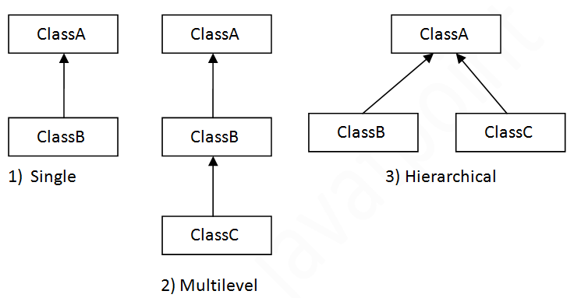
Types of inheritance in java
On the basis of class, there can be three types of inheritance in java: single, multilevel and hierarchical.

Slide 5
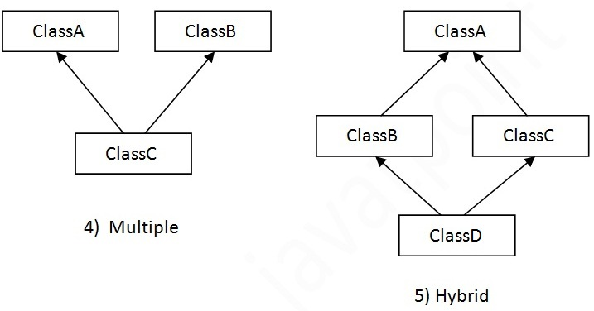
In java programming, multiple and hybrid inheritance is supported through interface only. We will learn about interfaces later.
Note: Multiple inheritance is not supported in java through class.

Slide 6
/*write a java program to create a class called person which gets the details such as SSno, name, native place. Create a subclass called projectmanager to get the details such as projectaccount,workplace, team size.
Again create one more class called father and get the detail as marital status, if the marital status as "married", get the details of number of children else if martial status as "Single", display "Awaiting for an AWESOME person".
Report the list for a single person using multi level inheritance in java.*/
import java.util.*;
class person // super class
{
int ssn;
String name, place;
void getdetails()
{
System.out.println("Enter the details of the person");
Scanner s = new Scanner(System.in);
ssn = s.nextInt();
name = s.next();
place = s.next();
}
} //superclass
class pm extends person //subclass
{
String acc,workplace;
int ts;
void getdata()
{
System.out.println("Enter the details of the project manager");
Scanner s = new Scanner(System.in);
ts = s.nextInt();
acc = s.next();
workplace = s.next();
}
void display()
{
System.out.println(ssn + " "+name+" "+place+" "+ts + " " +acc+ " " +workplace);
}
}//subclass
class sing
{
public static void main(String a[])
{
pm p =new pm();
p.getdata();
p.getdetails();
p.display();
}
}

Slide 7
Method overriding
If subclass (child class) has the same method as declared in the parent class, it is known as method overriding in java.
Usage of Java Method Overriding
Method overriding is used to provide specific implementation of a method that is already provided by its super class.
Method overriding is used for runtime polymorphism
Rules for Java Method Overriding
1. Method must have same name as in the parent class
2. Method must have same parameter as in the parent class.
3. Must be IS-A relationship (inheritance).

Slide 8
Example program – overriding1.java
class square
{
int a = 3;
void area()
{
int area = a*a;
System.out.println(area);
}
}
class cube extends square
{
int a = 5;
void area()
{
int area = 6*a*a;
super.area();
System.out.println(area);
}
}
class overriding1
{
public static void main(String ar[])
{
cube c = new cube();
c.area();
}
}

Slide 9
super keyword in java
The super keyword in java is a reference variable which is used to refer immediate parent class object.
Whenever you create the instance of subclass, an instance of parent class is created implicitly which is referred by super reference variable.
Usage of java super Keyword:
1. super can be used to refer immediate parent class instance variable.
2. super can be used to invoke immediate parent class method.
3. super() can be used to invoke immediate parent class constructor.

Slide 10
class square
{
int a = 3;
square()
{
System.out.println("this is parent class constructor");
}
void area()
{
int area = a*a;
System.out.println(area);
}
}
class cube extends square
{
int a = 5;
cube()
{
super(); // calling the constructor of super class
}
void area()
{
//super(); // dont use super like this
int area = 6*a*a;
super.area();
System.out.println(area);
}
}
class super1
{
public static void main(String ar[])
{
cube c = new cube();
c.area();
}
}

Slide 11
Dynamic Method Dispatch
Dynamic Method Dispatch is a process in which a call to an overridden method is resolved at runtime rather than compile-time.
Another name for Dynamic Method Dispatch is Run-time polymorphism
In this process, an overridden method is called through the reference variable of a superclass. The determination of the method to be called is based on the object being referred to by the reference variable.

Slide 12
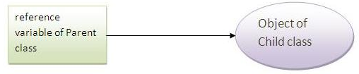
Upcasting
When reference variable of Parent class refers to the object of Child class, it is known as upcasting. For example:

Slide 13
Note: Runtime polymorphism can't be achieved by data members.

Slide 14
Abstract class
A class that is declared with abstract keyword, is known as abstract class in java. It can have abstract and non-abstract methods (method with body).
Before learning java abstract class, let's understand the abstraction in java first.

Slide 15
Abstraction is a process of hiding the implementation details and showing only functionality to the user.
Ways to achieve Abstraction
There are two ways to achieve abstraction in java
Abstract class (0 to 100%)
Interface (100%)

Slide 16
abstract class
A class that is declared as abstract is known as abstract class. It needs to be extended and its method implemented. It cannot be instantiated.
Syntax:
abstract class <classname> {}

Slide 17
abstract method
A method that is declared as abstract and does not have implementation is known as abstract method. Example abstract method
abstract void printStatus();//no body and abstract
Example program absfaculty.java

Slide 18
// program absfaculty . Java
abstract class faculty
{
abstract void marks();
}
class student1 extends faculty
{
void marks()
{
System.out.println("I got first class!!!");
}
}
class student2 extends faculty
{
void marks()
{
System.out.println("I got distinction....hurray!!!");
}
}
class absfaculty
{
public static void main(String args[])
{
faculty f2 = new faculty(); // faculty is abstract: it cannot be instantiated....
faculty f = new student1();
faculty f1 = new student2();
f.marks();
f1.marks();
}
}

Slide 19
CAN abstract class can have data member, abstract method, method body, constructor and main() method??????????
Whether all the methods in the abstract class to be abstract methods…???/// (abstr.java)
Rule: If there is any abstract method in a class, that class must be ________________________
Rule: If you are extending any abstract class that have abstract method, you must either provide the implementation of the method or make this class abstract.

Slide 20
// sample program using abstraction – abstr.java
abstract class animal{
animal(){System.out.println("animal is a living being");}
abstract void legs();
void domestic(){System.out.println("cat,dog,parrot.....are domestic animal");}
}
class lion extends animal{
void legs(){System.out.println("lion has four legs ....");}
}
class abstr
{
public static void main(String args[])
{
animal obj = new lion();
obj.legs(); // abstract method
obj.domestic(); //non-abstract method.
}
}

Slide 21
Interface in JAVA
The interface in java is a mechanism to achieve 100% abstraction.
There can be only abstract methods in the java interface not method body.
It is used to achieve abstraction and multiple inheritance in Java (wrong program on multiple inheritance = kk.java).
Note: It cannot be instantiated just like abstract class.
Note: Java Interface also represents IS-A relationship. (ie it can be inherited)

Slide 22
// sample wrong program kk.java
class A
{
void show()
{
System.out.println("SDF");
}
}
class B
{
void show1()
{
System.out.println("SDFsadfasdf");
}
}
class b extends A,B
{
void show2()
{
System.out.println("SDFsdafasfs");
}
}
class kk
{
public static void main(String a[])
{
b b1 = new b();
b1.show2();
}
}

Slide 23
How the compiler takes the interface
The java compiler adds public and abstract keywords before the interface method. More, it adds public, static and final keywords before data members (Very important) (Example program interface1.java)
Interface cable
{
Int pins = 3;
void usedas();
}
Interface cable
{
Public static final Int pins = 3;
Public abstract void usedas();
}
Compiler

Slide 24
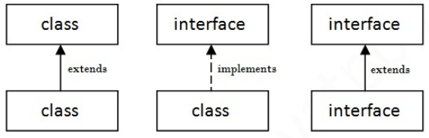
Understanding relationship between classes and interface
Example class to implement interface – interface1.java

Slide 25
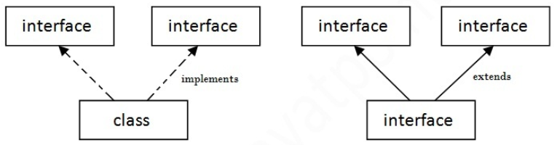
Multiple inheritance in Java by interface (multiinher.java)
If a class implements multiple interfaces
or
an interface extends multiple interfaces i.e. known as multiple inheritance.

Slide 26
interface audio
{
void listen();
}
interface video
{
void show();
}
class movie implements audio,video
{
public void listen()
{
System.out.println("Awesome song");
}
public void show()
{
System.out.println("Excellent scene");
}
}
class multiinher
{
public static void main(String ar[])
{
movie m = new movie();
m.show();
m.listen();
}
}

Slide 27
Questions
Multiple inheritance is not supported through class in java but it is possible by interface, why?
Can we define a class inside the interface?
Similar to nested class…. Is nested interface possible??????

Slide 28
Interface inheritance
A class implements interface but one interface extends another interface .
class Museum implements Statue // class implements interface
{
public void broken(){System.out.println("Rocks broken from the mountains");}
public void carved(){System.out.println("broken rocks carved as statue");}
public static void main(String args[]){
Museum m = new Museum();
m. broken();
m. carved();
}
}
interface rock //interface1
{
void broken();
}
interface Statue extends rock // interface inheritance
{
void carved();
}

Slide 29
Program discussed in the classroom
write a java program which contains two interfaces such as area and volume. Declare the variables lenght and breadth in the interface area along with a method called area(),whereas declare a variable height in the interface volume along with the method volume()
extend the interface area into the interface volume.
Create a class cuboid that implements interface volume and calculate the volume of the cuboid by creating your own methods if necessary

Slide 30
Solution for the program discussed in the classroom
interface area
{
void area();
int length=10,breadth=10;
}
interface volume extends area
{
void volume();
int height=10;
}
class cuboid implements volume
{
public void area()
{
System.out.println("ASDF");
}
public void volume()
{
int cal=length*breadth*height;
System.out.println(cal);
}
}
class mainn
{
public static void main(String str[])
{
cuboid c = new cuboid();
c.volume();
}
}

Slide 31
Garbage collector in JAVA
In java, garbage means unreferenced objects.
Garbage Collection is process of reclaiming the runtime unused memory automatically. In other words, it is a way to destroy the unused objects.
To do so, we were using ________function in C language and _______in C++. But, in java it is performed automatically. So, java provides better memory management.
free
Delete ()

Slide 32
Advantage of Garbage Collection
It makes java memory efficient because garbage collector removes the unreferenced objects from heap memory.
It is automatically done by the garbage collector(a part of JVM) so we don't need to make extra efforts.

Slide 33
Ways for objects to be unreferenced:
By nulling the reference ( object = null)
By assigning a reference to another ( obj1 = obj2)
By annonymous object etc. ( new classname())

Slide 34
finalize() method
The finalize() method is invoked each time before the object is garbage collected. This method can be used to perform cleanup processing. This method is defined in Object class as:
protected void finalize(){}
Note: The Garbage collector of JVM collects only those objects that are created by new keyword. So if you have created any object without new, you can use finalize method to perform cleanup processing (destroying remaining objects).

Slide 35
gc() method
The gc() method is used to invoke the garbage collector to perform cleanup processing. The gc() is found in System and Runtime classes.
public static void gc(){}
Note: Garbage collection is performed by a daemon thread called Garbage Collector(GC). This thread calls the finalize() method before object is garbage collected.
Note: A daemon thread is a thread that does not prevent the JVM from exiting when the program finishes but the thread is still running
Program – garbage.java

Slide 36
class garbage
{
public void finalize()
{
System.out.println("object is garbage collected");
}
public static void main(String args[])
{
garbage g1 = new garbage();
garbage g2=new garbage();
garbage g3=new garbage();
g1=null;
g2=null;
g3=null;
System.gc();
System.out.println("SADF");
}
}

Slide 37
JAVA inner classes
Java inner class or nested class is a class which is declared inside the class or interface.
We use inner classes to logically group classes and interfaces in one place so that it can be more readable and maintainable.
Additionally, it can access all the members of outer class including private data members and methods.

Slide 38
class Java_Outer_class{
//code
class Java_Inner_class{
//code
}
}

Slide 39
Advantage of java inner classes
There are basically three advantages of inner classes in java. They are as follows:
1) Nested classes represent a special type of relationship that is it can access all the members (data members and methods) of outer class including private.
2) Nested classes are used to develop more readable and maintainable code because it logically group classes and interfaces in one place only.
3) Code Optimization: It requires less code to write.

Slide 40
Types of Nested classes
There are two types of nested classes
non-static (inner classes)
static nested classes.
Non-static nested class (inner class)
Member inner class
Anonymous inner class
Local inner class
Static nested class
Nested Interfaces

Slide 41
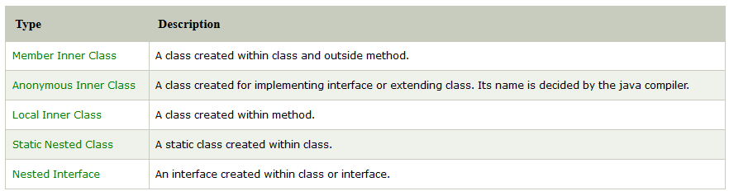
Non-static nested class

Slide 42
Member inner class
class out
{
private int a=100;
class in
{
void display()
{
System.out.println("a: "+a);
} //inner class
} //outer class
public static void main(String args[])
{
out o=new out();
out.in i=o.new in();
i.display();
} //main
} //class

Slide 43
Java Anonymous inner class
A class that have no name is known as anonymous inner class in java. It should be used if you have to override method of class or interface.
Java Anonymous inner class can be created by two ways:
Class (may be abstract or concrete).
Interface

Slide 44
Java anonymous inner class example using class
abstract class Employee
{
abstract void working();
}
class aina
{
public static void main(String args[])
{
Employee e=new Employee()
{
void working()
{
System.out.println("I am a software Engineer");}
};
e.working();
}
}

Slide 45
Java anonymous inner class example using interface
// Anonyms inner class using interface
interface Animal
{
void legs();
}
class ain_interface
{
public static void main(String args [])
{
Animal a=new Animal()
{
public void legs()
{
System.out.println("All animals have 4 legs");
}
};
a.legs();
}
}

Slide 46
Java Local inner class
Generally method will be declared inside a class. But, if a class created inside a method is called local inner class in java.
If you want to invoke the methods of local inner class, you must instantiate this class inside the method.(localinner.java)

Slide 47
class localInner
{
private int a=330;//instance variable
void display()
{
class Local
{
void show()
{
System.out.println(a);
}
}
Local l=new Local();
l.show();
}
public static void main(String args[]){
localInner lo=new localInner();
lo.display();
}
}

Slide 48
Rules for local inner classes
Rule 1:
Local variable can't be private, public or protected.
Rule 2:
Local inner class cannot be invoked from outside the method.

Slide 49
Java static nested class
When a static class is created inside a class is called static nested class in java.
It cannot access non-static data members and methods. It can be accessed by outer class name.
It can access static data members of outer class including private.
Static nested class cannot access non-static (instance) data member or method.
Example program staticinner.java

Slide 50
class out{
static int outvalue=30;
static class in{
void display()
{
System.out.println("out value is"+outvalue);
}
}
public static void main(String args[]){
out.in oi=new out.in();
oi.display();
}
}

Slide 51
Nested interface
An interface declared within another interface or class is known as nested interface. The nested interfaces are used to group related interfaces so that they can be easy to maintain. The nested interface must be referred by the outer interface or class. It can't be accessed directly.
Points to remember for nested interfaces
Nested interface must be public if it is declared inside the interface but it can have any access modifier if declared within the class.
Nested interfaces are declared static implicitely.
Program – nestinterface.java

Slide 52
interface A{
void show();
interface B{
void display();
}
}
class nestinterface implements A.B
{
public void display()
{
System.out.println("inside nested interface");
}
public static void main(String args[])
{
A.B o=new nestinterface();//upcasting here
o.display();
}
}

Slide 53
Food for though
Can we define a class inside the interface?

Slide 54
interface A
{
class yes
{
void display()
{
System.out.println("ASDF");
}
}
}
class yesa implements A
{
public void display1()
{
System.out.println("ASDFGGG");
}
}
class b
{
public static void main(String ar[])
{
yesa y = new yesa();
A.yes y1 = new A.yes();
y1.display();
y.display1();
}
}

Slide 55
Packages in JAVA
A java package is a group of similar types of classes, interfaces and sub-packages.
Package in java can be categorized in two form, built-in package and user-defined package.
There are many built-in packages such as java, lang, awt, javax, swing, net, io, util, sql etc.

Slide 56
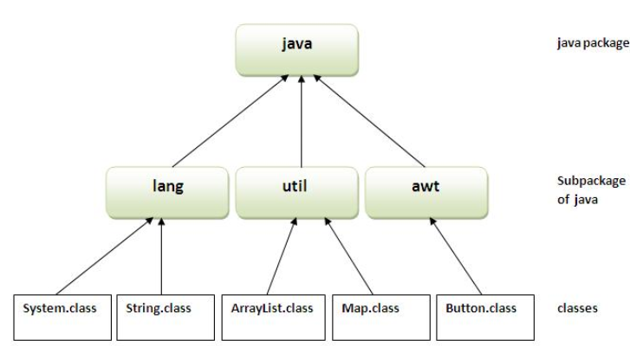

Slide 57
Our first package program
The keyword package is mandatory to create package programs in java
Let us now create a simple program with filename as first2.java
Let the code be as such:
package firstpack;
public class first2
{
public static void main(String a[])
{
System.out.println("this is inside first program");
}
}

Slide 58
How to compile java package
Since we are not using any IDE, we have to follow the way to compile:
Syntax:
javac -d directory javafilename
For example
javac -d . first2.java
(After this you can see a folder created in the current directory)

Slide 59
How to run java package program
To run package program a qualified name e.g. firstpack.first2 etc to run the class.
To Compile: javac -d . first2.java
To Run: java firstpack.first2
Output: this is inside first program
The -d is a switch that tells the compiler where to put the class file i.e. it represents destination. We can use any directory name like /home (in case of Linux), d:/abc (in case of windows) etc. If we want to keep the package within the same directory, we can use . (dot). The . represents the current folder.

Slide 60
How to access package from another package?
There are three ways to access the package from outside the package.
import package.*;
import package.classname;
fully qualified name.

Slide 61
Accessing package using Packagename.*
If we use package.* then all the classes and interfaces of this package will be accessible but not subpackages.
The import keyword is used to make the classes and interface of another package accessible to the current package.

Slide 62
Program for accessing using packagename.*
Step1: create a program with a package in it without main function
// program contains package; class; method.
Ex: package firstpack;
public class first10
{
public void display()
{
System.out.println ("this is inside first program");
}
}

Slide 63
Step 2: create another class with package and with main function and also the package to be imported.
EX:
package pack1; //newly created package
import firstpack.*; // firstpack is imported here so that all the methods defined will be used in this program
class second // another class with main function
{
public static void main(String a[])
{
first2 f = new first2(); // creating object for the program in package firstpack
f.display(); // this is the method in first2 class
}
}

Slide 64
To run the package program
Step 3: compile the program without main class (Don’t execute….)
Ex: javac –d . First2.java
(Since it is not having main we can’t execute)
Step 4: Compile the program where main in present…
Ex: javac –d . Second.java ( we can see the folder ____________created)
Run the program: java ______________???
OUTPUT : _________________________
Note: If you import a package, ___________will not be imported.

Slide 65
Sub-packages
Package inside the package is known as subpackage. The packages that come lower in the naming hierarchy are called "sub package" of the corresponding package higher in the hierarchy i.e. the package that we are putting into another package is called "sub package".

Slide 66
Wrapper classes in java
A Wrapper class is a class whose object wraps or contains a primitive data types. When we create an object to a wrapper class, it contains a field and in this field, we can store a primitive data types. In other words, we can wrap a primitive value into a wrapper class object.
Need of Wrapper Classes
1.They convert primitive data types into objects. Objects are needed if we wish to modify the arguments passed into a method (because primitive types are passed by value).
2. The classes in java.util package handles only objects and hence wrapper classes help in this case also.
3. Data structures in the Collection framework, such as ArrayList and Vector, store only objects (reference types) and not primitive types.
An object is needed to support synchronization in multithreading.

Slide 67
Autoboxing and Unboxing in Java
Autoboxing: Converting a primitive value into an object of the corresponding wrapper class is called autoboxing. For example, converting int to Integer class. The Java compiler applies autoboxing when a primitive value is:
• Passed as a parameter to a method that expects an object of the corresponding wrapper class.
• Assigned to a variable of the corresponding wrapper class.
Unboxing: Converting an object of a wrapper type to its corresponding primitive value is called unboxing. For example conversion of Integer to int. The Java compiler applies unboxing when an object of a wrapper class is:
• Passed as a parameter to a method that expects a value of the corresponding primitive type.
• Assigned to a variable of the corresponding primitive type.

Slide 68
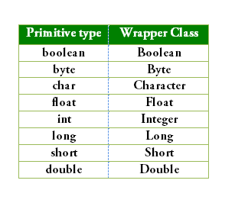
The following table lists the primitive types and their corresponding wrapper classes, which are used by the Java compiler for autoboxing and unboxing:

Slide 69
Java program to illustrate the concept of Autoboxing and Unboxing- autorun.java
import java.io.*;
class autoun
{
public static void main(String ar[])
{
Integer i =new Integer(10);
int j=i;
System.out.println("Value of i"+i);
System.out.println("Value of j"+j);
Character a = 'A';
char c = a;
System.out.println("the value of a "+a);
System.out.println("The value of c "+c);
}
}

Slide 70
This keyword
class thiskey
{
int a;
int b;
// Parameterized constructor
thiskey(int a, int b)
{
this.a = a;
this.b = b;
}
void display()
{
//Displaying value of variables a and b
System.out.println("a = " + a + " b = " + b);
}
public static void main(String[] args)
{
thiskey t= new thiskey(10, 20);
thiskey u = new thiskey(100,200);
t.display();
u.display();
}
}

Slide 71
This()
class thiskey1
{
int a;
int b;
thiskey1()
{
this(10, 20);
System.out.println("Inside default constructor \n");
}
thiskey1(int a, int b)
{
this.a = a;
this.b = b;
System.out.println(a+b);
System.out.println("Inside parameterized constructor");
}
public static void main(String[] args)
{
thiskey1 t = new thiskey1();
}
}

Slide 72
ALL THE BEST

