Slide 1
CSE 1007 – Java Programming
Dr. A. Anitha
Associate Prof.
SITE
Win Sem 2020-2021

Slide 2
Introduction
Java
A complete programming language developed by Sun
Can be used to develop either web based or stand-alone software
Many pre-created code libraries available
For more complex and powerful programs

Slide 3
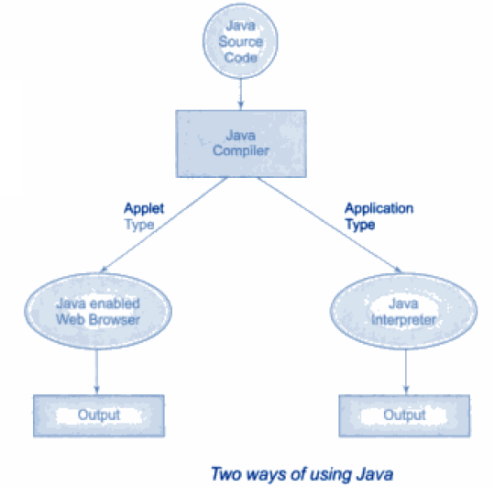
Two ways of using Java

Slide 4
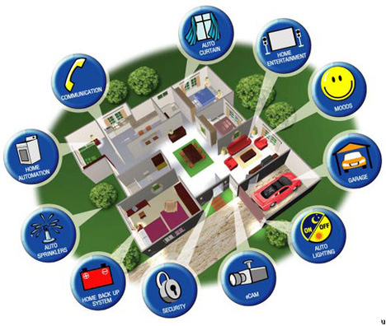

Slide 5
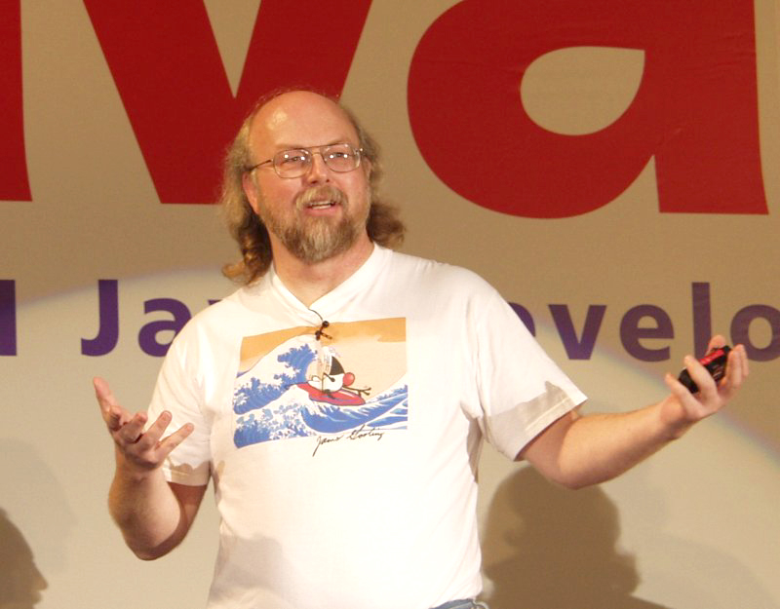
Java History
Sun Microsystems funded an internal research project “Green” to investigate this opportunity.
Result: A programming language called “Oak”
Blatant advertisement: James Gosling was a graduate of the C Computer Science program.

Slide 6


Java History
Problem: There was already a programming language called Oak.
The “Green” team met at a local coffee shop to come up with another name...
Java!

Slide 7

Java: History
The concept of intelligent devices didn’t catch on.
Project Green and work on the Java language was nearly canceled.

Slide 8
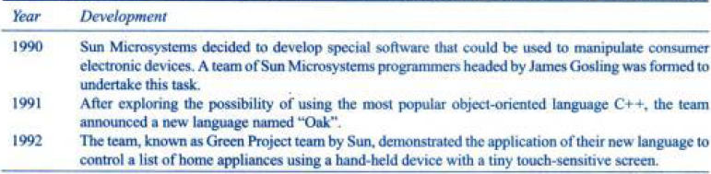
History of JAVA

Slide 9
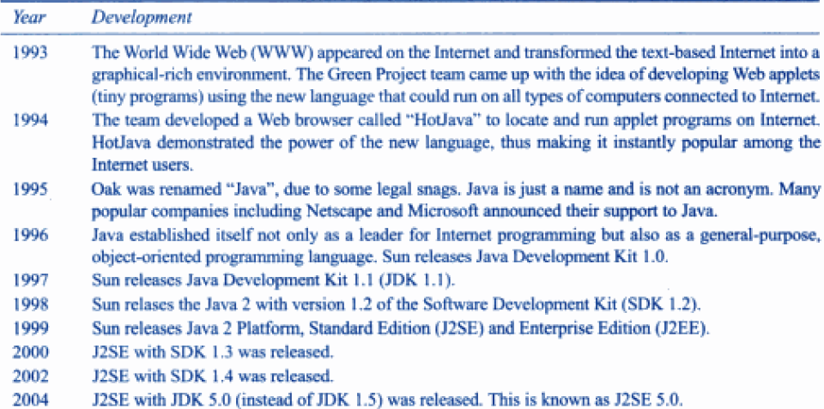

Slide 10


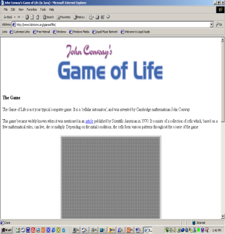
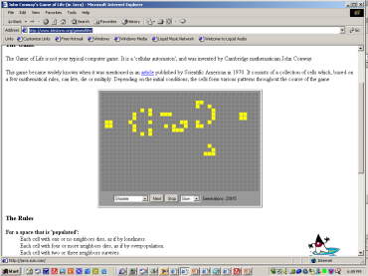

Java: History
Java enabled web browsers allowed for the downloading of programs (Applets).
Java is still used in this context today:
Facebook (older version)
Hotmail (older version)
Your computer at home running a web browser
Server containing a web page
User clicks on a link
Java Applet downloaded
Java version of the Game of Life: http://www.bitstorm.org/gameoflife/
Online checkers: http://www.darkfish.com/checkers/index.html

Slide 11
Java and C
Java does not have struct and union
Java does not support pointer
Keywords such as sizeof and typedef are avoided
Type modifiers – auto , register, extern, integers (signed and unsigned) are not defined
Void is not necessary as in C
Instanceof and >>> - new operators

Slide 12
JAVA and C++
Not supports
Operator overloading, template class, multiple inheritance (replaced as interface), global variables, pointers, finalize ( destructor), no header files in JAVA

Slide 13

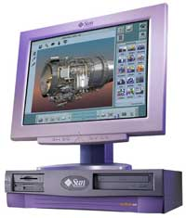
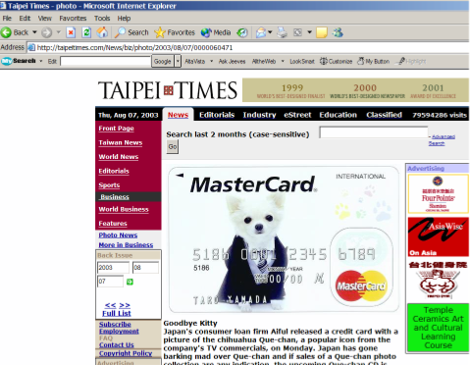

Java: Write Once, Run Anywhere
Consequence of Java’s history: platform-independence
Click on link to Applet
Mac user running Safari
Virtual machine translates byte code to
native Mac code and the Applet is run
Web page stored on Unix server
Byte code is downloaded
Windows user running Internet Explorer
Byte code (part of web page)

Slide 14
Java: Write Once, Run Anywhere
Consequence of Java’s history: platform-independent
Mac user running Safari
Web page stored on Unix server
Click on link to Applet
Byte code is downloaded
Windows user running Internet Explorer
Virtual machine translates byte code to
native Windows code and the Applet is run

Slide 15

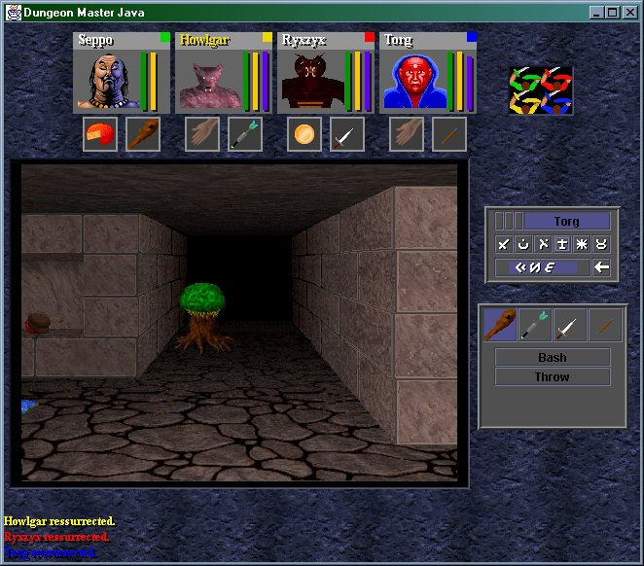
Java: Write Once, Run Anywhere
But Java can also create standard (non-web based) programs
Dungeon Master (Java version)
http://homepage.mac.com/aberfield/dmj/
Kung Fu Panda 2: THQ
Examples of mobile Java games: http://www.mobilegamesarena.net

Slide 16
How Java Works
Java's platform independence is achieved by the use of the Java Virtual Machine
A Java program consists of one or more files with a .java extension
these are plain old text files
When a Java program is compiled the .java files are fed to a compiler which produces a .class file for each .java file
The .class file contains Java bytecode.
Bytecode is like machine language, but it is intended for the Java Virtual Machine not a specific chip such as a Pentium or PowerPC chip

Slide 17
More on How Java Works
To run a Java program the bytecode in a .class file is fed to an interpreter which converts the byte code to machine code for a specific chip (IA-32, PowerPC)
Some people refer to the interpreter as "The Java Virtual Machine" (JVM)
The interpreter is platform specific because it takes the platform independent bytecode and produces machine language instructions for a particular chip
So a Java program could be run an any type of computer that has a JVM written for it.
PC, Mac, Unix, Linux, BeaOS, Sparc

Slide 18
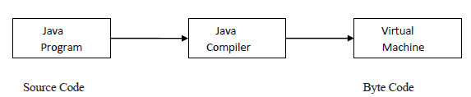
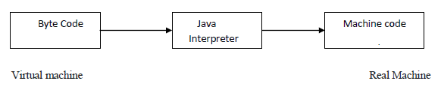
JVM
JVM (Java Virtual Machine) is an abstract machine. It is a specification that provides runtime environment in which java bytecode can be executed.
JVMs are available for many hardware and software platforms.
The JVM performs following main tasks: Loads code Verifies code Executes code Provides runtime environment
Proces of Compilation
Process of converting byte code to machine code

Slide 19
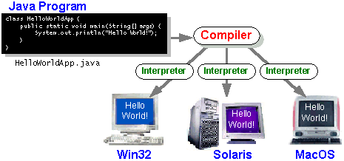
Creating, Compiling And Running Java Programs
The Interpreter's are sometimes referred to as the Java Virtual Machines

Slide 20
Creating, Compiling And Running Java Programs
Type it in with the text editor of your choice
Java program
filename.java
(Unix file)
Java compiler
javac
Java byte code
filename.class
(UNIX file)
To compile the program at the command line type "javac filename.java"
Java Interpreter
java
To run the interpreter, at the command line type "java filename"

Slide 21
Compiling The Smallest Java Program
Smallest.java
public class Smallest
{
public static void main (String[] args)
{
}
}
Type “javac Smallest.java”
javac
Smallest.class
(Java byte code)
10000100000001000 00100100000001001
: :

Slide 22

Running The Smallest Java Program
Smallest.class
(Java byte code)
10000100000001000 00100100000001001
: :
java
Type “java Smallest”
(Platform/Operating specific binary
10100111000001000 00100111001111001
: :

Slide 23
Why Java called as Platform Independent language?
Javac – compiler that converts source code to byte code.
JVM- interpreter that converts byte code to machine language code. Java is both compiler & interpreter based language. Once the java code also known as source code is compiled, it gets converted to native code known as BYTE CODE which is portable & can be easily executed on all operating systems.
Byte code generated is basically represented in hexa decimal format. This format is same on every platform be it Solaris work station or Macintosh, windows or Linux.
After compilation, the interpreter reads the generated byte code & translates it according to the host machine.
Byte code is interpreted by Java Virtual Machine which is available with all the operating systems we install. so to port Java programs to a new platform all that is required is to port the interpreter and some of the library routines. Source code -> javac ->Universal byte code
Universal byte ->jvm/java -> execute them on a particular machine.
Another reason the makes Java a Platform independent language is the elimination of undefined or architecture dependent constructs. Therefore Java is called platform independent language.

Slide 24
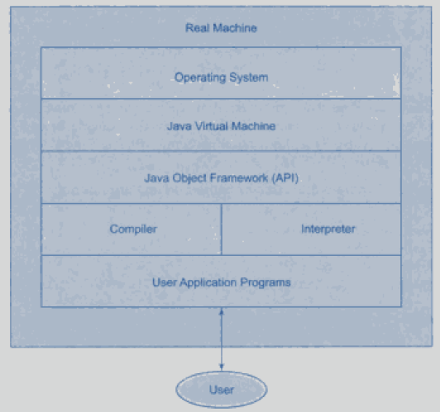
Layers of interaction of Java Program

Slide 25
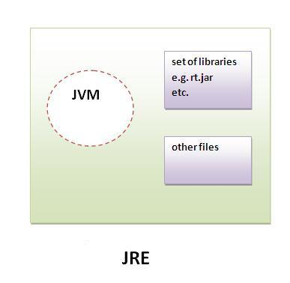
JRE
JRE is an acronym for Java Runtime Environment.It is used to provide runtime environment.It is the implementation of JVM.It physically exists.It contains set of libraries + other files that JVM uses at runtime.
Implementation of JVMs are also actively released by other companies besides Sun Micro Systems.
JVM, JRE and JDK are platform dependent because configuration of each OS differs. But, Java is platform independent.

Slide 26
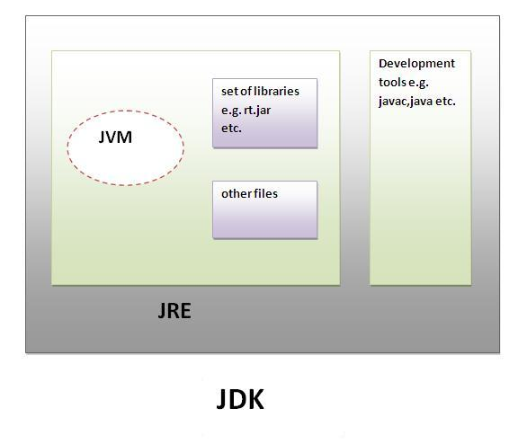
JDK
JDK is an acronym for Java Development Kit.It physically exists.It contains JRE + development tools.

Slide 27
Characteristics of Java
Java is simple
Java is object-oriented
Java is distributed
Java is interpreted
Java is robust
Java is secure
Java is architecture-neutral
Java is portable
Java’s performance
Java is multithreaded
Java is dynamic

Slide 28
Building First Java application program
Step1 : Open a Text editor
Step2: write the source code with .java extension
Step 3: Save the file and note down the path
(if the source code was written in the path as jdk – well and good) else set the path
Step 4: compile using javac < filename>.java
Step 5: if any errors, identify and compile again.
Step 6: if no errors found, run the program using java <classname>.
You can see the output…..

Slide 29
Simple Java Program:
Class Sample
{
public static void main(String args[])//starting point of interpreter to begin execution
{
System.out.println(“Hello”);
}
}
public –is an access specifier, making the main method accessible to all other classes
static-says that this method belongs to entire class. Interpreter uses this method before any objects are created.
Type modifier void –says that main method does not return any value

Slide 30
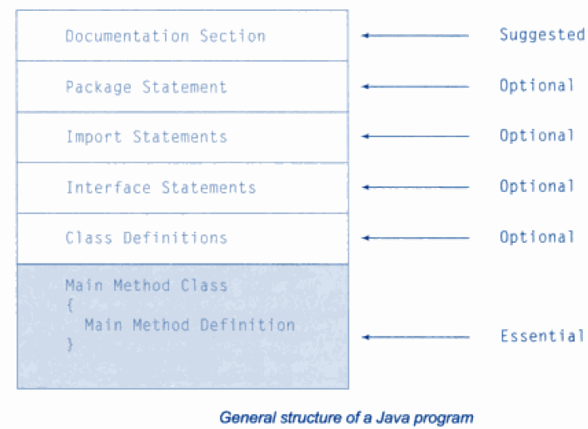
Java Program Structure

Slide 31
Java Program Structure
Package:
The statement informs the compiler that the classes defined here belongs to this package.
Eg: package student;
A package is a namespace that organizes a set of related classes and interfaces. You can think of packages as being similar to different folders on your computer.
Import:
Import Statements: instructs the interpreter to load the test class contained in the package student. Eg. import student.test;
Interface Statements:
Like a class but includes a group of method declarations.
Class definitions: Primary and essential element of a java program. Map the objects to real world problems.
Main Method:
Creates objects of various classes and establishes communication between them. On reaching the end of main, the program terminates and control passes back to the OS.

Slide 32
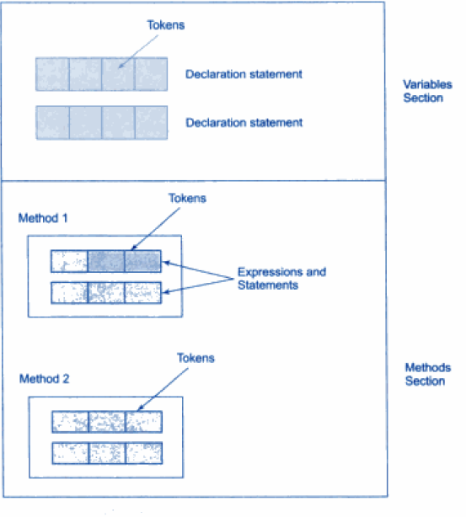
TOKENS
In Java program, all characters are grouped into symbols called tokens.
Tokens are- identifier, keyword, separator, operator, literal and comment.

Slide 33
IDENTIFIER
The first category of token is an Identifier.
Identifiers are used by programmers to name things in Java such as variables, methods, fields, classes, interfaces, exceptions, packages, etc.
All characters in an identifier are significant, including the case (upper/lower) of the alphabetic characters.
Eg: The identifier Count and count denote different names in Java

Slide 34
Keywords
Keywords are the second category of tokens in Java.
Keyword sometimes also called as reserved word.
Keywords have inbuilt meaning and the programmers cannot use for other things.
Below are the list of all keywords in Java.

Slide 35
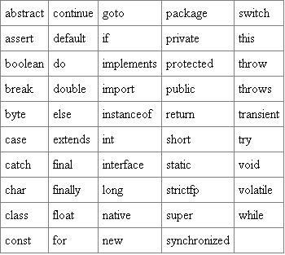
KEYWORDS

Slide 36
SEPARATORS
The third category of token is a Separator.
; , . ( ) { } [ ]
Eg: Math.max(count,limit);
In the above segment the identifiers are Math, max, count, limit.
And the separators are . ( , ) ;

Slide 37
OPERATORS
The fourth category of token is operator.
The keywords instanceof and new are the part of operators.
Below is the list of the operators in Java.

Slide 38
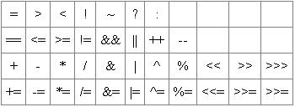
OPERATORS

Slide 39
LITERALS
The fifth category of tokens is literals.
A constant value in a program is denoted by a literal. Literals represent numerical (integer or floating-point), character, boolean or string values.
Integer literals: 33 0 -9 Floating-point literals: .3 0.3 3.14f Character literals: '(' 'R' 'r' '{' Boolean literals: (predefined values)true false String literals: "language" "0.2" "r" ""

Slide 40
Literals
int, short, byte
Optional initial sign (+ or -) followed by digits 0 – 9 in any combination.
long
Optional initial sign (+ or -) followed by digits 0–9 in any combination, terminated with an L or l.
***Use the capital L because the lowercase l can be confused with the number 1.

Slide 41
Floating-Point Literals
float
Optional initial sign (+ or -) followed by a floating-point number in fixed or scientific format, terminated by an F or f.
double
Optional initial sign (+ or -) followed by a floating-point number in fixed or scientific format.

Slide 42
char and boolean Literals
char
Any printable character enclosed in single quotes
A decimal value from 0 – 65535
'\m' , where \m is an escape sequence. For example, '\n' represents a newline, and '\t' represents a tab character.
boolean
true or false

Slide 43
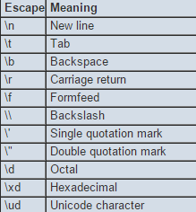
ESCAPE SEQUENCES
Eg:
If we output "Pack\age", Java would print on the console
Pack
age

Slide 44
String Literals
String is actually a class, not a basic data type; String variables are objects
String literal: text contained within double quotes.
Example of String literals:
"Hello"
"Hello world"
"The value of x is "

Slide 45
String Concatenation Operator (+)
Combines String literals with other data types for printing
Example:
String hello = "Hello";
String there = "there";
String greeting = hello + ' ' + there;
System.out.println( greeting );
Output is:
Hello there

Slide 46
LITERALS
null literal: special kind of literal that is used to represent a special value.
Comments: The sixth and final category of tokens is the Comment.
Comments allow us to place any form of documentation inside our Java code. They can contain anything that we can type on the keyboard comment.

Slide 47
LITERALS
Comments:
Comments are declared in two ways:
Line-Oriented: begins with // and continues until the end of the line.
Block-Oriented: begins with /* and continues (possibly over many lines) until */ is reached.

Slide 48
Error Types
Syntax error / Compile errors
caught at compile time.
compiler did not understand or compiler does not allow
Runtime error
something “Bad” happens at runtime. Java breaks these into Errors and Exceptions
Logic Error
program compiles and runs, but does not do what you intended or want

Slide 49
How to get input from user?
Scanner class is present in java.util package
import this package in our program.
create an object of Scanner class and then use the methods of Scanner class.
Scanner a = new Scanner(System.in);
Scanner is the class name,
a is the name of object,
new keyword is used to allocate the memory System.in is the input stream.
Following methods of Scanner class are used in the program below :- 1) nextInt() to input an integer 2) nextFloat() to input a float 3) nextLine() to input a string
4) next().charAt(0) to input a char

Slide 50
How to get input from user?
import java.util.Scanner;
class GetInputFromUser
{
public static void main(String args[])
{
int a;
float b;
String s;
char ch;
Scanner in = new Scanner(System.in);
System.out.println("Enter a string");
s = in.nextLine();
System.out.println("You entered string "+s);
System.out.println("Enter an integer");
a = in.nextInt();
System.out.println("You entered integer "+a);
System.out.println("Enter a float");
b = in.nextFloat();
System.out.println("You entered float "+b);
System.out.println("Enter a character");
ch = in.next().charAt(0);
System.out.println("You entered Character"+ch);
}
}
Output:
Enter a string
hilda
You entered string hilda
Enter an integer
4
You entered integer 4
Enter a float
45.6
You entered float 45.6
Enter a character
r
You entered Character r

Slide 51
Command Line Arguments
A Java application can accept any number of arguments from the command line.
Eg:
public class parseint {
public static void main(String[] args) {
int sum = 0;
for (int i = 0; i < args.length; i++) {
sum += Integer.parseInt(args[i]);
}
System.out.println(sum);
}
}
compile by > javac parseint.java
run by > java parseint 1 3 4
Output:
8

Slide 52
Command Line Arguments
Eg:
public class Echo {
public static void main (String[] args) {
for (String s: args) {
System.out.println(s);
}
}
}
Output
java Echo Hi Hot Java
Hi
Hot
Java

Slide 53
Objects in java
An entity that has state and behavior is known as an
object
An object has three characteristics:
state: represents data (value) of an object.
behavior: represents the behavior (functionality) of an object
identity: Object identity is typically implemented via a unique ID. The value of the ID is not visible to the external user. But, it is used internally by the JVM to identify each object uniquely.

Slide 54
Class in Java
A class is a group of objects which have common
properties. It is a template or blueprint from which
objects are created. It is a logical entity. It can't be
physical.
A class in Java can contain:
fields
methods
constructors
blocks
nested class and interface

Slide 55
Syntax for class
Class <classname>
{
Fields < data with datatypes>;
Methods <member functions>;
}
Instance variable: A variable which is created inside the class for the use of methods.

Slide 56
With main()
Programs can be created having
classes and objects inside main (refer employee.java)
Classes and objects outside main (refer employee2.java)

Slide 57
// simple program on class - employee.java
class employee
{
float salary =0.0f;
int empid = 0;
String name;
public static void main(String ar[])
{
employee e = new employee();
System.out.println(e.empid);
System.out.println(e.name);
System.out.println(e.salary);
}
}

Slide 58
// simple program using multi class outside main - employee2.java
class employee
{
float salary =23.45f;
int empid = 1001;
String name="asdf";
}
class employee2
{
public static void main(String ar[])
{
employee e = new employee();
System.out.println(e.empid);
System.out.println(e.name);
System.out.println(e.salary);
}
}

Slide 59
3 ways of initialize the objects
Using reference variable ( refer employee3.java)
Using methods (refer employee4.java)
Using constructor (refer to constructor concepts)

Slide 60
// initialize the objects using reference - employee3.java
class employee
{
float salary =0.0f;
int empid = 0;
String name;
}
class employee3
{
public static void main(String ar[])
{
employee e = new employee();
e.salary=20.900f;
e.empid=1001;
System.out.println(e.empid);
System.out.println(e.name);
System.out.println(e.salary);
}
}

Slide 61
// initialize the object using methods - employee4.java
class employee
{
float salary =0.0f;
int empid = 0;
String name;
void getdata( int eid, float sal, String nam)
{
empid = eid;
salary = sal;
name = nam;
}
void putdata()
{
System.out.println(empid);
System.out.println(name);
System.out.println(salary);
} }
class employee4
{
public static void main(String ar[])
{
employee e = new employee();
//e.salary=20.900f;
//e.empid=1001;
e.getdata(1001, 23.45f,"asdf");
e.putdata();
}
}

Slide 62
Constructor in java
Definition
Type of constructor – default and parameterized constructor
Constructor overloading in java (refer employee5.java)
Copy constructor (copy the values of one object to another)
( refer employee6.java)
By assigning the values of one object into another
By clone() method of Object class
The java.lang.Cloneable interface - clone() method generates CloneNotSupportedException.
Syntax:
protected Object clone() throws CloneNotSupportedException
Ex: employee5 e2 = employee5 (e1).clone();

Slide 63
// constructor overloading – employee5.java
class employee
{
float salary =0.0f;
int empid = 0;
String name;
employee(int id,float sal,String nm)
// constructor overloading
{
empid =id;
salary=sal;
name = nm;
}
employee(int id,float sal) // constructor overloading
{
empid =id;
salary=sal;
}
void putdata()
{
System.out.println(empid);
System.out.println(name);
System.out.println(salary);
}
}
class employee5
{
public static void main(String ar[])
{
employee e1= new employee(1002,34.5f, "fghj");
employee e2 = new employee(1001,23.45f );
e1.putdata();
e2.putdata();
}
}

Slide 64
// copy constructor - copy the values of one object into another using java constructor – employee6.java
class employee
{
float salary =0.0f;
int empid = 0;
String name;
employee(int id,float sal,String nm)
{
empid =id;
salary=sal;
name = nm;
}
employee(employee e)
{
salary = e.salary;
empid = e.empid;
name= e.name;
}
void putdata()
{
System.out.println(empid);
System.out.println(name);
System.out.println(salary);
}
}
class employee6
{
public static void main(String ar[])
{
employee e1= new employee(1002,34.5f, "fghj");
employee e2 = new employee(e1);
e1.putdata();
e2.putdata();
}
}

Slide 65
// copy constructor - copy the values of one object into another without using java constructor - employee7.java
class employee
{
float salary =0.0f;
int empid = 0;
String name;
employee() {}
employee(int id,float sal,String nm)
{
empid =id;
salary=sal;
name = nm;
}
void putdata()
{
System.out.println(empid);
System.out.println(name);
System.out.println(salary);
}
}
class employee7
{
public static void main(String ar[])
{
employee e1= new employee(1002,34.5f, "fghj");
employee e2 = new employee();
e2.name = e1.name;
e2.salary = e1.salary;
e2.empid = e1.empid;
e1.putdata();
e2.putdata();
}
}

Slide 66
Returning and passing instance objects in java
Passing object as parameter (refer basket1.java)
Passing Instance Variables one by one
(refer basket2.java)

Slide 67
// program to passing instance objects in java to a method -
basket1.java
class basket
{
private int apples=0;
int oranges = 0;
basket(int a,int o)
{
apples =a;
oranges = o;
}
void full(basket b)
{
int a,o;
a = b.apples;
o = b.oranges;
System.out.println("apples and oranges are "+ (a+o));
}
}
class basket1
{
public static void main(String a[])
{
basket b = new basket(100,200);
b.full(b);
}}

Slide 68
// program to passing objects in java instance variable one by one – basket2.java
class basket
{
private int apples=0;
int oranges = 0;
basket(int a,int o)
{
apples =a;
oranges = o;
}
void full(int a1, int o1)
{
int a,o;
a = a1;
o = o1;
System.out.println("apples and oranges are "+ (a+o));
}
}
class basket2
{
public static void main(String a[])
{
basket b = new basket(100,200);
b.apples = 200;
b.oranges=300;
b.full(b.apples,b.oranges);
}}

Slide 69
What is the difference between the programs basket1.java and basket2.java…..?

Slide 70
Arrays in JAVA
Java array is an object the contains elements of similar data type. It is a data structure where we store similar elements. We can store only fixed set of elements in a java array.
Array in java is index based, first element of the array is stored at 0 index.
Advantage of Java Array
Code Optimization: It makes the code optimized, we can retrieve or sort the data easily.
Random access: We can get any data located at any index position.

Slide 71
Disadvantage of Java Array
Size Limit: We can store only fixed size of elements in the array. It doesn't grow its size at runtime. To solve this problem, collection framework is used in java.
Types of Array in java
There are two types of array.
Single Dimensional Array
Multidimensional Array

Slide 72
Single Dimensional Array in java
Syntax to Declare an Array in java
dataType[] arr; (or)
dataType []arr; (or)
dataType arr[];
Instantiation of an Array in java
arrayRefVar[] =new datatype[size];

Slide 73
import java.io.*;
import java.util.*;
class array1
{
public static void main(String ay[])
{
int a[] = new int[10];
Scanner s = new Scanner(System.in);
for(int i =0;i<10;i++)
{
a[i]=s.nextInt();
}
for(int i =0;i<10;i++)
{
System.out.println(a[i]);
}
}
}

Slide 74
Multidimensional array in java
In such case, data is stored in row and column based index (also known as matrix form).
Syntax to Declare Multidimensional Array in java
dataType[][] arrayRefVar; (or)
dataType [][]arrayRefVar; (or)
dataType arrayRefVar[][]; (or)
dataType []arrayRefVar[];
Example to instantiate Multidimensional Array in java
int[][] arr=new int[3][3];//3 row and 3 column

Slide 75
class arraymulti{
public static void main(String args[]){
//declaring and initializing 2D array
int arr[][]={{1,2,3},{4,5,6},{7,8,9}};
//printing two-dimensional array
for(int i=0;i<3;i++)
{
for(int j=0;j<3;j++)
{
System.out.print(arr[i][j]+" ");
}
System.out.println();
}
}}

Slide 76
Passing Array to method in java
import java.io.*;
import java.util.*;
class passingarraytofun
{
public static void main (String ar[])
{
int arr[]=new int[10];
Scanner s = new Scanner(System.in);
System.out.println("enter 5 elements");
for(int i =0;i<5;i++)
{
arr[i]=s.nextInt();
}
double avg;
avg a =new avg();
avg = a.getAverage( arr ) ;
System.out.println( "Average value is: "+ avg );
} }
class avg
{
double getAverage(int arr[])
{
int i;
double avg;
double sum=0;
for (i = 0; i < arr.length; ++i)
{
sum += arr[i];
}
avg = sum / arr.length;
return avg;
}
}

Slide 77
Array of objects Class obj[]= new Class[array_length]
import java.util.*;
class student
{
int marks;
String regno;
}
class arrayofobj
{
public static void main(String args[])
{
Scanner s = new Scanner(System.in);
int n=0,total=0,size=0;
System.out.println("enter the number of students");
size=s.nextInt();
student[] arr = new student[size];
//arr[0].marks = 0;
String reg;
System.out.println("Enter the mark and regno of every student");
for(int i = 0; i<size;i++)
{
arr[i] = new student();
n = s.nextInt();
reg=s.next();
arr[i].marks = n;
arr[i].regno=reg;
total += arr[i].marks;
}
System.out.println("the entered details are as follows");
for(int i=0;i<size;i++)
{
System.out.println("the regno:\t"+arr[i].regno+"\tmarks:\t"+arr[i].marks);
}
System.out.println("the sum is" + total); } }

Slide 78
Returning the object
A method can return an object in a similar manner as that of returning a variable of primitive types from methods. When a method returns an object, the return type of the method is the name of the class to which the object belongs and the normal return statement in the method is used to return the object. This can be illustrated in the following program ( refer returnobj.java)

Slide 79
// prgm to return object – returnobj.java
class cloth
{
String material;
float cost;
String brandname;
String size;
int quantity;
cloth(String m, float c, String bn, String s, int q)
{
material =m; cost = c; brandname = bn; size =s; quantity=q;
}
cloth buy (cloth x)
{
//cloth c = new cloth("cotton",2456.34f, "Peter England", "L",2);
Return c;
}
}
class returnobj
{
public static void main(String ar[])
{
cloth c1 = new cloth("Jeans",4456.34f, "Elite", "S",200);
cloth c2 ;
c2 = c1.buy(c1);
System.out.println(c1.material);
System.out.println(c1.cost);
System.out.println(c1.brandname);
System.out.println(c1.size);
System.out.println(c1.quantity);
System.out.println("\nAfter returning the objects\n");
System.out.println(c2.material);
System.out.println(c2.cost);
System.out.println(c2.brandname);
System.out.println(c2.size);
System.out.println(c2.quantity);
}}

Slide 80
Static in java
static variables
static methods
static blocks of code.

Slide 81
Static variable
It is a variable which belongs to the class and not to object(instance)
Static variables are initialized only once , at the start of the execution . These variables will be initialized first, before the initialization of any instance variables
A single copy to be shared by all instances of the class
A static variable can be accessed directly by the class name and doesn’t need any object
Syntax : <class-name>.<variable-name>

Slide 82
Java Static Method
It is a method which belongs to the class and not to the object(instance)
A static method can access only static data. It can not access non-static data (instance variables)
A static method can call only other static methods and can not call a non-static method from it.
A static method can be accessed directly by the class name and doesn’t need any object
Syntax : <class-name>.<method-name>
A static method cannot refer to "this" or "super" keywords in anyway
main method is static , since it must be accessible for an application to run , before any instantiation takes place.

Slide 83
// program for static member and member function- static1.java
class stat
{
static int datamember1=100; // static member
static void display()
{
System.out.println("hi i am static method");
}
static
{
System.out.println("this is static block");
}
}
class static1
{
public static void main(String ar[])
{
//stat s = new stat();
stat.display();
System.out.println(stat.datamember1);
}
}

Slide 84
Final in java
In the Java programming language, the final keyword is used in different contexts to explain an entity that can only be assigned once. Once a final variable has been assigned, it always constant
Final can be:
Variable (cannot change the value of final variable(It will be constant)) (refer Final.java)
Method (any method as final, you cannot override it.)
Class (any class as final, you cannot extend it.)
Example program in Final.java

Slide 85
String handling in JAVA
String is an object -sequence of char values(array of characters = java string)
Java String class provides a lot of methods to perform operations on string such as compare(), concat(), equals(), split(), length(), replace(), compareTo(), intern(), substring() etc.
The java.lang.String class implements Serializable, Comparable and CharSequence interfaces.

Slide 86
CharSequence Interface
The CharSequence interface is used to represent sequence of characters.
It is implemented by String, StringBuffer and StringBuilder classes. It means, we can create string in java by using these 3 classes.
The java String is immutable i.e. it cannot be changed. Whenever we change any string, a new instance is created. For mutable string, you can use StringBuffer and StringBuilder classes.

Slide 87
To create string object
Two ways:
Using string literal
Using new keyword
1.Using String literal
- String s1="Welcome";
String s2="Welcome";//new instance not created
1.Using new keyword
- String s1=new String("Welcome“);
String s2=new String("Welcome“);
//new instance will be created

Slide 88
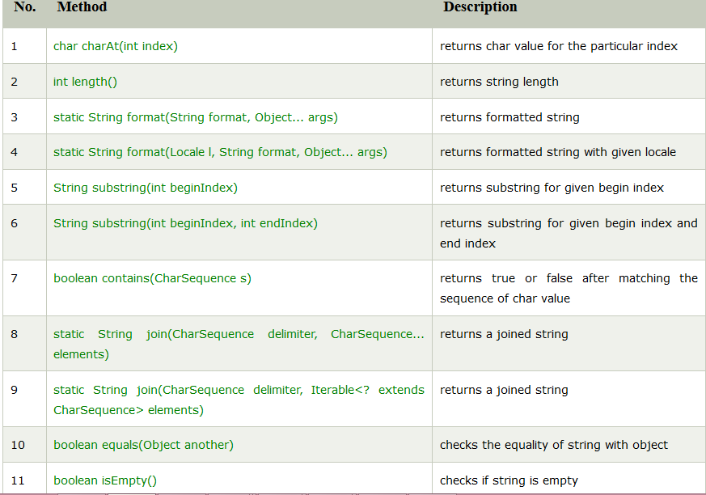

Slide 89
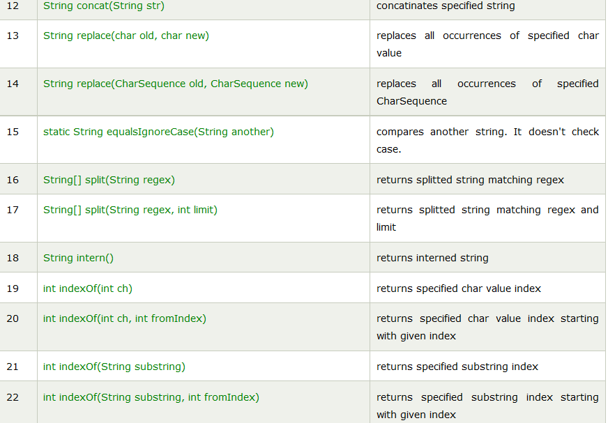

Slide 90
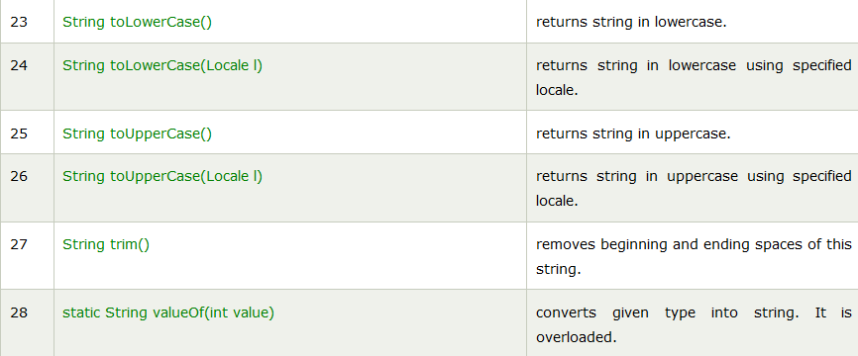

Slide 91
Immutable String in Java
Immutable simply means unmodifiable or unchangeable.
Once string object is created its data or state can't be changed but a new string object is created.

Slide 92
Java String compare
There are three ways to compare string in java:
By equals() method
By = = operator
By compareTo() method

Slide 93
equals()
The String equals() method compares the original content of the string. It compares values of string for equality. String class provides two methods:
public boolean equals(Object another) compares this string to the specified object.
public boolean equalsIgnoreCase(String another) compares this String to another string, ignoring case.

Slide 94
compareTo()
The String compareTo() method compares values lexicographically and returns an integer value that describes if first string is less than, equal to or greater than second string.
Suppose s1 and s2 are two string variables. If:
s1 == s2 :0
s1 > s2 :positive value
s1 < s2 :negative value

Slide 95
contains() method
Syntax : public boolean contains(CharSequence sequence)
searches the sequence of characters in this string. It returns true if sequence of char values are found in this string otherwise returns false.
Ex:
String name=“I love java programming
System.out.println(name.contains(“love java"));
System.out.println(name.contains(“programming"));
System.out.println(name.contains(“welcome"));
Output: ????

Slide 96
String format
The java string format() method returns the formatted string by given locale, format and arguments.
public static String format(String format, Object... args)
and,
public static String format(Locale locale, String format, Object... args)
locale : specifies the locale to be applied on the format() method.
format : format of the string.
args : arguments for the format string. It may be zero or more.

Slide 97
String name=“XXX";
String sf1=String.format("name is %s",name);
String sf2=String.format("value is %f",32.33434);
String sf3=String.format("value is %32.12f",32.33434);//returns 12 char fractional part filling with 0
Output:
name is XXX
value is 32.334340
value is 32.334340000000

Slide 98
String tokenizer
The java.util.StringTokenizer class allows you to break a string into tokens. It is simple way to break string.
Constructors
StringTokenizer(String str) - creates StringTokenizer with specified string.
StringTokenizer(String str, String delim) -creates StringTokenizer with specified string and delimeter.
StringTokenizer(String str, String delim, boolean returnValue) - creates StringTokenizer with specified string, delimeter and returnValue.

Slide 99
Methods of StringTokenizer class
boolean hasMoreTokens() | checks if there is more tokens available.
String nextToken() | returns the next token from the StringTokenizer object.
String nextToken(String delim) | returns the next token based on the delimeter.
boolean hasMoreElements() | same as hasMoreTokens() method.
Object nextElement() | same as nextToken() but its return type is Object.
int countTokens() | returns the total number of tokens.

Slide 100
import java.util.*;
class tokenizer
{
public static void main(String args[])
{
StringTokenizer st = new StringTokenizer("This is a tokenizerr
program"," ");
while (st.hasMoreTokens())
{
System.out.println(st.nextToken());
}
}
}

Slide 101
String Builder
The java.lang.StringBuilder class is mutable sequence of characters. This provides an API compatible with StringBuffer, but with no guarantee of synchronization.
Constructors:
Constructor | Description
StringBuilder() | creates an empty string Builder with the initial capacity of 16.
StringBuilder(String str) | creates a string Builder with the specified string.
StringBuilder(int length) | creates an empty string Builder with the specified capacity as length.

Slide 102
Method | Description
public StringBuilder append(String s) | is used to append the specified string with this string. The append() method is overloaded like append(char), append(boolean), append(int), append(float), append(double) etc.
public StringBuilder insert(int offset, String s) | is used to insert the specified string with this string at the specified position. The insert() method is overloaded like insert(int, char), insert(int, boolean), insert(int, int), insert(int, float), insert(int, double) etc.
public StringBuilder replace(int startIndex, int endIndex, String str) | is used to replace the string from specified startIndex and endIndex.
public StringBuilder delete(int startIndex, int endIndex) | is used to delete the string from specified startIndex and endIndex.
public StringBuilder reverse() | is used to reverse the string.
public int capacity() | is used to return the current capacity.
public void ensureCapacity(int minimumCapacity) | is used to ensure the capacity at least equal to the given minimum.

Slide 103
Method continues…..
public char charAt(int index) | is used to return the character at the specified position.
public int length() | is used to return the length of the string i.e. total number of characters.
public String substring(int beginIndex) | is used to return the substring from the specified beginIndex.
public String substring(int beginIndex, int endIndex) | is used to return the substring from the specified beginIndex and endIndex.

Slide 104
Example programs
import java.util.*;
class strbuild
{
public static void main(String args[])
{
StringBuilder sb=new StringBuilder("Welcome ");
sb.append("to JAVA Programming");//now original string is changed
System.out.println(sb);
}
}

Slide 105
Insert()
class strbuild
{
public static void main(String args[])
{
StringBuilder sb=new StringBuilder("Welcome");
sb.insert(1,"Java");//now original string is changed
System.out.println(sb);
}
}

Slide 106
Replace()
class strbuild
{
public static void main(String args[])
{
StringBuilder sb=new StringBuilder("Welcome");
sb.replace(1,3,"Java");
System.out.println(sb);
}
}

Slide 107
Delete()
class strbuild
{
public static void main(String args[])
{
StringBuilder sb=new StringBuilder("Welcome");
//sb.replace(1,3,"Java");
sb.delete(1,3);
System.out.println(sb);
}
}

Slide 108
class strbuild
{
public static void main(String args[])
{
StringBuilder sb=new StringBuilder("Welcome");
//sb.replace(1,3,"Java");
//sb.delete(1,3);
sb.reverse();
System.out.println(sb);
}
}

Slide 109
String Buffer
The java.lang.StringBuffer class is a thread-safe, mutable sequence of characters.
Following are the important points about StringBuffer
A string buffer is like a String, but can be modified.
It contains some particular sequence of characters, but the length and content of the sequence can be changed through certain method calls.
They are safe for use by multiple threads.
Every string buffer has a capacity.

Slide 110
Constructors
Sr.No. | Constructor & Description
1 | StringBuffer() This constructs a string buffer with no characters in it and an initial capacity of 16 characters.
2 | StringBuffer(CharSequence seq) This constructs a string buffer that contains the same characters as the specified CharSequence.
3 | StringBuffer(int capacity) This constructs a string buffer with no characters in it and the specified initial capacity.
4 | StringBuffer(String str) This constructs a string buffer initialized to the contents of the specified string.

Slide 111
Modifier and Type | Method | Description
public synchronized StringBuffer | append(String s) | is used to append the specified string with this string. The append() method is overloaded like append(char), append(boolean), append(int), append(float), append(double) etc.
public synchronized StringBuffer | insert(int offset, String s) | is used to insert the specified string with this string at the specified position. The insert() method is overloaded like insert(int, char), insert(int, boolean), insert(int, int), insert(int, float), insert(int, double) etc.

Slide 112
public synchronized StringBuffer | replace(int startIndex, int endIndex, String str) | is used to replace the string from specified startIndex and endIndex.
public synchronized StringBuffer | delete(int startIndex, int endIndex) | is used to delete the string from specified startIndex and endIndex.
public synchronized StringBuffer | reverse() | is used to reverse the string.
public int | capacity() | is used to return the current capacity.
public void | ensureCapacity(int minimumCapacity) | is used to ensure the capacity at least equal to the given minimum.
public char | charAt(int index) | is used to return the character at the specified position.

Slide 113
ensureCapacity()
The ensureCapacity() method of StringBuffer class ensures that the given capacity is the minimum to the current capacity. If it is greater than the current capacity, it increases the capacity by (oldcapacity*2)+2. For example if your current capacity is 16, it will be (16*2)+2=34.

Slide 114
public int | length() | is used to return the length of the string i.e. total number of characters.
public String | substring(int beginIndex) | is used to return the substring from the specified beginIndex.
public String | substring(int beginIndex, int endIndex) | is used to return the substring from the specified beginIndex and endIndex.

Slide 115
Difference between String and StringBuffer
 | String | StringBuffer
1) | String class is immutable. | StringBuffer class is mutable.
2) | String is slow and consumes more memory when you concat too many strings because every time it creates new instance. | StringBuffer is fast and consumes less memory when you cancat strings.
3) | String class overrides the equals() method of Object class. So you can compare the contents of two strings by equals() method. | StringBuffer class doesn't override the equals() method of Object class.

Slide 116
Difference between StringBuffer and StringBuilder
No. | StringBuffer | StringBuilder
1) | StringBuffer is synchronized i.e. thread safe. It means two threads can't call the methods of StringBuffer simultaneously. | StringBuilder is non-synchronized i.e. not thread safe. It means two threads can call the methods of StringBuilder simultaneously.
2) | StringBuffer is less efficient than StringBuilder. | StringBuilder is more efficient than StringBuffer.

