Slide 1
JAVA FX

Slide 2
What is JavaFX?
JavaFX is a Java library used to build Rich Internet Applications. The applications written using this library can run consistently across multiple platforms.
The applications developed using JavaFX can run on various devices such as Desktop Computers, Mobile Phones, TVs, Tablets, etc.
To develop GUI Applications using Java programming language, the programmers rely on libraries such as Advanced Windowing Toolkit and Swing.
After the advent of JavaFX, these Java programmers can now develop GUI applications effectively with rich content.

Slide 3
Features of JAVAfx
Written in Java − The JavaFX library is written in Java and is available for the languages that can be executed on a JVM, which include − Java, Groovy and JRuby. These JavaFX applications are also platform independent.
FXML − JavaFX features a language known as FXML, which is a HTML like declarative markup language. The sole purpose of this language is to define a user Interface.
Scene Builder − JavaFX provides an application named Scene Builder. On integrating this application in IDE’s such as Eclipse and NetBeans, the users can access a drag and drop design interface, which is used to develop FXML applications (just like Swing Drag & Drop and DreamWeaver Applications).
Swing Interoperability − In a JavaFX application, you can embed Swing content using the Swing Node class. Similarly, you can update the existing Swing applications with JavaFX features like embedded web content and rich graphics media.

Slide 4
Built-in UI controls − JavaFX library caters UI controls using which we can develop a full-featured application.
CSS like Styling − JavaFX provides a CSS like styling. By using this, you can improve the design of your application with a simple knowledge of CSS.
Rich set of API’s − JavaFX library provides a rich set of API’s to develop GUI applications, 2D and 3D graphics, etc. This set of API’s also includes capabilities of Java platform. Therefore, using this API, you can access the features of Java languages such as Generics, Annotations, Multithreading. The traditional Java Collections library was enhanced and concepts like observable lists and maps were included in it. Using these, the users can observe the changes in the data models.
Integrated Graphics library − JavaFX provides classes for 2d and 3d graphics.

Slide 5
Packages of JAVAFx
JavaFX provides a complete API with a rich set of classes and interfaces to build GUI applications with rich graphics. The important packages of this API are −
javafx.animation − Contains classes to add transition based animations such as fill, fade, rotate, scale and translation, to the JavaFX nodes.
javafx.application − Contains a set of classes responsible for the JavaFX application life cycle.
javafx.css − Contains classes to add CSS–like styling to JavaFX GUI applications.
javafx.event − Contains classes and interfaces to deliver and handle JavaFX events.
javafx.geometry − Contains classes to define 2D objects and perform operations on them.
javafx.stage − This package holds the top level container classes for JavaFX application.
javafx.scene − This package provides classes and interfaces to support the scene graph. In addition, it also provides sub-packages such as canvas, chart, control, effect, image, input, layout, media, paint, shape, text, transform, web, etc. There are several components that support this rich API of JavaFX.

Slide 6
JavaFX is the latest ___________environment that Java uses.
Its predecessors include _______and __________

Slide 7
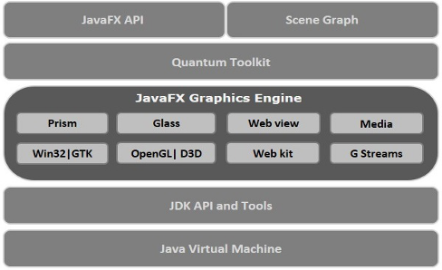
Architecture of JAVAFX

Slide 8
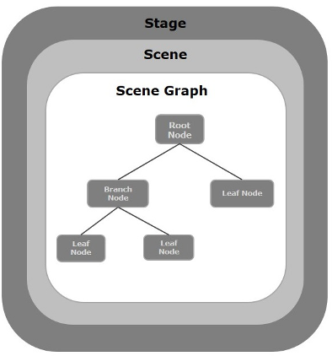
JAVA Application structure

Slide 9
Stage
A stage (a window) contains all the objects of a JavaFX application. It is represented by Stage class of the package javafx.stage.
The primary stage is created by the platform itself. The created stage object is passed as an argument to the start() method of the Application class.
The show() method to display the contents of a stage.

Slide 10
Scene
A scene represents the physical contents of a JavaFX application. It contains all the contents of a scene graph. The class Scene of the package javafx.scene represents the scene object. At an instance, the scene object is added to only one stage.
we can create a scene by instantiating the Scene Class. we can opt for the size of the scene by passing its dimensions (height and width) along with the root node to its constructor.
EX: StackPane root = new StackPane();
root.getChildren().add(btn);
Scene scene = new Scene(root, 300, 250);

Slide 11
Scene Graph
In JavaFX, the GUI Applications were coded using a Scene Graph. A Scene Graph is the starting point of the construction of the GUI Application. It holds the (GUI) application primitives that are termed as nodes.
A node is a visual/graphical object and it may include −
Geometrical (Graphical) objects − (2D and 3D) such as circle, rectangle, polygon, etc.
UI controls − such as Button, Checkbox, Choice box, Text Area, etc.
Containers − (layout panes) such as Border Pane, Grid Pane, Flow Pane, etc.
Media elements − such as audio, video and image objects.

Slide 12
Node class
The Node Class of the package javafx.scene represents a node in JavaFX, this class is the super class of all the nodes.
As discussed earlier a node is of three types −
Root Node − The first Scene Graph is known as the Root node.
Branch Node/Parent Node − The node with child nodes are known as branch/parent nodes. The abstract class named Parent of the package javafx.scene is the base class of all the parent nodes, and those parent nodes will be of the following types −
Group − A group node is a collective node that contains a list of children nodes. Whenever the group node is rendered, all its child nodes are rendered in order. Any transformation, effect state applied on the group will be applied to all the child nodes.
Region − It is the base class of all the JavaFX Node based UI Controls, such as Chart, Pane and Control.
WebView − This node manages the web engine and displays its contents.
Leaf Node − The node without child nodes is known as the leaf node. For example, Rectangle, Ellipse, Box, ImageView, MediaView are examples of leaf nodes.

Slide 13
Three main things
First, that the class uses “extends Application.“
Second, we required method named “start(Stage primaryStage).“
Finally, we tell the Stage to appear by “primaryStage.show();“
This is what makes the application visible.

Slide 14
First example
import javafx.application.Application;
import javafx.stage.Stage;
public class firstfx extends Application
{
public void start(Stage primaryStage) {
primaryStage.show();
}
public static void main(String[] args) {
launch(args);
}
}

Slide 15
launch
Launch a standalone application.
This method is typically called from the main method().
It must not be called more than once or an exception will be thrown(IllegalStateException). This is equivalent to launch(TheClass.class, args) where TheClass is the immediately enclosing class of the method that called launch.
It must be a subclass of Application or a RuntimeException will be thrown.
The launch method does not return until the application has exited, either via a call to Platform.exit or all of the application windows have been closed.
Typical usage is:
public static void main(String[] args)
{
Application.launch(args);
}

Slide 16
Label using FX
import javafx.application.*;
import javafx.scene.*;
import javafx.scene.layout.*;
import javafx.scene.control.*;
import javafx.stage.*;
public class fxlabel extends Application
{
public void start(Stage pstage)
{
Label l1 = new Label("welcome");
StackPane root = new StackPane();
Scene s = new Scene(root,300,300);
root.getChildren().add(l1);
pstage.setScene(s);
pstage.setTitle("Simple JAVAFX example");
pstage.show();
}
public static void main(String ar[])
{
launch(ar);
}
}

Slide 17
What all we can see
First, it has a label. The label is just text that will appear on the screen.
Second it has a “StackPane" layout - which
means that the the text will appear in the middle of the application.

Slide 18
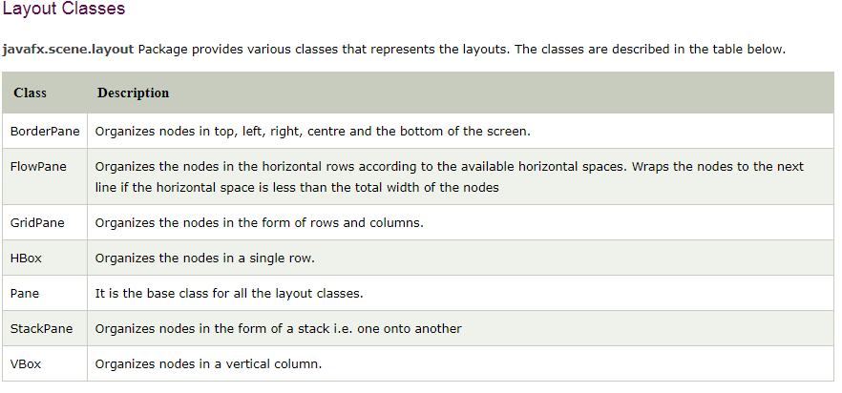
Layouts
There are many different layouts.
The following are some of the more common layouts:

Slide 19
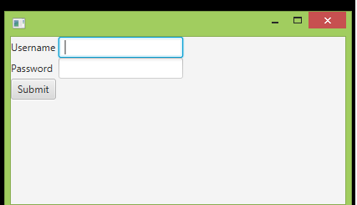
Example on gride pane layout
import javafx.application.Application;
import javafx.scene.Scene;
import javafx.scene.control.*;
import javafx.scene.layout.*;
import javafx.stage.*;
public class gridpane extends Application
{
public void start(Stage pstage)
{
Label l1=new Label("Username ");
Label l2=new Label("Password");
TextField t1=new TextField();
TextField t2=new TextField();
Button b1=new Button ("Submit");
GridPane root=new GridPane();
Scene scene = new Scene(root,400,200);
root.addRow(0, l1,t1);
root.addRow(1, l2,t2);
root.addRow(2, b1);
pstage.setScene(scene);
pstage.show();
}
public static void main(String[] args) {
launch(args);
}
}

Slide 20
Life cycle of JAVA Fx
Lifecycle of JavaFX Application
The JavaFX Application class has three life cycle methods, which are −
start() − The entry point method where the JavaFX graphics code is to be written.
stop() − An empty method which can be overridden, here you can write the logic to stop the application.
init() − An empty method which can be overridden, but you cannot create stage or scene in this method.
In addition to these, it provides a static method named launch() to launch JavaFX application.
Since the launch() method is static, you need to call it from a static context (main generally). Whenever a JavaFX application is launched, the following actions will be carried out (in the same order).
An instance of the application class is created.
Init() method is called.
The start() method is called.
The launcher waits for the application to finish and calls the stop() method.

Slide 21
Steps for create JAVAFX application
Step 1: Creating a Class
Create a Java class and inherit the Application class of the package javafx.application and implement the start() method of this class as follows.
public class Samplefx extends Application
{ public void start(Stage primaryStage) throws Exception { }
}
Step 2: Creating a Group Object
In the start() method creates a group object by instantiating the class named Group, which belongs to
the package javafx.scene, as follows.
Group root = new Group();
Step 3: Creating a Scene Object
Create a Scene by instantiating the class named Scene which belongs to the package javafx.scene. To this class, pass the Group object (root), created in the previous step.
In addition to the root object, you can also pass two double parameters representing height and width of the screen along
with the object of the Group class as follows.
Scene scene = new Scene(root,600, 300);

Slide 22
Step 4: Setting the Title of the Stage
You can set the title to the stage using the setTitle() method of the Stage class. The primaryStage is a Stage object which is passed to the start method of the scene class, as a parameter.
Using the primaryStage object, set the title of the scene as Sample Application as shown below.
primaryStage.setTitle("Sample Application");
Step 5: Adding Scene to the Stage
You can add a Scene object to the stage using the method setScene() of the class named Stage. Add the Scene object prepared in the previous steps using this method as shown below.
primaryStage.setScene(scene);
Step 6: Displaying the Contents of the Stage
Display the contents of the scene using the method named show() of the Stage class as follows.
primaryStage.show();
Step 7: Launching the Application
Launch the JavaFX application by calling the static method launch() of the Application class from the main method as follows.
public static void main(String args[]){ launch(args); }

Slide 23
Creating a Text Node
Text text = new Text();
text.setFont(Font.font("verdana", FontWeight.BOLD, FontPosture.REGULAR, 20)); // font of the text
//Setting the text to be added.
text.setText("Hi!! welcome to JAVA FX programming");
//setting the position of the text
text.setX(50);
text.setY(50);
text.setFill(Color.BROWN);
//Setting the Stroke
text.setStrokeWidth(2);
text.setUnderline(true);
// Setting the stroke color
text.setStroke(Color.BLUE);
//Creating a Group object
Group root = new Group(text);

Slide 24
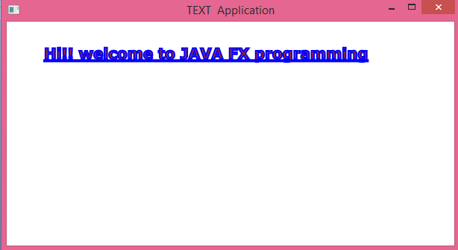

Slide 25
2D shapes
Using the JavaFX library, you can draw −
Predefined shapes such as Line, Rectangle, Circle, Ellipse, Polygon, Polyline, Cubic Curve, Quad Curve, Arc.
Path elements such as MoveTO Path Element, Line, Horizontal Line, Vertical Line, Cubic Curve, Quadratic Curve, Arc.
The package javafx.scene.shape

Slide 26
Line object
//Creating a line object
Line line = new Line();
//Setting the properties to a line
line.setStartX(100.0);
line.setStartY(150.0);
line.setEndX(500.0);
line.setEndY(150.0);
//Creating a Group
Group root = new Group(line);

Slide 27
To create a rectangle
Rectangle rectangle = new Rectangle();
//Setting the properties of the rectangle
rectangle.setX(150.0f);
rectangle.setY(75.0f);
rectangle.setWidth(300.0f);
rectangle.setHeight(150.0f);
//Creating a Group object
Group root = new Group(rectangle);

Slide 28
Other 2D shapes
Rounded Rectangle
Circle
Ellipse
Polygon
Polyline
Cubic Curve
QuadCurve
Arc

Slide 29
Animations
Fade Transition
Fill Transition
Rotate Transition
Scale Transition
Stroke Transition
Translate Transition
Path Transition

Slide 30
Animation
Rotation (rotate.java)
RotateTransition rotateTransition = new RotateTransition();
//Setting the duration for the transition
rotateTransition.setDuration(Duration.millis(1000));
//Setting the node for the transition
rotateTransition.setNode(hexagon);
//Setting the angle of the rotation
rotateTransition.setByAngle(360);
//Setting the cycle count for the transition
rotateTransition.setCycleCount(50);
//Setting auto reverse value to false
rotateTransition.setAutoReverse(false);
//Playing the animation
rotateTransition.play();
//Creating a Group object
Group root = new Group(hexagon);

Slide 31
UI Controls
JavaFX Label:
javafx.scene.control.Label class represents label control. As the name suggests, the label is the component that is used to place any text information on the screen. It is mainly used to describe the purpose of the other components to the user. You can not set a focus on the label using the Tab key.
Package: javafx.scene.control
Constructors:
Label(): creates an empty Label
Label(String text): creates Label with the supplied text
Label(String text, Node graphics): creates Label with the supplied text and graphics

Slide 32
Adding a Node to the scene graph
import javafx.application.Application;
import javafx.scene.Scene;
import javafx.scene.control.Label;
import javafx.scene.layout.StackPane;
import javafx.stage.Stage;
public class LabelTest extends Application
{
public void start(Stage primaryStage) throws Exception
{
Label my_label=new Label("This is an example of Label");
StackPane root = new StackPane();
Scene scene=new Scene(root,300,300);
root.getChildren().add(my_label);
primaryStage.setScene(scene);
primaryStage.setTitle("Label Class Example");
primaryStage.show();
}
public static void main(String[] args) {
launch(args);
}
}

Slide 33
Creating a button as node
Button btn=new Button("This is a button");
Button b2 = new Button("Exit");
TextField tf1=new TextField();
GridPane root = new GridPane();
root.addRow(0, tf1,btn);
root.addRow(1,b2);
Scene scene=new Scene(root,300,300);
// root.getChildren().add(btn);
// root.getChildren().add(tf1);
primaryStage.setScene(scene);
primaryStage.setTitle("Button Class Example");
primaryStage.show();

Slide 34
JavaFx menus
JavaFX Menu
JavaFX provides a Menu class to implement menus. Menu is the main component of a any application. In JavaFX, javafx.scene.control.Menu class provides all the methods to deal with menus. This class needs to be instantiated to create a Menu.
The following sample of code shows the implementation of JavaFX menu.
ManuBar menubar = new MenuBar(); //creating MenuBar
Menu MenuName = new Menu("Menu Name"); //creating Menu
MenuItem MenuItem1 = new MenuItem("Menu Item 1 Name"); //creating Menu Item
MenuName.getItems().add(MenuItem1); //adding Menu Item to the Menu
menubar.getMenus().add(MenuName); //adding Menu to the MenuBar

Slide 35
MenuBar menubar = new MenuBar();
Menu FileMenu = new Menu("Colors");
MenuItem filemenu1=new MenuItem("RED");
MenuItem filemenu2=new MenuItem("GREEN");
MenuItem filemenu3=new MenuItem("BLUE");
Menu EditMenu=new Menu("Flowers");
MenuItem EditMenu1=new MenuItem("ROSE");
MenuItem EditMenu2=new MenuItem("JASMINE");
MenuItem EditMenu3=new MenuItem("LILLY");
EditMenu.getItems().addAll(EditMenu1,EditMenu2,EditMenu3);
root.setTop(menubar);
FileMenu.getItems().addAll(filemenu1,filemenu2,filemenu3);
menubar.getMenus().addAll(FileMenu,EditMenu);

Slide 36
Event handling in javafx
Types of Events
In general, the events are mainly classified into the following two types.
1. Foreground Events
Foreground events are mainly occurred due to the direct interaction of the user with the GUI of the application. Such as clicking the button, pressing a key, selecting an item from the list, scrolling the page, etc.
2. Background Events
Background events doesn't require the user's interaction with the application. These events are mainly occurred to the operating system interrupts, failure, operation completion, etc.

Slide 37
Events in JAVAFX
An instance of any of its subclass is an event. JavaFX provides a wide variety of events. Some of them are are listed below.
Mouse Event − This is an input event that occurs when a mouse is clicked. It is represented by the class named MouseEvent. It includes actions like mouse clicked, mouse pressed, mouse released, mouse moved, mouse entered target, mouse exited target, etc.
Key Event − This is an input event that indicates the key stroke occurred on a node. It is represented by the class named KeyEvent. This event includes actions like key pressed, key released and key typed.
Drag Event − This is an input event which occurs when the mouse is dragged. It is represented by the class named DragEvent. It includes actions like drag entered, drag dropped, drag entered target, drag exited target, drag over, etc.
Window Event − This is an event related to window showing/hiding actions. It is represented by the class named WindowEvent. It includes actions like window hiding, window shown, window hidden, window showing, etc.

Slide 38
Processing Events in JavaFX
JavaFX provides the class javafx.event.Event which contains all the subclasses representing the types of Events that can be generated in JavaFX. Any event is an instance of the class Event or any of its subclasses.
There are various events in JavaFX i.e. MouseEvent, KeyEvent, ScrollEvent, DragEvent, etc. We can also define our own event by inheriting the class javafx.event.Event.
.

Slide 39
The properties of an event
 | Property | Description
1 | Event Type | It is the type of the event that is being generated. It is basically the instance of EventType class. It is hierarchical. The instance of EventType class is further classified into various type of events for example KeyEvent class contains KEY_PRESSED, KEY_RELEASED, and KEY_TYPED types.
2 | Source | It represents source of the event i.e. the origin which is responsible to generate the event.
3 | Target | It is the node on which the event is generated. It remains unchanged for the generated event. It is the instance of any of the class that implements the EventTarget interface.

Slide 40
Event handlers
Event Handlers and Filters
Event Handlers and filters contains application logic to process an event. A node can be registered to more than one Event Filters. The interface javafx.event.EventHandler must be implemented by all the event handlers and filters.

Slide 41
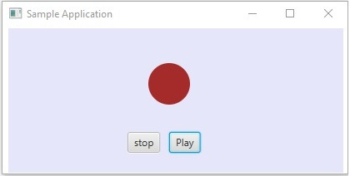
Target − The node on which an event occurred. A target can be a window, scene, and a node.
Source − The source from which the event is generated will be the source of the event. In the above scenario, mouse is the source of the event.
Type − Type of the occurred event; in case of mouse event – mouse pressed, mouse released are the type of events.
If you click on the play button, the source will be the ________, the target node will be the ________________and the type of the event generated is the ___________________.

Slide 42
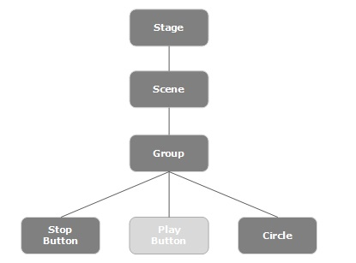
Event dispatch chain

Slide 43
Event Capturing Phase
After the construction of the event dispatch chain, the root node of the application dispatches the event. This event travels to all nodes in the dispatch chain (from top to bottom). If any of these nodes has a filter registered for the generated event, it will be executed. If none of the nodes in the dispatch chain has a filter for the event generated, then it is passed to the target node and finally the target node processes the event.

Slide 44
Event Bubbling Phase
In the event bubbling phase, the event is travelled from the target node to the stage node (bottom to top). If any of the nodes in the event dispatch chain has a handler registered for the generated event, it will be executed. If none of these nodes have handlers to handle the event, then the event reaches the root node and finally the process will be completed.

Slide 45
Event Handlers and Filters
Event filters and handlers are those which contains application logic to process an event. A node can register to more than one handler/filter. In case of parent–child nodes, you can provide a common filter/handler to the parents, which is processed as default for all the child nodes.
As mentioned above, during the event, processing is a filter that is executed and during the event bubbling phase, a handler is executed. All the handlers and filters implement the interface EventHandler of the package javafx.event.

Slide 46
Adding and Removing Event Filter
To add an event filter to a node, you need to register this filter using the method addEventFilter() of the Node class.
//Creating the mouse event handler
EventHandler<MouseEvent> eventHandler = new EventHandler<MouseEvent>()
{
@Override public void handle(MouseEvent e)
{
System.out.println("Hello World");
circle.setFill(Color.DARKSLATEBLUE); } }; //Adding event Filter Circle.addEventFilter(MouseEvent.MOUSE_CLICKED, eventHandler);
Refer to program eventfiltercircle.java

Slide 47
Example - eventfilter
EventHandler<MouseEvent> eventHandler = new EventHandler<MouseEvent>()
{
public void handle(MouseEvent e)
{
System.out.println("Sucess");
circle.setFill(Color.BLUE);
// System.exit(0);
}
};
//Registering the event filter
circle.addEventFilter(MouseEvent.MOUSE_CLICKED, eventHandler);

Slide 48
Adding and Removing Event Handlers
To add an event handler to a node, you need to register this handler using the method addEventHandler() of the Node class as shown below.
//Creating the mouse event handler EventHandler<javafx.scene.input.MouseEvent> eventHandler = new EventHandler<javafx.scene.input.MouseEvent>()
{
public void handle(javafx.scene.input.MouseEvent e)
{
System.out.println("Hello World");
circle.setFill(Color.BLUE); }
};
//Adding the event handler circle.addEventHandler(javafx.scene.input.MouseEvent.MOUSE_CLICKED, eventHandler);

Slide 49
Event handler example
//Handling the key typed event
EventHandler<KeyEvent> etext = new EventHandler<KeyEvent>()
{
public void handle(KeyEvent event) {
rotateTransition.play();
}
};
//Adding an event handler to the text feld
textField.addEventHandler(KeyEvent.KEY_TYPED, etext);
//Handling the mouse clicked event(on box)
EventHandler<javafx.scene.input.MouseEvent> ebox =
new EventHandler<javafx.scene.input.MouseEvent>()
{
public void handle(javafx.scene.input.MouseEvent e)
{
rotateTransition.stop();
}
};
//Adding the event handler to the box
box.addEventHandler(javafx.scene.input.MouseEvent.MOUSE_CLICKED, ebox);

Slide 50
Convenience Methods
EventHandler Property | Description | Setter Methods
onDragDone | This is of the type EventHandler of DragEvent. | setOnDragDone(EventHandler value )
onDragDropped | This is of the type EventHandler of DragEvent. This is assigned to a function which is to be called when the mouse is released during a drag and drop operation. | setOnDragDropped(EventHandler value )

Slide 51
onDragEntered | This is of the type EventHandler of DragEvent. This is assigned to a function which is to be called when the drag gesture enters the node. | setOnDragEntered(EventHandler value )
onDragExited | This is of the type EventHandler of DragEvent. This is assigned to a function which is to be called when the drag gesture exits the node. | setOnDragExited(EventHandler value )
onDragOver | This is of the type EventHandler of DragEvent.This is assigned to a function which is to be called when the drag gesture progresses within the node. | setOnDragOver(EventHandler value )

