Slide 1
Java Servlets

Slide 2
Topics to be covered
Introduction to Entreprises Java (JEE)
Basic Application Structure
Web Containers
Creating Servlets, Configuring Servlets
Understanding HTTP methods -Parameters and Accepting Form Submissions
Init parameters, File Uploading
Accessing Databases with JDBC

Slide 3
Enterprises Java ( Java EE)
Enterprise applications provide the business logic for an enterprise.
They are centrally managed and often interact with other enterprise software.
The aim of the Java EE platform is to provide developers with a powerful set of APIs while shortening development time, reducing application complexity, and improving application performance.

Slide 4
Basic Application Structure
web.xml: The web.xml file is the deployment descriptor for a Servlet-based Java web application (which most Java web apps are)
src/java: Java source files for the module
src/conf: configuration files for the module, with the exception of web applications
web: web pages, style sheets, tag files, and images (web applications only)
web/WEB-INF: configuration files for web applications (web applications only)
nbproject: NetBeans project files
When an example has multiple application modules packaged into an EAR file, its submodule directories use the following naming conventions:
example-name-app-client: application clients
example-name-ejb: enterprise bean JAR files
example-name-war: web applications

Slide 5
Web container in Servlets
Web container also known as a Servlet container is the component of a web server that interacts with Java servlets.
A web container is responsible for managing the lifecycle of servlets, mapping a URL to a particular servlet and ensuring that the URL requester has the correct access rights

Slide 6
Example web containers
Open source Web containers
Apache Tomcat (formerly Jakarta Tomcat) is an open source web container available under the Apache Software License.
Apache Tomcat 6 and above are operable as general application container (prior versions were web containers only)
Apache Geronimo is a full Java EE 6 implementation by Apache Software Foundation.
Enhydra, from Lutris Technologies.
GlassFish from Oracle (an application server, but includes a web container).
Jetty, from the Eclipse Foundation. Also supports SPDY and WebSocket protocols.
Jaminid contains a higher abstraction than servlets.
Payara is another application server, derived from Glassfish.
Winstone supports specification v2.5 as of 0.9, has a focus on minimal configuration and the ability to strip the container down to only what you need.
Tiny Java Web Server (TJWS) 2.5 [1], small footprint, modular design.
Virgo from Eclipse Foundation provides modular, OSGi based web containers implemented using embedded Tomcat and Jetty. Virgo is available under the Eclipse Public License.
WildFly (formerly JBoss Application Server) is a full Java EE implementation by Red Hat, division JBoss.

Slide 7
Commercial Web containers
iPlanet Web Server, from Oracle.
JBoss Enterprise Application Platform from Red Hat, division JBoss is subscription-based/open-source Java EE-based application server.
JRun, from Adobe Systems (formerly developed by Allaire Corporation).
WebLogic Application Server, from Oracle Corporation (formerly developed by BEA Systems).
Orion Application Server, from IronFlare.
Resin Pro, from Caucho Technology.
ServletExec, from New Atlanta Communications.
IBM WebSphere Application Server.
SAP NetWeaver.
tc Server, from SpringSource Inc.

Slide 8
Introduction
Servlet technology is used to create web application (resides at server side and generates dynamic web page).
Servlet technology is robust and scalable because of java language. Before Servlet, CGI (Common Gateway Interface) scripting language was popular as a server-side programming language.
There are many interfaces and classes in the servlet API such as Servlet, GenericServlet, HttpServlet, ServletRequest, ServletResponse etc.
web app is a client-server software application in which the client (or user interface) runs in a web browser

Slide 9
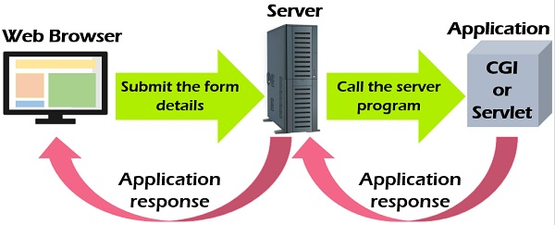
Difference between CGI and Servlet

Slide 10
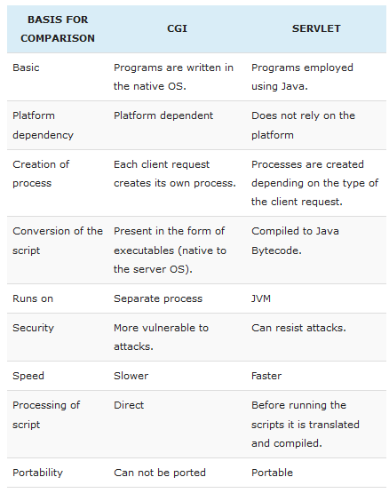

Slide 11
What is a Servlet?
Servlet is a technology i.e. used to create web application.
Servlet is an API that provides many interfaces and classes including documentations.
Servlet is an interface that must be implemented for creating any servlet.
Servlet is a class that extend the capabilities of the servers and respond to the incoming request. It can respond to any type of requests.
Servlet is a web component that is deployed on the server to create dynamic web page.
A Web component on the server-side is the one invoked by the client using Web (Internet) as medium (interface) of communication.

Slide 12
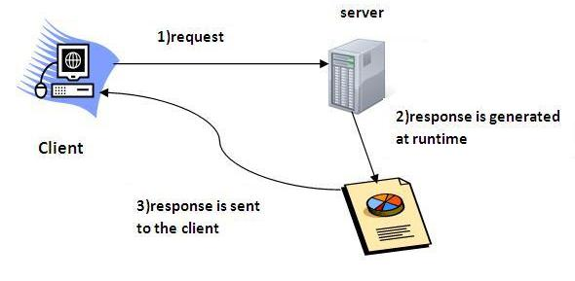

Slide 13
What is web application?
A web application is an application accessible from the web. A web application is composed of web components like Servlet, JSP, Filter etc. and other components such as HTML.
The web components typically execute in Web Server and respond to HTTP request.

Slide 14
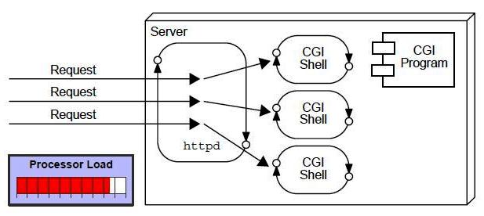
CGI(Common Gateway Interface)
CGI technology enables the web server to call an external program and pass HTTP request information to the external program to process the request. For each request, it starts a new process.

Slide 15
Disadvantages of CGI
There are many problems in CGI technology:
If number of clients increases, it takes more time for sending response.
For each request, it starts a process and Web server is limited to start processes.
It uses platform dependent language e.g. C, C++, perl.

Slide 16
Advantage of Servlet
There are many advantages of servlet over CGI.
The web container creates threads for handling the multiple requests to the servlet. Threads have a lot of benefits over the Processes such as they share a common memory area, lightweight, cost of communication between the threads are low.
The basic benefits of servlet are as follows:
better performance: because it creates a thread for each request not process.
Portability: because it uses java language.
Robust: Servlets are managed by JVM so no need to worry about memory leak, garbage collection etc.
Secure: because it uses java language..

Slide 17
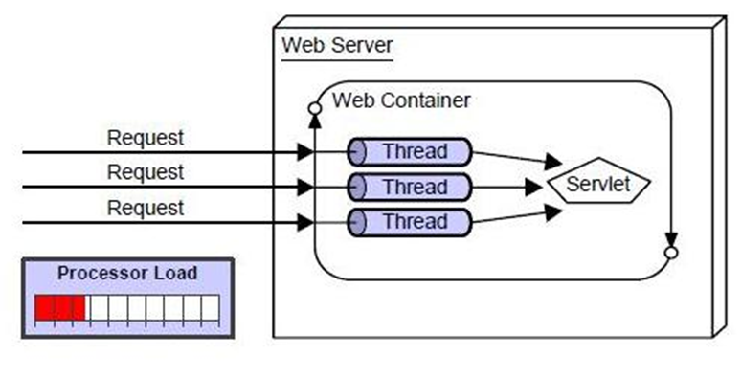

Slide 18
Terminology in servlet
Let's first discuss these points before starting the servlet technology.
The basic terminology used in servlet are given below:
HTTP
HTTP Request Types
Difference between Get and Post method
Container
Server and Difference between web server and application server
Content Type
Introduction of XML
Deployment

Slide 19
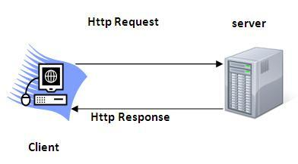
HTTP (Hyper Text Transfer Protocol)
Http is the protocol that allows web servers and browsers to exchange data over the web.
It is a request response protocol.
Http uses reliable TCP connections by default on TCP port 80.
It is stateless means each request is considered as the new request. In other words, server doesn't recognize the user bydefault.

Slide 20
Http Request Methods
Every request has a header that tells the status of the client. There are many request methods. Get and Post requests are mostly used.
HTTP Request | Description
GET | Asks to get the resource at the requested URL.
POST | Asks the server to accept the body info attached. It is like GET request with extra info sent with the request.
HEAD | Asks for only the header part of whatever a GET would return. Just like GET but with no body.
TRACE | Asks for the loopback of the request message, for testing or troubleshooting.
PUT | Says to put the enclosed info (the body) at the requested URL.
DELETE | Says to delete the resource at the requested URL.
OPTIONS | Asks for a list of the HTTP methods to which the thing at the request URL can respond

Slide 21
What is the difference between Get and Post?
GET | POST
1) In case of Get request, only limited amount of data can be sent because data is sent in header. | In case of post request, large amount of data can be sent because data is sent in body.
2) Get request is not secured because data is exposed in URL bar. | Post request is secured because data is not exposed in URL bar.
3) Get request can be bookmarked | Post request cannot be bookmarked
4) Get request is idempotent. It means second request will be ignored until response of first request is delivered. | Post request is non-idempotent
5) Get request is more efficient and used more than Post | Post request is less efficient and used less than get.

Slide 22
Server
It is a running program or software that provides services.
There are two types of servers:
Web Server
Application Server
Web Server
Web server contains only web or servlet container. It can be used for servlet, jsp, struts, jsf etc. It can't be used for EJB.
Example of Web Servers are: Apache Tomcat .

Slide 23
Application Server
Application server contains Web and EJB containers. It can be used for servlet, jsp, struts, jsf, ejb etc.
Example of Application Servers are:
JBoss Open-source server from JBoss community.
Glassfish provided by Sun Microsystem. Now acquired by Oracle.
Weblogic provided by Oracle. It more secured.
Websphere provided by IBM.

Slide 24
Content Type
Content Type is also known as MIME (Multipurpose internet Mail Extension) Type. It is a HTTP header that provides the description about what are you sending to the browser.
There are many content types:
text/html
text/plain
application/msword
application/vnd.ms-excel
application/jar
application/pdf
application/octet-stream
application/x-zip
images/jpeg
video/quicktime etc.

Slide 25
Servlet API
The javax.servlet and javax.servlet.http packages represent interfaces and classes for servlet api.
The javax.servlet package contains many interfaces and classes that are used by the servlet or web container. These are not specific to any protocol.
The javax.servlet.http package contains interfaces and classes that are responsible for http requests only.

Slide 26
Interfaces in javax.servlet package
There are many interfaces in javax.servlet package. They are as follows:
Servlet
ServletRequest
ServletResponse
RequestDispatcher
ServletConfig
ServletContext

Slide 27
Classes in javax.servlet package
There are many classes in javax.servlet package. They are as follows:
GenericServlet
ServletInputStream
ServletOutputStream
ServletRequestWrapper
ServletResponseWrapper

Slide 28
Interfaces in javax.servlet.http package
Interfaces in javax.servlet.http package
There are many interfaces in javax.servlet.http package. They are as follows:
HttpServletRequest
HttpServletResponse

Slide 29
Classes in javax.servlet.http package
There are many classes in javax.servlet.http package. They are as follows:
HttpServlet
Cookie

Slide 30
Before Coding it is time for us to know the steps of create a servlet example

Slide 31
Servlet Interface
Servlet interface provides common behaviour to all the servlets.
Servlet interface needs to be implemented for creating any servlet (either directly or indirectly). It provides 3 life cycle methods that are used to
initialize the servlet
to service the requests
to destroy the servlet

Slide 32
Life Cycle of a Servlet (Servlet Life Cycle)
The web container maintains the life cycle of a servlet instance. Let's see the life cycle of the servlet:
Servlet class is loaded.
Servlet instance is created.
init method is invoked.
service method is invoked.
destroy method is invoked.

Slide 33
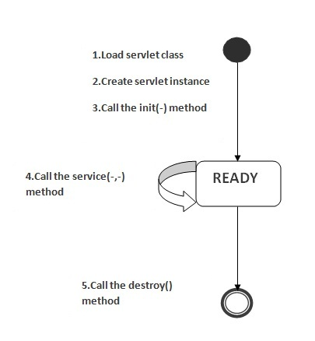

Slide 34
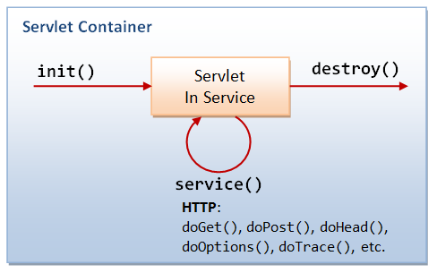

Slide 35
These methods like init, destroy and service which are lifecycle methods.
These methods should be called by framework only and not explicitly by our code.
We can override these methods to add our application/business logic.
Also only init and destroy should be overridden.

Slide 36
As displayed in the above diagram, there are three states of a servlet: new, ready and end.
The servlet is in new state if servlet instance is created.
After invoking the init() method, Servlet comes in the ready state.
In the ready state, servlet performs all the tasks.
When the web container invokes the destroy() method, it shifts to the end state

Slide 37
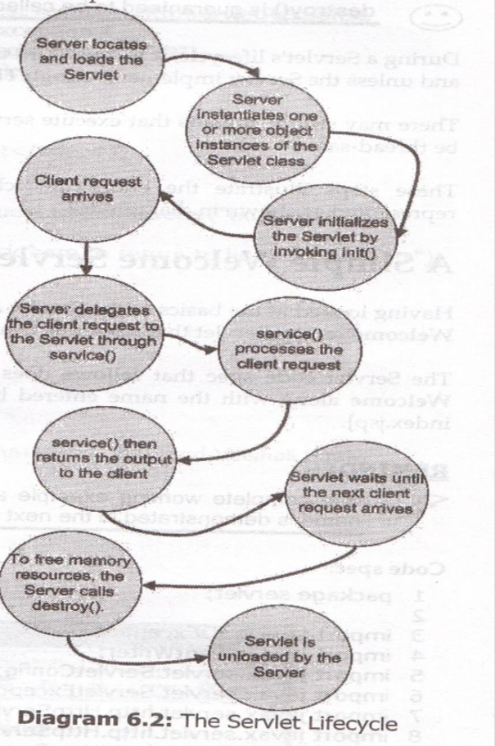

Slide 38
Sample program using init() method
public void doGet(HttpServletRequest request,
HttpServletResponse response)
throws IOException, ServletException
{
response.setContentType("text/html");
PrintWriter out = response.getWriter();
out.println("<HTML>");
out.println("<HEAD>");
out.println("<TITLE>");
out.println("Using the init Method");
out.println("</TITLE>");
out.println("</HEAD>");
out.println("<BODY>");
out.println("<H1>Using the init Method</H1>");
out.println(msg);
out.println("</BODY>");
out.println("</HTML>");
}
}
import java.util.*;
import java.io.*;
import javax.servlet.*;
import javax.servlet.http.*;
public class MyServlet extends HttpServlet {
String str = "";
public void init(ServletConfig config)
{
str = “My first JAVA SERVLET PROGRAM!!!!";
}

Slide 39
First java servlet program
import java.io.*;
import javax.servlet.*;
import javax.servlet.http.*;
import java.util.*;
public class First extends HttpServlet //GenericServlet
{
public void doGet(HttpServletRequest req, HttpServletResponse res) throws ServletException, IOException
{
//res.ContentType("text/html");
PrintWriter p = res.getWriter();
p.println("<html>");
p.println("<head>");
p.println("<title> First program </title>");
p.println("</head>");
p.println("<body>");
p.println("<h3> WELCOME TO FIRST SERVLET PROGRAMMING</h3>");
p.println("Time:"+(new Date().toLocaleString()));
p.println("</body>");
p.println("</html>");
}
}

Slide 40
Thank you

