Slide 1
Server Side Development
Java Server Pages

Slide 2
Topics
JSP Fundamentals
JSP Scripting Elements
JSP Implicit Objects
JSP Directives
JSP Actions
JSP Example (Loan Calculator)
Servlets & JSPs together
Tag Libraries
Deploying and Running a JSP Application
Notes:
Prevention: locks at doors, window bars, walls round the property
Detection: stolen items are missing, burglar alarms, closed circuit TV
Reaction: call the police, replace stolen items, make an insurance claim …
Prevention: encrypt your orders, rely on the merchant to perform checks on the caller, don’t use the Internet (?) …
Detection: an unauthorized transaction appears on your credit card statement
Reaction: complain, ask for a new card number, etc.

Slide 3
Java Server Pages (JSP)
Fundamentals
Java Server Pages are HTML pages embedded with snippets of Java code.
  It is an inverse of a Java Servlet
Four different elements are used in constructing JSPs
  Scripting Elements
  Implicit Objects
  Directives
  Actions
Notes:
Prevention: locks at doors, window bars, walls round the property
Detection: stolen items are missing, burglar alarms, closed circuit TV
Reaction: call the police, replace stolen items, make an insurance claim …
Prevention: encrypt your orders, rely on the merchant to perform checks on the caller, don’t use the Internet (?) …
Detection: an unauthorized transaction appears on your credit card statement
Reaction: complain, ask for a new card number, etc.

Slide 4
Java Server Pages (JSP)
Architecture
JSPs run in two phases
  Translation Phase
  Execution Phase
In translation phase JSP page is compiled into a servlet
  called JSP Page Implementation class
In execution phase the compliled JSP is processed
Receive
Request
HTTP Server
JSP Container
Page Compiler Servlet
JSP Servlet
Current?
No
Parse JSP
Yes
JSP Servlet
Loaded?
Generate JSP
Servlet Source
Yes
No
Load Servlet
Compile JSP
Servlet
JSP Page Servlet
Generate
Response
Send
Response
Notes:
Prevention: locks at doors, window bars, walls round the property
Detection: stolen items are missing, burglar alarms, closed circuit TV
Reaction: call the police, replace stolen items, make an insurance claim …
Prevention: encrypt your orders, rely on the merchant to perform checks on the caller, don’t use the Internet (?) …
Detection: an unauthorized transaction appears on your credit card statement
Reaction: complain, ask for a new card number, etc.

Slide 5
Scripting Elements
Types
There are three kinds of scripting elements
  Scriptlets
  Expressions
  Declarations
Notes:
Prevention: locks at doors, window bars, walls round the property
Detection: stolen items are missing, burglar alarms, closed circuit TV
Reaction: call the police, replace stolen items, make an insurance claim …
Prevention: encrypt your orders, rely on the merchant to perform checks on the caller, don’t use the Internet (?) …
Detection: an unauthorized transaction appears on your credit card statement
Reaction: complain, ask for a new card number, etc.

Slide 6
scriptlet tag
In JSP, java code can be written inside the jsp page using the scriptlet tag.
A scriptlet tag is used to execute java source code in JSP. Syntax is as follows:
<% java source code %>

Slide 7
Index.jsp
<html>
<body>
<% out.print("welcome to jsp"); %>
</body>
</html>

Slide 8
Expression tag
The code placed within JSP expression tag is written to the output stream of the response. So you need not write out.print() to write data. It is mainly used to print the values of variable or method.
Syntax of JSP expression tag
<%= statement %>

Slide 9
Expression tag:
<html>
<body>
<%= "welcome to jsp" %>
</body>
</html>
Scriptlet tag:
<html>
<body>
<% out.print("welcome to jsp"); %>
</body>
</html>

Slide 10
JSP expression tag that prints current Date and time
<html>
<body>
<%= (new java.util.Date().toString())%>
</body>
</html>

Slide 11
Index.html
<html>
<body>
<form action=“first.jsp">
<input type="text" name=“uname">
<input type="submit" value=“Submit”><br/> </form>
</body>
</html>

Slide 12
To print name using getparameter()
<html>
<body>
<%= "Welcome "+request.getParameter("uname") %>
</body>
</html>

Slide 13
JSP declaration tag
The JSP declaration tag is used to declare fields and methods.
The code written inside the jsp declaration tag is placed outside the service() method of auto generated servlet.
So it doesn't get memory at each request.
Syntax of JSP declaration tag
The syntax of the declaration tag is as follows:
<%! field or method declaration %>

Slide 14
<html>
<body>
<%! int data=50; %>
<%= "Value of the variable is:"+data %>
</body>
</html>

Slide 15
Declares a method
<html>
<body>
<%!
int square (int a){
return (a*a);
}
%>
<%= “Sqaure of a is:"+square(3) %>
</body>
</html>

Slide 16
Declarations
Declarations are used to define methods & instance variables
  Do not produce any output that is sent to client
  Embedded in <%! and %> delimiters
  Example:
  <%!
    Public void jspDestroy() {
    System.out.println(“JSP Destroyed”);
    }
    Public void jspInit() {
    System.out.println(“JSP Loaded”);
    }
    int myVar = 123;
  %>
  The functions and variables defined are available to the JSP Page as well as to the servlet in which it is compiled
Notes:
Prevention: locks at doors, window bars, walls round the property
Detection: stolen items are missing, burglar alarms, closed circuit TV
Reaction: call the police, replace stolen items, make an insurance claim …
Prevention: encrypt your orders, rely on the merchant to perform checks on the caller, don’t use the Internet (?) …
Detection: an unauthorized transaction appears on your credit card statement
Reaction: complain, ask for a new card number, etc.

Slide 17
JSP Implicit Objects
There are 9 jsp implicit objects. These objects are created by the web container that are available to all the jsp pages.
The available implicit objects are out, request, config, session, application etc.

Slide 18
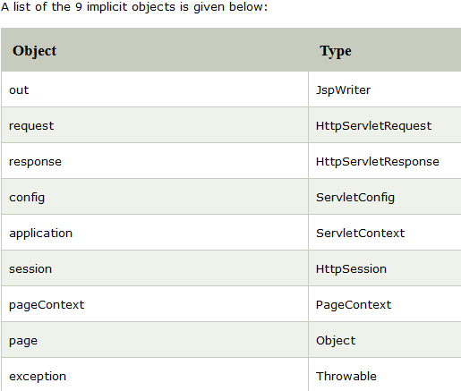

Slide 19
JSP out implicit object
PrintWriter out=response.getWriter();
Ex: index.jsp
<html>
<body>
<% out.print("Today is:"+java.util.Calendar.getInstance().getTime()); %>
</body>
</html>

Slide 20
JSP request implicit object
index.html
<form action="welcome.jsp">
<input type="text" name="uname">
<input type="submit" value="go"><br/>
</form>
welcome.jsp
<%
String name=request.getParameter("uname");
out.print("welcome "+name);
%>

Slide 21
JSP response implicit object
index.html
<form action="welcome.jsp">
<input type="text" name="uname">
<input type="submit" value="go"><br/>
</form>
welcome.jsp
<%
response.sendRedirect("http://www.google.com"); %>

Slide 22
JSP config implicit object
In JSP, config is an implicit object of type ServletConfig. This object can be used to get initialization parameter for a particular JSP page. The config object is created by the web container for each jsp page.
Generally, it is used to get initialization parameter from the web.xml file.

Slide 23
<servlet-mapping>
<servlet-name>Mtech</servlet-name>
<url-pattern>/welcome</url-pattern>
</servlet-mapping>
</web-app>
welcome.jsp
<%
out.print("Welcome "+request.getParameter("uname"));
String driver=config.getInitParameter("dname");
out.print("driver name is="+driver);
%>
index.html
<form action="welcome">
<input type="text" name="uname">
<input type="submit" value="go"><br/>
</form>
web.xml file
<web-app>
<servlet>
<servlet-name>mtech</servlet-name>
<jsp-file>/welcome.jsp</jsp-file>
<init-param>
<param-name>dname</param-name>
<param-value>sun.jdbc.odbc.JdbcOdbcDriver</param-value>
</init-param>
</servlet>

Slide 24
JSP application implicit object
In JSP, application is an implicit object of type ServletContext.
The instance of ServletContext is created only once by the web container when application or project is deployed on the server.
This object can be used to get initialization parameter from configuaration file (web.xml). It can also be used to get, set or remove attribute from the application scope.
This initialization parameter can be used by all jsp pages.

Slide 25
<%
out.print("Welcome "+request.getParameter("uname"));
String driver=application.getInitParameter("dname");
out.print("driver name is="+driver);
%>

Slide 26
session implicit object
For servlet program
  Project Samplesummer->index.jsp->firstsession_>secondservlet

Slide 27
JSP session implicit
Project → jspsession-> first.jsp-> second.jsp
Output :
From index.jsp the name is carried till second page through first.jsp

Slide 28
pageContext implicit object
In JSP, pageContext is an implicit object of type PageContext class.The pageContext object can be used to set,get or remove attribute from one of the following scopes:
page
request
session
application

Slide 29
The pageContext object represents the environment for the page, containing useful information like page attributes, access to the request, response and session objects, as well as the JspWriter referenced by out. This object also has methods for including another URL's contents, and for forwarding or redirecting to another URL. For example, to forward a request to another resource from in a JSP page, we can do that by using the pageContext variable:
pageContext.forward ("other.jsp");

Slide 30
Example JSPpagecontext
Jsppagecontext→index.jsp→first.jsp→second.jsp

Slide 31
Exception Handling in JSP implicit object
Jspexception->index.jsp->divide.jsp->exp.jsp

Slide 32
JSP Directives
The jsp directives are messages that tells the web container how to translate a JSP page into the corresponding servlet.
There are three types of directives:
page directive
include directive
taglib directive

Slide 33
Directives
Basics & Types
Messages sent to the JSP container
  Aids the container in page translation
Used for
  Importing tag libraries
  Import required classes
  Set output buffering options
  Include content from external files
The jsp specification defines three directives
  Page: provide information about page, such as scripting language that is used, content type, or buffer size
  Include – used to include the content of external files
  Taglib – used to import custom actions defined in tag libraries
Notes:
Potential Damages:
1. Change orders placed by the client (Instead of 500 widgets he can make the order 50,000 widgets)
2. Change meeting venues to send people on wild goose chases

Slide 34
Page Directives
Basics & Types
Page directive sets page properties used during translation
  JSP Page can have any number of directives
  Import directive can only occur once
  Embedded in <%@ and %> delimiters
Different directives are
  Language: (Default Java) Defines server side scripting language (e.g. java)
  Extends: Declares the class which the servlet compiled from JSP needs to extend
  Import: Declares the packages and classes that need to be imported for using in the java code (comma separated list)
  Session: (Default true) Boolean which says if the session implicit variable is allowed or not
  Buffer: defines buffer size of the jsp in kilobytes (if set to none no buffering is done)
Notes:
Potential Damages:
1. Change orders placed by the client (Instead of 500 widgets he can make the order 50,000 widgets)
2. Change meeting venues to send people on wild goose chases

Slide 35
Page Directives
Types con’t.
Different directives are (cont’d.)
  autoFlush:When true the buffer is flushed when max buffer size is reached (if set to false an exception is thrown when buffer exceeds the limit)
  isThreadSafe: (default true) If false the compiled servlet implements SingleThreadModel interface
  Info: String returned by the getServletInfo() of the compiled servlet
  errorPage: Defines the relative URI of web resource to which the response should be forwarded in case of an exception
  contentType: (Default text/html) Defines MIME type for the output response
  isErrorPage: True for JSP pages that are defined as error pages
  pageEncoding: Defines the character encoding for the jsp page
Notes:
Potential Damages:
1. Change orders placed by the client (Instead of 500 widgets he can make the order 50,000 widgets)
2. Change meeting venues to send people on wild goose chases

Slide 36
Page Directives
Example
<%@
page language=“java”
buffer=“10kb”
autoflush=“true”
errorPage=“/error.jsp”
import=“java.util.*, javax.sql.RowSet”
%>
Notes:
Potential Damages:
1. Change orders placed by the client (Instead of 500 widgets he can make the order 50,000 widgets)
2. Change meeting venues to send people on wild goose chases

Slide 37
Attributes of JSP page directive
import
contentType
extends
info
buffer
language
isELIgnored
isThreadSafe
autoFlush
session
pageEncoding
errorPage
isErrorPage

Slide 38
1. Import:
Ex:
<%@ page import="java.util.Date" %> Today is: <%= new Date() %>
2. Content type: This defines the
MIME(Multipurpose Internet Mail Extension) type of the HTTP response.The default value is "text/html;charset=ISO-8859-1".
Ex: <%@ page contentType=application/msword %>

Slide 39
3)extends
The extends attribute defines the parent class that will be inherited by the generated servlet.It is rarely used.
4)info
This attribute simply sets the information of the JSP page which is retrieved later by using getServletInfo() method of Servlet interface.
Ex: < %@ page info=“written by VIT" %>
The web container will create a method getServletInfo() in the resulting servlet.
For example:
public String getServletInfo() {
return " written by VIT "; }
}

Slide 40
5)buffer
The buffer attribute sets the buffer size in kilobytes to handle output generated by the JSP page.The default size of the buffer is 8Kb.
Ex: <%@ page buffer="16kb" %>
6)language
The language attribute specifies the scripting language used in the JSP page. The default value is "java".

Slide 41
A cookie is a small piece of information that is passed back and forth in the HTTP request and response.
Even though a cookie can be created on the client side using some scripting language such as JavaScript, it is usually created by a server resource, such as a servlet.

Slide 42
The cookie sent by a servlet to the client will be passed back to the server when the client requests another page from the same application.
In servlet programming, a cookie is represented by the Cookie class in the javax.servlet.http package. You can create a cookie by calling the Cookie class constructor and passing two String objects: the name and value of the cookie.

Slide 43
8)isThreadSafe
Servlet and JSP both are multithreaded.If you want to control this behaviour of JSP page, you can use isThreadSafe attribute of page directive.The value of isThreadSafe value is true.If you make it false, the web container will serialize the multiple requests, i.e. it will wait until the JSP finishes responding to a request before passing another request to it.If you make the value of isThreadSafe attribute like: <%@ page isThreadSafe="false" %>
The web container in such a case, will generate the servlet as:
public class Sampel_jsp extends HttpJspBase
implements SingleThreadModel{
.......
}
9) errorpage
10)isErrorpage

Slide 44
Include Directive
Basics
Used to insert template text and JSP code during the translation phase.
  The content of the included file specified by the directive is included in the including JSP page
Example
  <%@ include file=“included.jsp” %>
  JSP – Taglib directive – custom tags
Notes:
Potential Damages:
1. Change orders placed by the client (Instead of 500 widgets he can make the order 50,000 widgets)
2. Change meeting venues to send people on wild goose chases

Slide 45
JSP Actions
Basics & Types
Processed during the request processing phase.
  As opposed to JSP directives which are processed during translation
Standard actions should be supported by J2EE compliant web servers
Custom actions can be created using tag libraries
The different actions are
  Include action
  Forward action
  Param action
  useBean action
  getProperty action
  setProperty action
  plugIn action
Notes:
Potential Damages:
1. Change orders placed by the client (Instead of 500 widgets he can make the order 50,000 widgets)
2. Change meeting venues to send people on wild goose chases

Slide 46
JSP Actions
Include
Include action used for including resources in a JSP page
  Include directive includes resources in a JSP page at translation time
  Include action includes response of a resource into the response of the JSP page
  Same as including resources using RequestDispatcher interface
  Changes in the included resource reflected while accessing the page.
  Normally used for including dynamic resources
Example
  <jsp:include page=“inlcudedPage.jsp”>
  Includes the the output of includedPage.jsp into the page where this is included.
Notes:
Potential Damages:
1. Change orders placed by the client (Instead of 500 widgets he can make the order 50,000 widgets)
2. Change meeting venues to send people on wild goose chases

Slide 47
JSP Action Tags
There are many JSP action tags or elements. Each JSP action tag is used to perform some specific tasks.
The action tags are used to control the flow between pages and to use Java Bean. The Jsp action tags are given below.

Slide 48
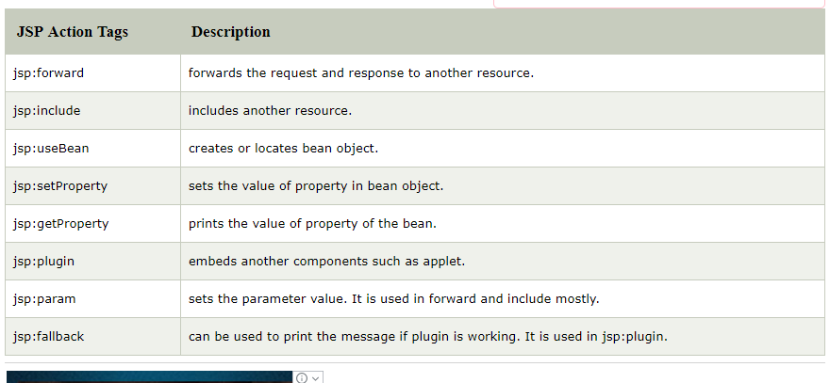

Slide 49
<jsp:forward page="name.jsp" >
<jsp:param name="name" value="VIT University" />
</jsp:forward>

Slide 50
Include
<jsp:include page="welcome.jsp" />

Slide 51
JavaBean
A JavaBean is a Java class that should follow the following conventions:
It should have a no-arg constructor.
It should be Serializable.
It should provide methods to set and get the values of the properties, known as getter and setter methods.

Slide 52
Why java bean??
A bean encapsulates many objects into one object so that we can access this object from multiple places. Moreover, it provides easy maintenance.

Slide 53
JavaBean Properties
A JavaBean property is a named feature that can be accessed by the user of the object. The feature can be of any Java data type, containing the classes that you define.
A JavaBean property may be read, write, read-only, or write-only. JavaBean features are accessed through two methods in the JavaBean's implementation class:

Slide 54
1. getPropertyName ()
For example, if the property name is firstName, the method name would be getFirstName() to read that property. This method is called the accessor.
2. setPropertyName ()
For example, if the property name is firstName, the method name would be setFirstName() to write that property. This method is called the mutator.

Slide 55
Java beans
Java beans enables to design and create reusable software components that integrate with each other, with applications, and with development tools,
It is set of java objects that provides the infrastructure for the components to be written in Java language

Slide 56
Step 1: create a java class
public class Library implements java.io.Serializable{
private int bookid;
private String bookname;
public int getBookid() {
return bookid;
}
public void setBookid(int bookid) {
this.bookid = bookid;
}
public String getBookname() {
return bookname;
}
public void setBookname(String bookname) {
this.bookname = bookname;
}

Slide 57
jsp:useBean action tag
The jsp:useBean action tag is used to locate or instantiate a bean class. If bean object of the Bean class is already created, it doesn't create the bean depending on the scope. But if object of bean is not created, it instantiates the bean.
Syntax of jsp:useBean action tag
<jsp:useBean id= "instanceName" scope= "page | request | session | application"
class= "packageName.className" type= "packageName.className"
beanName="packageName.className | <%= expression >" >
</jsp:useBean>

Slide 58
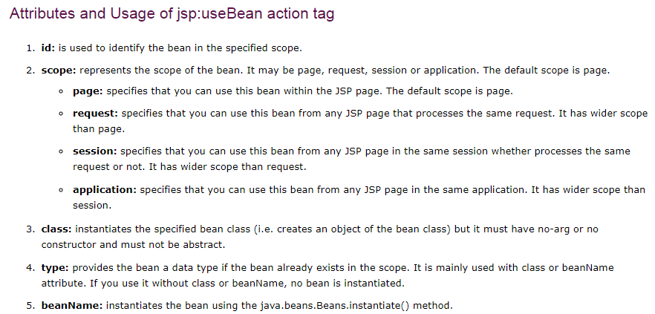

Slide 59
JSP Actions
Forward
Forwards the response to other web specification resources
  Same as forwarding to resources using RequestDispatcher interface
Forwarded only when content is not committed to other web application resources
  Otherwise an IllegalStateException is thrown
  Can be avoided by setting a high buffer size for the forwarding jsp page
Example
  <jsp:forward page=“Forwarded.html”>
  Forwards the request to Forwarded.html
Notes:
Potential Damages:
1. Change orders placed by the client (Instead of 500 widgets he can make the order 50,000 widgets)
2. Change meeting venues to send people on wild goose chases

Slide 60
JSP Actions
Param
Used in conjunction with Include & Forward actions to include additional request parameters to the included or forwarded resource
Example
  <jsp:forward page=“Param2.jsp”>
  <jsp:param name=“FirstName” value=“Sanjay”>
  </jsp:forward>
  This will result in the forwarded resource having an additional parameter FirstName with a value of Sanjay
Notes:
Potential Damages:
1. Change orders placed by the client (Instead of 500 widgets he can make the order 50,000 widgets)
2. Change meeting venues to send people on wild goose chases

Slide 61
JSP Actions
useBean
Creates or finds a Java object with the defined scope.
  Object is also available in the current JSP as a scripting variable
Syntax:
  <jsp:useBean id=“name”
  scope=“page | request | session | application”
  class=“className” type=“typeName” |
  bean=“beanName” type=“typeName” |
  type=“typeName” />
  At least one of the type and class attributes must be present
  We can’t specify values for bith the class and bean name.
Example
  <jsp:useBean id=“myName” scope=“request” class=“java.lang.String”>
  <% firstName=“Sanjay”; %>
  </jsp:useBean>
Notes:
Potential Damages:
1. Change orders placed by the client (Instead of 500 widgets he can make the order 50,000 widgets)
2. Change meeting venues to send people on wild goose chases

Slide 62
JSP Actions
get/setProperty (javabeans project in netbeans)
getProperty is used in conjunction with useBean to get property values of the bean defined by the useBean action
Example (getProperty)
  <jsp:getProperty name=“myBean” property=“firstName” />
  Name corresponds to the id value in the useBean
  Property refers to the name of the bean property
setProperty is used to set bean properties
Example (setProperty)
  <jsp:setProperty name=“myBean” property=“firstName” value=“Sanjay”/>
  Sets the name property of myBean to SanjayExample (setProperty)
  <jsp:setProperty name=“myBean” property=“firstName” param=“fname”/>
  Sets the name property of myBean to the request parameter fname
  <jsp:setProperty name=“myBean” property=“*”>
  Sets property to the corresponding value in request
Notes:
Potential Damages:
1. Change orders placed by the client (Instead of 500 widgets he can make the order 50,000 widgets)
2. Change meeting venues to send people on wild goose chases

Slide 63
JSP Actions
plugIn
Enables the JSP container to render appropriate HTML (based on the browser type) to:
  Initiate the download of the Java plugin
  Execution of the specified applet or bean
plugIn standard action allows the applet to be embedded in a browser neutral fashion
Example
  <jsp: plugin type=“applet” code=“MyApplet.class” codebase=“/”>
  <jsp:params>
  <jsp:param name=“myParam” value=“122”/>
  </jsp:params>
  <jsp:fallback><b>Unable to load applet</b></jsp:fallback>
  </jsp:plugin>
Notes:
Potential Damages:
1. Change orders placed by the client (Instead of 500 widgets he can make the order 50,000 widgets)
2. Change meeting venues to send people on wild goose chases

Slide 64
Custom Tags in JSP
Business logic is the programming that manages communication between an end user interface and a database.
The JavaServer Pages API allow you to define custom JSP tags that look like HTML or XML tags and a tag library is a set of user-defined tags that implement custom behavior.
Custom tags are user-defined tags. They eliminates the possibility of scriptlet tag and separates the business logic from the JSP page.
The same business logic can be used many times by the use of custom tag.
Advantages of Custom Tags
The key advantages of Custom tags are as follows:
Eliminates the need of scriptlet tag The custom tags eliminates the need of scriptlet tag which is considered bad programming approach in JSP.
Separation of business logic from JSP The custom tags separate the the business logic from the JSP page so that it may be easy to maintain.
Re-usability The custom tags makes the possibility to reuse the same business logic again and again.

Slide 65
Working of custom tag
A custom tag is a user-defined JSP language element.
When a JSP page containing a custom tag is translated into a servlet, the tag is converted to operations on an object called a tag handler.
The Web container then invokes those operations when the JSP page's servlet is executed.
The JSP 2.0 specification introduced the Simple Tag Handlers for writing these custom tags.

Slide 66
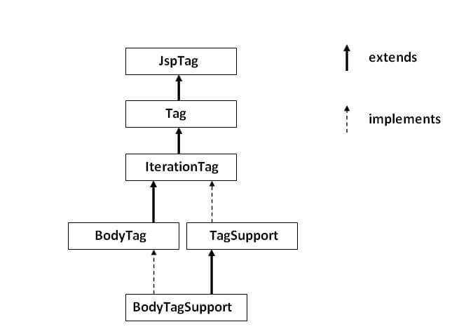
JSP Custom Tag API
JSP Custom Tag API
The javax.servlet.jsp.tagext package contains classes and interfaces for JSP custom tag API. The JspTag is the root interface in the Custom Tag hierarchy.
The javax.servlet.jsp.tagext package contains classes and interfaces for JSP custom tag API. The JspTag is the root interface in the Custom Tag hierarchy.

Slide 67
JspTag interface
The JspTag is the root interface for all the interfaces and classes used in custom tag. It is a marker interface.
Tag interface
The Tag interface is the sub interface of JspTag interface. It provides methods to perform action at the start and end of the tag.

Slide 68
Custom tags are used to extend the JSTL ( by avoiding scriplet tags)
To perform three steps are involved
creating the tag handler class
creating the tag library descriptor (TLD)
updating the deployment descriptor (web.xml).

Slide 69
Create the Tag Library Descriptor (TLD)
This is place where our application looks up references to tags used in JSPs. It can refer to individual tag files or other libraries.
Open the web application you want to add custom tags to in NetBeans IDE.
Right-click web module | New - File/Folder - Web - Tag Library Descriptor, click Next | provide a name and prefix. Click Finish.
A basic TLD is created. I normally remove the uri tag and commented text from the generated TLD file - keep things tidy.

Slide 70
Follow the manual given for creating customtags

