Slide 1
DATABASE MANAGEMENT SYSTEMS · REVIEW 3
Electronic Appliance
Store Management System
Final web application: login, roles, management screens, deployment
Sanjiv Shine Fernandas
Subject: Database Management Systems (DBMS)
Oracle Database 21c XE · XEPDB1
Flask · python-oracledb (Thin)
waitress · pytest
github.com/sanjiv283/Electronic_Appliance_Store_Manager
Notes:
Review 2 delivered the database and backend. Review 3 completes the application: authentication, roles, employee and account management, hardening and deployment.

Slide 2
What Review 3 adds
On top of the Review 2 schema, queries, PL/SQL objects and atomic sales
▪ Sign-in with two roles: Manager and Cashier
▪ Default-deny access: every page needs sign-in except /login and /health
▪ Employee management and user-account management (managers)
▪ Sale 'sold by' is always the signed-in employee
▪ Change own password; scrypt password hashes
▪ 8th table USERS in a separate script (auth.sql)
▪ Security hardening: open-redirect fix, status-only /health, clean CLI errors
▪ Bug found in manual testing: Oracle Decimal ids broke the 'cannot delete yourself' check — fixed with tests
▪ Production-style launcher (waitress) and deployment guide
▪ Manager accounts cannot be deleted in the app
▪ Live Oracle: 19/19 integration tests and 16/16 queries passed
Electronic Appliance Store Management System · DBMS Review 3 · Sanjiv Shine Fernandas
2 / 11
Notes:
Mention that the Decimal bug was caught by the student during manual use, after offline tests passed — evidence that live testing matters.

Slide 3
Architecture and request flow
Routes call services; services own all SQL
Browser
Flask routes
login gate · CSRF · roles
services/*.py
all SQL, bind variables
python-oracledb (Thin)
Oracle XEPDB1
8 tables
▪ Stock is deducted in exactly one place (services/sales.create_sale), never in a trigger
▪ App connects only as appliance_app; configuration comes from environment variables only (.env, git-ignored)
▪ A before_request gate enforces sign-in; CASHIER_ENDPOINTS lists what cashiers may open; everything else is manager-only
▪ A test enumerates every registered route, so a new page cannot ship without an access decision
Electronic Appliance Store Management System · DBMS Review 3 · Sanjiv Shine Fernandas
3 / 11
Notes:
Walk the flow left to right; stress that the browser never talks to Oracle and routes contain no SQL.

Slide 4
Roles and permissions
Area | Manager | Cashier
New sale, sales history, sale detail | yes | yes (sold-by = signed-in employee)
Products | full CRUD + restock | view only
Customers | full CRUD | list, add, edit
Dashboard and reports | yes | no (HTTP 403)
Categories and suppliers | full CRUD | no (HTTP 403)
Employees and user accounts | full CRUD (managers protected) | no (HTTP 403)
Change own password | yes | yes
Sessions last 8 hours. 5 failed sign-ins in 5 minutes return HTTP 429. Role changes apply at next sign-in.
Electronic Appliance Store Management System · DBMS Review 3 · Sanjiv Shine Fernandas
4 / 11
Notes:
Show a cashier login and a 403 on a manager page.

Slide 5
Database: the USERS table
auth.sql runs after schema.sql · 8 tables in total
Column | Rule
USER_ID | identity primary key
USERNAME | unique, CHECK lower-case
PASSWORD_HASH | scrypt hash, never the password
ROLE | CHECK IN ('MANAGER','CASHIER')
EMPLOYEE_ID | UNIQUE foreign key to EMPLOYEES (one login per employee)
CREATED_AT, LAST_LOGIN | timestamps
▪ Load order: schema → advanced_features → seed → auth
▪ No default accounts: the first manager is created with manage.py
▪ Live test INT-17 proves the CHECK and UNIQUE rules on Oracle
Electronic Appliance Store Management System · DBMS Review 3 · Sanjiv Shine Fernandas
5 / 11
Notes:
Passwords are never stored; only the hash.

Slide 6
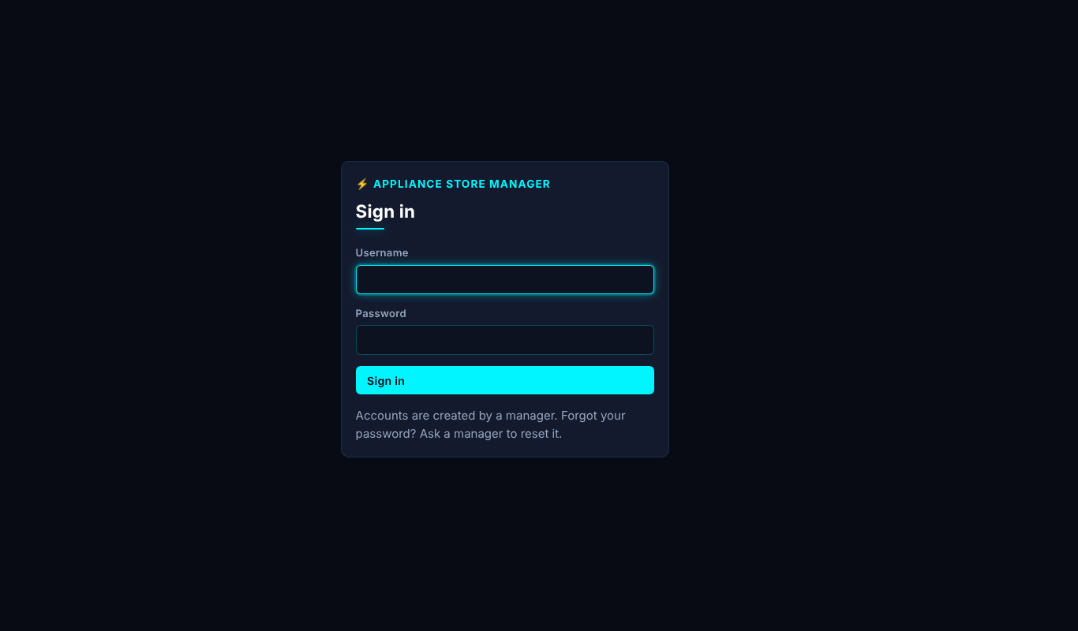
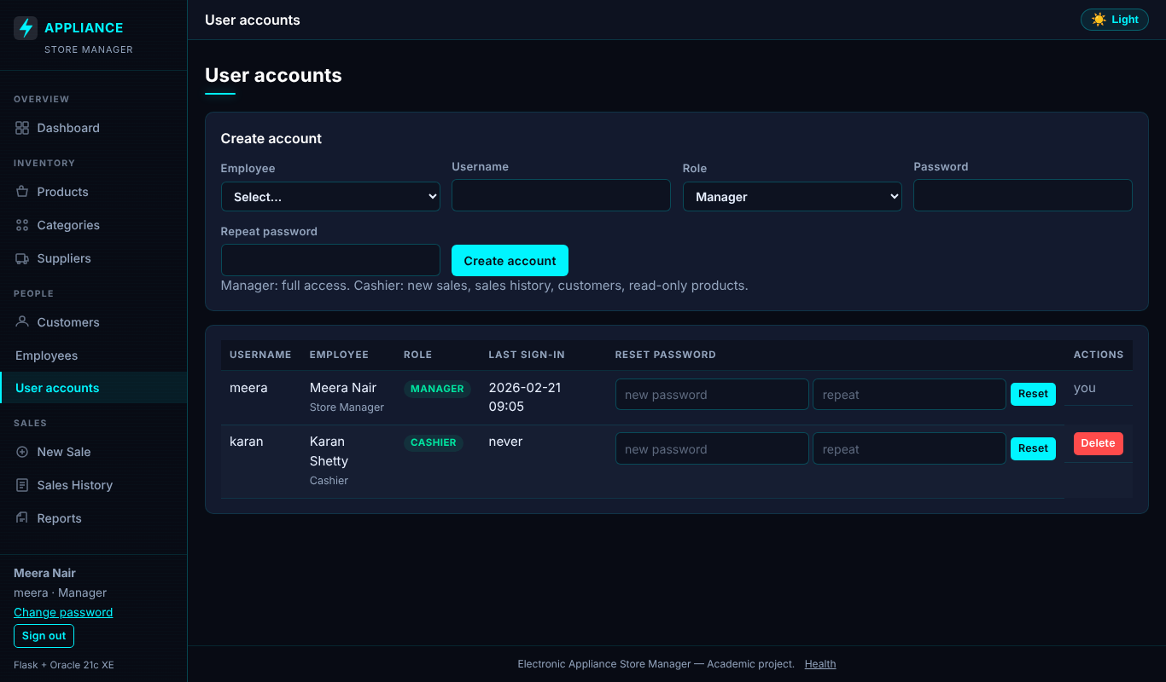
Sign-in and user accounts
Real templates, sample data (not live records)
Sign-in page
User accounts: own row 'you', managers 'protected'
Electronic Appliance Store Management System · DBMS Review 3 · Sanjiv Shine Fernandas
6 / 11
Notes:
Screenshots are rendered from the real templates with stubbed data.

Slide 7
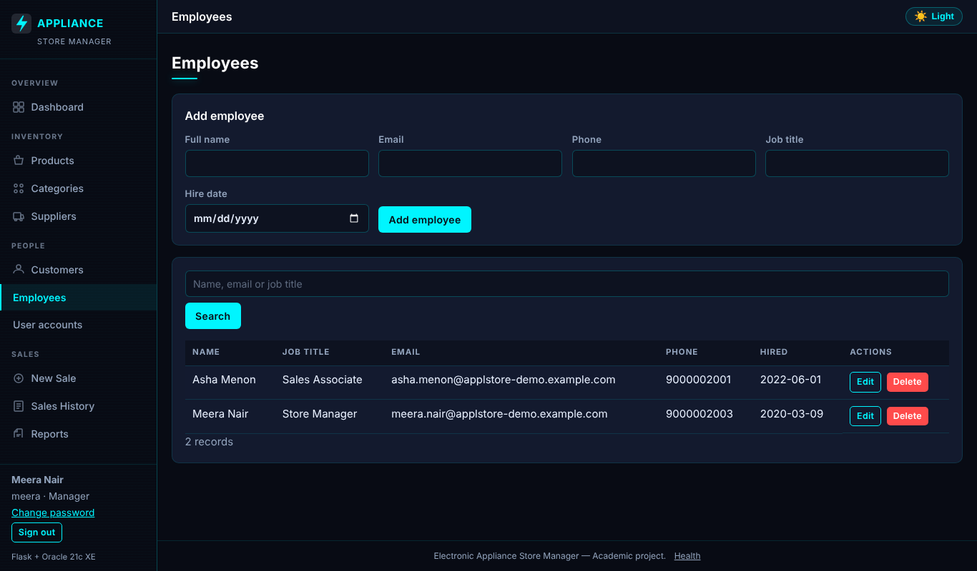
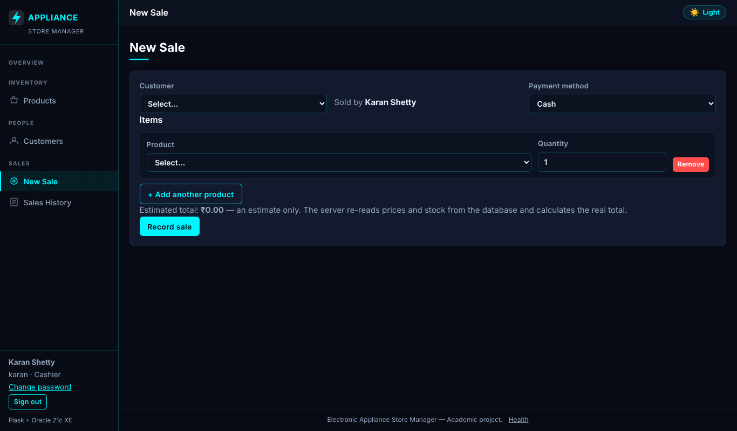
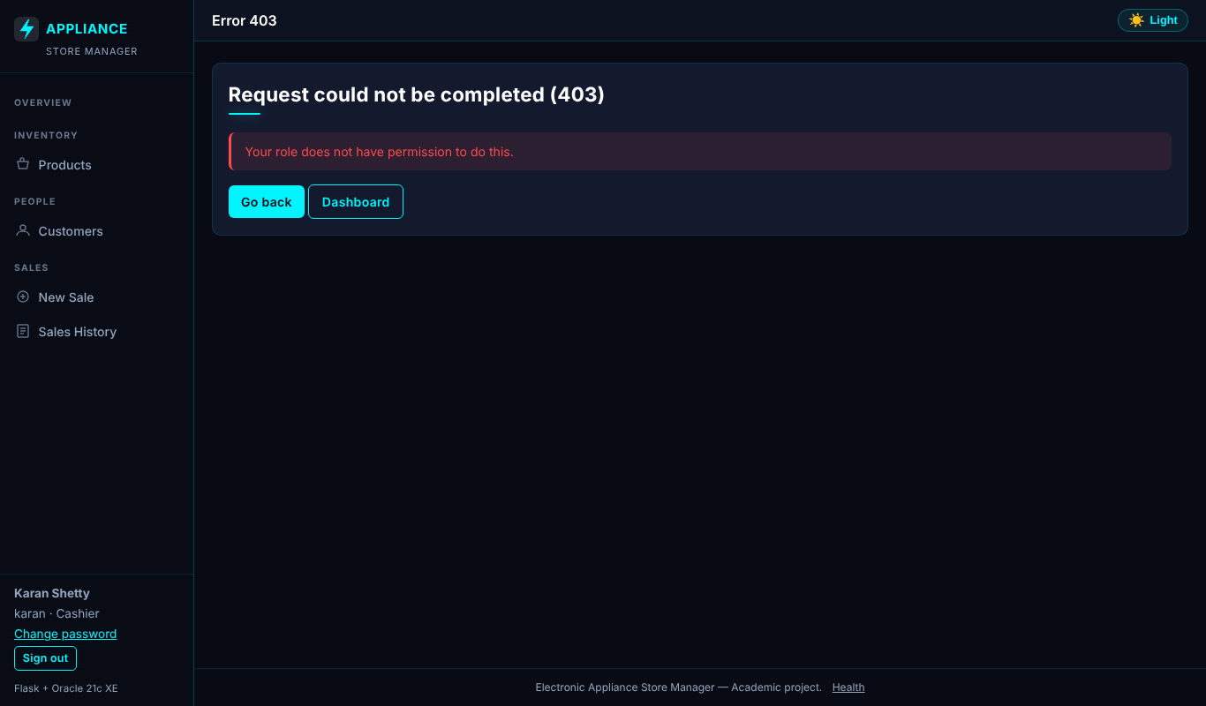
Employees and cashier view
Real templates, sample data (not live records)
Employee management (manager)
Cashier: restricted navigation
Cashier opening a manager page: 403
Electronic Appliance Store Management System · DBMS Review 3 · Sanjiv Shine Fernandas
7 / 11
Notes:
Role-filtered navigation, and the default-deny result when a cashier types a manager URL.

Slide 8
Security hardening
Findings from review and manual testing, with fixes
Finding | Fix
next= redirect with TAB/newline became an external URL or HTTP 500 | same-site paths only; control chars, backslash, // rejected
manage.py traceback on missing configuration | prints FAILED: … and exits 1
/health exposed DB user, service and variable names | status-only response; detail in server log
Oracle Decimal ids in the session cookie bypassed 'cannot delete yourself' | int casts + regression tests
Flask 31-day default session | 8-hour lifetime
Also: bind variables only, CSRF on every POST, escaped output, CSP, least-privilege DB user, hashed passwords.
Electronic Appliance Store Management System · DBMS Review 3 · Sanjiv Shine Fernandas
8 / 11
Notes:
The Decimal bug passed all offline tests; the student found it by using the app against Oracle.

Slide 9
Testing results
Offline suite run by the authoring environment · live suite run by the student on Oracle 21c XE
159
0
0
PASSED
FAILED
NOT RUN / BLOCKED
Suite | Scope | Result
test_config.py | Configuration | 12 PASSED
test_services.py | Validation, CRUD, sale transaction (fake DB) | 45 PASSED
test_routes.py | Routes, CSRF, errors, health | 19 PASSED
test_auth.py | Sign-in, roles, throttle, redirects, hashing | 64 PASSED
test_oracle_integration.py | Live Oracle (student run, 2026-10-22) | 19 PASSED
Live results were transcribed from the student's console output. First live run: 18/19 — the one failure was a mistake in the test, fixed, then 19/19.
All 16 queries also ran live without error.
Electronic Appliance Store Management System · DBMS Review 3 · Sanjiv Shine Fernandas
9 / 11
Notes:
Fakes prove logic, not Oracle behaviour; that is why the live suite exists.

Slide 10
Deployment and limitations
▪ python serve.py (waitress, 8 threads) on 127.0.0.1:8000
▪ HTTPS via a reverse proxy; APP_ENV=production turns on Secure cookies
▪ Start at boot with Task Scheduler or NSSM
▪ Backups with expdp / RMAN; password rotation steps
▪ docs/deployment.md has the full guide
▪ Login throttle is in-process: memory grows, not proxy-aware, resets on restart
▪ No password-reset e-mail or MFA; managers reset passwords
▪ Role changes apply at next sign-in
▪ HTTPS deployment and a recorded browser walkthrough not yet done
▪ Trigger test-cleanup bypass should be removed for production
Electronic Appliance Store Management System · DBMS Review 3 · Sanjiv Shine Fernandas
10 / 11
Notes:
Be upfront about the deferred throttle redesign and that HTTPS was not exercised.

Slide 11
Conclusion
DONE
Login, Manager/Cashier roles, default-deny gate, employee and account management
DONE
Hardening fixes with regression tests; Decimal-id bug fixed
DONE
159 tests PASSED (140 offline + 19 live on Oracle 21c XE); 16 queries ran live
DONE
README, deployment guide, demo guide, Review 2 and Review 3 reports
TO DO
Throttle redesign, HTTPS deployment, recorded role walkthrough
Electronic Appliance Store Management System · DBMS Review 3 · Sanjiv Shine Fernandas
11 / 11
Notes:
Offer to demonstrate a manager login, a cashier sale and a 403.

