Slide 1
DATABASE MANAGEMENT SYSTEMS · REVIEW 2
Electronic Appliance
Store Management System
Database Implementation & Backend Integration
Sanjiv Shine Fernandas
Subject: Database Management Systems (DBMS)
Oracle Database 21c XE · XEPDB1
Flask · python-oracledb (Thin)
HTML5 · CSS3 · vanilla JS
github.com/sanjiv283/Electronic_Appliance_Store_Manager
Notes:
Introduce the project, the student and the Review 2 scope: database implementation and backend integration.

Slide 2
Problem statement & objectives
THE PROBLEM
OBJECTIVES
▪ Appliance retail: high-value items, changing prices, limited stock
▪ Spreadsheets cause oversold items and lost price history
▪ Customer, supplier and product data get duplicated and inconsistent
▪ Concurrent cashiers can sell the same last unit twice
▪ Managers need quick answers: revenue, best sellers, low stock
▪ Normalized (3NF) Oracle schema with full integrity constraints
▪ Fictional seed data; 16 documented SQL queries
▪ View, procedure, function and trigger in PL/SQL
▪ Secure Flask ↔ Oracle connectivity (Thin mode, least-privilege user)
▪ CRUD + an atomic, lock-ordered sales transaction
▪ Automated tests with honest PASSED / BLOCKED reporting
Electronic Appliance Store Management System · DBMS Review 2 · Sanjiv Shine Fernandas
2 / 12
Notes:
Scope: master-data CRUD, sales, inventory reports. Out of scope: login/roles, returns, taxes.

Slide 3
System architecture
Routes call services; services own all SQL
Browser
TECHNOLOGY STACK
HTML5 · CSS3 · vanilla JS · Jinja2 CRUD forms
▪ Python · Flask · python-dotenv
▪ python-oracledb, Thin mode (no Oracle Client)
▪ Oracle Database 21c XE
▪ pytest + fake DB connection
▪ Windows local demonstration
▪ Connects only as appliance_app — never SYS/SYSTEM
Flask routes — app.py
routes for CRUD, sales and health · safe error pages
Service layer — services/*.py
validation · CRUD · sales transaction — bind variables only
services/database.py + python-oracledb (Thin)
connections · Oracle-error translation · config.py reads .env
Oracle 21c XE — XEPDB1 · schema appliance_app
7 tables · view · procedure · function · trigger · sequence
Electronic Appliance Store Management System · DBMS Review 2 · Sanjiv Shine Fernandas
3 / 12
Notes:
Single direction of dependency. Only services/database.py opens connections.

Slide 4
Entity-relationship diagram
Key columns shown · full column list in report §11 · matches database/schema.sql
PRODUCTS
CATEGORIES
N
PK PRODUCT_ID
UK MODEL_NO
FK CATEGORY_ID
FK SUPPLIER_ID
UNIT_PRICE · STOCK_QTY
N
SUPPLIERS
classifies
supplies
PK CATEGORY_ID
UK CATEGORY_NAME
DESCRIPTION
1
1
PK SUPPLIER_ID
UK SUPPLIER_NAME
CONTACT · EMAIL · PHONE
1
appears in
N
SALE_ITEMS
PK SALE_ITEM_ID
FK SALE_ID
FK PRODUCT_ID
QUANTITY · UNIT_PRICE
LINE_TOTAL
N
contains (1..N)
1
CUSTOMERS
SALES
EMPLOYEES
1
1
places
processes
PK CUSTOMER_ID
UK EMAIL
FULL_NAME · PHONE
N
PK SALE_ID · UK INVOICE_NO
FK CUSTOMER_ID
FK EMPLOYEE_ID
SALE_DATE · TOTAL_AMOUNT
N
PK EMPLOYEE_ID
UK EMAIL
FULL_NAME · JOB_TITLE
Electronic Appliance Store Management System · DBMS Review 2 · Sanjiv Shine Fernandas
4 / 12
Notes:
Seven tables, six one-to-many relationships. No cascade deletes, so sales history is protected. SALE_ITEMS keeps the price and quantity at sale time.

Slide 5
Database schema & relationships
Identity primary keys · all foreign keys are restrict (no cascade)
Table | Primary key | Foreign keys | Unique / CHECK highlights
CATEGORIES | CATEGORY_ID | — | UQ category name
SUPPLIERS | SUPPLIER_ID | — | UQ supplier name
PRODUCTS | PRODUCT_ID | CATEGORY_ID, SUPPLIER_ID | UQ model no · price ≥ 0 · stock ≥ 0
CUSTOMERS | CUSTOMER_ID | — | UQ e-mail
EMPLOYEES | EMPLOYEE_ID | — | UQ e-mail
SALES | SALE_ID | CUSTOMER_ID, EMPLOYEE_ID | UQ invoice no · payment ∈ {CASH, CARD, UPI, BANK_TRANSFER} · total > 0
SALE_ITEMS | SALE_ITEM_ID | SALE_ID, PRODUCT_ID | UQ (sale, product) · qty > 0 · line total = qty × price
▪ Relationships: category→products, supplier→products, customer→sales, employee→sales, sale→items, product→items
▪ 7 tables · 6 indexes on FK/report columns · sequence SEQ_INVOICE_NO · sample data: 14 products, 8 sales, 15 sale items
Electronic Appliance Store Management System · DBMS Review 2 · Sanjiv Shine Fernandas
5 / 12
Notes:
Deleting a customer, employee or product with history fails with ORA-02292, shown to the user as a friendly 409.

Slide 6
Normalization: 1NF → 3NF
1NF
2NF
3NF
▪ Atomic columns, a key in every table
▪ No repeating groups: many products per sale = rows in SALE_ITEMS, not PRODUCT1, PRODUCT2 …
▪ Single-column surrogate keys: no partial dependency possible
▪ SALE_ITEMS (SALE_ID, PRODUCT_ID): qty and price depend on both; product name is NOT copied in
▪ Non-key attributes depend only on the key
▪ PRODUCTS stores category/supplier as FKs, not names; SALES stores no customer or employee names
DOCUMENTED, DELIBERATE REDUNDANCY (not hidden)
▪ SALE_ITEMS.LINE_TOTAL = QUANTITY × UNIT_PRICE is derived, so strictly SALE_ITEMS is not 3NF — kept for audit/reporting and guarded by a CHECK constraint
▪ SALES.TOTAL_AMOUNT = sum of lines: computed once by the service; view V_SALES_SUMMARY exposes mismatches
Electronic Appliance Store Management System · DBMS Review 2 · Sanjiv Shine Fernandas
6 / 12
Notes:
Be upfront: LINE_TOTAL is a derived column, a controlled trade-off. SALE_ITEMS.UNIT_PRICE is the historical price, not a copy of the current price.

Slide 7
SQL queries & advanced database features
16 numbered queries in queries.sql · 4 objects in advanced_features.sql
16 QUERIES — CONCEPTS
PL/SQL OBJECTS
▪ Filtering, IN-subquery, INNER / LEFT JOIN (Q1–Q6)
▪ 5-table join over an invoice (Q7)
▪ GROUP BY, SUM/COUNT/AVG, HAVING (Q8–Q10)
▪ Scalar & correlated subqueries (Q11–Q12)
▪ NOT EXISTS, FETCH FIRST, RANK(), CASE (Q13–Q16)
V_SALES_SUMMARY (view)
sale + customer + employee + line count + TOTAL_MATCHES check
SP_RESTOCK_PRODUCT (procedure)
adds stock under a row lock; ORA-20001 / 20002 errors
FN_CUSTOMER_TOTAL_SPEND (function)
-- Query 12: above own-category average
SELECT p.PRODUCT_NAME, p.UNIT_PRICE
FROM PRODUCTS p
WHERE p.UNIT_PRICE >
(SELECT AVG(p2.UNIT_PRICE) FROM PRODUCTS p2
WHERE p2.CATEGORY_ID = p.CATEGORY_ID);
lifetime spend, 0 if none; ORA-20010 unknown customer
TRG_SALES_PROTECT_HISTORY (trigger)
blocks DELETE / UPDATE of posted sales (ORA-20030 / 20031); no stock logic
Electronic Appliance Store Management System · DBMS Review 2 · Sanjiv Shine Fernandas
7 / 12
Notes:
Syntax-checked statically (sqlglot, Oracle dialect) for the queries; all 16 also executed live on Oracle 21c XE without error.

Slide 8
Flask backend & Oracle connectivity
CONNECTIVITY & CRUD
ATOMIC SALE — services/sales.py
▪ config.py: DB_HOST / PORT / SERVICE_NAME / USER / PASSWORD from .env; placeholders count as missing; SYS/SYSTEM refused
▪ python-oracledb Thin mode; connection per unit of work, always closed
▪ Bind variables only; server-side validation; Decimal for money
▪ ORA errors translated to safe 400 / 404 / 409 / 503 messages
▪ /health and python -m services.database report success only after a real round trip
▪ CRUD: products, categories, suppliers, customers (+ sales and restock)
1 validate ids, payment, items (qty 1–1000)
2 check customer & employee exist
3 SELECT … FOR UPDATE WAIT 10 per product,
in ascending product id (no deadlock)
4 re-check stock after ALL locks held
5 total = Σ DB price × qty (never client)
6 INSERT sale + items, UPDATE stock (once)
7 COMMIT — any error → ROLLBACK
▪ Stock is deducted only here — the trigger never touches inventory
▪ Oversell protection: row locks + CHECK (STOCK_QTY ≥ 0)
Electronic Appliance Store Management System · DBMS Review 2 · Sanjiv Shine Fernandas
8 / 12
Notes:
Live concurrency proof (8 buyers, stock 5 -> exactly 5 succeed) PASSED on Oracle 21c XE.

Slide 9
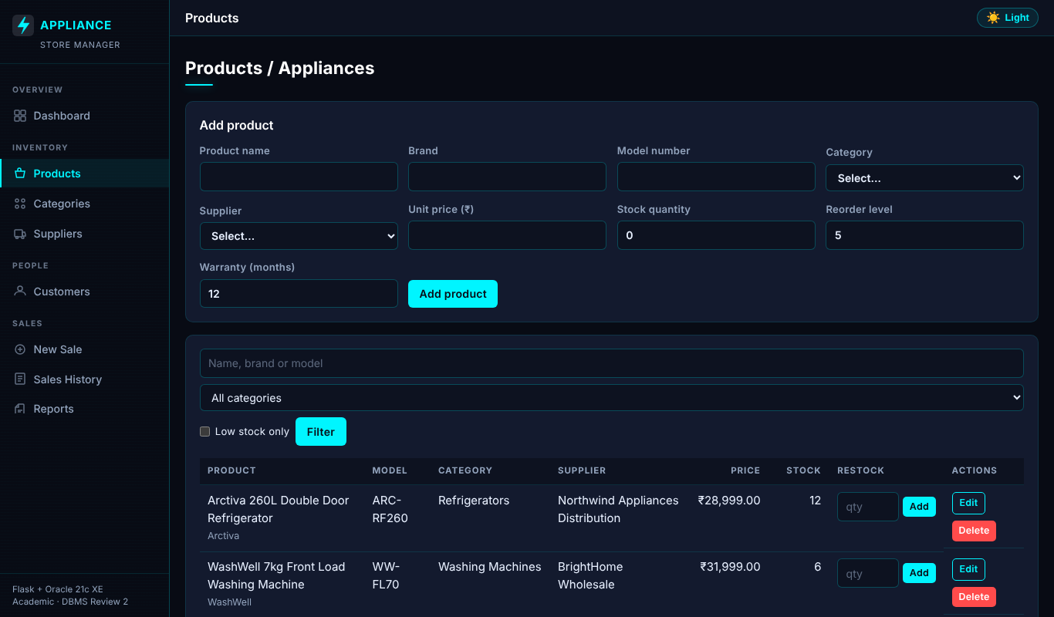
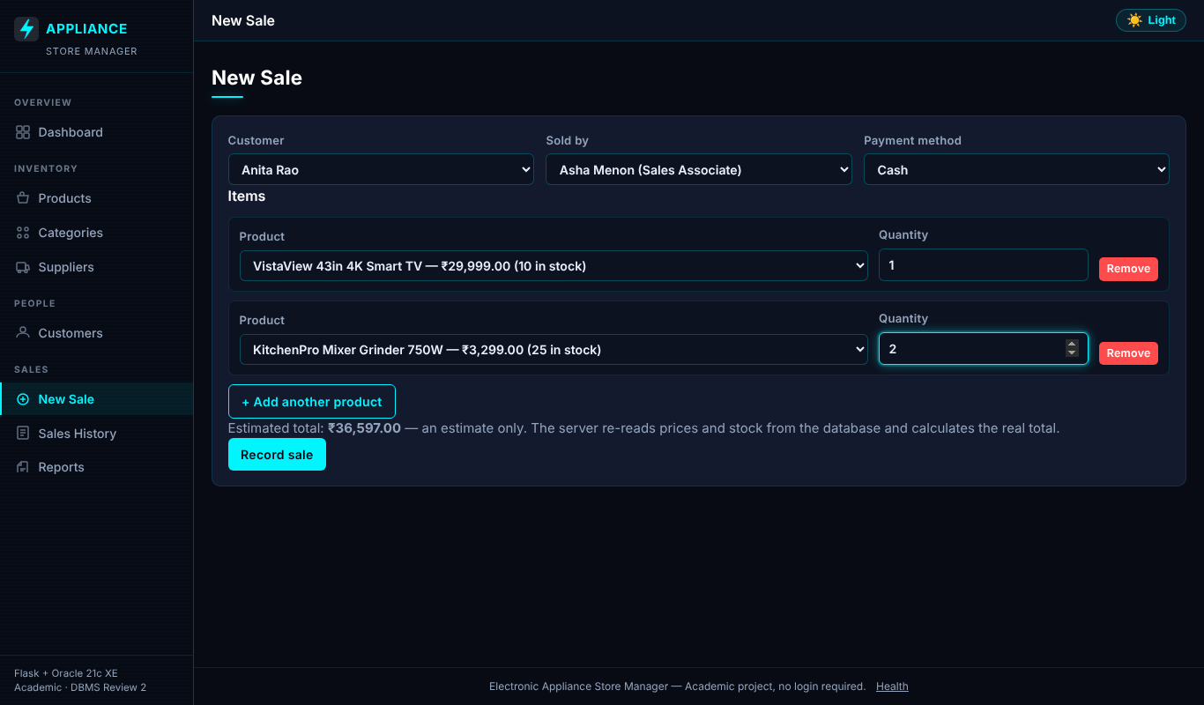
CRUD screens & sales workflow
Real Flask routes and templates · sample data
Products: create / edit / delete / restock
New sale — two lines, estimate only (server recalculates)
▪ Workflow: add / edit master data → New Sale → invoice page → stock falls exactly once
▪ Invalid input, missing references and referenced-row deletes return clear 400 / 404 / 409 messages
Screenshots show the real templates and routes rendered with seed-equivalent sample data — no Oracle was available, so they are not live database results.
Electronic Appliance Store Management System · DBMS Review 2 · Sanjiv Shine Fernandas
9 / 12
Notes:
Be explicit that the screenshots use stubbed service data. The real app without DB shows an honest 503 page.

Slide 10
Testing results
Strict statuses: PASSED · FAILED · NOT RUN · BLOCKED
92
0
0
0
PASSED
BLOCKED
FAILED
NOT RUN
Suite | Scope | Result
test_config.py | Configuration rules | 12 PASSED
test_services.py | Validation, CRUD, sale transaction (fake DB) | 45 PASSED
test_routes.py | Routes, CSRF, errors, escaping, health | 19 PASSED
test_oracle_integration.py | Live Oracle (constraints, PL/SQL, locking) | 16 PASSED
▪ 92 offline tests passed using a FAKE database connection: they prove application logic, not Oracle behaviour
▪ 16 live Oracle integration tests PASSED on Oracle 21c XE (student run, 2026-10-22); all 16 queries also ran live without error
▪ Also passed: Python compile check and SQL syntax parse of the 16 queries and the seed script
Electronic Appliance Store Management System · DBMS Review 2 · Sanjiv Shine Fernandas
10 / 12
Notes:
The live tests ran on a separate test schema on Oracle 21c XE and prove constraints, PL/SQL objects and concurrency. Results were transcribed from the student's console output.

Slide 11
Limitations & future improvements
KNOWN LIMITATIONS
FUTURE IMPROVEMENTS
▪ Live results come from one single-user run on one machine
▪ No login, roles or per-user audit trail — localhost demo only
▪ No returns, discounts, taxes or multi-currency; employees are seed-only
▪ LINE_TOTAL is a documented derived column; sale total consistency is service-enforced
▪ Trigger has a test-cleanup bypass (remove for production)
▪ Per-request connections, no pool
▪ Authentication and role-based access (admin / cashier)
▪ Connection pool; HTTPS deployment behind a WSGI server
▪ Returns/refunds, purchase orders to suppliers, tax and discounts
▪ Employee management screen; audit table fed by a trigger
▪ CI pipeline with an Oracle test container
▪ Charts and CSV export on reports
Electronic Appliance Store Management System · DBMS Review 2 · Sanjiv Shine Fernandas
11 / 12
Notes:
Naming limitations openly is part of the evaluation criteria for accuracy.

Slide 12
Conclusion & demonstration readiness
▪ Delivered: normalized 7-table Oracle design, seed data, 16 queries, 4 PL/SQL-side objects, secure Flask service layer, CRUD, atomic sales, tests and report
▪ Every claim above is backed by files in the repository; live Oracle results are labelled as a student run
DONE
Code, SQL scripts, tests (76 passed offline), report PDF / DOCX / MD, this deck
DONE
Screenshots of the real CRUD / sale templates (sample data) and honest 503 page
DONE
schema.sql → advanced_features.sql → seed.sql loaded in XEPDB1; 16 queries ran live
DONE
16 live integration tests PASSED on Oracle 21c XE (separate test schema)
TO DO
Rehearse docs/demo_guide.md (10 minutes); regenerate report matrix after live run
Demonstration readiness: live Oracle steps completed; rehearse the demo guide before the review.
Electronic Appliance Store Management System · DBMS Review 2 · Sanjiv Shine Fernandas
12 / 12
Notes:
Thank the panel; offer to demonstrate the sale transaction and the failing constraint inserts.

